Slide 1
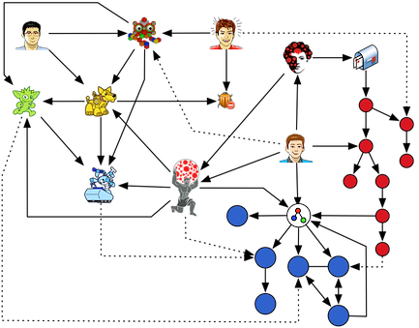
Lecture 6: Graph Theory

Slide 2
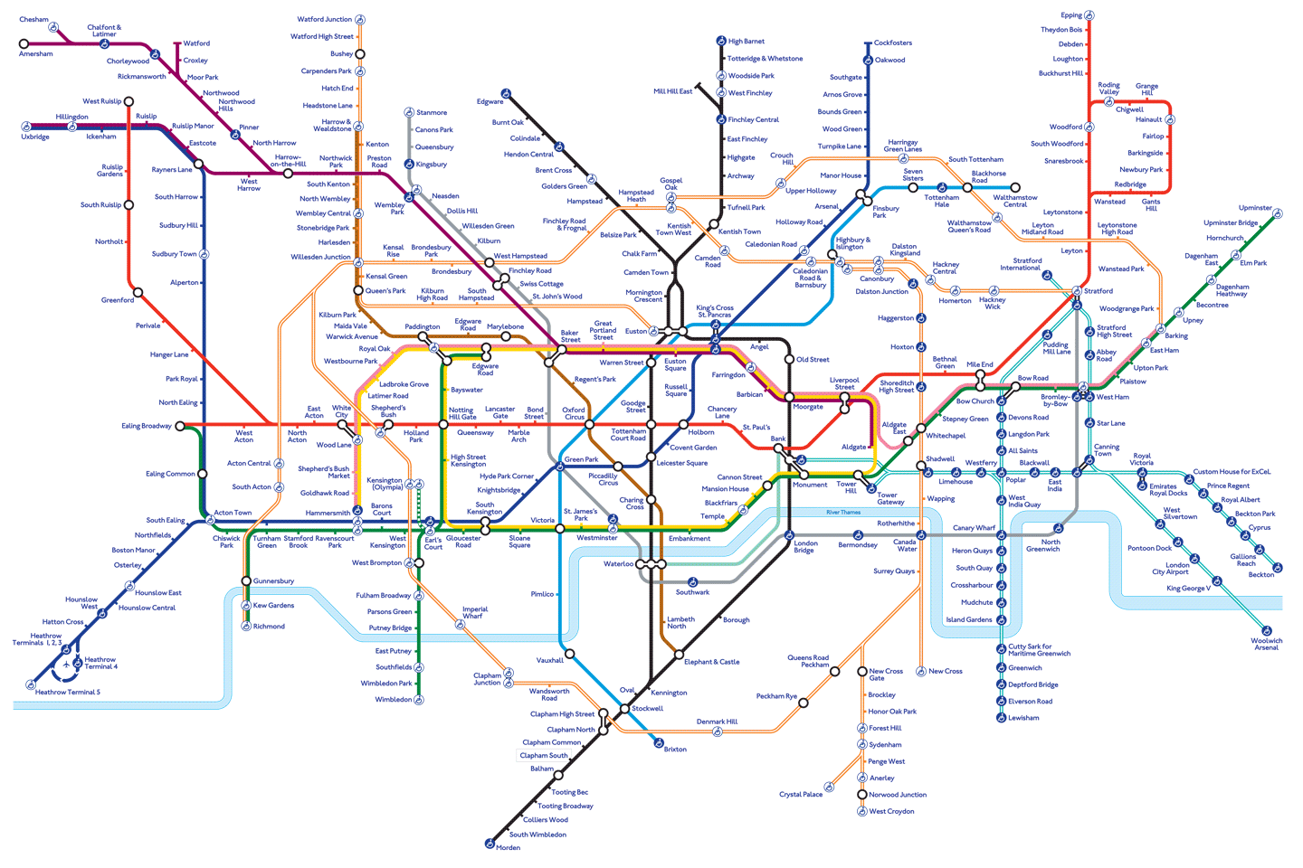
Graph Theory in everyday life

Slide 3
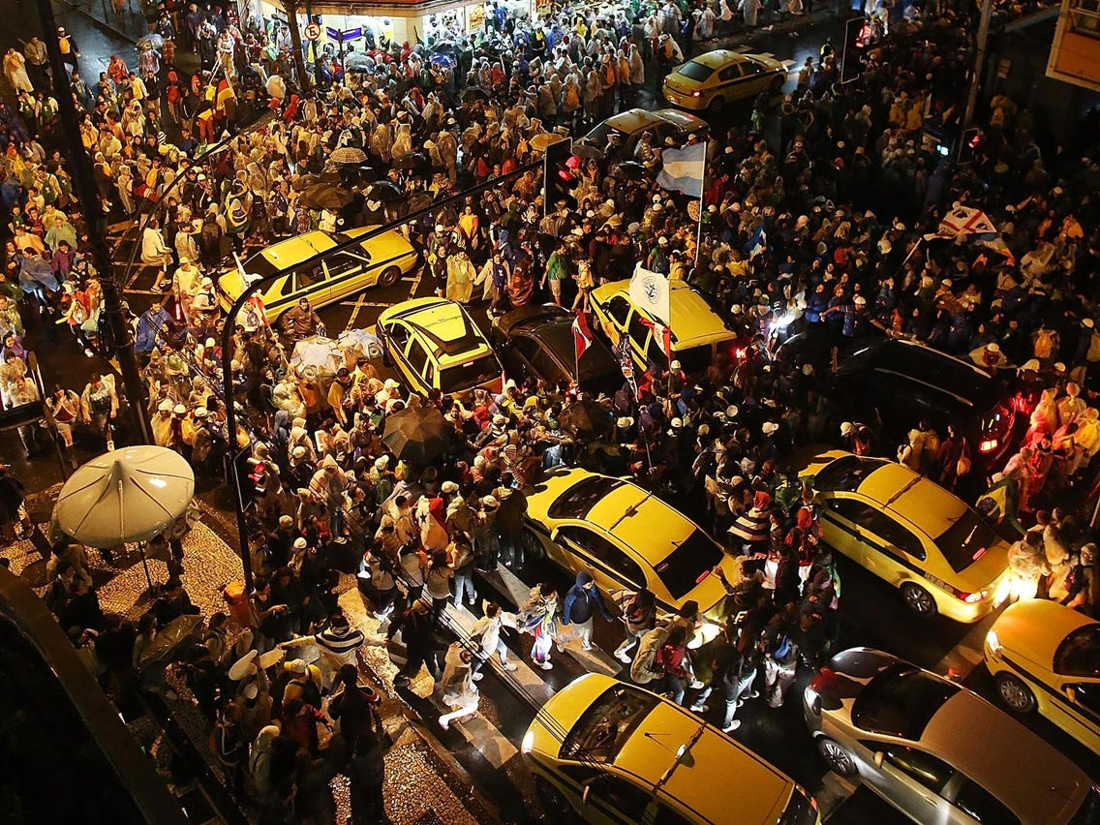
Graph theory is used in cybersecurity to identify hacked or criminal servers and generally for network security.
Graph theory, and in particular rooted tree diagrams of a genome, is used in the evolution of SARS-CoV-2.
Determining how best to add streets to congested areas of cities uses graph theory.
Graph theory is used in neuroscience to study brain network organization
Graph theory is used in DNA sequencing.
Design of radar and sonar systems uses graph theory via Golomb rulers.
Notes:
http://www.mathily.org/dm-rw.html

Slide 4
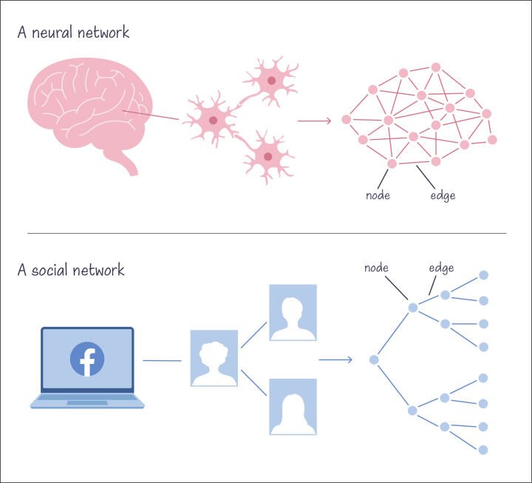
Graph Theory in Drug Design

Slide 5
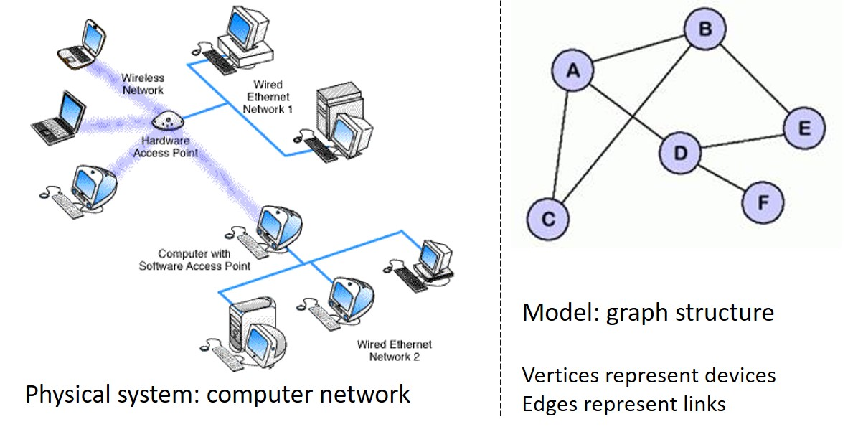

Slide 6
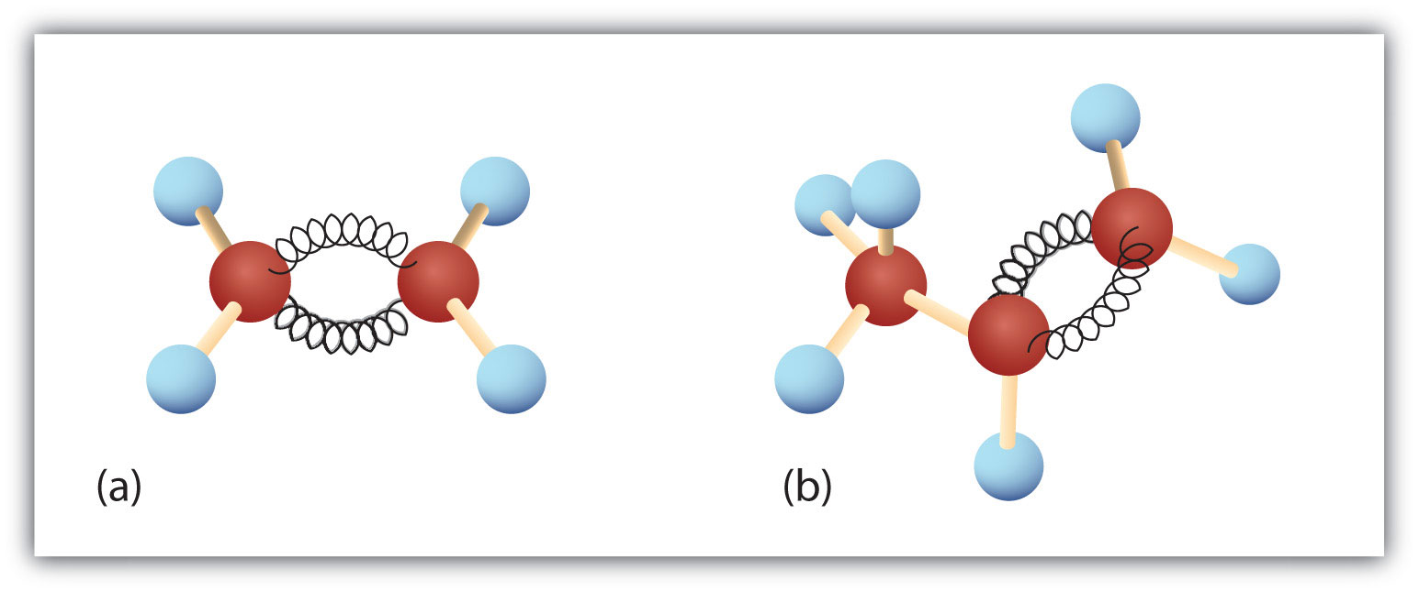
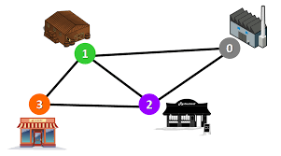
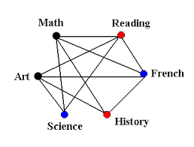
Varying Applications (examples)
Computer networks
Distinguish between two chemical compounds with the same molecular formula but different structures
Pages are linked by hyperlinks on the internet
Components of electric circuit
Solve shortest path problems between cities
Scheduling exams and assign channels to television stations

Slide 7
Graphs
A graph $G=(V, E)$ consists of $V$, a non-empty set of vertices and $E$ a set of edges. Edges connect either one or two vertices, called endpoints.
A
B
Simple graph:
each edge connects two different vertices
no two edges connect the same two vertices
not a simple graph
D
C
A simple railway tracks connecting different cities
Set of vertices and edges
Vertices cannot be empty set, but edges

Slide 8
Some terminology
Multigraph
Loop
Pseudograph
multiple edges connecting the same two vertices
an edge that connects a vertex to itself
may include loops as well as multiple edges
Notes:
Multigraph would not contain loops

Slide 9
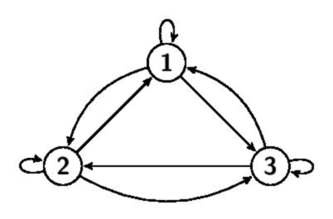
Directed Graph - Digraph
A graph $G=(V, E)$ where each edge is associated with pair of vertices. The directed edge associated with $(a, b)$ begins at $a$ and ends at $b$.

Slide 10
Summary
Type | Directed edges | Multiple edges | Loops
Simple Graph | Undirected | No | No
Multigraph | Undirected | Yes | No
Pseudograph | Undirected | Yes | Yes
Simple Directed Graph | Directed | No | No
Directed Multigraph | Directed | Yes | Yes
Mixed Graph | Both | Yes | Yes

Slide 11
More terminology

Slide 12
For undirected graphs
deg(a)=4
Adjacent vertices (neighbors) - (a, b) but (b, c)
Incident – edge B is incident with vertices e and b
Neighborhood: $N\left(A\right)=V_{v∈A}N(v)$
N(e)={a, b, c}
Degree: sum of ins and outs
Isolated (d)
Pendant (connected only once to another vertex) (e)
deg(b)=2
b
a
B
c
e
deg(c)=3
deg(e)=3
a
e
b
d
deg(d)=0
d
c

Slide 13
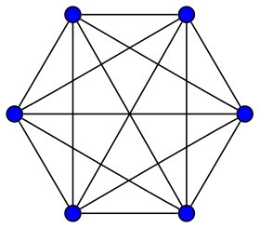
The hand-shaking theorem
Suppose there are 6 people in a room, and each must shake hands with every other person. How many handshakes?
Why not 30?
a
b
$$a=5$$
$$b=4$$
$$c=3$$
$$d=2$$
$$e=1$$
$$G\left(V, E\right) with m edges$$
$$=15$$
total handshakes
$$2m=\sum_{v∈v}{deg⁡(v)}$$
f
c
$$2m=30$$
$$m=15$$
e
d
How many edges are there if you have 10 vertices, each of degree 6?
$$2m=60,$$
$$m=30$$
Notes:
Handshaking Theorem:
Sum of degree of all vertices = 2 x Number of edges
https://www.gatevidyalay.com/handshaking-theorem-graph-theory-theorems/

Slide 14
Important
The following conclusions may be drawn from the Handshaking Theorem.
In any graph,
The sum of degree of all the vertices is always even.
The sum of degree of all the vertices with odd degree is always even.
The number of vertices with odd degree are always even.
Notes:
Handshaking Theorem:
Sum of degree of all vertices = 2 x Number of edges

Slide 15
For directed graphs
$$(a, b)$$
Adjacent to a is adjacent to b
Adjacent from b is adjacent from a
Initial vertex a
Terminal / end vertex b
In-degree of vertex $v=\deg^{−}(v)$ b: $v=\deg^{−}\left(b\right)=2$
Out-degree of vertex $v=\deg^{+}(v)$ b: $v=\deg^{+}\left(b\right)=1$
$\sum_{v∈v}{\deg^{−}\left(v\right)=}\sum_{v∈v}{\deg^{+}}\left(v\right)=|E|$
b
a
B
c
e
d
$$+1$$
$$+1$$
$$+1$$
Number of edges

Slide 16
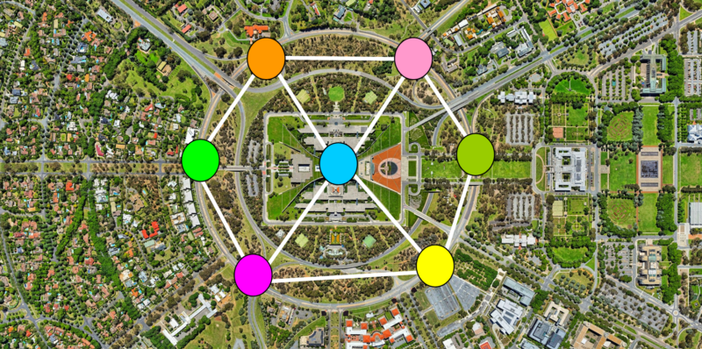
Representing graphs with matrices
Reference:
https://www.simplilearn.com/tutorials/data-structure-tutorial/graphs-in-data-structure

Slide 17
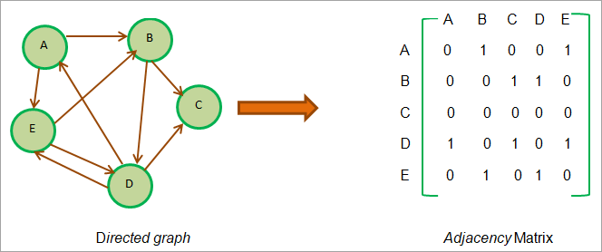
Directed graph
Adjacency matrix (vertex matrix)

Slide 18
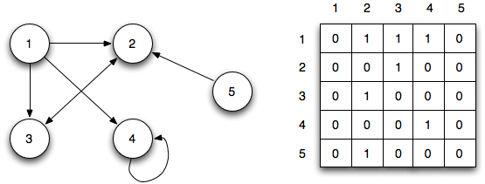
Adjacency matrix (vertex matrix)

Slide 19
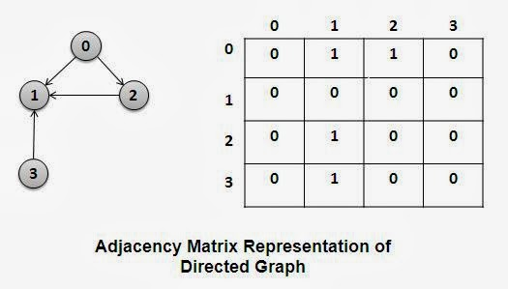
Adjacency matrix (vertex matrix)

Slide 20
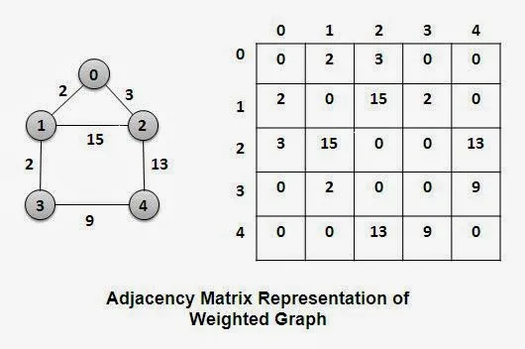
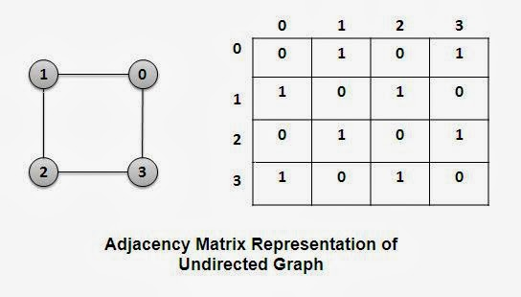
undirected graph
Adjacency matrix (vertex matrix)

Slide 21
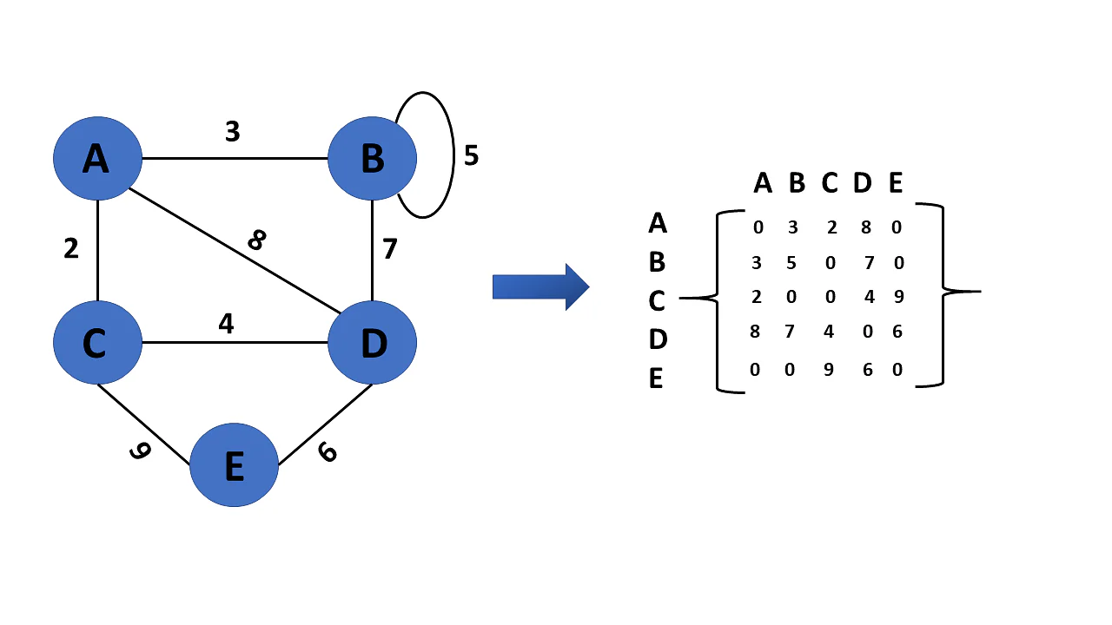
Adjacency matrix (vertex matrix)
Weighted Graph

Slide 22
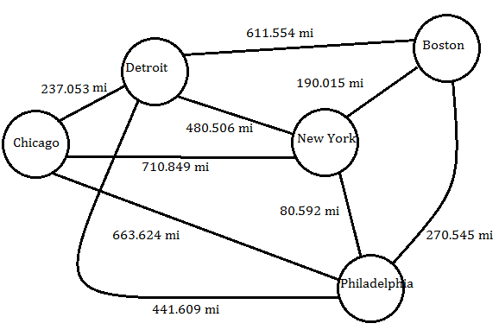

Slide 23
The Vertex-Edge Incidence Matrix
$$e_{1}$$
$$e_{2}$$
$$e_{1}$$
$$e_{2}$$
$$e_{3}$$
$$e_{4}$$
$$e_{3}$$
$$V_{1}$$
$$1$$ | $$1$$ | $$1$$ | $$0$$
$$1$$ | $$0$$ | $$0$$ | $$0$$
$$0$$ | $$1$$ | $$0$$ | $$1$$
$$0$$ | $$0$$ | $$1$$ | $$1$$
$$V_{2}$$
$$e_{4}$$
$$V_{3}$$
$$V_{4}$$

Slide 24
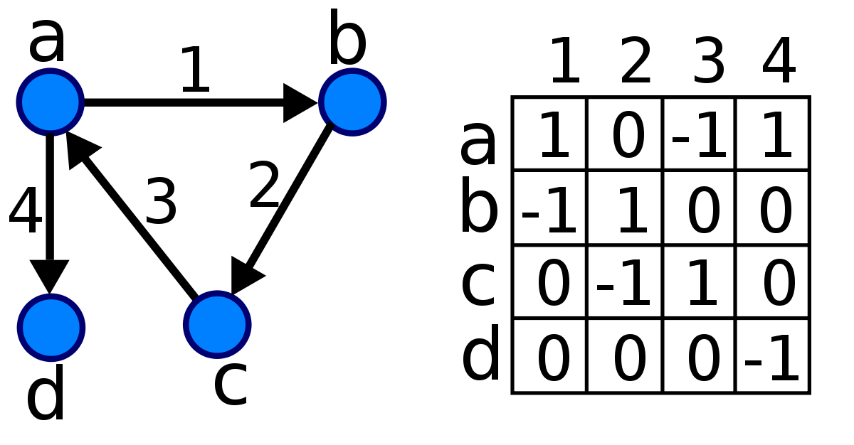
Create a matrix considering arrows.
Create a matrix without arrows.

Slide 25
Branches
$$1$$
$$2$$
Nodes
$$1$$
$$2$$
$$3$$
$$4$$
$$5$$
$$1$$
$$\left[\begin{matrix}1 & 0 & 0 & 0 & 1 \\ −1 & 1 & 0 & 1 & 0 \\ 0 & −1 & 1 & 0 & 0 \\ 0 & 0 & −1 & −1 & −1\end{matrix}\right]$$
$$4$$
$$2$$
$$5$$
$$3$$
$$3$$
$$4$$

Slide 26
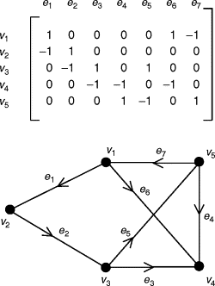
$$e_{1}$$
$$e_{2}$$
$$e_{3}$$
$$e_{4}$$
$$e_{5}$$
$$e_{6}$$
$$e_{7}$$
$$V_{1}$$
$$\left[\begin{matrix}1 & 0 & 0 & 0 & 0 & 1 & −1 \\ −1 & 1 & 0 & 0 & 0 & 0 & 0 \\ 0 & −1 & 1 & 0 & 1 & 0 & 0 \\ 0 & 0 & −1 & −1 & 0 & −1 & 0 \\ 0 & 0 & 0 & 1 & −1 & 0 & 1\end{matrix}\right]$$
$$V_{2}$$
$$V_{3}$$
$$V_{4}$$
$$V_{5}$$

Slide 27
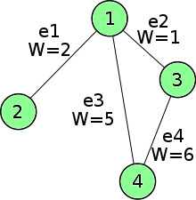
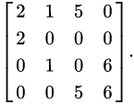
Incidence Matrix
 | $$e1$$ | $$e2$$ | $$e3$$ | $$e4$$
$$1$$ | $$2$$ | $$1$$ | $$5$$ | $$0$$
$$2$$ | $$2$$ | $$0$$ | $$0$$ | $$0$$
$$3$$ | $$0$$ | $$1$$ | $$0$$ | $$6$$
$$4$$ | $$0$$ | $$0$$ | $$5$$ | $$6$$
$$=$$
Weighted Graph

Slide 28
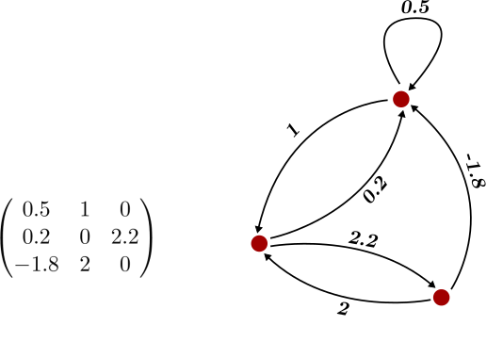
Adjacency Matrix
$$V_{1}$$
$$V_{2}$$
$$V_{3}$$
Weighted Graph

Slide 29
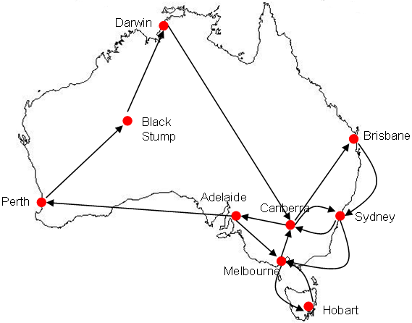
Homework

Slide 30
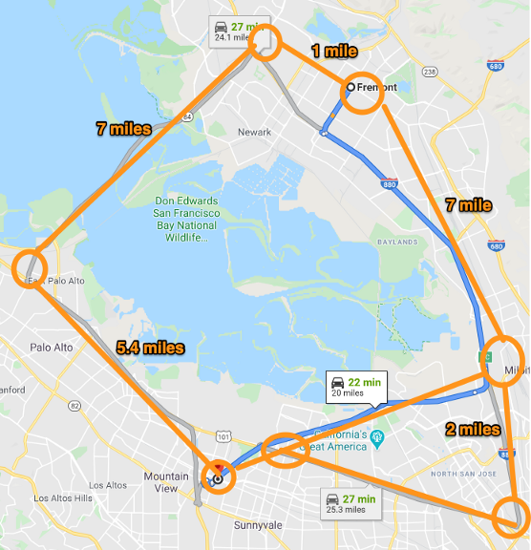
Homework

Slide 31
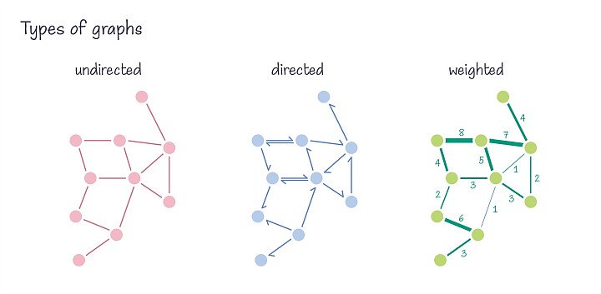
summary

Slide 32
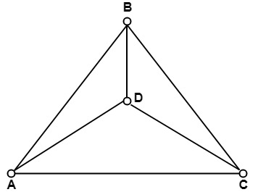
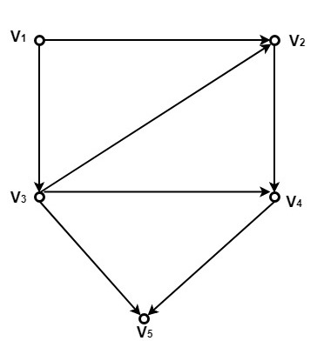
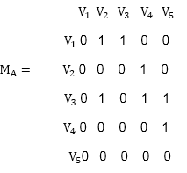
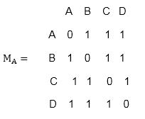
summary
Adjacency Matrix: rows and columns represent vertices.
undirected graph
directed graph

Slide 33
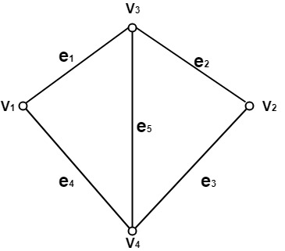
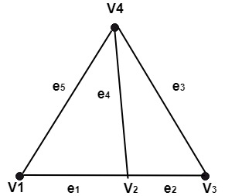
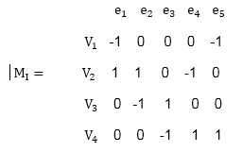
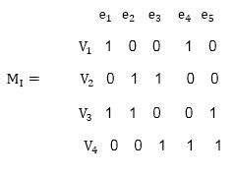
summary
Incidence Matrix: rows represent vertices and columns represent edges.
undirected graph
directed graph

Slide 34
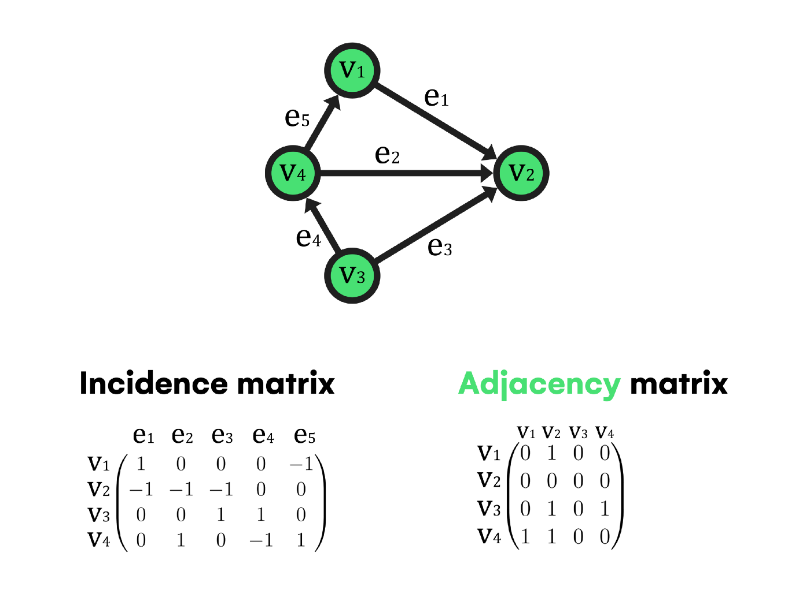
compare

Slide 35
reading
https://sitn.hms.harvard.edu/flash/2021/graph-theory-101/
https://towardsdatascience.com/what-is-graph-theory-and-why-should-you-care-28d6a715a5c2
https://www.xomnia.com/post/graph-theory-and-its-uses-with-examples-of-real-life-problems/

Slide 36
Special types of graphs
Importance of different graphs in our life:
Visual presentation of data makes it easier to understand large amounts of data, trends, and relationships.
The use of graphs in daily life also helps in making an analysis. For example, it provides structure in assessing performances, sales, and even deadlines.
Also, it helps making calculations easier.

Slide 37
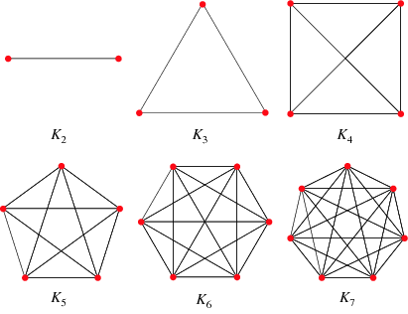
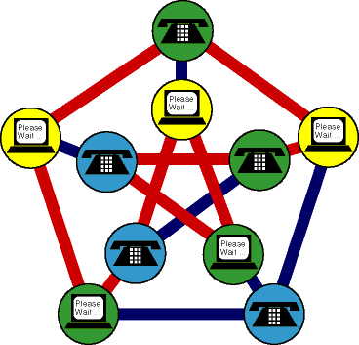
Complete graphs
$$K_{1}$$
A complete graph, denoted $K_{n}$, is a simple graph that contains exactly one edge between each pair of $n$ distinct vertices.

Slide 38
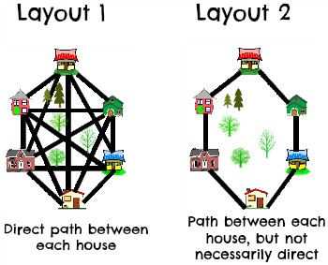
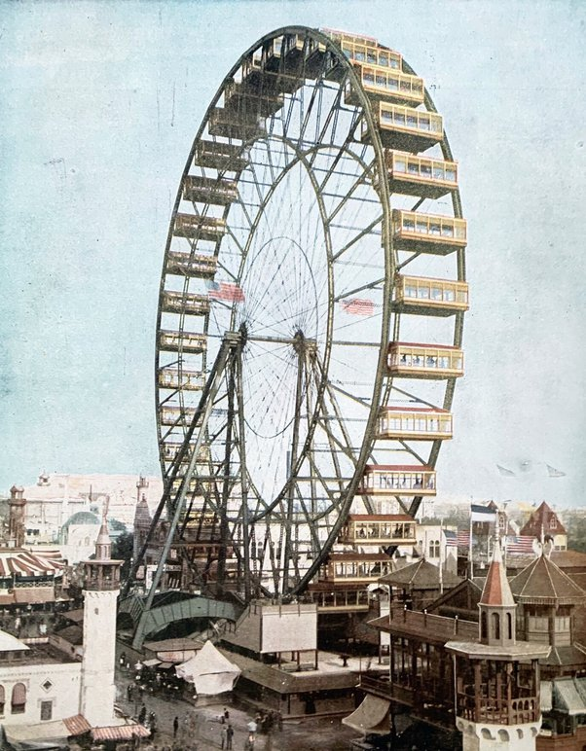
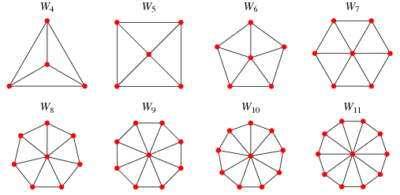
Cycles and wheels
A wheel $W_{n}$ is obtained when we add an additional vertex to $C_{n}$, and connect that vertex to each existing vertex.
A cycle $C_{n}$, $n≥3$, consists of vertices $v_{1}, v_{2}, .., v_{n}$ and edges $\left\{v_{1}, v_{2}\right\}, \left\{v_{2}, v_{3}\right\}, .., \left\{v_{n−1}, v_{n}\right\}, \{v_{n}, v_{1}\}$.
Notes:
A Ferris Wheel

Slide 39
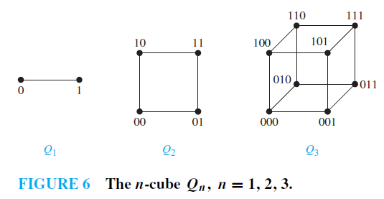
N-cubes or hypercubes
$$Q_{3}=2^{3}=8$$
$$Q_{2}=2^{2}=4$$
$$Q_{1}=2^{1}=2$$
An n-dimensional hypercube, or n-cube, denoted $Q_{n}$, is a graph with vertices representing the $2^{n}$ bit strings of length $n$. Adjacent vertices differ by exactly one bit-position.
$$Q_{0}=2^{0}=1$$
Vertices differ in exactly $1$ bit. They get joined by edge.
Notes:
https://www.researchgate.net/publication/335324962_HypercubeME_two_hundred_million_combinatorially_complete_datasets_from_a_single_experiment/figures?lo=1

Slide 40
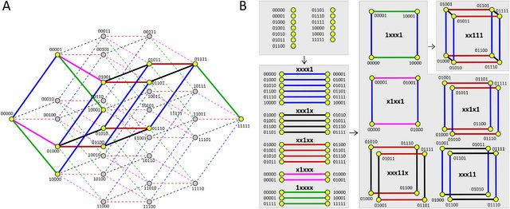
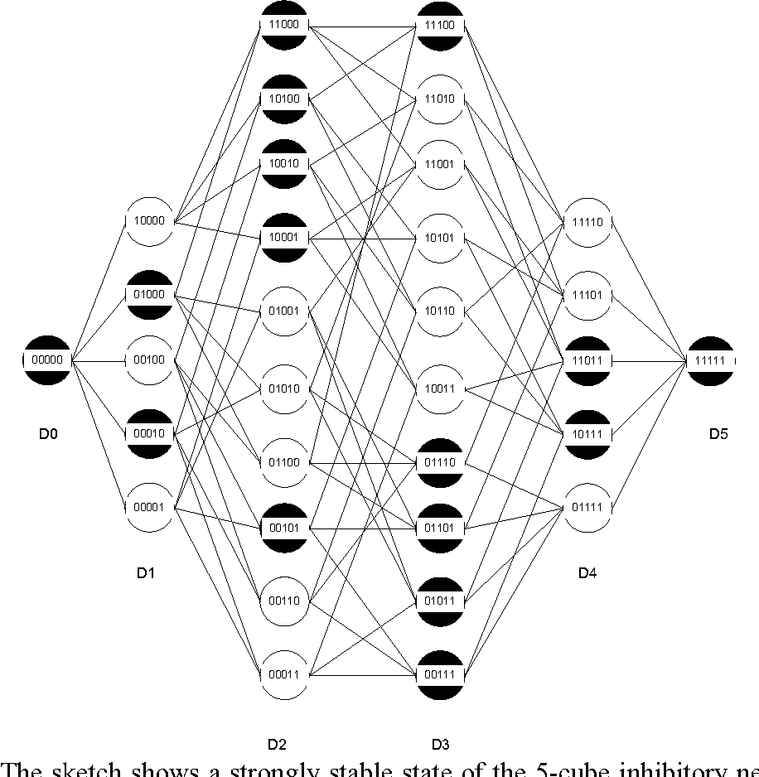
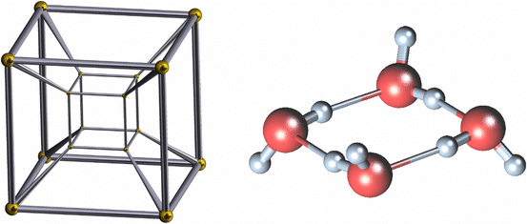
hypercubes applications
Hypercube Network
Mutations in Biology
Science

Slide 41
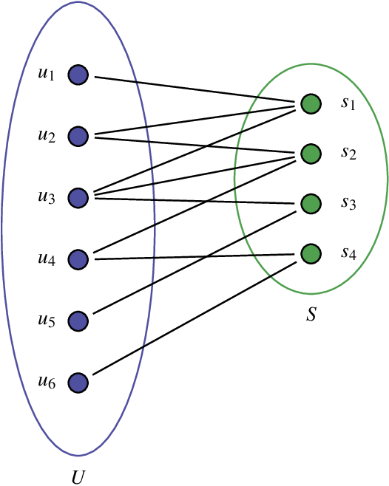
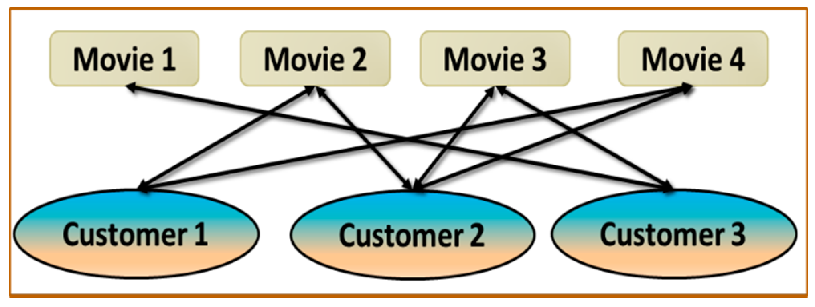
Bipartite graphs
A simple graph is a called bipartite if its vertex set, $V$, can be partitioned into two disjoint subsets such that each edge connects a vertex from one subset to a vertex of the other.

Slide 42
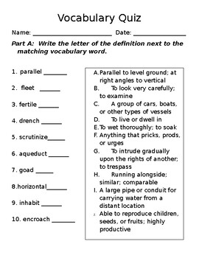
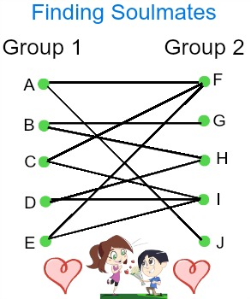
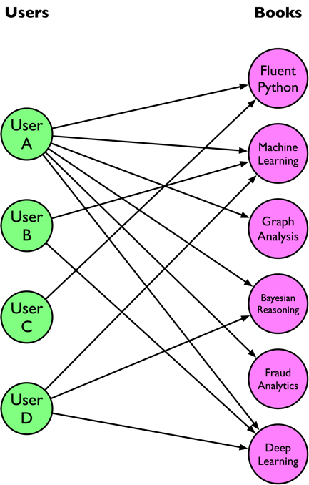
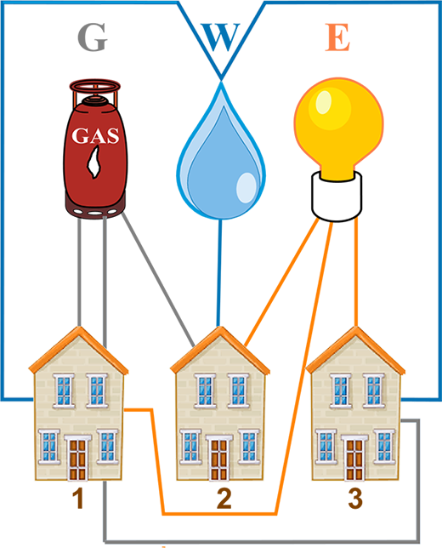
bipartite graph applications

Slide 43
Graph Coloring
Determine if graphs $G$or $H$ are bipartite. Try the graph coloring technique!

Slide 44
Isomorphism
a
d
b
g
f
e
c
$$⟺$$
Yes, it is a bipartite!

Slide 45
No need to continue, it is not a bipartite graph!

Slide 46
Complete bipartite graphs
A complete bipartite graph $K_{m,n}$ is a bipartite graph with subsets of m and n vertices, respectively with an edge between each pair of vertices from opposite subsets.

Slide 47
Suppose Adam, Ben, Chris, David and Eric are training for tasks at work. Adam and Chris are training for task 1, Ben, Chris and Eric are training for Task 2, David is training for task 3, Chris and Eric are training for task 4 and Eric is training for task 5. Create a graph to model this, then determine if a matching is possible.
graph
matching
A
B
C
D
E
1
2
3
4
5
$$D−3$$
$$E−5$$
$$C−4$$
$$A−1$$
$$B−2$$

Slide 48
has no matching
has no matching
has a matching
has a matching
Matching
Notes:
https://discrete.openmathbooks.org/dmoi2/sec_matchings.html#:~:text=A%20bipartite%20graph%20that%20doesn,but%20possibly%20belongs%20to%20none).

Slide 49
Applications of graph coloring
Scheduling problems in management science
Allocating transmission frequencies to TV and radio stations
Study of Cell Phone traffic
Coloring maps so that no two regions that share a boundary are the same color

Slide 50
Graph coloring
A coloring for a graph is a coloring of the vertices in such a way that the vertices joined by an edge
have different colors.
The chromatic number of a graph is the least number of colors needed to make a coloring.

Slide 51
Coloring a graph
Step 1:
Choose a vertex with highest degree, and color it. Use the same color to color as many vertices as you can without coloring vertices joined by an edge of the same color.
Step 2:
Choose a new color and repeat what you did in Step 1 for vertices not already colored.
Step 3:
Repeat Step 1 until all vertices are colored.

Slide 52
Color the graph and give its chromatic number.
Count degrees
Color the highest degree
Color vertices
Its chromatic number is 3

Slide 53
scheduling
Suppose we have several classes to offer but a limited number of class times. Some classes cannot be offered at the same time because the same instructor teaches the classes. What is the minimum number of classrooms needed for the following?
Course | Conflicts with
Algebra | Geom, Trig
Geometry | Calc, Alg
Calculus | Geom, Tri, Discret
Discrete | Calc, Trig
Trigonometry | Discrete, Calc, Alg
Chromatic number is 3. Which means we need 3 class times to hold these classes.

Slide 54
Three goals of scheduling problems
Optimization issues – Try to maximize profit, minimize cost.
Example: Scheduling machine time for earliest completion time
Equity – Try to make things fair for all participants.
Example: Schedule baseball games (same number home and away games)
Conflict Resolution – Try to prevent conflicts from happening.
Example: Scheduling college final examinations for end of term

Slide 55
Scheduling
 | F | M | H | P | E | I | S | C
French (F) |  | X |  | X | X | X |  | X
Math (M) | X |  |  |  | X | X
History (H) |  |  |  |  |  | X | X | X
Philosophy (P) | X |  |  |  |  |  |  | X
English (E) | X | X |  |  |  | X
Italian (I) | X | X | X |  | X |  | X
Spanish (S) |  |  | X |  |  | X
Chemistry (C) | X |  | X | X
An education center is offering eight courses during its summer session. The table shows with an X which pairs of courses have one or more students in common. Only two air-conditioned lecture halls are available for use at any one time.
To design an efficient way to schedule the final examinations, represent the information in this table by using a graph. In the graph, represent courses by vertices and join two courses by an edge if there is any student enrolled in both courses.

Slide 56
 | F | M | H | P | E | I | S | C
French (F) |  | X |  | X | X | X |  | X
Math (M) | X |  |  |  | X | X
History (H) |  |  |  |  |  | X | X | X
Philosophy (P) | X |  |  |  |  |  |  | X
English (E) | X | X |  |  |  | X
Italian (I) | X | X | X |  | X |  | X
Spanish (S) |  |  | X |  |  | X
Chemistry (C) | X |  | X | X
What if only two rooms have air-conditioning?
We see that $x = 4$.
This means that four times are needed.
Time Slot 1: F, H
Time Slot 2: P, I
Time Slot 3: C, M, S
Time Slot 4: E
Time Slot 1: F, H
Time Slot 2: P, I
Time Slot 3: C, M
Time Slot 4: E, S

Slide 57
Corncob College elects 10 students to serve as officers on 8 committees. The list of the members of each of the committees is:
• Corn Feed Committee: Darcie, Barb, Kyler
• Dorm Policy Committee: Barb, Jack, Anya, Kaz
• Extracurricular Committee: Darcie, Jack, Miranda
• Family Weekend Committee: Kyler, Miranda, Jenna, Natalie
• Homecoming Committee: Barb, Jenna, Natalie, Skye
• Off Campus Committee: Kyler, Jenna, Skye
• Parking Committee: Jack, Anya, Miranda
• Student Fees Committee: Kaz, Natalie
They need to schedule meetings for each of these committees, but two committees cannot meet at the same time if they have any members in common.
a) Draw a graph representing this situation. (Hint: let the vertices represent the committees.)
b) How many different meeting times will we need?

Slide 59
The mathematics department has six committees, each meeting once a month. How many different meeting times must be used to ensure that no member is scheduled to attend two meetings at the same time if the committees are
C1 = {Arlinghaus, Brand, Zaslavsky},
C2 = {Brand, Lee, Rosen},
C3 ={Arlinghaus, Rosen, Zaslavsky},
C4 = {Lee, Rosen, Zaslavsky},
C5 = {Arlinghaus, Brand},
C6 = {Brand, Rosen, Zaslavsky}?
5 meeting times are needed

Slide 60
Graphing online tool
https://graphonline.ru/en/#
https://mathigon.org/course/graph-theory/introduction

Slide 61
Homework

Slide 62
Homework
The mathematics department at Cornucopia College will offer seven courses next semester: Math 105 (M), Numerical Analysis (N), Linear Operators (O), Probability (P), Differential Equations (Q), Real Analysis (R), Statistics (S). The department has twelve students, who will take the following classes:
Alice: N, O, Q Chaz : R, M
Bob: N, R, S Dan: N,O
Greg: M,P Emma: O, M
Homer: R,O Kate: P,S
Inez: N, Q Lara: P,Q
Fonz: N, R Jill: N,S,Q
The department needs to schedule class times for each of these courses, but two courses cannot meet at the same time if they have any students in common. How many different class times will they need?

Slide 63
Applications of graphs

Slide 64
Suppose 8 devices (computers, printers, etc.) must be connected through a local area network.
Let’s explore how this might look.
Star
Ring
Hybrid

Slide 65
Suppose you have 9 processors to carry out an algorithm. Describe three different ways to arrange the processors and the advantage or disadvantage of each.
Linear Array
Complete
Mesh Network

Slide 66
Trees

Slide 67
A tree is a simple, connected, undirected graph with no simple circuits. This means there is a unique simple path between any two of its vertices.

Slide 68
Rooted trees
A tree in which one vertex has been designated as the root and every edge is directed away from the root. We typically place the root at the top of the tree.
Create a rooted tree from 5.

Slide 69
More terminology for rooted trees
m-ary tree
binary tree:
parent: a
child: b, c
sibling: b and c
ancestor: a
descendants: b - p
leaf: no children
internal vertices: has children

Slide 70
Binary tree

Slide 71
m-ary tree

Slide 72
Balanced m-ary trees
The height of a rooted tree is the maximum of the levels of vertices.
A rooted m-ary tree of height $h$ is balanced if all leaves are at levels $h$ or $h−1$.
Example: Find the level of each vertex in the following rooted tree. What is the height of this tree?
Level: 0
Level: 1
$$h=4$$
Level: 2
Level: 3
Not balanced: leaves at $h−2$ also exist
Level: 4

Slide 73
Balanced m-ary trees
Balanced
Not Balanced
Balanced
Balancing the tree makes for better search times $O(log⁡(n))$ as opposed to $O(n).$
An unbalanced tree is, in its worst case, just a linked list and the worst case to find an element becomes $O(n)$, instead of $O(logn)$.
A balanced tree avoids this worst case, and ones that are nearly as bad.
Notes:
In some applications, if the height of the tree is very high, then it is acceptable for the tree to be balanced.
If the difference between the levels is not exactly one. For example, if the height of the tree is 100, and the leaves at the levels 100, 99, 98 then we can also say that the tree is balanced.

Slide 74
Properties of trees
A tree with $n$ vertices has $n−1$ edges
A full $m−ary$ tree with $i$ internal vertices contains $n=mi+1$vertices
A full $m−ary$ tree with:
$n$ vertices has $i=\frac{n−1}{m}$ internal vertices and $l=\frac{\left(m−1\right)n+1}{m}$ leaves
$i$ internal vertices has $n=mi+1$ vertices and $l=\left(m−1\right)i+1$ leaves
$l$ leaves has $n=\frac{(ml−1)}{m−1}$ vertices and $i=\frac{l−1}{m−1}$ internal vertices

Slide 75
Suppose someone starts a chain letter. Each person is asked to send the letter to four other people.
Everyone does it. How many people have seen the letter, including the original sender, if no one
receives more than one letter, and the chain ends after 100 people read it but did not send it on. How many people sent out the letter?
It is a tree, because no one receives more than one letter.
How many people sent out the letter? $i=?$
leaves =100
internal vertices
$m=4$ (full m-ary tree)
$$n=\frac{ml−1}{m−1}$$
$$i=\frac{l−1}{m−1}$$
How many people have seen the letter: $n=?$
$$n=\frac{4\left(100\right)−1}{4−1}=\frac{399}{3}=133$$
$$i=\frac{100−1}{4−1}=\frac{99}{3}=33$$

Slide 76
A chain letter starts when a person sends a letter to five others. Each person who receives the letter either sends it to five other people who have never received it or does not send it to anyone. Suppose that 10,000 people send out the letter before the chain ends and that no one receives more than one letter. How many people receive the letter, and how many do not send it out?
$i$ internal vertices has $n=mi+1$ vertices and $l=\left(m−1\right)i+1$ leaves
$m=5$ (full 5-ary tree)
How many do not send it out: $l=?$
$$i=10000$$
$$l=\left(5−1\right)∙10000+1=40001$$
How many people receive the letter: $n=?$
$$n=5∙10000+1=50001$$

Slide 77
How many matches are played in a tennis tournament of 27 players?
$$26 matches$$
There are 256 players in a chess tournament (singles). Two players play a match. Matches are played on a knockout basis, the loser is eliminated after each match. How many matches need to be played to declare a winner? There is no draw.
$$255 matches$$
In both questions, idea is the same:
$n=\left(number of players\right)=number of vertices$
Find $number of edges?$
A tree with $n$ vertices has $n−1$ edges

Slide 78
Which of these graphs are trees?

Slide 79
Answer these questions about the rooted tree illustrated.
a) Which vertex is the root?
b) Which vertices are internal?
c) Which vertices are leaves?
d) Which vertices are children of j?
e) Which vertex is the parent of h?
f ) Which vertices are siblings of o?
g) Which vertices are ancestors of m?
h) Which vertices are descendants of b?
Subtree

Slide 80
Dijkstra’s shortest path algorithm
Objective: to find the shortest path between any two vertices in a graph.

Slide 81
Usage of djikstra’s algorithm
Digital Mapping Services in Google Maps
Social Networking Applications
Telephone Network
IP routing to find Open shortest Path First
Flighting Agenda
Designate file server
Robotic Path

Slide 82
Find the shortest path from vertex A to every other vertex
Vertex | Shortest distance from A | Previous vertex
A | 0
B | 3 | D
C | 7 | E
D | 1 | A
E | 2 | D

Slide 83
Consider the start vertex, A
Distance from A to A = 0
Distances to all other vertices from A are unknown, therefore $∞$ (infinity)
Vertex | Shortest distance from A | Previous vertex
A | 0
B | $$∞$$
C | $$∞$$
D | $$∞$$
E | $$∞$$
Visited [ ] | Unvisited [A, B, C, D, E ]

Slide 84
Visit the unvisited vertex with the smallest known distance from the start vertex
This time around, it is vertex D
Vertex | Shortest distance from A | Previous vertex
A | 0
B | $$6$$ | A
C | $$∞$$
D | $$1$$ | A
E | $$∞$$
Visited [A] | Unvisited [B, C, D, E ]

Slide 85
For the current vertex, examine its unvisited neighbors
We are currently visiting D and its unvisited neighbors are B and E
For the current vertex, calculate the distance of each neighbor from the start vertex
Vertex | Shortest distance from A | Previous vertex
A | 0
B | $6$ $≫3$ | A $≫D$
C | $$∞$$
D | $$1$$ | A
E | $$2$$ | D
Visited [A, D] | Unvisited [B, C, E ]
Notes:
If the calculated distance of a vertex is less than the known distance, update the shortest distance

Slide 86
Visit the unvisited vertex with the smallest known distance from the start vertex
This time around, it is vertex E
$$2+2=4$$
We do not need to update the distance to B
Vertex | Shortest distance from A | Previous vertex
A | 0
B | $$3$$ | $$D$$
C | $$7$$ | E
D | $$1$$ | A
E | $$2$$ | D
$$2+5=7$$
Visited [A, D, E] | Unvisited [B, C]

Slide 87
For the current vertex, examine its unvisited neighbors
We do not need to update the distance to C
$$3+5=8$$
Vertex | Shortest distance from A | Previous vertex
A | 0
B | $$3$$ | $$D$$
C | $$7$$ | E
D | $$1$$ | A
E | $$2$$ | D
Visited [A, D, E, B] | Unvisited [C]

Slide 88
We are currently visiting C and it has no unvisited neighbors
Vertex | Shortest distance from A | Previous vertex
A | 0
B | $$3$$ | $$D$$
C | $$7$$ | E
D | $$1$$ | A
E | $$2$$ | D
Visited [A, D, E, B, C] | Unvisited [ ]

Slide 89
Algorithm
Let distance of start vertex from start vertex = 0
Let distance of all other vertices from start = $∞$ (infinity)
Repeat
Visit the unvisited vertex with the smallest known distance from the start vertex
For the current vertex, examine its unvisited neighbors
For the current vertex, calculate distance of each neighbor from start vertex
If the calculated distance of a vertex is less than the known distance, update the shortest distance
Update the previous vertex for each of the updated distances
Add the current vertex to the list of visited vertices
Until all vertices visited
Notes:
https://www.youtube.com/watch?v=pVfj6mxhdMw

Slide 90
Algorithm
Let distance of start vertex from start vertex = 0
Let distance of all other vertices from start = $∞$ (infinity)
WHILE vertices remain unvisited
Visit unvisited vertex with the smallest known distance from the start vertex (call this current vertex)
FOR each unvisited neighbor of the current vertex
Calculate distance from start vertex
If the calculated distance of this vertex is less than the known distance
Update the shortest distance to this vertex
Update the previous vertex with the current vertex
end if
NEXT unvisited neighbor
Add the current vertex to the list of visited vertices
END WHILE

Slide 91
practice
Find the shortest path from vertex A to all
other vertices.
Notes:
https://www.youtube.com/watch?v=5GT5hYzjNoo

Slide 93
Try it
Find the shortest path from vertex A to all
other vertices.
Show your solution in a table format as shown below.
Vertex | Shortest distance from A | Previous vertex
a | 0
b
c
d
e
z

Slide 94
continue the solution

Slide 95
Try it
Find the shortest path from vertex A to all other vertices.
Show your solution in a table format as shown below (for each vertex).
 | a | b | c | d | e | f | z
a

Slide 96
Find the shortest path from $V_{1}$to $V_{6}$.
Find the shortest path from vertex $1$ to any other vertex.
Show your solution in a table format (for each vertex).

Slide 97
Find the shortest path from vertex a to each vertex using Dijkstra’s algorithm.

Slide 98
Dijkstra’s algorithm
Finding the shortest path from a vertex to any other vertices.
Show your solution in a table format (both).

Slide 99
Use Dijkstra’s algorithm to find the shortest route from A to J. State your shortest route and its length.
Route: A C F E G J
Length: 53 km

Slide 100
Homework
Use Dijkstra’s algorithm to find the shortest route from A to any other vertices. State your shortest route and its length.

Slide 101
HOMEWORK
Kütahya is a city famous for its ceramics. A company located in Kütahya will distribute the ceramic dinner sets it produced to other provinces in the Aegean Region. The distribution truck of each province is separate. A route for each truck is required. What are the shortest distance routes to the seven provinces in the region starting from Kütahya? Show your answer by creating a model. To solve the problem, you may use the map below and the distances between the provinces.

Slide 102
Recall: trees are graphs that have no circuits.

Slide 103
Subgraph
A subgraph for a graph is a graph whose vertices and edges are subsets of the original graph.
Not a tree
Tree

Slide 104
Spanning Trees
A spanning tree for a graph is a subgraph that includes every vertex of the original and is a simple tree with no cycles and loops.
Notes:
A tree that contains only vertices of degree one or two is called a path graph.
If two path graphs contain the same number of vertices, then they are isomorphic.

Slide 105
Find the spanning tree for the graph below.
This graph has 8 vertices, 9 edges and 2 circuits.
A spanning tree for 8 vertices must have 7 edges.
We must remove 2 edges and break 2 circuits.
We break the two circuits by removing a single edge from each. Two possibilities of many:

Slide 106
Find all spanning tree for the graph below.
This graph has 7 vertices, 7 edges and 1 circuit.
A spanning tree for 7 vertices must have 6 edges.
We must remove 1 edge and break the circuit.

Slide 107
Find 3 different spanning trees for the graph below.
This graph has 5 vertices, 7 edges, multiple overlapping circuits.
A spanning tree for 5 vertices must have 4 edges.
We must remove 3 edges and break the circuits.
All of these are subgraphs of the original graph, have no circuits, and include all the vertices. So, they are spanning trees.

Slide 108
Minimum spanning tree (mst)
A weighted graph is called a network.
total / sum of weights of edges must be minimum.

Slide 109
Recall: trees cannot form a cycle
Define MST

Slide 110
Define MST
A spanning tree for 5 vertices must have 4 edges.

Slide 111
Try it

Slide 112
If there are thousands of vertices and edges, how will it be solved?
Algorithms:
Prim’s Algorithm
Kruskal’s Algorithm

Slide 113
Prim's Algorithm
To find the MST we can use Prim’s Algorithm (Greedy Algorithm)
Basically, Prim’s algorithm is a modified version of Dijkstra’s algorithm. First, we choose a node to start from and add all its neighbors to a priority queue.
Step 1:
Select any node to be the first of T.
Step 2:
Consider which arcs connects nodes in T to nodes outside T. Pick $1$ with minimum weight (if more than $1$, choose any). Add this arc and node to T.
Step 3:
Repeat Step 2 until T contains every node of the graph.

Slide 114
❌
❌
❌
Weight:
❌
❌
❌
❌
$$7+2+4+5=18$$

Slide 115
Converting a network to matrix form
Step 1:
Select any node to be the first of T.
Step 2:
Circle the new node of T in the top row and cross out the row corresponding to this new node.
Step 3:
Find the smallest weight left in the columns of the nodes of T. Circle this weight. Then choose the node whose row the weight is in to join T. If several choose any.
Step 4
Repeat steps 2 and 3 until T contains every node.
 | $$A$$ | $$B$$ | $$C$$ | $$D$$ | $$E$$
$$A$$ | $$−$$ | $$6$$ | $$4$$ | $$8$$ | $$2$$
$$B$$ | $$6$$ | $$−$$ | $$5$$ | $$8$$ | $$6$$
$$C$$ | $$4$$ | $$5$$ | $$−$$ | $$9$$ | $$4$$
$$D$$ | $$8$$ | $$8$$ | $$9$$ | $$−$$ | $$7$$
$$E$$ | $$2$$ | $$6$$ | $$4$$ | $$7$$ | $$−$$
Weight:
$$7+2+4+5=18$$

Slide 117
Step 1 - Remove all loops and parallel edges
Step 2 - Choose any arbitrary node as root node
Step 3 - Check outgoing edges and select the one with less cost

Slide 118
Prim’s Algorithm

Slide 119
Consider the following pseudocode for Prim’s algorithm.

Slide 120
Kruskal's Algorithm
To find the MST of a graph with n nodes
Step 1:
Choose the arc of least weight.
Step 2:
Choose from those arcs remaining the arc of least weight which do not form a cycle. (if more than 1, choose any)
Step 3:
Repeat Step 2 until (n-1) arcs have been chosen.

Slide 121
❌
❌
❌
$$AE=2$$
$$EC=4$$
$$=18$$
$$ED=7$$
$$BC=5$$

Slide 123
Find the Minimum Spanning Tree using Kruskal’s Algorithm:

Slide 124
Answer
Find the Minimum Spanning Tree using Kruskal’s Algorithm:

Slide 125
Take a look at the pseudocode for Kruskal’s algorithm.

Slide 126
What is difference between Prims and Kruskal algorithm?
Prim's Algorithm grows a solution from a random vertex by adding the next cheapest vertex to the existing tree.
Kruskal's Algorithm grows a solution from the cheapest edge by adding the next cheapest edge to the existing tree / forest.

Slide 127
Let’s highlight some key differences between the two algorithms.
As we can see, the Kruskal algorithm is better to use regarding the easier implementation and the best control over the resulting MST. However, Prim’s algorithm offers better complexity.

Slide 128
Prim’s & Kruskal’s algorithms in real life

Slide 129
Applications
Applications where Kruskal’s algorithm is generally used:
Applications where Prim’s algorithm is generally used:
1. Landing cables
2. TV Network
3. Tour Operations
4. LAN Networks
5. A network of pipes for drinking water or natural gas.
6. An electric grid
7. Single-link Cluster
1. All the applications stated in the Kruskal’s algorithm’s applications can be resolved using Prim’s algorithm (use in case of a dense graph).
2. Network for roads and Rail tracks connecting all the cities.
3. Irrigation channels and placing microwave towers
4. Designing a fiber-optic grid or ICs.
5. Travelling Salesman Problem.
6. Cluster analysis.
7. Pathfinding algorithms used in AI(Artificial Intelligence).
8. Game Development
9. Cognitive Science

Slide 130
Time for Practice

Slide 131
Find MST using:
Prim’s Algorithm
Kruskal’s Algorithm

Slide 134
Homework

