Slide 1
Burn in the forensic medicine
Dr.Dilman Azad Hassan

Slide 2
Outlines:
At the end of this lecture, you will be able to:
Define burns.
Explain types of burn.
Identify antemortem and postmortem burn injury.

Slide 3
Burn and scalds
definition
Heat injury
Classification of the severity of burns
Moist thermal damage – scalds
Burns from dry heat
Ante-mortem versus post-mortem burns
Inhalation of soot
Toxic substances in fumes

Slide 4
Burn and scald
Damage to the tissues arising from the application of heat is commonly encountered in forensic pathology and sometimes provides a challenging problem in the distinction between ante-mortem and post-mortem burning, which may have serious criminal aspects

Slide 5
Heat injury
This may arise following a defect in body temperature control or, more commonly, from the external application of heat. Mammalian tissues can survive only within a relatively narrow range of temperatures , approximately 20–44°C.

Slide 6
Burn and scalds
When external heat is applied, the extent of damage
depends upon:
the applied temperature
the ability of the body surface to conduct away
the excess heat
the time for which the heat is applied.

Slide 7
Burns and scald
The temperature/time relationship is important , for it is sometimes forgotten that relatively low temperatures, even as little as 44°C, can cause damage if sustained long enough. This is attested by many negligence lawsuits concerning unconscious patients burned by forgotten hot-water bottles.

Slide 8
Burn and scald
Radiant heat can also cause severe damage, as is obvious from overexposure to sunlight or artificial sunlamps. The long-term effects also include malignant changes, now more important because pollution-induced changes in the stratosphere are allowing more ultraviolet radiation to reach the earth’s surface.

Slide 9
Moist thermal damage – scalds
‘scald’ refers to tissue damage from hot liquids, usually water. Other hot fluids include oils, molten rubber, other liquid chemicals and steam. Molten metals are usually at such a high temperature that the results are similar to dry burns. The water scald is a common domestic accident, especially to children and old people, that group at the extremes of life who are vulnerable to so many types of accident.

Slide 10
Moist thermal damage – scalds
A scald, unless from some superheated oil, does not cause charring, carbonization or singeing of surface hairs as does dry heat. It resembles a first-degree dry burn in that there is reddening, desquamation and blistering, but the shape of the scald tends to be different.

Slide 11
Moist thermal damage – scalds
The appearance of scalds may resemble dry burns except for the distribution and the fact that, if due to immersion, the severity of the skin damage is usually uniform over the whole of the burnt area up to the sharply demarcated margin. When hot or boiling water has been poured or splashed onto the body, the worst scalds will be at the area of initial contact where the fluid was hottest, but decrease in severity as the cooling liquid runs away.

Slide 12
Moist thermal damage – scalds
In children who pull containers of hot liquid down on themselves, the scalds tend to be on the face, neck, chest and arms, with ‘shadow areas’ of undamaged skin in the axillae and on the back.
The severity of a scald depends on the duration of contact with the skin, as well as the temperature. When hot water is splashed, tipped or thrown, it has only a momentary contact, falling away under gravity. The large surface area allows rapid cooling, so damage must occur in a short time, which necessitates the temperature being high if severe damage is to be caused.

Slide 13
Burns from dry heat
More common than scalds, burns due to dry heat maybe caused by high temperature applied to the body surface by conduction or radiation. Convection is merely a variant of conduction in this respect; as hot gas impinges on the surface, the molecules transfer their high energy in a similar fashion to the direct contact of a hot solid

Slide 14
Burns from dry heat:
Radiation causes damage through the conversion of infrared frequencies into thermal heat on absorption at the skin interface. As with scalds, the tissue damage is a function of temperature and time. A warm water-pipe will cause a burn if left long enough in contact with the same area of skin, but most dry burns are due to high temperatures acting for a shorter time.

Slide 15
Burns and sudden death associated with bathing
Voluntary exposure to heat during recreational activities is becoming increasingly common, as bathing in saunas or other types of hot baths has become more popular due to the recognition of the health benefits. Burns associated with sauna bathing are rare and can occur by direct contact with the heat source, i.e., stove or flames in the case of a stove heated with a wood fire, hot steam, water or prolonged exposure to hot dry air, the latter of which is usually associated with unconsciousness and can be potentially fatal due to the risk of rhabdomyolysis.

Slide 16
Classification of the severity of burns:
First degree:
erythema and blistering without loss of dermis. There is capillary dilatation and transudation of fluid into the tissues, causing swelling. If small(<1 cm) this blister may resorb, otherwise it will burst, leaving a reddened base. A first-degree burn will heal without scarring.

Slide 17
Second degree:
destruction of the full thickness of skin. The epidermis is coagulated or charred, and a central zone of necrotic tissue is surrounded by first-degree burns or a zone of hyperemia, or both.
The injury cannot heal without scarring.

Slide 18
Third degree:
destruction of deeper tissues below the skin. This can be of any severity, from damage to subcutaneous fat to loss of muscle, bone and even a whole limb.

Slide 19
Clinically the depth of burn injury is categorized as superficial, superficial dermal, deep dermal and full thickness. For the pathologist a more precise anatomical description of the areas burned is essential for his autopsy report.

Slide 20
Small burns rarely cause deaths, but as burn size increases mortality rises. A large area involved may be more dangerous to life than a deeper, more localized burn. The mortality rates vary a lot depending on the burn size, prior condition of the injured person, age, possible concomitant inhalation injury and the effectiveness of treatment.

Slide 21
During the past three decades several factors have contributed to better survival after burn injury: better control of wound infection through new antibiotics and better infection control techniques, early wound excision, improved grafting techniques and establishment of specialized burn centres.

Slide 22
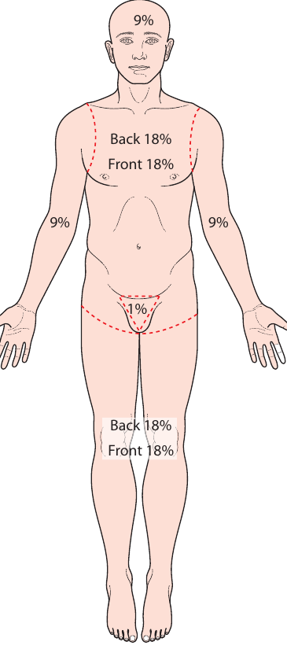
The rule of nine

Slide 23
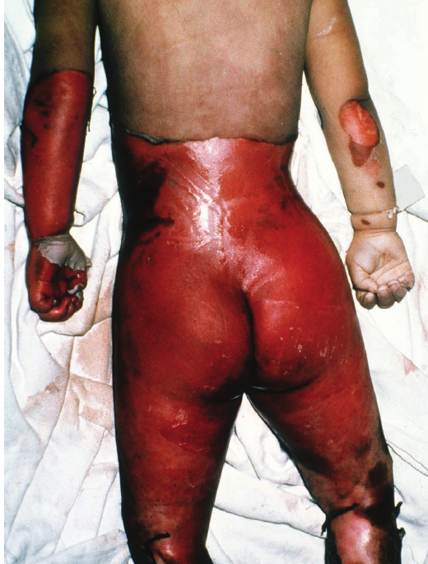
Scald or wet burn in child left accidentally in bath

Slide 24
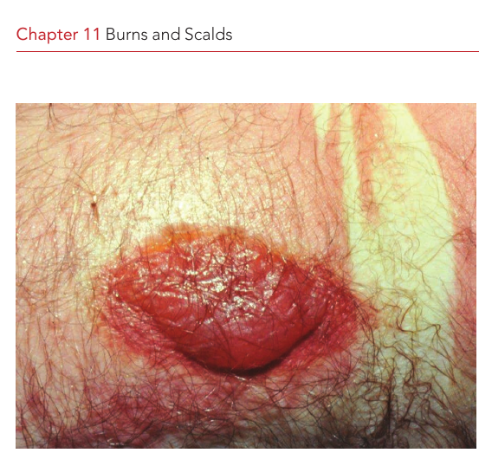
Second degree of burn in house fire victim look to pink coloration of hypostasis due to carbon monoxide poisoning

Slide 25
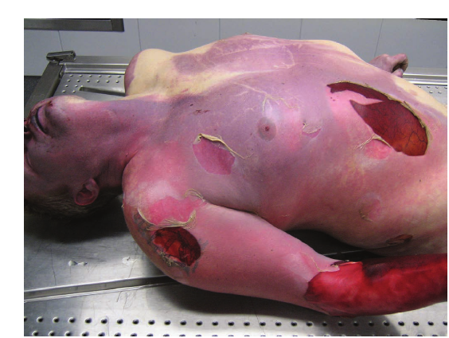
A dead body found in a sauna after heat exposure there is loss of epidermis

Slide 26
Gross appearances at autopsy:
The body may present a wide range of damage from mere reddening over wide areas to almost total cremation, in which a search may have to be made at the scene of the fire to collect or even discover the remnants.
The latter have a marginal red zone of variable width, usually 5–20 mm across. Blisters may be present either in the main burn or as islands beyond the periphery. Most ante-mortem blisters will have a bright red base when burst and an erythematous areola.

Slide 27
Post-mortem heating and deposition of smoke may mimic or overlie the ante-mortem appearances, the surface often being blackened by soot deposition.
In postmortem burn injury there is no sign of inflammation and intravital sign.

Slide 28
Blisters can form post-mortem but are pale yellow unless on scorched skin. There is rarely a red base or erythematous areola, though this sign cannot be depended upon absolutely. The contained fluid is thin and clear. Traditionally most authors claim that differentiation can be made between an ante-mortem and a post-mortem blister by an analysis for protein and chloride. The blister formed in life is said to contain more protein and chlorides, but no absolute figures are offered and the authors have yet to meet a pathologist who does this as a routine

Slide 29
summary
A burn is an injury that can be produced from different sources like heat ,radiation or chemicals…….
There are 3 different degrees that are based on the type of burn , and these degrees are classified according to depth of the burn .
But rule of nine is used to divide the body according to the surface involved with the burn.

Slide 30
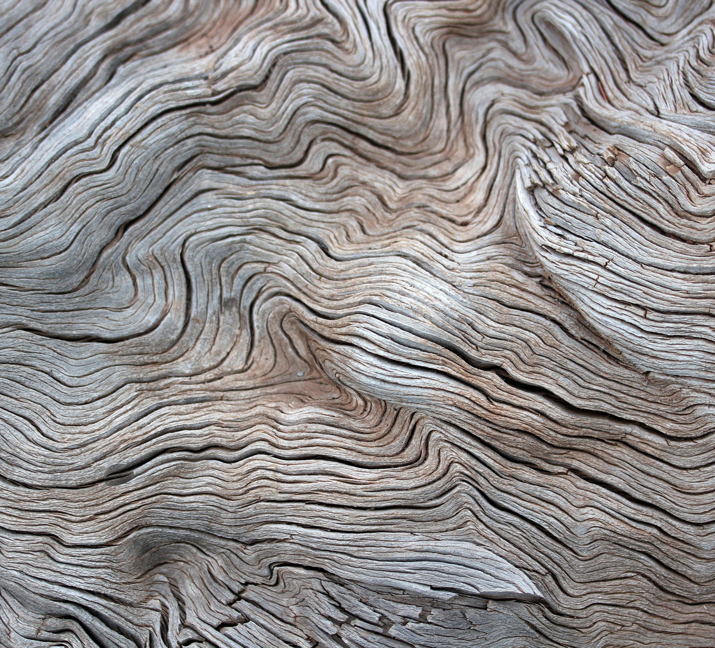
Thank you

