Slide 1
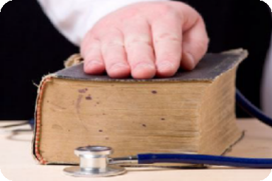
MEDICAL ETHICS
WE TOO NEED ONE DAY ???
1

Slide 2
WHAT ARE MEDICAL ETHICS
Medical ethics refers
Chiefly to the rules of etiquette adopted by the medical profession to regulate professional conduct with each other, but also towards their individual patients and towards society, and includes considerations of the motives behind that conduct.
3

Slide 3
PATENTS ARE DEMANDING UNLIKE PAST- FOLLOW ETHICS
Patients are entitled to good standards of practice and care from their doctors .Essential elements of this are professional competence, good relationships with patients and colleagues and observance of professional ethical obligations

Slide 4
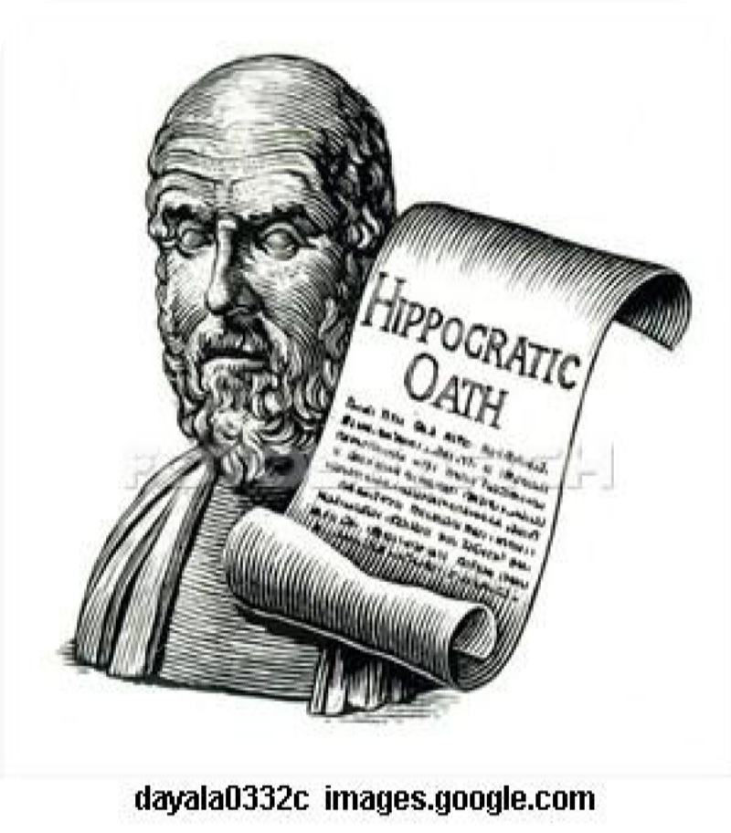
DEFINITION OF MEDICAL ETHICS
The practice of medicine
is rooted in a covenant of
trust among patients,
healthcare professionals, and society.
The ethics of medicine
must seek to balance the
healthcare professional’s
responsibility to each
patient and the
professional, collective
obligation to all who need medical care.

Slide 5
BASIC RIGHTS AND ETHICAL DUTIES
Human Rights
Access to health care
Right to non-discrimination
Right to privacy and confidentiality
Human
Dignity
Right to environment that is not harmful to health or well being

Slide 6
PRINCIPLES OF MEDICAL ETHICS
The good of the patient is paramount
TRUST must be nurtured before all else
Avoid conflicts of interest .
Avoid perception .
Respect rights of patient
safeguard confidentiality
respect self-determination
communicate honestly with all
maintain competence

Slide 7
TYPES OF ETHICS
Medical Ethics: Clinical obligations
fidelity first to patients’ interests
telling the truth (cancer, errors)
Professional Ethics: Obligations of the profession
self-regulation
education of self and others
Bioethics: Guides for public policy
gene technology, stem cell research
health system reform

Slide 8
WHAT IS THE NEED FOR MEDICAL ETHICS?
The practice of medicine and the practice of ethics are inseparable.
Every clinical decision invokes an ethical decision as well.
In many instances, the ethical issue may not be readily apparent.
In others conflicts arise between ethical principles and medical decisions, which require the clinician to be well versed with the former in order to guide the latter.

Slide 9
ETHICAL PRINCIPLES
Autonomy: Respect for an individual’s autonomy or ability to make decisions for him/herself
includes respect for their privacy and confidentiality
need to provide sufficient information for them to make informed choices
truth telling
protection of persons with diminished or impaired autonomy.

Slide 10
ETHICAL PRINCIPLES
Justice: This refers to the need to treat all people equally and fairly
Society uses a variety of factors as a criteria for distributive justice, including the following:
to each person an equal share
to each person according to need
to each person according to effort
to each person according to contribution
to each person according to merit
to each person according to free-market exchanges
We should strive to provide some decent minimum level of health care for all citizens, regardless of ability to pay

Slide 11
ETHICAL PRINCIPLES
Beneficence: This refers to the tradition of acting always in the patients’ best interest to maximise benefits and minimise harm.
Non-malfeasance: This principle ensures
that treatment produce harm
Negligence
Misconduct
or research ought not to

Slide 12
ETHICAL VS. LEGAL OBLIGATIONS
Medical ethics and the law are not the same, but often help define each other
Breach of ethical obligation may not necessarily mean breach of law
Breach of ethical obligation may be used to prove medical malpractice or medical negligence
14

Slide 13
MICRO LEVEL ETHICAL PRINCIPLES
I. Respect for Autonomy (or Person)
Respect the decisions of autonomous persons and protect persons who lack decision-making capacity (e.g., confused patients, mentally ill).
Recognize the capacity of mentally and legally competent patients
:
To think and make decisions independently
To act on the basis of their decisions
To communicate their wishes to health workers
Uphold patient confidentiality

Slide 14
ETHICAL PRINCIPLES
II. Non-Maleficence (Not inflicting harm)
Health professionals should not inflict harm on patients
III. Beneficence
Act in the best interests of patients or research participants.
Contribute to patient welfare – help patients further health interests

Slide 15
LEARNING ABOUT ETHICAL ISSUES REQUIRES….
An understanding of the issue-the science and knowledge base
An understanding of ethical frameworks and principles-not just case studies and anecdotes
An understanding of one’s own values
Ability to think through the issue-logic and argument
Recognition of uncertainty-limits to knowledge
18

Slide 16
INFORMED CONSENT
Definition: A patient’s willing acceptance of a medical intervention after adequate disclosure from their MD of the nature of the intervention, risks, benefits and alternative treatment options
What constitutes informed consent?
Disclosure: information to allow reasonable person to make a decision
Understanding: comprehension of the information given
Voluntary: no coercion or incentive to accept or deny a treatment
Agreement: verbal or written (preferred) to discussed intervention
Many are screening patients for HIV without informed consent ?
Many are doing sex determination in fetus even it is prohibited ???

Slide 17
THE RELATION BETWEEN LAW AND ETHICS
Ethical values have often been influenced by and influenced legal doctrine and legal principles are closely related to ethical principles.
Ethical obligations exceed legal duties
Law serves to demarcate the limits of
of of
individual autonomy in the interests
society. It also protects the rights
individuals
21

