Slide 1
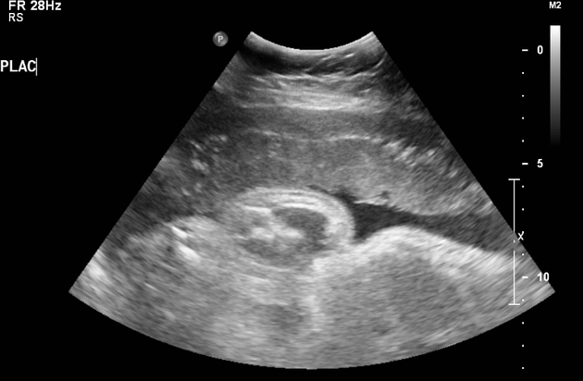
pregnancy bleeding and complications
Dr. Sahar Ismail Abdulla
PhD.in Maternity Nursing
2024

Slide 2
Learning Outcomes
Learning Outcomes By the end of this session, you will be able to… • Define abortion and its types • Explain ectopic pregnancy and its types • Explain the midwifery assessment and management for abortion and ectopic pregnancy
Define abruptio placenta and their firsk factors
Identify placenta previa with their types

Slide 3
1-Abortion
Abortion is the termination of pregnancy by expulsion of the products of conception prior to the ability of the fetus to survive if born.
• This is generally accepted to be up to 20 weeks’ gestation or 500 grams in weight

Slide 4
Classification of Abortion
Type Definition
Early Abortion before 12 weeks gestation
Late Abortion between 12 and 20 weeks gestation
Spontaneous Pregnancy loss at < 20 weeks gestation
Threatened Vaginal bleeding occurring before 20 weeks gestation without cervical dilation

Slide 5
Types of miscarriage
1- Spontaneous Abortion
2- induced Abortion
Spontaneous Abortion • It is also commonly known as “miscarriage” Occurs naturally,. Approximately 10 to 15 % of all clinically diagnosed pregnancies are lost , but the actual number is likely higher because many miscarriages occur so early in pregnancy that a women doesn't realize she's pregnant.
induced Abortion
Induced abortion occurs with the help of medical devices or with assistance.

Slide 6
Causes
• The primary reason is genetic abnormality (75 to 90%).
Blighted ovum. Blighted ovum occurs when no embryo forms.
Intrauterine fetal demise. In this situation an embryo forms but stop developing and dies before any symptoms of pregnancy loss occur.
Molar pregnancy and partial molar pregnancy . With molar pregnancy, both sets of chromosomes come from the father . Amolar pregnancy is associated with abnormal growth of the placenta; there is usually no fetal development

Slide 7
Causes
• Other reasons include:
-­ abnormal progesterone levels -­ thyroid abnormalities -­ uncontrolled diabetes -­ uterine anomalies -­ infection -­ autoimmune disease

Slide 8
What does not cause miscarriage?
Routine activities such as :
Exercise, including high – intensity activities such as jogging and cycling
Sexual intercourse.
Working, provided that the women is not exposed to harmful chemicals or radiation.

Slide 9
Symptoms
Sign and symptoms
Vaginal spotting or bleeding
Pain or cramping in abdomen or lower back
Fluid or tissue passing from vagina

Slide 10
Risk factors
Age: women older than 35 have a higher risk of miscarriage than do younger women.
Previous miscarriages. Women who have had two or more consecutive miscarriages are at higher risk of miscarriage.
Uterine or cervical problems. Certain uterine abnormalities or weak cervical tissues ( incompetent cervix ) might increase the risk of miscarriage.
Smoking, alcohol and illicit drugs.
Weight. ( under weight or over weight)

Slide 11
Diagnosis
The main differential diagnoses to exclude in a suspected miscarriage include: Ectopic pregnancy, Hydatidiform mole or Cervical/uterine malignancy. • Confirm diagnosis and gestational age — In most cases, pregnancy loss is diagnosed with transvaginal ultrasound.

Slide 12
there are two categories of elective abortion procedures:
Medical abortions involve the use of medication to terminate the pregnancy and can be done within 10 weeks from your last menstrual period.
Surgical abortions, often referred to as “in-clinic abortions,” terminate the pregnancy through a surgical procedure. Surgical abortions can be done throughout all three trimesters, depending on your state’s abortion laws

Slide 13
Threatened Abortion
is defined as vaginal bleeding before 20 weeks gestational age in the setting of a positive urine and/or blood pregnancy test with a closed cervical os, without passage of products of conception and without evidence of a fetal or embryonic demise. A threatened abortion can present during early pregnancy with lower abdominal pain, and/or vaginal bleeding.

Slide 14
Inevitable Abortion
• When a spontaneous abortion is almost certain to occur and cannot be stopped, it is classified as inevitable. • This happens when there is external cervical os may be dilated and/or rupture of the membranes in addition to vaginal bleeding and lower abdominal or back pain, the internal os is usually open.

Slide 15
Inevitable Abortion Management
If the woman is in the first trimester, does not have excessive bleeding or pain, has normal vital signs. • Two choices: 1. Consulting physician to assist the abortion by terminating the pregnancy with a suction D&C. 2. The other choice is for the woman to return home to await the inevitable spontaneous evacuation of the products of conception. (observe bleeding and temperature)

Slide 16
Incomplete Abortion
• When a miscarriage begins, but some pregnancy tissue stays in the womb. • The retained placenta (all or part) will eventually be the cause of bleeding, or infection. • The midwife involves the consulting physician regarding the management of care in the event of an infection and to complete evacuation of the uterus.

Slide 17
What is the difference between a complete and incomplete miscarriage?
may also be called a "spontaneous abortion." Other terms for the early loss of pregnancy include: Complete abortion: All of the products (tissue) of conception leave the body. Incomplete abortion: Only some of the products of conception leave the body

Slide 18
Missed Abortion (MA)
the fetus dies but the products of conception are retained for a prolonged period of time (2 or more weeks).
Does hCG drop with missed miscarriage?
After a miscarriage, hCG levels begin to drop, but they don't decrease to zero immediately. So, if take a pregnancy test immediately after experiencing a miscarriage, it will almost certainly still be positive. Eventually, hCG levels drop enough that they can't be detected by a pregnancy test.

Slide 19
Management of MA
• Order an ultrasound examination for confirmation of fetal death. • If fetal death has occurred, there is an increased risk of abnormal clotting mechanisms and potential development of disseminated intravascular coagulopathy (DIC).

Slide 20
Management of MA cont.
The woman should be referred for medical management. • The following baseline coagulation studies may be requested:
1.Prothrombin 2. Partial prothrombin
3. Fibrinogen 4. Platelets

Slide 21
Habitual Abortion( Recurrent)
is the term applied when spontaneous abortion has terminated the course of three or more consecutive pregnancies.
the most common cause • parental chromosomal abnormalities, untreated hypothyroidism, uncontrolled diabetes mellitus, certain uterine anatomic abnormalities, and antiphospholipid antibody syndrome (APS)

Slide 22
Habitual Abortion cont.,
• Developmental abnormalities of the genital tract (e.g., bicornuate uterus,
vaginal septum) should be ruled out. • Follow-­‐up care of the woman by the physician/midwife team includes: -­ support through the grieving process -­ counseling regarding contraception -­ resumption of sexual intercourse within 2 to 4 weeks -­ future pregnancy counseling

Slide 23
Treatment of recurrent abortion
low-dose aspirin tablets and low-dose heparin injections (blood thinner) in the early part of pregnancy may improve the chances of a live birth.

Slide 24
Rh-­‐negative mothers
Regardless of the category of spontaneous abortion,
all Rh­‐negative mothers with negative antibody titers should receive Rh immune globulin (e.g., RhoGAM) within 72 hours of the abortion.

Slide 25
After abortion and future pregnancies
Ovulation may start as soon as two weeks after a miscarriage .
Period might return within four to six weeks.
Any type of contraception can be used immediately after a miscarriage.
having sex should be avoided for two weeks after a miscarriage.
Planning pregnancy: a women should be ready physically and emotionally.

Slide 26
2- Ectopic Pregnancy
• Ectopic pregnancy occurs whenever the blastocyst implants anywhere except in the endometrium lining the uterine cavity. • Possible sites for ectopic pregnancy include: -­ the cervix - ­fallopian tubes - ­ovaries -­ abdomen.

Slide 28
Etiopathology
Common conditions that increase the risk of EP include the following :
pelvic inflammatory disease : previous tube infections(salpingitis)
History of tubal pregnancy:(previous ectopic pregnancy)
History of tubal surgery and conception after tubal ligation
Infertile subject undergoing ovulation induction with different ovulogens
Other causative factors: intrauterine contraceptive device(IUCD) and rupture appendix.

Slide 29
Symptoms of ectopic pregnancy
Symptoms include:
-­vaginal bleeding and spotting -­ occasionally pelvic pain.
Note: Because the levels of B-­‐hCG are lower and more slowly rising, a woman may have fewer presumptive signs of pregnancy.

Slide 30
Diagnosis of ectopic pregnancy
Early diagnosis of ectopic pregnancy in recent years has greatly improved the outcome of tubal patency and diminished the numbers of catastrophic tubal rupture.
• Consideration of ectopic pregnancy in the differential of all early pregnancy vaginal bleeding and pelvic pain as well as the use of serial B‐hCG, serum progesterone, and ultrasound have increased the likelihood of early diagnosis.

Slide 31
in a normal pregnancy, the β-HCG level doubles every 48-72 hours until it reaches 10,000-20,000mIU/mL.

Slide 32
Medical management
• Medical management of ectopic pregnancy with methotrexate has diminished the need for surgical intervention and has also
improved the potential of preserving tubal function and therefore a woman’s
fertility. • However, medical management is reliant on early diagnosis prior to significant
distortion of the fallopian tube and rupture of the pregnancy into the abdomen.

Slide 33
Tubal pregnancy
• It accounts for 95 percent or more of ectopic pregnancies.
• Signs and symptoms are those of tubal rupture or abortion and may vary widely from woman to woman.

Slide 34
Tubal pregnancy signs and symptoms
• Sudden experience of sharp, stabbing, tearing, severe lower abdominal pain. • Hypotension and other signs of shock may or may not develop quickly. • Abdomen is tender, and vaginal examination is quite painful. • Movement of the cervix elicits exquisite pain. • A tender, boggy mass may be felt to one side of the uterus. • Pain in the neck or shoulder, especially on inspiration

Slide 35
Nursing and medical management
• Screening with history, physical assessment, and laboratory evaluation, including ultrasound scanning, is within the scope of midwifery care.
• Medical management (uterine curettage, methotrexate administration and Laparoscopy)

Slide 36
Ovarian Pregnancy
• Ovarian pregnancy is rare. • Vaginal bleeding or spotting may be the presenting complaint. • Symptoms relate to rupture into the peritoneal cavity and are similar to those of tubal rupture.

Slide 37
Abdominal pregnancy (AP)
• Is almost always the result of an early tubal pregnancy rupture or abortion into the peritoneal cavity. • In a few exceedingly rare cases, the fertilized ovum makes the abdomen the site of its primary implantation. • Ultrasound examination may or may not make the diagnosis, especially later in pregnancy.

Slide 38
Cervical Pregnancy
Cervical pregnancy is also rare. • Signs and symptoms include: -­ painless bleeding soon after the time of implantation -­ palpation of a cervical mass with distention and thinning of the cervical wall -­ partial dilatation of the external cervical os -­ slightly enlarged uterine fundus

Slide 39
Diagnosis will be made with slowly rising BhCG levels and
ultrasound exam.
• Referral for medical management is always indicated.

Slide 40
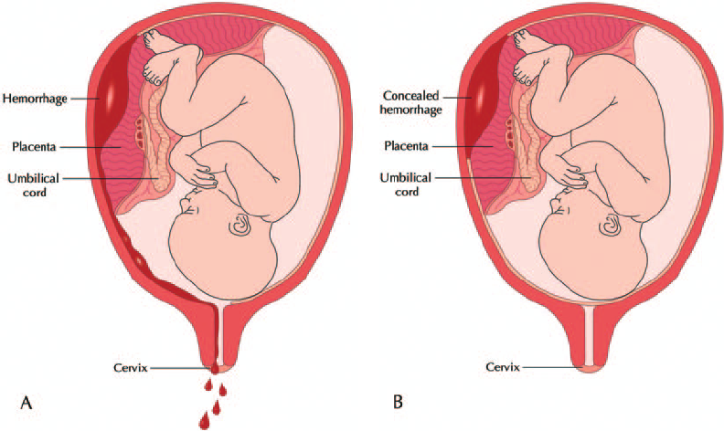
3- Placental Abruption
The separation of the placenta from its site of implantation before the delivery of the fetus and its occurred after 20 weeks of gestation and prior to birth.

Slide 41
Risk factors
Previous placental abruption:- If experienced placental abruption before, at higher risk of experiencing it again.
High blood pressure:- whether chronic or as a result of pregnancy increases the risk of placental abruption.
Abdominal trauma:- Trauma to abdomen such as from a fall or other type of blow to the abdomen makes placental abruption more likely.
Substance abuse:- Placental abruption is more common in women who smoke or use cocaine during pregnancy.

Slide 42
Premature rupture of the membranes:- During pregnancy, the baby is surrounded and cushioned by a fluid-filled membrane called the amniotic sac. The risk of placental abruption increases if the sac leaks or breaks before labor begins.
Blood-clotting disorders:- Any condition that impair blood's ability to clot increases the risk of placental abruption.
Multiple pregnancy:- If carrying more than one baby, the delivery of the first baby can cause changes in the uterus that trigger placental abruption before the other baby or babies are delivered.
Maternal age:- Placental abruption is more common in older women, especially after age 40.

Slide 43
Signs and symptoms
Vaginal bleeding
Abdominal pain
Back pain
Uterine tenderness
Rapid uterine contractions
Change of fetal heart rate
Shock

Slide 44
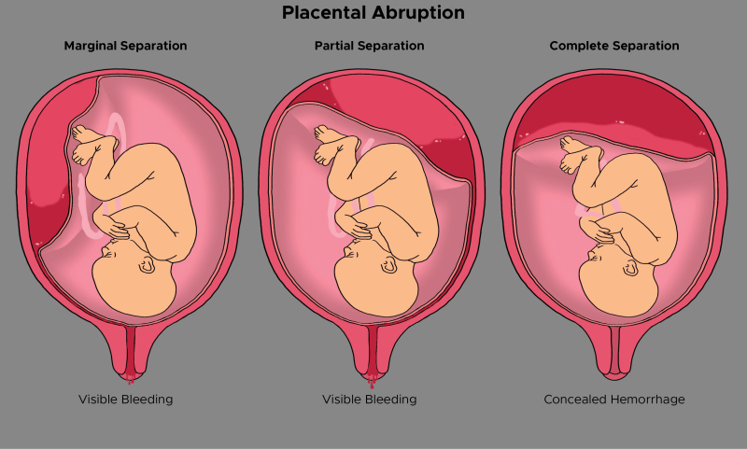
Types of placenta abruption

Slide 45
Management
ICU therapy → Oxygen + IV. fluid + R.B.C.
Treatment of hypovolemic shock: intensive transfusion with blood
Assessment of fetus
Vaginal delivery + electronic fetal monitoring
Cesarean section
Hysterectomy for severely damaged uterus

Slide 46
4- placenta previa
The placenta is an organ that grows on the inside, upper part of the uterus (womb) when the woman´s pregnant. • It has many large blood vessels to carry oxygen and nutrients from mother to the fetus (baby).
About 15 minutes after mother deliver the baby, the placenta comes off the uterus and goes out the vagina.
Placenta previa is a condition when the placenta blocks all or part of the cervix in the last months of pregnancy.
Placenta previa occurs when the placenta doesn't move to the top of the uterus.

Slide 47
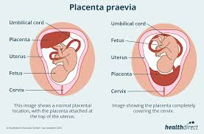

Slide 48
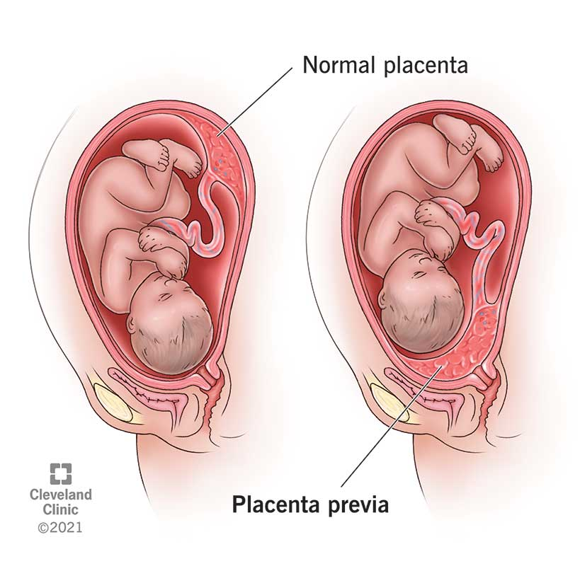

Slide 49
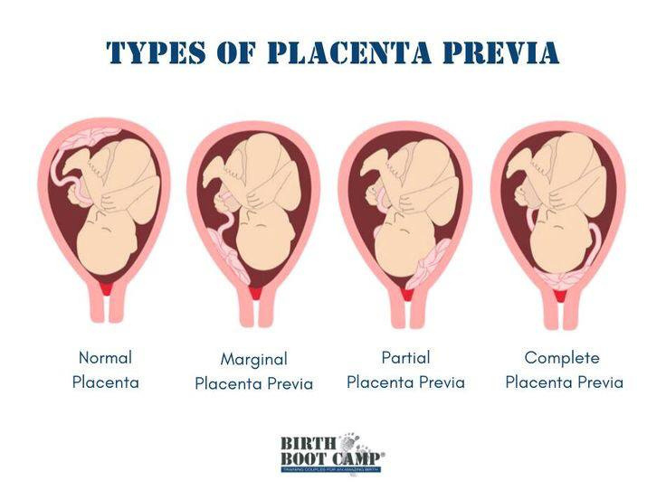

Slide 50
Symptoms of placenta previa
Bright red bleeding from the vagina. The bleeding often starts near the second half of pregnancy. It can also start, stop, then start again a few days later.
➣Mild cramping or contractions in the abdomen, belly or back. The amount of vaginal bleeding can vary and is often not accompanied by any pain

Slide 51
What causes placenta previa?
There isn't a known cause of placenta previa. There are some factors that can increase
risk factors of placenta previa
1.Previous cesarean section.
2.Previous uterine surgery.
3. Multiple pregnancies.
4. Advanced maternal age(>35).
5.- Smoking, Cocaine use.
6.- Assisted reproductive technology

Slide 52
diagnosis for placenta previa
In the third trimester, vaginal bleeding can be due to labor, placental abruption, vasa previa, orplacenta previa.
Ultrasonography and also need a transvaginal ultrasound or TVS 2-Sometimes a MRI could be done .
How is placenta previa is treated
More ultrasounds to track where the placenta is.
➣Bed rest or hospital stay.
➣Early delivery of the baby. This will be based on how
much bleeding you have, how far along your baby is, and
how healthy the baby is.
➣Cesarean section delivery.
➣Blood transfusion for severe blood loss.
➣Pelvic rest which mean no sex.
➣Medicine to prevent early labor and to help
pregnancy continue to at least 36 weeks

Slide 53
Assessing for sign and symptom of vaginal
bleeding and fetal distress.
➣Providing support and education to the client and
her family.
➣For a majority of women a cesarean birth will be
planned.

Slide 54
Learning outcome
Now, you will be able to… • Explain abortion and ectopic pregnancy and its type • Explain the nursing assessment and management for abortion and ectopic pregnancy , placenta abrubtio
And placenta previa.

Slide 55
Any Questions?

