Slide 1
Wounds from Forensic Prospect

Slide 2
Out comes
At the end of lecture student will be able to:
-define the wounds.
-categories types of the wound.
-comparing tyees other wounds.
-how to examine the wounds.

Slide 3
Role of the Pathologist
•
•
•
•
Determine type of wound
Measure the dimensions (length, width, depth)
Position relative to anatomical landmarks
Determine initial location if wound involves cutting, slashing, etc.
Determine height of victim, other contributing factors like heart problems.
•

Slide 4
Analysis of Wounds
Not every crime victim is murdered.
Pathologists can contribute to proof of the severity of a crime or that a crime actually occurred in some cases for a living victim.
Some victims are too young to testify and some are too severely injured to remember the crime.
Wounds provide evidence of the crime.

Slide 5
Wound Categories
Bruises (or contusions)
Abrasions (or grazes or scratches)
Lacerations
Incised wounds
Puncture (or stab) wounds
Gunshot wounds

Slide 6
Gunshot Wounds
This will be discussed with ballistics talk

Slide 7

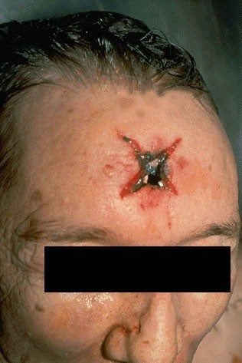
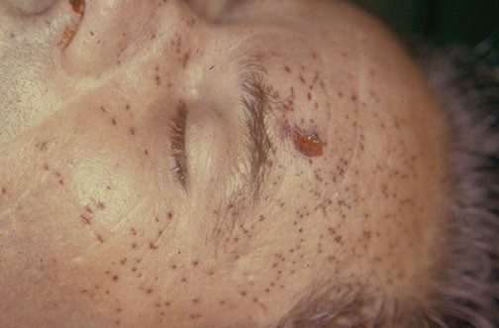

Gunshot Wounds
Stippling – powder burns on the skin when the gun is inches to a few feet from the victim
Starring of a contact wound – barrel touching the skin

Slide 8

Gunshot wounds
Contact Wound: Muzzle applied to skin at shooting.
Impression of muzzle burned around entrance wound
Close Range (6-8 inches): Stippling
Intermediate Range (1- 3 ft.):
hot fragments of burning gunpowder; “ball”
Distant (greater than 3 ft.): No soot or burning of wound margins
Entrance wound: surrounding skin dragged in
Exit wound: skin pushed out

Slide 9
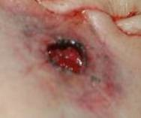
Close range
•
Close Range
•
(6-8 inches): Entrance surrounded by stippling-
HOT soot traveling for short distance; BURNS

Slide 10
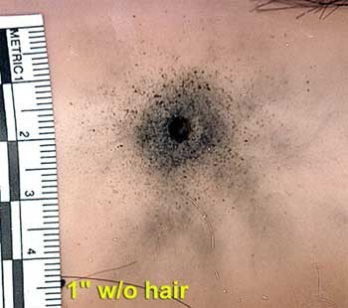
Intermediate range
•
Intermediate range
•
1-3 feet
•
Gunpowder “ball”

Slide 11
Bruises
A bruise is "a hemorrhage into tissues produced by the escape of blood from blood vessels".
Bruises may be found in the skin, muscles, and internal organs.

Slide 12
Bruises
Bruises are typically produced by a blunt force impact, such as a blow or a fall.
They may also be produced by squeezing or pinching, where the force is applied gradually and then maintained.
Hickies or "love-bites" are superficial bruises.

Slide 13
Natural Bruises
Bruises may occur in a variety of natural diseases in which there is an abnormality of the clotting mechanism of the blood, e.g. scurvy (vitamin C deficiency), leukemia, alcoholic liver disease.
This bruising is "spontaneous" because the injury which produces it is so insignificant as to typically pass unnoticed.
The presence of such natural disease will exaggerate the bruising effects of any trauma.

Slide 14
Problems with Skin Bruises
Delayed appearance
Ageing (relative)
Site of Trauma
Shape of object
Degree of force
Post-mortem bruises
Post-mortem lividity

Slide 15
Classic Causes of Bruises
Finger pad bruises: battered babies, manual strangulation
Different ages: repeated assaults
Shoulders and arms: forceful restraint
Wrists and ankles: dragging
Inner thighs: forceful intercourse
Chest: resuscitation
Bruising is uncommon in Suicides

Slide 16
Bruises
The extent of bruising is inversely proportional to the sharpness of the impacting object.
Bruises may be associated with other blunt force injuries such as abrasions and lacerations.
As a general rule bruising is not associated with incised wounds or stab wounds where there is a free flow of blood from the cut blood vessels rather than leaking into the tissues.

Slide 17
Site of Trauma
In contrast with abrasions, the location of a bruise does not necessarily reflect the precise point of injury.
Leaking blood will follow the path of least resistance and gravity.

Slide 18
Delayed Appearance
Deep bruises may have delayed appearance at the skin
surface. Deep bruises may require as long as 12 or 24 hours to become apparent, and some may never do so
The more superficial the source of bleeding, the
sooner the discoloration will be seen on the skin surface.
In a living victim, a second examination in one or two days may show bruising.
In the dead, a further examination one or two days
after the original autopsy may show bruises which
were not previously seen and reveal previously faint bruises.

Slide 19
Autopsy and Bruising
Bruising in Deep Tissue
Possibly life-threatening
Sometimes no external injury
Revealed in autopsy
Documenting Bruising
Photography
Notes

Slide 20
Degree of Force
The size of a bruise is an unreliable indicator of the degree of force causing it.
However, a heavy impact is likely to produce a large bruise and a light impact to produce a small bruise.
If bruising is slight, it is reasonable to assume that the degree of violence was slight.

Slide 21
Determining Degree of Force in Bruise Patterns
Location:
Some areas of the body bruise more easily than others. The face bruises more readily than the hands.
Bruising occurs more readily in loose tissues and where there is a large amount of subcutaneous fat
Bruising is less apparent where the skin is strongly supported by fibrous tissue or if the muscle tone is good.

Slide 22
Determining Degree of Force in Bruise Patterns
Age
  Infants and the elderly tend to bruise more easily than young and middle aged adults.
  Infants have loose and delicate skin, and the abundant subcutaneous fat.
  Elderly have degenerative changes in the tissues which support the small blood vessels of the skin and subcutaneous tissues.
Gender:
  Women bruise more easily than men because they have more subcutaneous fat and this is particularly true of obese women.
Natural Disease
Skin color

Slide 23
Causitive Object
The shape of the bruise is most likely to reflect the shape of the causative object when the object is small and hard and death occurs soon after injury

Slide 24
Causitive Object
A doughnut bruise is produced by an object with a rounded contour (e.g. baseball).
Two parallel linear bruises result from a blow with a rod or stick
Bruises can follow rounded contours if they are caused by a flexible object like a lash

Slide 25
Causitive Object
Bruises produced by fingerpads as a result of gripping are usually larger than the fingerpads themselves.
The pattern and location suggests the mechanism of causation:
•
•
On the neck in throttling
On the upper arms in restraint.
Such bruises are referred to as patterned.

Slide 26
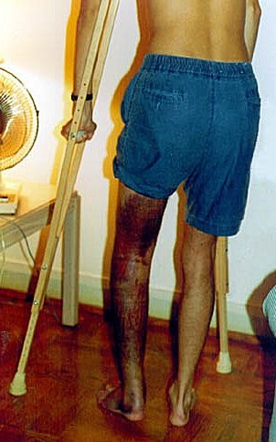
Aging of Bruises
Color changes a bruise goes through can give a rough estimate of time of injury
Colors result from breakdown of hemoglobin from tissues
  Dark blue/purple (1-18 hours)
  Blue/brown (~1 to 2days)
  Green (~ 2 to 3 days)
  Yellow (~3 to 7 days)
This rate assumes person is healthy, however.

Slide 27
Aging Bruises
While accurate estimation of the age of a single
bruise is not possible, a fresh bruise can be
distinguished easily from one which is several days old.
Establishing that bruises are of different ages may
be of medical importance where there is an allegation of repeated assaults:
  Child abuse
  Wife beating
  Where pre-existing injuries need to be distinguished
from those produced by a recent assault like a chronic alcoholic who was assaulted.

Slide 28
Post Mortem Bruises
Bruising is a phenomenon of living tissue- since it usually requires circulating blood to push the blood from the veins.
It isn’t possible to tell bruises that occurred causing death from those that occurred minutes earlier. You can only say they occurred at or about time of death.

Slide 29
Post Mortem Bruises
It requires considerable violence to produce a bruise
post mortem or after death.
These bruises are smaller relative to the degree of force used.
Post mortem bruises are most readily produced in areas of hypostasis (post mortem lividity, livor mortis) or where tissues can be forcibly compressed against bone.
A bruise can develop on the head after the body is left lying on the back.

Slide 30
Post Mortem Lividity (hypostasis,
livor mortis)
The settling, after death, of blood within the blood vessels under the influence of gravity.
This results in a purplish discoloration of parts of the body that are lower while sparing areas of pressure contact - contact pallor.
The pattern and distribution of lividity distinguishes it from bruising.
A body found on its back has livor mortis on the dorsal (back) side with pale areas where the bone contacted the floor.

Slide 31
Decomposition
Post mortem decomposition with its initial green
discoloration of the anterior abdominal wall is readily distinguished from bruising.
Putrefactive lysis of blood cells within the vessels
and decompositional breakdown of the vessel walls
results in diffusion of lysed blood into the adjacent tissues.
Existing bruises are enlarged by this process.
Later, putrefactive hemolytic staining of tissue may
mask ante mortem bruising (e.g. in the neck muscles in case of choking).

Slide 32
Patterns of Injury
Bruises to the knuckles of the hands, together with bruises of the eyelids, bridge of the nose, cheeks and lips, suggest a fist fight.
Bruising around the eyes (spectacle bruises) may be produced by direct blows, but also commonly result from a fracture of the base of the skull, e.g. in vehicle collisions or gunshot wounds to the head
They may also follow blunt impact to the forehead producing jolting of the eyeballs in their sockets with tearing of small orbital blood vessels.

Slide 33
Patterns of Injury
Bruising of the genitalia and around the anus suggests sexual assault.
Severe bruising of the genitalia, with or without laceration, can be produced by kicks.
Counter-pressure bruising, with or without abrasion, to the back, (shoulder blades, sacrum and pelvis) suggests pressure against a firm surface as in forceful restraint on the ground.
Similar bruising may be seen on boney prominences of the front of the pelvis.

Slide 34
Patterns of Injury
In kicking assaults with the shod foot, bruises are invariably associated with multiple abrasions and lacerations.
Gangs, individuals without weapons
The bruises and abrasions may be patterned by the boot.
Bruising is typically extensive and targeted on the face, neck, ears, groin, and kidney area.
Internal bruising is usually severe.

Slide 35
Patterns of Injury
Bruises are painful and therefore not commonly self- inflicted; extensive bruising creates a presumption of assault.
Accidents generally are unforeseen and the injuries they produce tend not to follow a recognizable pattern.
Some places bruise easily accidentally though: shins and hips.

Slide 36
Patterns of Injury
Injuries in motor vehicle collisions almost invariably include abrasions and lacerations as well as bruises.
Patterns of injury may allow reconstruction of incidents involving pedestrians or allow distinction between driver and front seat passenger.

Slide 37
Participation Question
Give me an example of forensic usefulness of analysis of bruises.

Slide 38
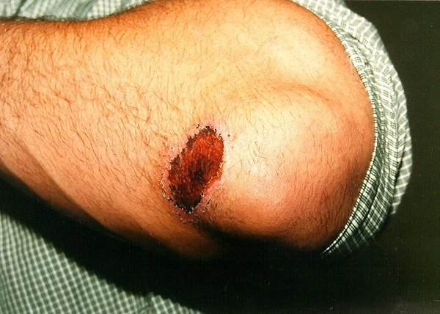
Abrasions
Friction injury removing skin or tissue

Slide 39
Abrasions
Side impact produces a moving abrasion:
•
•
Indicates direction. Trace material (e.g. grit).
Direct impact produces an imprint abrasion:
  Pattern of causative object.
All abrasions reflect site of impact (in contrast with bruises).
Assessment of age of abrasions is difficult.
Post-mortem abrasions - Brown, leathery

Slide 40
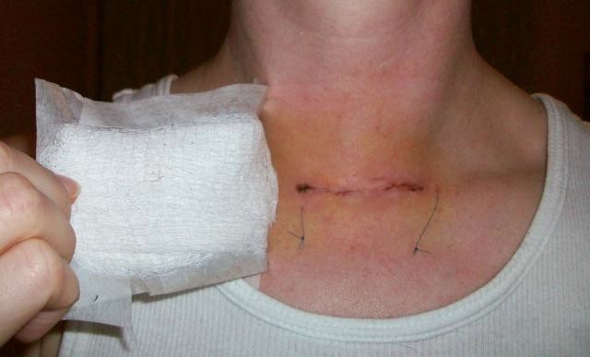

Incised Wounds (Cuts, Slashes, Stab)
Stab wounds or puncture wounds are penetrating injuries whose depth within the body is much greater than the dimensions of the wound on the body surface.
Breach of the full thickness of the skin due to contact with a sharp edge.

Slide 41
Stab Wounds
Forensic Importance
•
•
•
•
Reflects sharp edge, not weapon type No trace evidence
Bleeds profusely
Hemorrhage and air embolism
They can be produced by any long thin object which impacts the body with sufficient force to penetrate.
The typical instrument is a knife, but any sharp pointed, or keen-edged object will work.

Slide 42
Stab Wounds Should be Described at Autopsy:
Site relative to local anatomical landmarks as well as its distance from the midline and above the heel (or below the crown of the head).
Shape and Size including the dimensions with the wound edges closed back.
Direction (approximately) in three dimensions.
Depth of the wound track at autopsy.
Damage to tissues and organs along the wound track.
Effects of damage described above.

Slide 43
Stab Wounds: Shape of Weapon
A knife blade with a double edge will normally produce a symmetrical elliptical wound with both ends pointed, clean cut edges and without any associated bruising or marginal abrasion.
A knife with a single-edged blade may show relative blunting ("fish-tailing") of one end of the entry slit. A single edged blade can produce a wound with two pointed ends, mimicking an injury from a double edged blade.
A bayonet, which has a ridge along the back of the blade with a groove along each side, may produce a slit like an elongated letter "T".

Slide 44
Stab Wounds: Shape of Weapon
Stab wounds produced with relatively blunt instruments such as pokers, closed scissors and files, tend to bruise and scrape the wound margin.
These blunter instruments also tend to lacerate, as well as cleanly penetrate, the skin; the blunter the point of the instrument and the thicker its shaft, the more likely is the entry hole to become a ragged, often cross shaped split.
Forensic Pathologist sometimes practices wound type: The Body Farm.

Slide 45
Stab Wounds: Degree of Force
The most reliable estimate of blade width is made from the deepest wound with the shortest skin surface length.
It is easy to over-estimate the amount of force required to produce a stab wound.
The depth of a wound is not generally an indication of the degree of force used.

Slide 46
Stab Wounds: Degree of Force
The most critical factor is the sharpness of the point of the instrument; relatively little force is required to produce a stab wound provided a knife with a sharp point.
After clothing, the skin offers the greatest resistance to penetration; once this is overcome, then the blade easily cuts into deeper tissue.

Slide 47
Stab Wounds: Degree of Force
The penetration of bone does imply a significant degree of force.
The tip of the blade may break off when driven into bone and should be recovered for matching with the weapon.
In estimating the force exerted by an assailant, consideration should be given to the possibility of counter pressure by the victim, e.g. running or falling forwards.

Slide 48
Stab Wounds: Length of Weapon
The depth of the wound (the length of the wound track, provides some indication of the length of the stabbing instrument).
The wound track length may be less than the length of the instrument if the weapon was not thrust into the body to its full length.
The wound track can be longer than the knife if there is force compressing tissues.

Slide 49
Stab Wounds: Clothing
Cuts on the clothing should be noted and correlated with injuries to the body.
More than one cut on the clothing may correspond with a single injury to the body as a result of folds in the clothing.
Cuts to the clothing may not exactly overlie corresponding wounds to the body.
There may be stab or slash marks on the clothing without corresponding injuries to the body, e.g. "defense"-type slashes to the arms.

Slide 50
Stab Wounds: Clothing
Blood flow patterns on the clothing may indicate the position of the victim at the time of the stabbing.
  Blood drops on the tops of the shoes from a stab to the chest in a victim standing upright.
  Blood flow direction can change with movements of the body.
Wound track can be indicated by undercutting and beveling of the external wound.
Extrapolation from the direction of wound tracks to an opinion on the relative positions of an assailant and victim should be, since two potentially moving objects are involved.

Slide 51
Stab Wounds: Cause of Death
Most deaths from stab wounds are homicides.
Homicidal stab wounds are usually multiple, since most wounds leave the victim capable of some resistance for a measurable time during which the thrusts are repeated.
Single homicidal stabbings are often associated with drugged, drunk, sleeping, or otherwise partially incapacitated victims and are almost always aimed at the heart.

Slide 52
Stab Wounds: Cause of Death
Homicidal stab wounds to the chest are all likely to be deep, penetrating the chest wall, and more than one may be lethal.
Stabs in the back strongly suggest homicide.
In cases of multiple scattered stabs, the larger the number the greater the certainty of murder.
There is often a sexual motive to deaths with this type of "over-kill".

Slide 53
Defense Stab Wounds
"Defense wounds" are the result of the immediate and instinctive reaction of a victim to ward off anticipated injuries and may be seen in both homicidal and accidental deaths.
Defense wounds result from raising the arm to ward off the attack or attempts to grasp the weapon.
The resulting injuries may be stabs or slashes or both.

Slide 54
Defense Stab Wounds
Attempts to grab the knife results in deep cuts to the palm of the hand and the palm side of fingers.
With the hand in a gripping position the palm skin is loose and folded so that resultant cuts appear irregular and ragged.
They may be duplicated by the thrust and withdrawal of the weapon.
Penetration of the hand or arm is also a defense wound.
The absence of defense wounds does not exclude homicide since the victim may be incapable of effective defense.

Slide 55
Suicidal Stab Wounds
Suicide by stabbing is distinctive. The wounds, if multiple, have a location and direction accessible to the victim and are typically grouped in the "pit" of the stomach.
Use of one hand is indicated by a consistent direction of penetration.
Multiple wound tracks extending from the same slit in the skin reflects partial withdrawal of the weapon and further thrusts (possibly trial feelers), and suggests possible suicide.

Slide 56
Suicidal Stab Wounds
Typically a suicidal stabbing is to the bare skin and the clothing may be removed or pulled aside to effect this.
Defense wounds do not occur in suicide, although the sharpness of a knife may be tested by running the blade across the tips of the fingers.
Multiple scattered wounds weighs against suicide unless there was serious mental illness.

Slide 57
Suicidal Stab Wounds
Fatalities from a single stab wound can be
difficult and such a wound may be homicidal, suicidal, or accidental.
Autopsy findings should always be interpreted in
the light of information concerning the circumstances and scene of death.
If the stab wound was inflicted during a fight then
the usual defense is that it was accidental, the victim having ran or fallen on to the weapon.
The position and direction of the wound may help resolve the issue.

Slide 58
Stab vs Slash
Stab wounds are deep and not wide.
Slash wounds are wide and not deep.

Slide 59
Penetrating Wounds (Punctures)
Breach in full skin thickness and depth is greater than length
Long, thin, sharp or blunt object.
If sharp object then equals "stab wound".

Slide 60
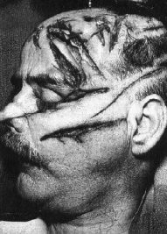
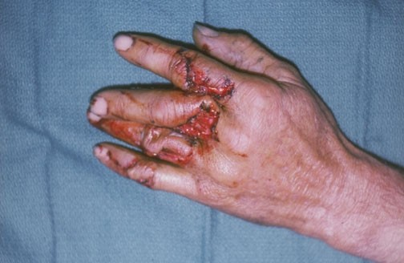
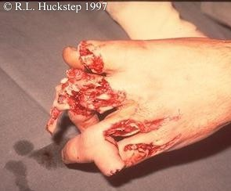
Lacerations (Tears, Splits)
Splitting of the skin by the direct crushing of blunt trauma.
Typically over bone, e.g. scalp, eyebrow, cheekbone.

Slide 61
Lacerations
Distinguished from incised wounds by:
  Adjacent abrasion/bruise
  Ragged edge
  Tissue bridges in depth
Forensic Importance
  Not related to object shape
  Trace evidence
  Relatively little blood loss (except scalp)
  Rarely suicidal

Slide 62
Lacerations
Typical Examples
  Circles/crescents from hammer
  Y-shaped from metal rod
  Inside lips from blow to mouth.
  Stretching lacerations in vehicular accidents.

Slide 63
Bite Marks
Double crescent of abrasions and bruises
Early Examination, loss of definition
Swab for saliva, photograph
Comparative value
Child abuse, sexual assault.

Slide 64
Summery:
"Wounds are a very important subject as they indicate external forces. They come in different types. It is important to measure them correctly and understand how the shape of the instrument affects the imprint on the area where the force is applied."

