Slide 1
Post mortem methods

Slide 2
Postmortem method
Dr. Dilman Azad Hassan
Forensic pathologist

Slide 3
Learning out come
At the end of this lecture the students will be able to:
. Define the autopsy
Identify how they examine the cadaver.
Describe types of autopsies.
Naming type of the incisions.

Slide 4
Definition of autopsy:
What is autopsy?

Slide 5
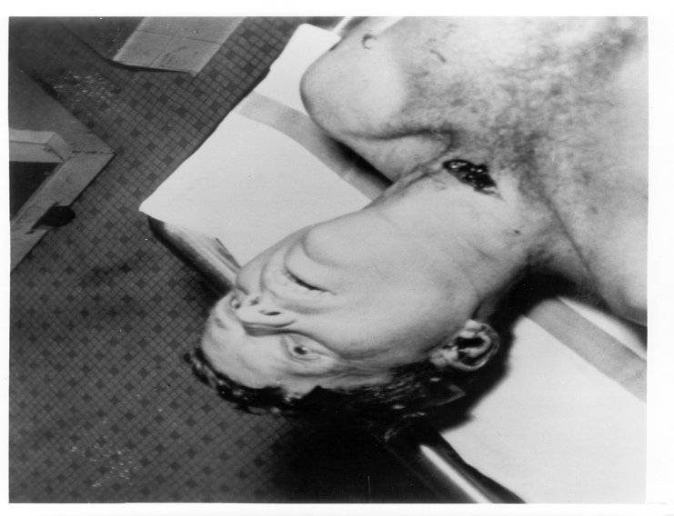
Autopsy-External
a. Body tag
b. Weight and height
c. Clothing and valuables identified
d. Scars, tattoos, injuries, wounds,
e. bruises recorded
f. Foreign objects noted
5
Notes:
5

Slide 6
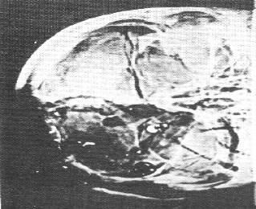
Autopsy-Internal
a. Dissection of head and abdomen
• b. Organs removed, weighed, measured
and examined
• c. Tissue samples examined under
microscope
• d. Fluid samples tested for drugs,
infection
6
Notes:
6

Slide 7
Postmortem methods
Three methods of postmortem evolved nowadays, as a result of the advances in diagnostic aids(X-ray and CT scan) which decreases the necessity for full autopsy, as they can give accurate diagnosis of the injuries in many situations with no need for full autopsy.

Slide 8
Postmortem methods
1_ Full body autopsy: In which all the body compartments must be opened, and all viscera extruded out for the detailed examination, this includes the chest, abdomen, cranium, all four limbs, and the spine from the back. This is the traditional method used.

Slide 9
Postmortem methods
2_ Partial (compartmental) autopsy: in which only the involved compartment dissected.

Slide 10
Postmortem methods
3_ Local autopsy: in which only the involved area or segment of the body dissected if the injury very accurately localized.

Slide 11
Types of incisions for opening
1- Linear incision from the submental region down to the pubis symphysis sparing the umbilicus.
2- Y shape incision start on the shoulder tips to the sternal notch then down to the pubis symphysis
3- U shape incision from below the mastoid on both sides down to the sternal notch then linear down to the symphysis pubis.

Slide 12
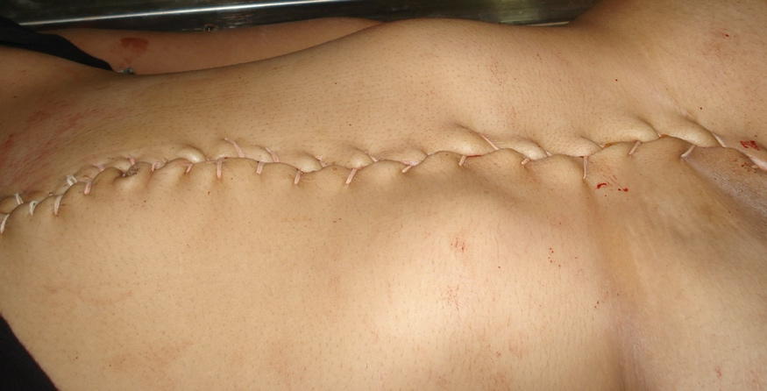

Slide 13
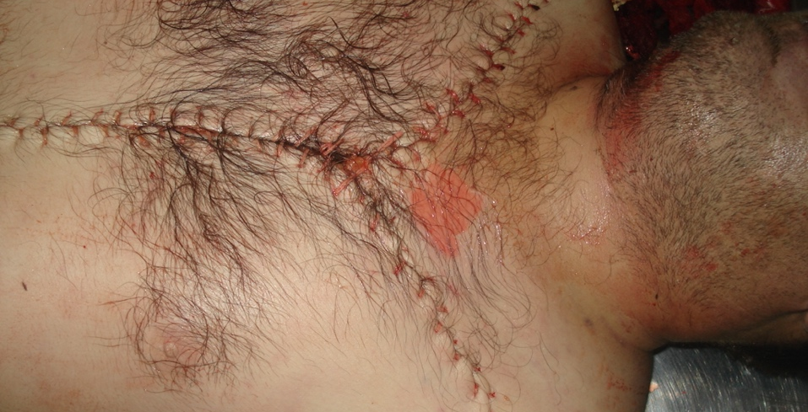

Slide 14
Question and activity for students: you can use internet for searching your answer
According to Iraqi law can we do autopsy 2 time in one cadaver?

Slide 15
Opening the cranium
The scalp opened by coronal incision from one mastoid process to the other down to the bone, and the flaps reflected anteriorly to the supraorbital ridges, and posteriorly to the inferior nuchal line. The cranium opened by electric saw. Take care not to tear the dura.

Slide 16
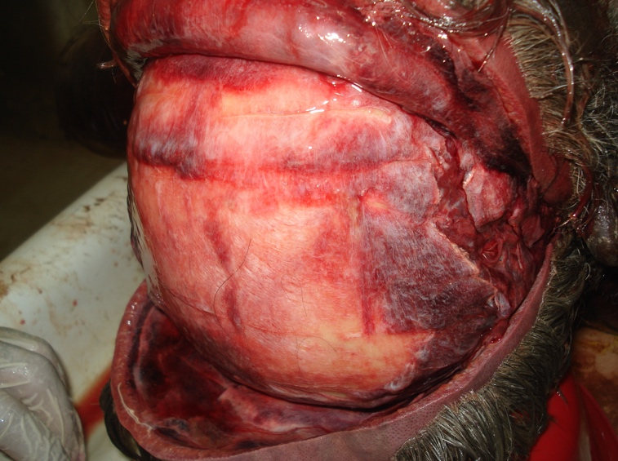

Slide 17
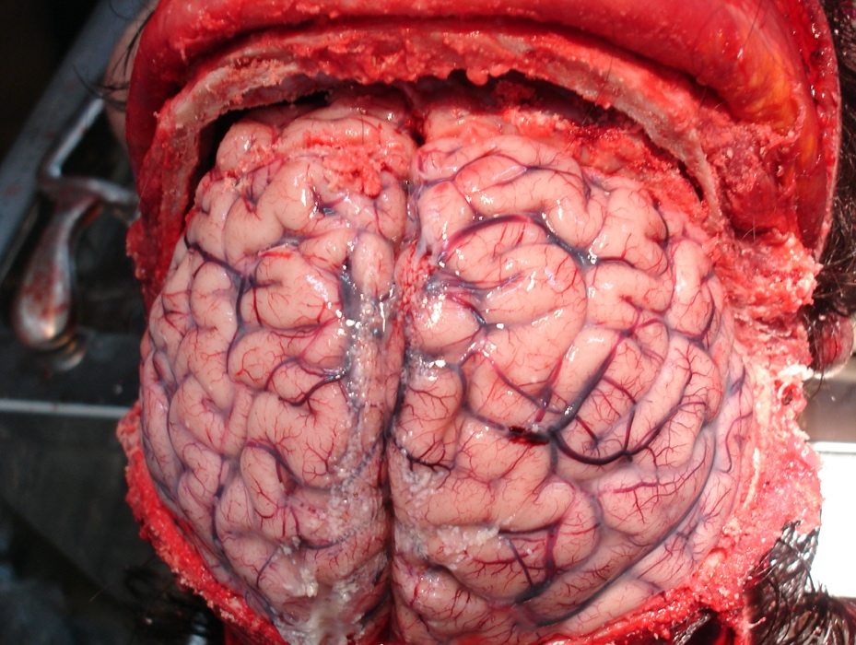

Slide 19
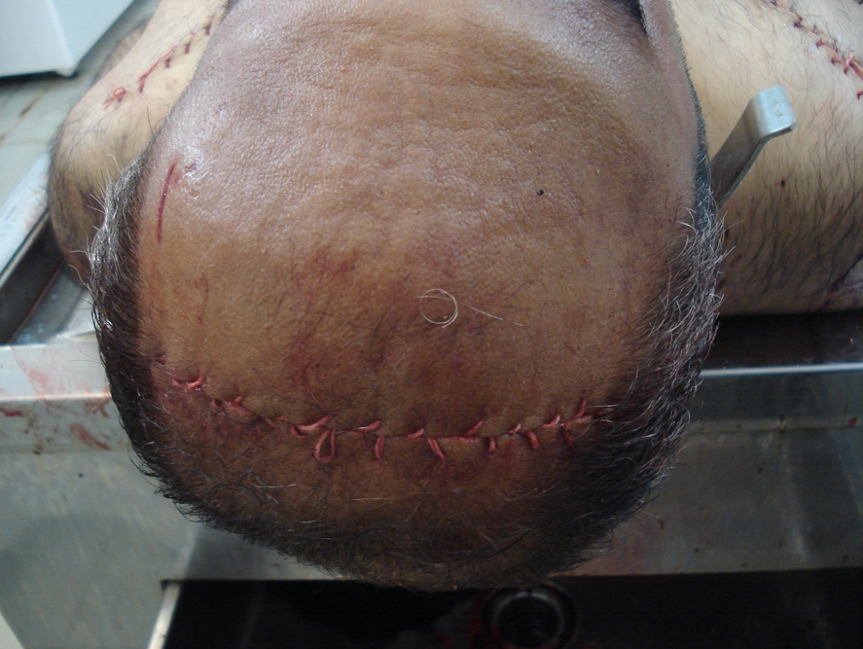

Slide 20
Methods of exteriorization of the viscera
Four methods used to take the viscera of the neck, chest, abdomen, and pelvis out of the body in order to examine them in details.
1_Letulle method
Or( En Masse) method, by exteriorization of the viscera starting from the pharynx down to the deep pelvis in one mass. This is the classic method of evisceration.
2_Ghon method
In which the viscera removed in blocks as the case necessitate. This method used in cases when specific block of viscera need to be dissected.
3_Virchow method
In which the specific organ need to be dissected only exteriorized outside the body, this method used when there is specific pathologic or traumatic entity searched for.

Slide 21
Methods of exteriorization of the viscera
4_Rokitansky method
This method of dissecting the organs in situ used when transmissible disease diagnosed to prevent the spread of the infection.

Slide 22
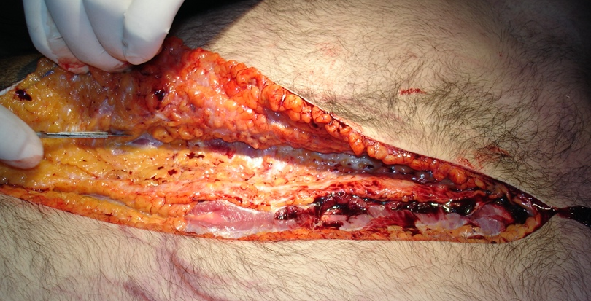

Slide 23
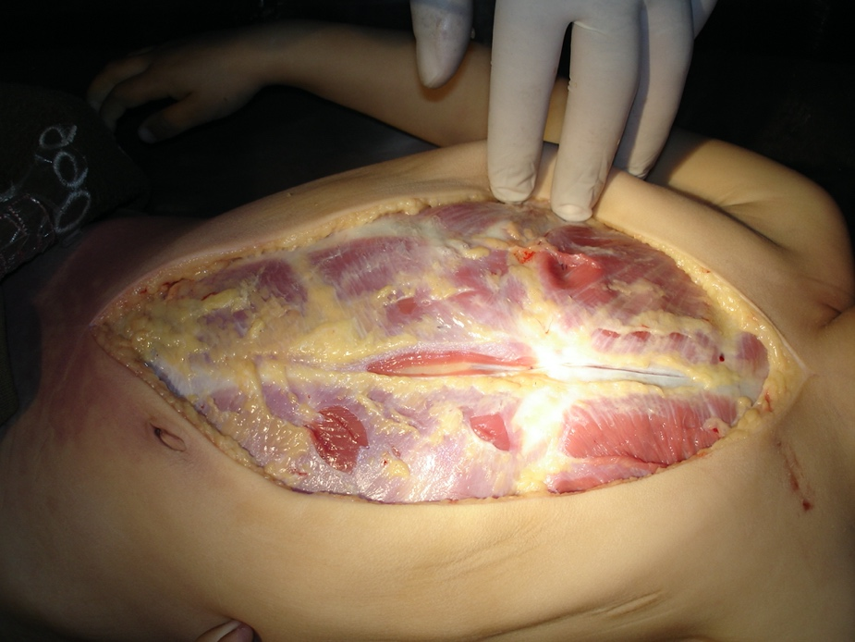

Slide 24
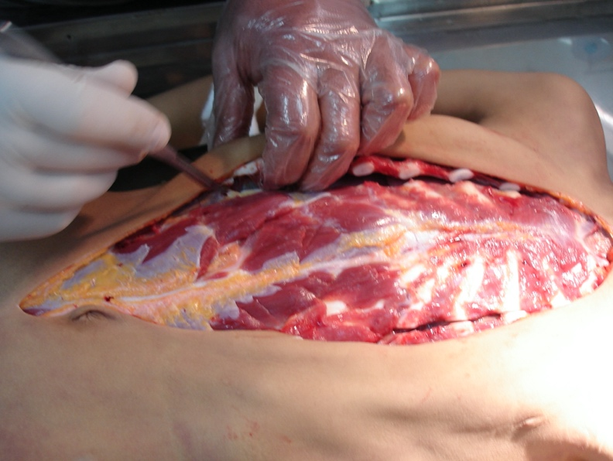

Slide 25
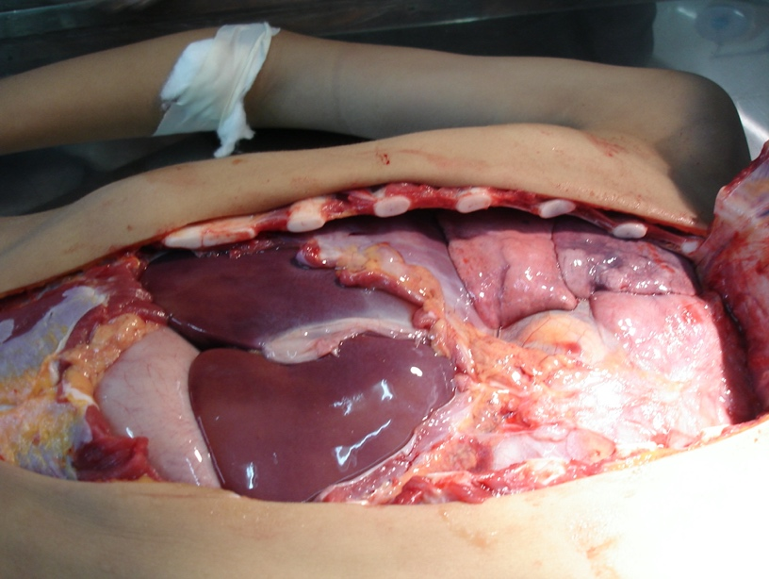

Slide 26
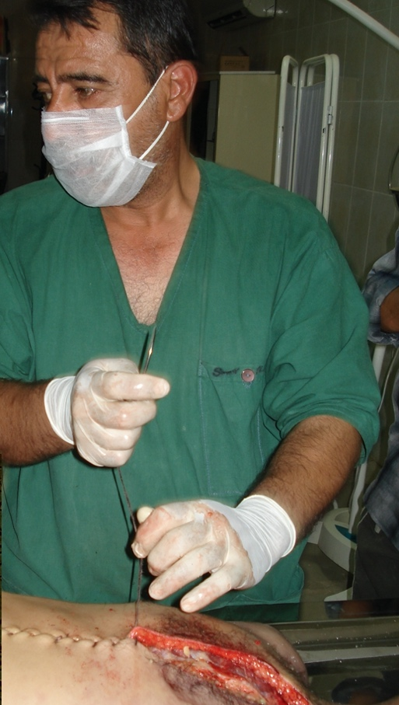
Closing the wound by perfect continuous suture using cotton thread to ensure that the wound would not disrupt while transforming or burying the deceased.

Slide 27
summery
Autopsy is very important science that help court and medicine.
We have three type of autopsies.
We have three type of incisions.
Scalp opening is important and take care about dura mater.
We knew about Methods of exteriorization of the viscera

Slide 28
References:
Knights' Forensic pathology.
Simpsons ' forensic medicine.
Textbook of forensic medicine and toxicology

Slide 29
Thank you

