Slide 1
Tishk International University
Engineering Faculty
Interior Design Department
Estimation for Interior Design
TOPIC: Bill OF Quantity (BOQ)
4th Grade- Spring Semester 2024-2025
Instructor: Barham Haidar Ali

Slide 2
Bill OF Quantity (BOQ)

Slide 3
BILLS OF QUANTITIES (BOQ)
The survival of any business is heavily depend on the success of commercial management.
When it comes to commercial management in construction industry, Bill of Quantities (BOQ) is the term which brings attention of every construction professionals and stakeholders.
It is one of the communication tool which connects the parties (Client, consultant & contractor) of construction project.

Slide 4
CONTIN’
Keith defines, BOQ is a schedule which categories, details and quantifies the materials and other cost items to be used in construction project. It is important to know that, direct costs & indirect costs are to be considered for complete cost of the project which are covered in different parts of the BOQ.
Generally BOQ is in tabular form which contents description, unit, quantity, rate & amount in different columns.

Slide 5
Sample of BOQ

Slide 6
Sample BOQ Document, PDF Description column provides a brief explanation of what to be done. For example, in the first item, the 32mm diameter CPVC pipes should be laid for cold water services in 20 bar operating pressure.
Specification & drawings are other two important items to be analyzed in detail for clear understanding. Here the term engineer means the consultant for the project. The Importance of BOQ BOQ shall be used in every phase (pre-contract & post-contract) of the project but need of BOQ differs based on different contract agreements & project. The major usages are listed below

Slide 7
The major usages are:
1. It provides basic idea of the project by giving the quantities to tenderers.
2. It defines the extent of the work. (But it should be identified in line with drawings & specification as well).
3. It gives estimated or anticipated contract sum. (very important to client)
4. It provides a basis for valuation of variation. (Variation is to be discussed in detail).

Slide 8
The major Parts of BOQ
Parts of BOQ can be varied according to the project size as well the practices. Generally it has measured works, Preliminaries & Provisional sums. The contract sum would be addition of these three items.

Slide 9
BILL OF QUANTITIES INTRODUCTION
Quantity surveying emerged as a separate profession in Britain in the 19th century. It is simply a task of measuring construction work required to implement the architects' design for new or renovated buildings. The purpose of the work is to produce quantified specifications of works known as Bills of Quantities

Slide 10
OBJECTIVES
The objectives of the Bill of Quantities are: (1) to provide sufficient information on the quantities of Works to be performed to enable bids to be prepared efficiently and accurately; and when a contract has been entered into, (2) to provide a priced Bill of Quantities foruse in the periodic valuation of works executed.
In order to attain these objectives, works are itemized in the Bill of Quantities in sufficient detail to distinguish between the different classes of works, or between works of the same nature carried out in different locations or in other circumstances which may give rise to different considerations of cost. Consistent with these requirements, the layout and content of the Bill of Quantities are required to be as simple and brief as possible.
The large data bank of information contained in the Bill of Quantities can be used in many ways to help the post-contract control of a project.

Slide 11
QUANTITY SURVEYOR
Bill of Quantities form a part of the contract in many countries. The World
Bank and FIDIC documents also include Bill of Quantities.
In order to produce the Bill of Quantities, a detailed quantity survey ormaterials takeoff has to be completed. The services are provided by a professional Quantity Surveyor (QS).
A Quantity Surveyor is usually hired by the owner at the inception of a project. The QS makes cost feasibility studies, establishes construction budget, makes cost checks at all

Slide 12
stages of the design process, and prepares a final Bill of Quantities. This Bill of Quantities is included in the bidding documents of the project. The bidders use this information, along with the construction drawings and specifications, as the basis fortheir pricing of the work.
The QS advises the owner on contractual arrangements and compiles certificates of interim and final payment to the contractordoing the work.
Based on their detailed knowledge of construction costs, the Quantity Surveyors can provide design cost planning service that allows customers to decide on their total budget, even before any design work is commissioned. Without cost planning, designs may result in bids that are too expensive

Slide 13
AN OVERVIEW OF BILLS OF QUANTITIES
The Bills of Quantities are usually indicated by items of work, units of measurement, quantities of work, rate fordoing the work, and total value of the work. An example is shown below:

Slide 14
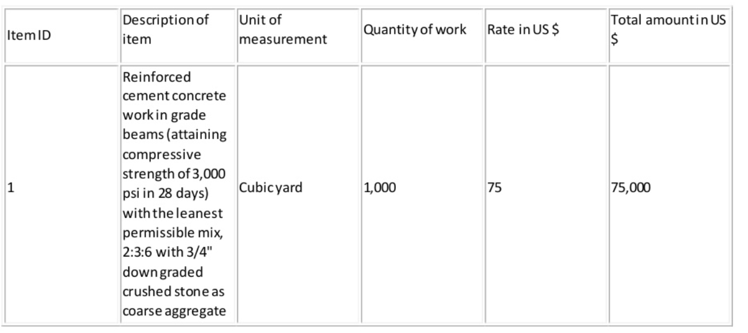

Slide 15
Usually the contractorgoes through the Bills of Quantities and would quote her/his rate as a percentage above or below the rates indicated.
Even though the QS employed by the owner provides a detailed estimate forthe project, sometimes the rates and total amount to do the works may not be shown in the Bills of Quantities. In that case, the bidder provides the rates of the items at which she/he is capable to do the works.
Pricing of different items of work are done on the basis of the cost of materials, equipment, labor, and overheads and profit.

Slide 16
Materials: The materials costs are calculated by examining the material quotations received fromsuppliers, applying appropriate wastage factors, and delivery charges.
Equipment: Cost of equipment is calculated usually as a percentage of the cost of materials. Depending on whether the equipment is owned or rented, this percentage will vary.
Labor: The most difficult element to price is the labor cost. Most of the times, it is not sufficient to rely on published standard rates. Allowances for absences due to sickness, loss of time due to inclement weather, overtime, etc. are required to be built in to arrive at a pragmatic all-inclusive labor rate. Rate of productivity is another factor that plays an important role in fixing labor prices.
Overheads and profit: Once the cost of materials, equipment, and labor has been added up, a percentage foroverhead and profit is added to the item rate. This percentage may vary from project to project depending on how well the document has been prepared by the QS and also on market conditions. It may range from2.5 to over 25 percent.

Slide 17
Once the pricing of all individual items forall trades is completed, the amounts are carried to a summary page to indicate the total bid price.

Slide 18
SOME OTHER ADVANTAGES OF THE USE OF BILL OF QUANTITIES
Save the cost and time of several contractors measuring the same design in order to calculate their bids for competition.
Provide a consistent basis for competitive bids so that the contractor who is the most efficient and least expensive in providing the items of work is likely to be commissioned for the job.
Provide an open basis for the contract; the client provides an extensive and clear statement of the work he/she requires and the contractor states the price at which he/she is prepared to undertake the job.
Provide a very strong basis for financial administration of the contract

Slide 19
The preparation of a BQ also has other advantages as well, such as
Assisting the comparison and assessment of tenders, as tenders will be based on the same information;
Providing a good and fair basis for assessing variations during construction;
Being a basis for assessing and recommending progress claims and payments;
Helping to reduce the tender period (and its associated costs) as the tenderers then do not have to each individually reproduce the tender documents for their own ‘quick’ (though it may take weeks), and sometimes abridged, measurement and builders’ quantities;
And it also provides a basis for project cost analysis, so that future cost planning efforts have reliable information to refer to.

Slide 20
Benefits of Bills of Quantities
Bills of Quantities which we produce allow for obtaining a competitive tender price for completing the building works, valuing the extent of building works complete for the purpose of making payments to the contractor, valuing variations in the content or extent of building works, or to support applications for tax or other financial incentives.

Slide 21
Our detailed measurement for the purpose of bills of quantities production is beneficial for a number of reasons:
It saves considerable time and cost of several contractors measuring the same design in order to calculate their bids for competition;
It provides a consistent basis for obtaining competitive tenders from contractors;
It provides an extensive and clear statement of the work to be executed;
It provides a very strong basis for budgetary control and accurate cost reporting of the contract including: - the preparation of cash flow forecasts,
a basis for valuing variations, and
a basis for the preparation of progress payments (ie. interim payments) •

Slide 22
CONTIN’
It allows, when BQ items are codified, reconciliation and any necessary transfers and adjustments to be made to the cost plan;
When priced it provides data to support claims for grants;
It provides one of the best sources of real-time cost data, which can be used for estimating the cost of future building projects.

Slide 23
Types of Bill of Quantities
The main use of a bill of quantities in support of a contract is the traditional and proven means of securing a lump-sum price for carrying out the building works for the client. SC Quantity Surveyors produce several types of Bills of Quantities which include
Firm (to obtain a lump-sum price for a fully designed building project)
Approximate (subject to re measurement as built)

Slide 24
Firm Bill of Quantities
The reliability of the tender price will increase in relation to the accuracy of the quantities provided (i.e. the more precisely the work is measured and described). Provided there were no design changes, then firm bills of quantities would provide a price at tender stage, which would equal the final cost. However, there will be changes, and the bill of quantities provides a good basis for cost control, since the direct cost can be assessed with reference to the bill of quantity rates. In general the firmer the bill of quantities the better it is as a means of financial control.

Slide 25
Approximate Bill of Quantities
SC Quantity Surveyors can produce approximate bills of quantities which are mainly used when there is insufficient details to prepare firm bills of quantities or where the client has decided that the time and cost of a firm bill of quantities is not warranted. These types of contracts do not provide a lump-sum price, but instead tender price totals (ie. a quantified schedule of rates), since the quantities are subject to re-measurement on completion by the quantity surveyor. In general these contracts are usually subject to greater variation than lump sum contracts and therefore should only be used where time is a limiting factor or where there is great uncertainty in respect of certain elements, such as major excavations and earthworks

Slide 26
CONTIN’
It is important to note that the initial resource cost of approximate bills of quantities is likely to be lower than firm bills of quantities, but the need for re-measurement invariably results in an overall higher resource cost. Although the measured quantities are approximate, the descriptions of work items should be correct in the approximate bill of quantities.

Slide 27
CONTIN’
Bills of Quantities that are required for a lump sum contract based on firm or approximate quantities will normally be prepared by the employer's quantity surveyor, whereas under a design and build contract, the employer's project team will prepare the employer's requirements and the Bill of Quantities or quantified schedules of work will be prepared by either the main contractor or, more likely, the main contractor's work package contractors. In general the choice of who quantifies building works is solely down to the employer's preference of contract strategy.

