Slide 1
Tishk international university
Faculty of Education
Computer Education Department
INTRODUCTION TO COMPUTERS
Imad Nihad
Week 4
IT205
Fall 2024/25
4

Slide 2
What is e-mail?
E-mail, email, or electronic mail is a message that may contain text, files, images, or other attachments sent through a network to a specified individual or group of individuals.
The first e-mail was sent by Ray Tomlinson in 1971. Tomlinson sent the e-mail to himself as a test e-mail message, containing the text "something like QWERTYUIOP."
The username cannot be longer than 64 characters long, and the domain name cannot be longer than 254 characters.
ahmad.nadhmi@tiu.edu.iq
User
At
Domain

Slide 3
Email Fields
To: the main recipient(s) of your email.
From: contain your e-mail address.
Subject: a few words describing the e-mail's contents. The subject lets the recipient see what the e-mail is about, without opening and reading the full e-mail.
CC ("Carbon Copy"): allows you to specify recipients who are not direct addressees (listed in the "To" field).
BCC ("Blind Carbon Copy"): is like CC, except the recipients are secret.
Signature: is a block of text that is automatically inserted to the end of an email message you send. Generally, a signature is used to provide the recipient with your name, email address, business contact information, website URL.

Slide 4
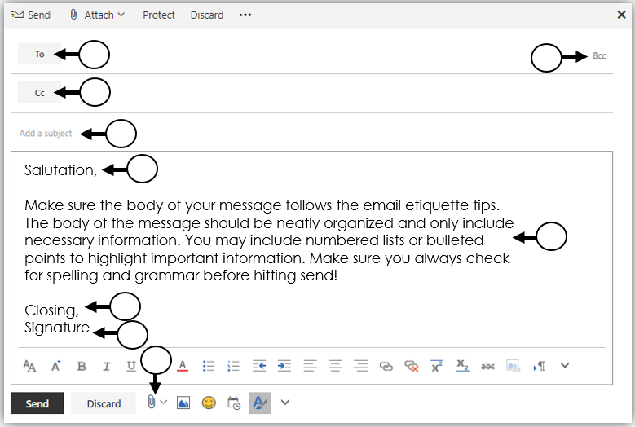

Slide 5
Salutation Samples
Hello [Name],
Is popular and more formal than beginning with “Hi”. This salutation is still personalized with the recipient’s name and friendly, but it may be more suitable for official and business professional.
Dear [Name],
Is best for formal emails and emails for contacting someone in a position of respect or authority.
Good morning / afternoon / evening,
“Good morning,” “Good afternoon,” and “Good evening,” are reliable and inoffensive email openers. These polite, generic email greetings are usually used when emailing groups of people for professional reasons or impersonal, semi-formal emails.
Greetings,
This greeting is a common email starter when you aren’t sure who the recipient is or how to spell their name. “Greetings,” is a safe, polite and conservative start to an email.
Hi there,
If you aren’t sure of the spelling or name of your recipient, starting an email with “Hi there,” is a safe choice for most informal emails.
To Whom It May Concern,
This email starter is most often used in official and formal business communications when you may not know who the recipient is.

Slide 6
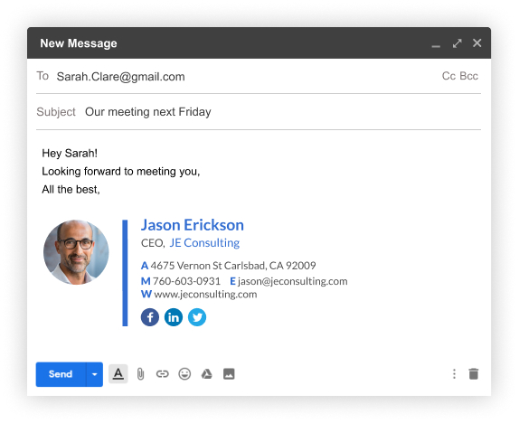
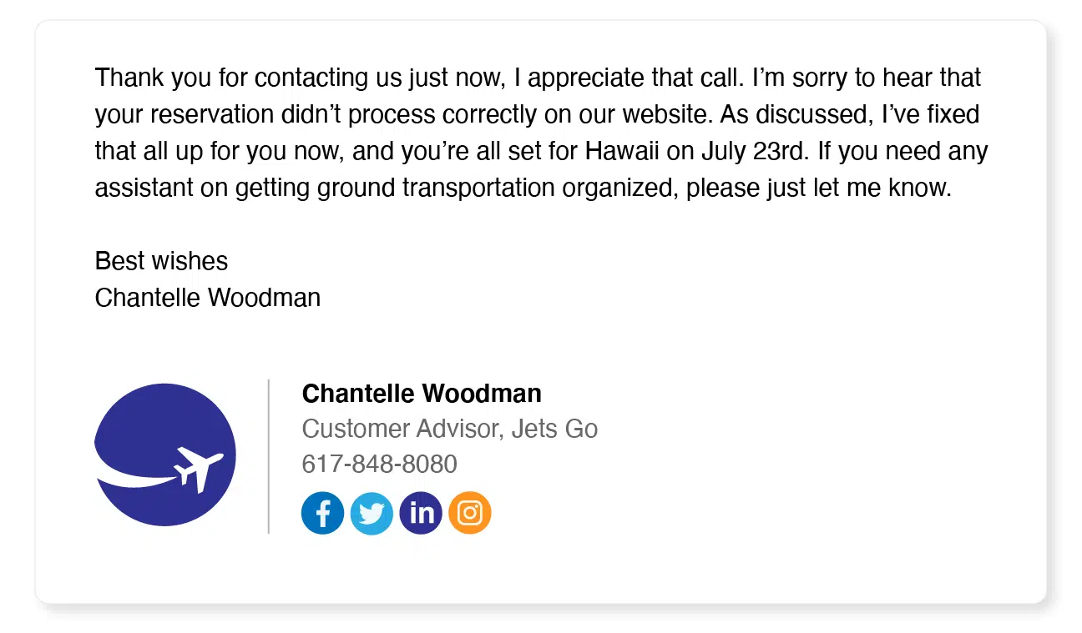
Email Closing Sincerely, Best regards, Best, Yours truly, Respectfully, Kind regards, Regards,
Email Signature

Slide 7
Free delivery - Sending an e-mail is virtually free, outside the cost of Internet service.
Global delivery - E-mail can be sent to nearly anywhere around the world, to any country.
Instant delivery - An e-mail can be instantly sent and received by the recipient over the Internet.
File attachment - An e-mail can include one or more file attachments, allowing a person to send documents, pictures, or other files with an e-mail.
Long-term storage - E-mails are stored electronically, which allows for storage and archival over long periods of time.
Environmentally friendly - Sending an e-mail does not require paper.
Advantages of e-mail

Slide 8
Reference
Rai, N., & Kaur, G. (2019). Letters and Email. Writing in Community and Justice Services.

Slide 9
THANK YOU

