Slide 1
Dealing with Computers
Ms. Firdaws Azad
Introduction to IT
Semester 1
Lab 1
2024 - 2025

Slide 2
Outline
Contact Information:
Knowing each other:
Course Overview:
Course Outline and Topics:
Lab rules:
Turning on Computers:
Other Computer Systems:
Input/output devices:
dealing with folders:
Compressed ‘zipped’ folders:
E-mails:
Shutting Down Computers:

Slide 3
Objectives
By the end of this lab you will learn to:
Deale with computers
Write & send emails

Slide 4
Contact Information:
Lecturer Name: Ms. Firdaws Azad
Office: Education Building - Room Number 129
Email: firdaws.azad@tiu.edu.iq
Office Hours:
Mon 9:00 – 10:00
Thurs 2:00 – 3:00

Slide 5
Knowing Each Other:
Your Knowledge about computers ? On a scale of 1 to 10, how would you rate yourself in using a Desktop Computer ?
Have you create Reports or presented on any topics before ?
On a scale of 1 to 10, how would you rate yourself in creating reports or giving presentations?
What is your perspective about this course ? What do you want to learn ?

Slide 6
Course overview:
20 marks
10: Project
10: Presentation

Slide 7
Course Outline and Topics:
Introduction – Dealing with Computers: 1 week
MS Word: 3 weeks
MS PowerPoint: 1 week
Presentation: 2 - 3 weeks
MS Excel: 1 week !!

Slide 8
Lab Rules:
Your Responsibilities during the labs will be:
No speaking with each other.
No mobile using.
Not allowed to exit lab without asking.
Shutting down computers and arranging the chairs before exiting the lab.
Taking your stuffs with you.

Slide 9
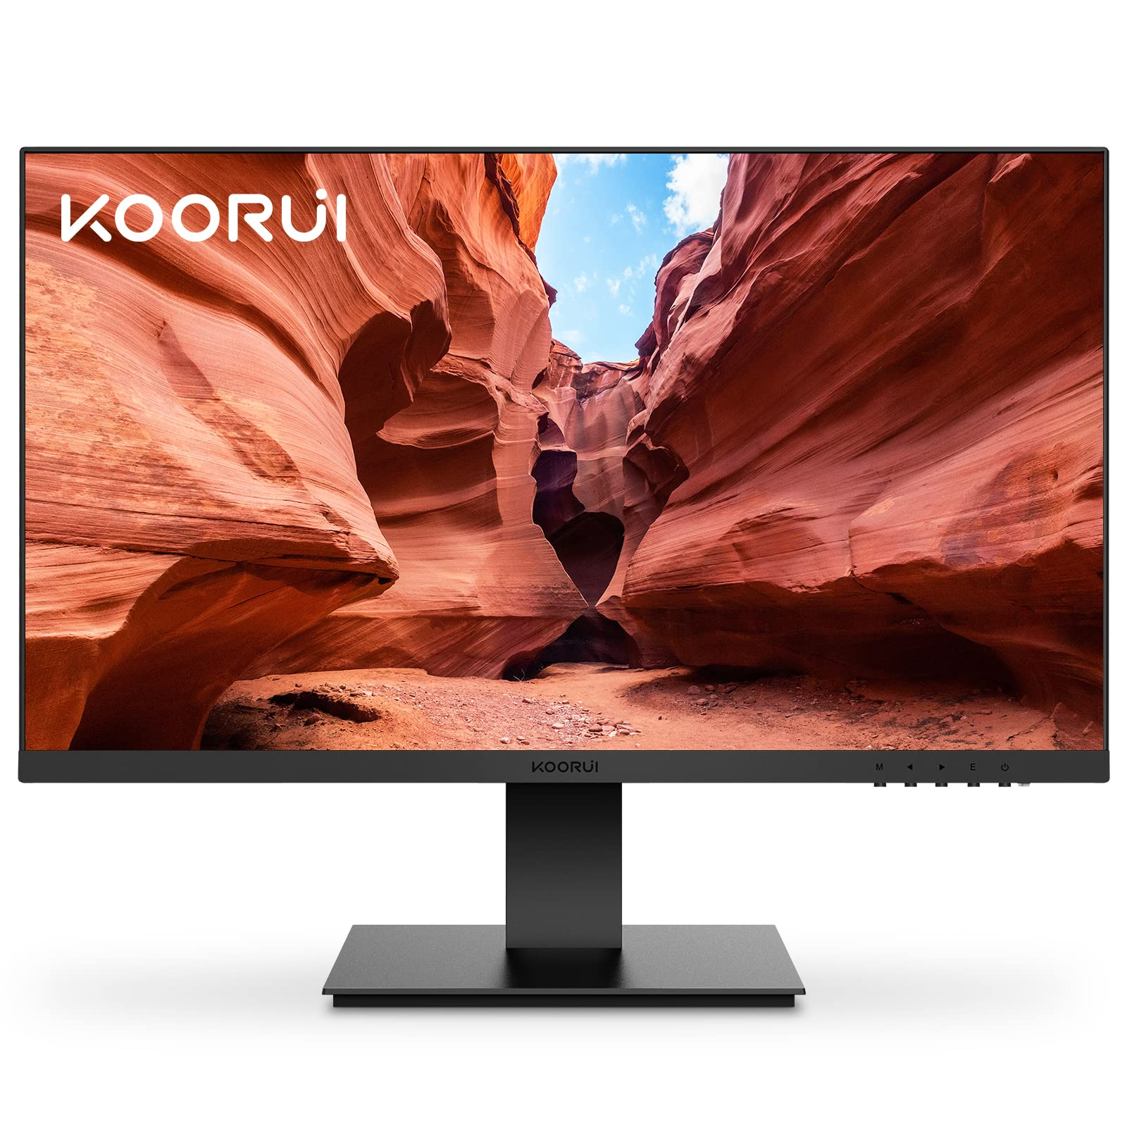
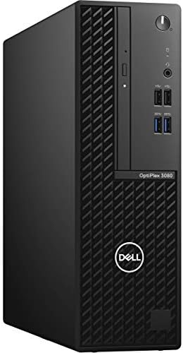
Turning on Desktop Computers:
Case:
Monitor:

Slide 10
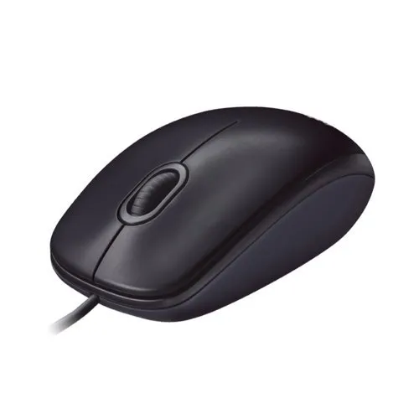
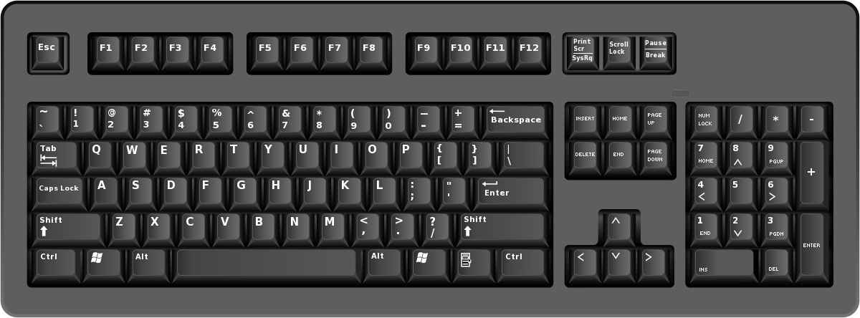
Input/Output Devices:
Mouses:
Keyboards:

Slide 11
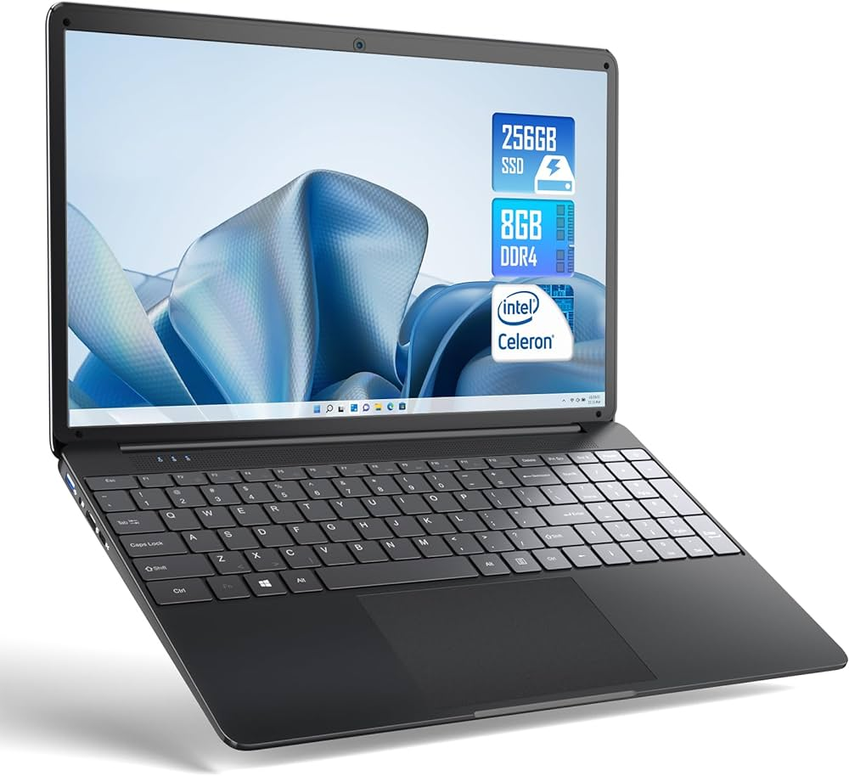
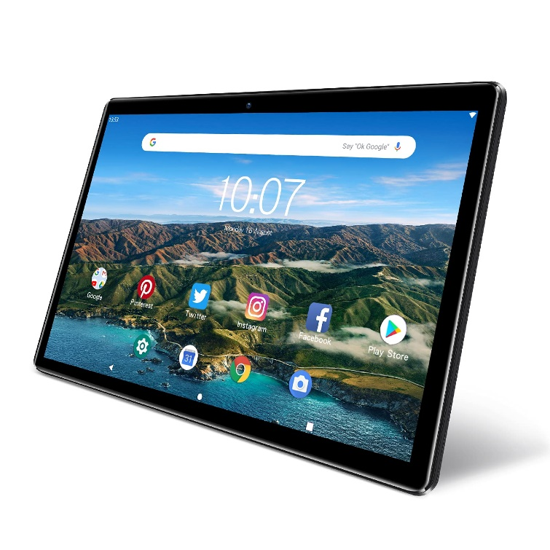
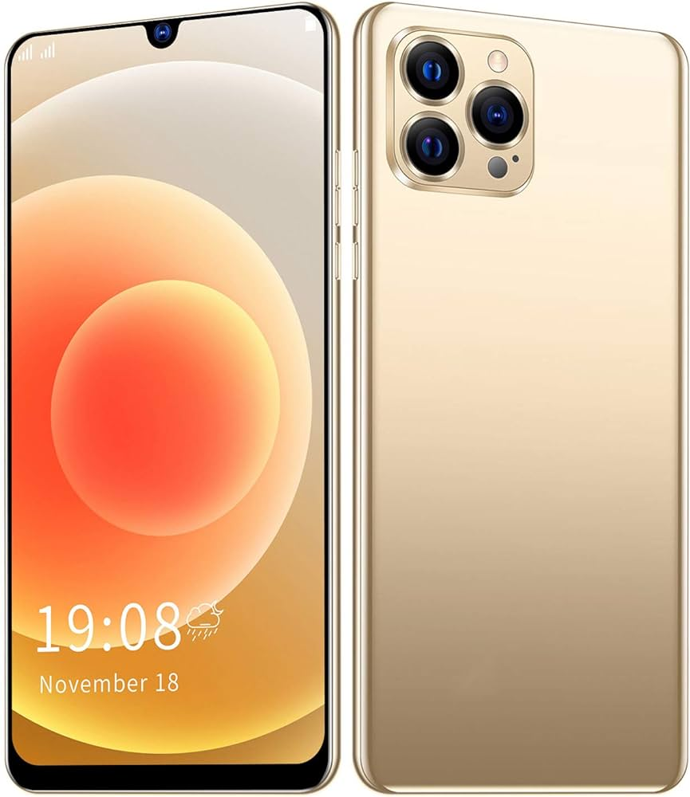
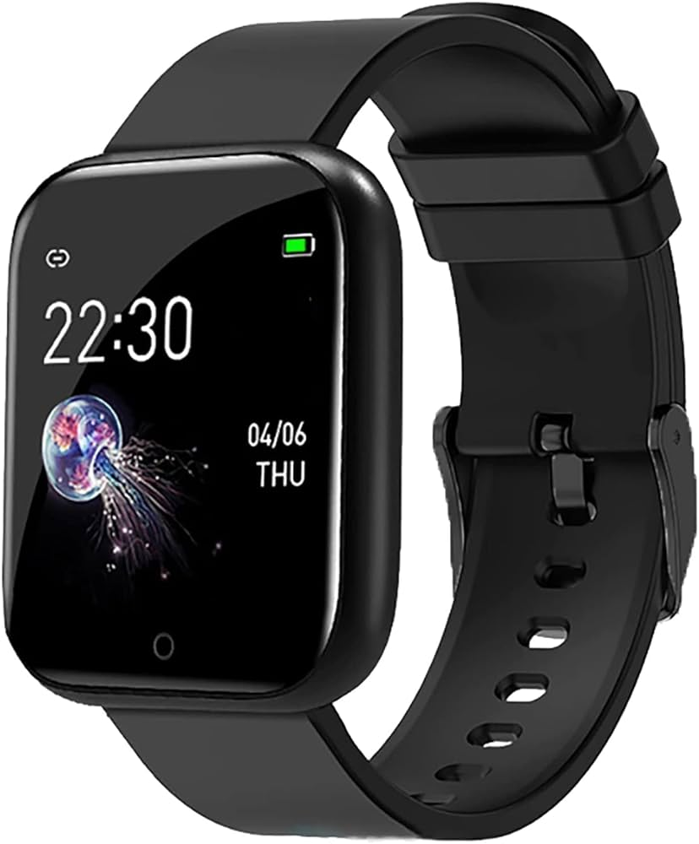
Other Computer Systems:
Laptop Computers
Tablet Computers
Smartphones
Smartwatches

Slide 12
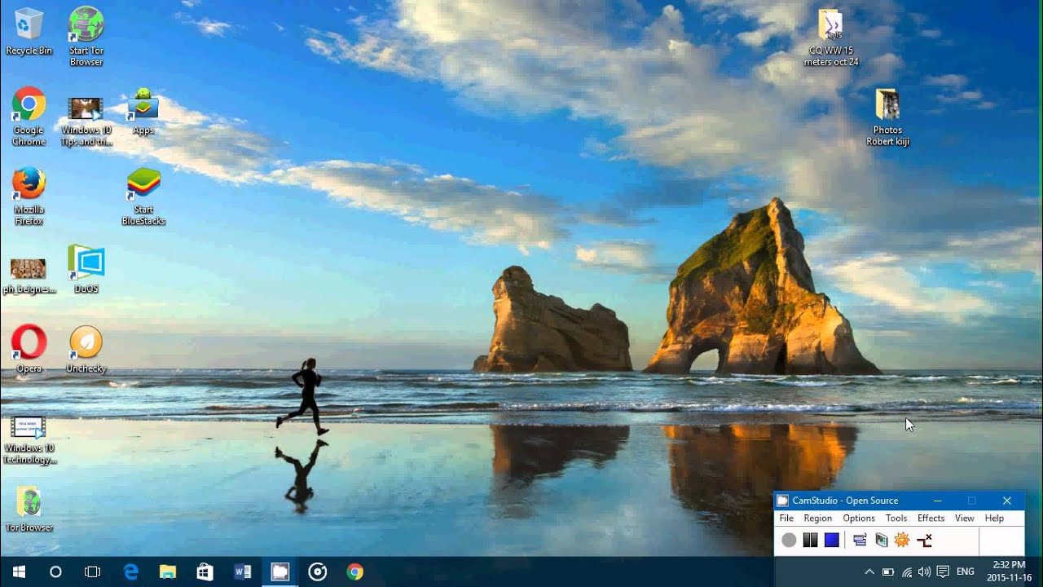
Desktop:

Slide 13
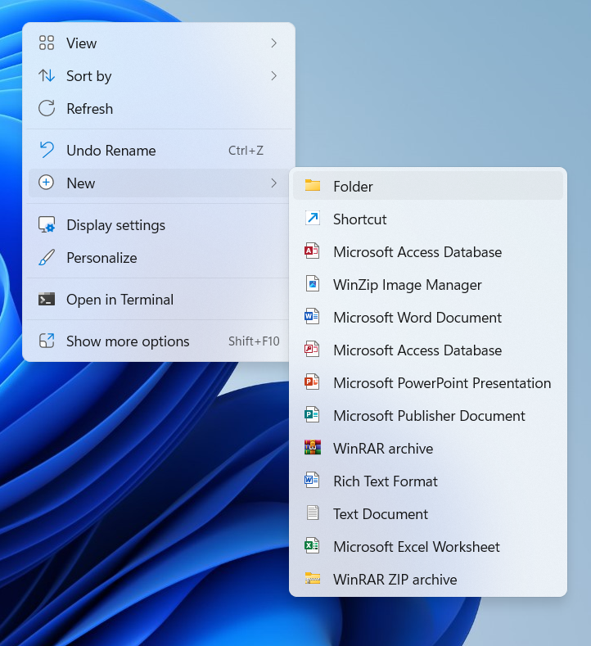
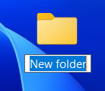
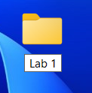
Folders
Creating a New Folder:
Renaming the Folder:
( CTRL + SHIFT + N)

Slide 14
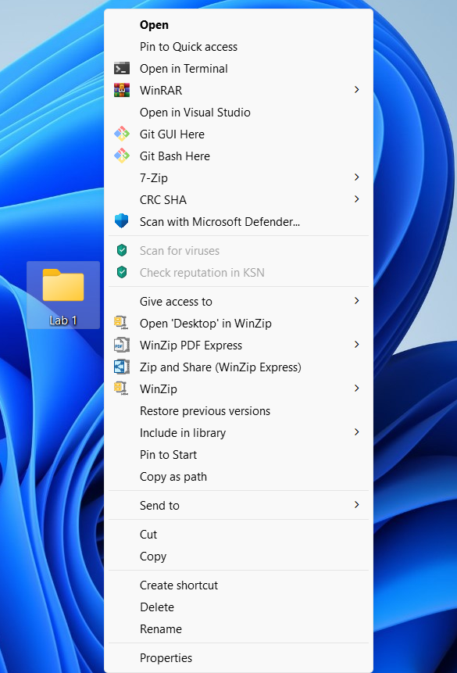
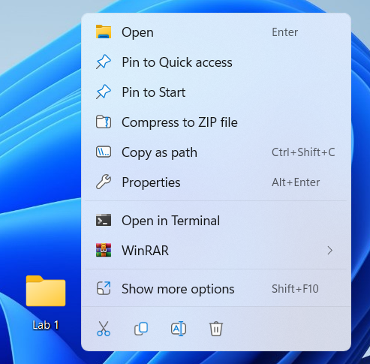
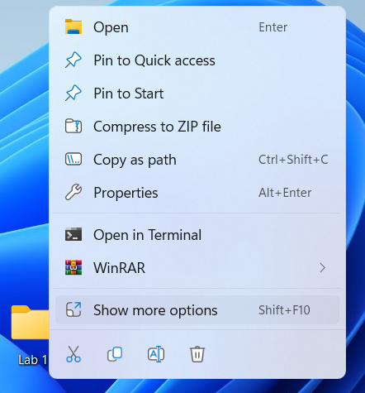
Folders
Folder Context menu:

Slide 15
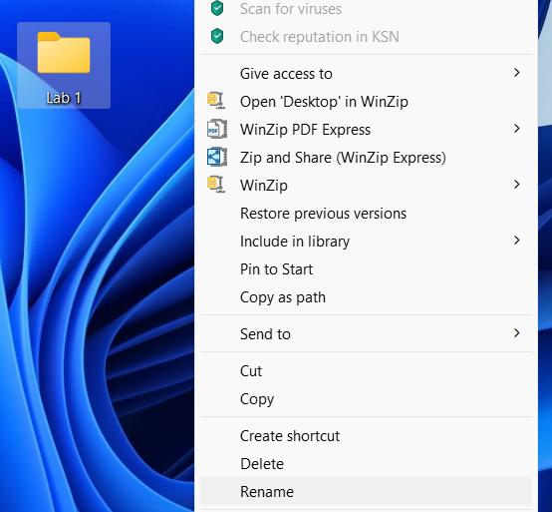
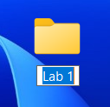
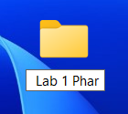
Folders
Renaming a folder:

Slide 16
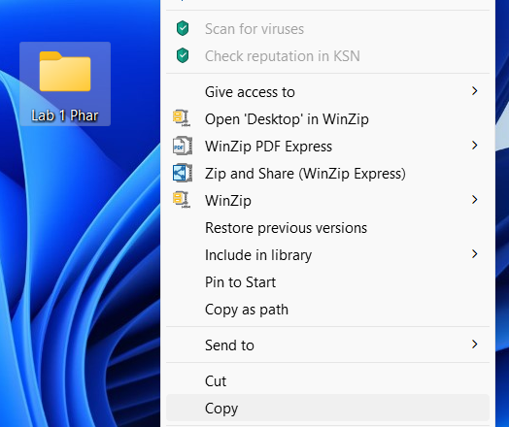
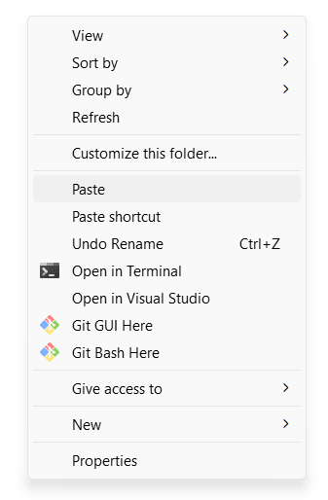
Folders
Copy-pasting a folder:
( CTRL + C)
( CTRL + V)

Slide 17
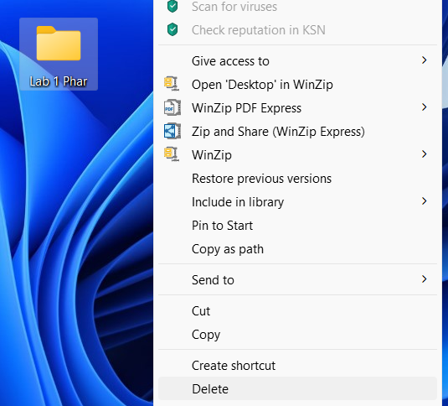
Folders
Deleting a folder:
( CTRL + D)

Slide 18
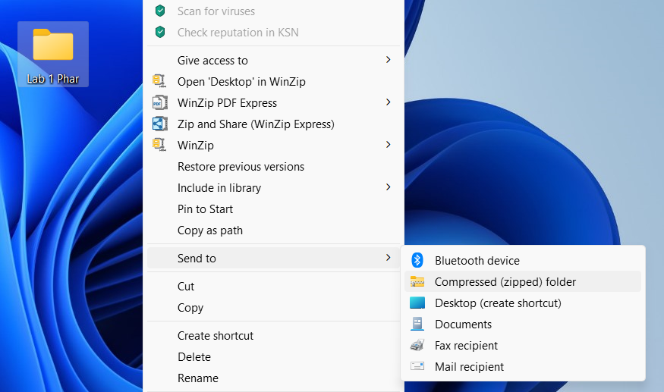
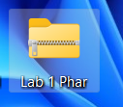
Zipped Folders
Compressed zipped folder:

Slide 19
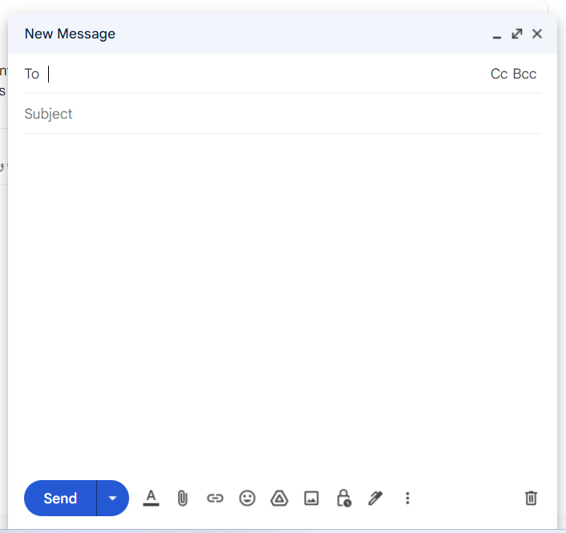
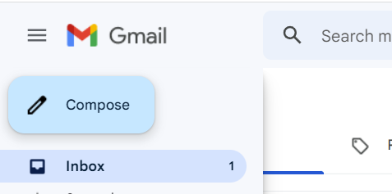
E-mail:
Writing an email:

Slide 20
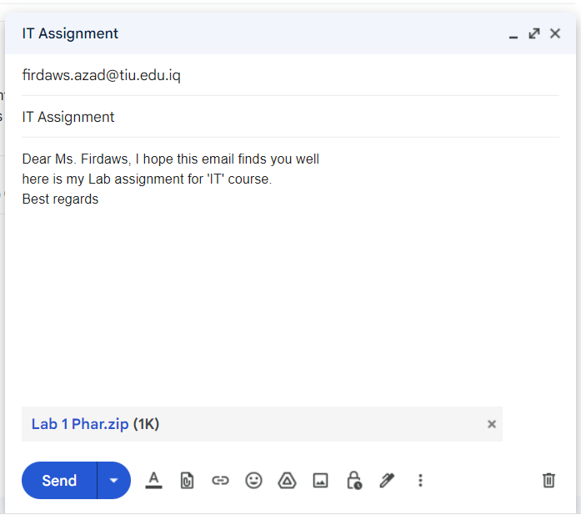
E-mail:
Attaching files:

Slide 21
Classwork

Slide 22
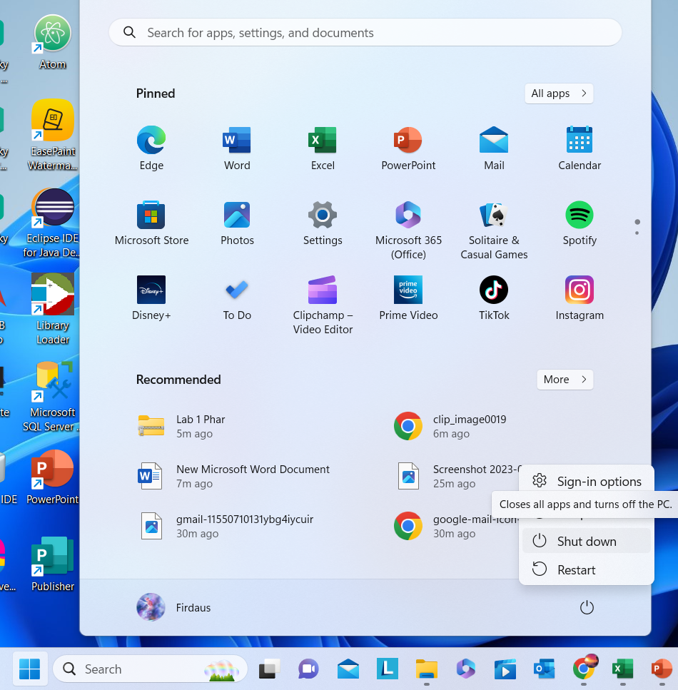
Shutting Down:

Slide 23
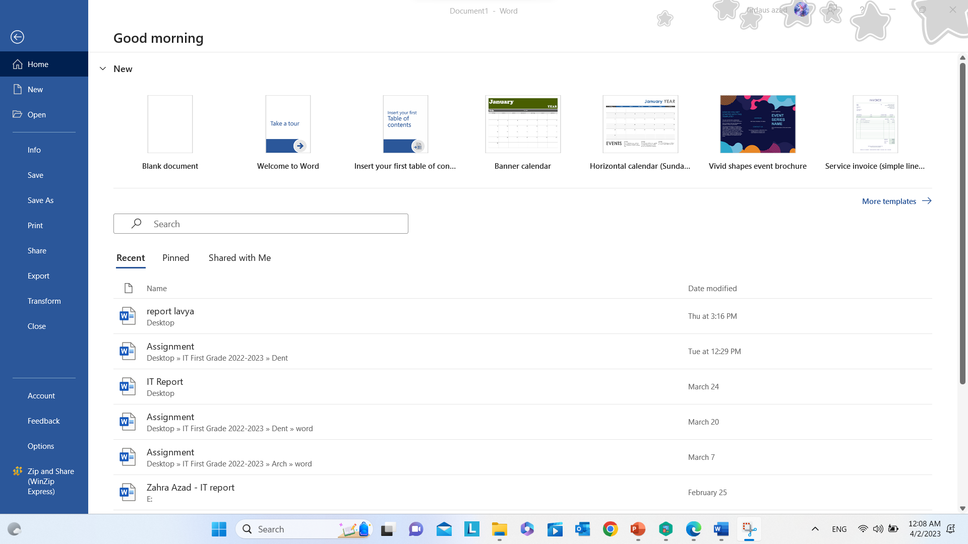
Microsoft word:
Used to create reports.

Slide 24
Ribbon:
Home tab
Insert tab
Design tab

Slide 25
Ribbon:
Home tab
Insert tab
Design tab

Slide 26
Ribbon:
Home tab
Insert tab
Design tab

Slide 27
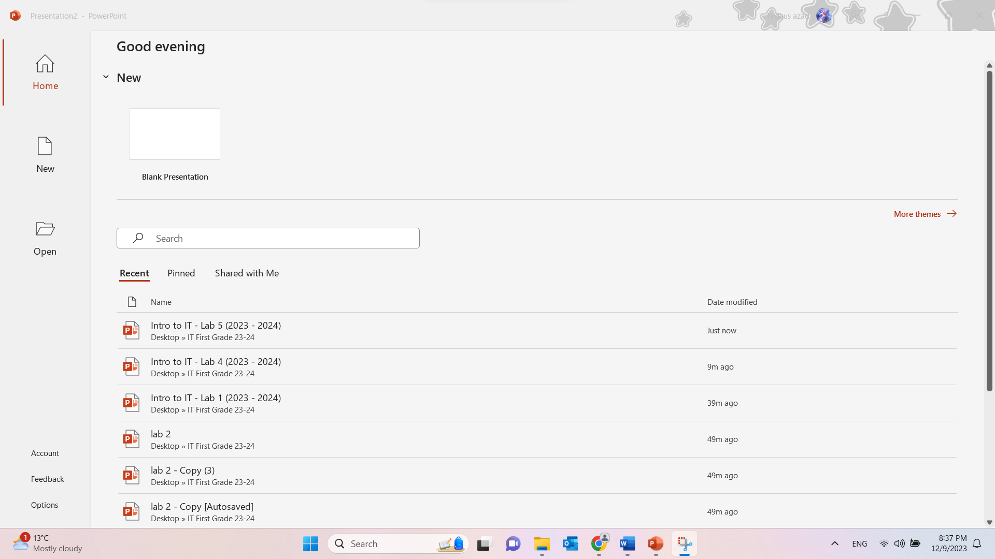
Power Point:

Slide 28
References
[1] S. C. K. G. Akash Saxena, Fundamentals of Computers, Laxmi Publications (P) LTD.
[2] M. T. Roland Birbal, Log on to IT, 2020.
[3] D. S. Shrivastava, MS Office, New Delhi: Firewall Media.

Slide 29
Ending of Lab 1

