Slide 1
Microsoft word home tab
Ms. Firdaws Azad
Introduction to IT
Semester 1
Lab 2
2024 - 2025

Slide 2
Outline
Microsoft word:
Dealing with paragraphs:
Blank Documents:
Home tab:
Sections in home tab:
Insert tab:
Sections in insert tab:
Design tab:
Page background:

Slide 3
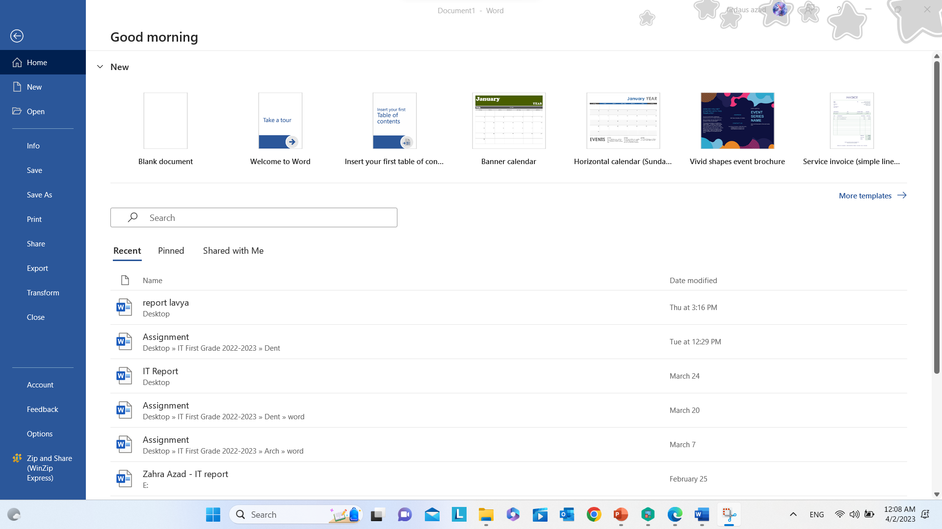
Microsoft word:
Used to create reports.

Slide 4
Creating a blank document:

Slide 5
Ribbon:
Home tab
Insert tab
Design tab

Slide 6
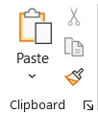
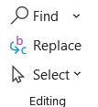
Undo, Clipboard, & Editing Sections:
Undo (Ctrl + Z)
Redo (Ctrl + Y)
Copy (Ctrl + C)
Paste (Ctrl + V)
Find (Ctrl + F)
Replace (Ctrl + H)
Select All (Ctrl + A)

Slide 7
Undo, Clipboard, & Editing Sections:
Undo (Ctrl + Z): allows users to reverse the last action or series of actions they performed
Redo (Ctrl + Y): allows you to reverse the last action, "Redo" lets you reapply the action that was undone. This is useful when you change your mind or decide that the previously undone action was the correct one.
Copy (Ctrl + C): to duplicate selected content, such as text, images, or files. The copied content is placed in a temporary storage area called the clipboard, from where it can be pasted into another location or document.
Paste (Ctrl + V): to insert the content stored in the clipboard (previously copied or cut) into a new location or document. This action allows users to transfer information from one place to another.
Find (Ctrl + F): allows you to search for specific words, phrases
Replace (Ctrl + H): allows you to find a specific word, phrase, or formatting in your document and replace it with another word, phrase, or formatting.
Select All (Ctrl + A): you can select all the text in a document using either a keyboard shortcut or options available in the ribbon.

Slide 8
Font Section:
Font
Font size
Increase font size
Decrease font size
Bold
Italic
Underline
Strikethrough
Subscript
Superscript
Change case
Text effects
Text highlight color
Font color
Clear all formatting

Slide 9
Paragraph Section:
Bullets: unordered list.
Numbering: ordered list.
Multilevel list
Align left
Center
Align right
Justify: aligns text along both the left and right margins, creating a clean and even appearance on both sides of the page.
Line and paragraph spacing
Shading
Borders
=rand(5,4): used to create random paragraphs.

Slide 10
Ribbon:
Home tab
Insert tab
Design tab

Slide 11
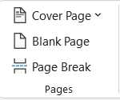
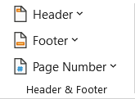
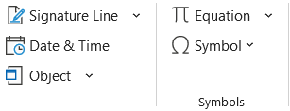
Insert tab:
Cover page
Blank page
Table
Pictures
Shapes
SmartArt
Chart
Header
Footer
Page Number
Date & Time
Equation
Symbol

Slide 12
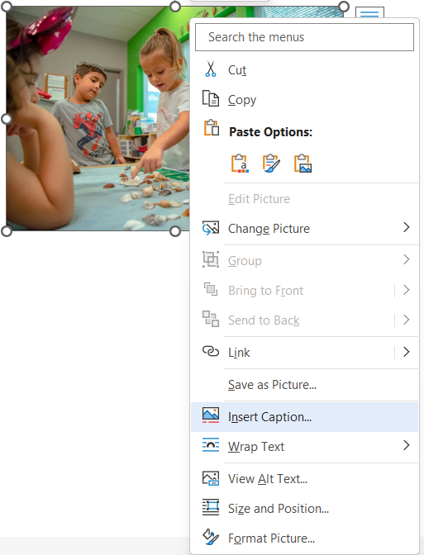
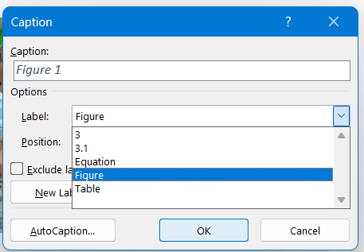
Picture Caption:

Slide 13
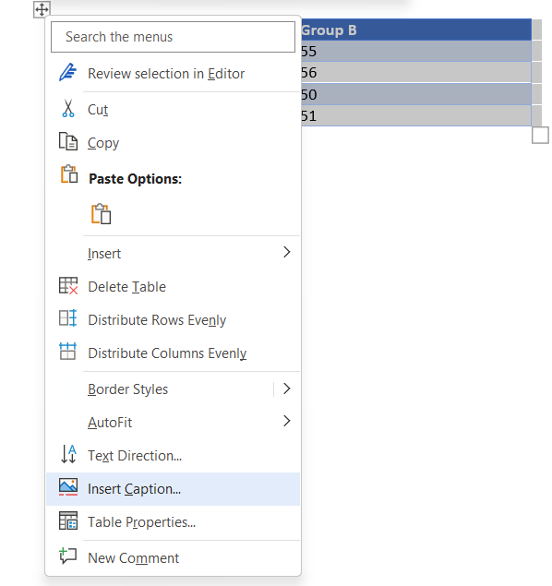
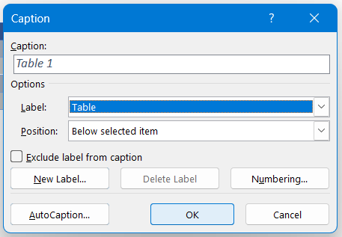
Table Caption:

Slide 14
Ribbon:
Home tab
Insert tab
Design tab

Slide 15
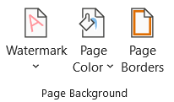
Page Background:
Watermark: is a recognizable image or pattern embedded into the document.
Page color: changes the color of the page.
Page borders: sets border for the pages.

Slide 16
References
[1] D. S. Shrivastava, MS Office, New Delhi: Firewall Media.

Slide 17
Ending of Lab 2

