Slide 1
S
Input and Output units
Imad Nihad
(IT 205)
Week 3-4
Fall 2024/25
3

Slide 2
Outline
Overview of Functionalities of a Computer
Central Processing Unit
Input Unit
Output Unit
File Extension

Slide 3
Overview of Functionalities of a Computer
All types of computers follow the same basic logical structure and perform the following five basic operations :
Take Input
Store Data
Processing Data
Output
Control the workflow

Slide 4
CPU
Control Unit
Input Unit
Output Unit
Arithmetic & Logic Unit

Slide 5
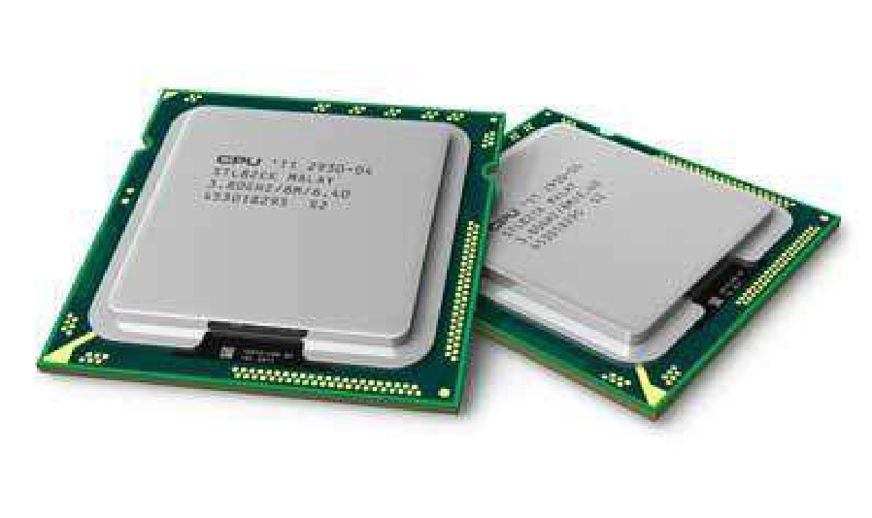
Central Processing Unit (CPU)
CPU is considered as the brain of the computer.
CPU performs all types of data processing operations.
It controls the operation of all parts of the computer.
The CPU is sometimes also referred to as the central processor unit, or processor for short or microprocessor.
CPU itself has following two components.
Control Unit
ALU (Arithmetic Logic Unit)
CPU
Control Unit
Arithmetic & Logic Unit

Slide 6
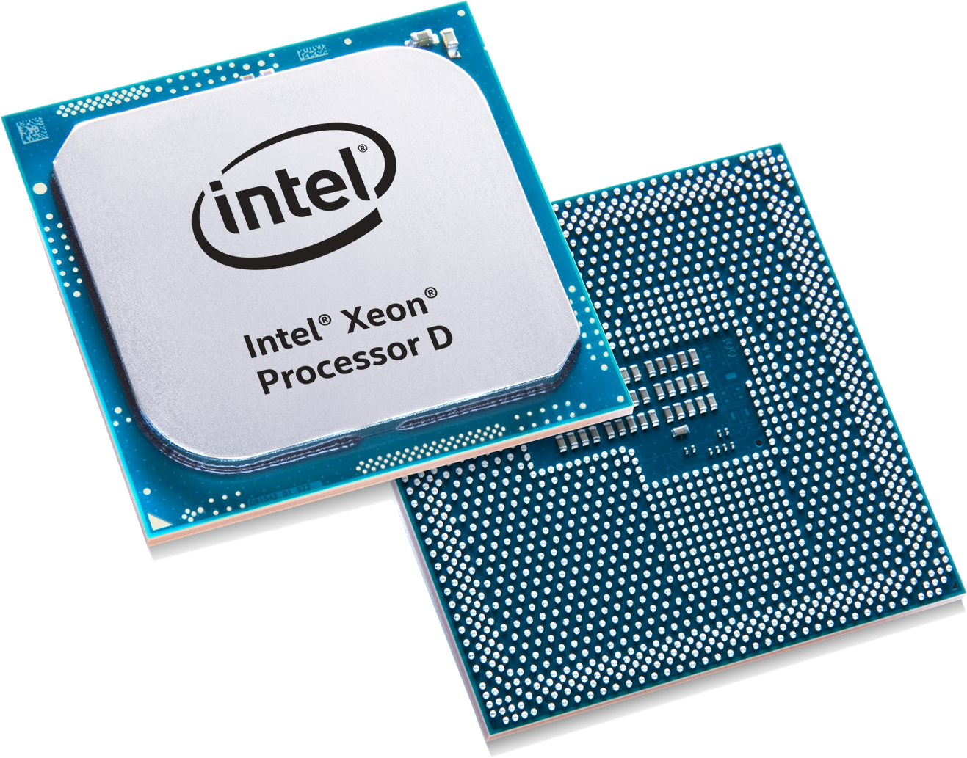
Central Processing Unit (CPU)
Control Unit:
This unit controls the operations of all parts of the computer but does not carry out any actual data processing operations.
Functions of this unit are:
It is responsible for controlling the transfer of data and instructions among other units of a computer.
It obtains the instructions from the memory, interprets them, and directs them.
It communicates with Input/output devices for transfer of data or results from storage.
It does not process or store data.

Slide 7
Central Processing Unit (CPU)
Arithmetic Logic Unit (ALU):
This unit consists of two subsections namely,
Arithmetic Section
Logic Section
Arithmetic Section
Function of arithmetic section is to perform arithmetic operations like addition, subtraction, multiplication, and division. All complex operations are done by making repetitive use of the mentioned operations.
Logic Section
Function of logic section is to perform logic operations such as comparing, selecting, matching, and merging of data.

Slide 8
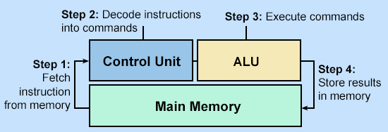
Central Processing Unit (CPU)
Function of CPU:
There have been a lot of improvements over the years since the first CPUs came on the world. Despite that, the primary function of the CPU has remained the same consisting of three steps; fetch, decode, and execute.

Slide 9
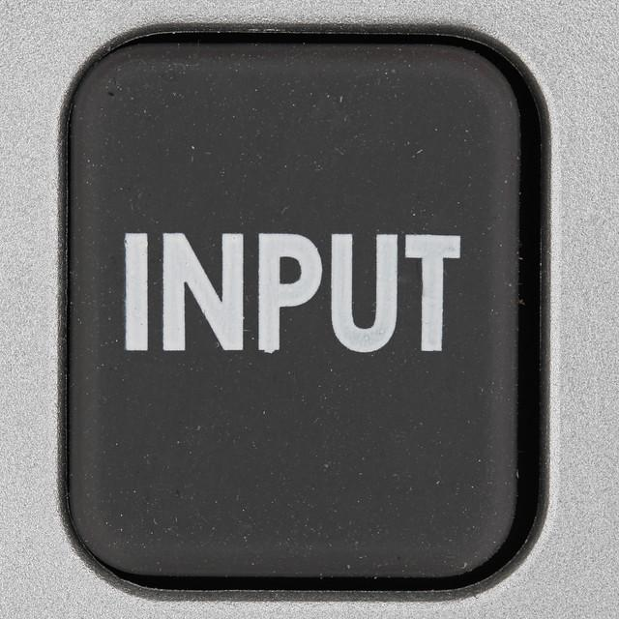
Input Unit
Input devices are peripheral devices that enter data and instructions into the computer.
Following are some of the important input devices which are used in a computer:
Scanner
Microphone
Optical Character Reader (OCR)
Bar Code Reader
Keyboard
Mouse
Joystick
Light pen
Track Ball

Slide 10
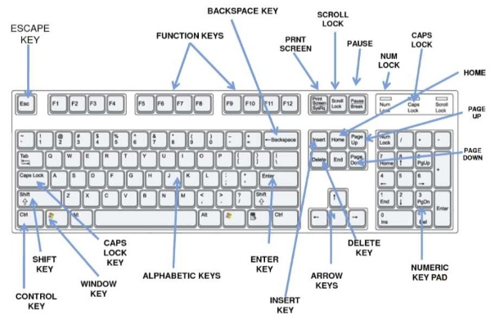
Input Unit
Keyboard:
Keyboard is the most common and very popular input device which helps to input data to the computer.
Keyboard Layouts: QWERTY (others: QWERTZ, AZERTY, and DVORAK).

Slide 11
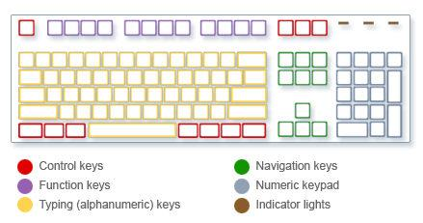
Input Unit
Keyboard – Organizations of the Keys:
Typing (alphanumeric) keys: These keys include the same letter, number, punctuation, and symbol keys found on a traditional typewriter.
Control keys: These keys are used alone or in combination with other keys to perform certain actions. The most frequently used control keys are Ctrl, Alt, the Windows logo key﻿ Picture of the Windows logo key, and Esc.
Function keys: The function keys are used to perform specific tasks. They are labeled as F1, F2, F3, and so on, up to F12. The functionality of these keys differs from program to program.
Navigation keys: These keys are used for moving around in documents or webpages and editing text. They include the arrow keys, Home, End, Page Up, Page Down, Delete, and Insert.
Numeric keypad: The numeric keypad is handy for entering numbers quickly. The keys are grouped together in a block like a conventional calculator or adding machine.

Slide 12
Input Unit
Keyboard – Shortcuts:
CTRL + W = Close window | CTRL + V = Paste
CTRL + A = Select All | CTRL + P = Print
CTRL + S = Save | CTRL + ALT + Arrows = Rotate window
CTRL + F = Find | ALT + TAB = Switch windows
CTRL + Z = Undo | ALT + F4 = Closs application
CTRL + Y = Redo | Windows + P = Presentation Display Mode
CTRL + X = Cut | Windows + D = Show or hide the desktop
CTRL + C = Copy | F5 = Refresh

Slide 13
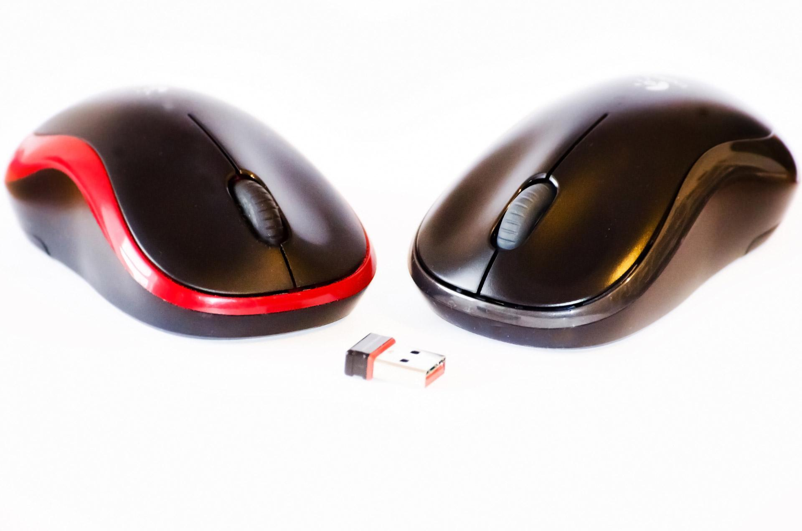
Input Unit
Mouse:
Mouse is the most popular pointing device. Generally, it has two buttons called the left and the right button and a wheel is present between the buttons. A mouse can be used to control the position of the cursor on the screen.
Five basic actions of the mouse:
Click: Press and release the left mouse button.
Right-Click: Press and release the right mouse button.
Double-Click: Press and release the left mouse button twice rapidly.
Drag and Drop: Press and do not release the left mouse button, then move the mouse with the button still held down, and finally release the button.
Scroll: Many mice have a scroll wheel between the left and right buttons.

Slide 14
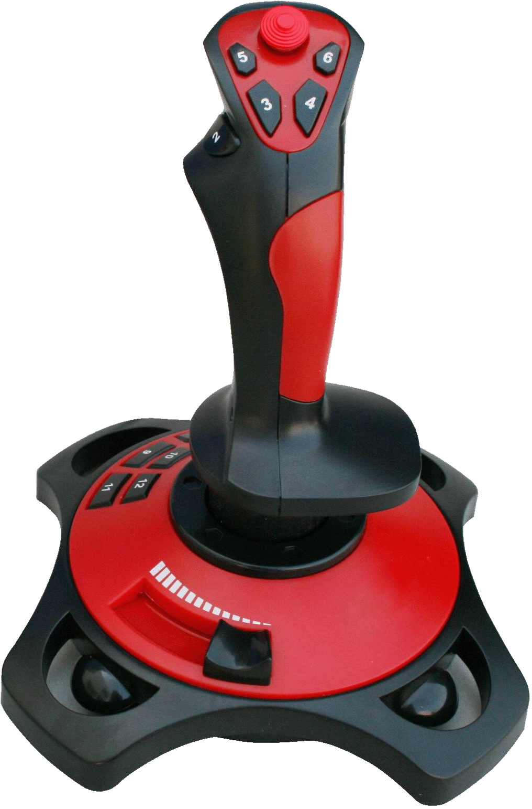
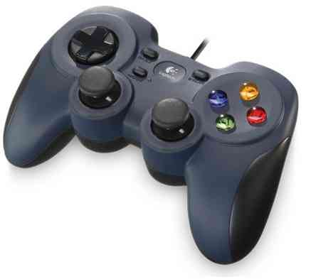
Input Unit
Joystick:
Joystick is also a pointing device, which is used to move the cursor position on a monitor screen. The joystick can be moved in all four directions. The function of the joystick is like a mouse. It is mainly used in Computer Aided Designing (CAD) and playing computer games.

Slide 15
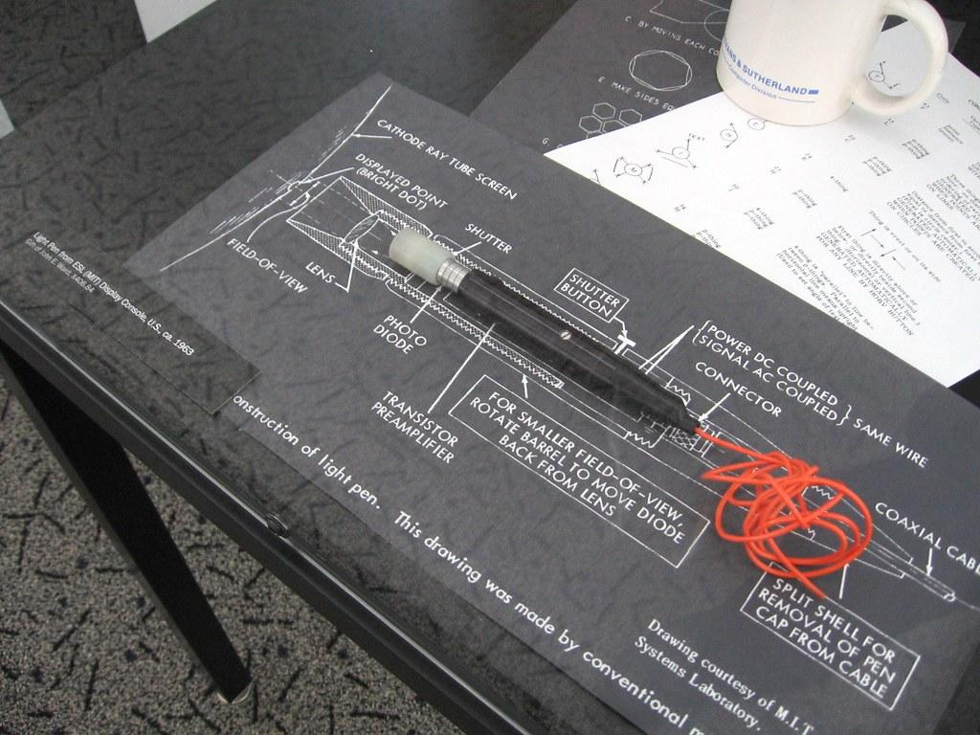
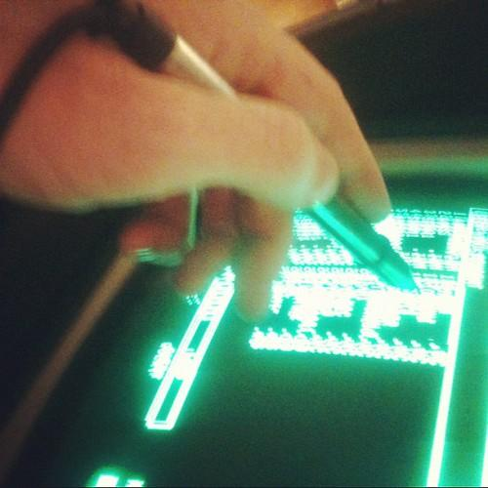
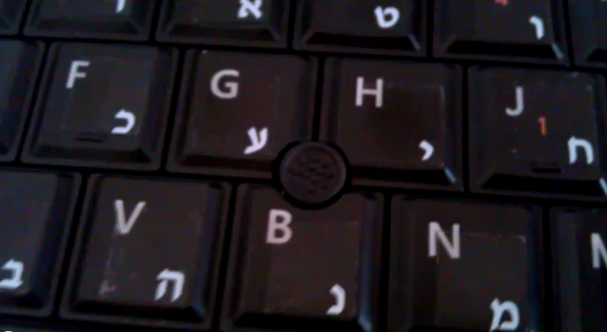
Input Unit
Light Pen:
Light pen is a pointing device like a pen. It is used to select a displayed menu item or draw pictures on the monitor screen.
Track Ball:
Track ball is mostly used in notebook or laptop computer, instead of a mouse. This is a ball which is half inserted and by moving fingers on the ball, the pointer can be moved. A track ball comes in various shapes like a ball, a button, or a square.

Slide 16
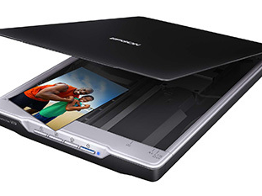
Input Unit
Scanner:
Scanner works more like a photocopy machine. It is used when some information is available on paper, and it is to be transferred to the computer for further manipulation.
Microphone:
Microphone is works to input sound that is then stored in a digital form. The microphone is used for various applications such as adding sound to a multimedia presentation or for mixing music.

Slide 17
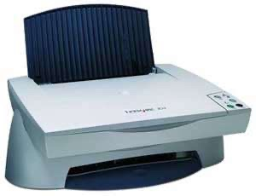
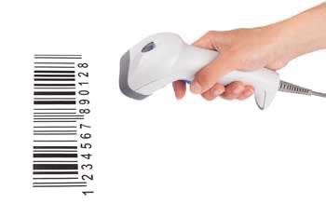
Input Unit
Optical Character Reader (OCR):
OCR is used to read a printed text. OCR scans the text optically, character by character, converts them into a machine-readable code, and stores the text on the system memory.
Bar Code Reader:
Bar Code Reader is used for reading bar coded data (data in the form of light and dark lines). Bar coded data is generally used in labelling goods, numbering the books, etc.

Slide 18
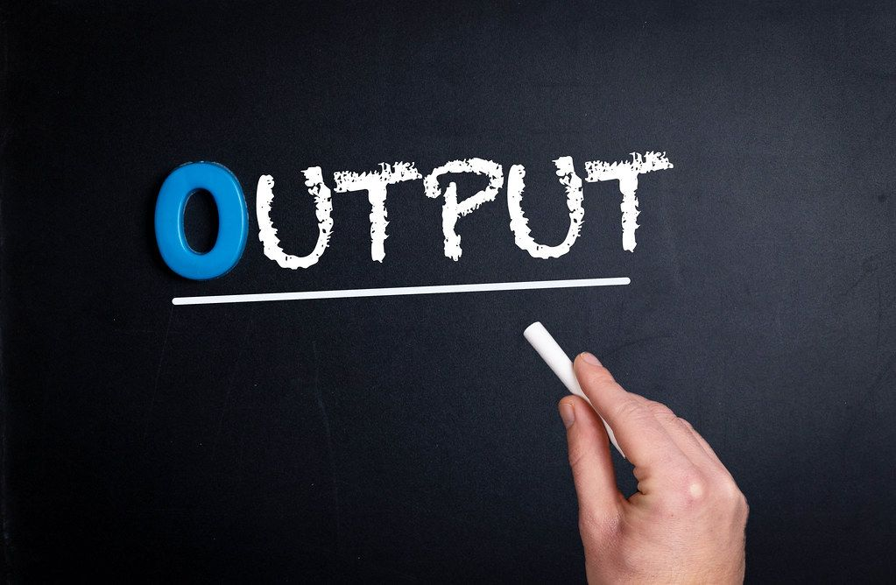
Output Unit
An output device allows data to be transmitted by the computer in a human-friendly form.
Following are some of the important output devices:
Monitor
Printer
Speaker
Headphone
Projector

Slide 19
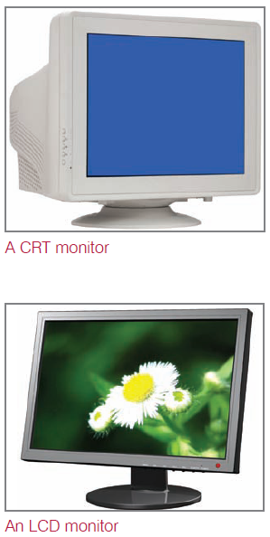
Monitor
A monitor is a very common type of output device that help to provide output in the form of graphically and text as well. There are two main types of monitor:
Cathode Ray Tube: The CRT display is made up of small picture elements called pixels. The smaller the pixels, the better the image clarity or resolution.
Flat-Panel Display Monitor: The flat-panel display refers to a class of video devices that have reduced volume, weight and power requirement in comparison to the CRT. The flat-panel display is divided into two categories:
Emissive Displays - are devices that convert electrical energy into light. For example, plasma panel and LED (Light- Emitting Diodes).
Non-Emissive Displays - use optical effects to convert sunlight or light from some other source into graphics patterns. For example, LCD (Liquid- Crystal Device).
Cathode-Ray Tube (CRT) Monitor
Monitor
Emissive Displays
Flat-Panel Display Monitor
Non-Emissive Displays

Slide 20
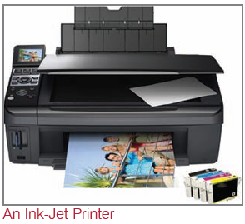
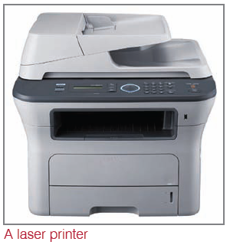
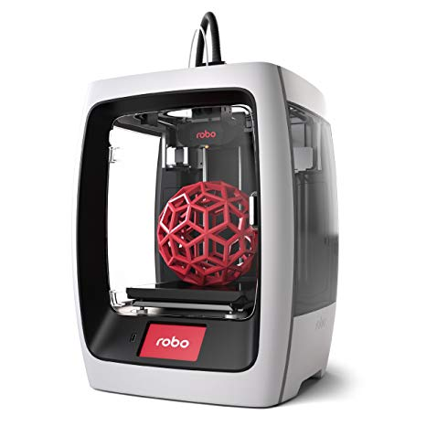
Printer
A printer is an output device that prints text and computer-generated images onto paper or onto another physical medium, such as a transparent film.
Printers can print in monochrome or color mode. There are many types of printers on the market to meet users’ demands.
The most common types of printers you find on the market are inkjet printers, laser printers and 3D printers.
3D Printer

Slide 21
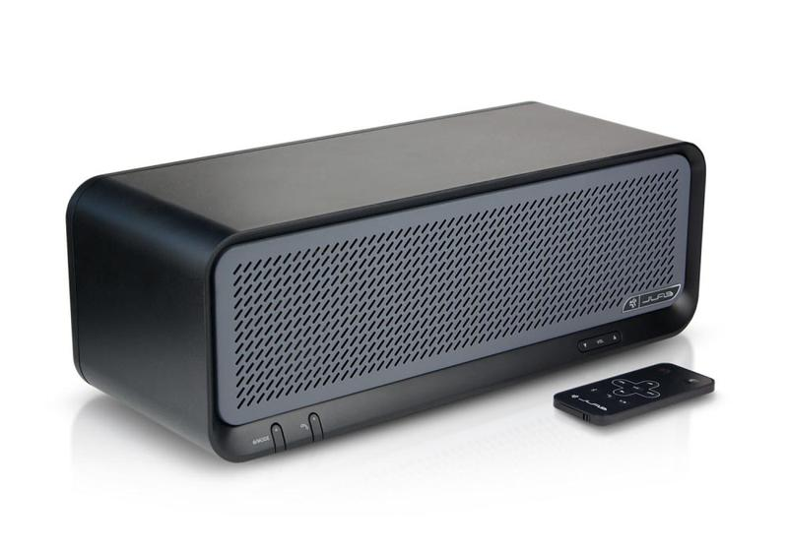
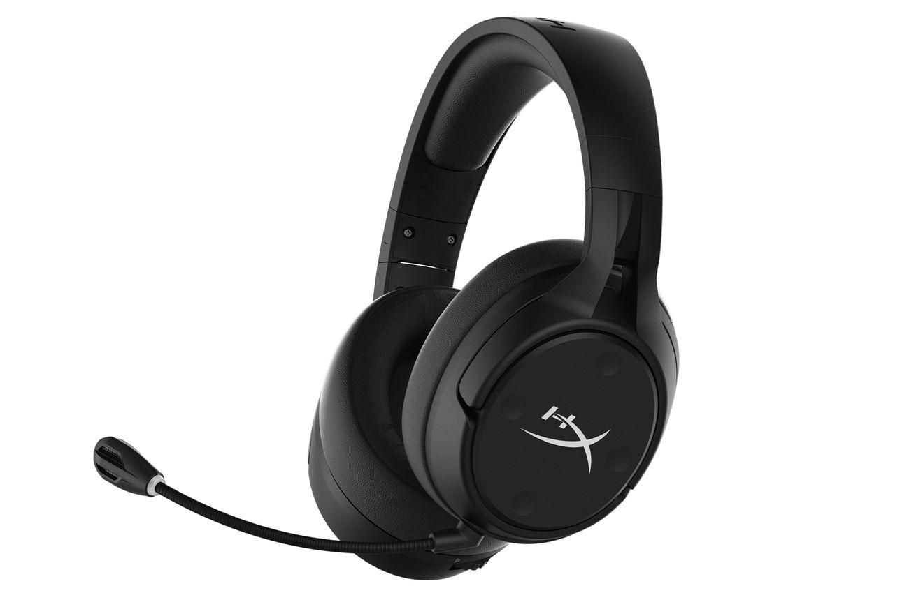
Speakers and Headphones
A speaker is an output device that plays sound generated by the computer’s sound card. The speaker is attached to the sound card by a cable. Most computers also have an internal speaker that is attached to the mainboard and that can play simple sounds.
A headphone is a pair of speakers worn over or in the ears so only the wearer can hear the sound. A headphone with an integrated microphone is usually called a headset.

Slide 22
File Extension
A file extension is the suffix at the end of a filename that indicates what type of file it is.
Extension | File Type
.docx | Microsoft Word Document
.pptx | Microsoft Power Point
.xlsx | Microsoft Excel Spreadsheet
.jpg | JPEG Image
.psd | Adobe Photoshop Document
.pdf | Portable Document File
.zip | Zipped File
.rar | WinRAR Compressed Archive
.cpp | C++ Source Code File
.java | Java Source Code File
.m | MATLAB
.py | Python Source Code
Lecture2.pdf
File name
File extension

Slide 23
References
Computer Fundamentals. By Tutorials Point. (2017).
Computing Essentials. By Timothy J. O’Leary. (2017).

Slide 24
THANK YOU

