Slide 1
Tishk international university
Faculty of Education
Computer Education Department
Numerical Systems
Imad Nihad
Week 5-6
Fall 2024/25
5-6

Slide 2
Introduction to computer
Numbering System

Slide 3
What is numbering system
A numbering system (or numeration system) is a system for expressing numbers in a consistent manner using symbols or digits. It is a way of counting and representing numerical values. Different numbering systems use different bases (also called radix), and each base uses a specific set of digits or symbols to represent numbers

Slide 4
Decimal
Binary
Examples of numbering System
Octal
Hexadecimal

Slide 5
Decimal Numbering system

Slide 6
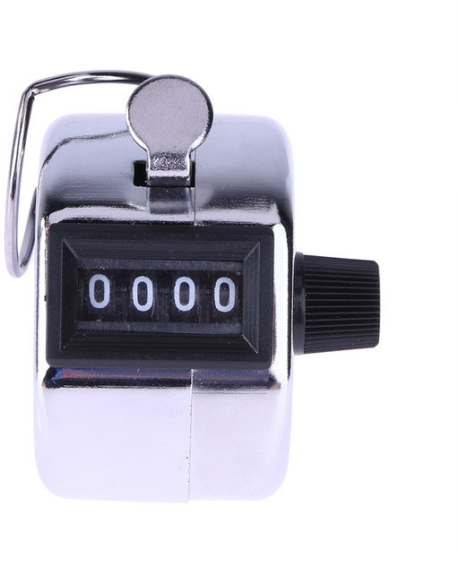
Decimal Numbering system

Slide 7
Decimal number system, also called Hindu-Arabic, or Arabic, number system, in mathematics, positional numeral system employing 10 as the base
This is the type of numerical systems which we use it in our life. It is easiest way for humans to understand
requiring 10 different numerals, the digits
What is Decimal Numbering system
• | 0 | 1 | 2 | 3 | 4 | 5 | 6
 |  | 7 | 8 | 9

Slide 8
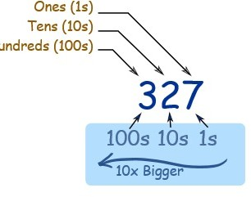
Decimal Numbering system

Slide 9
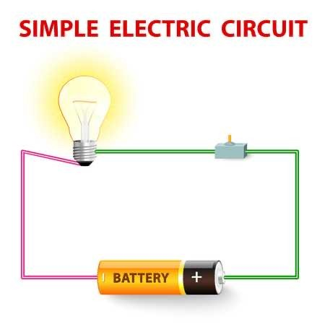
What is this?

Slide 10
Binary Numbering system
The binary system in computing is a number system that uses only two digits: 0 and 1. These digits are called bits (short for binary digits). Computers use the binary system because their electronic circuits can easily represent two states: on (1) and off (0), which correspond to the binary values.

Slide 11
Octal Numbering system
The octal numbering system is a base-8 number system that uses eight digits: 0, 1, 2, 3, 4, 5, 6, and 7. Each digit in an octal number represents a power of 8. It is commonly used in computing because it is more compact than binary (base-2) and is easier to understand and work with, especially in contexts like computer programming and digital electronics.
Each digit represented by 3 bits
0 1 2 3 4 5 6 7

Slide 12
Hexadecimal
Numbering system
is a number expressed in the base-16 numeral system or Hexadecimal numeral system, which uses 16 symbols: form 0 to F Mostly used it mathematics and digital electronics
Each digit represented by 4 bits
6
9
 | 0 | 1 7 | 2 8 | 3 9 | 4 | 5
 | A | B | C | D | E | F
 | 10 | 11 | 12 | 13 | 14 | 15

Slide 13
Converting the systems

Slide 14
How to convert Decimal to Binary
To convert binary to decimal there are two major ways
Division
subtraction

Slide 15
Division
Device the decimal number by 2 and take the reminder
Why dividing by 2?
Because it is converting from base 10 to base 2, that is why it must be divided by 2

Slide 16
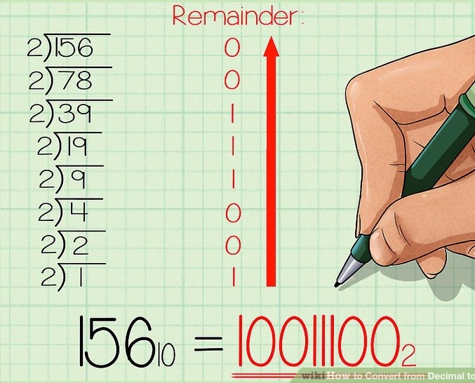
Division Cont…

Slide 17
Subtraction
Write down the bellow numbers
2⁸
256
Subtract the decimal number with the biggest number in the list that will give positive result
For example your number is 156, which is between 256 and 128.
156-128= 28, 28 is between 32 and 16 , 28-16=12….. Till the result will be zero
For those which have been used in the subtraction put 1 and the others put 0
₂7 | ₂6 | ₂5 | ₂4 | ₂3 | ₂2 | ₂1 | ₂0
128 | 64 | 32 | 16 | 8 | 4 | 2 | 1
256 128 | 64 | 32 | 16 | 8 | 4 | 2 | 1
0 1 | 0 | 0 | 1 | 1 | 1 | 0 | 0

Slide 18
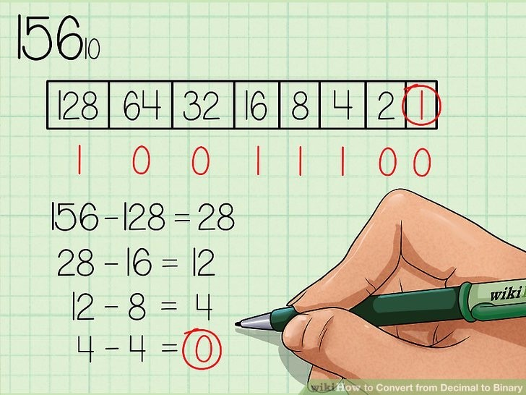
Subtraction Cont…

Slide 19
How to convert Binary to Decimal
Write down the binary number
For example 10011011
Then write the following umbers above it
And the numbers which are above 1s and ignore the ones over 0s
128+16+8+2+1=155
256 128 | 64 | 32 | 16 | 8 | 4 | 2 | 1
1 | 0 | 0 | 1 | 1 | 0 | 1 | 1

Slide 21
How to convert Octal to Binary
As it is mentioned before octal represented by 3 bits because the biggest number in octal is 7 and seven written 111 in binary
Write down the Octal number
for example 615
separate between numbers 6 1 5
For each number write 4 2 1
Then convert the numbers separately into binary
6 | 1 | 5
4 2 1 | 4 2 1 | 4 2 1
1 1 0 | 0 0 1 | 1 0 1 =110001101

Slide 22
How to convert Binary to Octal
Write down the binary number
For example 110001101
Separate make them groups of 3 digits 110|001|101
If the last group in the left was less than 2 digits make it 3 by adding zeroes
for example 1110101 = 001|110|101
Write down 4 2 1 above each group
421 421 421
110|001|101
Add the number above digit 1s for each group separately
421 421 421
110|001|101
4+2|1 |4+1
6 1 5= 615

Slide 23
How to convert Hexadecimal to Binary
As it is mentioned before octal represented by 4 bits because the biggest number in octal is 16 and seven written 1111 in binary
Write down the Octal number
for example F35
separate between numbers F |  |  | 3 | 5
For each number write 8 4 |  |  | 2 | 1
Then convert the numbers separately into binary
F | 3 | 5
8 4 2 1 | 8 4 2 1 | 8 4 2 1
1 1 1 1 | 0 0 1 1 | 0 1 0 1 =111100110101

Slide 24
How to convert Binary to Hexadecimal
Write down the binary number
For example 111100110101
Separate make them groups of 4 digits 1111|0011|0101
If the last group in the left was less than 2 digits make it 4 by adding zeroes
for example 0111100101 = 0010|1110|0101
Write down 8 4 2 1 above each group
8421 8421 8421
1111|0011|0101
Add the number above digit 1s for each group separately
8421 8421 8421
1111|0011|0101
8+4+2+1|2+1|4+1
15(F) 3 5= F35

Slide 25
Useful Mind Map
Hexadecimal
Binary
Decimal
Octal

Slide 26
References
McGraw, G., & Lister, R. (2018). Computer arithmetic and number systems: A guide for engineers and computer scientists. Wiley.
Friedman, M., & Rusu, S. (2016). Digital design and computer architecture (2nd ed.). Elsevier.

