Slide 1

Tishk International University
Faculty of Applied Science
Nutrition and Dietetics Department
Safety and Lab. Operating System
Safety and Lab. Operating System
A. Lecturer.: Amani Tahsin
Contact Info: amani.tahsin@tiu.edu.iq

Slide 2
Objectives
To give a background for students to face Lab. and protect themselves from unwanted situations.
To handle their works properly.
To provide basis for setting up health, safety and environmental policy(HSE).

Slide 3
Introduction
What is Safety?
Hazardous and toxic substances.
OSHA, GHS, WHMIS

Slide 4

A Historical Example: US

Slide 5


Slide 6
What is definition of safety?
Safety is no accident. Safety can also be defined to be the control of recognized hazards to achieve an acceptable level of risk.
What is definition of the hazardous and toxic substances?
Hazardous and toxic substances are defined as those chemicals present in the workplace which are capable of causing harm. In this definition, the term chemicals includes dusts, mixtures, and common materials such as paints, fuels, and solvents.

Slide 7

Who is responsible for safety?
Every one is Responsible, BUT
first is You!

Slide 8

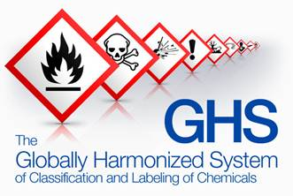

OSHA, 1971 US
GHS, 2003 UN
WHMIS, 1988 CA

Slide 9
Agency Information
There are several agencies that are involved in safety compliance:
National Institute of Health (NIH)
In charge of laboratories that use or contain recombinant DNA (rDNA). As they specify the practices for constructing and handling the rDNA.
Centers for Disease Control and Prevention (CDC)
In charge of laboratories that use or contain infectious agents.

Slide 10
Occupational Safety and Health Administration (OSHA)
Primarily monitors hazardous materials, Blood borne pathogens and occupational exposure to hazardous chemicals in laboratories.
OSHA is in charge of monitoring work conditions and eliminating physical and health hazards at the work place.
Environmental Protection Agency (EPA)
Is in charge of the wastes. Many hazardous wastes are used in research laboratories and they pose a threat to humans, animals, plants, and the environment.
There are also biohazardous wastes that are regulated and must be decontaminated and disposed of properly.

Slide 11
The importance of laboratory quality
Laboratory quality can be defined as accuracy, reliability and timeliness of reported test results.
The laboratory results must be as accurate as possible, all aspects of the laboratory operations must be reliable, and reporting must be timely in order to be useful in a clinical or public health setting.

Slide 12

Quality systems in the Laboratory
Quality Management System addresses all processes.
The complexity of the laboratory system requires many factors that must be addressed to assure quality in the laboratory.

Slide 13
Some of these factors include:
The laboratory environment
Quality control procedures
Communications
Record-keeping
Competent and knowledgeable staff
Good quality reagents and equipment.

Slide 14
Quality systems in the production facility
Another important aspect of ensuring that a process stays in control is maintenance of the facility, utilities and equipment.
Once established, qualification status must be maintained through;
Routine monitoring
Maintenance
Calibration procedures

Slide 15
Facilities and Safety
Many factors must be a part of the quality management of facilities and safety. These include:
• Security—which is the process of preventing unwanted risks and hazards from entering the laboratory space.
• Containment—which seeks to minimize risks and prevent hazards from leaving the laboratory space and causing harm to the community.
• Safety—which includes policies and procedures to prevent harm to workers, visitors, and the community.
• Ergonomics—which addresses facility and equipment adaptation to allow safe and healthy working conditions at the laboratory site.

Slide 16
Laboratory Safety
Is the key to reducing injury and illness.
There are many exposures in the Lab that pose a hazard to your health and you may have never considered them as a hazard before.

Slide 17
WHY IS LABORATORY SAFETY IMPORTANT?
TO PREVENT:
  Adverse health effects from exposure to chemicals
  Exposure to organisms, diseases, etc. in laboratories
  Laboratory equipment hazards - if not maintained properly

Slide 18
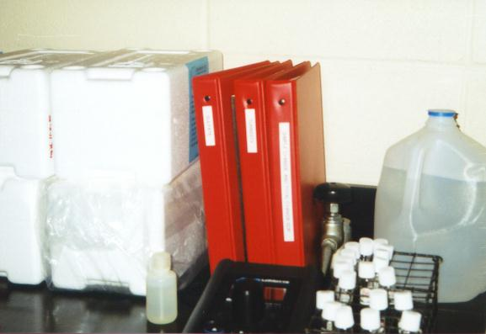
  Laboratory Policies and Procedures
Must be:
written and available

Slide 19
Material Safety Data Sheets (MSDSs)
MSDSs are written or printed materials concerning a hazardous chemical.
For chemicals received by the laboratory must be supplied by the manufacturer, distributor, or importer and must be maintained and readily accessible to laboratory workers.
Employers must have an MSDS in the workplace for each hazardous chemical in use.

Slide 20
MSDS sheets must contain:
1. Name of the chemical;
2. Manufacturer’s information;
3. Hazardous ingredients/identity information;
4. Physical/chemical characteristics;
5. Fire and explosion hazard data;
6. Reactivity data;
7. Health hazard data;
8. Precautions for safe handling and use; and
9. Control measures.

Slide 21
What is a COSHH assessment?
A COSHH assessment is a systematic examination of a task or process that involves using a potentially hazardous substance.
A COSHH Assessment is carried out for the purpose of identifying hazardous substances you may use, whether the precautions you have taken are acceptable and what control measures are in place.

Slide 22
What is a HAZARD?
Hazard: something that could cause harm
  For instance: Crossing the street, a sharp knife, slippery floor, electricity, carrying heavy loads, (more).
Hazardous event (accident): something that causes harm.

Slide 23
Identifying Hazards
* Chemicals
Classification
  Toxic: Small doses cause death or serious illness.
  Harmful: Large doses cause death or serious illness.
  Corrosive: destroys flesh on contact.
  Irritant: can cause inflammation of skin, eyes or lungs.

Slide 24
WHMIS 2015- Hazards Classes and Categories
What is hazard?
Hazardous = unsafe, risky
Hazard Groups
Physical Hazards Group
Health Hazards Group

Slide 25
Hazard Classes
Physical Hazards
Flammable gases
Flammable aerosols
Oxidizing gases
Gases under pressure
Flammable liquids
Flammable solids
Self-reactive substances and mixtures
Pyrophoric liquids and solids
Self-heating substances and mixtures
Substances and mixtures which, in contact with water, emit flammable gases
Oxidizing liquids and solids
Organic peroxides
Corrosive to metals
Combustible dusts
Simple asphyxiant
Pyrophoric gases
Physical hazards not otherwise classified
Health Hazards
Acute toxicity
Skin corrosion/irritation
Serious eye damage/eye irritation
Respiratory or skin sensitization
Germ cell mutagenicity
Carcinogenicity
Reproductive toxicity
Specific target organ toxicity – single exposure
Specific target organ toxicity – repeated exposure
Aspiration hazard
Biohazardous infectious materials
Health hazards not otherwise classified

Slide 26
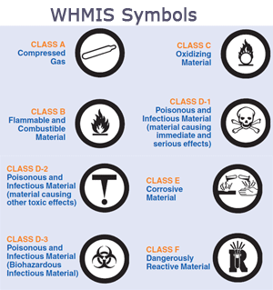
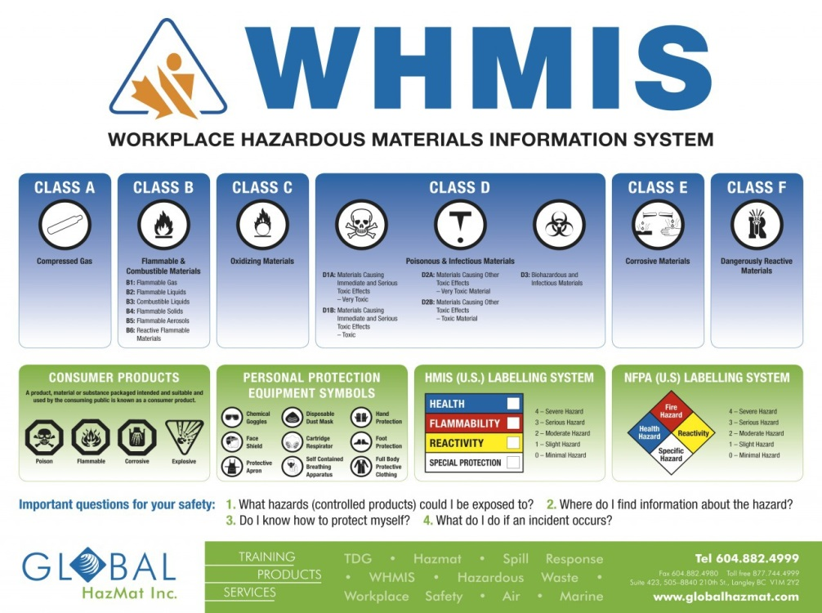
Hazard Categories

Slide 27




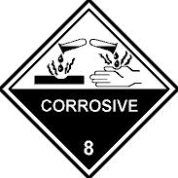




Identification of hazards
Flammable
Explosive
Toxic/Poison
Irritant
Corrosive
Environmental
In addition to symbols, detailed information about Risk (R) and safety (S) phrases, can be found in catalogues and Material Safety Data sheets (MSDS)

Slide 28
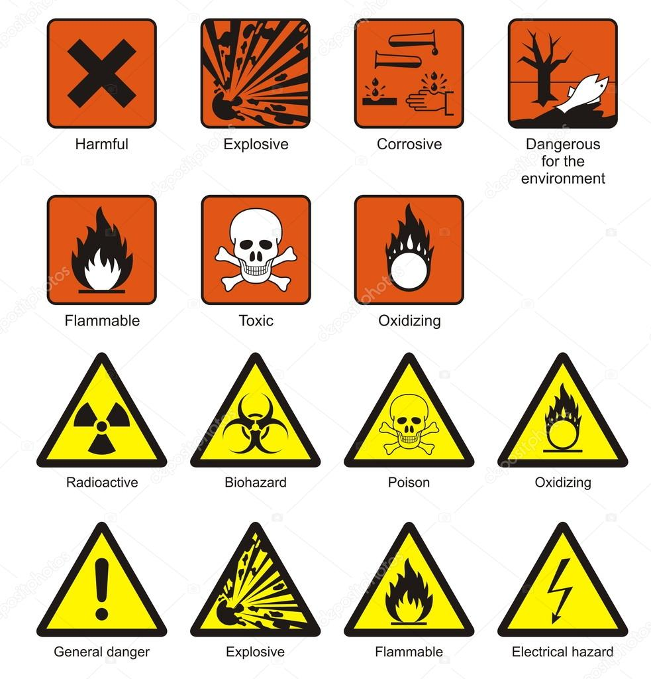

Slide 29
Hazards Classification
Risk to health resulting from acute, repeated or prolonged exposure:
  - very toxic or toxic
  - harmful
  - corrosive
  - irritant
  - cancer causing
  - hazards to reproduction
  - can cause non-heritable birth defects
  - sensitizing
Fire and explosion hazards may be classified as follows
  - explosive
  - oxidizing
  - extremely flammable
  - highly flammable
  - flammable
The following properties present a hazard to the environment are:
  - toxic to living organisms
  - persistent in the environment
  - bioaccumulative

Slide 30
Working safely
with solvents

Slide 31
What is a solvent?
Chemical substance which is used to dissolve or dilute other substances and materials (solutes) without chemical changes.

Slide 32
Main Dangers of solvents
Toxic effects
Corrosive effects
Flammable nature
Reactive nature – incompatible chemicals

Slide 33

How can solvents affect health?
Some of the short-term effects are:
irritation of eyes, lungs and skin;
headache;
nausea;
dizziness;
light-headedness.
Increased chance of having an accident.
Long-term effects e.g. dermatitis.
Unconsciousness and even death can result from exposure to very high concentrations of solvent vapours.

Slide 34

How can solvents get into the body?
● Breathing in vapours and fumes.
● Contact with skin
● Ingestion (e.g. hand to mouth contact, eating with contaminated hands)

Slide 35
Classification of Solvents
Inorganic solvents
  water and aqueous solutions containing special additives (surfactants, detergents, PH buffers, inhibitors).
  acids and bases e.g. liquid anhydrous ammonia (NH₃),concentrated sulfuric acid (H₂SO₄)
Organic solvents
  Oxygenated solvents
    contain oxygen. e.g. alcohols, glycol ethers, methyl acetate, ethyl acetate, ketones, esters, and glycol ether/esters.
  Hydrocarbon solvents
    consist only of hydrogen and carbon atoms.
    -Aliphatic solvents: have straight-chain structure; e.g.hexane, gasoline, kerosene.
    -Aromatic solvents: have benzene ring structure; e.g. benzene, toluene and xylene.
  Halogenated solvents
    contain halogenic atoms :(Cl, F , Br or I).

Slide 36

Questions
&

