Slide 1
Aromatherapy Introduction, history, types of Application
Dr. Kamran Javed Naquvi
Course name: AROMATHERAPY
Grade 4- Spring Semester 2024-2025
Course code: PHAR 429
Lecture 1

Slide 2
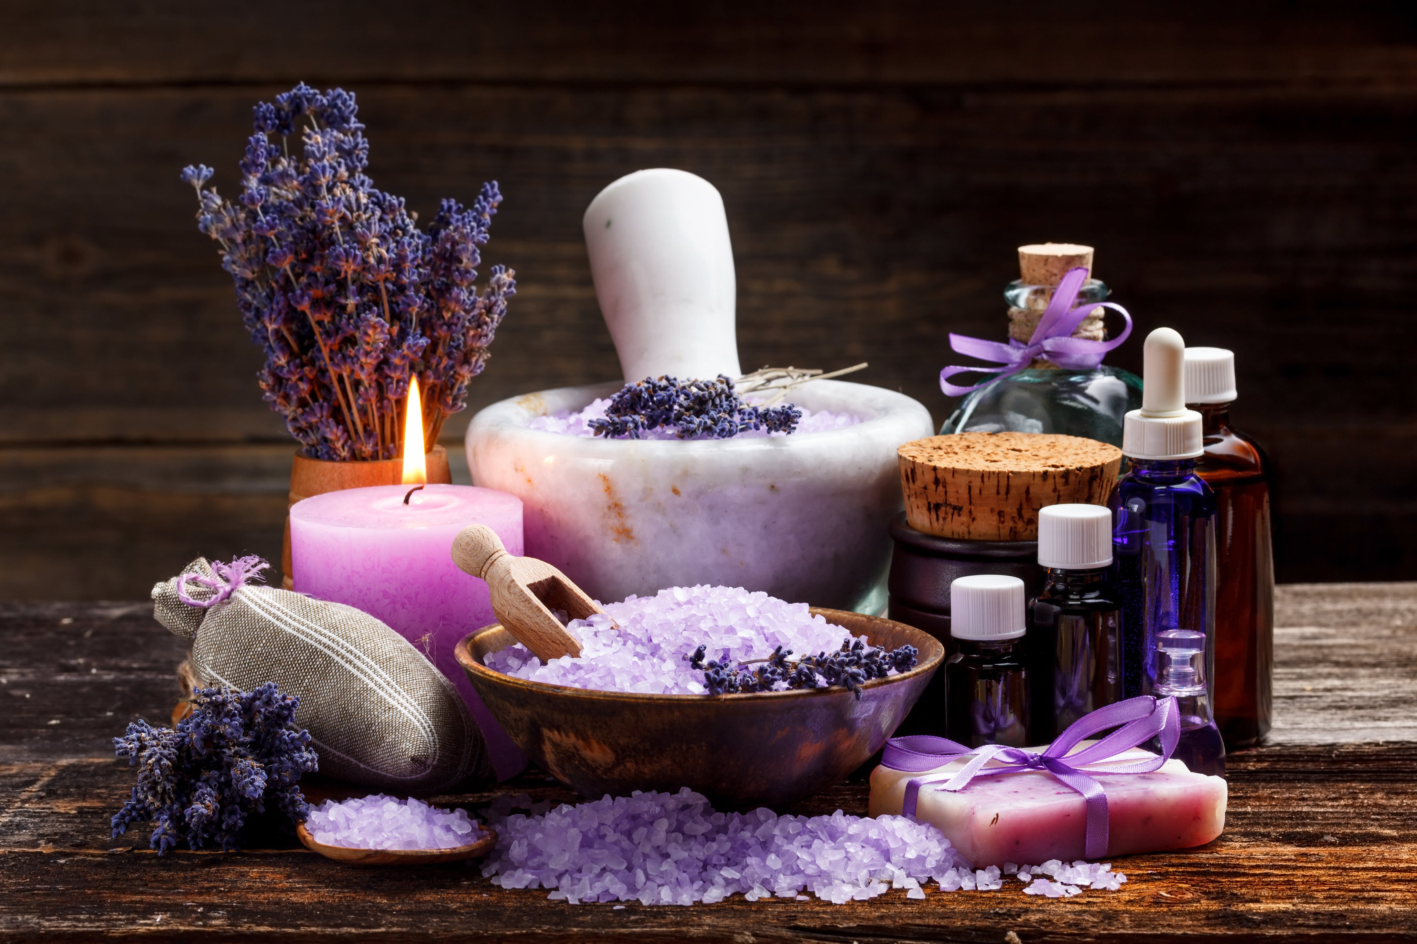
Aromatherapy
Aromatherapy is a holistic healing practice that uses the natural aromas and scents of essential oils extracted from plants to promote physical, emotional, and mental well-being.
The term "aromatherapy" is derived from the combination of two words: "aroma," which refers to the pleasant or distinctive smell, and "therapy," which indicates a treatment or healing process.
It is offered as a complementary therapy or as a form of alternative medicine.

Slide 3
………………………….Aromatherapy
Aromatherapy is often used to address a range of issues, including stress reduction, relaxation, mood enhancement, pain management, improved sleep, and support for various physical and mental health conditions.
While many people find aromatherapy to be a pleasant and relaxing experience.
It's important to note that scientific evidence supporting its efficacy for specific health claims may vary, and individual responses can vary as well.

Slide 4
Key components of Aromatherapy
Essential Oils: These are concentrated extracts from various parts of plants, such as flowers, leaves, bark, roots, or seeds. Essential oils are rich in aromatic compounds and are believed to have therapeutic properties.
Inhalation: Aromatherapy often involves inhaling the fragrances of essential oils through methods like diffusion, steam inhalation, or direct inhalation. The scent molecules are thought to interact with the olfactory system and affect the brain, influencing emotions and physiological responses.

Slide 5
Topical Application: Some aromatherapy practices involve applying diluted essential oils directly to the skin through massage, baths, or compresses. This is believed to facilitate absorption and promote various therapeutic effects.
Massage: Aromatherapy massage combines the benefits of massage therapy with the use of essential oils. The oils are usually diluted in a carrier oil and applied to the skin during the massage session.

Slide 6
Aromatherapy & Psychology
Aromatherapy regulates mood by connecting olfaction and the limbic system to stimulate the release of endorphins and serotonin.
Endorphins and serotonin have calming, soothing, and relaxing effects that can relieve anxiety.

Slide 7
Aromatherapy & Psychology
Olfactory System and Emotions: The olfactory system, responsible for the sense of smell, is closely linked to the limbic system in the brain, which plays a key role in emotions and memory. Aromas can trigger emotional responses and memories, influencing mood and behavior.
Associative Learning: Aromatherapy can influence associative learning, where certain scents become associated with specific emotions or experiences. For example, if a particular essential oil is consistently used during a calming activity, the smell of that oil may become associated with relaxation.

Slide 8
Aromatherapy & Psychology
Psychological Impact of Scents:
Different scents are believed to have various psychological effects.
For instance, lavender is often associated with relaxation and stress reduction, while citrus scents may be linked to increased energy and alertness.
The psychological impact of scents is subjective and can vary among individuals based on personal preferences and past experiences.

Slide 9
Aromatherapy & Psychology
Mind-Body Connection:
Aromatherapy is often used to support the mind-body connection. The relaxation induced by pleasant aromas can have positive effects on mental health, potentially reducing stress and anxiety.
Stress Reduction and Relaxation:
Aromatherapy is commonly employed to promote relaxation and alleviate stress. Certain essential oils, such as lavender, chamomile, or bergamot, have calming properties.

Slide 10
History of Aromatherapy
Ancient Civilizations:
Aromatherapy has ancient origins, with evidence of aromatic plants use for medicinal and religious purposes found in civilizations such as Egypt, China, India, and Greece.
In ancient Egypt, aromatic plants and their extracts were used in embalming processes (Mummifying), cosmetics, and religious rituals. The famous Ebers Papyrus, an ancient Egyptian medical text, contains references to the therapeutic use of aromatic oils.

Slide 11
History of Aromatherapy
Ancient China and India:
In traditional Chinese medicine, the use of aromatic substances, including herbs and incense, was integral to balancing the body's vital energy (Qi).
Ayurveda, the traditional system of medicine in India, incorporated the use of aromatic substances for physical and spiritual well-being. Essential oils were extracted from plants and used in massage, bathing, and religious ceremonies.

Slide 12
History of Aromatherapy
Greece and Rome:
Ancient Greek and Roman cultures involved the use of fragrances for both practical and therapeutic purposes. Greek physicians such as Hippocrates explored the medicinal properties of aromatic plants.
The Roman Empire continued the use of aromatics for perfumes, cosmetics, and medicinal applications. The physician and herbalist Dioscorides documented the properties of numerous plants, including aromatic ones, in his work "De Materia Medica."

Slide 13
History of Aromatherapy
18th to 19th Centuries:
The 18th century saw the development of the perfume and fragrance industries in France. The use of essential oils expanded beyond medicinal and religious contexts to include personal grooming and luxury.
In the 19th century, the term "Aromatherapy" was coined by René-Maurice Gattefossé, a French chemist, after he accidentally discovered the healing properties of lavender oil in treating burns. He is known as the Father of Aromatherapy

Slide 14
History of Aromatherapy
Contemporary Aromatherapy:
Aromatherapy continued to evolve in the latter half of the 20th century and into the 21st century. It gained popularity in holistic and alternative medicine practices.
Today, aromatherapy is widely used for its potential benefits in promoting relaxation, reducing stress, and addressing various physical and emotional concerns. It is employed in a range of settings, including spa treatments, massage therapy, and complementary healthcare.

Slide 15
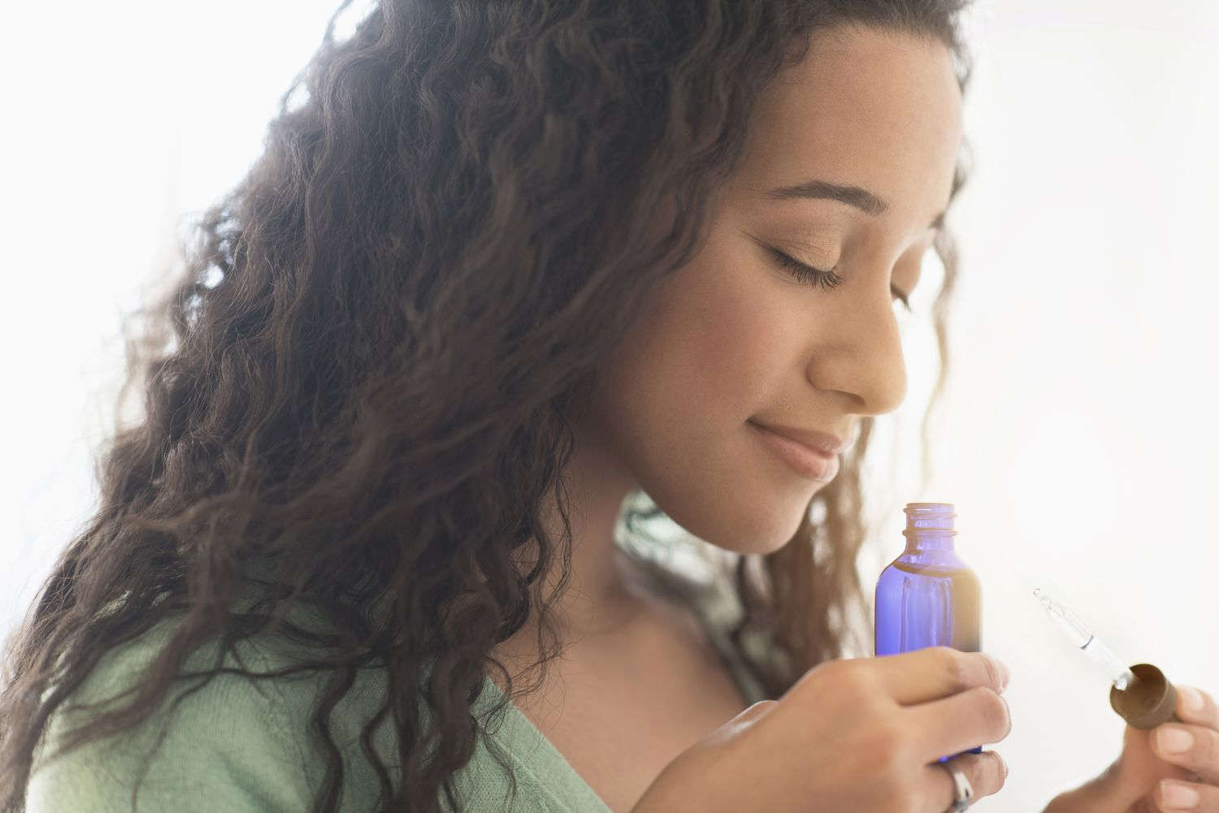
Types of Aromatherapy
Inhalation Aromatherapy:
Direct Inhalation: Inhaling essential oils directly from the bottle or using a cloth with a few drops of oil. This method is convenient and can be done anytime.

Slide 16
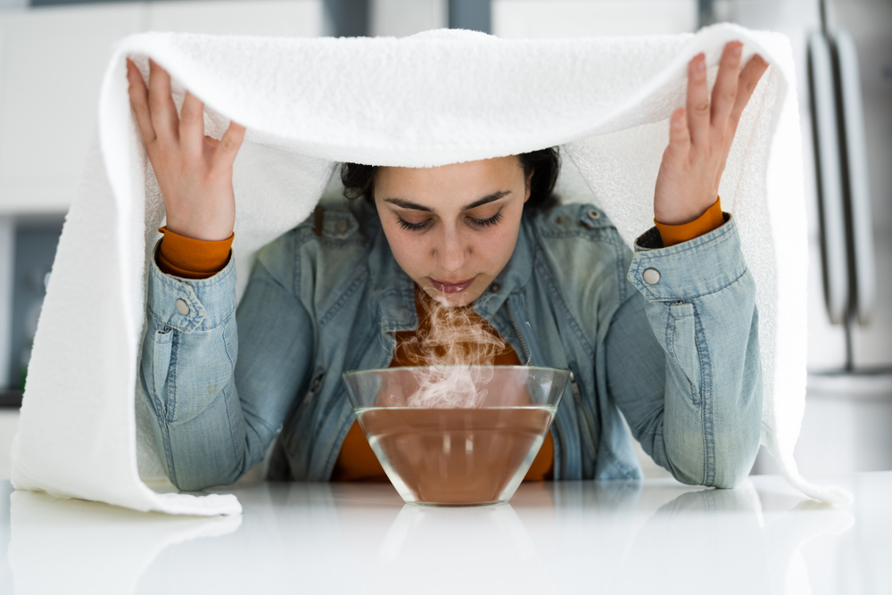
Steam Inhalation: Adding a few drops of essential oil to hot water and inhaling the steam. This method is often used for respiratory and sinus issues.

Slide 17
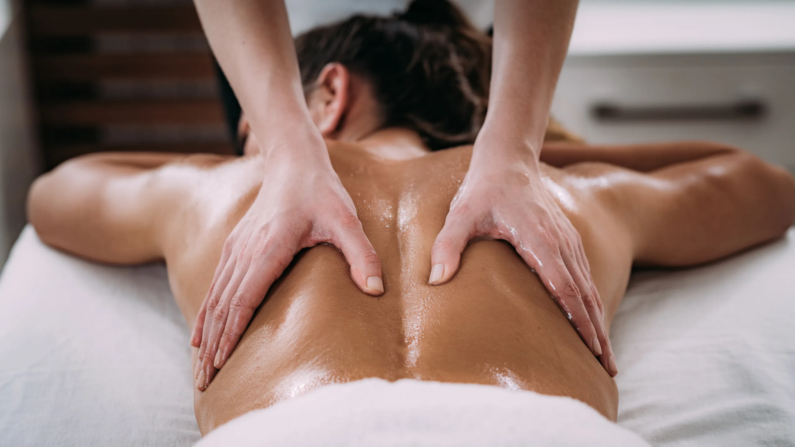
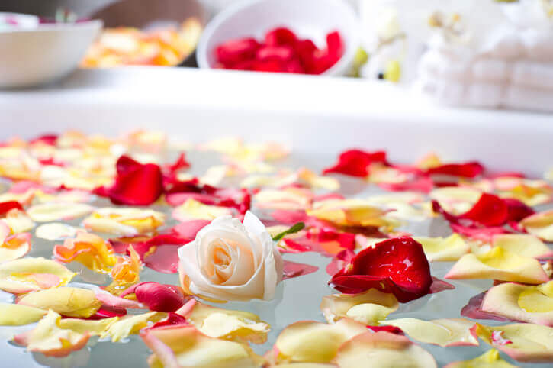
Topical Aromatherapy:
Massage: Diluting essential oils in a carrier oil and using them for massage. This method combines the benefits of touch and aromatherapy.
Baths: Adding a few drops of essential oil to a bath. The warm water facilitates the dispersion of the aroma and can promote relaxation.
Compresses: Soaking a cloth in water mixed with essential oils and applying it to a specific area of the body.

Slide 18
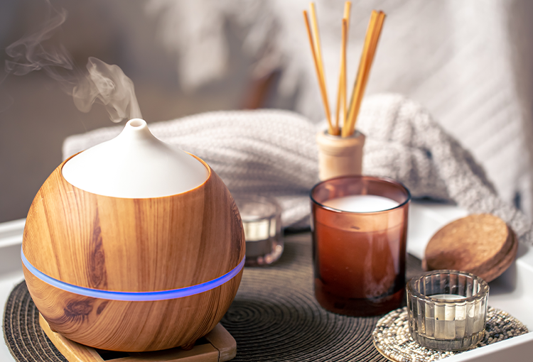
Aerial Aromatherapy:
Diffusers: Using devices like ultrasonic diffusers, nebulizers, or reed diffusers to disperse essential oils into the air. This method is popular for creating a pleasant atmosphere in a room.

Slide 19
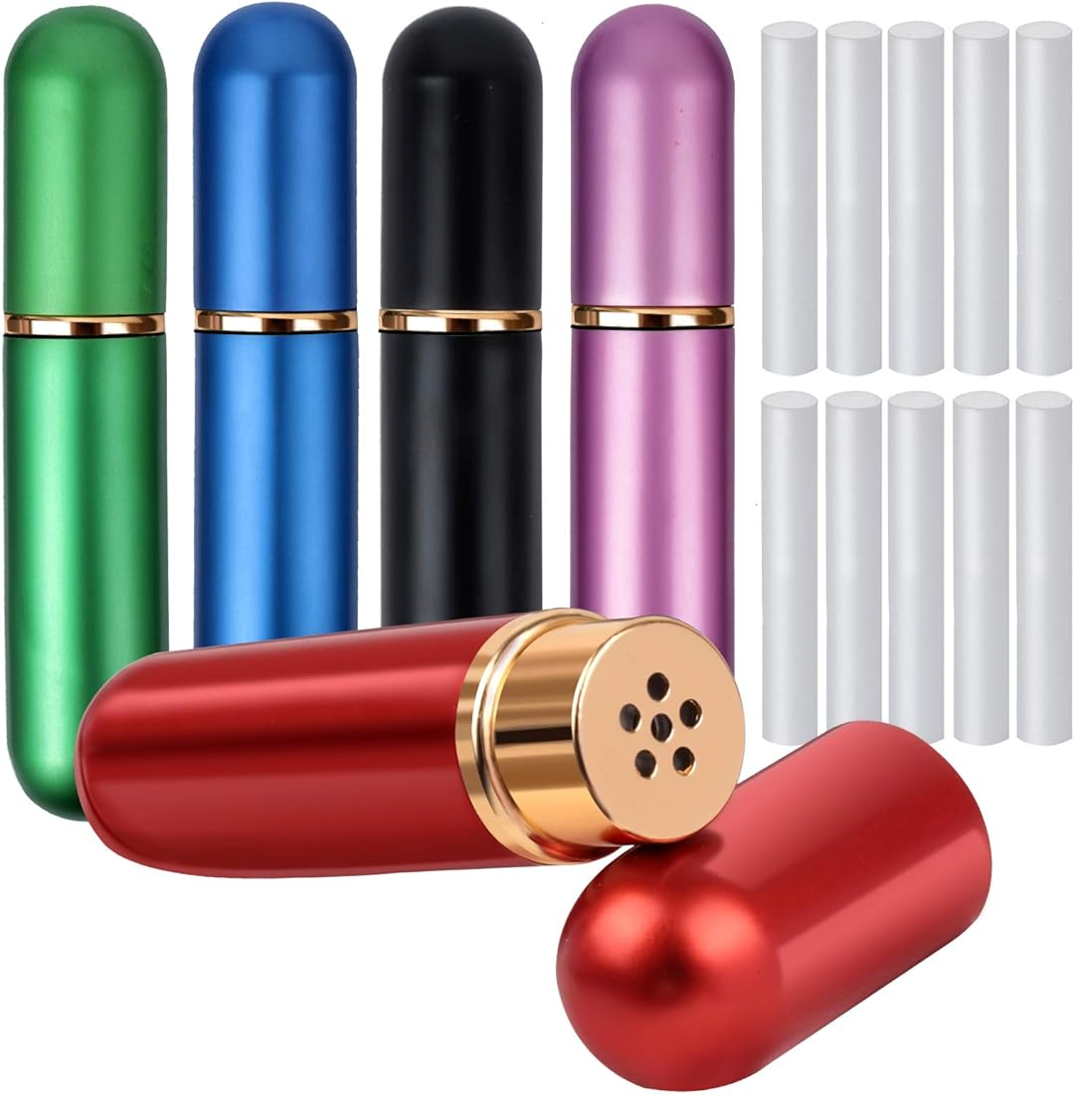
Environmental Aromatherapy:
Sprays: Creating room or linen sprays by diluting essential oils in water and spraying them in the air or on surfaces. This method is often used for refreshing spaces.
Self-Care Aromatherapy:
Personal Inhalers: Portable inhalers containing a cotton wick soaked in essential oils. Users can inhale from the inhaler throughout the day for personal aromatherapy.

Slide 20
Culinary Aromatherapy:
Cooking with Essential Oils: Adding food-grade essential oils to recipes for flavor and potential health benefits. Common culinary oils include peppermint, lemon, and basil.
Holistic Aromatherapy:
Energy Work: Combining aromatherapy with practices like Reiki or other energy healing modalities. This approach aims to balance energy and enhance the therapeutic effects of essential oils.

Slide 21
Reiki
Reiki is a pseudoscientific form of energy healing, a type of alternative medicine originating in Japan.
Reiki practitioners use a technique called palm healing or hands-on healing through which, according to practitioners, a "universal energy" is transferred through the palms of the practitioner to the client, to encourage emotional or physical healing.
It is based on qi ("chi"), which practitioners say is a universal life force, although there is no empirical evidence that such a life force exists.
Reiki is used as an illustrative example of pseudoscience in scholarly texts and academic journal articles
Clinical research does not show reiki to be effective as a treatment for any medical condition, including cancer, diabetic neuropathy, anxiety or depression.

Slide 22
References
Evans, W. C. (2009). Trease and Evans' Pharmacognosy. Elsevier Health Sciences.
Price S, Price L. Aromatherapy for health professionals. 4th Edn., London: Churchill Livingstone; 2011.
Lis-Balchin M. Aromatherapy Science: A guide for healthcare professionals. London: Pharmaceutical Press; 2006

Slide 23
Thank You

