Slide 1
Role of essential oils in aromatherapy
Dr. Kamran Javed Naquvi
Course name: AROMATHERAPY
Grade 4- Spring Semester 2024-2025
Course code: PHAR 429
Lecture 2

Slide 2
Essential oils
Essential oils are concentrated, volatile compounds derived from various parts of plants, including leaves, flowers, stems, bark, and roots. These oils capture the characteristic fragrance and therapeutic properties of the plants they are extracted from.
Several essential oils are considered pharmaceutically important due to their potential therapeutic properties. Here are some examples along with their botanical names, family names, and common uses:

Slide 3
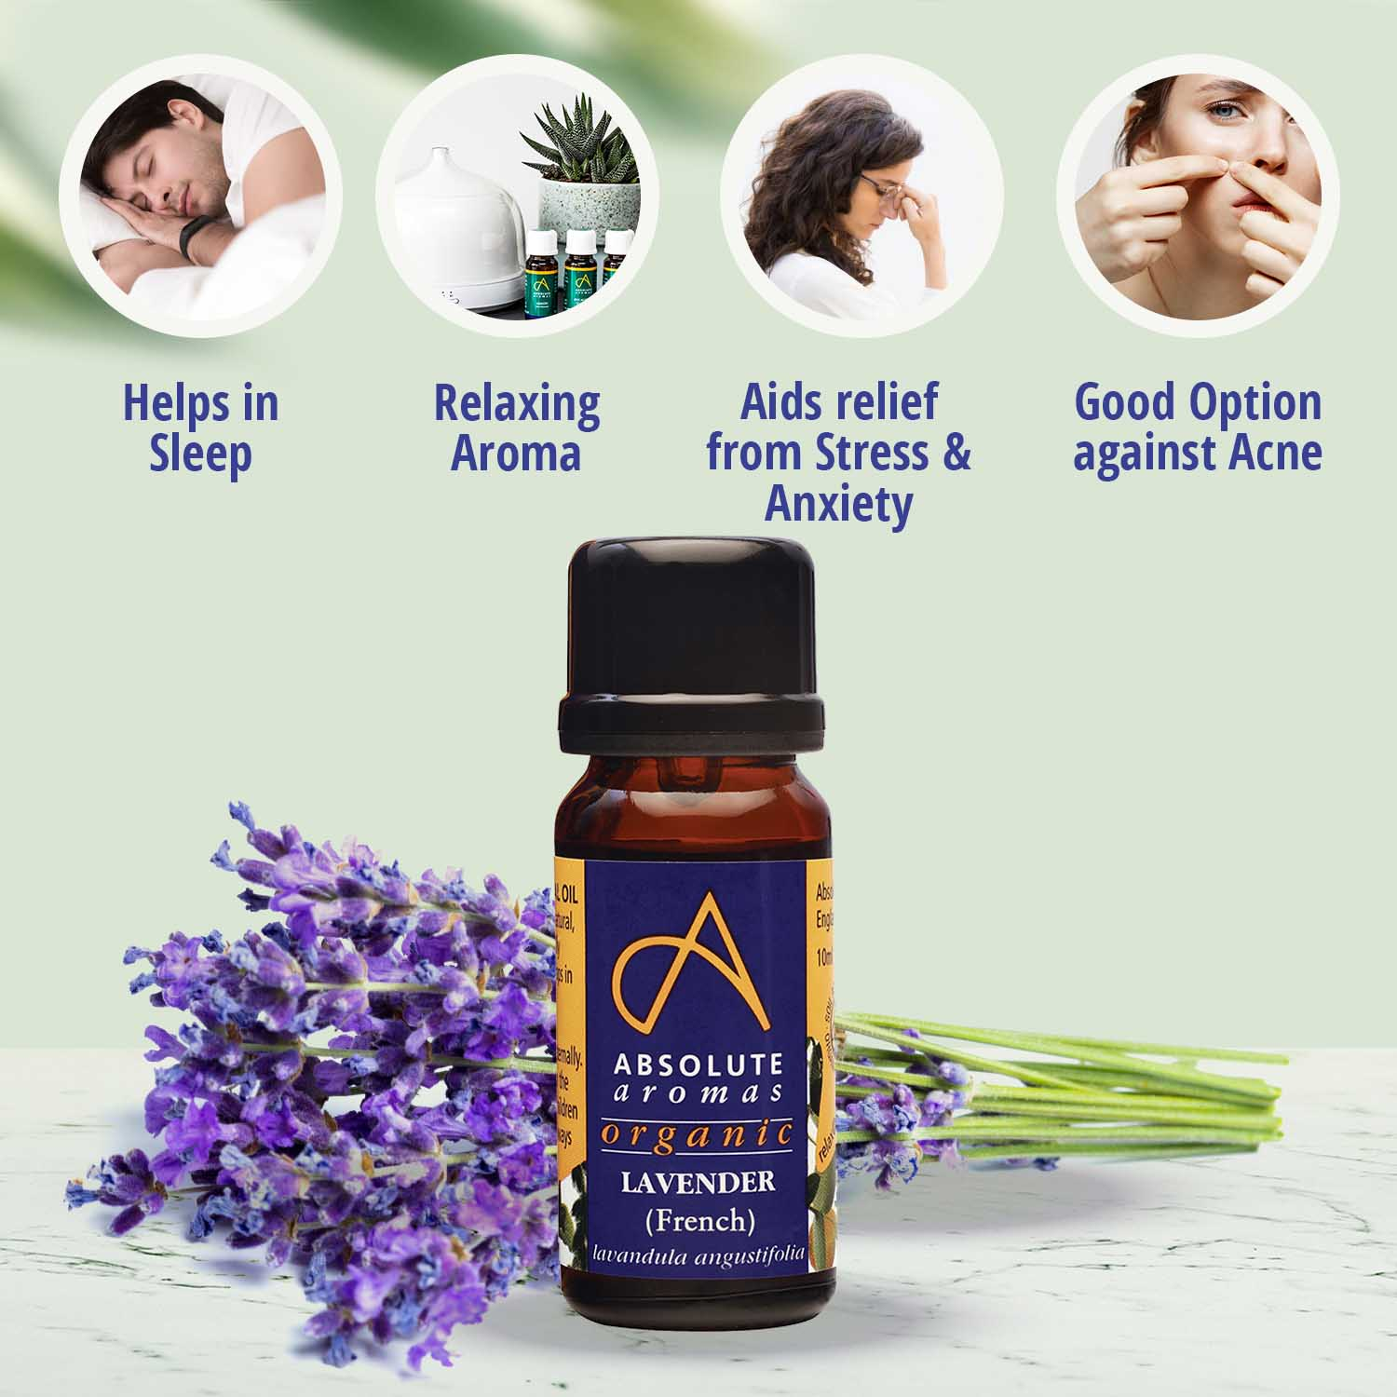
Examples
1. Lavender (Lavandula angustifolia)
Family: Lamiaceae
Main Chemical Constituents: Linalool, linalyl acetate, 1,8-cineole
Uses: Calming and relaxing, promotes sleep, anti-anxiety, anti-inflammatory, and mild antimicrobial properties.

Slide 4
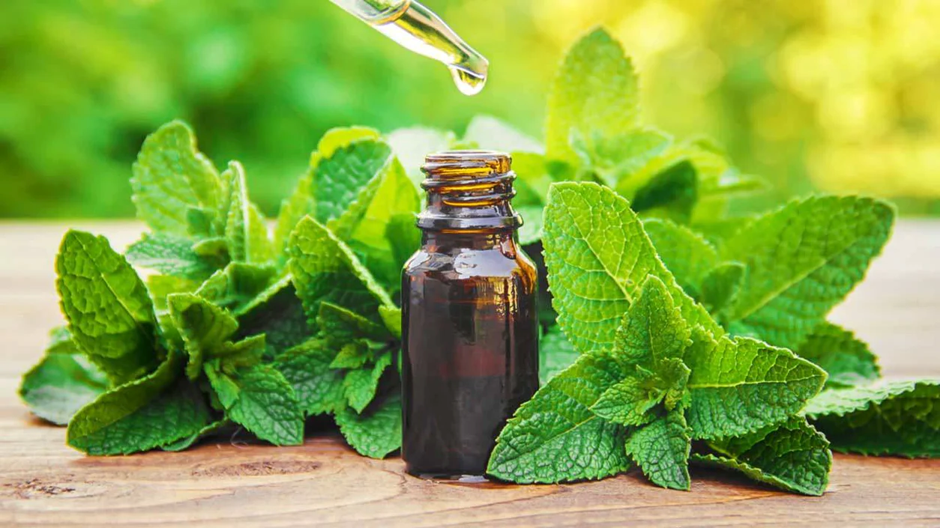
2. Peppermint (Mentha × piperita)
Family: Lamiaceae
Main Chemical Constituents: Menthol, menthone
Uses: Menthol provides a cooling sensation and can help with headaches and respiratory issues., improves focus and concentration, relieves headaches, and anti-nausea, and may aid in digestive issues.

Slide 5
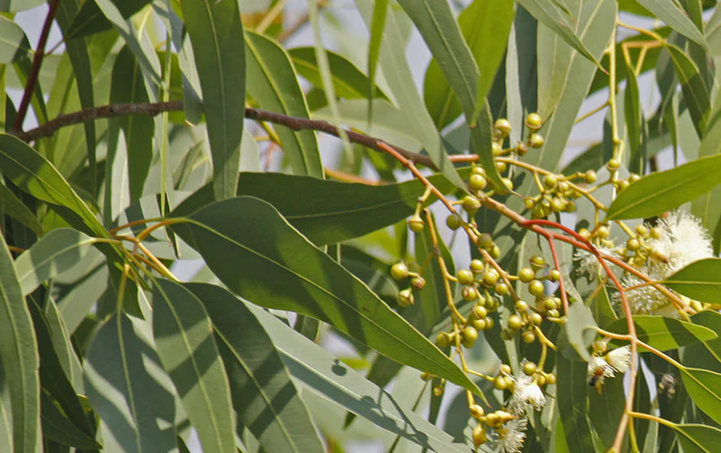
3. Eucalyptus (Eucalyptus globulus, Family: Myrtaceae):
Main Chemical Constituents: 1,8-cineole, alpha-pinene
Properties: 1,8-cineole contributes to eucalyptus oil's decongestant and expectorant effects, making it beneficial for respiratory conditions.

Slide 6
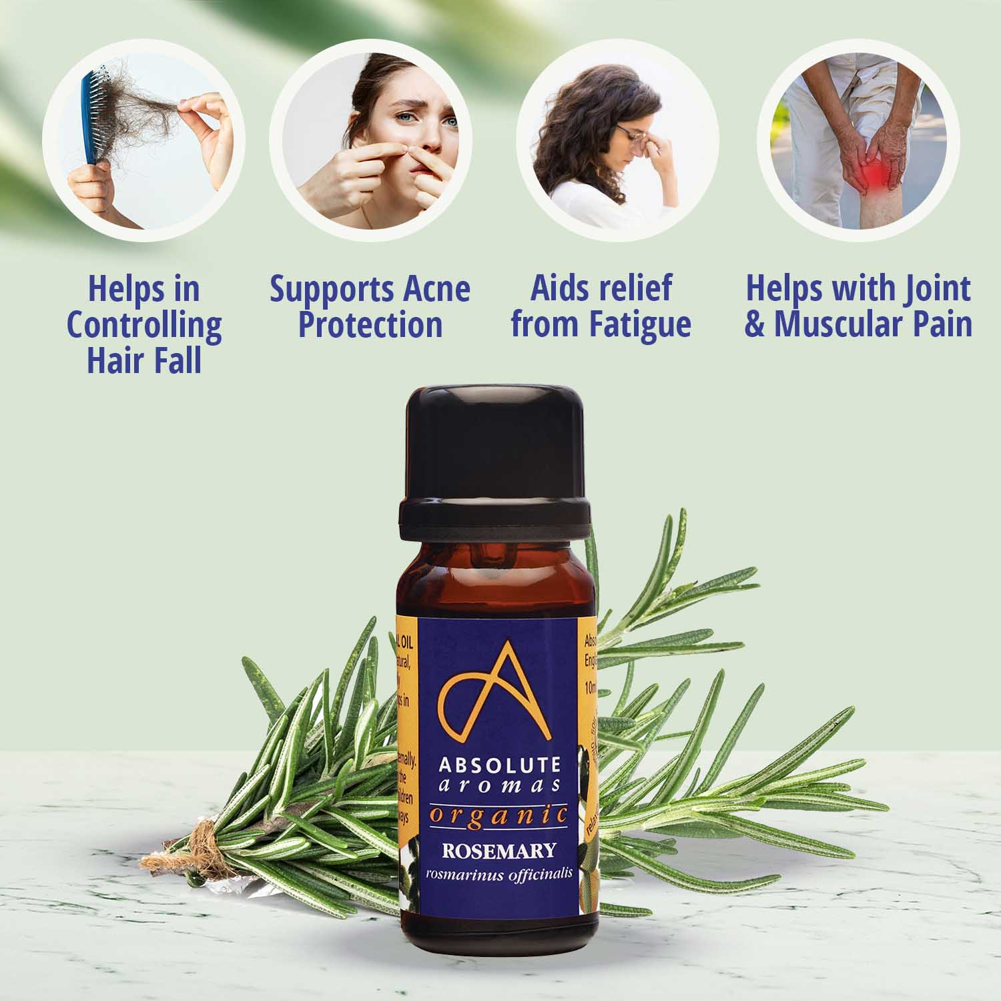
4. Rosemary (Rosmarinus officinalis)
Family: Lamiaceae
Main Chemical Constituants: 1,8-cineole, camphor
Uses: Stimulating, improves concentration and memory, antioxidant, and has potential antimicrobial properties.

Slide 7
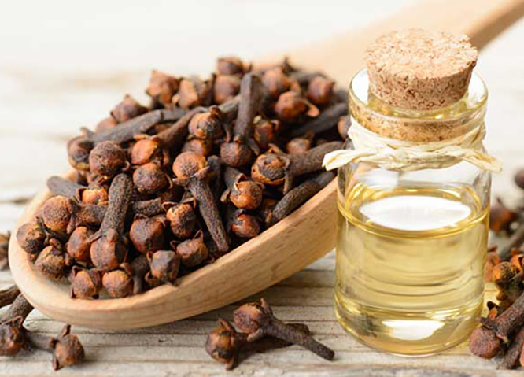
5. Clove (Syzygium aromaticum):
Family: Myrtaceae
Main Chemical Constituents: Eugenol, eugenyl acetate
Properties: Eugenol is known for its analgesic and antimicrobial properties, making clove oil useful for dental issues and pain relief.

Slide 8
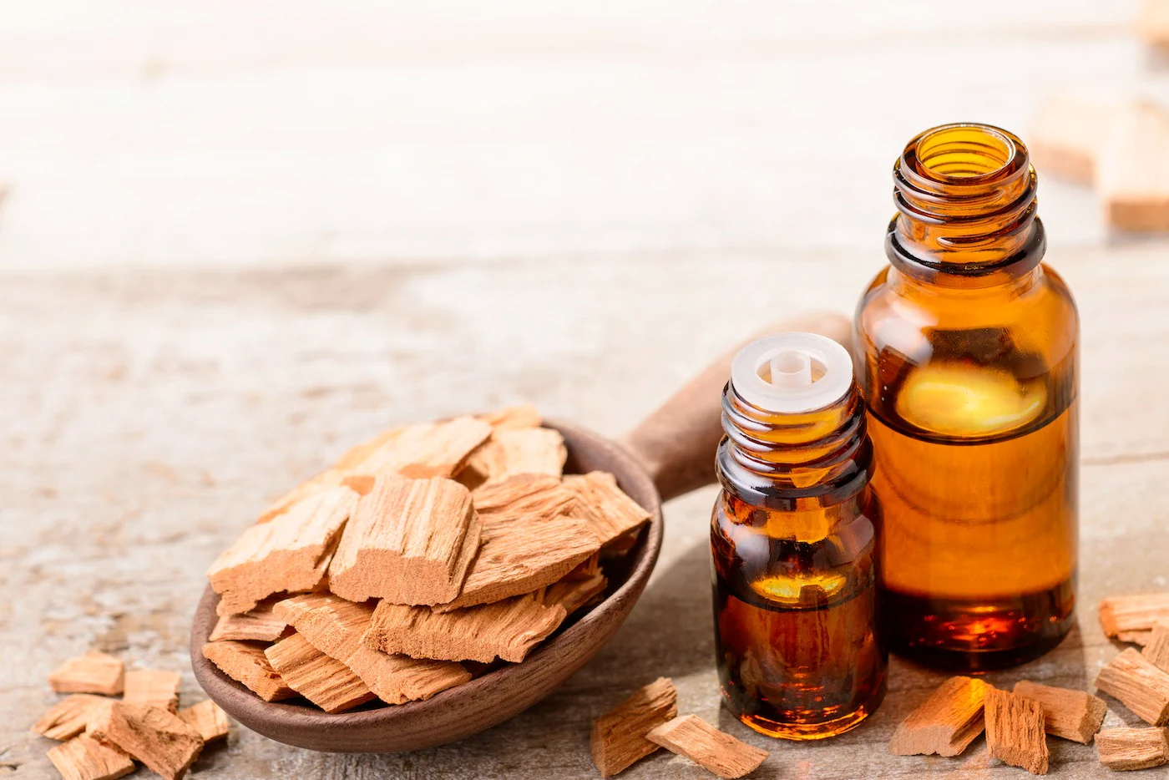
6. Sandalwood (Santalum album)
Family: Santalaceae
Main Chemical Constituents: α-santalol, β-santalol
Properties: Sandalwood oil is known for its calming effects and may have anti-inflammatory and skin-soothing properties.
Uses: Calming, anti-inflammatory, may aid in respiratory conditions, and is often used in skincare.

Slide 9
How does essential oil work in Aromatherapy?
The therapeutic effects of essential oils in aromatherapy are achieved through several mechanisms involving the olfactory system, the limbic system, and the physical properties of the oils. Here's how essential oils work in aromatherapy:
1. Inhalation and Olfactory System:
Detection of Aromas: Essential oils are volatile compounds that release aromatic molecules into the air.
Inhalation: When you inhale the aroma of essential oils, airborne molecules enter the nose and come into contact with the olfactory receptors.

Slide 10
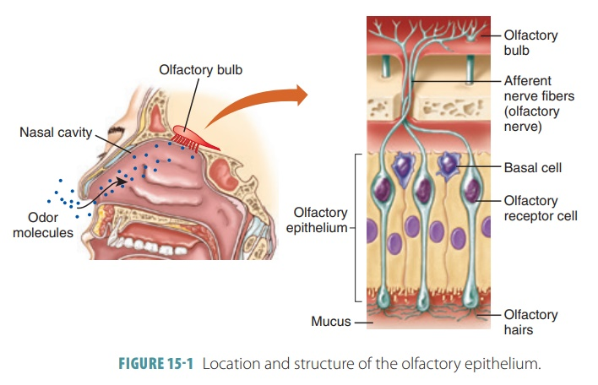
2. Olfactory Receptors and the Olfactory Bulb:
Olfactory Receptors: These specialized cells in the nasal cavity detect and recognize the specific aromatic molecules of essential oils.
Olfactory Bulb: The olfactory receptors transmit signals to the olfactory bulb, located at the base of the brain, which processes and interprets the scents.

Slide 11
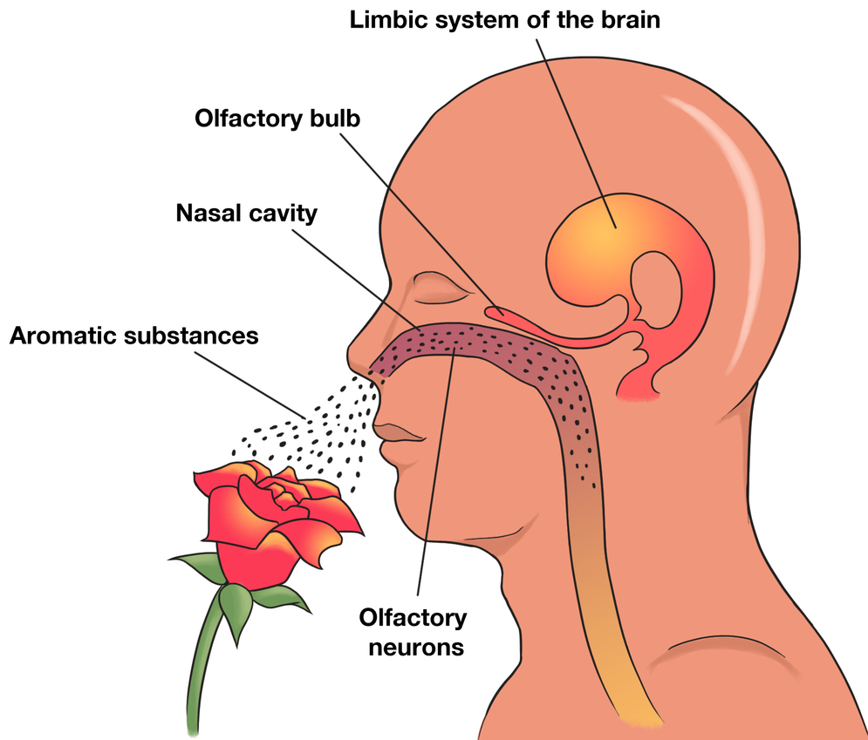
3. Limbic System Activation:
Connection to Emotions and Memory: The olfactory bulb is directly connected to the limbic system, which plays a crucial role in emotions, memory, and certain physiological responses.
Emotional Impact: Essential oil aromas can evoke emotional responses and influence mood through the limbic system. For example, calming oils may reduce stress, while uplifting oils can enhance mood.

Slide 12
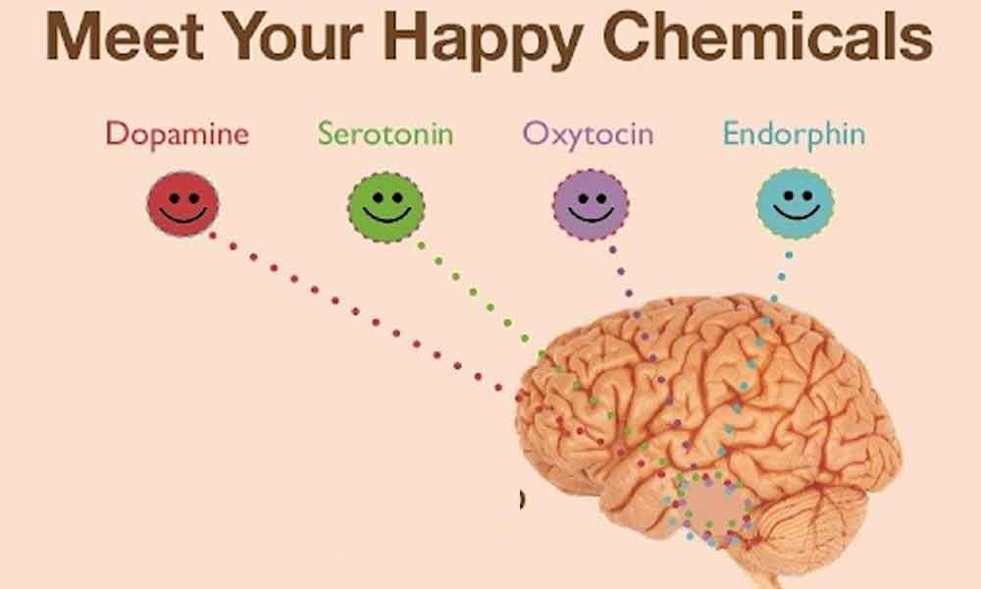
4. Neurotransmitter Release:
Neurotransmitters: Inhalation of essential oil aromas can lead to the release of neurotransmitters like serotonin and dopamine in the brain.
Mood Regulation: These neurotransmitters play a role in regulating mood and emotions, contributing to the overall psychological effects of aromatherapy.
Endorphins are often referred to as "feel-good" neurotransmitters because they act as natural pain relievers and mood enhancers. Oxytocin is often called the "love hormone" or "bonding hormone" because it is released during social interactions, hugs, and positive social experiences. It is also involved in promoting relaxation.

Slide 13
5. Physical Effects:
Absorption through the Skin: In addition to inhalation, essential oils can be absorbed through the skin when applied topically.
Systemic Effects: When absorbed, the active compounds in essential oils may enter the bloodstream and have systemic effects on the body.

Slide 14
6. Therapeutic Properties:
Chemical Constituents: Essential oils contain various chemical constituents, each with its therapeutic properties.
Specific Uses: Different oils are selected for their specific properties to address physical and mental health concerns. For example, eucalyptus oil is chosen for respiratory issues, while lavender is used for relaxation.

Slide 15
7. Stimulation of Physiological Responses:
Anti-Inflammatory and Antimicrobial Effects: Some essential oils possess anti-inflammatory, antibacterial, and antiviral properties, influencing physiological responses in the body.
Respiratory Support: Oils like eucalyptus and tea tree can support respiratory health by clearing congestion and fighting infections.

Slide 16
8. Enhancement of Cognitive Function:
Stimulation: Certain essential oils, such as peppermint and rosemary, are believed to have stimulating effects on cognitive function.
Focus and Concentration: Aromatherapy with these oils may improve alertness, focus, and mental clarity.

Slide 17
9. Creation of Therapeutic Atmospheres:
Diffusion: Essential oils are often diffused into the air using devices like diffusers, creating therapeutic environments in homes, offices, or healthcare settings.
Atmospheric Effects: The aromas contribute to a pleasant and calming atmosphere, promoting relaxation and stress reduction.

Slide 18
What are the benefits of using essential oil in aromatherapy?
Stress Reduction:
Certain essential oils, such as lavender, chamomile, and frankincense, are known for their calming and stress-relieving properties.
Aromatherapy with these oils can help create a relaxing atmosphere, reducing feelings of stress and anxiety.
Improved Sleep and Insomnia Relief:
Essential oils like lavender and bergamot are often used to promote better sleep and alleviate insomnia.
Aromatherapy before bedtime can create a soothing environment, facilitating relaxation and improving sleep quality.

Slide 19
Citrus oils, such as bergamot (Citrus bergamia) and orange, are known for their uplifting and mood-enhancing properties. Aromatherapy with these oils can help improve mood, boost energy, and create a positive atmosphere.
Essential oils like peppermint and rosemary are believed to have stimulating effects on cognitive function. Aromatherapy may enhance focus, concentration, and mental clarity, making it beneficial for tasks that require thinking effort.

Slide 20
Some essential oils, including eucalyptus, peppermint, and chamomile, possess analgesic and muscle relaxant properties. Aromatherapy massages or topical application of these oils may help alleviate pain and tension in muscles and joints.
Eucalyptus, tea tree, and peppermint oils are known for their respiratory benefits. Aromatherapy with these oils can help clear nasal passages, relieve congestion, and support respiratory health.

Slide 21
Peppermint and lavender oils are commonly used in aromatherapy for headache and migraine relief. Inhaling these oils may help alleviate tension and reduce the severity of headaches.
Essential oils like tea tree, lavender, and chamomile are known for their skin-soothing and wound-healing properties. Aromatherapy may contribute to skin health when applied topically in diluted forms.

Slide 22
Clary sage (Salvia sclarea) and geranium (Pelargonium graveolens) essential oils are believed to have hormone-balancing effects. Aromatherapy may be used to ease menstrual discomfort and support hormonal balance.
Ginger, peppermint, and lemon essential oils are commonly used to reduce nausea. Aromatherapy with these oils may be helpful for individuals experiencing nausea or motion sickness.

Slide 23
Risks associated with essential oils
Skin Irritation and Sensitization:
Undiluted essential oils can cause skin irritation, redness, and allergic reactions, especially in individuals with sensitive skin.
It's crucial to dilute essential oils in a suitable carrier oil before applying them to the skin and perform a patch test to check for any adverse reactions.
Phototoxicity:
Certain citrus essential oils, such as bergamot, lime, and grapefruit, can cause skin sensitivity when exposed to sunlight (phototoxicity).
Users should avoid applying phototoxic oils to areas of the skin that will be exposed to sunlight for an extended period.

Slide 24
Risks associated with essential oils
Respiratory Sensitivity:
Some individuals may be sensitive or allergic to certain essential oils when inhaled, leading to respiratory issues, headaches, or nausea.
Caution is advised when using strong oils like eucalyptus or peppermint, especially in enclosed spaces.
Interaction with Medications:
Essential oils can interact with medications, affecting their absorption, metabolism, or effectiveness.
Individuals taking medications should consult with a healthcare professional before using essential oils, especially if they have underlying health conditions.

Slide 25
Risks associated with essential oils
Pregnancy and Breastfeeding:
Pregnant and breastfeeding women should exercise caution when using essential oils, as some oils may pose risks to the developing fetus or nursing infant.
It's advisable to consult with a healthcare provider before incorporating essential oils into a wellness routine during pregnancy or breastfeeding.
Toxicity in Children and Pets:
Some essential oils can be toxic to children and pets, leading to adverse reactions or poisoning.
Oils such as eucalyptus, tea tree, and wintergreen can be particularly harmful. Always keep essential oils out of reach of children and pets.

Slide 26
Risks associated with essential oils
Ingestion Risks:
Ingesting essential oils can be dangerous and should be avoided unless under the guidance of a qualified healthcare professional.
Swallowing essential oils can lead to gastrointestinal issues, toxicity, and adverse effects on internal organs.
Quality and Purity Concerns:
Poor-quality or adulterated essential oils may contain contaminants or synthetic additives, posing health risks.
It's crucial to purchase essential oils from reputable suppliers that provide high-quality, pure products.

Slide 27
Risks associated with essential oils
Overuse and Sensitization:
Prolonged or excessive use of certain essential oils may lead to sensitization, where the body becomes overly responsive to the oil, resulting in adverse reactions.
It's advisable to practice moderation and avoid prolonged, continuous exposure to the same essential oil.
Environmental Sensitivity:
Some individuals may be environmentally sensitive to diffused essential oils, experiencing headaches, respiratory discomfort, or other symptoms.
Proper ventilation and consideration for others in shared spaces are important when using aromatherapy diffusers.

Slide 28
References
Evans, W. C. (2009). Trease and Evans' Pharmacognosy. Elsevier Health Sciences.
Price S, Price L. Aromatherapy for health professionals. 4th Edn., London: Churchill Livingstone; 2011.
Lis-Balchin M. Aromatherapy Science: A guide for healthcare professionals. London: Pharmaceutical Press; 2006

Slide 29
Thank You

