Slide 1
General Reminders!!
All deadlines must be met!
Phones, any electronic = count as absent, and deduct from your total average.
Sleeping in class = Count as absent
Participation is highly recommended as it will greatly contribute to your final Mark
Don’t ask for absence permission- this is dealt with by the HoD !!

Slide 2
Course Evaluation Criteria
Throughout the spring semester 10% is graded on your quizzes.
Homework which will be explained later is 5% of your total grades.
A mind map/diagram-summary of each bacteria will be (individual based) activity with 5% of your total grades- you will each receive your subjects later.
Midterm Exam is based on 30% including variety of question types: (True-False, MCQ, Blanks, Reasoning, Short answers, assay questions, Diagrams…etc.)
Presentation 10%.
Final Exam 40%.

Slide 3
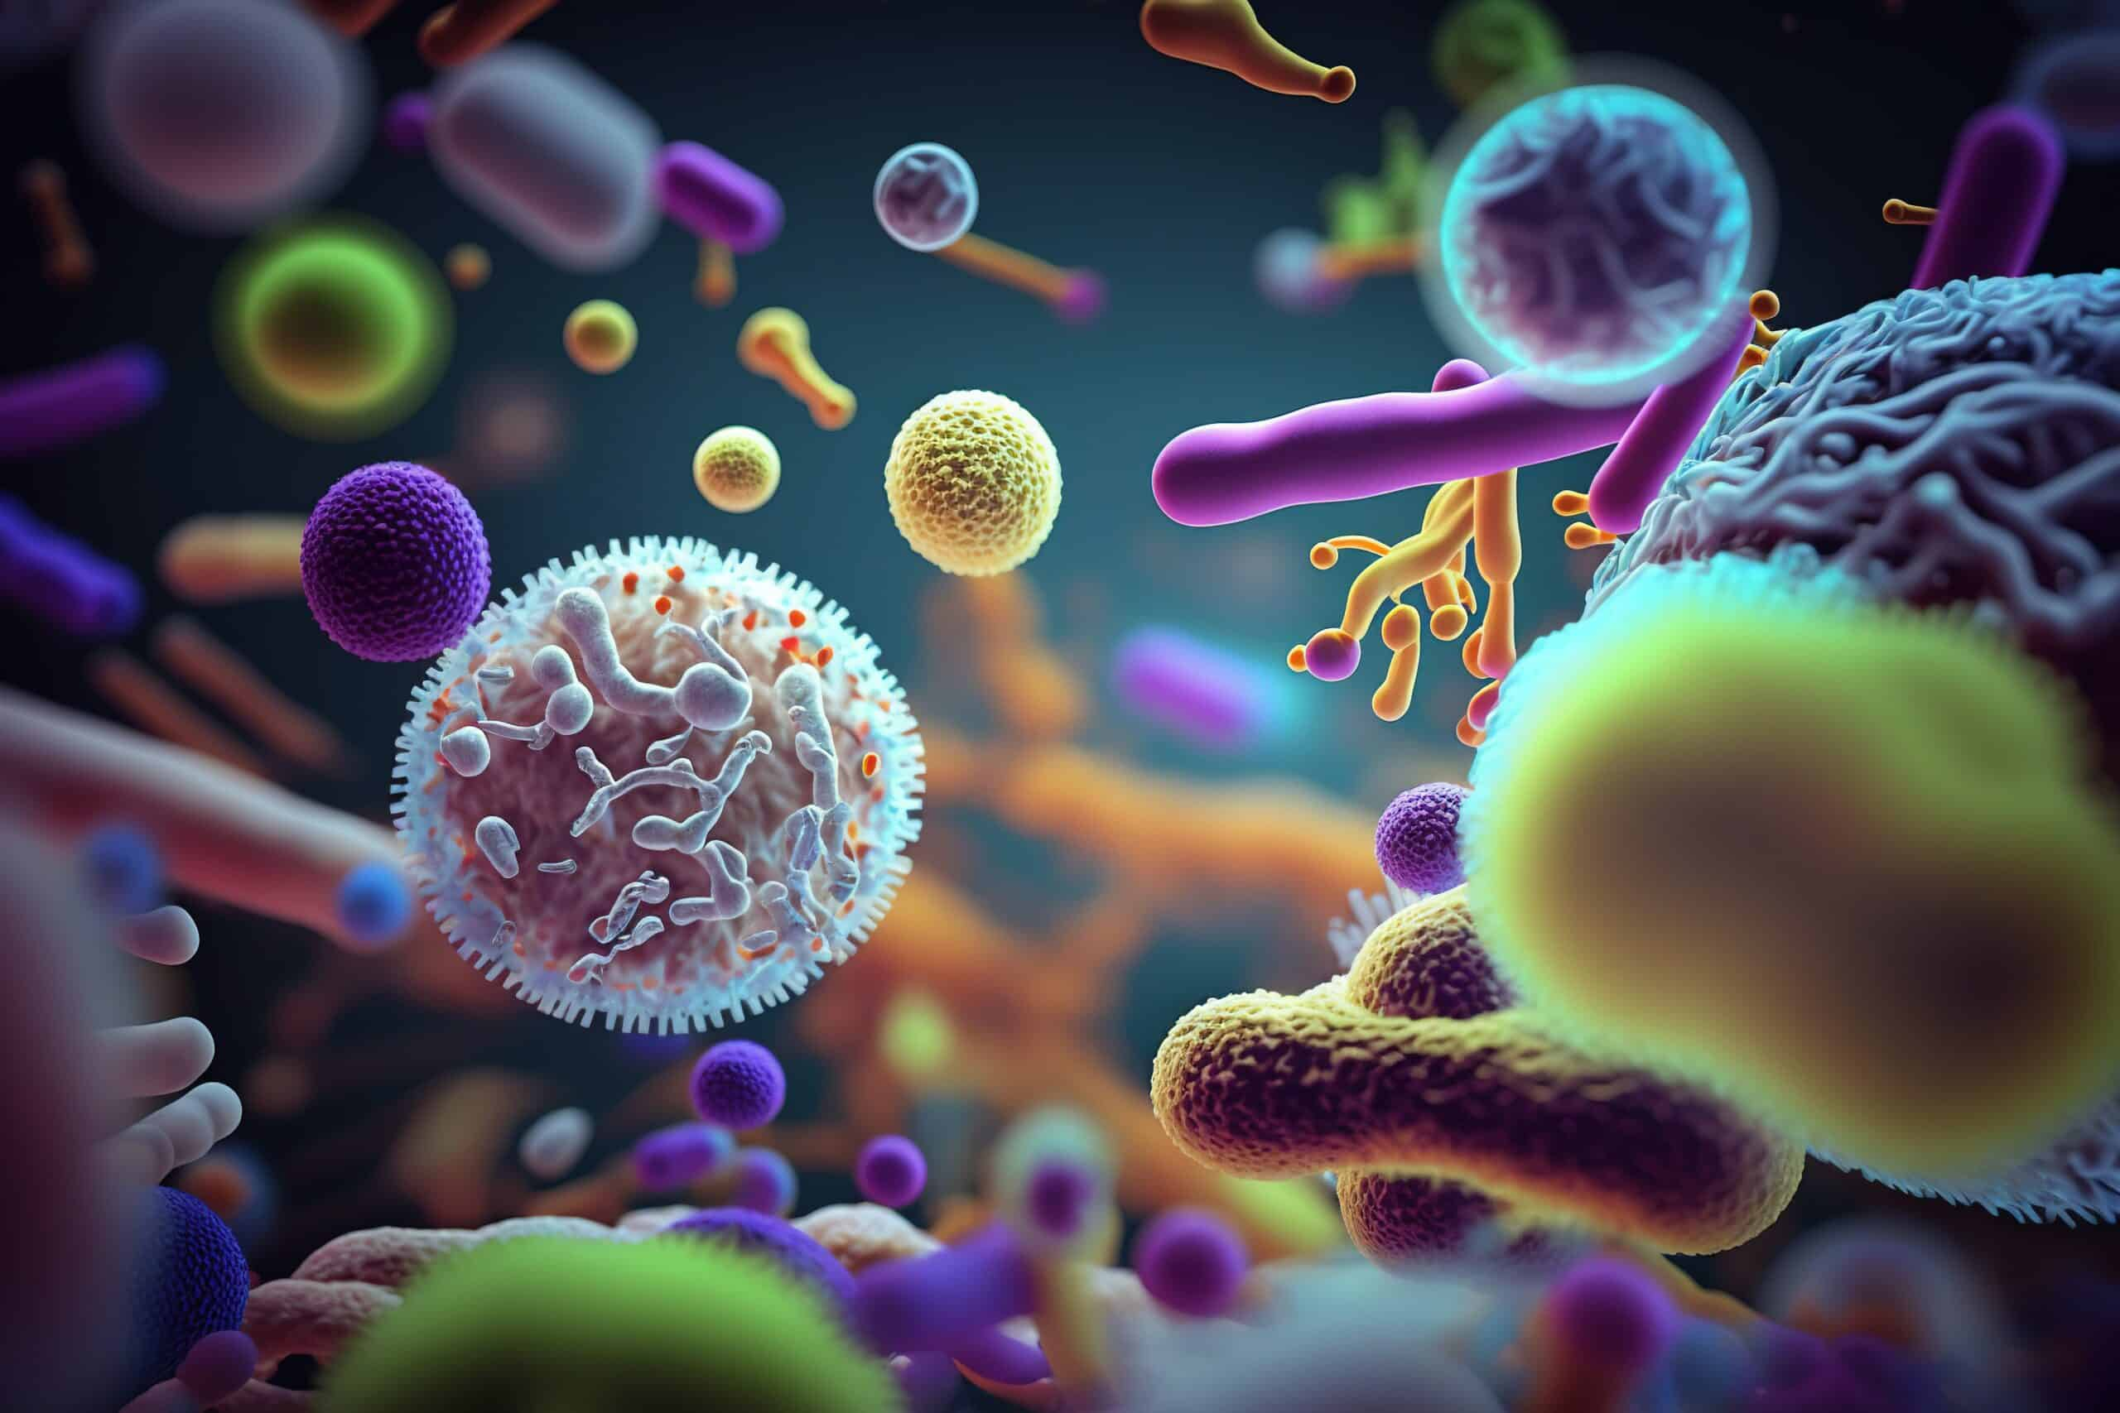

Bacteria-Basic concepts
Ms. Heshu J. Ahmed
Medical Bacteriology 423
Spring Semester
Week one

Slide 4
Overview
Bacteria are the smallest and most versatile independently living cells.
This Lecture examines the structural, metabolic, and genetic features that contribute to the ubiquity and diversity of this large group of microorganisms.
The discussion which follows focuses on the characteristics of the tiny sliver of the bacterial world which causes disease in humans.

Slide 5
Objectives
The goal is to provide the background and vocabulary fundamental to understanding how bacterial pathogens deploy their structural and metabolic products to confound the immune system and produce injury to the human hosts they invade

Slide 6
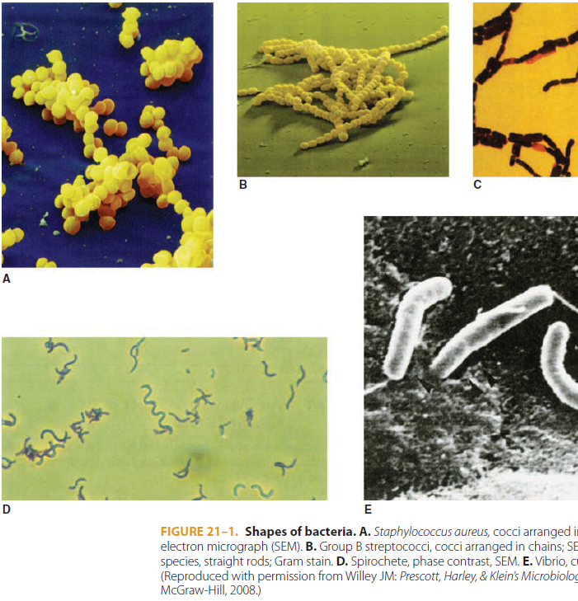
Introduction
Bacteria are the smallest and most versatile independently living cells.
The major morphologic forms are spheres, rods, bent or curved rods, and spirals
Spherical or oval bacteria are called cocci (singular: coccus) and are typically arranged in clusters or chains.
Rods are called bacilli (singular: bacillus) and may be straight or curved.
Bacilli that are small and pleomorphic to the point of resembling cocci are often called coccobacilli.
Spiral-shaped bacteria may be rigid or flexible and undulating.

Slide 7
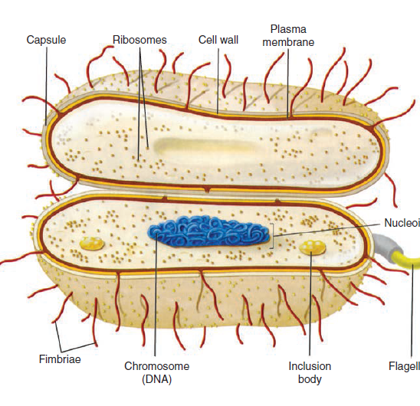
Bacterial Structure
Bacterial cells consist of two main parts: the outer layer and the inside core.
The outer layer like; Envelope and other appendages.
The inside core contains the genetic material (nucleoid) and the working substance called cytoplasm.

Slide 8
Bacterial Structure cont.
The cytoplasm is similar to that of eukaryotic cells, but because there is no nucleus it is not clearly separated from the genetic material.
Bacterial cells have the essential macromolecules of life: DNA, RNA, proteins, carbs, and phospholipids.
in addition to some macromolecules unique to bacteria such as the peptidoglycan and lipopolysaccharide found in bacterial cell walls.

Slide 9
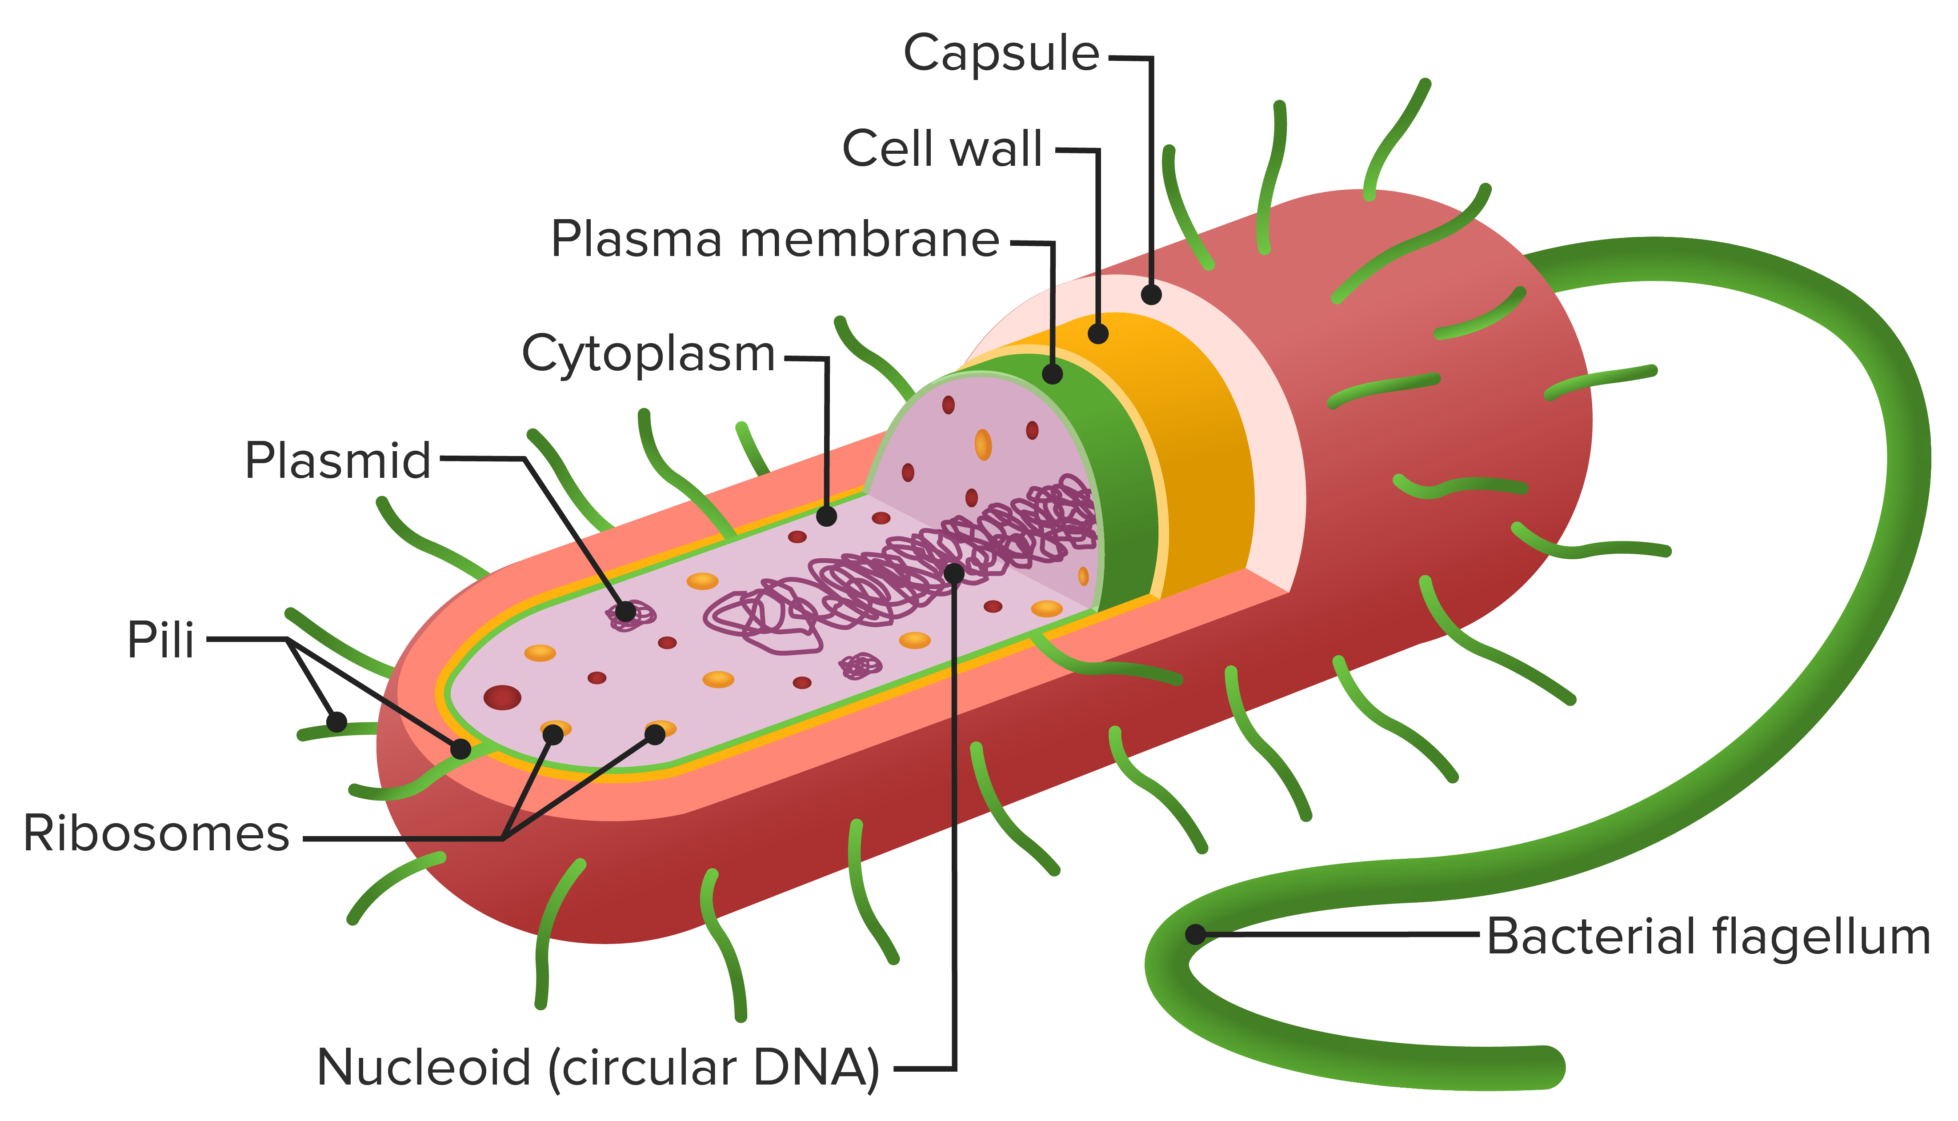
ENVELOPE AND APPENDAGES
the envelope not only protects the cell against chemical and biological threats in its environment but is also the location for many metabolic processes
Structures in the envelope and certain appendages also mediate attachment to human cell surfaces, the first step in disease.

Slide 10
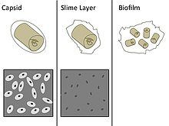
Capsule
Many bacterial cells surround themselves with a hydrophilic gel.
If the material forms a reasonably discrete layer, it is called a capsule;
if it is amorphous (loosely organized and less structured), it is called a slime layer.
Most capsules are polysaccharides made of single or multiple types of sugar residues.
but some bacteria like Bacillus anthracis have protein-based capsules (poly-D-glutamate).
Capsules provide some general protection for bacteria, but their major function in pathogenic bacteria is protection from the immune system.

Slide 11
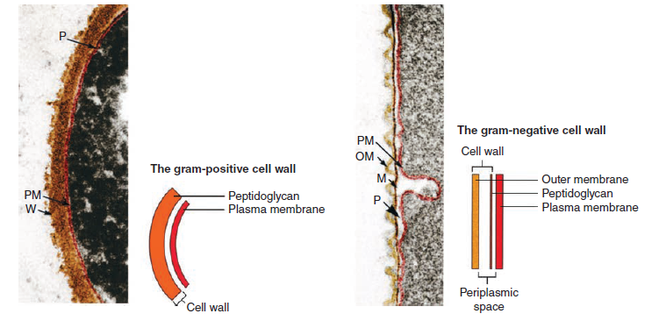
Cell Wall
Internal to the capsule (if one exists) but still outside the cell.
a rigid cell wall surrounds all bacterial cells except wall-less bacteria such as mycoplasmas and Chlamydia.
This wall protects the cell from mechanical disruption and bursting caused by the pressure resulting from the hypertonicity of the cell interior relative to the environment.
It also provides a barrier against certain toxic chemical and biologic agents. Its form is responsible for the shape of the cell.
while still permitting the rapid exchange of nutrients and metabolic byproducts required for rapid growth.

Slide 12
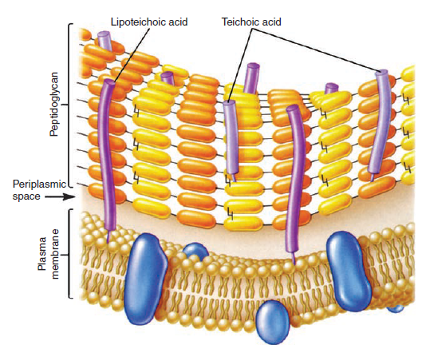
Gram-positive Cell Wall
The gram-positive cell wall contains two major components, peptidoglycan and teichoic acids, plus additional carbohydrates and proteins, depending on the species.
Peptidoglycan consists of a linear glycan chain of two alternating sugars, N-acetylglucosamine (NAG) and N-acetylmuramic acid (NAM)
Adjacent glycan chains are cross-linked by peptide bonds between peptide amino acids side chains.
The peptidoglycan sac derives its great mechanical strength from the fact that it is a covalently bonded structure.
Most enzymes found in mammalian hosts and other biologic systems do not degrade peptidoglycan; one important exception is lysozyme, the hydrolase in tears and other secretions, which cleaves the bonds between muramic acid and glucosamine residues.

Slide 13
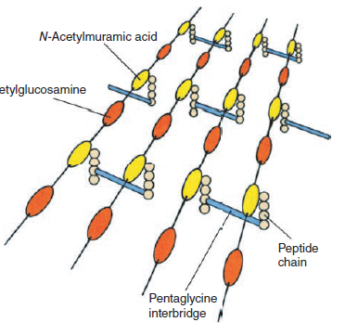
Gram-positive Cell Wall
A second component of the gram-positive cell wall is teichoic acid. These compounds are polymers of either glycerol phosphate or ribitol phosphate, with various sugars.
A type of teichoic acid called lipoteichoic acid and appears to play a role in anchoring the wall to the cell membrane and as an epithelial cell adhesin.

Slide 14
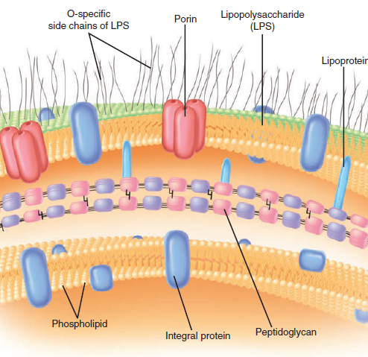
Gram-negative Cell Wall
In gram-negative cells, the amount of peptidoglycan has been greatly reduced, in a periplasmic space.
Outside this periplasm is an outer membrane.
The proteins in solution in the periplasm consist of enzymes with hydrolytic functions, sometimes antibiotic-inactivating enzymes, and various binding proteins with roles in chemotaxis and in the active transport of solutes into the cell.

Slide 15
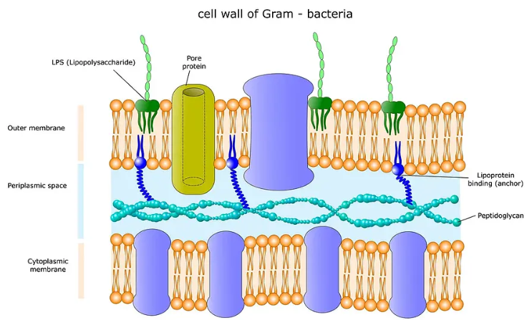
Gram-negative Cell Wall - Outer membrane:
The bacterial outer membrane like eukaryotic membranes with two layers of phospholipids and proteins. Yet, its chemical composition is biologically unique.
The inner layer contains regular phospholipids, while the outer layer has lipopolysaccharide (LPS), known as endotoxin, which is highly toxic to humans and animals.
Even in small amounts, such as the amounts released to circulation during the course of a gram-negative infection, this substance can produce a fever and shock syndrome called gram-negative or endotoxic shock.
Special structural proteins, called porins, form pores through the outer membrane that make it possible for hydrophilic solute molecules to diffuse through it and into the periplasm.

Slide 16
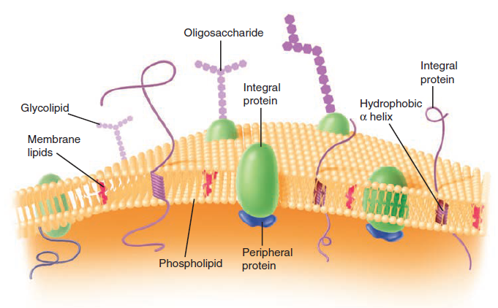
Cell Membrane
Generally, the cell (plasma) membrane of bacteria is similar to the familiar bilayer membrane of most cells.
However, there are important differences. The bacterial cell membrane is exceptionally rich in proteins and does not contain sterols (except mycoplasmas).
It contains the entire electron transport system of the cell.
It contains receptor proteins that function in chemotaxis.

Slide 17
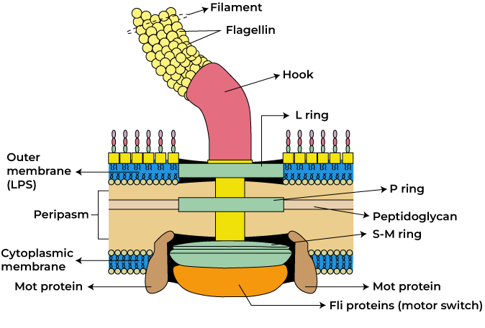
Flagella
Flagella are molecular organelles of motility found in many species of bacteria, both gram-positive and gram-negative.
They may be distributed around the cell, at one pole or at both ends of the cell
The presence or absence of flagella and their position are important taxonomic characteristics.
The flagellar apparatus is complex but consists entirely of proteins attached to the cell by a basal body consisting of several proteins organized as rings on a central rod.

Slide 18
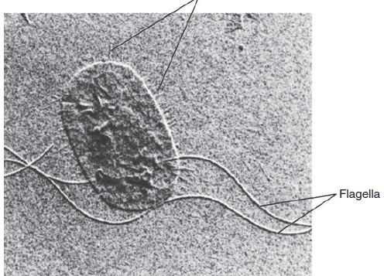
Pili
Pili (also called fimbriae) are hair-like projections found on the surface of cells of many gram-positive and gram-negative species.
They are composed of molecules of a protein called pilin arranged to form a tube with a small, hollow core.
There are two general classes, common pili and sex pili.
Up to a thousand common pili cover the surface of the cell, They are, in many cases, adhesins, which are responsible for the ability of bacteria to colonize surfaces and cells.
Some pili are specialized for adherence to certain cell types such as enterocytes or uroepithelial cells. That why some strains are tissue specific.
The sex pilus is involved in the exchange of genetic material between some gram-negative bacteria.

Slide 19
Cytoplasm
It is densely packed with ribosomes, which are much more abundant than in the cytoplasm of eukaryotic cells. This is a reflection of the higher growth rate of bacteria
The bacterial cytoplasm has a cytoskeleton which localizes proteins, participates in cell division, and along with the cell wall peptidoglycan, gives shape to the cell.
In the bacterial cell the microfilaments are made from actin and the microtubules from tubulin.

Slide 20
Nucleoid
The nucleoid is a region of the cytoplasm which contains the genome and a collection of related proteins.
The bacterial genome resides on a single chromosome and bacterial pathogens contains between 600 and 6000 genes encoded in one large, circular molecule of double-stranded DNA.

Slide 21
Plasmids
Many bacteria contain small, usually circular, double-stranded DNA molecules separate from the chromosome.
Plasmids typically contain up to 30 genes and replicate independent of the chromosome.
They are unlikely to contain genes essential for survival of the cell but may have specialized genes such as those mediating virulence or resistance to antimicrobial agents. In fact, many attributes of virulence including, production of pili and exotoxins.

Slide 22
References
Sherris Medical Microbiology: An Introduction to Infectious Diseases.
Jawetz, Melnick & Adelberg's Medical Microbiology by Geo. F. Brooks, Karen C. Carroll, and Janet S. Butel
Prescott's Microbiology by Joanne Willey, Linda Sherwood, and Christopher J. Woolverton

