Slide 1
Tishk International University
Faculty of Applied Science
Medical Technical Radiology
General Physics
1-Electricity
First Grade- 2024-2025
Instructor: Prof. Dr. Ronak T. Ali

Slide 2
Notes:
Physics in Radiological Imaging
Physics forms the backbone of the technologies used in radiology to produce medical images. Key areas include:

Slide 4
Notes:
Electricity is a type of energy that consists of the movement of electrons between two points when there is a potential difference between them, making it possible to generate what is known as an electric current.
Let’s see a practical example to understand it better. What happens when we turn on the light switch? The electrical circuit is closed, connecting the first point to the second. The electrons start to move through the metallic copper wire (the conductive element), and we immediately have light. The circulation of electrons through the conductor wire is transformed into electric ligh

Slide 17
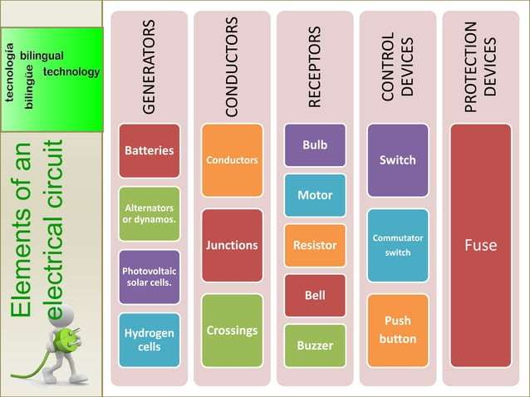

Slide 19
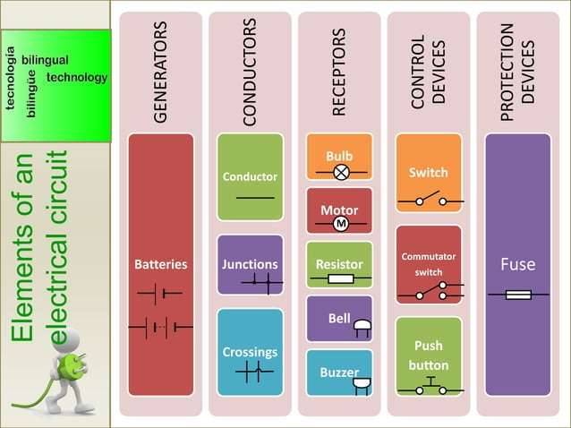

Slide 23
Notes:
Resistance is the opposition to current flow in a circuit. The unit of resistance is the ohm and the symbol is the omega (W). There are four
factors which affect the amount of resistance in a circuit:
1. Conductive material
2. Length of conductor
3. Cross-sectional diameter
4. Temperature

