Slide 1

Case studies on SERUM URIC ACID level
Dr. Jaafaru Sani/Tolaz Kadhim
Advance Clinical Biochemistry II (MA 416)
Spring Semester
Week three
19/02/2024

Slide 2

Outlines
• Definition of case study
Advantages of case study
Case one and its response
Case two and its response

Slide 3

Objectives
At the end of this lesson, the students should be able to:
Understand the concept and aim of case studies.
Study carefully and interpret clinical and laboratory-based potential cases.
Make sense of the case(s) and provide potential, meaningful and relevant solution(s)

Slide 4

Introduction
Case study has been described as an intensive, systematic health-wise investigation of a single individual, group, or community.
It could even be an investigation of other units that the scientist (expert) examines.
Case studies are also a record of clinical interactions which help us to frame questions for more rigorously designed clinical studies.

Slide 5
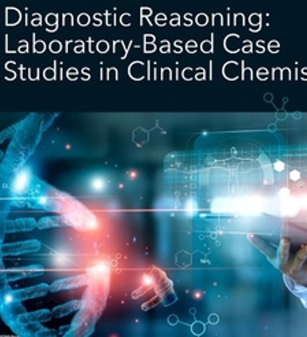
Advantages
Ability to see a relationship between phenomena, context, and people in health care delivery.
Flexibility to collect data through various means and make sense of it.
Ability to capture the context of participants and present it in real-life situations.
Flexibility to be used at various points in a health care service delivery, including clinical pilot research.

Slide 6
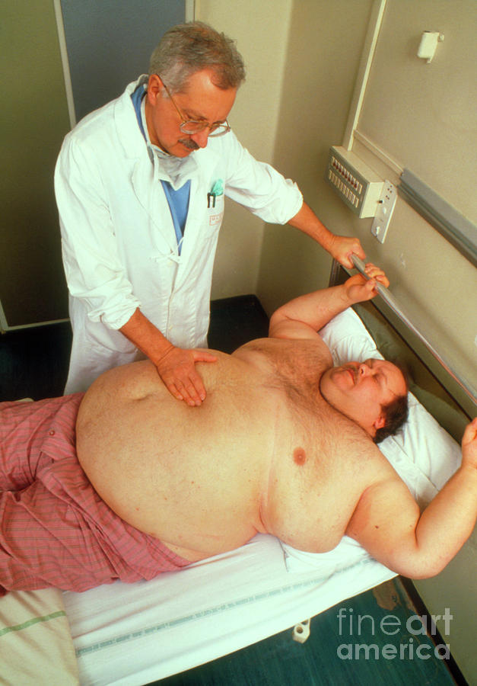

Case 1
A 48‐year‐old manager was admitted with severe gassy pain in his lower left lumbar region and associated history of haematuria. He was overweight with a blood pressure of 165/105. Serum lipids on the admission showed triglyceride of 5.2 mmol/L (high). Total cholesterol of 7.2 mmol/L (high) and an HDL cholesterol of 0.8 mmol/L. (low). Serum calcium was normal, but the uric acid was 0.75 mmol/L.

Slide 7
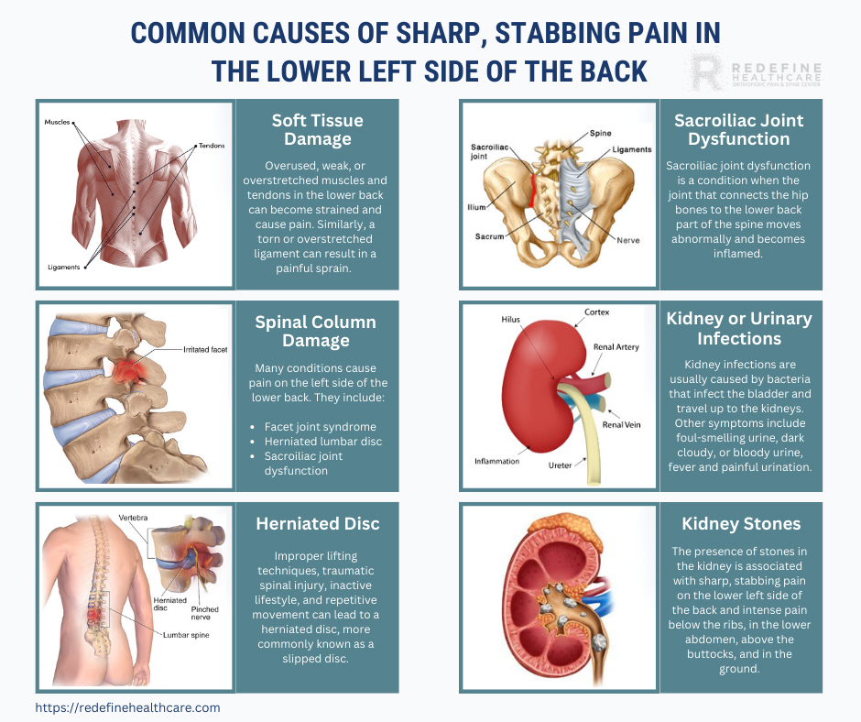
Cont.
Further questioning revealed an episode of severe pain in the joint of his left foot while holidaying in Spain.
This was treated while abroad and resolved after a few days, but he could not remember what treatment had been given.
What are the possible complications the man is suffering from?
What is the likely cause of this man’s condition?

Slide 8
Response to the case
The clinical history here, together with the high serum urate level, all point towards the diagnosis of primary gout.
The joints are the common body parts involved in chronic gout attacks.
The acute joint pain coincides with his holiday period.
Possibly he overindulges in alcohol and protein-rich foods that may well have precipitated the initial episode (hematuria).

Slide 9
Cont.
The high serum urate is likely to be longstanding and has led to the formation of renal stones.
A history of severe lumbar pain, colicky in nature and associated with hematuria, is classical for renal colic.
Where possible, examination of any stones passed or removed should be undertaken to confirm that these are composed of uric acid.
There is a known association of gout with hyperlipidemia, particularly a raised triglyceride.
Gout is associated with hypertension and obesity.

Slide 10

Case 2
During authorizing clinical results before release to the wards. The clinical biochemist on duty was surprised to find a serum uric acid level that was extremely low (undetectable on the lab analyzer). Initially, she felt that it was an analytical error and asked for the result to be repeated, again, the result was the same after the repeat. She rang up the hematology ward to discuss this result with the Specialist Registrar. Where she was told that the patient had acute lymphoblastic leukemia which was being actively treated.
Can you suggest a likely explanation for this finding?

Slide 11

Response to the case
It turned out that the patient had acute lymphoblastic leukemia which was being actively treated.
In anticipation of possible problems arising from the excessive formation of urate (as a consequence of massive cell lysis), the patient was on treatment with rasburicase.
Rasburicase is a genetically engineered urate oxidase (uricase) that converts uric acid to water‐soluble allantoin.

Slide 12

Cont.
The drug is used to treat hyperuricemia in adults and children with leukemia, lymphoma, or other cancer types who are receiving therapy.
Recall that uric acid is a natural substance that can build up in the blood as tumors break down.
The drug is so effective that could reduce the serum urate to virtually undetectable levels.
Thus, the laboratory finding was a correct analytical result.

Slide 13


