Slide 1

Estimation of Serum bilirubin
Dr. Jaafaru Sani/Tolaz Kadhim
Advance Clinical Biochemistry II (MA 416)
Spring Semester
Week Four
26/02/2025

Slide 2

Objectives
At the end of this lesson, the students should be able to:
Understand the concept of bilirubin metabolism and associated disorders
Understand the principle behind the bilirubin test.
Understand the step-by-step procedure for determination of serum bilirubin.

Slide 3
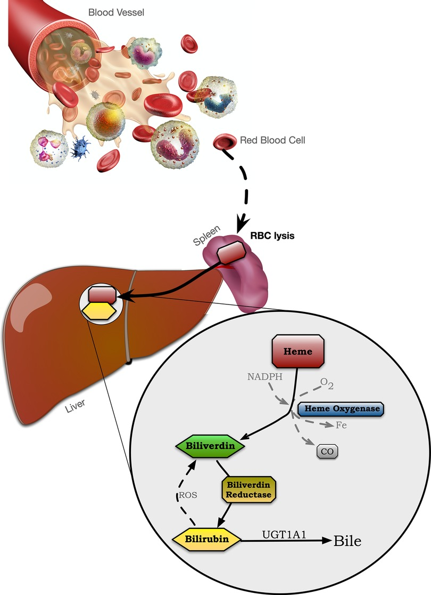
Introduction
Bilirubin is a yellowish molecule found in bile.
It is made during the normal body process of RBC breaking down.
It is produced when heme molecules of hemoglobin break down in the spleen and are mainly secreted into stool and urine.

Slide 4
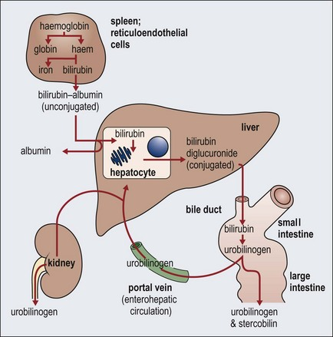
Cont.
Bilirubin is responsible for the coloration of stools and urine.
Elevated levels of serum bilirubin indicate certain diseases.
A healthy liver removes most of the bilirubin from the body in conjugated form.

Slide 5
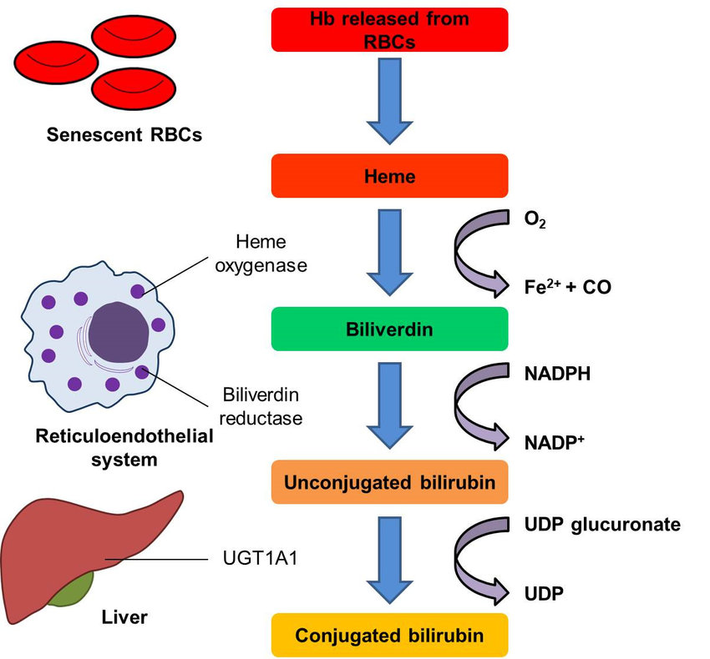
Cont.
It is produced in the form of a water-insoluble molecule (unconjugated) and transported to the liver along with albumin.
The liver converts unconjugated to conjugated bilirubin by adding a sugar molecule known as glucuronate through a glucuronidation reaction.

Slide 6
Types of Bilirubin:
Total Bilirubin:
direct bilirubin + indirect bilirubin
Indirect bilirubin:
Unconjugated bilirubin (water insoluble, produced in the spleen)
Direct Bilirubin:
Conjugate (water soluble, converted in the liver).

Slide 7
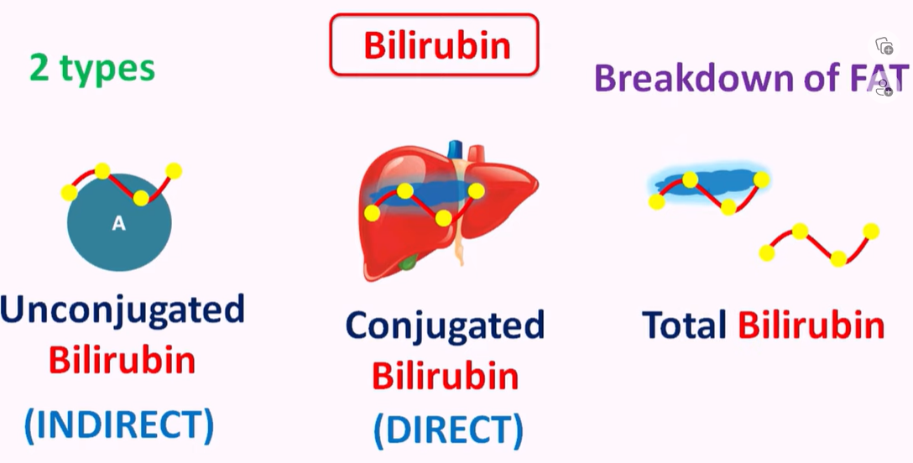

Slide 8
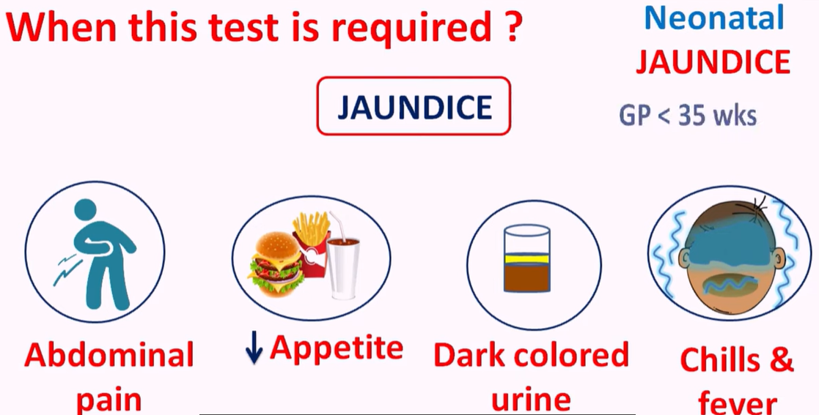

Slide 9
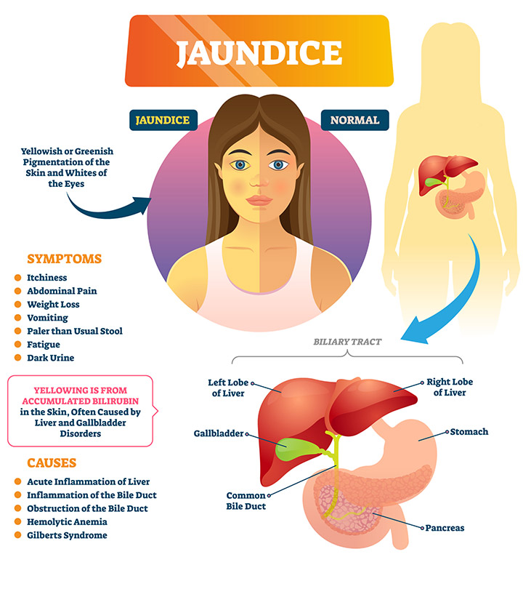

Slide 10
Principle
Bilirubin reacts with diazo reagent to produce azobilirubin.
Azobilirubin is purple colored compound.
Intensity of color is proportional to amount of bilirubin in serum.
Reactions:
Direct Reaction
Involve direct or conjugated bilirubin
The reaction occurs in an aqueous medium
Indirect Reaction
Carried out in methyl alcohol.
Methyl alcohol solubilizes unconjugated bilirubin.

Slide 11
Reagents
R1 (Total Bilirubin)
Sulfanillic acid 30 mmol/L
DMSO 7 mol/L
Hydrochloric acid 130 mmol/L
R2 (Direct Bilirubin)
Sulfanillic acid 30 mmol/L
Hydrochloric acid 130 mmol/L
R3 (Total and Direct Bilirubin)
Sodium Nitrite 0.74 mmol/L

Slide 12
Procedure
Total Bilirubin Direct Bilirubin
Reagent/Tubes | Assay tube (µL) | Blank tube (µL)
R1 | 1000 | 1000
R3 | 50 | -
dH₂O | - | 50
Serum sample | 100 | 100
Reagent/Tubes | Assay tube (µL) | Blank tube (µL)
R2 | 1000 | 1000
R3 | 50 | -
dH₂O | - | 50
Serum sample | 100 | 100
Measure the Absorbance at 550 nm immediately after adding the serum sample

Slide 13
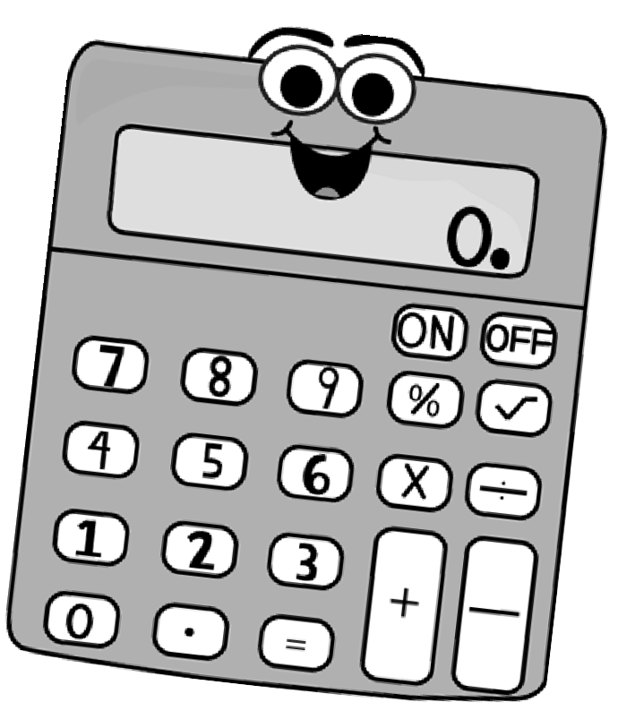



Calculations
Conc. (mg/dL) =
𝑨𝒃𝒔𝒐𝒓𝒃𝒂𝒏𝒄𝒆 𝒐f sample -
𝑨𝒃𝒔𝒐𝒓𝒃𝒂𝒏𝒄𝒆 𝒐𝒇 Blank
× 11.4
11.4 is a standard factor under the condition that absorbance was taken in a cuvette of 1 cm path length, at 550 nm wavelength and 37°C

Slide 14
Normal Range
Total bilirubin (5 days – 60 years) =
0.3 – 1.2 or 0.2 – 1.0 (> 60 years) mg/dL
Direct bilirubin (5 days – 90 years) =
<0.2 mg/dL

Slide 15


