Slide 1
PHARMACOLOGY
Khder Hussein Rasul
Pharmacology, MA 411
Spring Semester
First week
04/02/2025

Slide 2
TISHK International University
Department of Medical Analysis
Subject: Pharmacology
Grade: 4th Stage
Lecturer's name-Khder Hussein Rasul
Academic Year: 2024/2025

Slide 3
Department: Medical Analysis
Course name: Pharmacology
Lecturer: Khder Hussein Rasul
Contact: e-mail: khder.rasul@tiu.edu.iq
Time (in hours) per week: 4hr./ week

Slide 4
Course overview
This course provides understanding of pharmacology, including
Drug classifications
Mechanisms of drug action
Pharmacokinetics
Pharmacodynamics
Drug interactions.

Slide 5
The Course keywords
Pharmacokinetics
Pharmacodynamics
Drug metabolism
Bioavailability
Half-life
Clearance
Drug-receptor interaction

Slide 6
Student's obligation
Exam policy:
Student should take exam during the course
Classroom polices:
1. Attendance: students are strongly encouraged to attend in class on a regular basis, as participation is important to understanding of the material. This is students opportunity to ask questions. Students are responsible for obtaining any information during the class which provided.
2. Lateness: Lateness to class is disruptive
3. Electronic devices: Not allowed to use in the class.
4. Talking: During class, please refrain from side conversations. These can be disruptive to your fellow students

Slide 7
Course objectives
Understand fundamental pharmacological principles, including drug absorption, distribution, metabolism, and excretion.
Classify drugs based on therapeutic use, mechanism of action and chemical properties.
Explain the mechanisms of drug action and their effects on the human body.
Recognize adverse drug reactions, contraindications, and the importance of pharmacovigilance.
Describe the pharmacology of key drug classes, including antibiotics, cardiovascular drugs, analgesics, and chemotherapy agents.
Interpret laboratory data related to drug monitoring and toxicology.

Slide 8
My expectation
Participate in discussions
Let me know when you experience problems, so I have a chance to assist you
Respect classmates and instructor

Slide 9
You can expect of me
Knowledge and expertise
Effective communication
Accessibility and availability
Respect for diversity
Make scientific environment
Listen to your ideas
Quick response to your inquiries
Assessment and feedback

Slide 10
Topics
Introduction to pharmacology
Pharmacokinetics
Pharmacodynamics
Autonomic nervous system pharmacology
Cardiovascular pharmacology
Antimicrobial agents
Endocrine and metabolic pharmacology
Hematological and chemotherapy drugs
Toxicology and drug safety
Drug Interactions and clinical pharmacology

Slide 11
Teaching methods
Using power point
White board
Scientific animations during teaching time

Slide 12
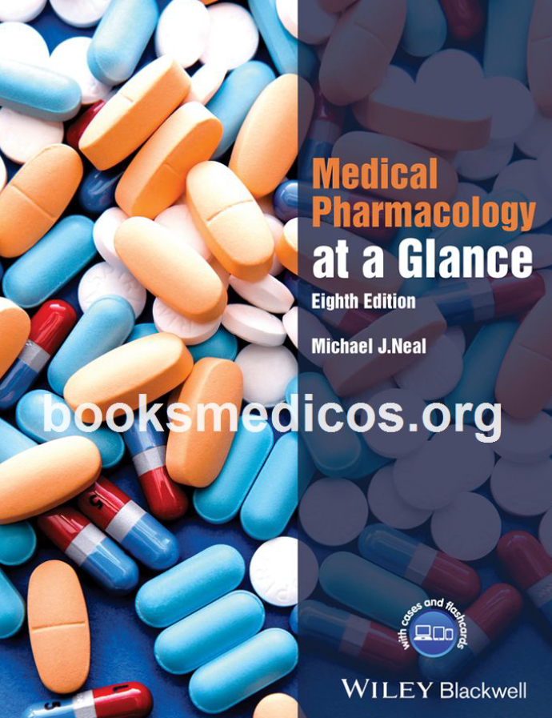
References

Slide 13
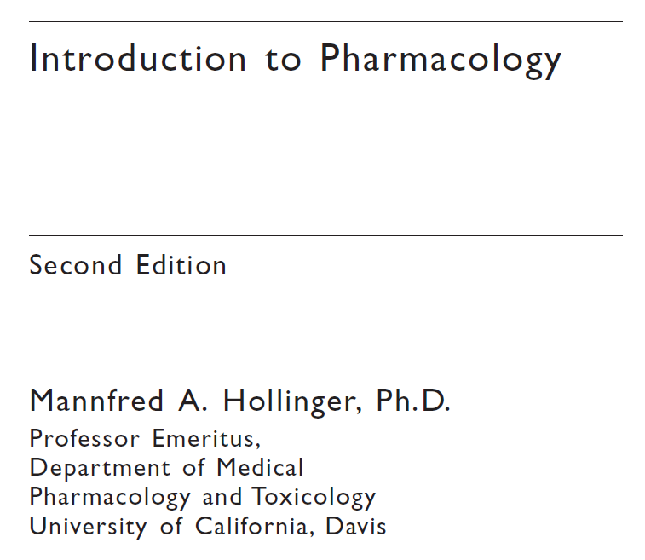
References

Slide 14
Questions
What are the four main processes of pharmacokinetics?
What are the main routes of drug administration?
Which organ is primarily responsible for drug metabolism?
What is the difference between an agonist and an antagonist?
What does the term "potency" mean in pharmacology?
A ……………… is any substance that alters physiological functions when introduced into the body.
The primary organ responsible for drug excretion is the ………………
A drug that binds to a receptor and activates it is called an ……………… (agonist, antagonist).
The class of drugs used to relieve pain is called …………………
The …………………. is the ratio of a drug’s toxic dose to its effective dose.

