Slide 1
Pharmacokinetics (drug absorption)
Khder Hussein Rasul
Pharmacology, MA 411
Spring Semester
Third week
18/02/2025

Slide 2
Outline
Pharmacokinetics
Drug absorption

Slide 3
Objectives
At the end of the lesson, the students should be able to understand:
Methods od frug movement through biological membrane
Factors affecting drug absorption
Routes of drug administration & absorption
Bioavailability and factors affecting drugs bioavailability

Slide 4
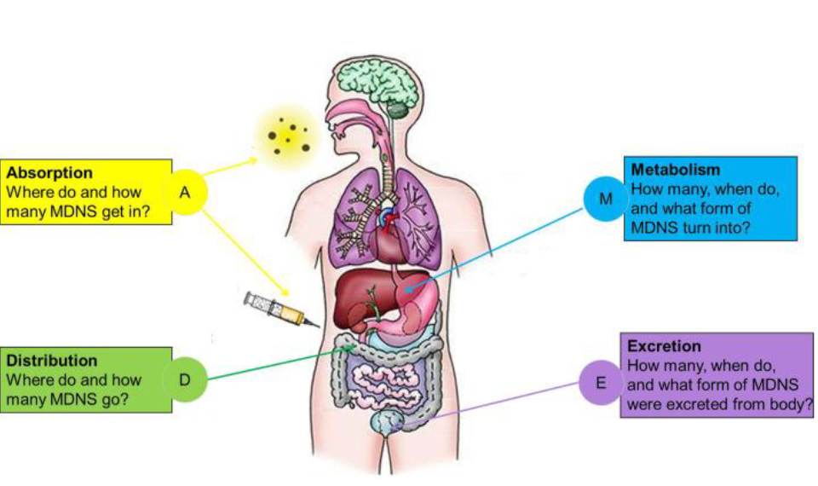
Pharmacokinetics (PK)
Pharmacokinetics (PK) is the study of how drugs move through the body over time.
It involves four main processes:
Absorption (How the drug enters the bloodstream)
Distribution (How the drug spreads throughout the body)
Metabolism (How the body modifies the drug)
Excretion (How the drug is eliminated from the body)

Slide 5
Absorption
Absorption: is the process by which a drug moves from its site of administration into the bloodstream.
All administered drugs go to bloodstream and get distributed to reach their action sites
The rate at which a drug reaches its site of action depends on
Rate of absorption
Rate of distribution.
In fact, the absorption is the transportation of the drug across the biological membranes.
To reach its site of action, a drug must cross a number of biological barriers and membranes, predominantly lipid.

Slide 6
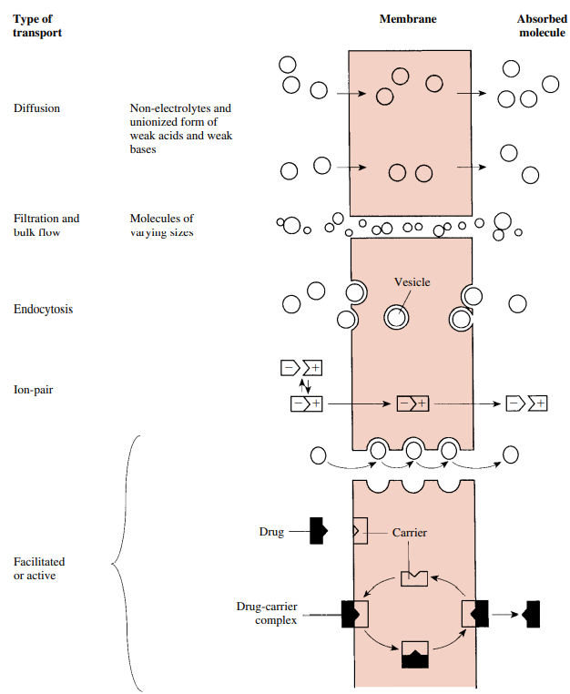
Absorption
There are different mechanisms for a drug to be transported across a biological membrane:
Simple diffusion
Facilitated diffusion
Pinocytosis

Slide 7
Simple diffusion
The major role for the transportation of the drugs across the cell membrane is simple (passive) diffusion.
The substances move across a membrane according to a concentration gradient.
The concentration gradient is the factor that determines the route and rate of the diffusion.
No energy is required.
There is no special transport (carrier) protein.
The concentration gradient and the lipid solubility of the drug are the two main factors that determine the diffusion rate (speed) of the drug.

Slide 8
Facilitated diffusion
Occurs by the carrier proteins.
Net flux of drug molecules is from the high concentration to low concentration.
No energy is required.
Saturable.

Slide 9
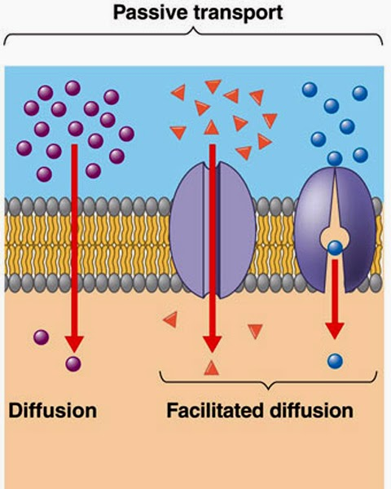
Simple and facilitated diffusion

Slide 10
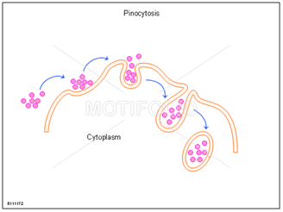
Pinocytosis
The drugs which have MW over 900 can be transported by pinocytosis.
It requires energy.
The drug molecule holds on the cell membrane and then surrounded with plasma membrane and inserted into the cell within small vesicles.

Slide 11
Factors affecting drug absorption
Drug related factors
Molecular size (If the molecular size increases, absorption rate decreases)
Lipid solubility (Lipid-soluble drugs cross membranes easily)
Concentration of the drug
Degree of ionization
Dosage form
Chemical nature (Salt/organic forms, crystal forms, solvate form etc.)

Slide 12
Factors affecting drug absorption
B) Site of application related factors
Blood flow at site of application: if the blood flow is high at the site of application, it causes an increase in absorption rate.
Area of absorption: If the surface area that allows the absorption of the drug molecules is wide, then absorption rate from that surface becomes high.

Slide 13
Routes of drug administration & absorption
A) Enteral routes (through the GI Tract)
Oral
Sublingual
Rectal
B) Parenteral routes
Intravenous (IV)
Intramuscular (IM)
Subcutaneous (SC)

Slide 14
Routes of drug administration & absorption
C) Other routes of administration
Inhalation
Topical (Skin & Mucous Membranes

Slide 15
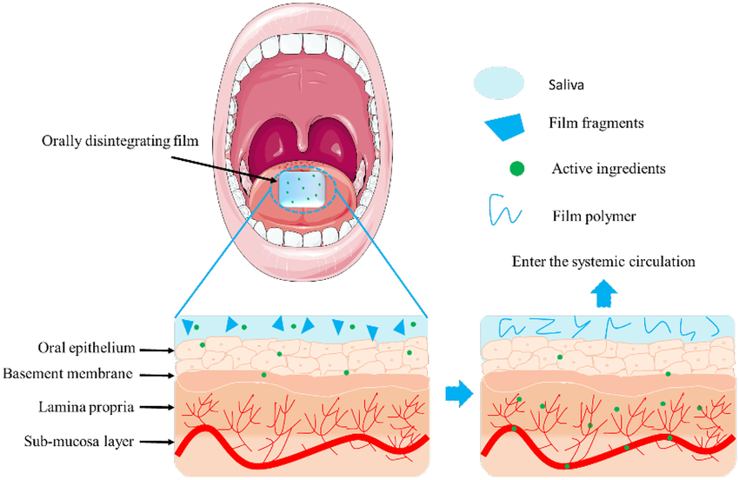
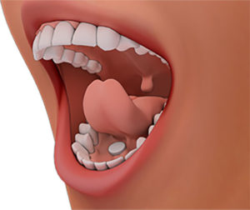
Enteral routes (through the GI Tract)
Absorption from the Alimentary Tract
Oral Cavity and Sublingual Absorption:
Drugs absorbed from the oral cavity enter the general circulation directly. Diffusion process is very rapid for un-ionized drugs.
The oral mucosa is highly vascularized and its epithelial lining is quite thin.
Drug absorption from the oral cavity is limited due to the slow dissolution rate.

Slide 16
Enteral routes (through the GI Tract)
Absorption from the Alimentary Tract
Oral Cavity and Sublingual Absorption:
Advantages:
Rapid absorption.
Avoids first-pass metabolism.
Disadvantages:
Limited drug types (only lipophilic, small molecules).
Unpleasant taste for some drugs.

Slide 17
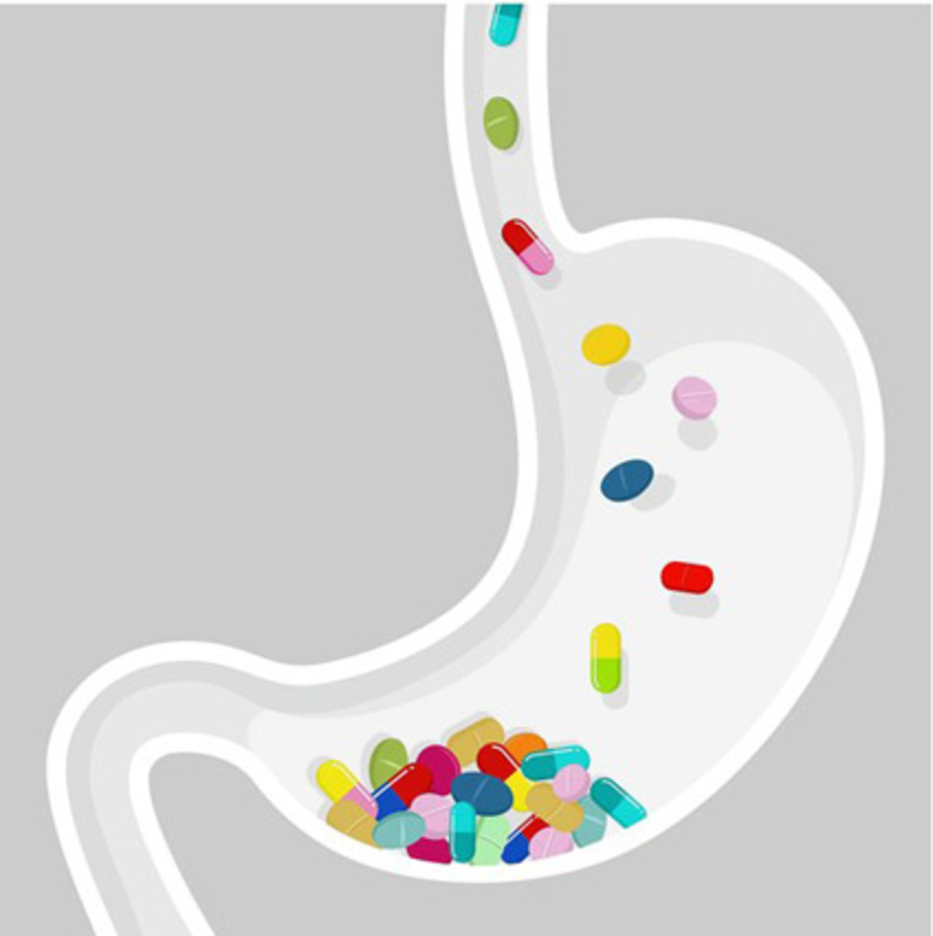
Absorption from the Stomach
The rich blood supply and the contact of stomach contents with epithelial lining of the gastric mucosa provide a potential site for drug absorption.
Many variables can alter stomach emptying time making the extent of gastric absorption vary from patient to patient.
The low pH of the gastric contents (pH 1–2) may have consequences for absorption because it can affect the degree of drug ionization.

Slide 18
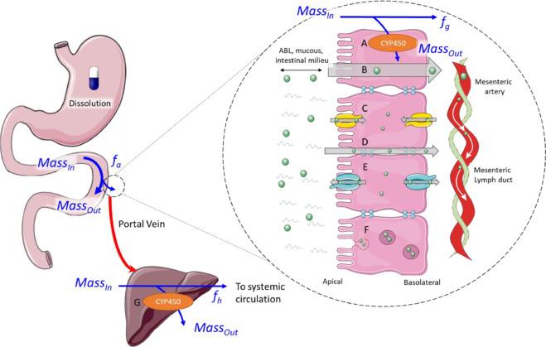
Absorption from the Small Intestine
The epithelial lining of the small intestine consists of many villi and microvilli and has a complex supply of blood vessels into which drugs are absorbed.
The small intestine, with its large surface area and high blood perfusion rate, has a greater capacity for absorption than does the stomach.
Most drug absorption occurs in the proximal jejunum, & the predominant process for most drug absorption is through diffusion.

Slide 19
Absorption from the Large Intestine
The large intestine has a considerably smaller absorptive surface area than the small intestine.
The most distal portion of the large intestine, the rectum, can be used directly as a site of drug administration.
Although the surface area available for absorption is not large, absorption can still occur, owing to the extensive vascularity of the rectal mucosa.
Drugs absorbed from the rectum largely escape the biotransformation to which orally administered drugs are subject.

Slide 20
Absorption from Parenteral routes
Intramuscular and Subcutaneous (IM & SC):
IM and SC injections - most common parenteral drug administration.
Drug absorption generally is more rapid via IM than SC.
Drug absorption from IM and SC sites depends on
The quantity and composition of the connective tissue
The capillary density in the area.

Slide 21
Absorption from Parenteral routes
Intravenous (IV) Administration:
IV drug administration ensures immediate pharmacological response.
Problems of absorption are circumvented because the entire quantity of the drug enters the vasculature directly (useful for poorly absorbed drugs).
The rate of injection should be slow enough to prevent excessively high local drug concentrations & termination of undesired effects.
A serious disadvantage of IV drug administration becomes clearly apparent when an overdose is inadvertently given.

Slide 22
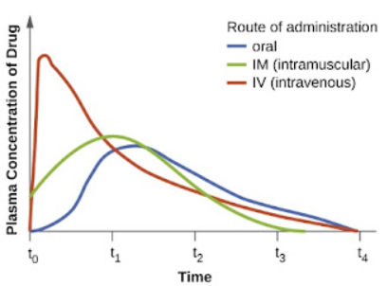
Routes of drug administration & absorption

Slide 23
Absorption from the Lung
The lungs serve as a major site of administration for a number of agents given for both local and systemic effects.
Such drugs can be inhaled as gases (volatile anesthetics) or as aerosols (suspended liquid droplets or solid particles).
Absorption of agents from the lung is facilitated by the large surface area of the pulmonary alveolar membranes.
Pulmonary absorption of volatile anesthetics across the alveolar-capillary barrier is very rapid because of the relatively high lipid–water partition coefficients.

Slide 24
Absorption of Drugs through the Skin
Most drugs that have been incorporated into creams or ointments are applied to the skin for their local effect.
If penetration of the skin by lipid-insoluble compounds does occur, it is probably accomplished by diffusion through the hair follicles, sweat glands, or sebaceous glands

Slide 25
Bioavailability of Drug
Bioavailability refers to the fraction (percentage) of an administered drug that reaches the systemic circulation in its active form.
Types of bioavailability are as follows:
Absolute Bioavailability: When the route of administration is IV, the Bioavailability achieved will be 100%. And If the reference standard is an IV dose, it is referred to as absolute BA.
Relative Bioavailability

Slide 26
Factors affecting Drugs Bioavailability
State of the drug (solution, suspension, or solid form)
Particle Size (small size have higher surface area)
Route of administration (Parenteral route “100% Bioavailable”)
Plasma protein binding (when binds to the drug, BA increases) compare to free drugs
Dosage form (Solution>Suspension>Powder>Tablets>Capsules)
GIT flora (the drug administered via oral route has decreased BA)
Disease Status (severe reoccurring disease decreases BA of a drug)

