Slide 1

Anterior pituitary and prolactin
Zhikal O. Khudhur
Endocrinology BIO 414
Spring Semester
Week number: 4
Date: 2/ 2024

Slide 2

Objectives
Pituitary glands
Anterior and posterior pituitary glands
Anterior and posterior pituitary gland hormones
Anterior and posterior pituitary gland hormone's target tissues
Anterior and posterior pituitary gland hormone's function
Anterior and posterior pituitary gland hormone’s regulation

Slide 3
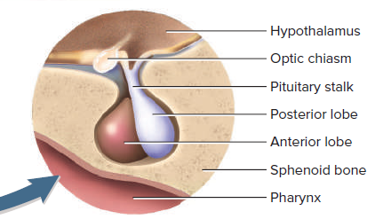
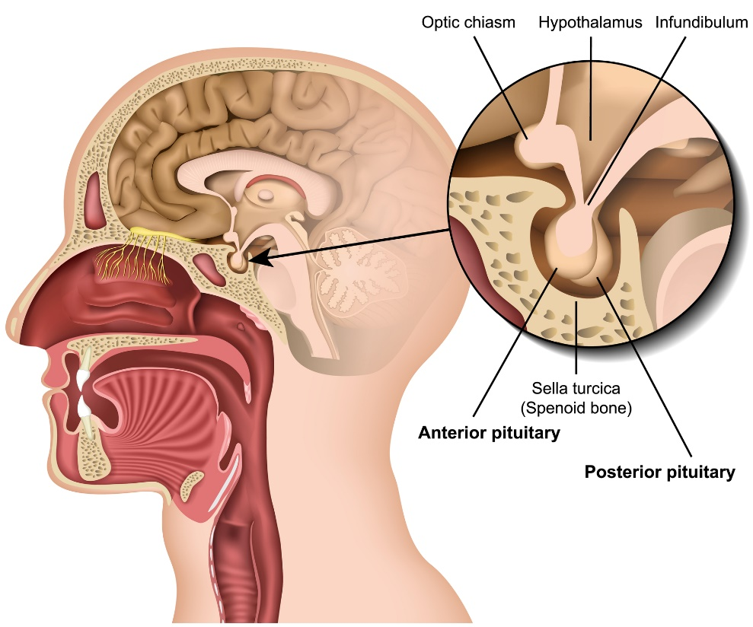

The pituitary gland
The pituitary gland also called hypophysis
Hypophysis is suspended from the floor of the hypothalamus by a stalk (infundibulum) and is enclosed by the sella turcica of the sphenoid bone.

Slide 4
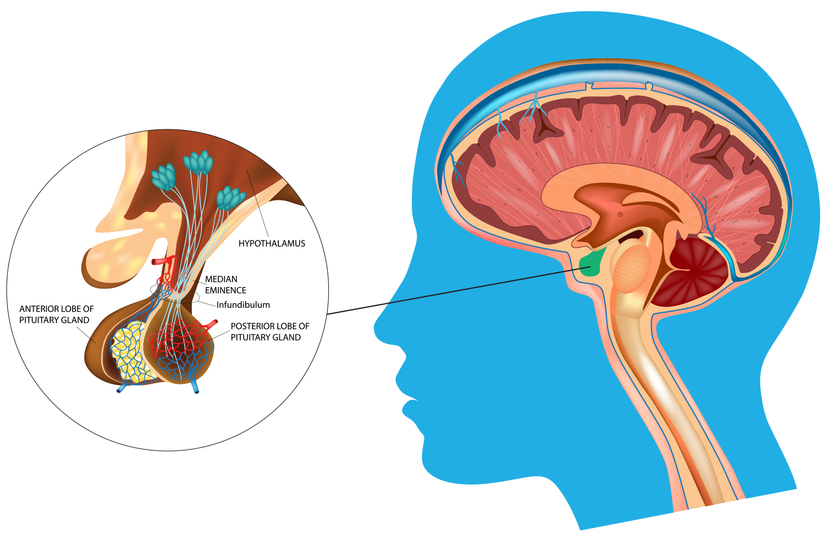
The pituitary gland
Despite its small size, the pituitary gland regulates many body functions.
Pituitary gland is composed of two major portions which include anterior pituitary gland (adenohypophysis) which is separate glandular tissue, and the posterior pituitary gland (neurohypophysis), which is an extension of the nerve tissue of the hypothalamus.

Slide 5
Anterior pituitary gland
Anterior pituitary gland also called adenohypophysis
Hormones of anterior pituitary gland are regulated by releasing and inhibiting hormones from the hypothalamus.
Releasing and inhibiting hormones are secreted into primary capillaries in the hypothalamus and pass through the hypophyseal portal veins to another capillary network in the anterior pituitary gland. Here
The releasing hormones are absorbed and stimulate secretion of the anterior pituitary hormones. While, inhibiting hormones suppress anterior pituitary gland to secrete hormones.
The hormones of the anterior pituitary gland regulate many body functions.

Slide 6
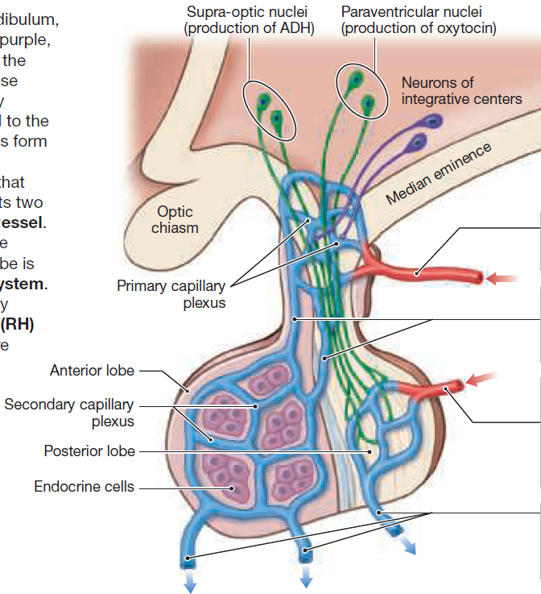
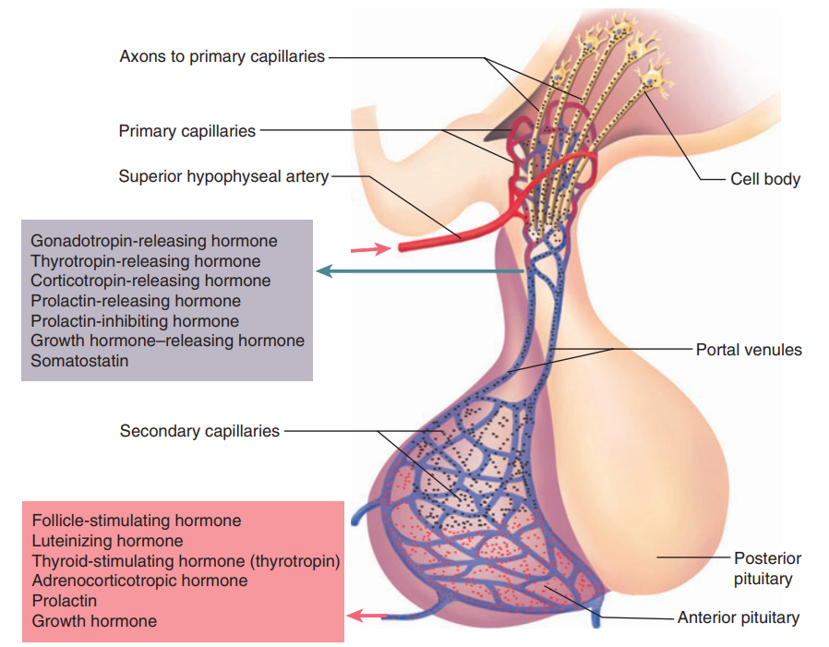
Anterior pituitary gland

Slide 7
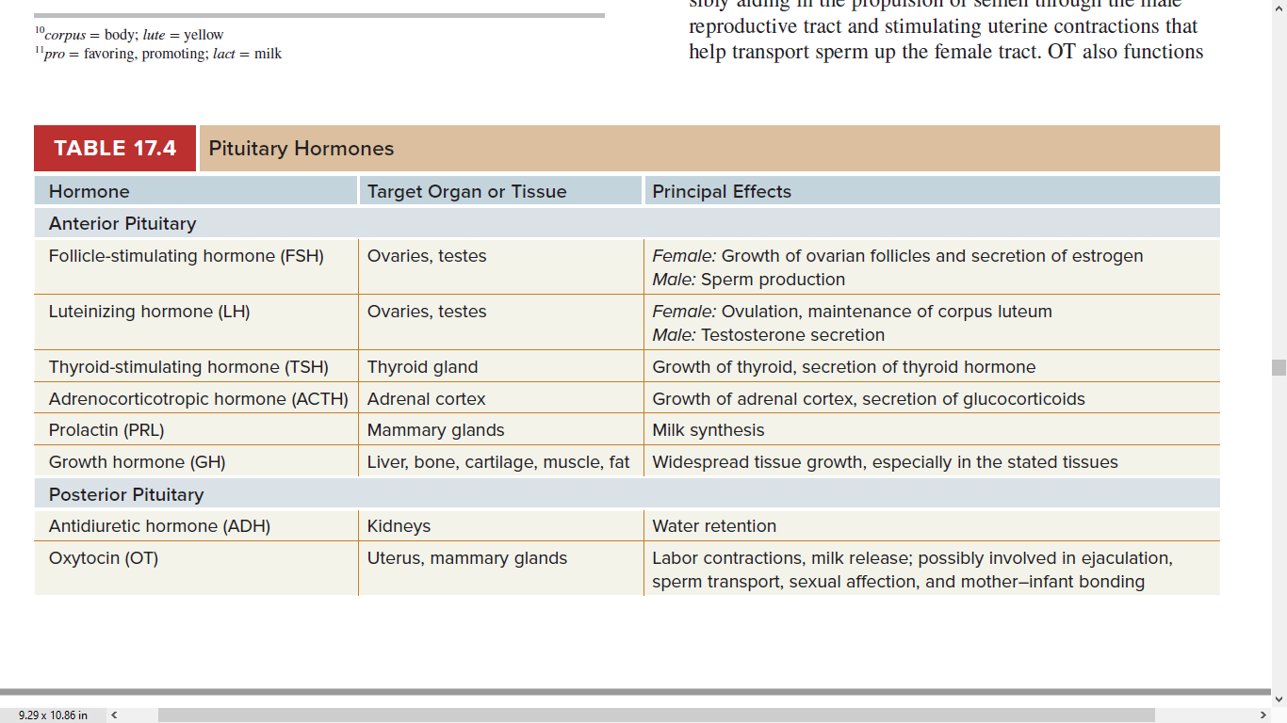
Pituitary gland hormones, their target tissues and functions

Slide 8
Anterior pituitary gland hormone -Follicle-stimulating hormone
Follicle-stimulating hormone (FSH) is one of the gonadotropic hormones.
FSH has effects on the gonads: the ovaries or testes.
FSH is named for one of its functions in women. Within the ovaries are ovarian follicles that contain potential ova (egg cells). FSH stimulates the growth of ovarian follicles; that is, it initiates egg development. FSH also stimulates the secretion of estrogen by the ovaries.
In men, FSH initiates sperm production within the testes.
The secretion of FSH is stimulated by the hypothalamus, which produces gonadotropin-releasing hormone (GnRH).
FSH secretion is decreased by inhibin, a hormone produced by the ovaries or testes.

Slide 9
Anterior pituitary gland hormone -Luteinizing hormone
Luteinizing hormone (LH) is another gonadotropic hormone.
In women, LH is responsible for ovulation, the release of a mature ovum from an ovarian follicle. LH then stimulates that follicle to develop into the corpus luteum, which secretes progesterone.
In men, LH stimulates the interstitial cells of the testes to secrete testosterone.
The secretion of LH is stimulated by the hypothalamus, which produces gonadotropin-releasing hormone (GnRH).

Slide 10
Anterior pituitary gland hormone -Thyroid-stimulating hormone
Thyroid-stimulating hormone (TSH) is also called thyrotropin
The target organ for TSH is the thyroid gland.
TSH stimulates the normal growth of the thyroid gland and the secretion of thyroxine (T4) and triiodothyronine (T3).
The secretion of TSH is stimulated by thyrotropin-releasing hormone (TRH) from the hypothalamus. When metabolic rate (energy production) decreases, TRH is produced.

Slide 11
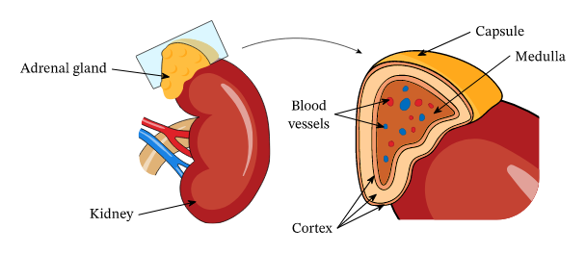
Anterior pituitary gland hormone -Adrenocorticotropic hormone
Adrenocorticotropic hormone (ACTH) stimulates the secretion of cortisol and other hormones by the adrenal cortex.
Secretion of ACTH is increased by corticotropin-releasing hormone (CRH) from the hypothalamus. CRH is produced in any type of physiological stress situation

Slide 12
Anterior pituitary gland hormone -Growth hormone
Growth hormone (GH) is also called somatotropin.
The anterior pituitary gland produces at least a thousand times as much GH as any other hormone.
The general effect of GH is to stimulate mitosis and cellular differentiation and thus to promote tissue growth throughout the body.
The secretion of GH is regulated by two hormones from the hypothalamus. Growth hormone-releasing hormone (GHRH), which increases the secretion of GH, is produced during hypoglycemia and exercise. Another stimulus for GHRH is a high blood level of amino acids; the GH then secreted will ensure the conversion of these amino acids into protein. Somatostatin may also be called growth hormone inhibiting hormone (GHIH), and, as its name tells us, it decreases the secretion of GH. Somatostatin is produced during hyperglycemia.

Slide 13
Anterior pituitary gland hormone –Prolactin hormone
Prolactin, as its name suggests, is responsible for lactation. More precisely, prolactin initiates and maintains milk production by the mammary glands.
The regulation of secretion of prolactin is complex, involving both prolactin-releasing hormone (PRH) and prolactin-inhibiting hormone (PIH) from the hypothalamus.
The mammary glands must first be acted upon by other hormones such as estrogen and progesterone, which are secreted in large amounts by the placenta during pregnancy. Then, after delivery of the baby, prolactin secretion increases, and milk is produced.
If the mother continues to breast-feed, prolactin levels remain high.

Slide 14
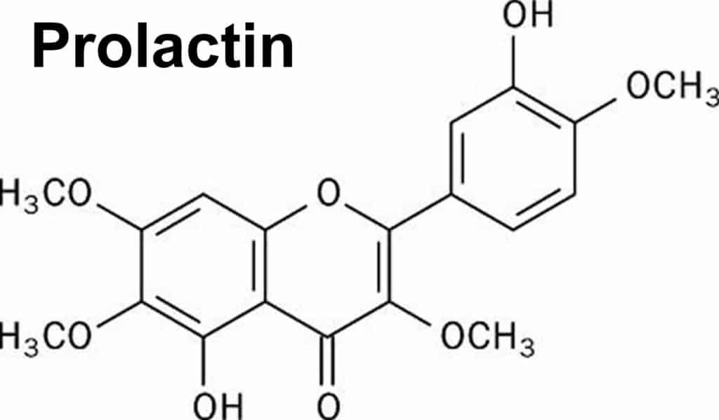
Prolactin
Prolactin (PRL) is produced primarily by the anterior pituitary gland.
Lactotroph cells in the anterior pituitary synthesize and secrete prolactin.

Slide 15
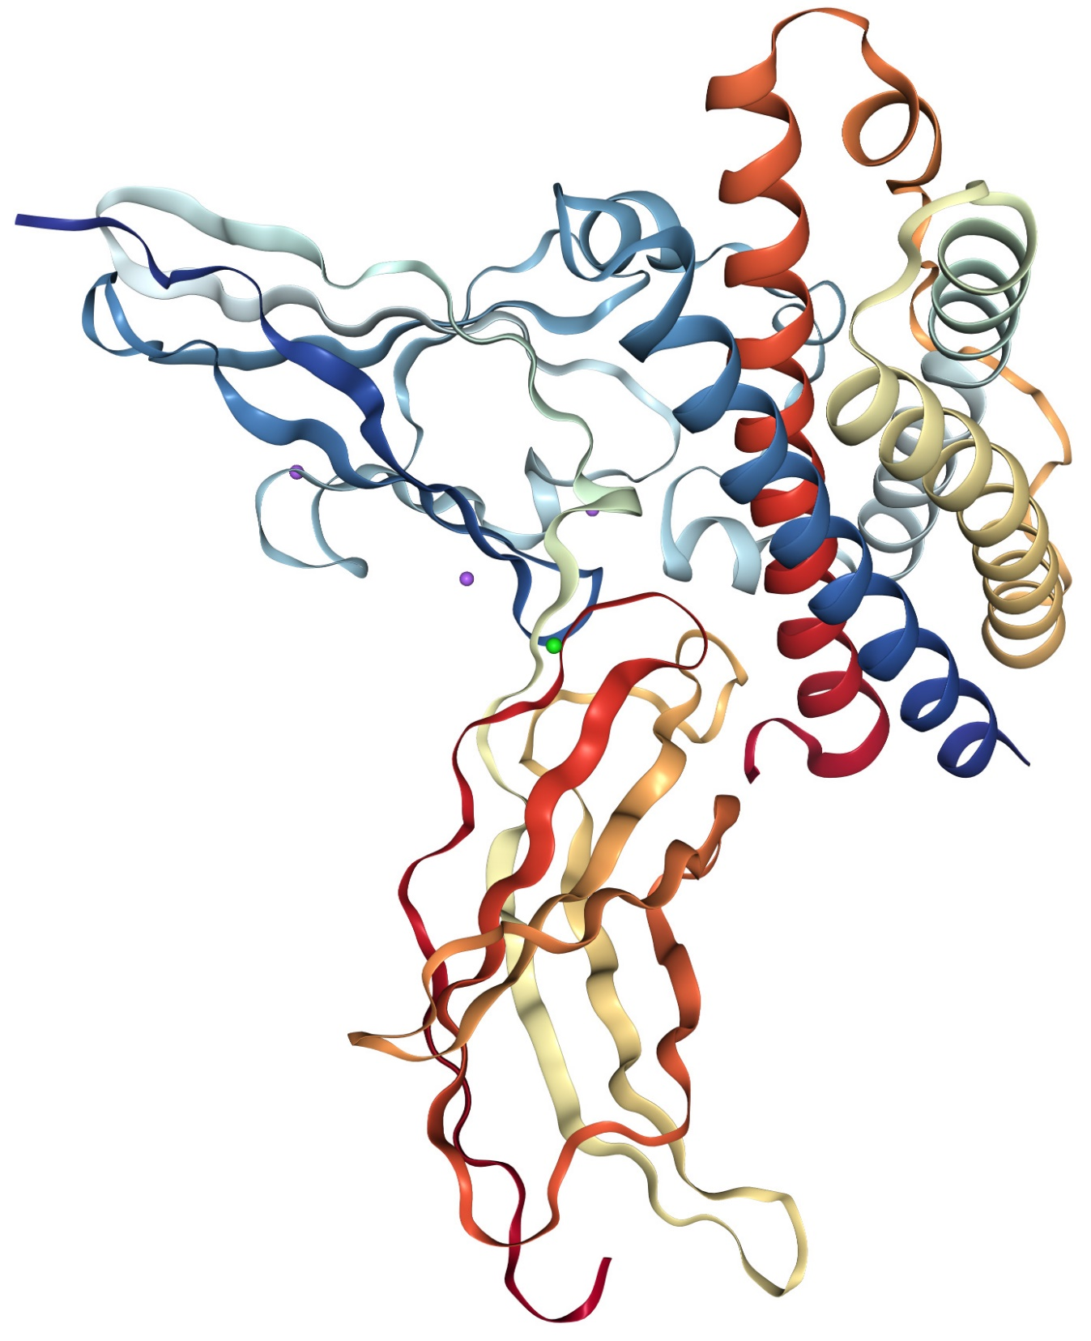
Structure of Prolactin
Prolactin is a single-chain polypeptide hormone.
Contains 199 amino acids.
Structurally similar to growth hormone and placental lactogen.
Exists in monomeric, dimeric, and polymeric forms.

Slide 16
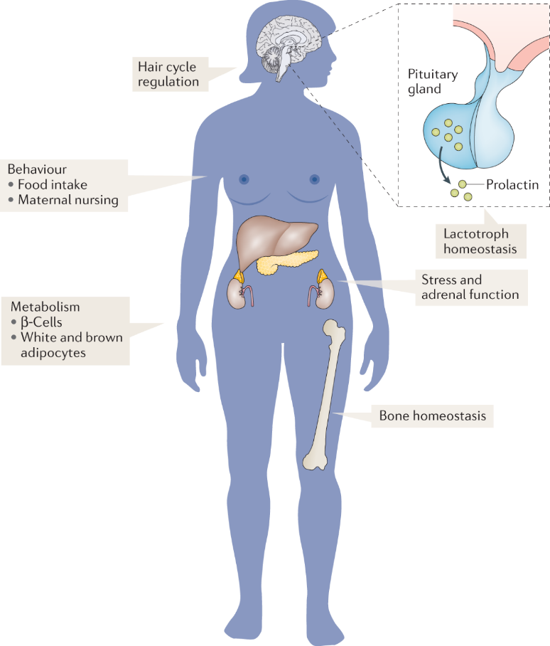
Target Cells and Receptors
Main Target Cells: Mammary gland epithelial cells.
Binds to prolactin receptors (PRLR), a type of cytokine receptor.
Found in:
  Mammary glands (milk production)
  Ovaries (modulating reproductive function)
  Liver (metabolic effects)
  Brain (behavioral effects)
  Immune cells (immune modulation)

Slide 17
Effects of Prolactin
Reproductive System: Inhibits gonadotropin-releasing hormone (GnRH), affecting ovulation and spermatogenesis.
Lactation: Stimulates milk production in mammary glands.
Metabolism: Influences fat metabolism and insulin sensitivity.
Immune System: Modulates immune responses.
Behavioral Effects: Influences maternal behaviors and stress response.

Slide 18
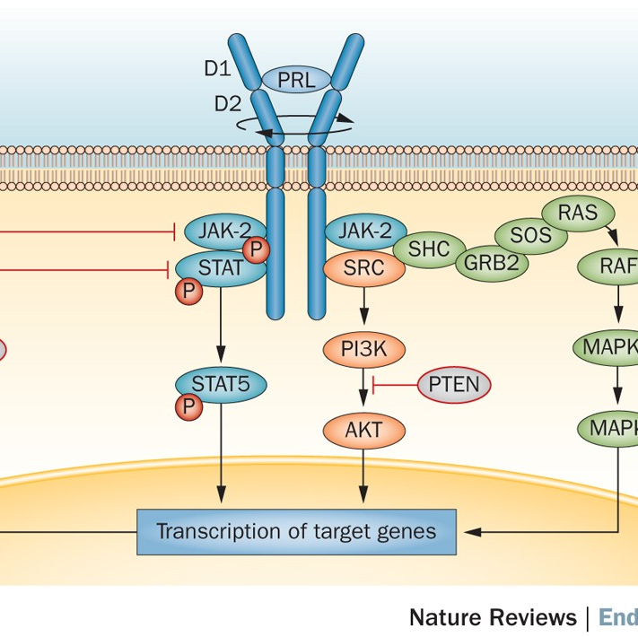
Mechanism of Action
Binds to prolactin receptor (PRLR), activating JAK-STAT signaling pathway.
Steps:
  PRL binds to PRLR on target cell membrane.
  Activates Janus kinase (JAK).
  Signal transducer and activator of transcription (STAT) proteins are phosphorylated.
  STAT proteins enter the nucleus and regulate gene transcription.
  Stimulates protein synthesis (e.g., casein for milk production).

Slide 19
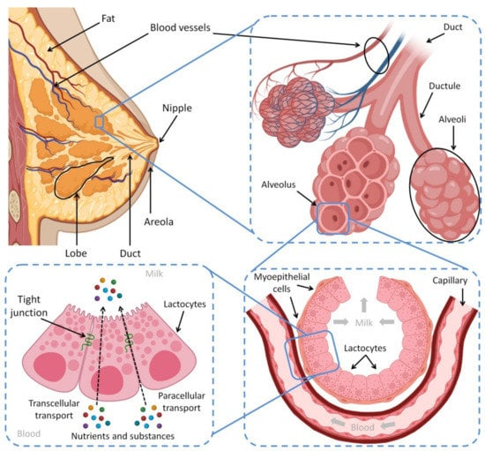
Role of Prolactin in Milk Production
Step 1: Suckling stimulates sensory receptors in the nipple.
Step 2: Sensory signals are transmitted to the hypothalamus, reducing dopamine release.
Step 3: Reduced dopamine leads to increased prolactin secretion from the anterior pituitary.
Step 4: Prolactin binds to its receptors on mammary epithelial cells.
Step 5: JAK-STAT signaling is activated, leading to increased transcription of milk protein genes (e.g., casein, lactalbumin).
Step 6: Stimulates synthesis and secretion of milk components, including proteins, fats, and lactose.
Step 7: Milk is stored in alveoli until released by oxytocin-induced contraction.

Slide 20
https://www.youtube.com/watch?v=bYBil33k27I

Slide 21
Role of Prolactin in Menstrual Cycle
Regulation of Menstrual Cycle:
  Prolactin inhibits GnRH secretion from the hypothalamus.
  Reduced GnRH leads to decreased FSH and LH release from the anterior pituitary.
  Lower FSH and LH levels impair follicle development and ovulation, leading to menstrual irregularities or amenorrhea in cases of hyperprolactinemia.
  Prolactin also affects estrogen and progesterone production, influencing endometrial growth.

Slide 22
Role in Fat Redistribution:
  Prolactin regulates adipose tissue metabolism by influencing lipid storage and mobilization.
  Increases lipogenesis (fat storage) in specific areas, such as the breasts and thighs, particularly during pregnancy and lactation.
  Modulates lipolysis (fat breakdown) in response to energy demands.
  Affects leptin signaling, which influences appetite regulation and body weight maintenance.

Slide 23
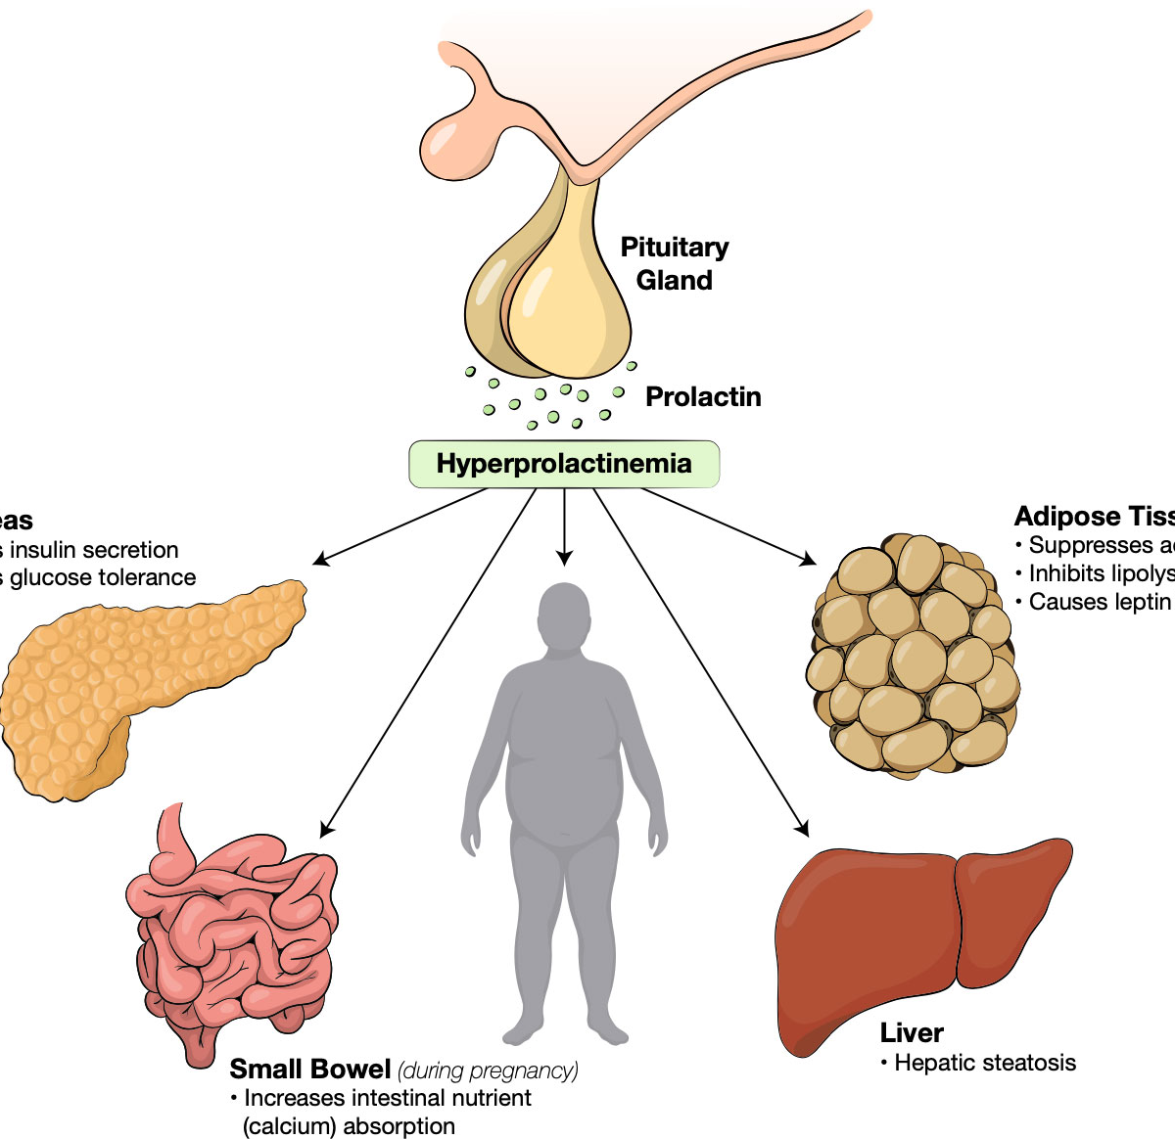
Disorders Related to Prolactin
Hyperprolactinemia (High Prolactin Levels):
  Causes: Pituitary tumors (prolactinoma), hypothyroidism, medications.
  Symptoms: Galactorrhea (milk secretion without pregnancy), infertility, menstrual irregularities, reduced libido.
  Treatment: Dopamine agonists (e.g., bromocriptine, cabergoline).
Hypoprolactinemia (Low Prolactin Levels):
  Causes: Pituitary damage, Sheehan’s syndrome.
  Symptoms: Poor lactation, menstrual disturbances.
  Treatment: Underlying cause management.

Slide 24
References
Greenstein B. & Wood D. F. (2011). The endocrine system at a glance (3rd ed.). Wiley-Blackwell
Melmed S. Auchus R. J. Goldfine A. B. Koenig R. Rosen C. J. & Williams R. H. (2020). Williams textbook of endocrinology (14th ed.). Elsevier. Boron W. F. & Boulpaep E. L. (2021).
Boron & boulpaep concise medical physiology. Elsevier. Barrett K. E. Barman S. M. Yuan J. X.-J. & Brooks H. (2019).
Ganong's review of medical physiology (review questions) (26th ed.). McGraw-Hill Education LLC Molina P. E. (2018). Endocrine physiology (Fifth). McGraw-Hill Education.

Slide 25
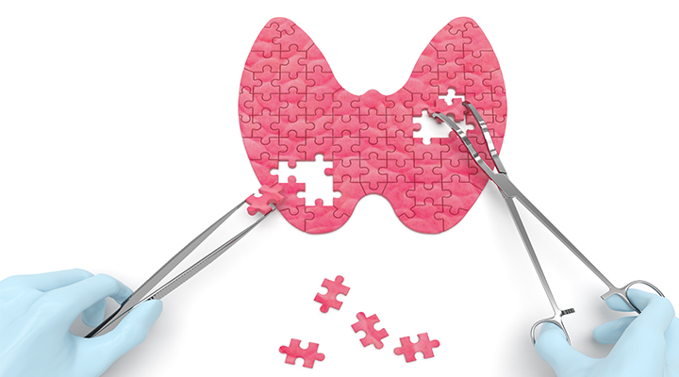
Thank you

