Slide 1
chemistry & Isolation techniques of essential oils
Dr. Kamran Javed Naquvi
Course name: AROMATHERAPY
Grade 4- Spring Semester 2024-2025
Course code: PHAR 429
Lecture 3

Slide 2
Essential oils
Volatile oils are fragrant compounds derived from both plant and animal origins. They possess the unique characteristic of evaporating upon exposure to air at ordinary temperature and are hence known as volatile or ethereal oils.
These represent the essence of active constituents of the plant and hence are also known as essential oils.

Slide 3
The presence of volatile oils is important in various biological processes such as pollination, defense mechanisms, and communication with other organisms.
These oils play a crucial role in the ecology and physiology of plants and have been utilized by humans for medicinal, culinary, and aromatic applications.

Slide 4
Schizogenous glands are specialized structures found in plants that produce essential oils. These glands are characterized by the formation of cavities or sacs within plant tissues, which contain volatile compounds. When these cavities rupture or release their contents, the essential oils are released into the surrounding environment.
On the other hand, lysigenous glands, or schizolysigenous glands, are a subtype of schizogenous glands.

Slide 5
Storage
These oils are often stored in specialized structures within plants, such as secretory cells, glandular trichomes, oil ducts, or resin ducts.
Secretory Cells: Some plants contain secretory cells that produce and store volatile oils. These cells are often located in specific plant organs such as leaves, flowers, stems, or roots. Within these cells, biosynthetic pathways produce the volatile compounds, which are then accumulated and stored until needed.

Slide 6
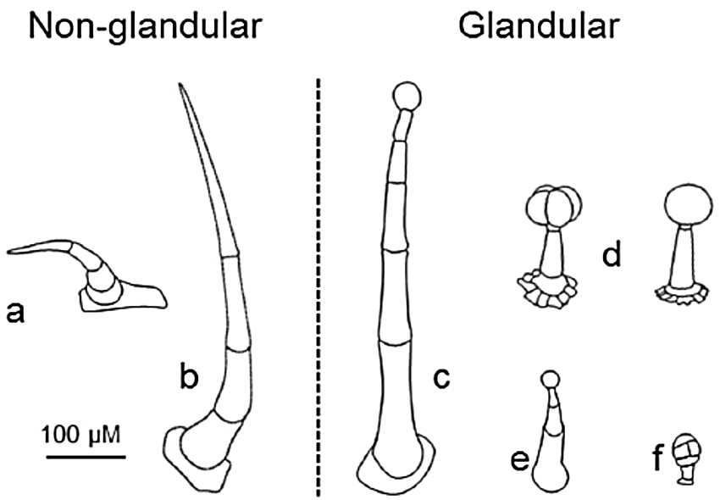
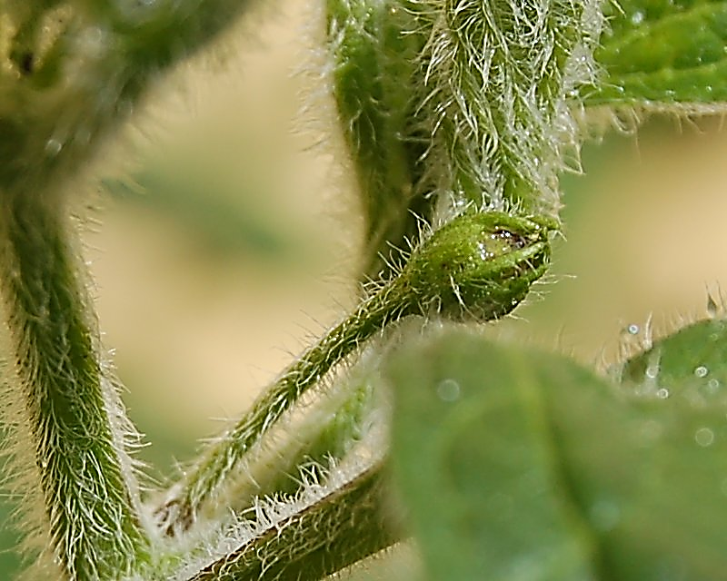
Glandular Trichomes: Many plants have glandular trichomes, which are hair-like structures found on the surface of leaves, stems, and other plant parts. These trichomes can secrete volatile oils directly onto the plant's surface, where they serve various functions, such as attracting pollinators or deterring herbivores.

Slide 7
Oil Ducts: Some plants have specialized ducts or channels that transport and store volatile oils. These oil ducts are often found in plant tissues such as the bark, leaves, or fruits. They can act as reservoirs for storing these volatile compounds.
Resin Ducts: Certain plants produce resin ducts, which contain resinous substances along with volatile oils. These ducts are typically found in coniferous trees and other resinous plants.
The volatile oils stored within resin ducts contribute to the characteristic scent of the resin and may also serve protective functions against pests and pathogens.

Slide 8
Physical and Chemical Properties
These are chemically derived from terpenes (mainly mono and sesquiterpenes) and their oxygenated derivatives. These are made up of isoprene units (C₅H₈) and are usually, mono, sesqui, and diterpenes with empirical formulae as C₁₀H₁₆, C₁₅H_{24,} and C₂₀H₃₂ respectively.
These are soluble in alcohol and other organic solvents, practically insoluble in water,
Lighter than water (except Clove oil heavier),
Possess characteristic odor, have high refraction index, and most of them are optically active.
Volatile oils are colorless liquids, but when exposed to air and direct sunlight these become darker due to oxidation. Unlike fixed oils, volatile oils neither leave permanent grease spots on filter paper nor are saponified with alkalis.
Clove oil has a specific gravity greater than 1, making it heavier than water. This means that if you were to pour clove oil and water into a container, the clove oil would sink to the bottom while the water would float on top.

Slide 9
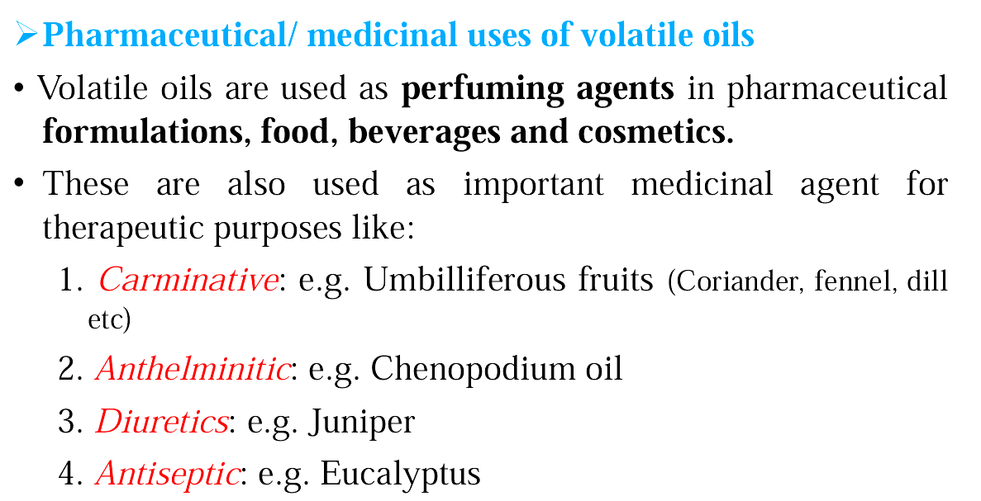

Slide 10
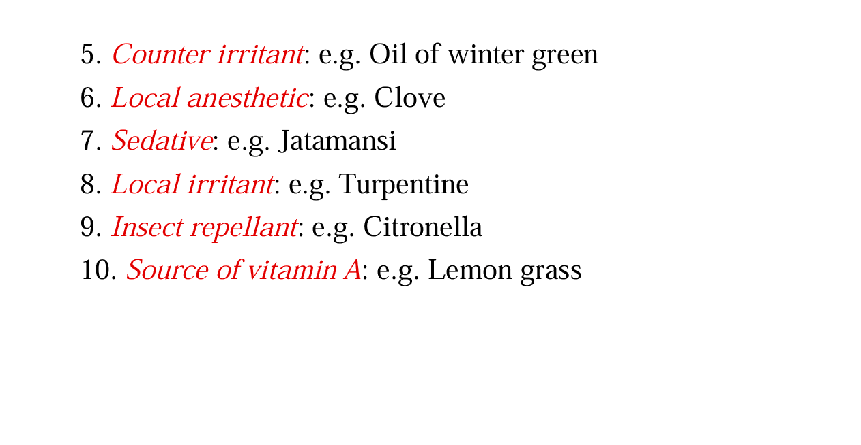

Slide 11
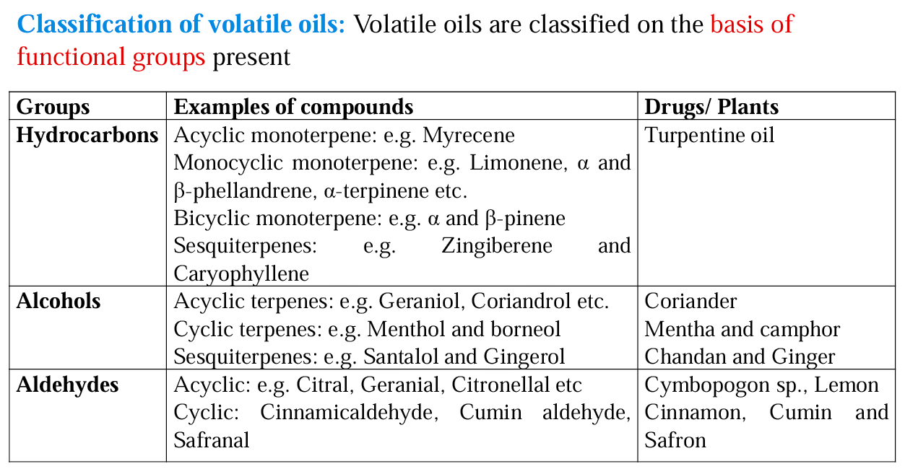

Slide 12
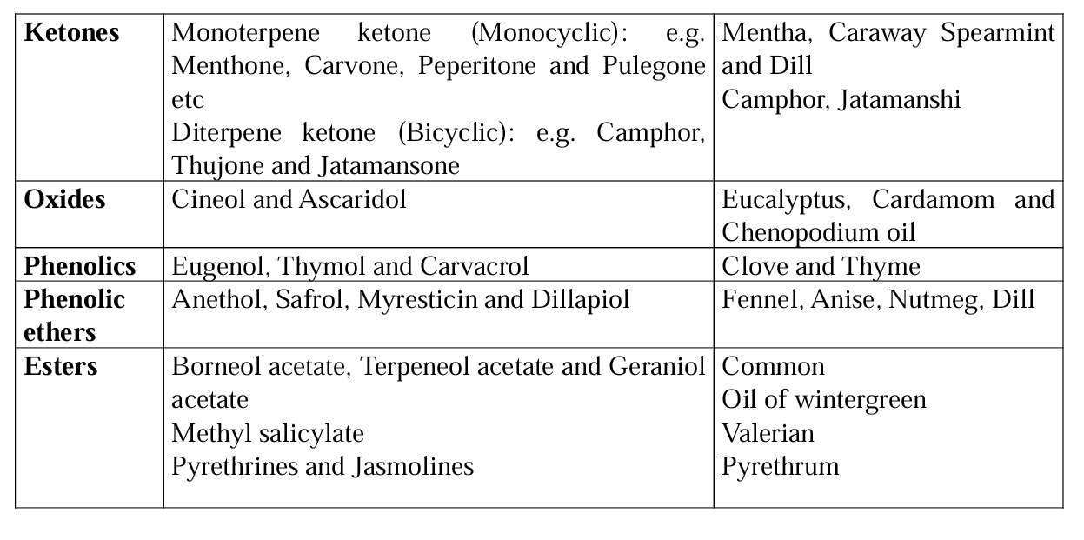

Slide 13
Terpenoids
Terpenoids are hydrocarbons of plant origin of the general formula (C₅H₈)_{n} as well as their oxygenated, hydrogenated and dehydrogenated derivatives.
Terpenoids are abundantly available in volatile oils. They contain a complex mixture of terpenes or sesquiterpenes, alcohols, aldehydes, ketones, acids, and esters. E.g. Menthol, Citral, Eugenol, Citronellol Geraniol, Limonene, etc.

Slide 14
Classification of Terpenoids
S. No. | Name of the class of terpenoids | No. of Isoprene units | Molecular formula | Examples
1 | Monoterpenes | 2 | C₁₀H₁₆ | Limonene, Pinenes, Myrcene
2 | Sesquiterpenes | 3 | C₁₅H₂₄ | β-Caryophyllene, Humulene, Germacrene D
3 | Diterpenes | 4 | C₂₀H₃₂ | Taxus, Carnosic Acid
4 | Triterpenes | 6 | C₃₀H₄₈ | Ursolic Acid, Oleanolic Acid, Glycyrrhizin
5 | Tetraterpenes | 8 | C₄₀H₆₄ | β-Carotene, Lycopene, Lutein
6 | Polyterpenes | n | (C₅H₈)_{n} | Rubber, Gutta-percha, Rosin

Slide 15
Extraction of volatile oil
Solvent Extraction This is the most used and economically important technique.
Raw materials are submerged in a solvent that can dissolve the desired aromatic compounds. Fragrant compounds from woody and fibrous plant materials are often obtained in this manner.
The technique can also be used to extract odorants that are too volatile for distillation or easily denatured by heat.
Commonly used solvents for maceration/solvent extraction include hexane and dimethyl ether. The product of this process is called a "concrete”

Slide 16
Solvent Extraction

Slide 17
Steam Distillation
Steam from boiling water is passed through the raw material for 60-105 minutes, which drives out most of their volatile fragrant compounds.
The condensate from distillation, which contains both water and the aromatics, is settled in a Florentine flask. This allows for the easy separation of the fragrant oils from the water as the oil will float to the top of the distillate where it is removed, leaving behind the watery distillate.
The water collected from the condensate, which retains some of the fragrant compounds and oils from the raw material, is called hydrosol and is sometimes sold for consumer and commercial use. This method is most commonly used for fresh plant materials such as flowers, leaves, and stems.

Slide 18
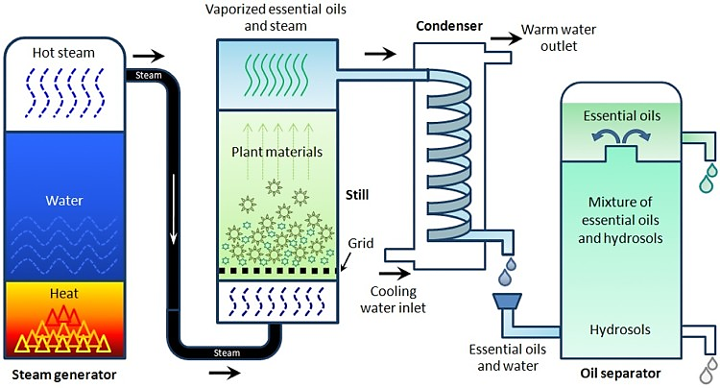
Steam distillation

Slide 19
Enfleurage
This process involves absorbing aromatic compounds into solid fat or wax, followed by extracting the fragrant oil using ethyl alcohol.
Extraction by enfleurage is commonly used when distillation is not possible because some fragrant compounds denature through high heat.
Enfleurage is a two-step process during which the odor of aromatic materials is absorbed into wax or fat and then extracted with alcohol.

Slide 20
Enfleurage

Slide 21
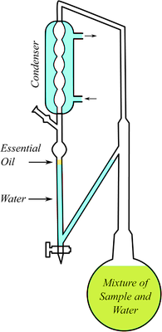
Hydro-distillation using a Clevenger Apparatus
Hydro-distillation using a Clevenger apparatus is a common method for extracting essential oils from plant materials.
The Clevenger apparatus, named after its inventor Friedrich Clevenger, is a simple distillation apparatus specifically designed for the extraction of essential oils.

Slide 22
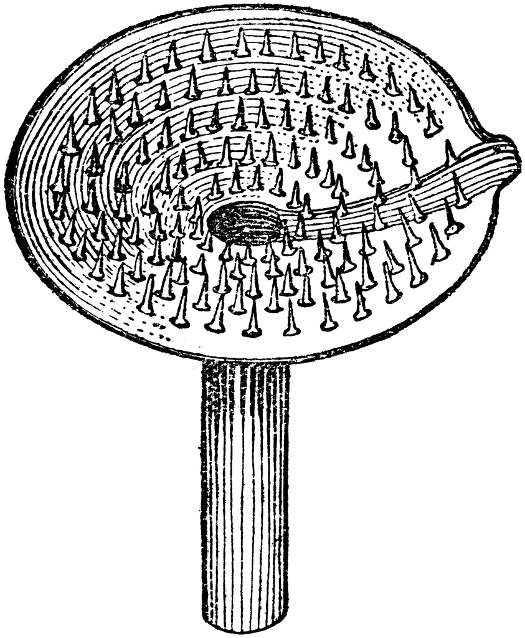
Ecuelle method
It is used for extraction of citrus oil, wherein cells in the rind are ruptured mechanically using pointed projections by twisting raw material over them in a clockwise direction either mechanically or manually.

Slide 23
Chemical Tests of volatile oils
To the thin section of drug, add an alcoholic solution of Sudan III. The red color obtained by globules indicates the presence of volatile oil.
To the thin section of drug, add a drop of tincture alkane. The red color obtained by globules indicates the presence of volatile oil.

Slide 24
References
Evans, W. C. (2009). Trease and Evans' Pharmacognosy. Elsevier Health Sciences.
Price S, Price L. Aromatherapy for health professionals. 4th Edn., London: Churchill Livingstone; 2011.
Lis-Balchin M. Aromatherapy Science: A guide for healthcare professionals. London: Pharmaceutical Press; 2006

Slide 25
Thank You

