Slide 1
Essential oils for Oily skin
Dr. Kamran Javed Naquvi
Course name: AROMATHERAPY
Grade 4- Spring Semester 2024-2025
Course code: PHAR 429
Lecture 4

Slide 2
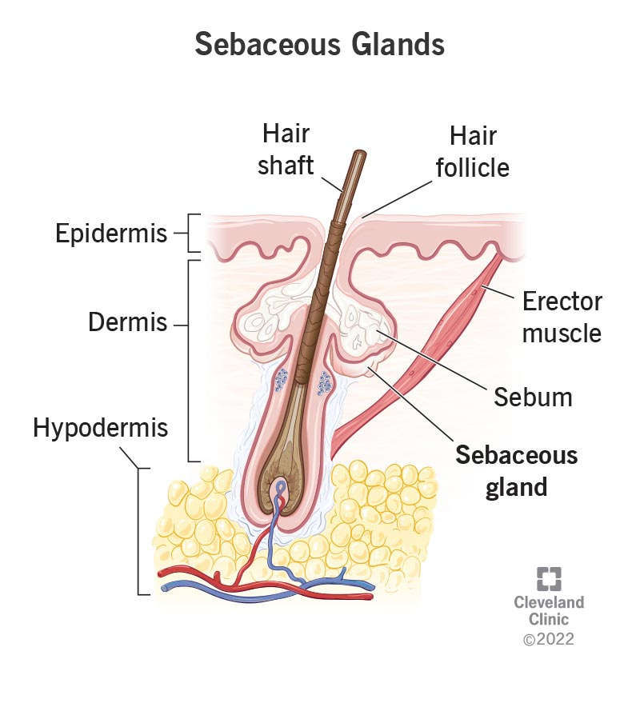
Oily skin
Oily skin is a skin type characterized by excess sebum production. Sebum is an oily substance produced by the sebaceous glands in the skin, which helps moisturize and protect the skin.
However, when the sebaceous glands produce too much sebum, it can lead to oily skin, which can manifest in various ways:

Slide 3
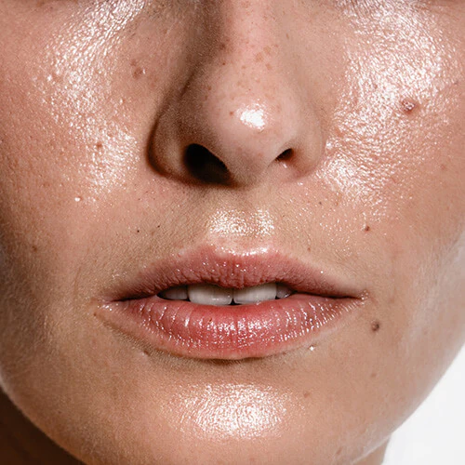
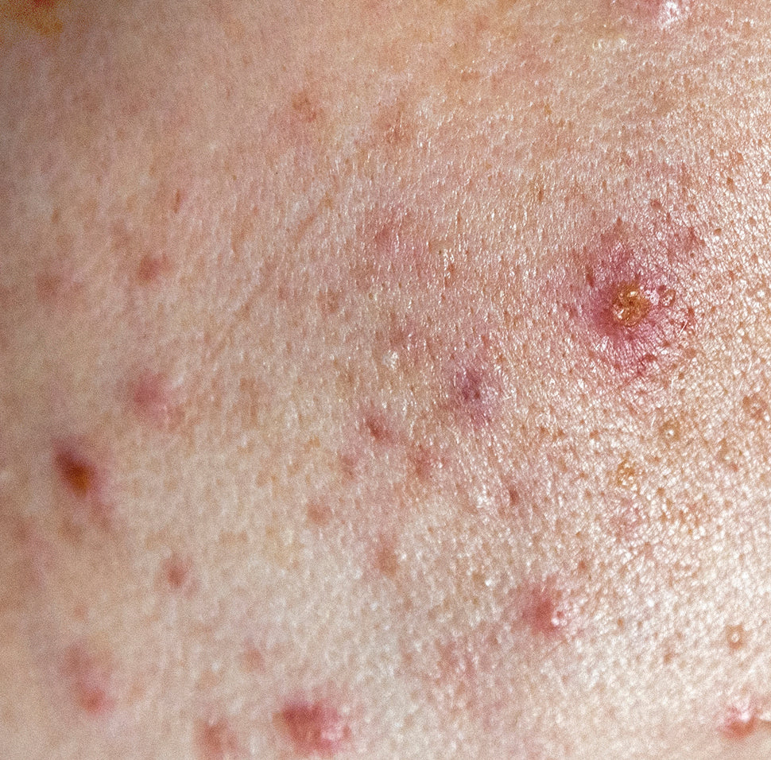
Shiny Appearance: Oily skin often appears shiny, especially in the T-zone (forehead, nose, and chin).
Enlarged Pores: Excess sebum production can cause pores to appear larger and more prominent.
Acne: Oily skin is more prone to acne breakouts due to excess oil clogging pores, leading to the formation of blackheads, whiteheads, pimples, and other types of acne.
Skin Texture: Oily skin may have a thicker or coarser texture compared to other skin types.
Makeup Breakdown: Makeup may not last as long on oily skin, as the excess oil can cause it to break down more quickly.

Slide 4
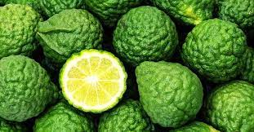
Bergamot
Biological Sources: It is obtained from the fruits of Citrus bergamia
Plant Family: Rutaceae
Native Habitat: Bergamot is believed to have originated in Southeast Asia. However, it is primarily cultivated in Southern Italy, particularly in the Calabria region.

Slide 5
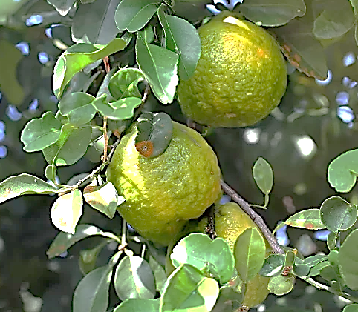
Morphology:
Tree: Bergamot is a small tree that typically grows up to 4 meters in height.
Leaves: The leaves are glossy, ovate, and dark green in color.
Fruit: The fruit is small, round, and yellow when ripe, resembling a miniature orange. It has a distinctive aromatic scent.
Flowers: Bergamot trees produce small, white flowers with a sweet fragrance.

Slide 6
Chemical Constituents: Essential Oil
Limonene: A major component responsible for its citrusy scent.
Linalyl acetate: Contributes to the floral aroma.
Linalool: Adds to the overall fragrance and has calming properties.
Bergapten: A psoralen compound that makes the skin photosensitive.
Citral: Provides a lemon-like scent.
Bergamottin: Another psoralen compound with potential health benefits.

Slide 7
Uses
Aromatherapy: Bergamot essential oil is widely used in aromatherapy for stress, anxiety, and depression.
Skincare: Bergamot oil is a common ingredient in skincare products due to its antiseptic and astringent properties. It may help treat acne, oily skin, and other skin conditions.
Fragrance: Bergamot's citrusy scent makes it a popular ingredient in perfumes, colognes, and other fragrances.
Flavoring: Bergamot oil is used as a flavoring agent in food and beverages, particularly in Earl Grey tea.
Insect Repellent: Bergamot oil is sometimes used as a natural insect repellent.

Slide 8
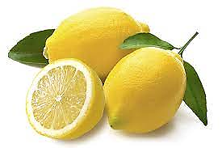
Lemon
Biological Sources: Citrus limon
Plant Family: Rutaceae
Scientific Name: Citrus limon
Native Habitat: Lemon trees are native to South Asia, primarily in Northeast India. Now it is cultivated in subtropical and tropical regions around the world.

Slide 9
Morphology:
Tree: Lemon trees are small to medium-sized evergreen trees, reaching heights of up to 10 to 20 feet.
Leaves: The leaves are elliptical, glossy, and dark green.
Fruit: Lemons are typically oval to elliptical in shape, with a bright yellow, smooth outer peel. The inner fruit is segmented into juicy, acidic pulp containing seeds.
Flowers: Lemon trees produce white, fragrant flowers with five petals, which are often referred to as lemon blossoms.

Slide 10
Chemical Constituents: Citric Acid, Vitamin C,
Limonene: A major component of lemon essential oil, limonene contributes to its citrusy aroma and is believed to have various health benefits.
Citral: Another compound responsible for lemon's citrus aroma, citral also exhibits antimicrobial properties.
Flavonoids: Lemons contain various flavonoids, including hesperidin and diosmin, which have antioxidant and anti-inflammatory properties.
Pectin: Lemon peel contains pectin, a type of soluble fiber that may have beneficial effects on digestion and cholesterol levels.
Uses:
Culinary, Beverages,
Preservation, Skincare,
Aromatherapy, Home Remedies,

Slide 11
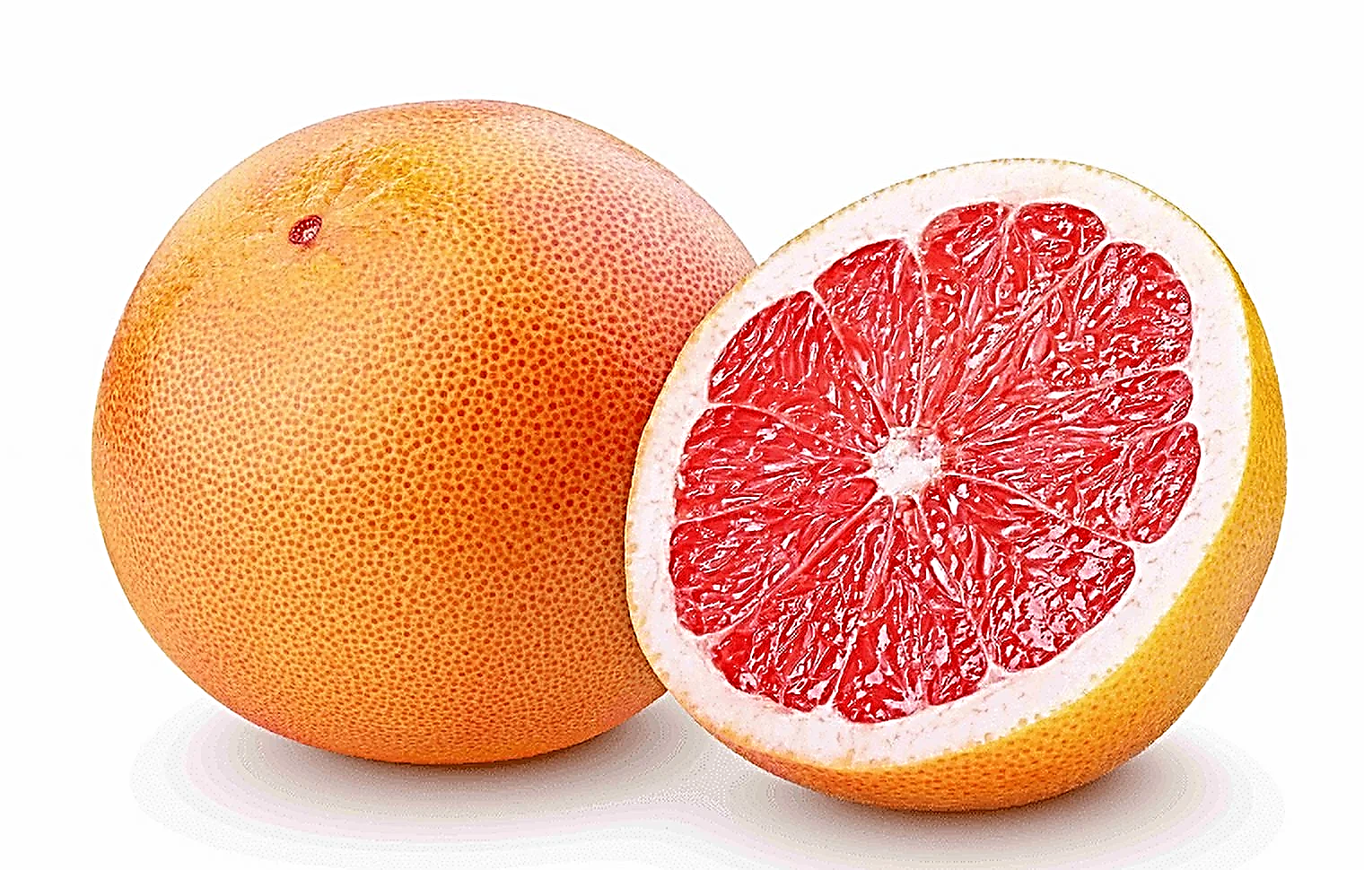
Grapefruit
Biological Sources: Citrus × paradisi
Plant Family: Rutaceae
Scientific Name: Citrus × paradisi
Native Habitat: Grapefruit is believed to be a hybrid citrus fruit originating from a cross between the pomelo (Citrus maxima) and the sweet orange (Citrus sinensis).

Slide 12
Chemical Constituents:
Citric Acid, Vitamin C,
Limonene: A major component of grapefruit essential oil, limonene gives it its characteristic citrus aroma and is believed to have various health benefits.
Nootkatone: A compound found in grapefruit peel, nootkatone has insect-repelling properties and is being investigated for its potential as an insecticide and flavoring agent.
Flavonoids: like naringin and hesperidin, which have antioxidant and anti-inflammatory properties.
Pectin: Grapefruit peel contains pectin, a soluble fiber that may have beneficial effects on digestion and cholesterol levels.

Slide 13
Uses
Skincare: Grapefruit extract or essential oil is sometimes used in skincare products for its astringent and cleansing properties. It may help treat oily skin and acne.
Aromatherapy: Grapefruit essential oil is used in aromatherapy for its uplifting and energizing scent. It is believed to help improve mood, reduce stress, and increase mental clarity.
Weight Management: Some people believe that grapefruit may aid in weight loss or weight management due to its low calorie and high fiber content.

Slide 14
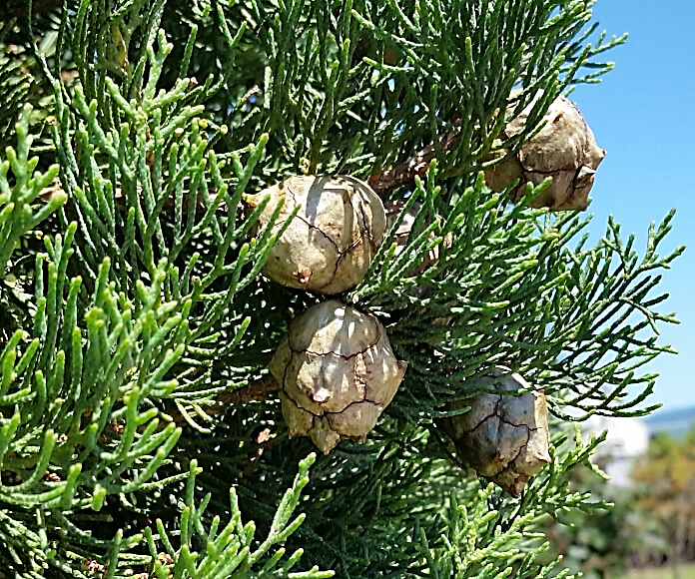
Cypress
Biological Sources:
Plant Family: Cupressaceae
Scientific Name: Cupressus sempervirens
Native Habitat: Cypress trees are native to the eastern Mediterranean region, particularly in countries like Greece, Turkey, and Cyprus.

Slide 15
Chemical Constituents:
Essential Oil: Cypress trees produce an essential oil that contains various chemical constituents, including:
Alpha-pinene: A major component, strong antibacterial and antifungal properties. Effective against Staphylococcus aureus, Escherichia coli, and Candida species.
Delta-3-carene: Contributes to the woody and fresh scent of cypress oil.
Limonene: Another common terpene found in cypress oil, limonene adds citrusy notes to the aroma.
Camphene: Provides a camphor-like scent to the essential oil.

Slide 16
Benefits of Cypress Oil for Oily Skin
Regulates Sebum Production – Cypress oil helps control excess oil without overly drying the skin.
Astringent Properties – Tightens pores and reduces shine, making it useful for acne-prone skin.
Antibacterial & Antimicrobial – Helps prevent acne by fighting bacteria and reducing inflammation.
Improves Circulation – Promotes better skin health and detoxification.
Soothing & Calming – Reduces redness and irritation, making it beneficial for sensitive, oily skin.

Slide 17
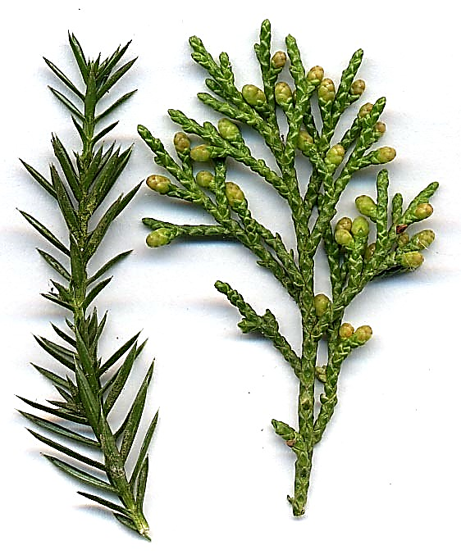
Juniper
Biological Sources:
Plant Family: Cupressaceae
Scientific Name: Juniperus spp. (several species within the genus Juniperus like, Juniperus chinensis, Juniperus communis)
Native Habitat: Juniper is a genus of coniferous trees and shrubs that are distributed throughout the Northern Hemisphere, including North America, Europe, Asia, and Africa.

Slide 18
Chemical Constituents:
Essential Oil: Juniper berries contain essential oil with various chemical constituents, including:
Alpha-pinene
Sabinene: Contributes to the spicy and woody scent of juniper oil.
Myrcene,
Limonene,
Terpinen-4-ol,
Flavonoids such as quercetin and kaempferol,
Tannins.

Slide 19
Uses
Aromatherapy: It promotes feelings of relaxation, clarity, and emotional balance. Juniper oil is often diffused, inhaled, or used in massage blends.
Medicinal: Juniper berries have a long history of use in traditional medicine for various purposes, including Digestive, Urinary, and Respiratory diseases.
Topical Use: Juniper oil or extracts may be applied topically to the skin to help soothe muscle aches, improve circulation, and support skin health.
Culinary: Juniper berries are used as a flavoring agent in culinary applications, particularly in European cuisine.
Alcoholic Beverages: Juniper berries are a key ingredient in the production of gin, a popular distilled spirit with a distinctive juniper flavor.

Slide 20
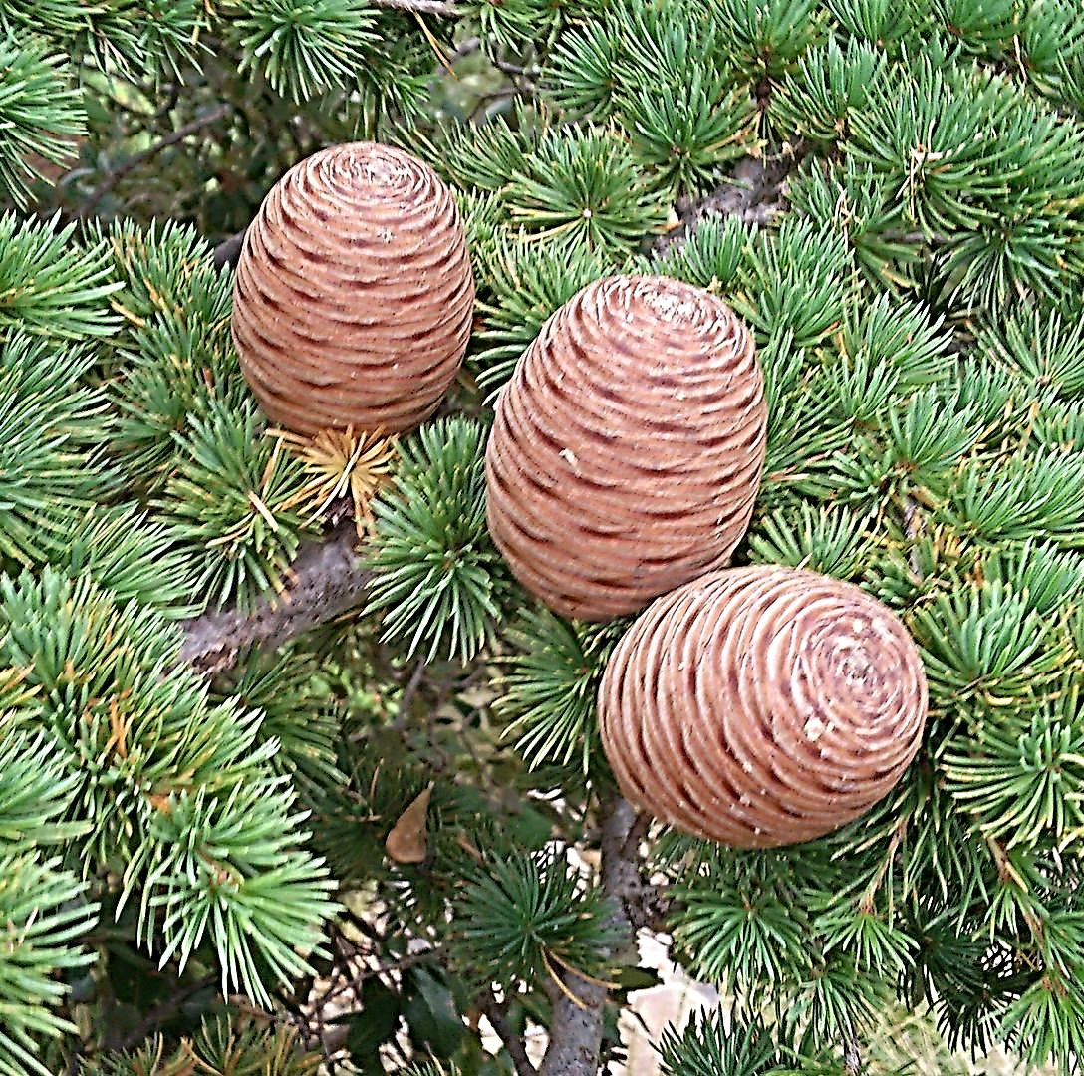
Cedrus deodara
It is a large evergreen coniferous tree that can reach 40–50 m and has a trunk up to 3 m in diameter.
The leaves are needle-like, mostly 2.5–5 cm long, slender (1 mm), clusters of 20–30

Slide 21
Chemical Constituents
Alpha-Cedrene, Beta-Cedrene
Thujopsene, Caryophyllene
Cedrol, Himachalol
Alpha-Eudesmol, Gamma-Eudesmol

Slide 22
Uses
Aromatherapy: Diffusing the oil in a room or inhaling it directly from the bottle can help promote relaxation, reduce stress, and create a sense of balance and tranquility.
Respiratory Support: Inhaling Cedrus deodara oil vapor may help alleviate respiratory symptoms such as congestion, coughing, and bronchitis.
Skin Care: Cedrus deodara oil has astringent, antiseptic, and anti-inflammatory properties, making it beneficial for skin care. It can be diluted with a carrier oil and applied topically to the skin to help treat acne, oily skin, and minor skin irritations.
Hair Care: Adding a few drops of Cedrus deodara oil to your shampoo or conditioner can help promote healthy hair and scalp.

Slide 23
References
Evans, W. C. (2009). Trease and Evans' Pharmacognosy. Elsevier Health Sciences.
Price S, Price L. Aromatherapy for health professionals. 4th Edn., London: Churchill Livingstone; 2011.
Lis-Balchin M. Aromatherapy Science: A guide for healthcare professionals. London: Pharmaceutical Press; 2006

Slide 24
Thank You

