Slide 1
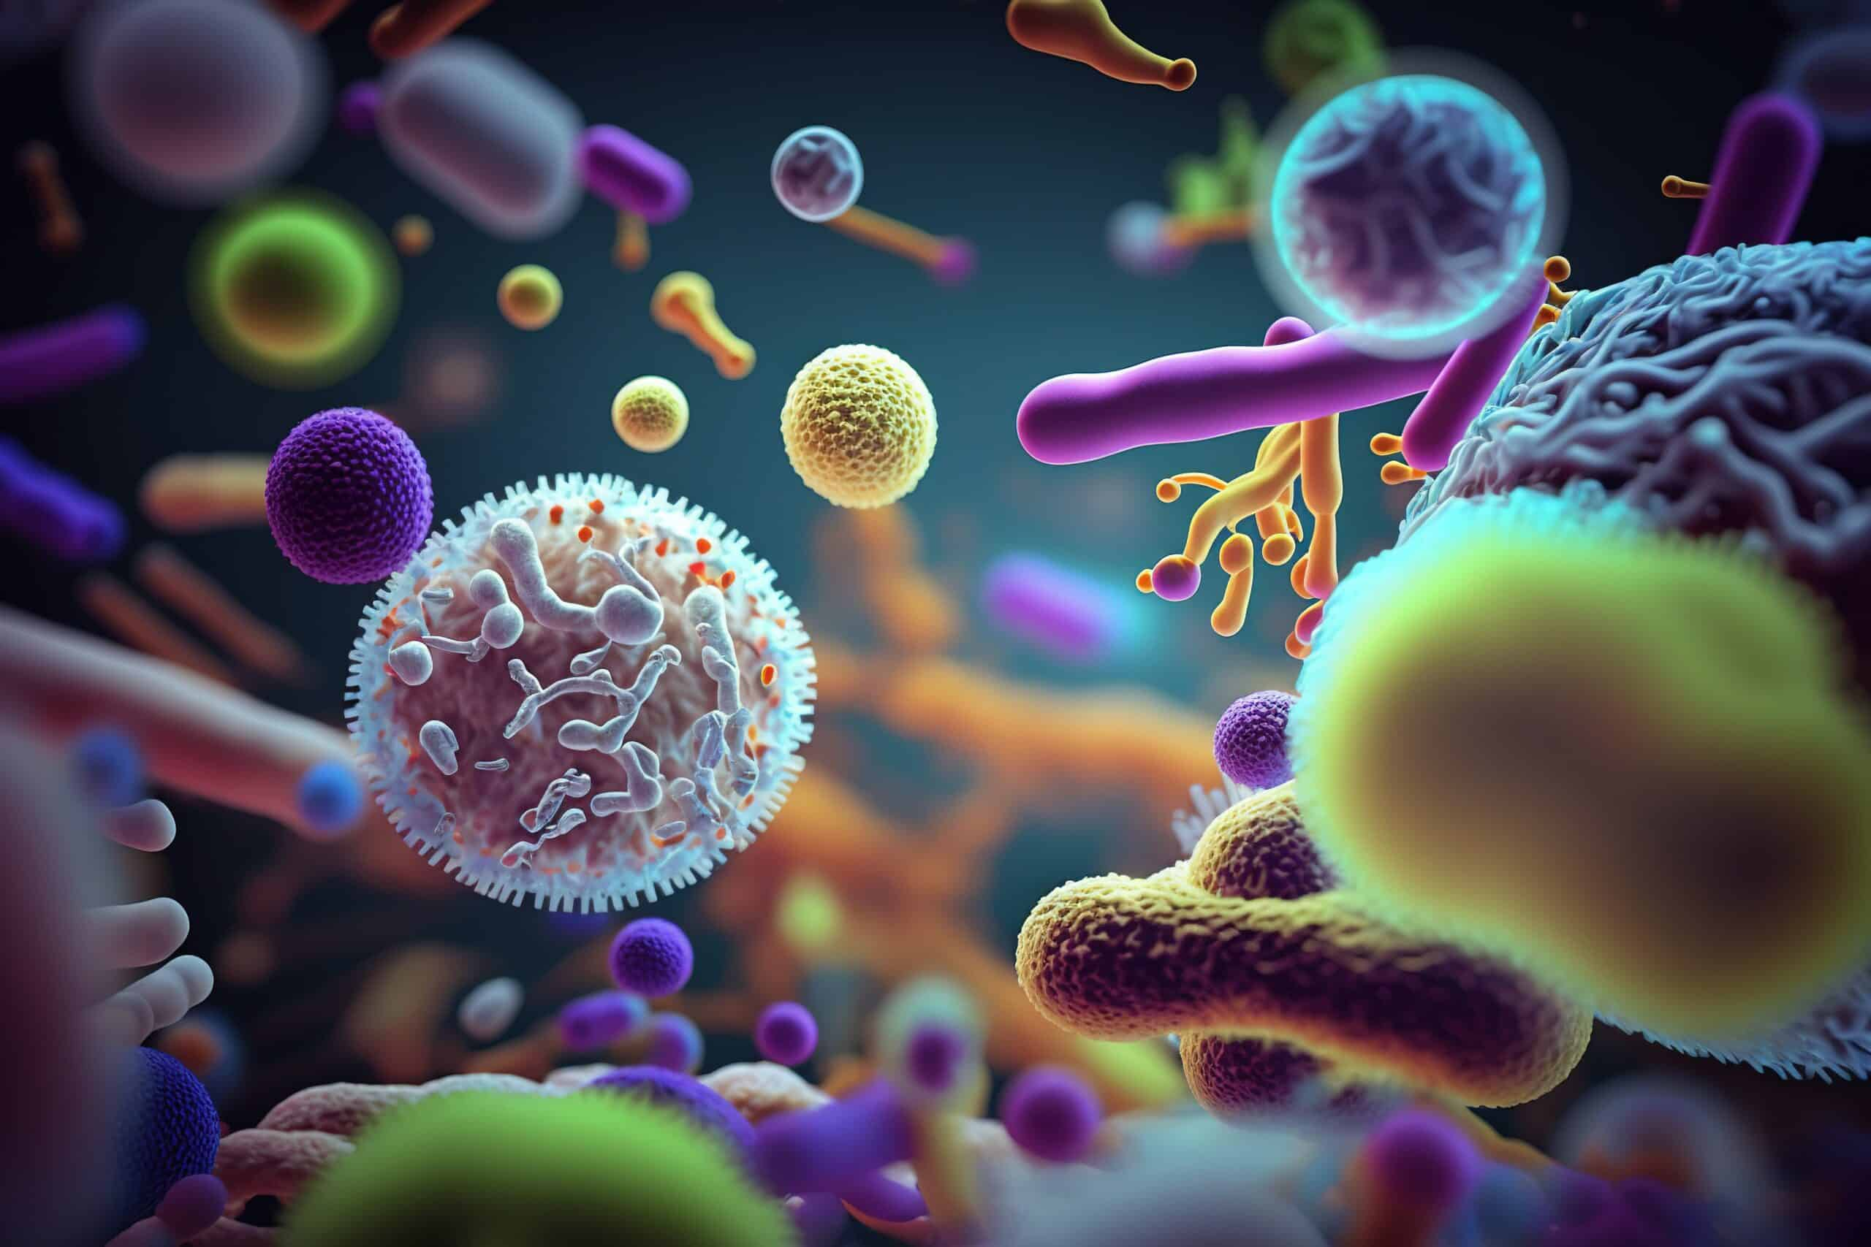

Staphylococci
Ms. Heshu J. Ahmed
Medical Bacteriology 423
Spring Semester
Week Three

Slide 2
Outline
Group characteristics
Structure
Metabolism
Toxins and extracellular enzymes
Epidemiology
Pathogenesis
Diagnosis
Resistance in staphylococci

Slide 3
Objectives
1. Introduce staphylococci and group characteristics.
2. Explore staphylococci virulence factors and mechanisms.
3. Discuss staphylococcal infections epidemiology.
4. Examine staphylococcal infection diagnostic methods.
5. Discuss staphylococcal resistance.

Slide 4
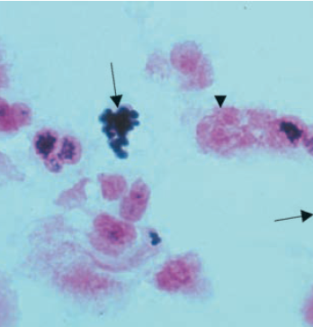
STAPHYLOCOCCI: GROUP CHARACTERISTICS
staphylococci have a marked tendency to form clusters
Staphylococci have a typical gram-positive cell wall structure.
Like all medically important cocci, they are non-flagellate, nonmotile, and non–spore-forming.
In contrast to streptococci, staphylococci produce catalase
More than one dozen species of staphylococci colonize humans; of these, S aureus is by far the most virulent.
The ability of S aureus to form coagulase separates it from other, less virulent species

Slide 5
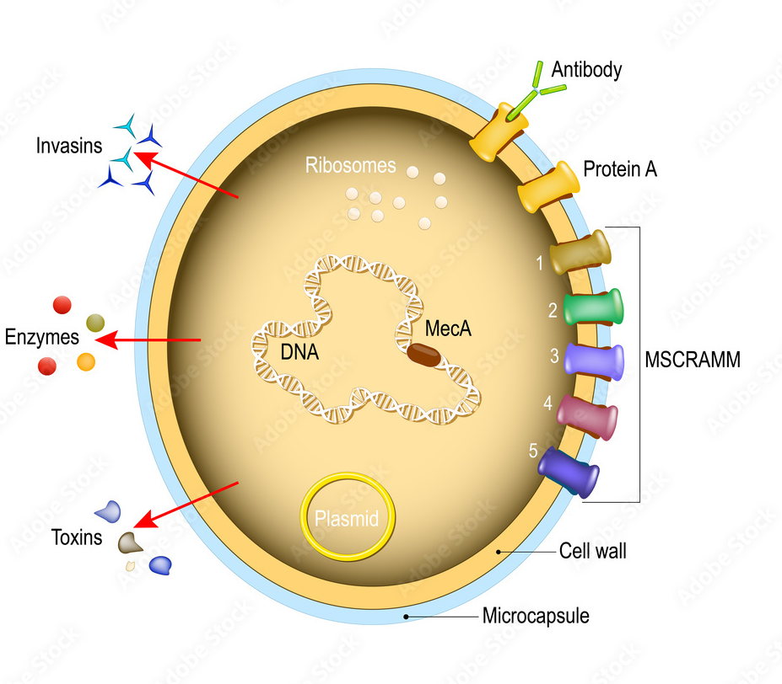
STRUCTURE
Surface proteins such as clumping factors(Clfs), which bind to fibrinogen, and fibronectin-binding proteins (FnBPs) likely play a role in the early stages of infection.
Another protein, surface protein A (SpA), is unique in that it binds the Fc portion of IgG molecules, leaving the antigen-reacting Fab portion directed externally (turned around).
SpA is also able to stimulate cytokines (TNF-α), platelets, and activate B cells.

Slide 6
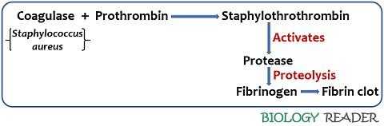
Metabolism
After overnight incubation on blood agar, S aureus produces white colonies that tend to turn a color with time.
The most important laboratory test used to distinguish S aureus from other staphylococci is the production of coagulase,
Coagulase is an enzyme which binds prothrombin in a manner that provides for the cleavage of fibrinogen to fibrin.
It is demonstrated by incubating staphylococci in plasma; this produces a fibrin clot in a few hours.

Slide 7
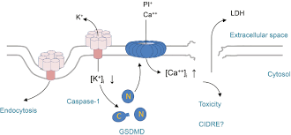
Toxins and Biologically Active Extracellular Enzymes

Slide 8
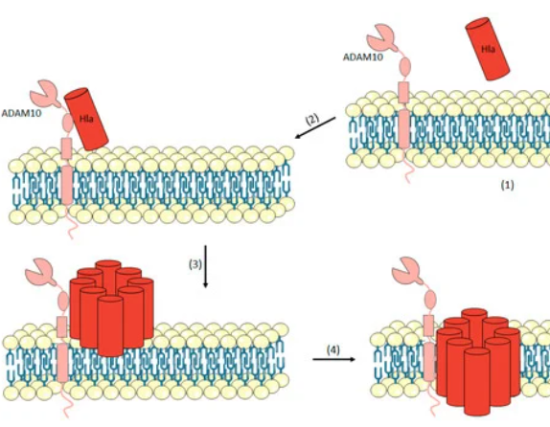
Toxins
Staphylococcus aureus produces a number of named cytolytic toxins (α, β, δ, γ), of which α-toxin is the most important.
α-Toxin, is a protein secreted by almost all strains of S aureus.
It is a pore-forming cytotoxin that lyses the cytoplasmic membranes by direct insertion into the lipid bilayer to form transmembrane pores. Leading to cell death.
Another pore-forming toxin is active against neutrophils and thus long ago named Panton-Valentine leukocidin (PVL).
PVL is also active against platelets. It causes tissue necrosis.

Slide 9
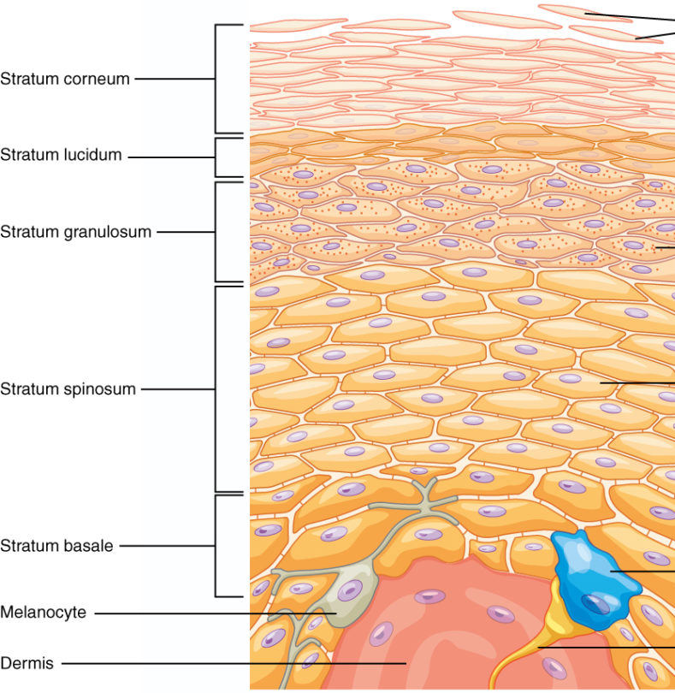
Exfoliatin
Exfoliatin is produced by a small proportion of S aureus strains.
It binds to a specific cell membrane ganglioside found only in the stratum granulosum of the keratinized epidermis of the skin.
There it causes intercellular splitting of the epidermis between the stratum spinosum and stratum granulosum, presumably by disruption of intercellular junctions.
The toxin itself is a protease which acts on desmosomes important to interkeratinocyte adhesion.

Slide 10
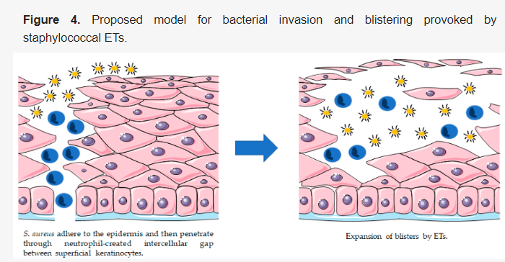

Slide 11
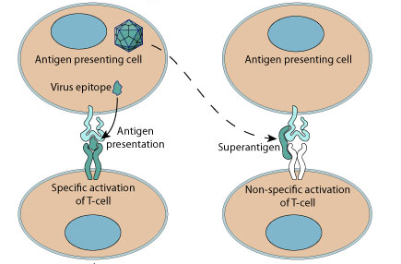
Staphylococcal Superantigen Toxins
The superantigens (SAgs) are a family of secreted proteins that are able to stimulate a large fraction of T cells, irrespective of the specificity of the T cell receptor (TCR) for antigen.
This process not only bypasses the specificity of antigen processing but results in massive cytokine release due to the ability of these superantigens to activate up to 20% of the total T-cell pool.
Examples of staphylococcal superantigens are staphylococcal enterotoxins,
and the more recently discovered toxic shock syndrome toxin (TSST-1).

Slide 12
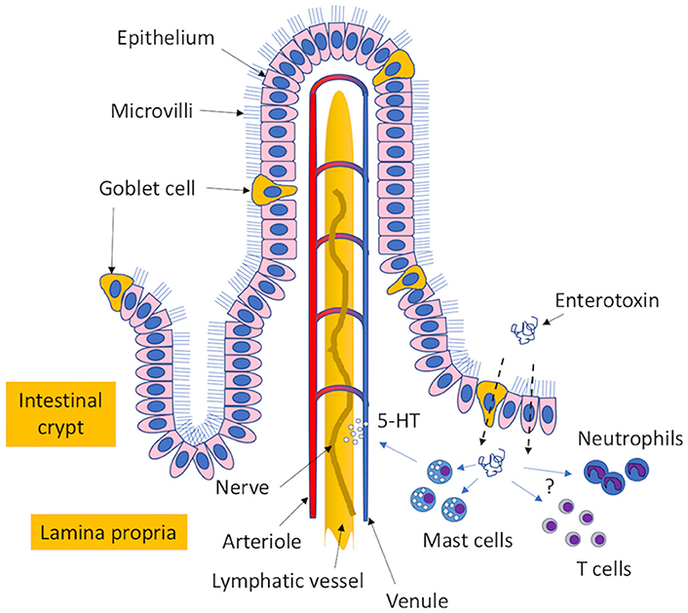
Staphylococcal Superantigen Toxins: enterotoxins
Once formed, these toxins are quite stable, still active even after boiling or exposure to gastric and jejunal enzymes
The enterotoxins transit through mucus-expelling goblet cells and epithelial cells in the intestinal epithelium to reach the lamina propria.
Here, the enterotoxins can interact with mast cells to induce the release of serotonin precursor, which interacts with the vagus nerve to cause an emetic response.

Slide 13
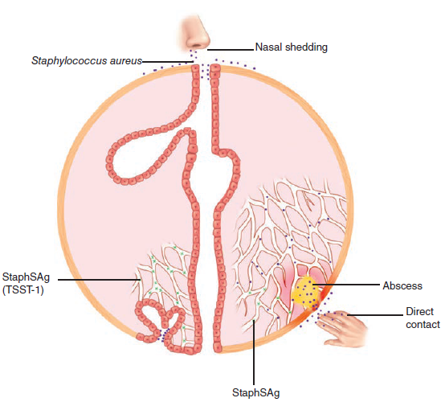
EPIDEMIOLOGY
The basic human habitat of S aureus is the nose.
From the nasal site, the bacteria are shed to the exposed skin and clothing of the carrier and others with whom they are in direct contact.
Spread is augmented by touching the face and, of course, nose picking. It is blocked by handwashing, S aureus can gain deeper access either through skin appendages or trauma
Most S aureus infections acquired in the community are autoinfections.
Unlike many pathogenic bacteria, S aureus can survive periods of drying; for example, recurrent skin infections can result from use of clothing contaminated with pus from a previous infection.

Slide 14
PATHOGENESIS
1. Primary Infection
The initial stages of attachment by S aureus are mediated by a number of surface proteins ; glycoprotein fibronectin, that mediates adhesion.
This allows S aureus to persist and to produce α-toxin and other cytolysins, which injure the cell.
As the lesions become destructive and spread below the surface, other proteins that bind to collagen and other elements of the extracellular matrix may play a role.
At this stage, actions of on fibrinogen-binding, and the antiphagocytic effect of protein A binding to IgG, and coagulase to limit the effectiveness of host phagocytes.
The inflammatory cells, fibrin, and other tissue components form a wall, which becomes the painfully familiar boil (A carbuncle )

Slide 15
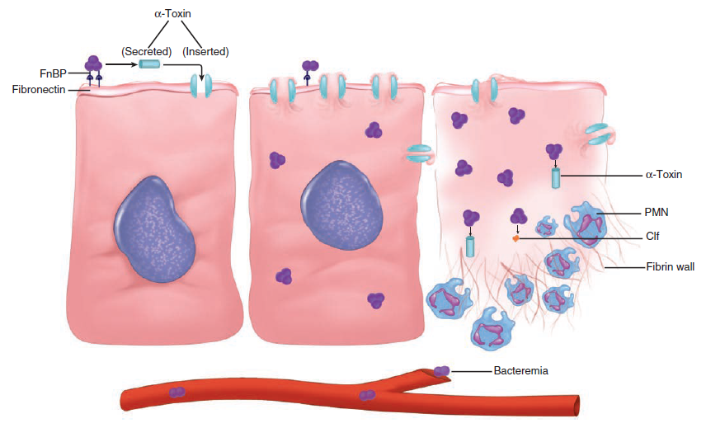

Slide 16
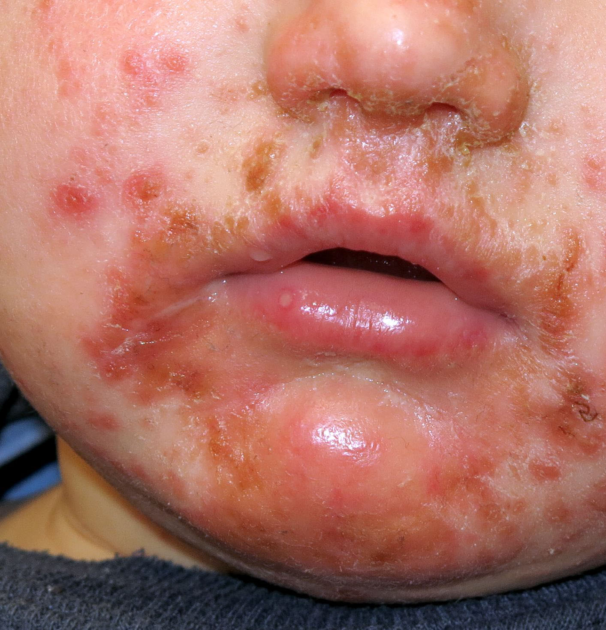
2.Toxin-mediated Disease
In staphylococcal food poisoning, there is no infection at all. The contaminating bacteria produce StaphSAg (superantigens) in the food, which can initiate its enterotoxin action on the intestine within hours of its ingestion.
Exfoliative Toxin absorbed at the infection site reaches its infant stratum granulosum binding site through the circulation causing widespread desquamation by its action on the keratinized epidermis as in the staphylococcal scalded skin syndrome.
In older children, exfoliative toxin-producing strains may also cause a localized blister-like lesion called bullous impetigo.
In staphylococcal TSS, TSST-1 is produced during the course of a staphylococcal infection with systemic disease as a result of absorption of toxin from the local site.

Slide 17
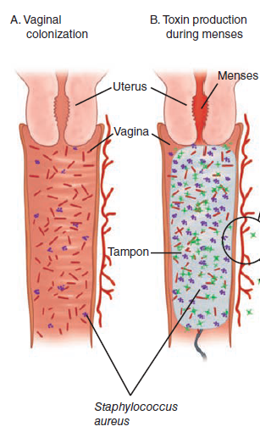
Menstruation-associated TSS
Menstruation-associated TSS requires a combination of improbable events.
At any one time, less than 15% of women carry S aureus in their vaginal flora, and less than 20% of these have the potential to produce TSST-1.
During menstruation, the relatively high protein level and pH in the vagina favor accelerated growth of these staphylococci.
In the presence of such a strain, the combination of menstruation and the composition of high-absorbency tampons provide pH and ionic conditions that enhance both the growth of the staphylococci and the production of TSST-1.
Toxin absorbed from the vagina can then circulate to produce the multiple effects of massive superantigen-mediated cytokine release

Slide 18
Diagnosis
Staphylococci grow overnight on blood agar incubated aerobically.
Catalase and coagulase tests performed directly from the colonies are sufficient for identification.
In epidemiologic investigations, molecular methods such as pulsed field gel electrophoresis are now used to “fingerprint” the spread of virulent clones.
Antibiotic susceptibility tests are indicated because of the emerging resistance to multiple antimicrobials, particularly methicillin-resistant S aureus (MRSA).
Deep staphylococcal infections such as osteomyelitis and deep abscesses present special diagnostic problems when the lesion cannot be directly aspirated or surgically sampled.
Blood cultures are usually positive in conditions such as acute staphylococcal arthritis, osteomyelitis, and endocarditis, but less often in localized infection such as deep abscesses.

Slide 19
TREATMENT
Most boils and superficial staphylococcal abscesses resolve spontaneously without antimicrobial therapy.
Those that are more extensive, deeper, or in vital organs require a combination of surgical drainage and antimicrobials for optimal outcome

Slide 20
STAPHYLOCOCCAL RESISTANCE
When penicillin was introduced to the public after World War II, virtually all strains of S aureus were highly susceptible.
Since then, incidences of plasmid coding for penicillinase has been reported.
This enzyme opens the β-lactam ring, making the drug unable to bind with its target. The vast majority of isolates are now penicillin resistant.
Most known resistance is the methicillin resistant staphylococcus aureus (MRSA).

Slide 21
References
Sherris Medical Microbiology: An Introduction to Infectious Diseases.
Jawetz, Melnick & Adelberg's Medical Microbiology by Geo. F. Brooks, Karen C. Carroll, and Janet S. Butel
Prescott's Microbiology by Joanne Willey, Linda Sherwood, and Christopher J. Woolverton

