Slide 1
ORTHOTICS AND PROSTHETICS
[PT 308]
Dr. AMINU A. IBRAHIM (BPT, MPTh, Ph.D)
LECTURE NOTES FOR 3rD GRADE BPT STUDENTS
SPRING SEMESTER 2024-2025
DEPARTMENT OF PHYSIOTHERAPY, FACULTY OF APPLIED HEALTH SCIENCES
TISHK INTERNATIONAL UNIVERSITY
2024/2025

Slide 2
2
LECTURE OUTLINE
Learning objectives
Orthosis
Definition
Components/materials
Function/indication
Classification/types
Review
Reading resources/additional materials

Slide 3
ORTHOSIS AND PROSTHESIS
COURSE OBJECTIVES
Define orthoses including functions and indications
Classify the types of orthoses
Describe the physiotherapist's role in orthotics
Identify challenges in orthotics and potential solutions

Slide 4
ORTHOTICS

Slide 5
ORTHOTICS AND PROSTHETICS
ORTHOTICS
Definition
Orthotics is the science concerned with orthoses designed to support, align, prevent, or correct deformities, or improve the function of a body part.
Orthoses = Braces
Orthosis: is an appliance or a medical device used to support, align, prevent or correct deformities or improve the function of a part of a body.
Splint: is an appliance used to support/immobilize part of a body.
Caliper: is a device applied to lower limb to support or control a joint.

Slide 6
ORTHOTICS AND PROSTHETICS
ORTHOTICS
Function/indications
Immobilization of a joint or body part
Prevent deformity
Correct deformity (e.g. scoliosis brace)
Maintains correction
Protection from injury or post-surgery recovery
Relieve weight bearing
Facilitates ambulation
Relieve pain or pain management (e.g. knee braces)

Slide 7
ORTHOTICS AND PROSTHETICS
ORTHOTICS
Classification/types
CLASSIFICATION/TYPES
STATIC
DYNAMIC /FUNCTIONAL
He

Slide 8
ORTHOTICS AND PROSTHETICS
ORTHOTICS
Classification/types
Static orthoses
Orthoses that does not allow motion during use.
Primarily used for protection, support, or positioning.
Typically used in the early stages of injury or recovery.
Dynamic or functional orthoses
Orthoses that allow motion during use.
Primarily used to improve ROM or function.
Often used in rehabilitation and recovery phases to encourage movement.

Slide 9
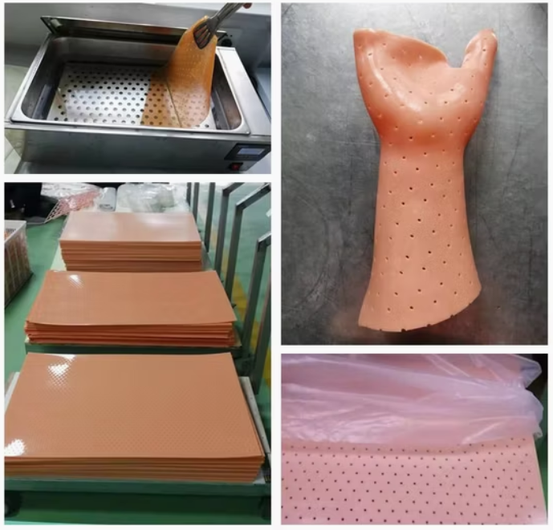
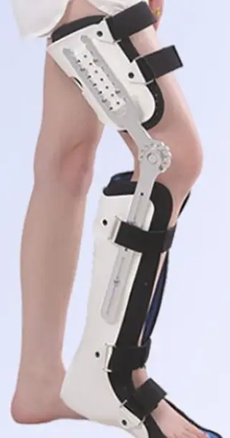
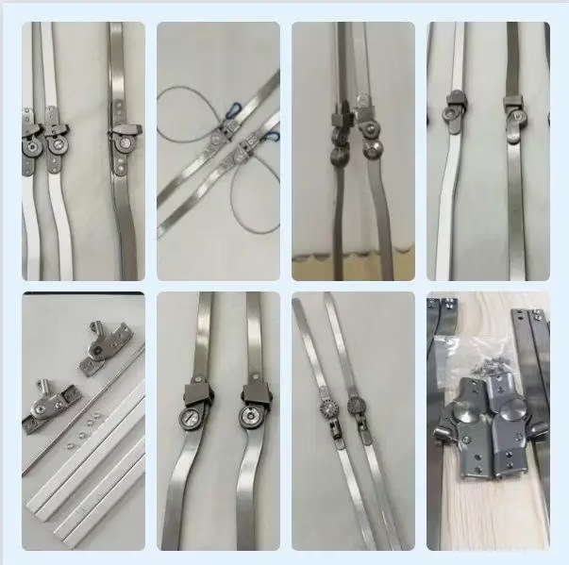
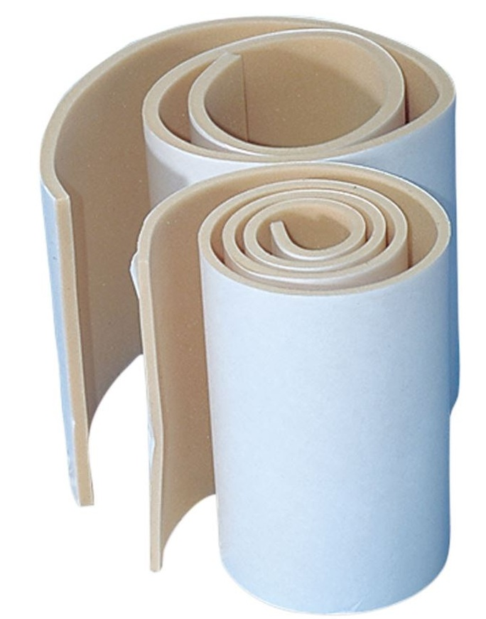
ORTHOTICS AND PROSTHETICS
ORTHOTICS
Materials used in orthoses
The following are typically used in making an orthosis
Thermoplastic materials (e.g., polypropylene).
Aluminum or steel for support.
Foam for padding.

Slide 10
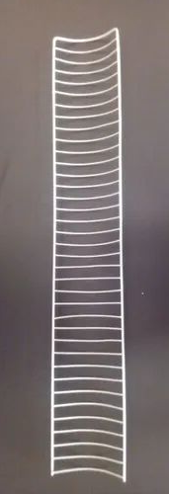
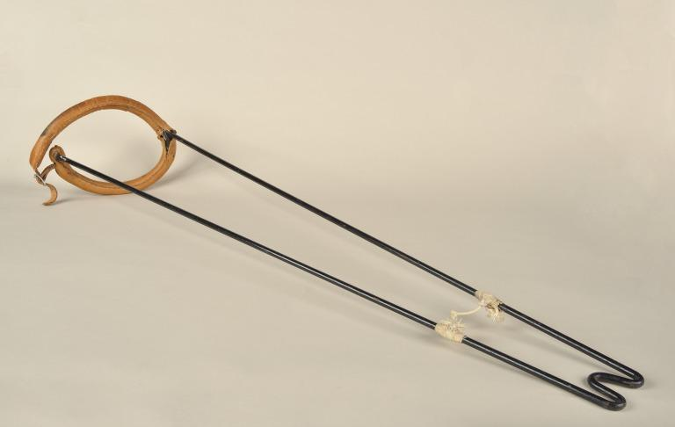
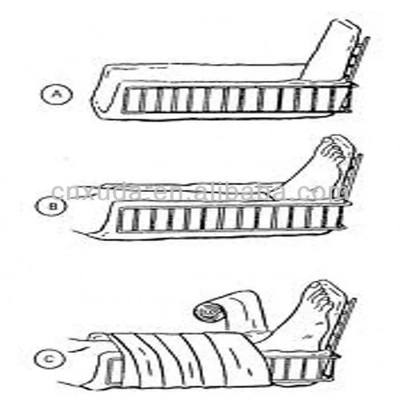
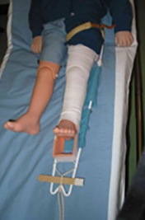
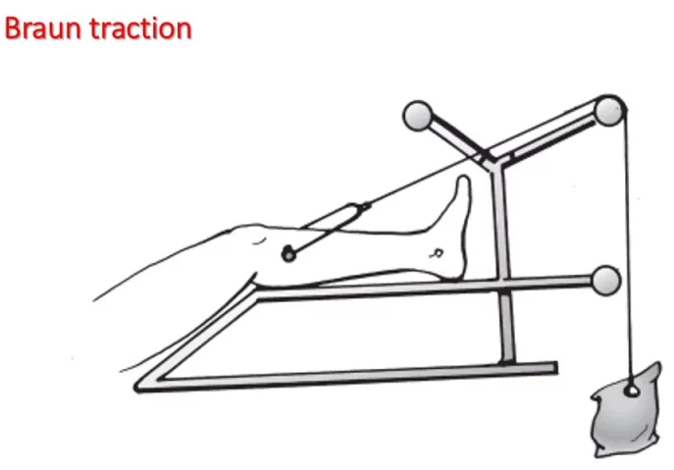
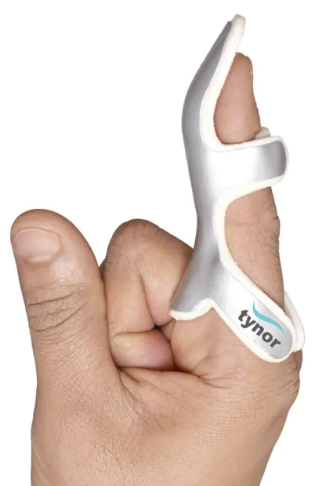
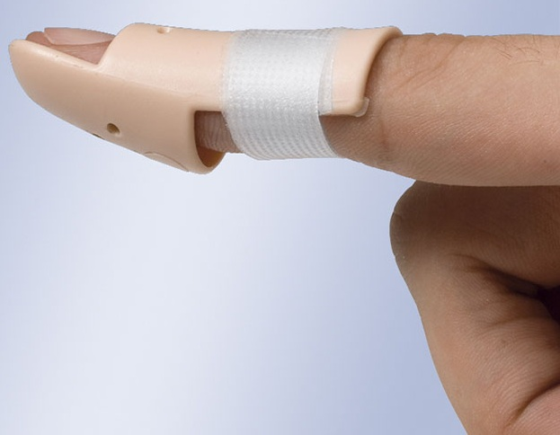
ORTHOTICS AND PROSTHETICS
ORTHOTICS
Common orthoses/braces, splints and their uses
Orthosis | Uses
Crammer-wire splint | Emergency immobilization
Thomas splint | Immobilization/reduction of femoral fracture
Bohler-Braun splint | Immobilization/reduction of LL fracture
Aluminum splint/stack splint/Frog splint | Immobilization of fingers
Crammer-wire splint
Thomas splint

Slide 11
ORTHOTICS AND PROSTHETICS
ORTHOTICS
Crammer-wire splint | Used for emergency immobilization e.g. limb fracture before applying permanent treatment.

Slide 12
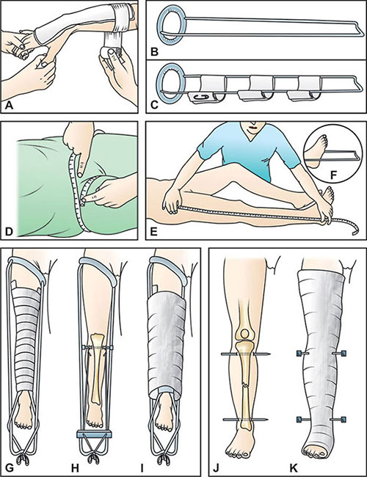
ORTHOTICS AND PROSTHETICS
ORTHOTICS
Thomas splint | Used for immobilization/reduction of femoral shaft & distal fractures

Slide 13
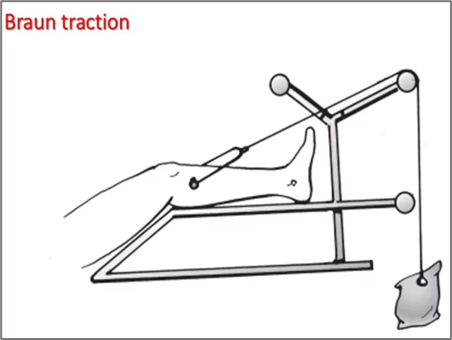
ORTHOTICS AND PROSTHETICS
ORTHOTICS
Bohler-Braun splint | 1. Used for stabilization of lower limb fracture e.g. femoral, proximal tibia 2. Post-surgical stabilization to maintain correct alignment of bones.

Slide 14
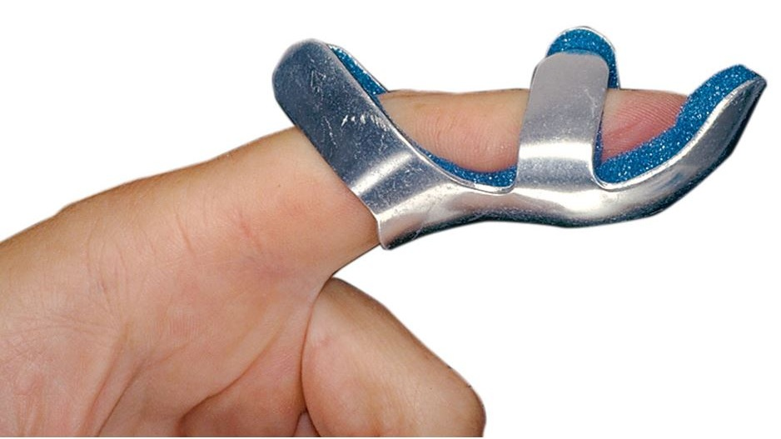
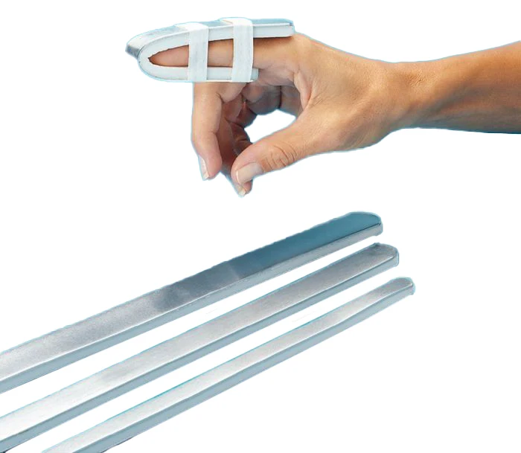
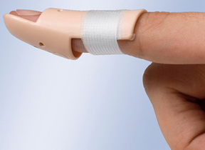
ORTHOTICS AND PROSTHETICS
ORTHOTICS
Frog splint | Typically U-shaped Used for immobilization of interphalangeal joints e.g. mallet finger
Aluminum splint | It is lightweight & flexible used for immobilization of interphalangeal joints
Stack splint | Used for immobilization of finger e.g. Mallet finger Keeps finger straight

Slide 15
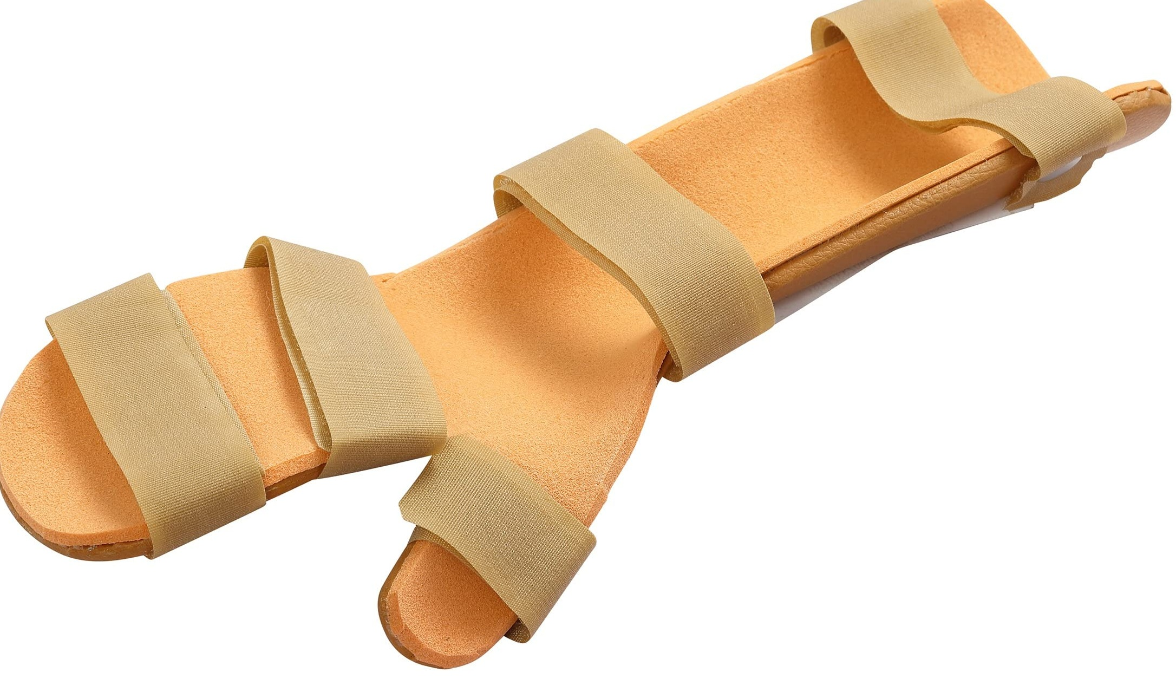
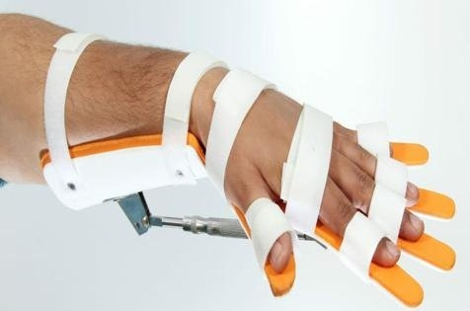
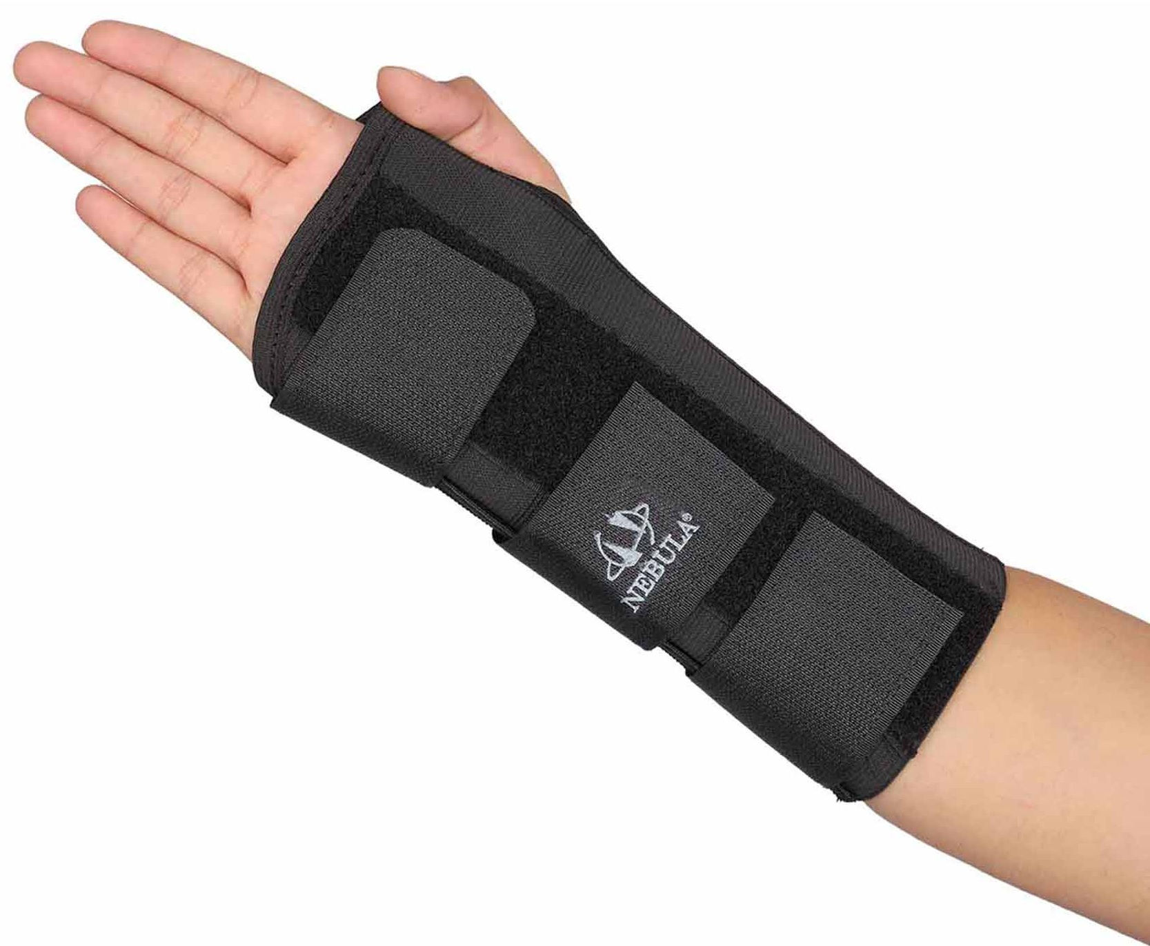
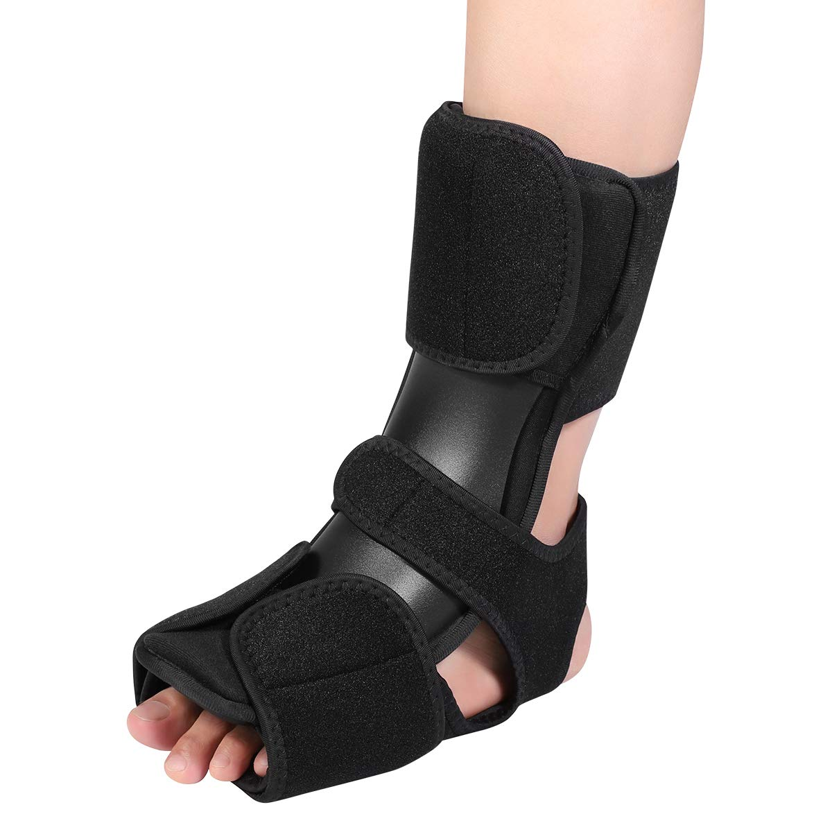
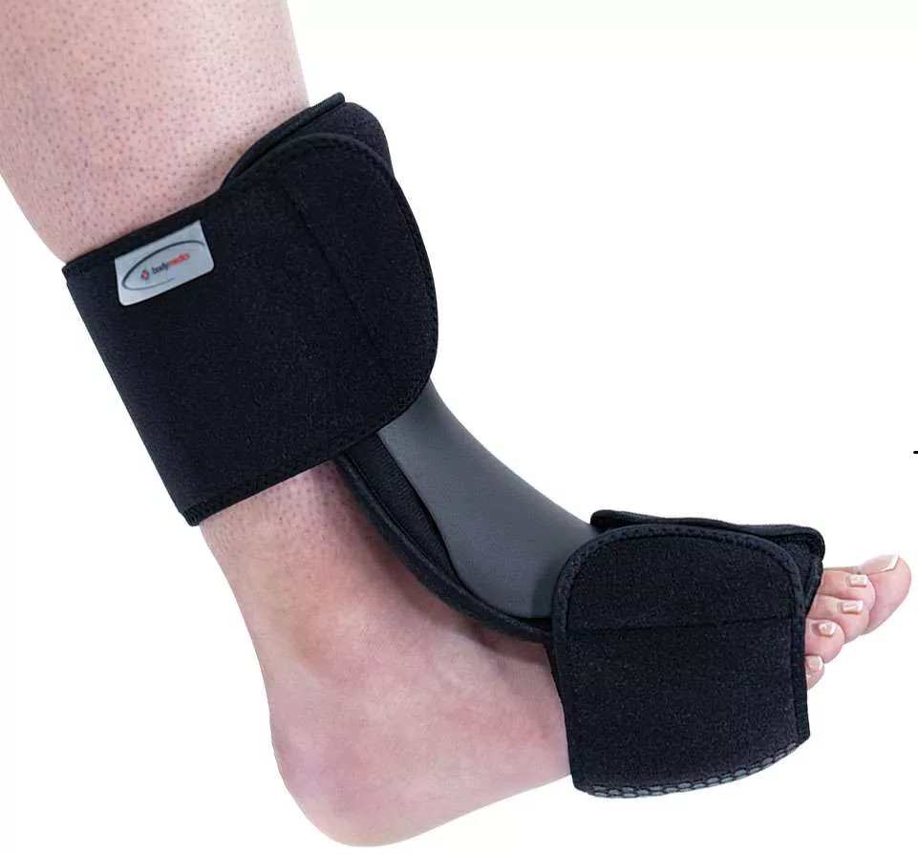
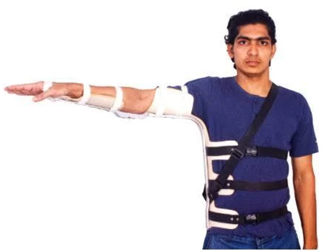
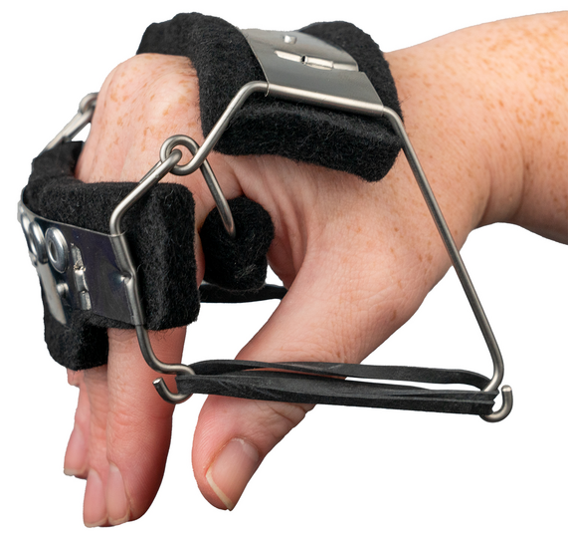
ORTHOTICS AND PROSTHETICS
ORTHOTICS
Orthosis | Uses
Cock-up splint | For radial nerve palsy (Hand drop)
Volkmann’s splint | For Volkmann’s Ischemic contracture (VIC)
Knuckle bender splint | For stabilization of tendon injury
Aeroplane splint | For brachial plexus injury (e.g. Erb’s palsy)
Toe-rising splint/foot drop splint | For foot drop
Volkmann’s splint
Cock-up splint
Knuckle bender splint
Aeroplane splint
Food drop splint

Slide 16
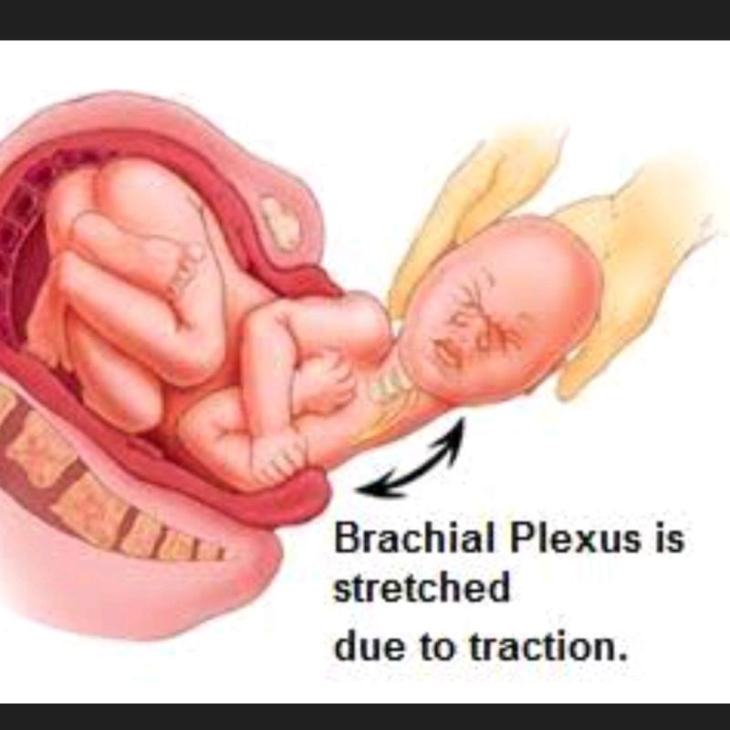
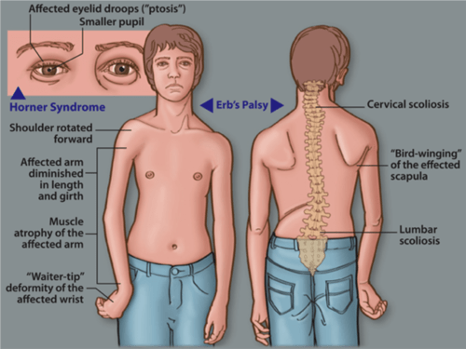
ORTHOTICS AND PROSTHETICS
ORTHOTICS

Slide 17
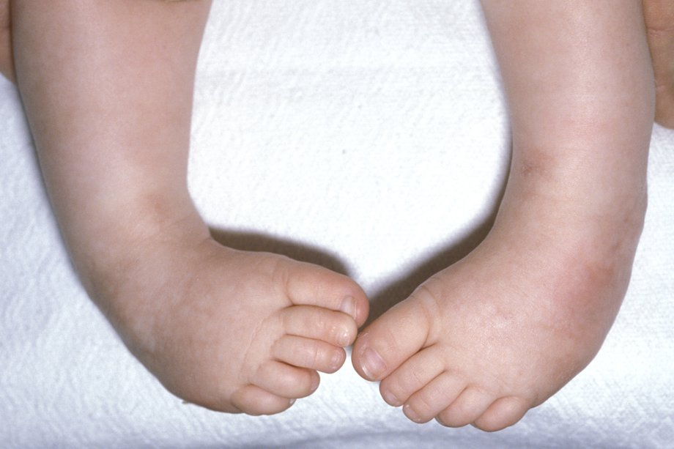
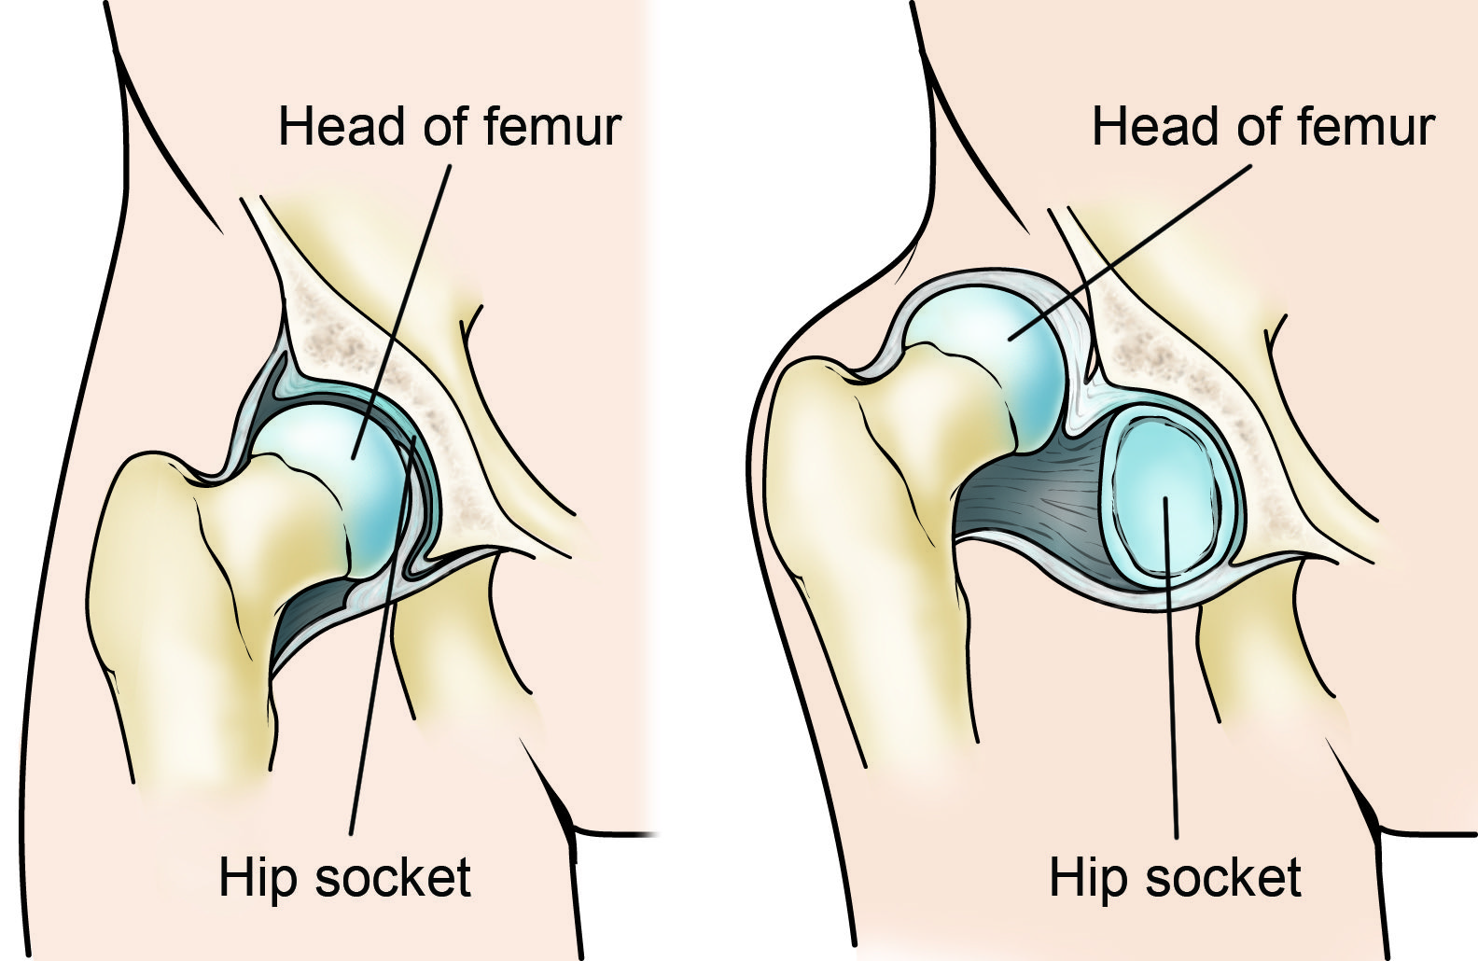
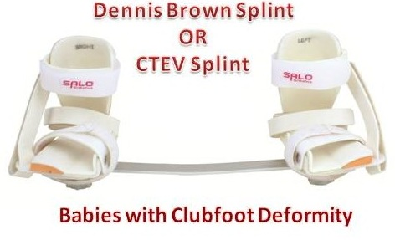
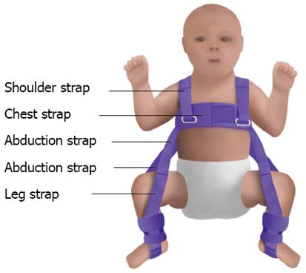
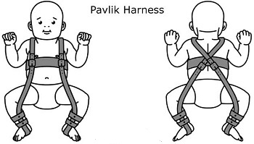
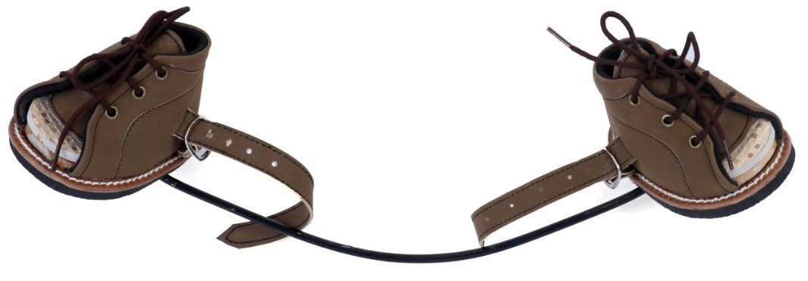
ORTHOTICS AND PROSTHETICS
ORTHOTICS
Orthosis | Uses
Von Rosen splint (Pavlik harness) | For developmental dysplasia (or dislocation) of the hip (DDH)
Dennis Brown/Steenbeck splint | For congenital talipes equinovarus (CTEV)
Pavlik harness
Denis Brown splint

Slide 18
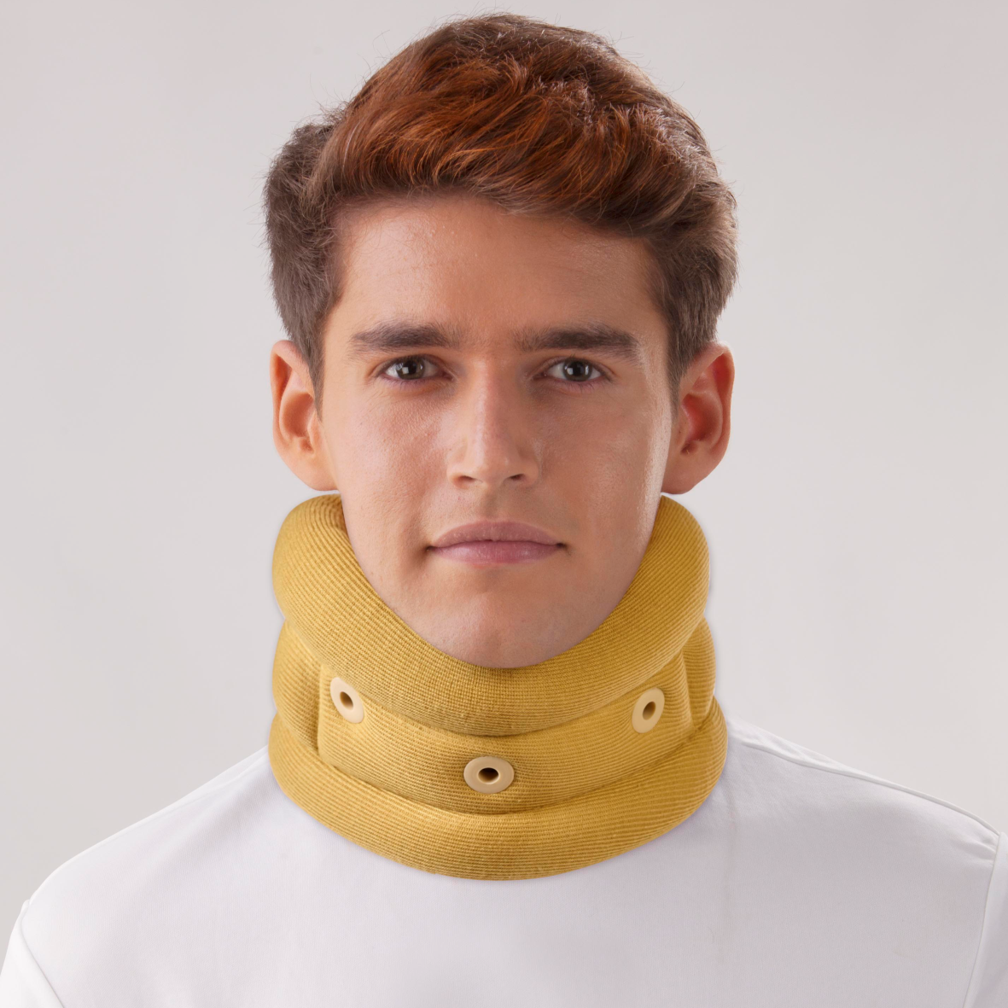
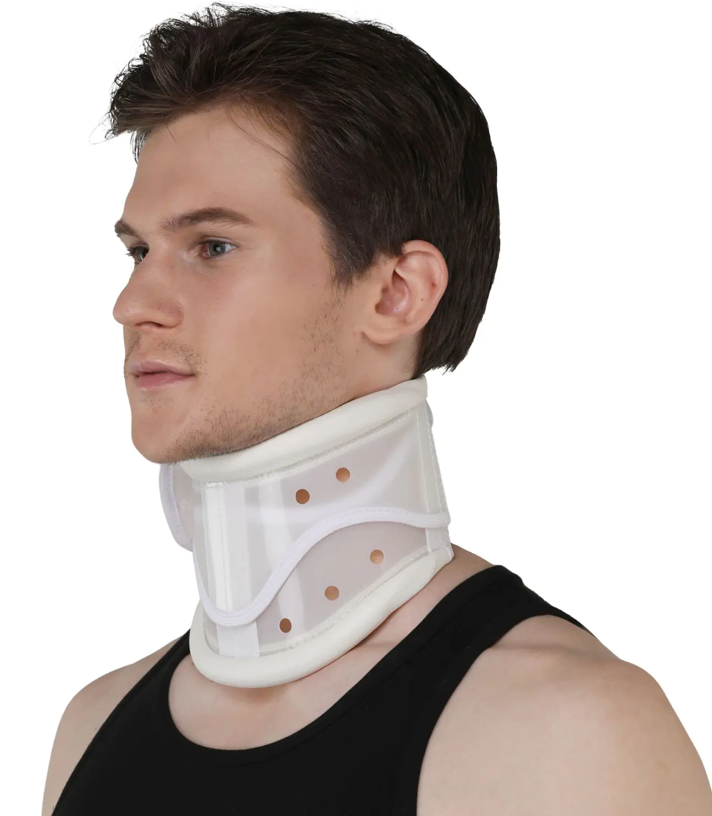
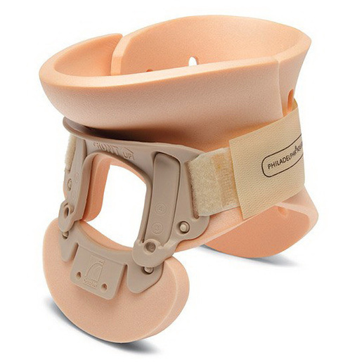
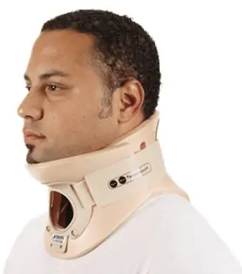
ORTHOTICS AND PROSTHETICS
ORTHOTICS
Orthosis | Uses
Cervical collar | For neck immobilization
Philadelphia collar | For neck immobilization (rigid support)
Four-post collar (SOMI brace) | For cervical spine injury
Halo vest | For cervical spine injury, TB cervical spine
Lumbar corset/belt | For lumbar immobilization, low back pain
Anterior spinal hyper extension (ASHE)/Tarlor’s brace | For dorso-lumbar spinal injury
Milwaukee brace, Boston brace | For scoliosis
Patella tendon bearing (PTB) brace | For weight bearing to distal LL (ankle & heel) e.g. in below knee amputation
Cervical collar
Philadelphia collar

Slide 19
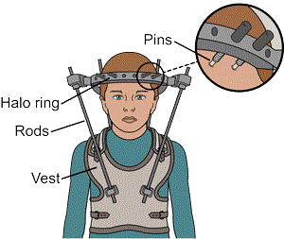
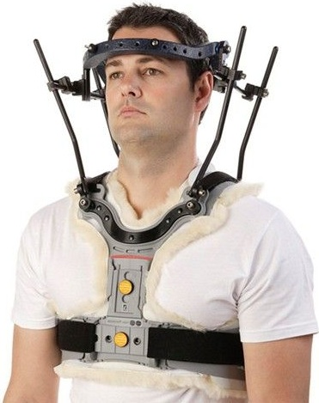
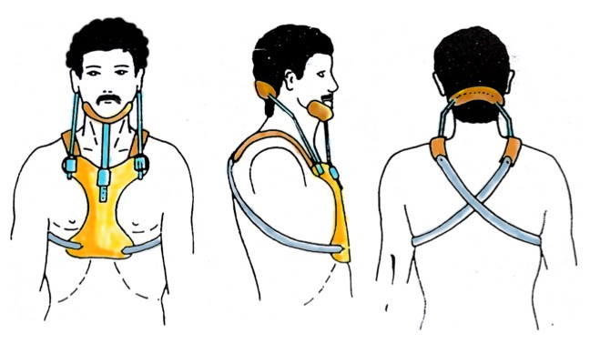
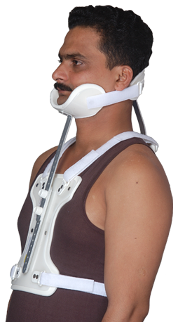
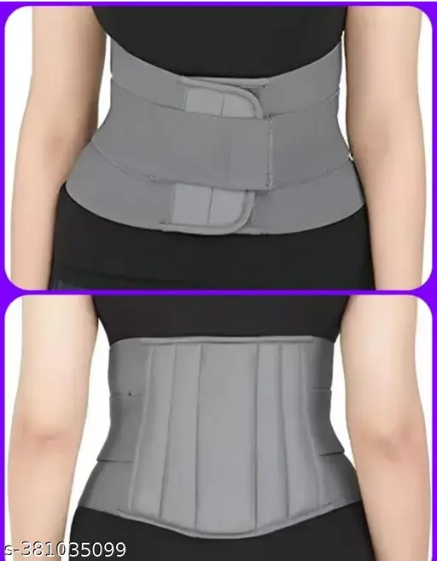
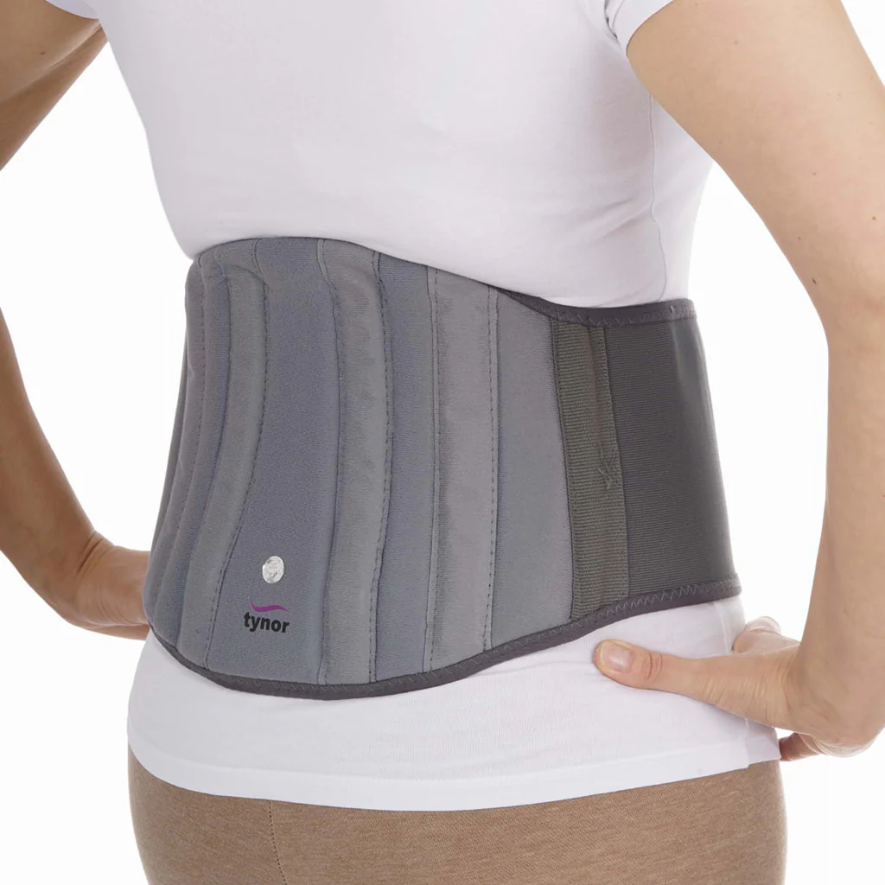
ORTHOTICS AND PROSTHETICS
ORTHOTICS
Four-post collar (SOMI brace)
Halo vest
Lumbar corset/belt

Slide 20
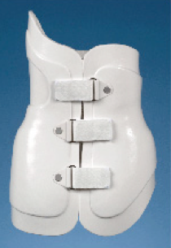
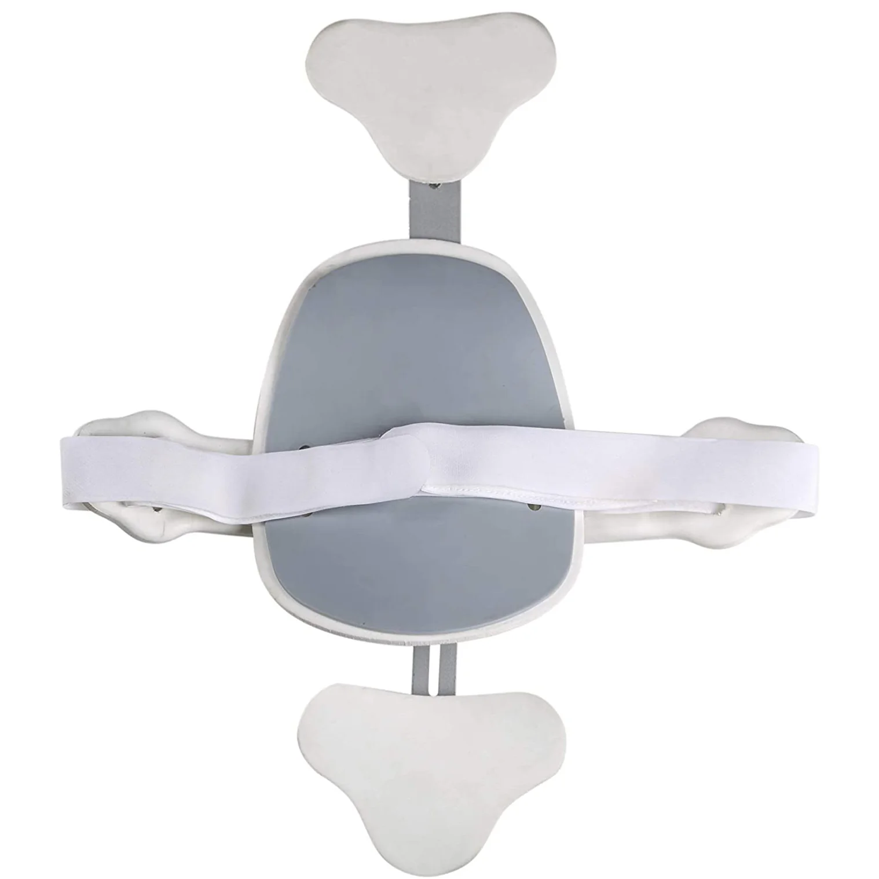
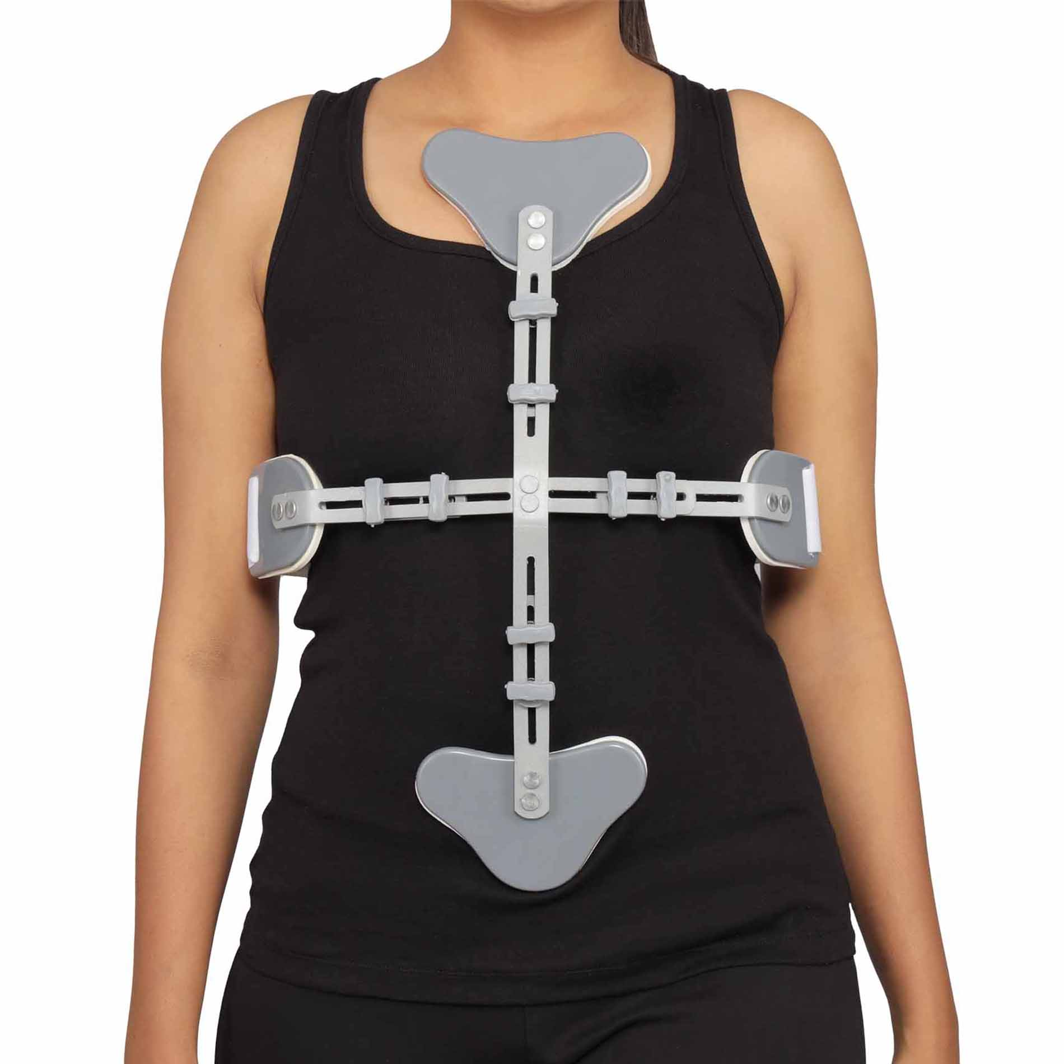
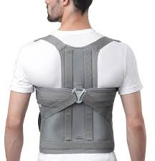
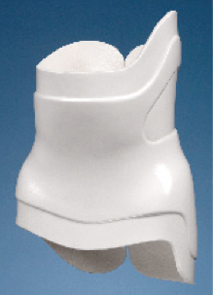
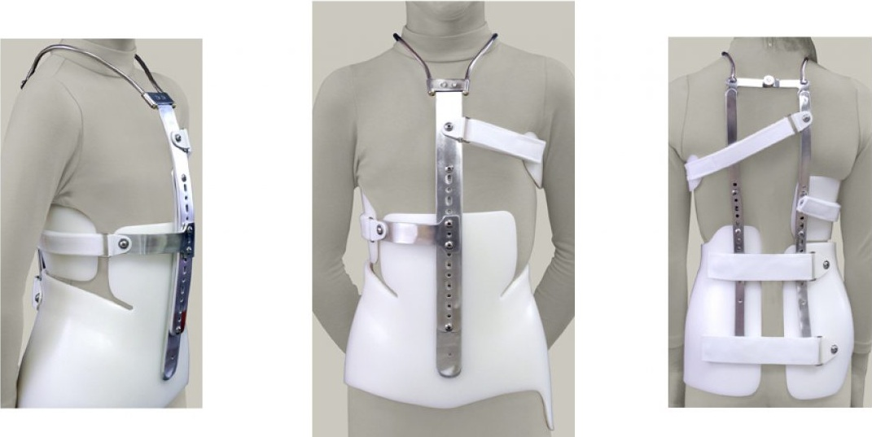
ORTHOTICS AND PROSTHETICS
ORTHOTICS
Boston brace
ASHE brace
Taylor’s vest
Milwaukee brace

Slide 21
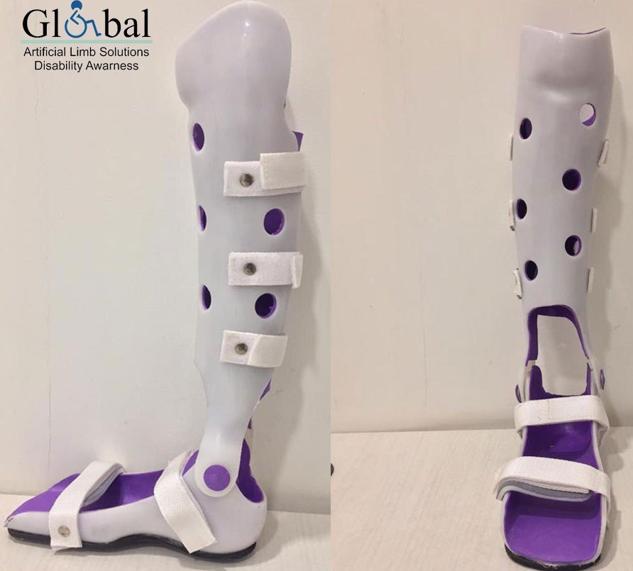
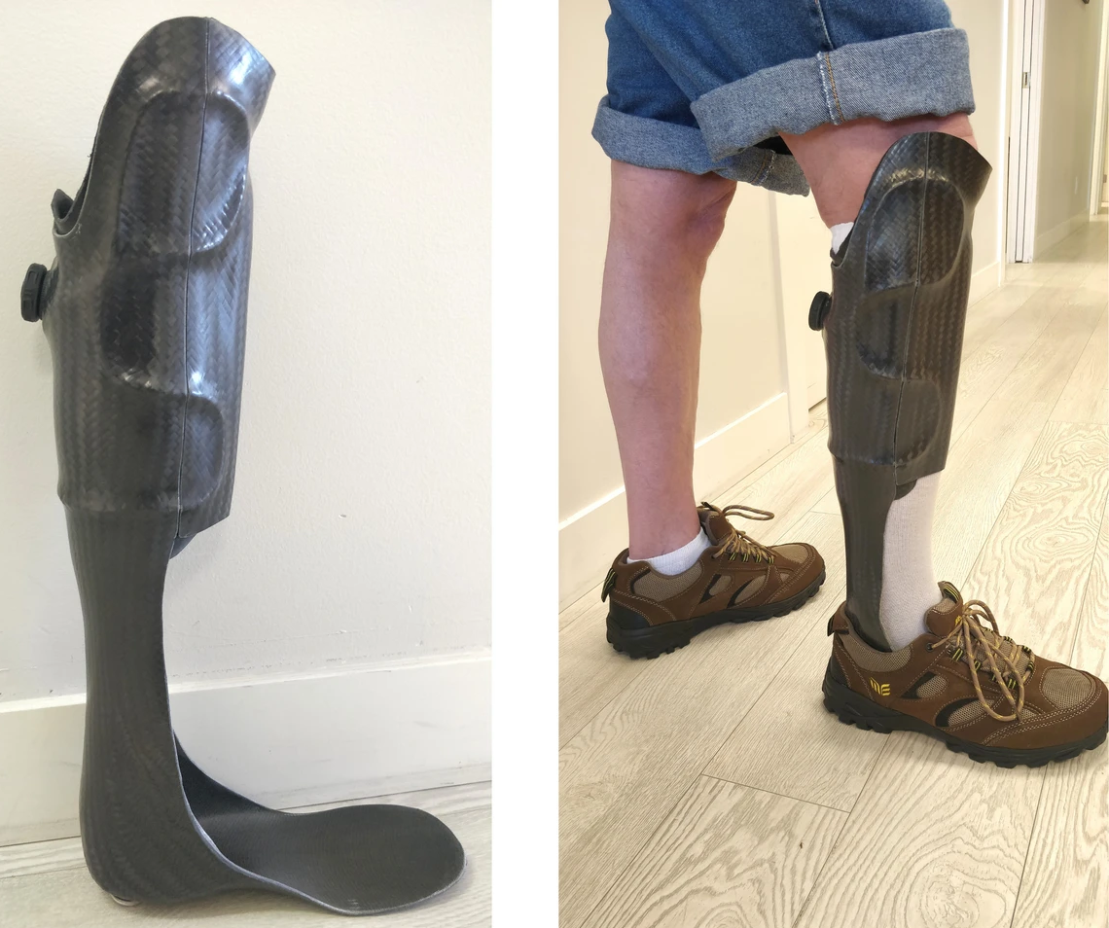
ORTHOTICS AND PROSTHETICS
ORTHOTICS
PTB brace

Slide 22
ORTHOTICS AND PROSTHETICS
REVIEW

Slide 23
OTHER READING SOURCES
TEXT
Chinnathurai, R., Sekar, P., Kumar, M. R., Manoj, K. N., & Kumar, C. S. (2010). Short textbook of prosthetics and orthotics. Jaypee Brothers Medical Publishers (P) Ltd.
Shurr, D. G., & Michael, J. W. (2001). Prosthetics and orthotics (2nd ed.) Prentice Hall.
Chui, K. K., Jorge, M., Yen, S.-C., & Lusardi, M. M. (2019). Orthotics and prosthetics in rehabilitation (4th ed.). Publisher.
Wilson, A. B. (Ed.). (Year). Orthosis and prosthesis (M. Dolan, Managing Ed.). Editorial board: A. L. Muilenburg, H. F. Gardner, A. Guilford, H. B. Hanger, S. Paul, R. E. Tooms, & W. L. M. Publisher.
Sinha, A. G., Tripathy, S. K., & Sharma, R. (2022). Orthoses, prostheses & assistive devices for physiotherapists [Kindle edition]. Jaypee Brothers Medical Publishers (P) Ltd.

Slide 24
THANKS FOR LISTENING

