Slide 1
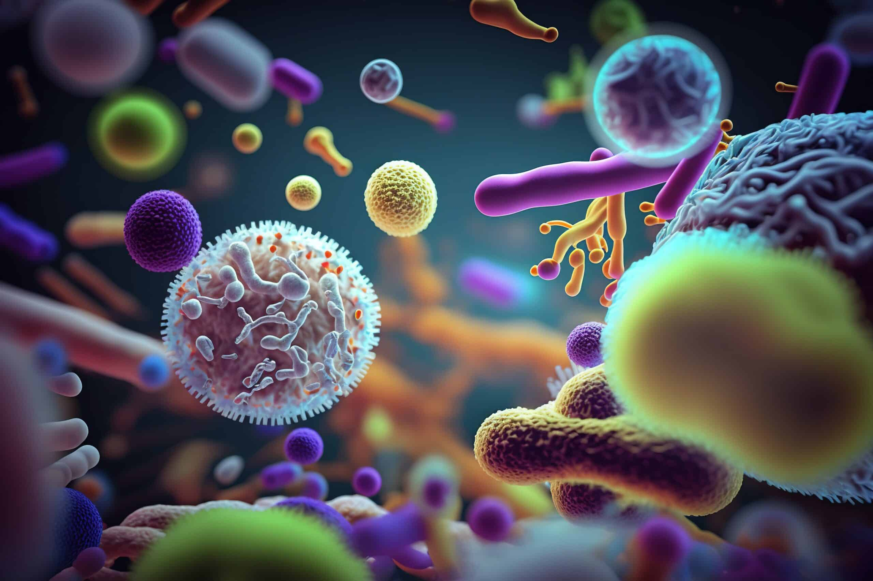

Gram Negative cocci: Neisseria:
Neisseria meningitidis & Neisseria gonorrhoeae
Ms. Heshu J. Ahmed
PhD Candidate
Medical Bacteriology 423
Spring Semester
Week Five

Slide 2
Outline
Characteristics of the bacteria
Epidemiology
Pathogenesis
Immunity
Manifestations
Diagnosis
Treatment

Slide 3
Objectives
Understand the mechanisms of antigenic variation in N. gonorrhoeae
Describe the epidemiology and transmission routes
Explain the pathogenesis of N. gonorrhoeae
Recognize the clinical manifestations

Slide 4
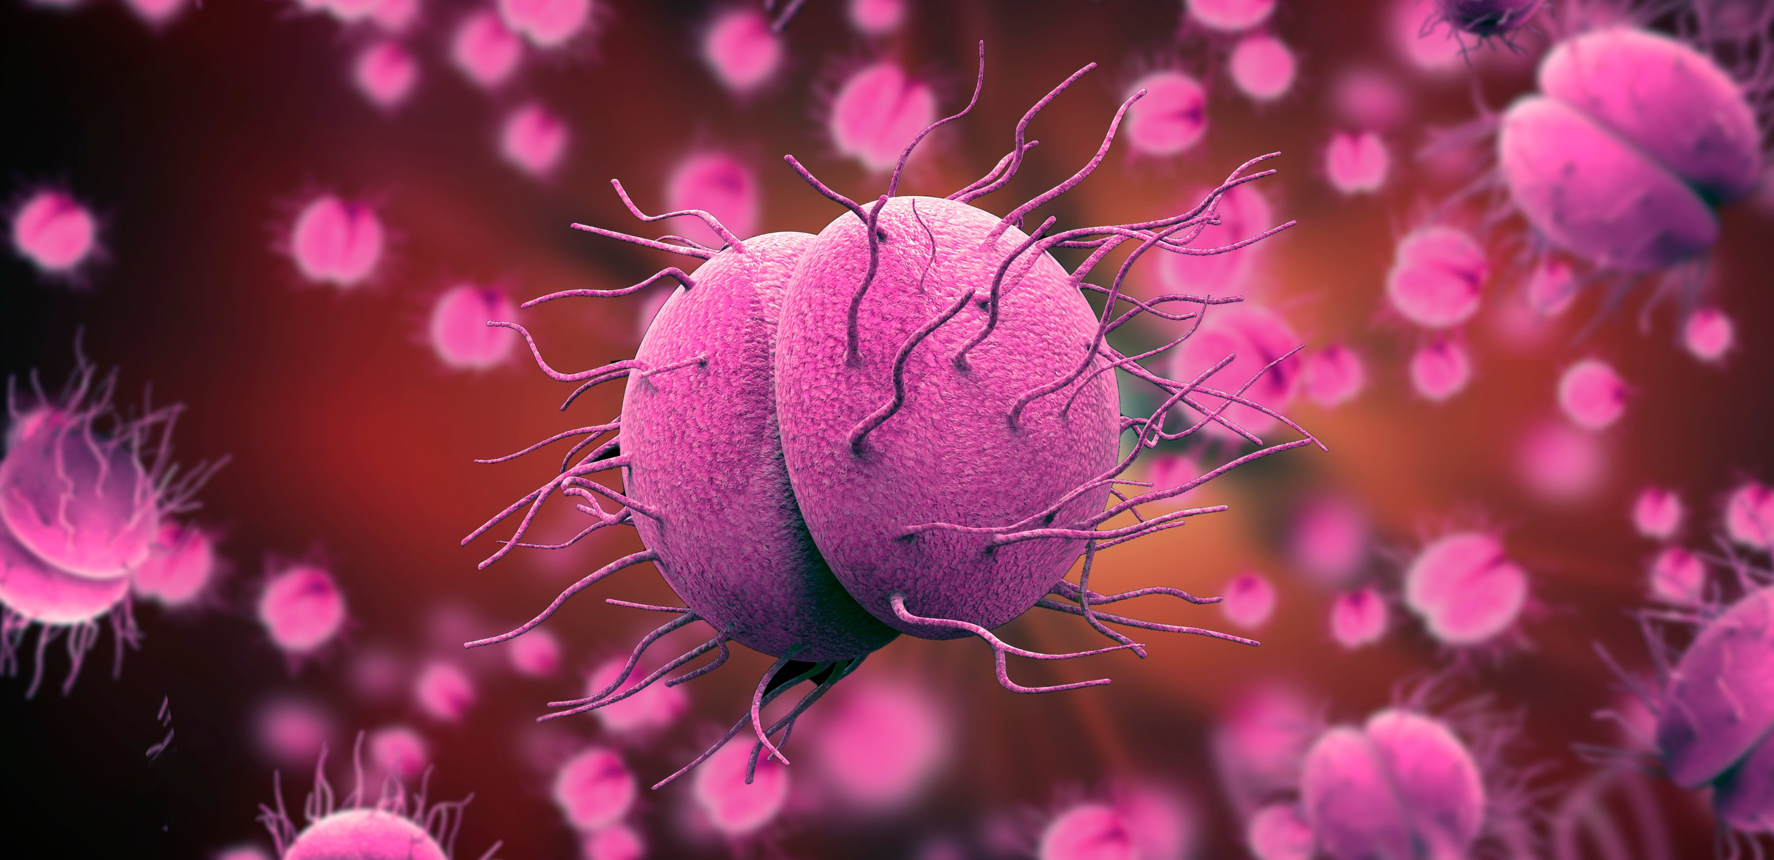
Introduction to Neisseria
The Genus Neisseria contains both pathogenic and commensal species.
Two major human pathogens:
  Neisseria meningitidis (Meningococcus)
  Neisseria gonorrhoeae (Gonococcus)
Commensal species inhabit the upper respiratory and alimentary tracts.

Slide 5
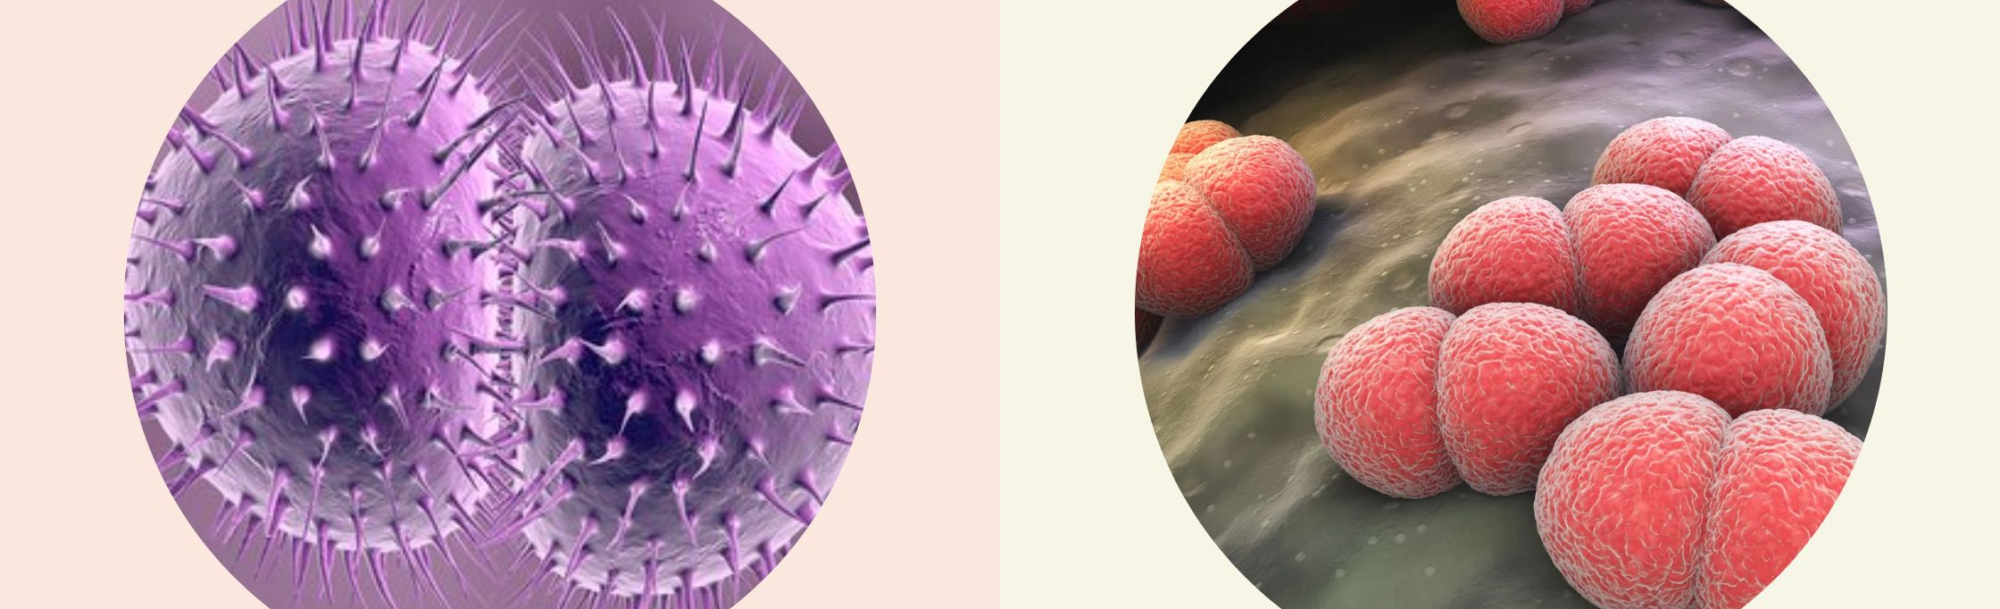
General Characteristics
Gram-negative diplococci (kidney-bean shaped, flattened adjacent sides)
Nonmotile, non–spore-forming, non–acid-fast
Cell wall: Peptidoglycan + outer membrane with LPS (LOS in Neisseria)
Obligate aerobes, require CO₂ enrichment
Oxidase-positive
Species differentiated by carbohydrate fermentation patterns

Slide 6
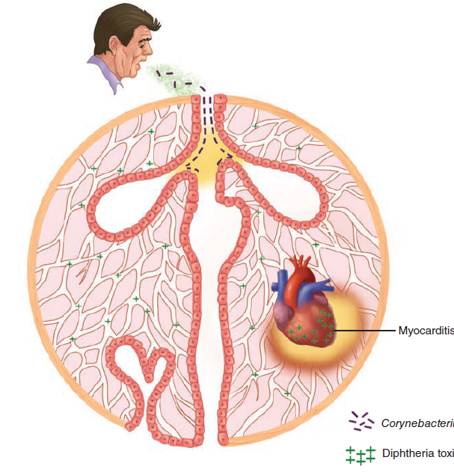
Epidemiology
Neisseria Cell Structures
Pili (Type IV): Adhesion, twitching motility
Outer Membrane Proteins (OMPs): Porins, adhesion molecules
Lipo-oligosaccharide (LOS):
  Similar to LPS but lacks long O-antigen
  Highly endotoxic
Capsule: Present in N. meningitidis only.

Slide 7
Neisseria meningitidis - Bacteriology
Grows on blood agar; enhanced by CO₂
Produces medium-sized smooth colonies
13 serogroups, based on capsule antigens
  Disease-associated: A, B, C, Y, W-135
Expresses pili & various OMPs
Capable of capsule switching via genetic recombination

Slide 8
Epidemiology of Meningococcal Disease
Spread via respiratory droplets
Carriage in 3–25% of healthy individuals
Close contact (e.g., families, dorms, military camps) increases transmission
Highest risk:
  Children (6 months–5 years)
  Young adults (18–25 years)
Serogroup A causes large epidemics (Africa, Asia, Middle East)

Slide 9
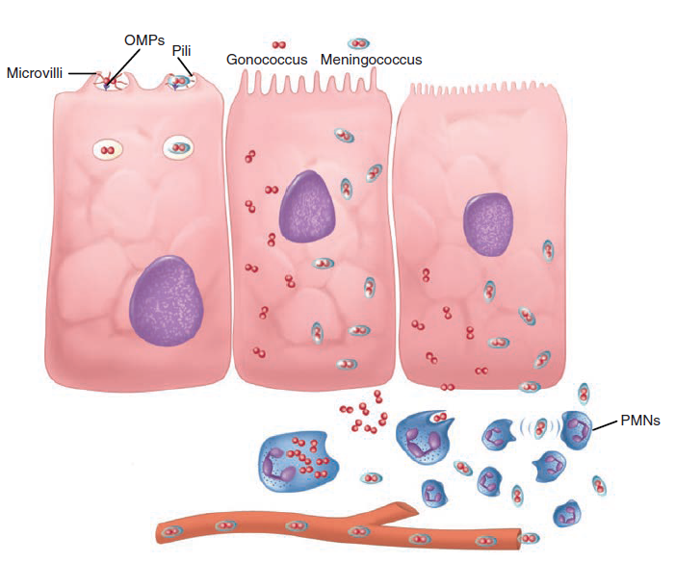
Pathogenesis of Meningococci
The Meningococcus is an exclusively human parasite
Attachment via pili to nasopharyngeal epithelium (CD46 receptor)
Formation of microcolonies, invade non-ciliated cells
Traverse epithelium → reach bloodstream
Capsule & LOS help evade the immune system
Endotoxin release causes inflammation and vascular damage

Slide 10
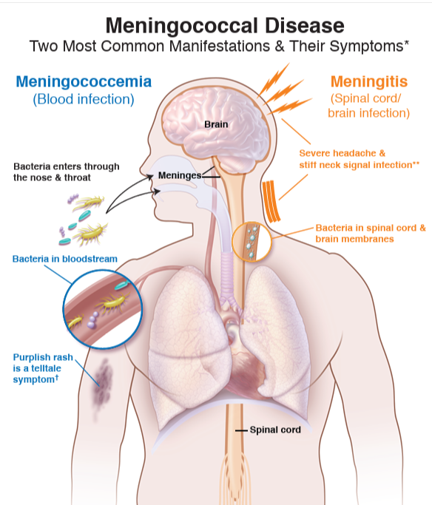
Clinical Manifestations
Acute purulent meningitis: Fever, stiff neck, photophobia
Petechial rash → DIC
Meningococcemia:
  With or without meningitis
  May lead to Waterhouse-Friderichsen syndrome
Less common: Pneumonia, arthritis

Slide 11
Diagnosis of Meningococcal Infection
Gram stain of CSF: Bean-shaped gram-negative diplococci
Culture: Blood, CSF, skin lesions (grows on blood/chocolate agar)
Carbohydrate fermentation tests, immunoassays, or NAA
Sero-grouping: Slide agglutination (not critical for immediate treatment)
Treatment & Prevention
Penicillin G: First-line (high CNS penetration)
Third-generation cephalosporins: Ceftriaxone, cefotaxime
Alternatives for allergy: Moxifloxacin, Chloramphenicol
Vaccination:
  Targets common serogroups (A, B, C, Y, W-135)
  Important in outbreak control and high-risk populations

Slide 12
Neisseria gonorrhoeae

Slide 13
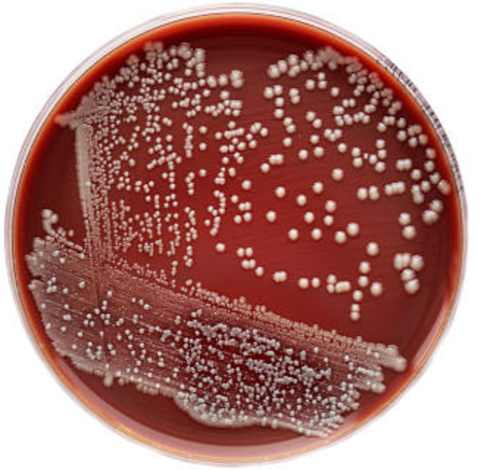
Bacteriology
Requires chocolate agar and CO₂
Colonies: Small, smooth, non-pigmented
Slow growing; mature colonies in 48 hrs
Possesses pili (type IV), similar to meningococcus
Fastidious and sensitive to environmental conditions

Slide 14
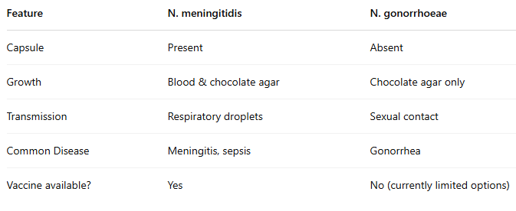
Comparison between N. meningitidis vs. N.gonorrhoeae

Slide 15
ANTIGENIC VARIATION
N. gonorrhoeae and N. meningitidis change their surface antigens from generation to generation.
In N. gonorrhoeae, pili, Opa proteins, and LOS undergo antigenic variation.
Pili variation is mainly due to recombination between expressed (pilE) and silent (pilS) genes.
Opa proteins are turned “on” or “off” by a process called replicative slippage.
LOS variation occurs, but the genetic mechanism is unknown.
These changes help the bacteria avoid immune detection and improve host attachment.

Slide 16
Epidemiology
Gonorrhea is a major public health issue.
Reported cases in the U.S. represent less than half the true number.
Highest rates: women (15–19) and men (20–24).
Asymptomatic carriers, especially women, are key to transmission.
Transmission is mostly sexual (genital, oral, rectal).
Nonsexual spread (e.g., toilet seats) is very rare.
Most infected men have symptoms; many women do not.

Slide 17
Pathogenesis:
1. Attachment and Invasion
Gonococci attach to mucosal surfaces using pili and Opa proteins.
Pili help initial attachment and movement across cells.
Opa proteins cause tighter binding.
Host cells then engulf the bacteria (phagocytosis).
Gonococci pass through cells into the submucosa.

Slide 18
2. Survival in the Submucosa
Gonococci resist host defenses without a capsule.
They activate LOS to avoid complement attack.
Pili and Opa proteins block phagocytosis.
Bacteria resist killing inside phagocytes using antioxidants.

Slide 19
3. Spread and Dissemination
Gonococci usually stay localized in the genital tract.
They cause inflammation and local tissue damage.
Infection can spread to deeper tissues: prostate, epididymis, and fallopian tubes.
Pili helps move bacteria to the fallopian tubes.
LOS and peptidoglycan fragments damage the epithelium.
Some infections spread to the bloodstream, causing DGI.

Slide 20
4. Genetic Regulation of Virulence
Gonococci regulate virulence in response to the environment.
Antigenic variation helps them adapt and survive.
Variants can be found in different infection sites in the same patient.

Slide 21
Manifestations:
1. Genital Gonorrhea
In men: urethritis with pus and pain in 2–7 days.
In women: cervicitis with discharge, pain, and menstrual issues.
Many women have mild or no symptoms.
2. Other Local Infections
Rectal: often asymptomatic; may cause pain, discharge, and bleeding.
Pharyngeal: from oral sex; usually asymptomatic.
Eye: conjunctivitis from exposure; serious in newborns (ophthalmia neonatorum).
3. Pelvic Inflammatory Disease (PID)
Gonorrhea can lead to PID in women.
Bacteria spread to the uterus, fallopian tubes, and ovaries.
PID causes pain, fever, and risk of infertility.

Slide 22
References
Sherris Medical Microbiology: An Introduction to Infectious Diseases.
Jawetz, Melnick & Adelberg's Medical Microbiology by Geo. F. Brooks, Karen C. Carroll, and Janet S. Butel
Prescott's Microbiology by Joanne Willey, Linda Sherwood, and Christopher J. Woolverton

