Slide 1

Thyroid gland
Zhikal O. Khudhur
Endocrinology BIO 414
Spring Semester
Week number: 6
Date: 3/ 2025

Slide 2

Objectives
Thyroid gland
Thyroid hormone synthesis
Thyroid hormone function
Calcitonin function and regulation
Thyroid hormone regulation

Slide 3
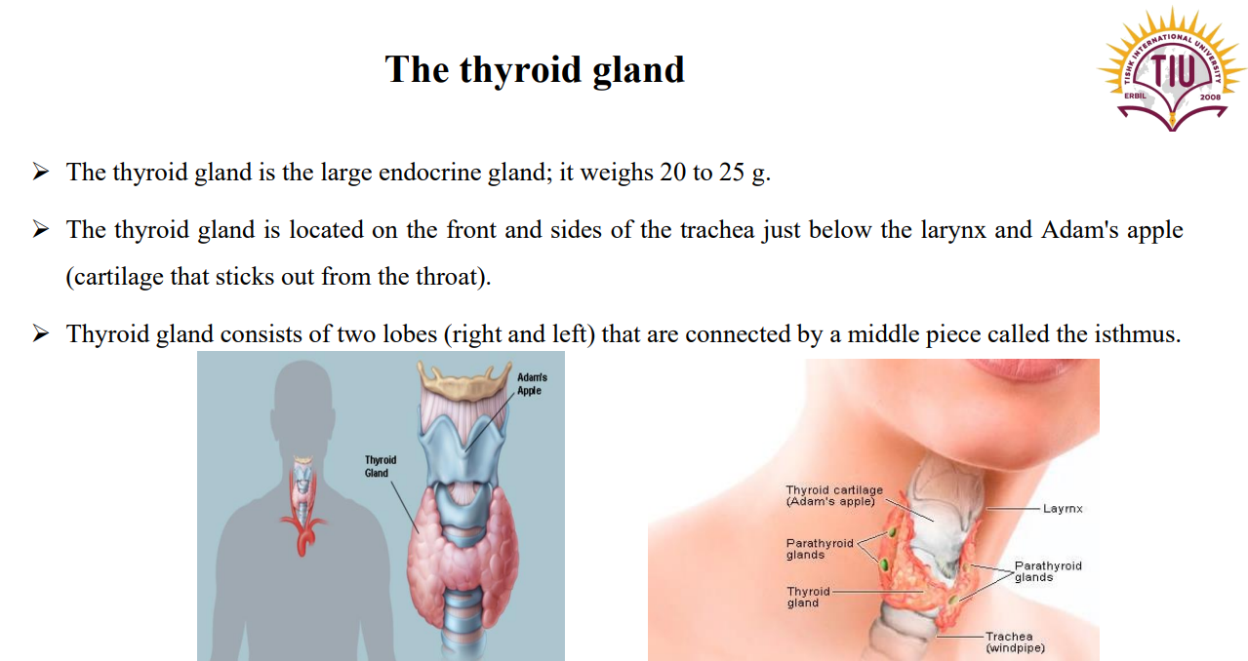

Slide 4
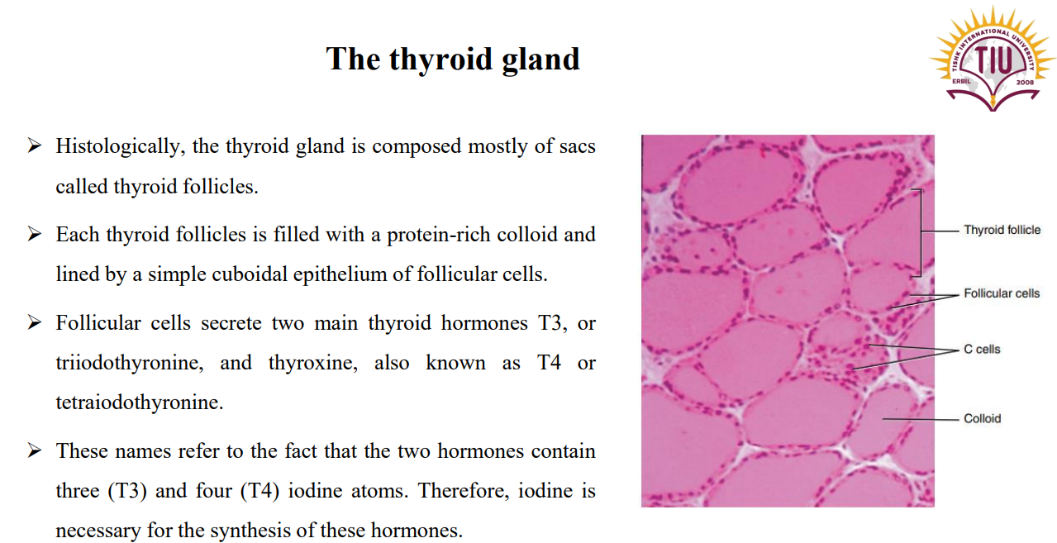

Slide 5
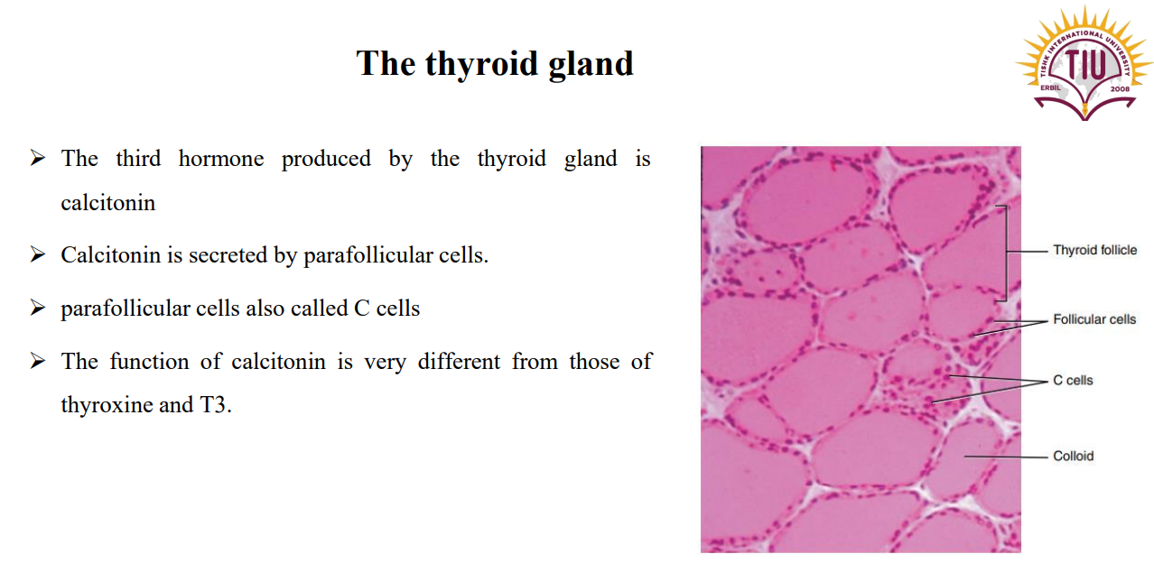

Slide 6
Thyroid Hormone synthesis
Step 1: Iodide Uptake
The follicular cells actively transport iodide (I⁻) from the bloodstream into the cell using the sodium-iodide symporter (NIS).
This process occurs at the basolateral membrane of the follicular cell.
Step 2: Iodide Transport to the Colloid
Iodide (I⁻) is transported from the follicular cell into the colloid (lumen of the follicle) via the pendrin transporter at the apical membrane.
Step 3: Oxidation of Iodide
The enzyme thyroid peroxidase (TPO) oxidizes iodide (I⁻) into iodine (I₂), which is essential for thyroid hormone synthesis.

Slide 7
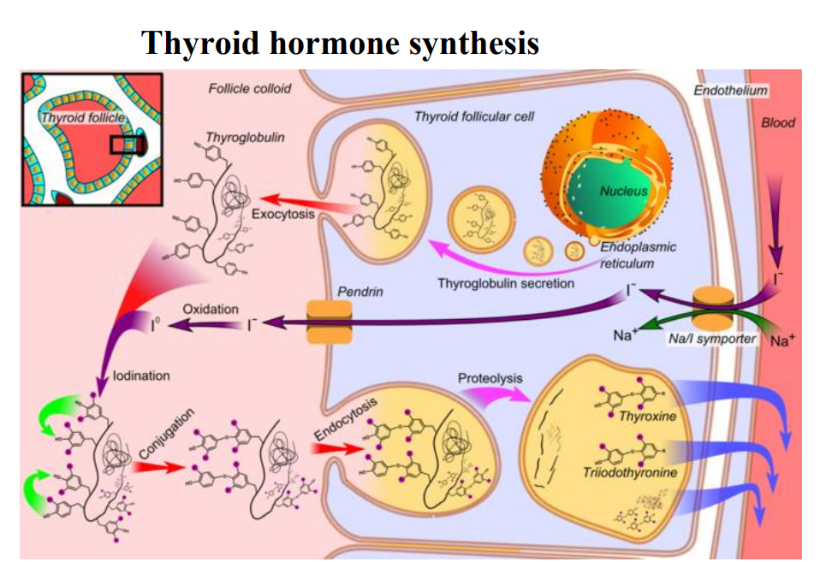

Slide 8
Thyroid Hormone synthesis
Step 4: Thyroglobulin (Tg) Synthesis and Secretion
Thyroglobulin (Tg), a large glycoprotein rich in tyrosine residues, is synthesized in the rough endoplasmic reticulum of follicular cells.
Tg is transported to the Golgi apparatus, where it is glycosylated and packaged into vesicles.
The vesicles release Tg into the colloid via exocytosis.

Slide 9
Step 5: Iodination of Tyrosine Residues (Organification)
Within the colloid, thyroid peroxidase (TPO) facilitates the attachment of iodine (I₂) to tyrosine residues in thyroglobulin.
This forms:
Monoiodotyrosine (MIT) (one iodine attached)
Diiodotyrosine (DIT) (two iodines attached)

Slide 11
Thyroid Hormone synthesis
Step 6: Coupling of Iodinated Tyrosine Residues
Thyroid peroxidase (TPO) catalyzes the coupling of iodinated tyrosines:
MIT + DIT → Triiodothyronine (T₃)
DIT + DIT → Thyroxine (T₄)
Step 7: Endocytosis of Thyroglobulin
Upon stimulation by thyroid-stimulating hormone (TSH), the follicular cells endocytose thyroglobulin from the colloid into the cytoplasm.

Slide 13
Step 8: Proteolysis and Hormone Release
Lysosomes containing proteolytic enzymes fuse with the endocytosed vesicles.
These enzymes cleave Tg, releasing:
T₃ (triiodothyronine)
T₄ (thyroxine)
MIT and DIT are also released but are deiodinated by deiodinase enzymes, recycling iodine back into the follicular cell.

Slide 14
Step 9: Hormone Secretion into the Bloodstream
T₃ and T₄ are transported across the basolateral membrane into the bloodstream via MCT8 (monocarboxylate transporter 8).
T₄ is the predominant hormone released (about 90%), but it is converted to the more active T₃ in peripheral tissues.
Regulation by TSH
The entire process is stimulated by thyroid-stimulating hormone (TSH), which binds to TSH receptors on follicular cells, increasing iodine uptake, Tg synthesis, TPO activity, and hormone release.

Slide 15
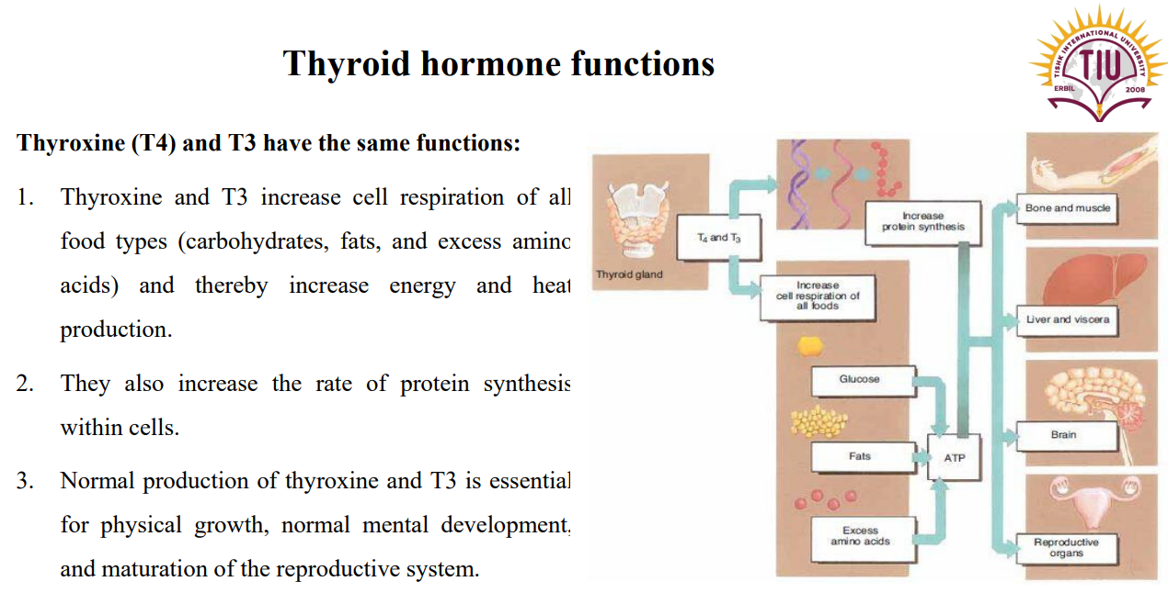

Slide 16
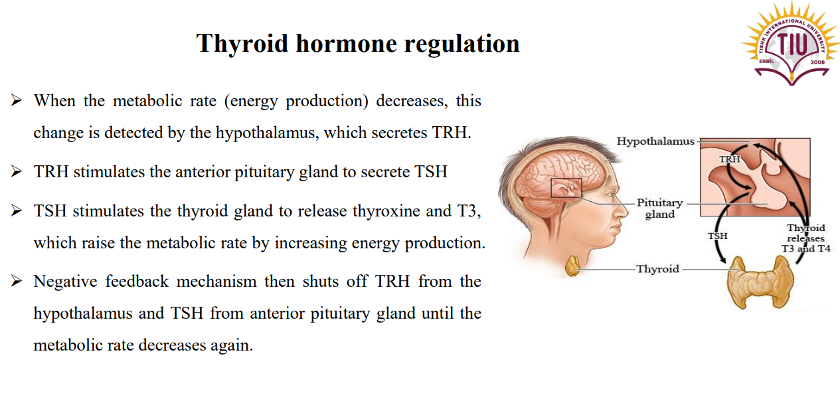

Slide 17
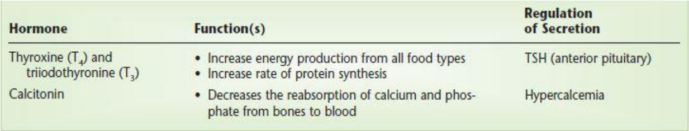

Slide 18
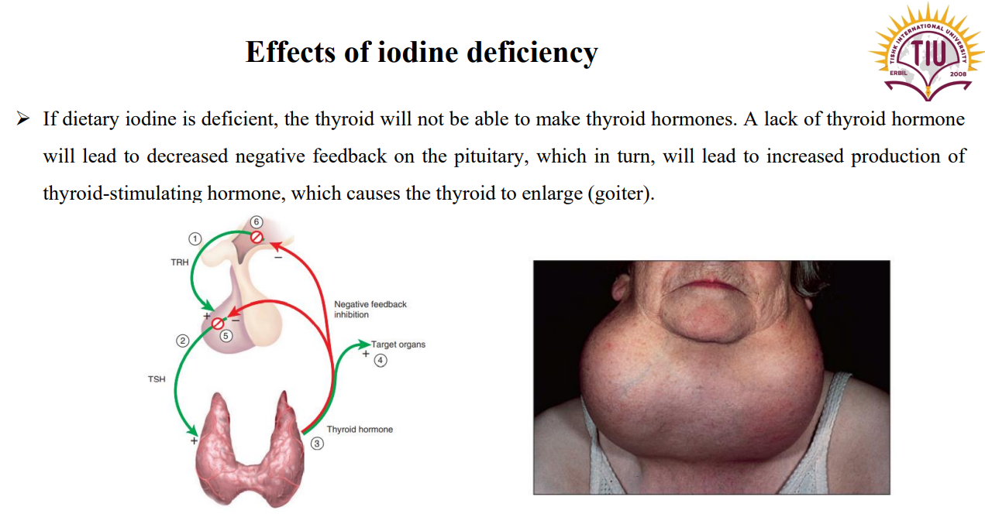

Slide 19
NEXT LECTURE
Parathyroid hormone and calcitonin.

Slide 20
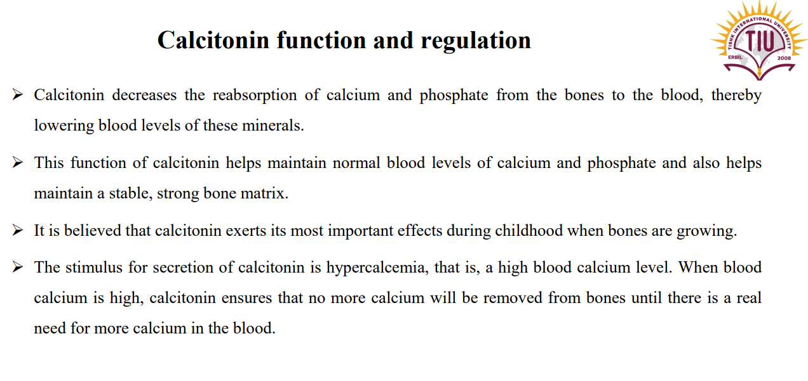

Slide 21
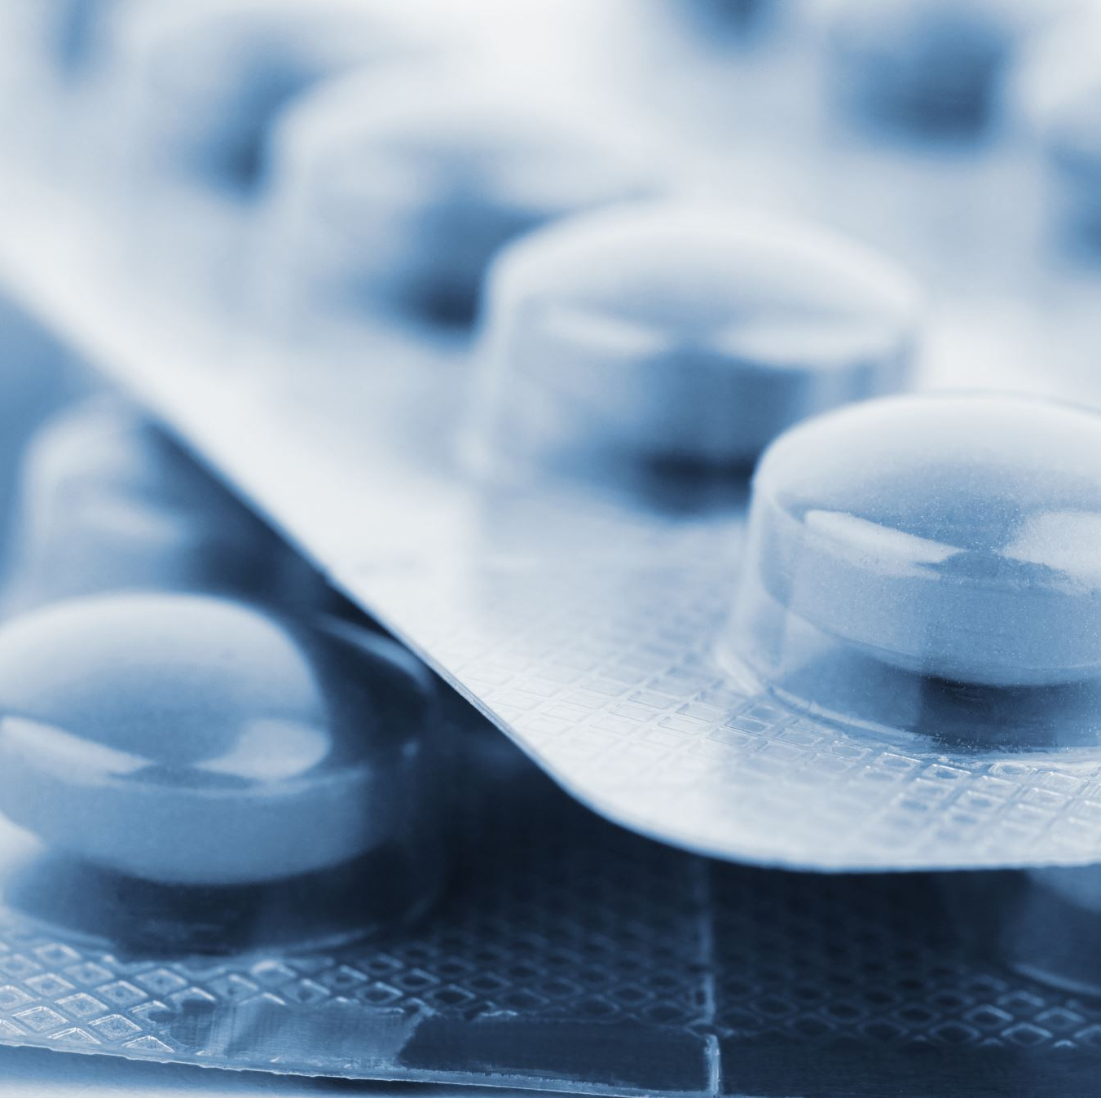
ASSIGNMENT
????????

Slide 22
References
Greenstein B. & Wood D. F. (2011). The endocrine system at a glance (3rd ed.). Wiley-Blackwell
Melmed S. Auchus R. J. Goldfine A. B. Koenig R. Rosen C. J. & Williams R. H. (2020). Williams textbook of endocrinology (14th ed.). Elsevier. Boron W. F. & Boulpaep E. L. (2021).
Boron & boulpaep concise medical physiology. Elsevier. Barrett K. E. Barman S. M. Yuan J. X.-J. & Brooks H. (2019).
Ganong's review of medical physiology (review questions) (26th ed.). McGraw-Hill Education LLC Molina P. E. (2018). Endocrine physiology (Fifth). McGraw-Hill Education.

Slide 23
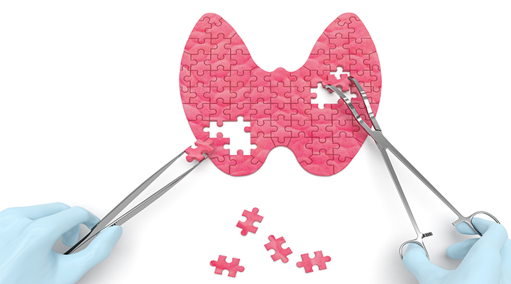
Thank you

