Slide 1

adrenal gland
Zhikal O. Khudhur
Endocrinology BIO 414
Spring Semester
Week number: 8
Date: /4/ 2025

Slide 2

Objectives
o
Adrenal gland
Hormones of adrenal medulla and their functions
Hormones of adrenal cortex and their functions

Slide 3
Learning outcome
At the end of this lecture students will be able to:
Describe the anatomical structure and zones of the adrenal gland and identify the hormones secreted by each zone.
Explain the physiological roles of adrenal hormones, including cortisol, aldosterone, and catecholamines, in maintaining homeostasis.
Differentiate between disorders of adrenal hyperfunction and hypofunction, such as Cushing’s syndrome, Addison’s disease, and pheochromocytoma.

Slide 4
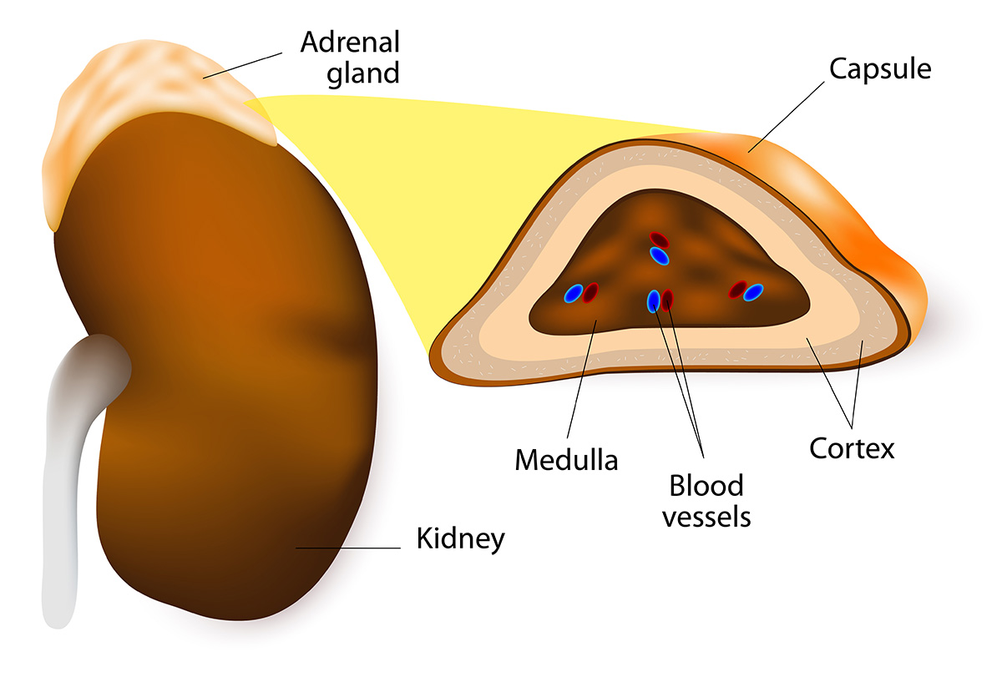
The two adrenal glands are located on top of kidneys, which gives them other name suprarenal glands.
Each adrenal gland consists of two parts: an inner adrenal medulla and an outer adrenal cortex.
The hormones produced by each part have very different functions.
Adrenal gland

Slide 5
Adrenal medulla
The cells of the adrenal medulla secrete epinephrine (adrenalin) and norepinephrine (noradrenalin), which collectively are called catecholamines.
Epinephrine and norepinephrine are both secreted in stress situations.
Norepinephrine is secreted in small amounts
Epinephrine secreted in larger amounts.

Slide 6
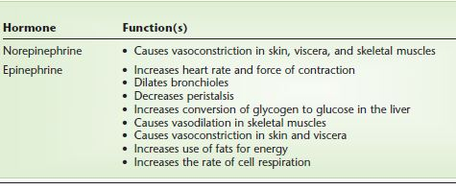
Functions of Epinephrine and norepinephrine
The hormones of the adrenal medulla and their function

Slide 7
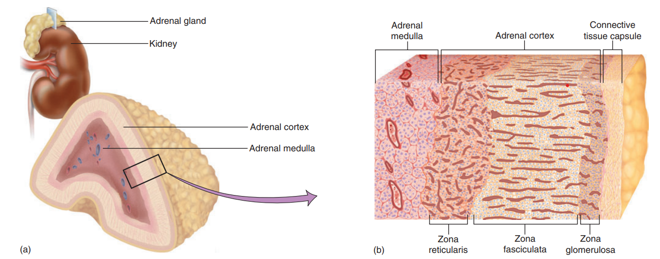
Adrenal cortex
The cortex synthesizes more steroid hormones known collectively as the corticosteroids, or corticoids.
The adrenal cortex has three layers of glandular tissue,
an outer zona glomerulosa
a thick middle zona fasciculata
an inner zona reticularis

Slide 8
Mineralocorticoids-Aldosterone
Mineralocorticoids secreted by zona glomerulosa, which act on the kidneys to control electrolyte balance such as aldosterone.
The target organs of aldosterone are the kidneys.
Aldosterone increases the reabsorption of sodium and the excretion of potassium by the kidney tubules.
As sodium ions are reabsorbed, hydrogen ions (H+) may be excreted in exchange. This is one mechanism to prevent the accumulation of excess H+ ions, which would cause acidosis of body fluids.

Slide 9
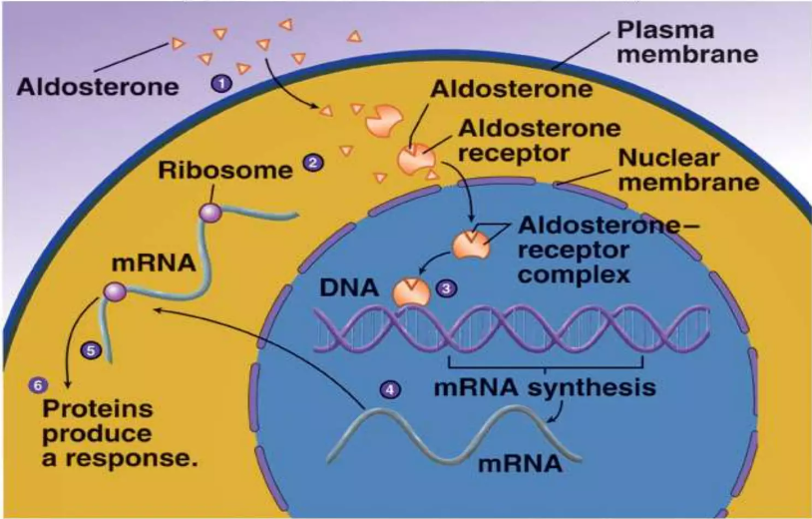

Slide 10
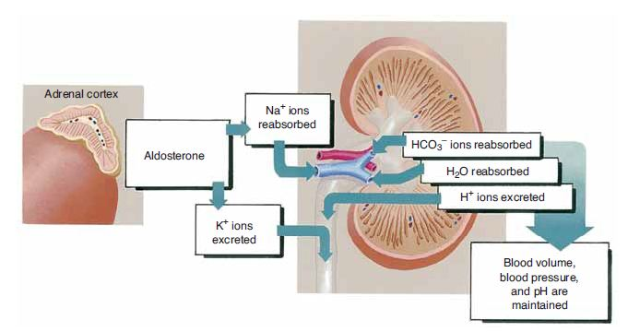
Mineralocorticoids-Aldosterone
Also, as Na+ ions are reabsorbed, negative ions such as chloride (Cl−) and bicarbonate (HCO3–) follow the Na+ ions back to the blood, and water follows by osmosis.
This indirect effect of aldosterone, the reabsorption of water by the kidneys, is very important to maintain normal blood volume and blood pressure.

Slide 11
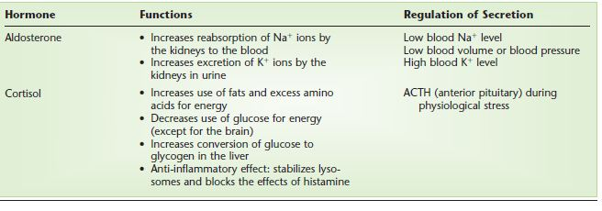
Mineralocorticoids-Aldosterone

Slide 12
Glucocorticoids such as cortisol (hydrocortisone) secreted mainly by zona fasciculata.
The direct stimulus for cortisol secretion is ACTH from the anterior pituitary gland, which in turn is stimulated by CRH from the hypothalamus. CRH is produced in the physiological stress situations.
Cortisol is secreted in any type of physiological stress situation: disease, physical injury, hemorrhage, fear or anger, exercise, and hunger.
Cortisol also has an anti-inflammatory effect.
Too much cortisol, however, decreases the immune response, leaving the body susceptible to infection
Glucocorticoids-Cortisol

Slide 13
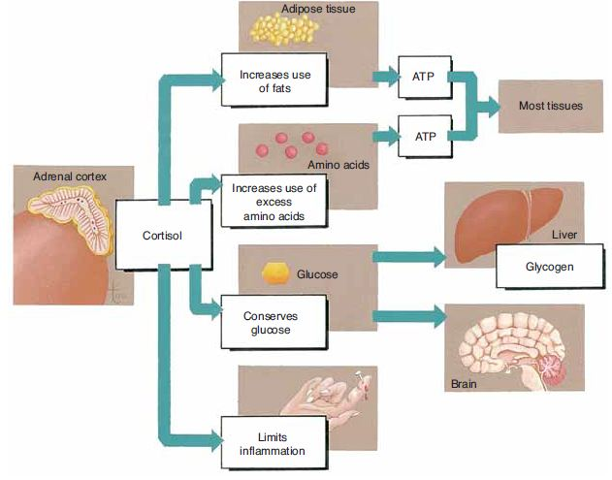
Glucocorticoids-Cortisol
Cortisol increases the use of fats and excess amino acids for energy and decreases the use of glucose. This is called the glucose sparing effect, and it is important because it conserves glucose for use by the brain.

Slide 14
Glucocorticoids-Cortisol

Slide 15
Sex steroids
Sex steroids secreted mainly by zona reticularis, including androgens and estrogens.
The sex hormones, “female” estrogen and “male” androgen, are produced in very small amounts, and their importance is not known with certainty.
They may contribute to rapid body growth during early puberty. After menopause, however, the ovaries no longer function, and the adrenals are the only remaining estrogen source.
Both androgens and estrogens promote adolescent skeletal growth and help to sustain adult bone mass.
The principal adrenal androgen is dehydroepiandrosterone (DHEA).
DHEA has weak hormonal effects in itself, but more importantly, other tissues convert it to the more potent androgen, testosterone.

Slide 16
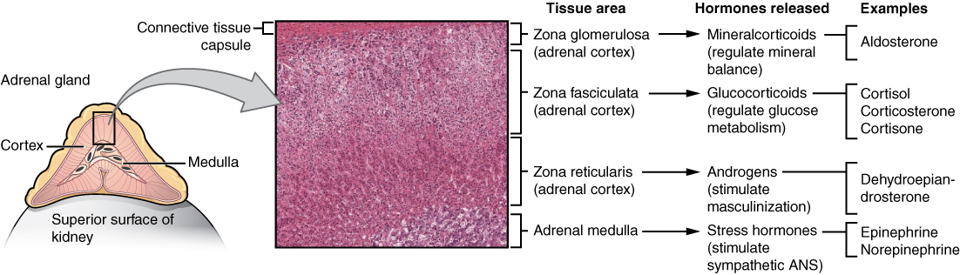

Slide 17
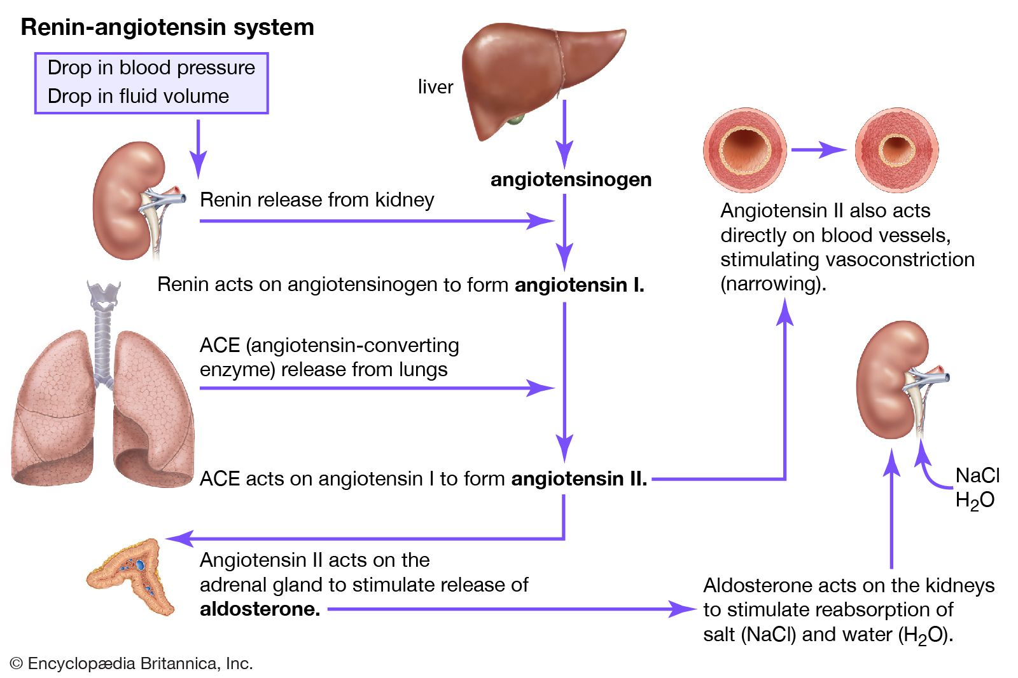

Slide 18
Recent updates.
Cortisol & HPA Axis:
New models show how brain receptors, vasopressin, and body rhythms affect cortisol levels and stress response.
CAH Treatment:
FDA approved Crenessity for classic CAH; it lowers androgen levels and reduces the need for high-dose steroids.
Cortisol Detection:
A new SPR sensor using phosphorene detects cortisol more accurately, helping diagnose stress disorders.
Aldosterone Therapy:
Triple T is a new, less invasive treatment for hormone-related high blood pressure, showing good early results.

Slide 19
References
Greenstein B. & Wood D. F. (2011). The endocrine system at a glance (3rd ed.). Wiley-Blackwell
Melmed S. Auchus R. J. Goldfine A. B. Koenig R. Rosen C. J. & Williams R. H. (2020). Williams textbook of endocrinology (14th ed.). Elsevier. Boron W. F. & Boulpaep E. L. (2021).
Boron & boulpaep concise medical physiology. Elsevier. Barrett K. E. Barman S. M. Yuan J. X.-J. & Brooks H. (2019).
Ganong's review of medical physiology (review questions) (26th ed.). McGraw-Hill Education LLC Molina P. E. (2018). Endocrine physiology (Fifth). McGraw-Hill Education.

Slide 20
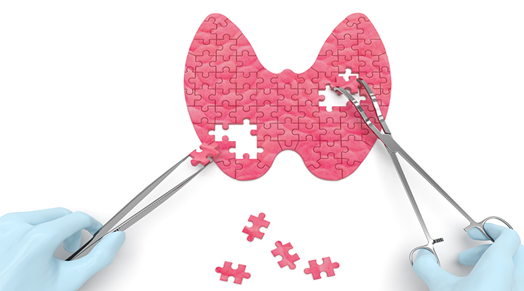
Thank you

