Slide 1
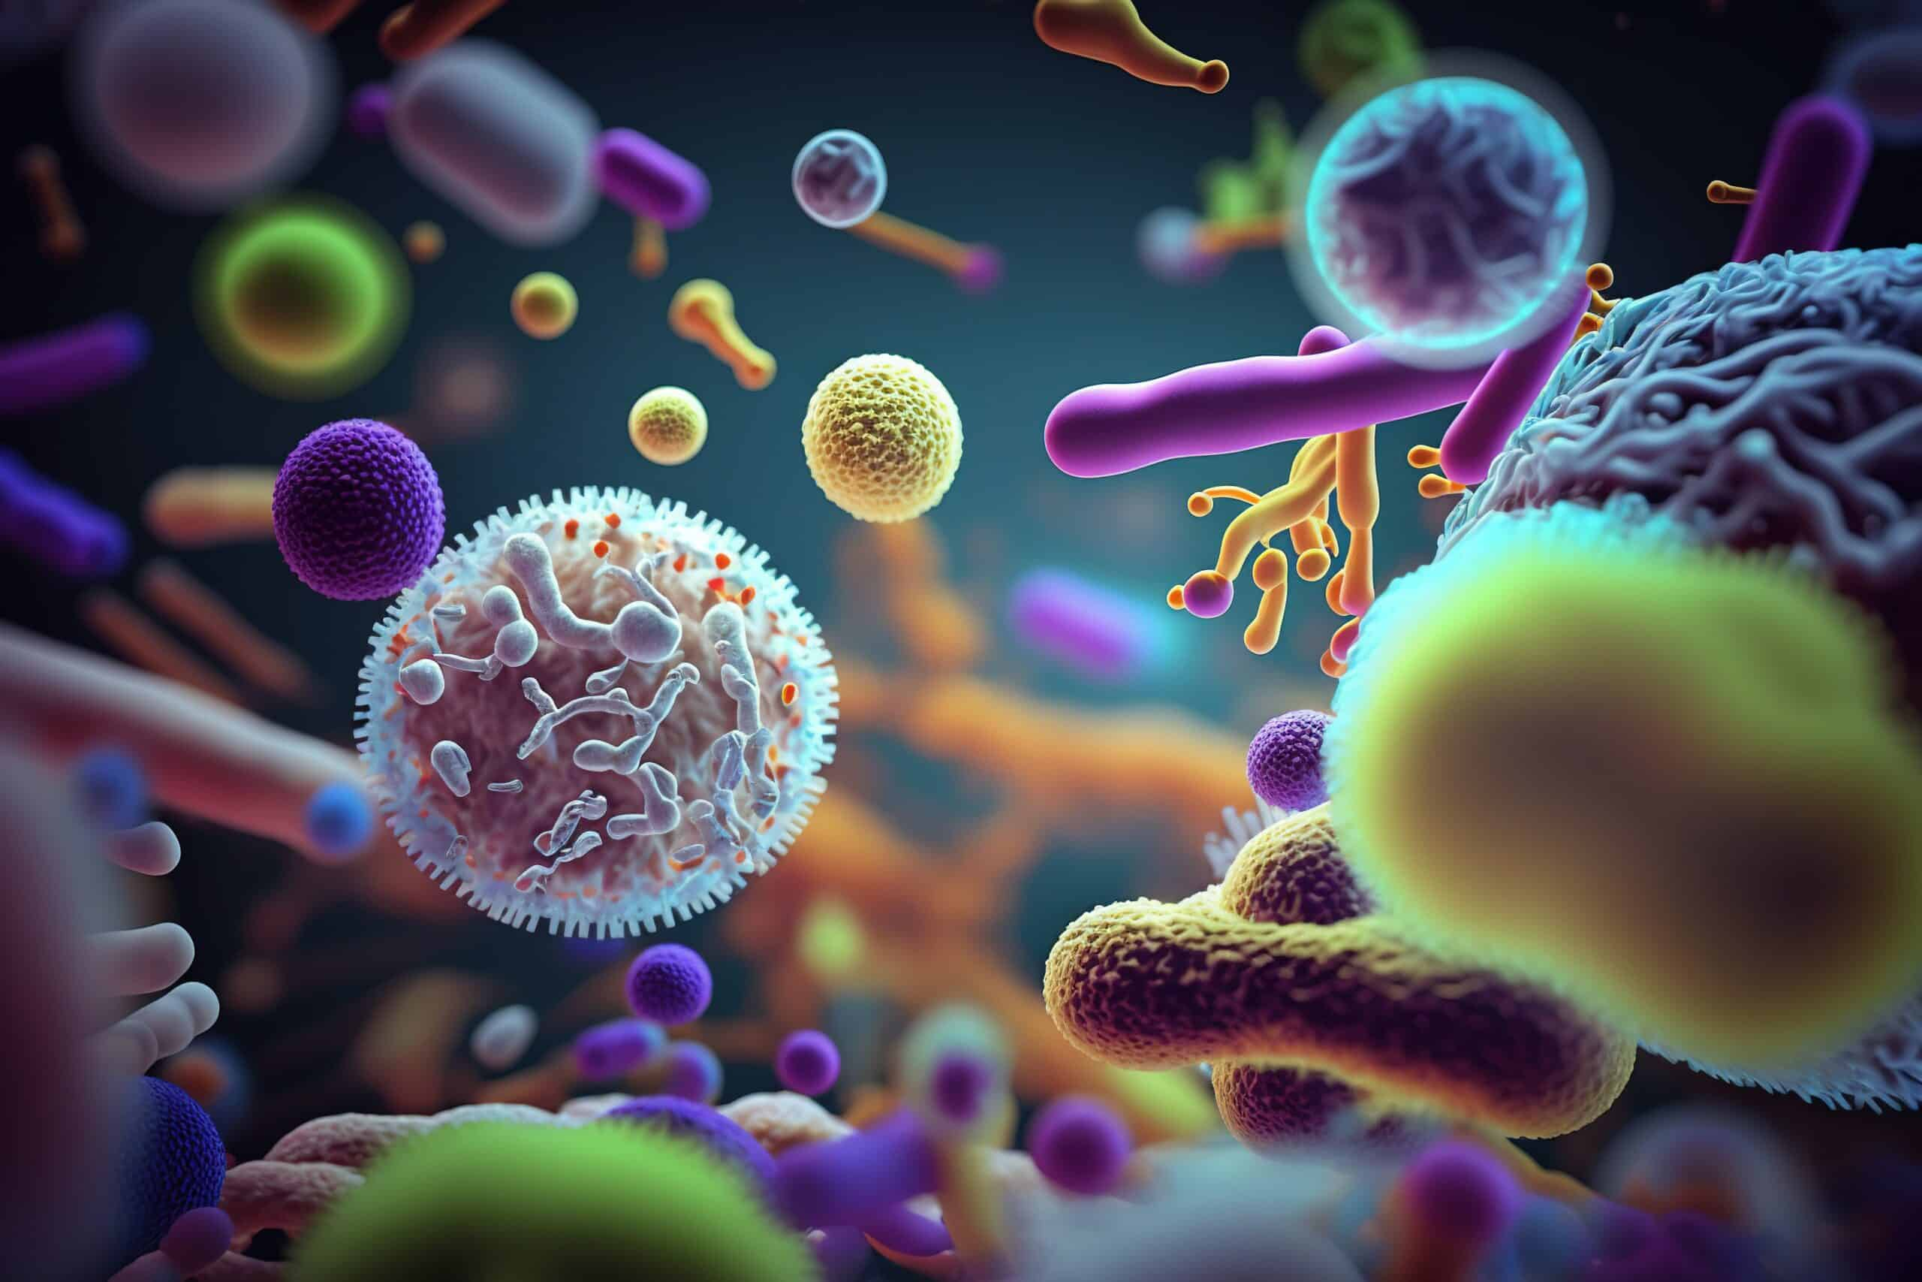

Pseudomonas
Ms. Heshu J. Ahmed
PhD Candidate
Medical Bacteriology 423
Spring Semester
Week Eight

Slide 2
Outline
Genus Pseudomonas
Pseudomonas aeruginosa
Epidemiology
Pathogenesis
Manifestations

Slide 3
Objectives
1. Provide an overview of the genus Pseudomonas and its most clinically significant species, Pseudomonas aeruginosa.
2. Explore the epidemiological factors contributing to the spread and prevalence of P. aeruginosa infections.
3. Examine the pathogenesis mechanisms employed by P. aeruginosa in causing opportunistic infections.
4. Discuss the diverse manifestations of P. aeruginosa infections across various body systems and clinical contexts.

Slide 4
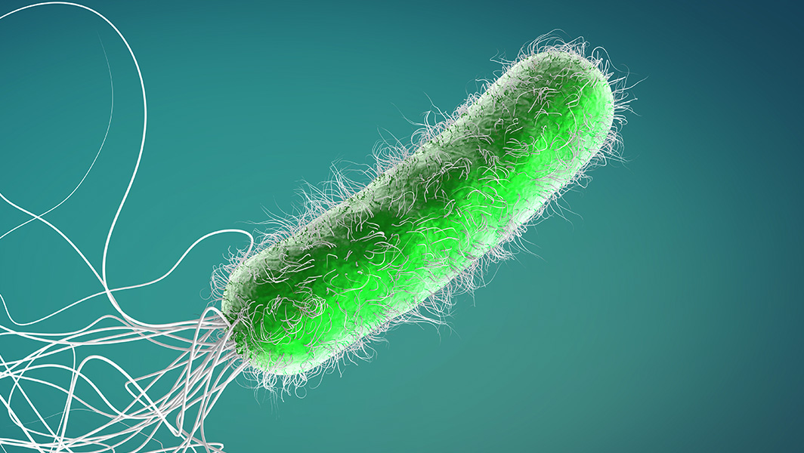
Genus Pseudomonas
There is a large number of Pseudomonas species, the most important of which is P aeruginosa.
Pseudomonas species are most frequently seen as colonizers and contaminants but are able to cause opportunistic infections.
Reports vary regarding the frequency of their isolation from cases of bacteremia, arthritis, abscesses, wounds, conjunctivitis, and urinary tract infections.

Slide 5
Pseudomonas aeruginosa
Pseudomonas aeruginosa is an aerobic, motile, gram-negative rod
P aeruginosa is sufficiently versatile in its growth and energy requirements to use simple molecules such as ammonia and carbon dioxide as sole nitrogen and carbon sources.
P.aeruginosa produces blue, yellow, or rust-colored pigments differentiates it from most other gram-negative bacteria
The blue pigment, pyocyanin, is produced only by P aeruginosa.
Fluorescein, a yellow pigment that fluoresces under ultraviolet light is produced by P aeruginosa and other species of pseudomonas.

Slide 6
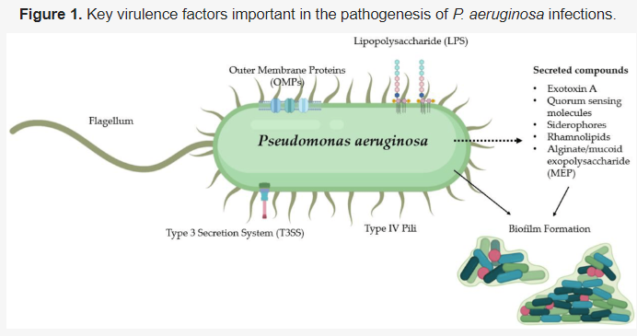
Pseudomonas aeruginosa
Lipopolysaccharide (LPS) and porin proteins are present in the outer membrane.
Porin proteins in Pseudomonas offer less permeability compared to Enterobacteriaceae, restricting passage of various molecules including antibiotics.
A mucoid exopolysaccharide slime layer is present outside the cell wall
This layer is created by secretion of alginate
Most strains of P aeruginosa produce multiple extracellular products, including:
  exotoxin A (ExoA) and
  other enzymes with phospholipase,
  collagenase,
  adenylate cyclase,
  or elastase activity.

Slide 7
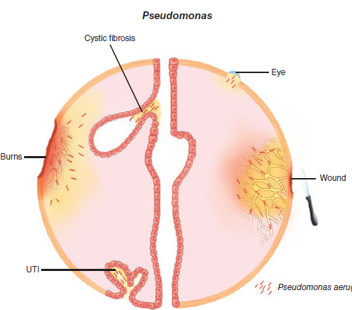
Epidemiology
The primary habitat of P aeruginosa is the environment.
It is found in water, soil.
P aeruginosa has been isolated from the throat and stool of 2% to 10% of healthy persons.
Infection with P aeruginosa, rare in healthy persons, is one of the most important causes of invasive infection in hospitalized patients with serious underlying disease, such as leukemia, CF, and extensive burns

Slide 8
Pathogenesis
Although P aeruginosa is an opportunistic pathogen, it is one of particular virulence.
The organism usually requires a significant break in first-line defenses:
  (such as a wound)
  or a route past them (such as a contaminated solution or endotracheal tube)
Attachment to epithelial cells is the first step in infection and is likely mediated by pili, flagella, and the extracellular polysaccharide slime.
The effect of ExoA is not immediate, since it is one of a number of virulence factors activated through a gene-regulating system called quorum sensing.

Slide 9
Quorum sensing
Under these conditions, lactones and/or quinolones secreted by P aeruginosa signal their presence to the other bacterial cells.
The system is quantitative so when the Pseudomonas cell population reaches a certain threshold, the signals direct the cytotoxin gene to be transcribed, and the toxin is then produced by the entire population at once.

Slide 10
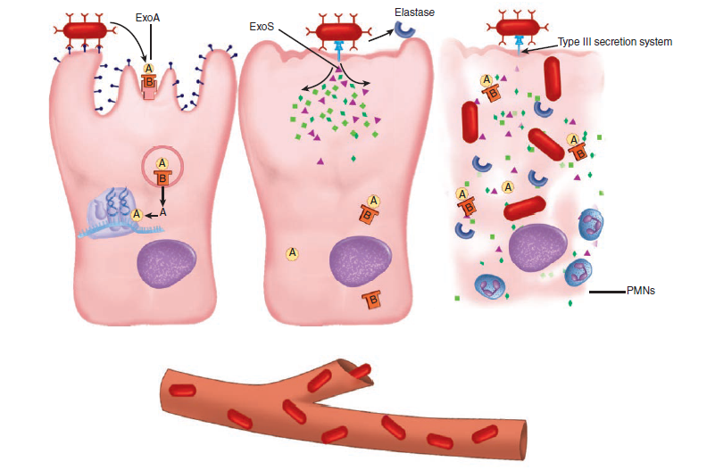
Pathogenesis
Pseudomonas disease, cellular view.
(Left) P aeruginosa binds and secretes the A–B exotoxin A (ExoA), which acts on protein synthesis by the same mechanism as diphtheria toxin.
(Middle) A type III injection secretion system delivers exoenzyme S (ExoS) to the cell cytoplasm. Elastase is secreted extracellularly.
(Right) All toxins act to destroy the cell and the bacteria may enter the blood.

Slide 11
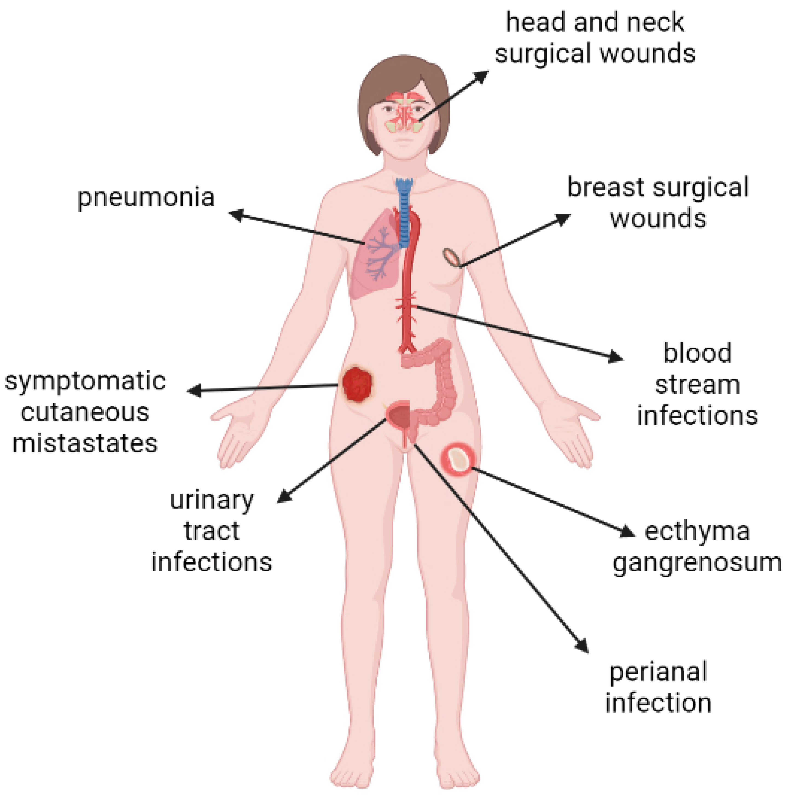
Manifestations

Slide 12
References
Sherris Medical Microbiology: An Introduction to Infectious Diseases.
Jawetz, Melnick & Adelberg's Medical Microbiology by Geo. F. Brooks, Karen C. Carroll, and Janet S. Butel
Prescott's Microbiology by Joanne Willey, Linda Sherwood, and Christopher J. Woolverton

