Slide 1

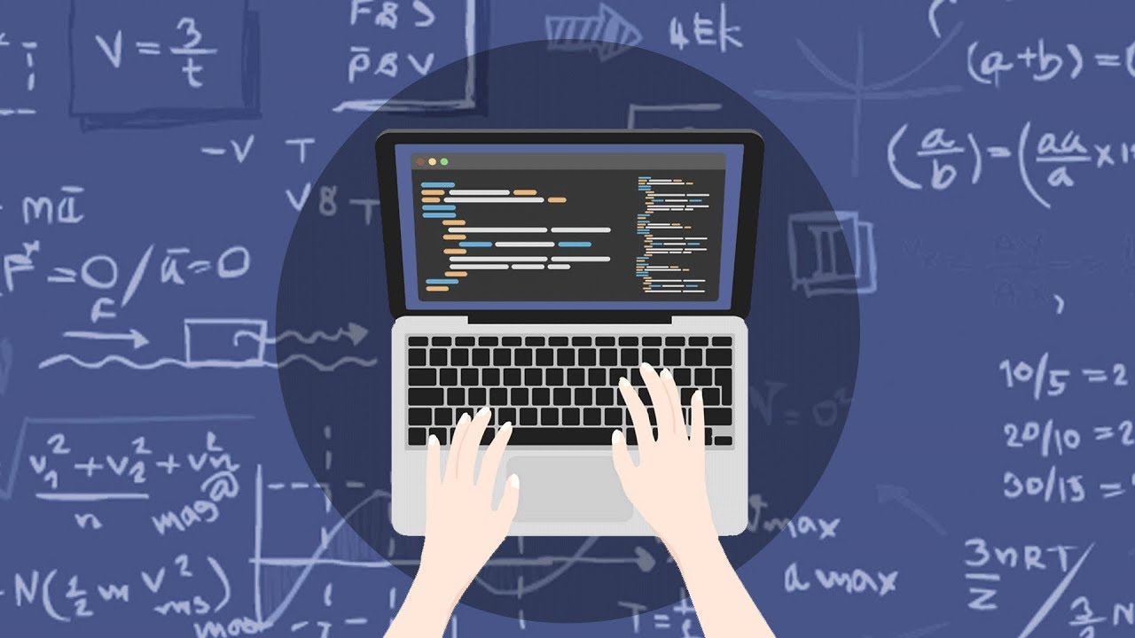
Introduction to Calculus

Slide 2
Basic Information
Lecturer: Dr. Rebaz A. Sharif
PhD Mathematics, University of Sulaimani/University of Leeds,UK
MSc. Pure Mathematics, University of Manchester, UK.
BSc. Mathematics, University of Leeds, UK.
Contact: rebaz.sharif@tiu.edu.iq
Office: Main Building, room # 252
Homework: Will be posted on the SIS system.
Lecture Notes: Will be posted on the Lecture Notes Webpage

Slide 3
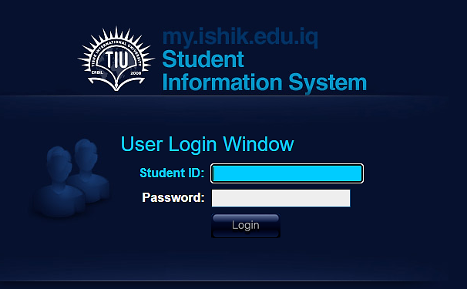
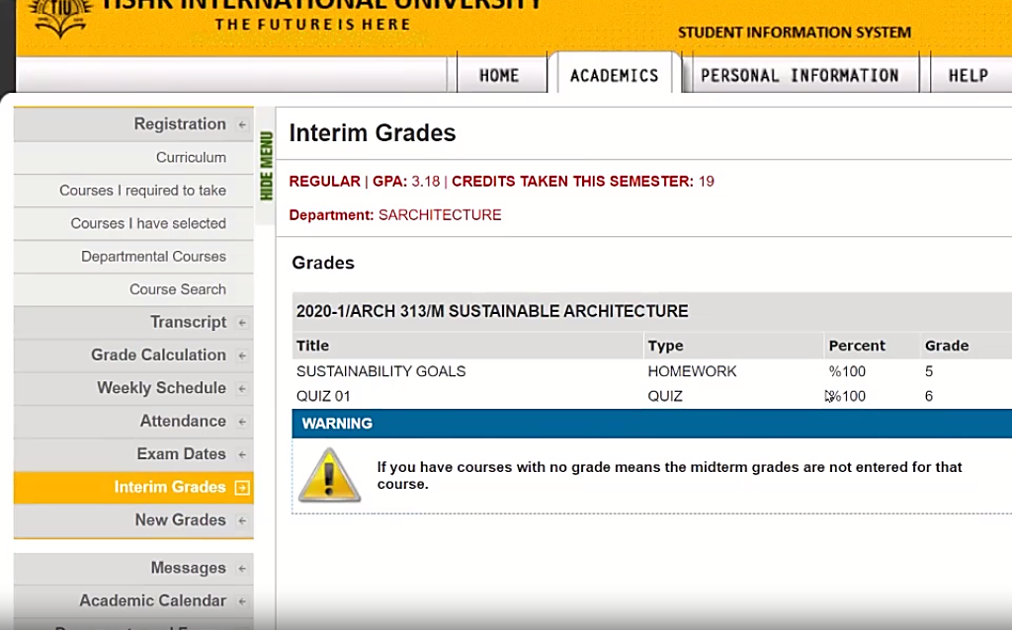

Slide 4
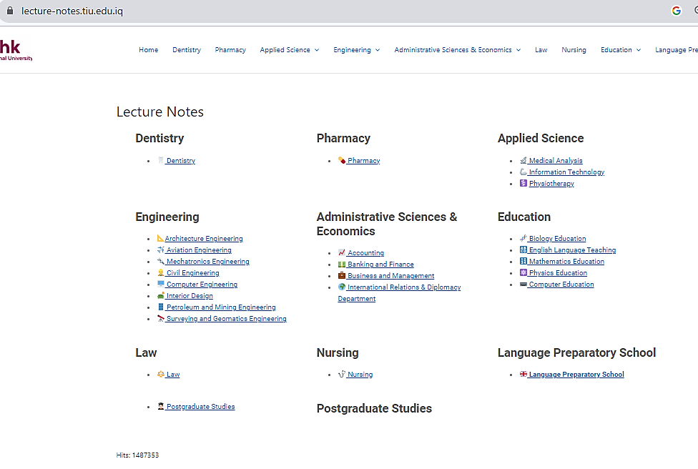
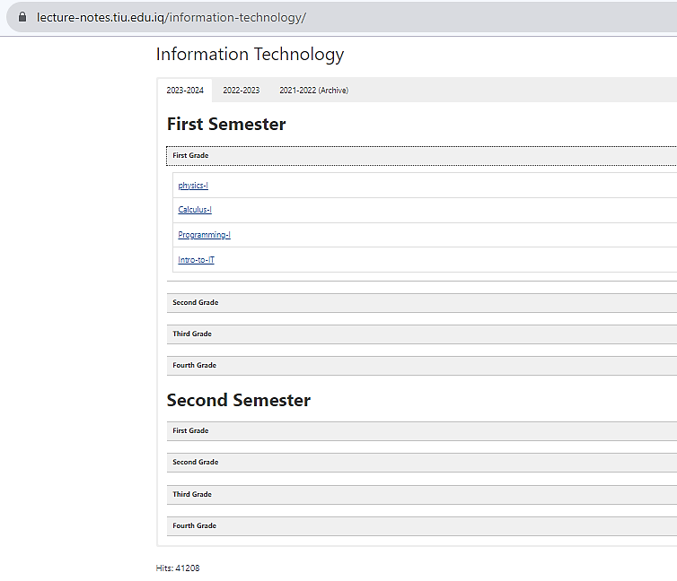

Slide 5


Students have an obligation to arrive on time and remain in the classroom for the duration of scheduled classes and activities.
Students have an obligation to write, homework, quizzes and final examinations at the times scheduled by the teacher and university.
Students have an obligation to show respectful behavior and appropriate classroom deportment. Should a student be disruptive and/or disrespectful, the teacher has the right to exclude the disruptive student from learning activities (classes) and may refer the case to the Director of Student Services under the Student Code of Conduct.
Food and Mobile Phones are not allowed in the classroom.
Students can leave the class in urgent cases only (Not for using mobile phones!) and should not make it a habit.
Class Rules

Slide 6


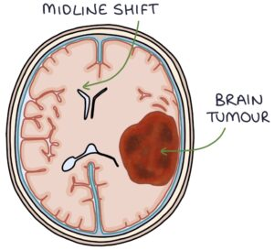
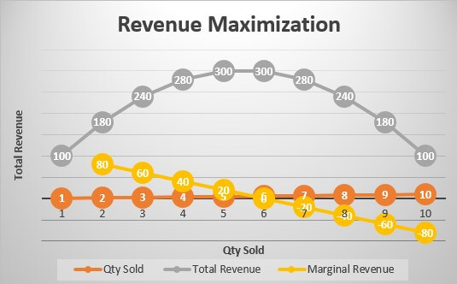
What is Calculus?
Study of change.
“What is the instantaneous rate of change of something?”
Real numbers, functions, limits, derivatives, continuity, integrals.
Notes:
Medicine, weather forecast, microeconomics, astrophysics

Slide 7
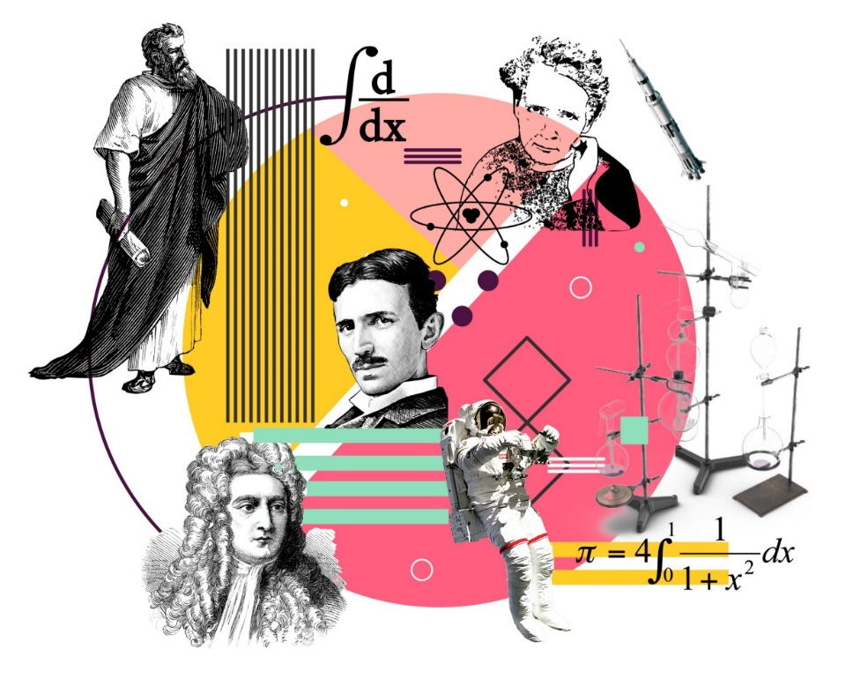
Where do you use calculus in the real world?
In fact, you can use calculus in a lot of ways and applications. Among the disciplines that utilize calculus include sports, physics, engineering, economics, statistics, math, medicine, space travel and IT/Computer Science.

Slide 8
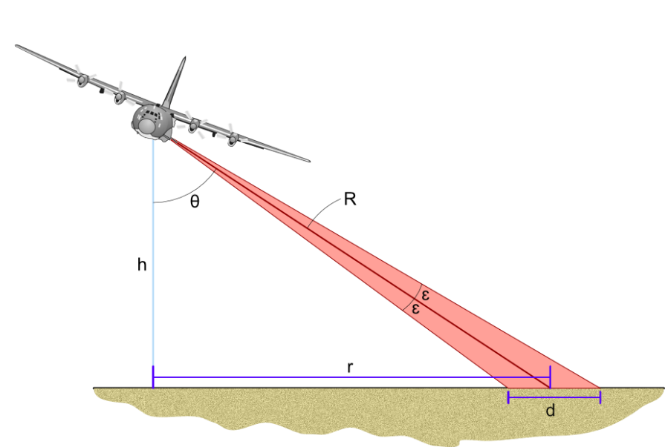
In Physics
Among the physical concepts that use concepts of calculus include motion, electricity, heat, light, harmonics, acoustics, astronomy, and dynamics.
In fact, even advanced physics concepts including electromagnetism and Einstein's theory of relativity use calculus.

Slide 9
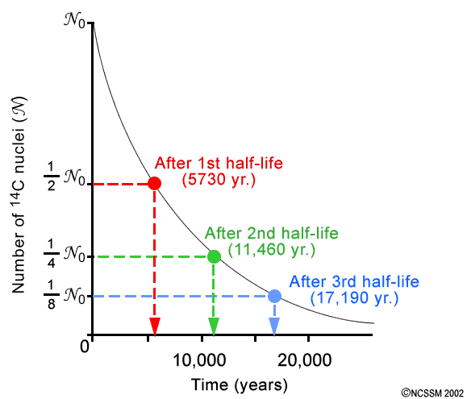
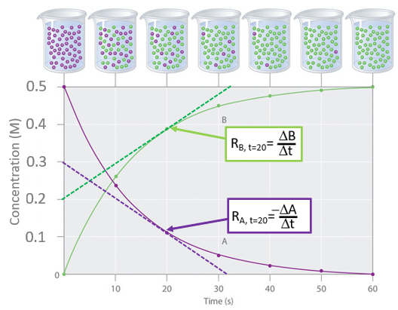
In Chemistry
Can be used to predict functions such as reaction rates and radioactive decay.

Slide 10
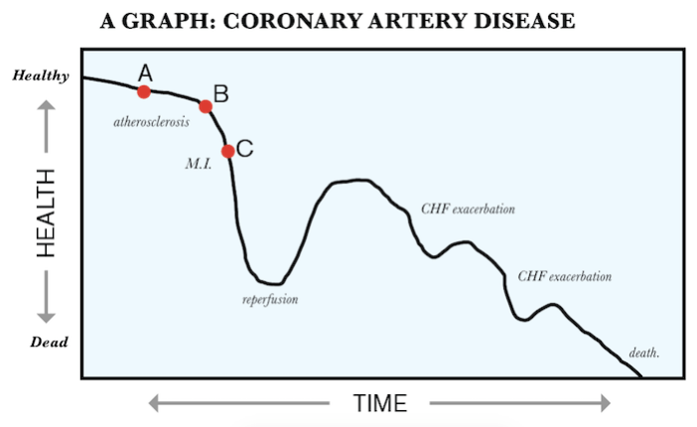
In Medical Science
Biologists use differential calculus to determine the exact rate of growth in a bacterial culture when different variables such as temperature and food source are changed.

Slide 11

In Economics
Is used to compute marginal cost and marginal revenue, enabling economists to predict maximum profit in a specific setting.

Slide 12
In Engineering
An Architect Engineer uses integration in determining the amount of the necessary materials to construct curved shape constructions (e.g. dome over a sports arena) and also to measure the weight of that structure. Calculus is used to improve the architecture not only of buildings but also of important infrastructures such as bridges.
In Electrical Engineering, Calculus (Integration) is used to determine the exact length of power cable needed to connect two substations, which are miles away from each other.
Space flight engineers frequently use calculus when planning for long missions. To launch an exploratory probe, they must consider the different orbiting velocities of the Earth and the planet the probe is targeted for, as well as other gravitational influences like the sun and the moon.

Slide 13


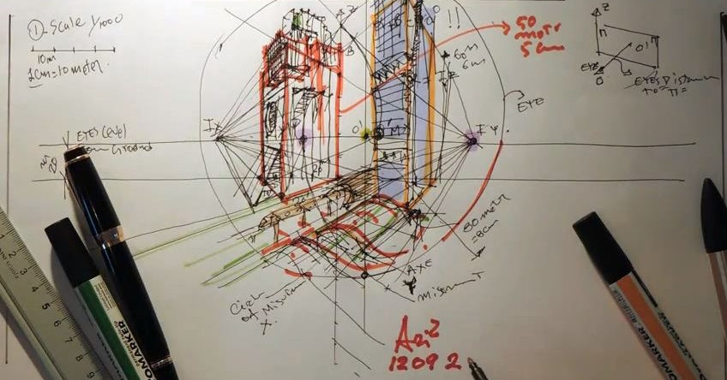

Slide 14
Let’s take a look at some other examples
Credit card companies use calculus to set the minimum payments due on credit card statements at the exact time the statement is processed by considering multiple variables such as changing interest rates and a fluctuating available balance.
Doctors and lawyers use calculus to help build the discipline necessary for solving complex problems, such as diagnosing patients or planning a prosecution case.
The field of epidemiology — the study of the spread of infectious disease — relies heavily on calculus. It can be used to determine how far and fast a disease is spreading, where it may have originated from and how to best treat it.

Slide 15


In Information Technology
Calculus is used for machine learning, data mining, scientific computing, image processing, and creating the graphics and physics engines for video games, including the 3D visuals for simulations. Calculus is also used in a wide array software programs that require it.

Slide 16



Course Evaluation Criteria
Quiz
Project
Logic
Midterm
Final Exam
15
10
5
30
40

Slide 17

High School Topics
Equations, Inequalities
Operation properties
Word Problems
Powers
Angles
Solving the system
Fractions
Graphs
Logarithm
2D Shapes
Arithmetic and Geometric Sequence
Limits
Matrices
Derivatives
Integrals

Slide 18

Fall 2024-2025 Calculus I
Syllabus

Slide 19
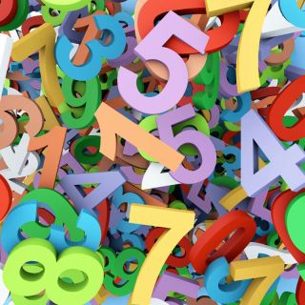
Week 1 (Pre-calculus)
Numbers and their representations & Types
Math Operations
Scientific Notation
Significant Numbers
Factorials

Slide 20

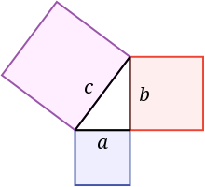
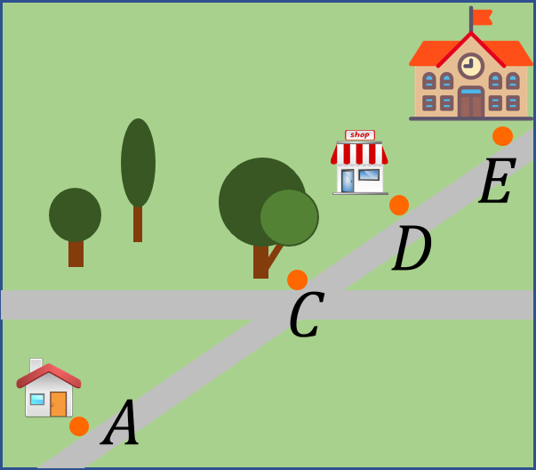
Week 2 - Week 3 (Pre-calculus)
Squares & Differences of Squares
Theorem of Pythagoras
Rationalizing denominator
Factorization of zero & Inequalities
Distance, midpoint & Absolute Value
Lines and Circles, their equations

Slide 21


Week 4 (Pre-calculus)
Quadratics and their graphs
Exponential and Logarithmic Functions

Slide 22
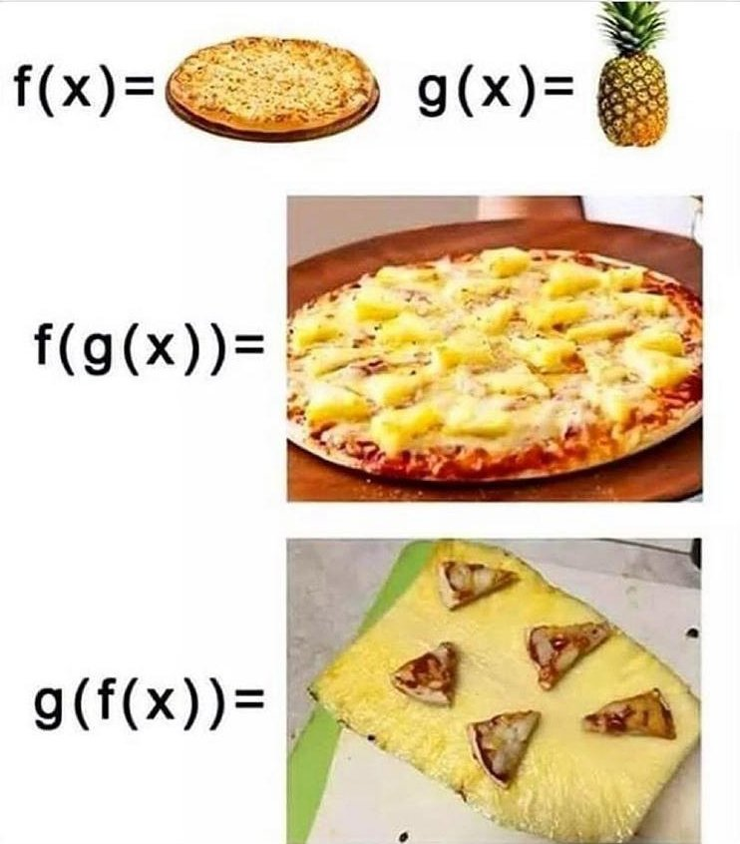
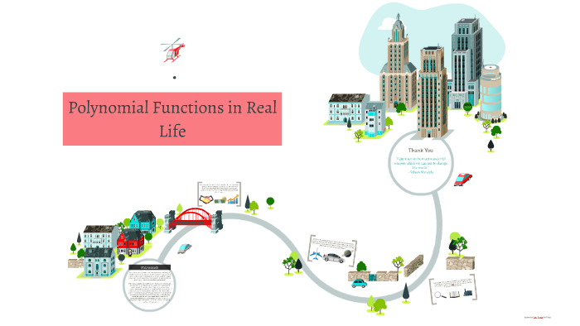
Week 5 – Week 6
Polynomial Functions
Composite Functions

Slide 23

Study Methods for Effective Learning

Slide 24


Slide 25
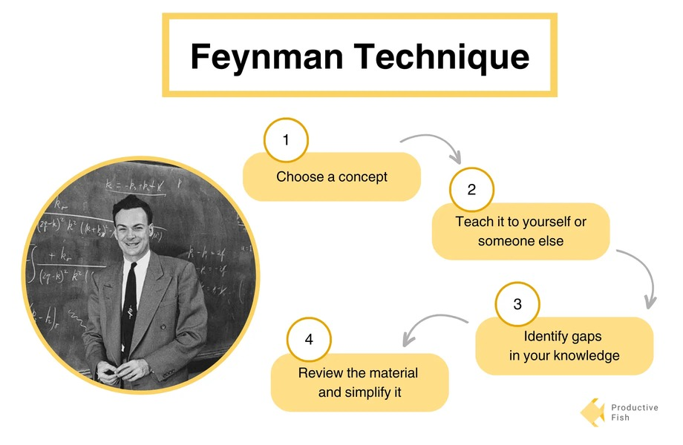

Slide 26



Utilize Technology Wisely:
Use digital tools and apps to help you study, but don't let them distract you.
Online resources like Khan Academy, Coursera, or edX can supplement your learning.
Seek Help When Needed:
Don't hesitate to ask teachers, professors, or peers for clarification when you're stuck.
Utilize available resources such as tutoring services or office hours.

