Slide 1


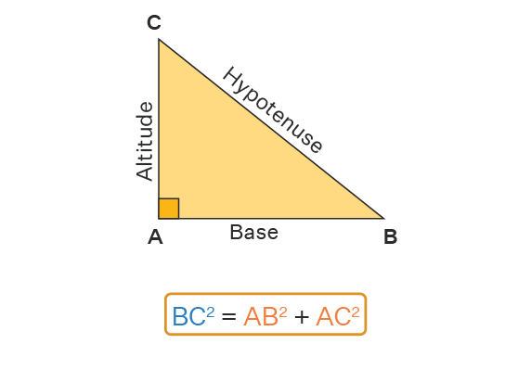
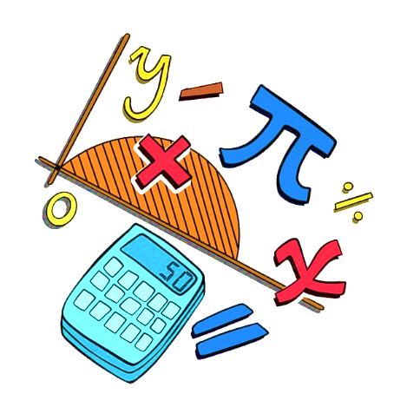
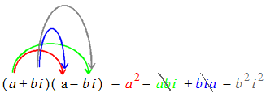
Lecture 2
Surd Expressions
Perfect Square Trinomials
Theorem of Pythagoras
Rationalizing the denominator
Factorization of zero
Inequalities

Slide 2

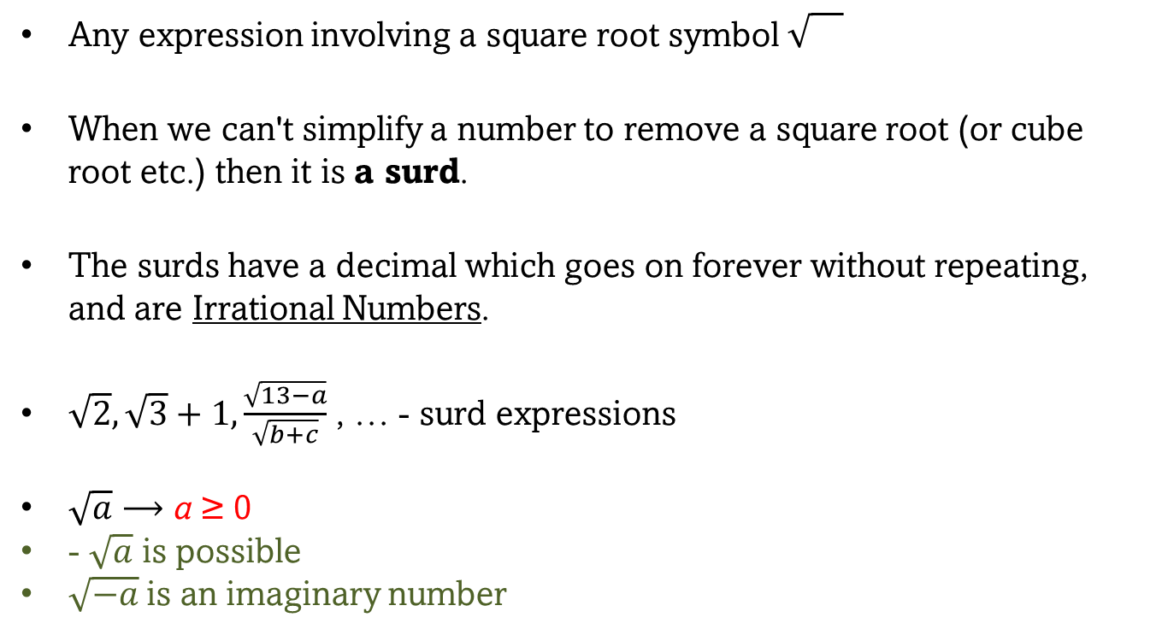
Surd Expressions
Any expression involving a square root symbol
When we can't simplify a number to remove a square root (or cube root etc.) then it is a surd.
The surds have a decimal which goes on forever without repeating, and are Irrational Numbers.
$\sqrt{2}, \sqrt{3}+1, \frac{\sqrt{13−a}}{\sqrt{b+c}}$ , … - surd expressions
$\sqrt{a}$ ⟶ a ≥ 0
- $\sqrt{a}$ is possible
$\sqrt{−a}$ is an imaginary number

Slide 3



Squares and Differences of Squares
${(a+b)}^{2}=a^{2}+2ab+b^{2}$
${(a−b)}^{2}=a^{2}−2ab+b^{2}$
$a^{2}−b^{2}=(a+b)(a−b)$

Slide 4


$${(a+b)}^{2}=a^{2}+2ab+b^{2}$$
${(2x^{2}+5)}^{2}={(2x^{2})}^{2}+2×\left(2x^{2}\right)×\left(5\right)+5^{2}= {4x}^{4}+20x^{2}+25$

Slide 5


$${(a−b)}^{2}=a^{2}−2ab+b^{2}$$
${(3y^{2}−7)}^{2}={(3y^{2})}^{2}−2×\left(3y^{2}\right)×\left(7\right)+7^{2}= {9y}^{4}−42y^{2}+49$

Slide 6
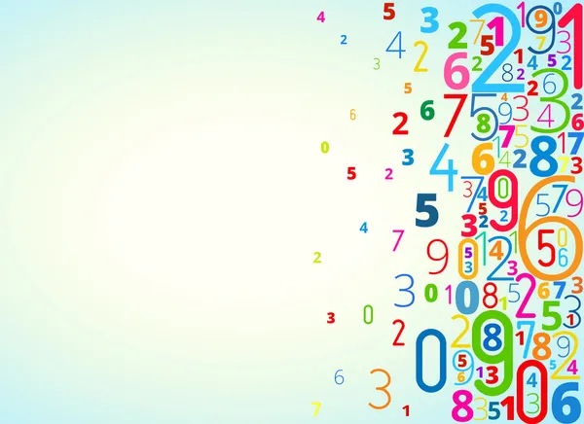





$$a^{2}−b^{2}=(a+b)(a−b)$$
${4z}^{2}−81=(2z+9)(2z−9)$
$$2z×2z$$
$$9×9$$
$$a=2z b=9$$
$$6(3x+y)(3x−y)$$
$54x^{2}−6y^{2}=$

Slide 7

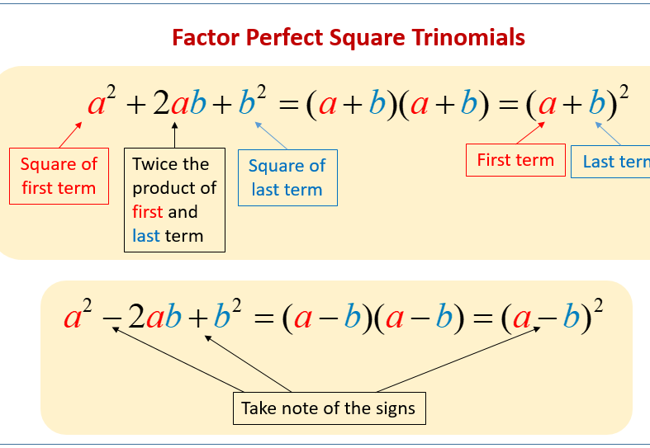

Slide 8
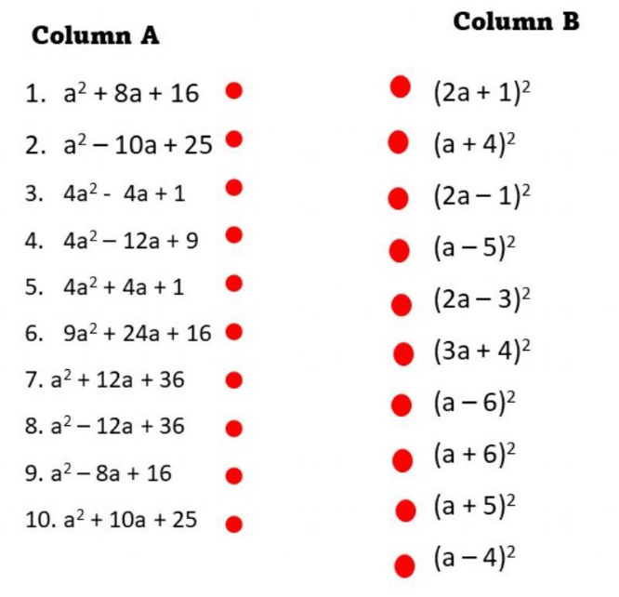
Match Column A with its factor in Column B by joining its line.

Slide 9
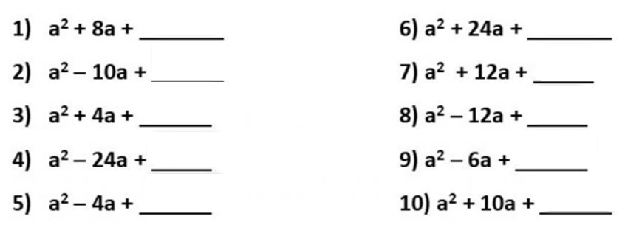
Complete the following expression to make a perfect square trinomial.

Slide 10










Practice
$64n^{2}− 32n+4$
$49x2 + 84x + 36$
$10−140n+490n^{2}$
$25x^{2}+9$
$9+ 18p+9p^{2}$
$2y^{5}−162y$
$9x2 − 12x + 4$
$x^{3}y−4xy^{3}$
$288b^{2}+672b+392$
$81x2 − 180x + 100$
$96v^{2}+48v+6$
$36x2 + 132x + 121$
$640v^{2}+1120v+490$
$x^{2}−\frac{9}{64}$

Slide 11

























Slide 12

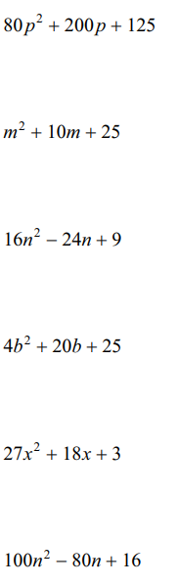

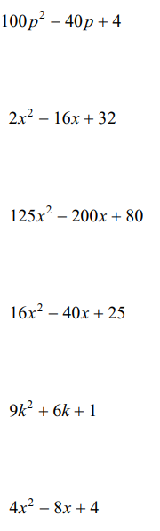



Slide 13
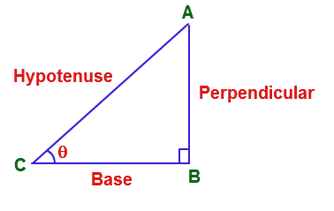
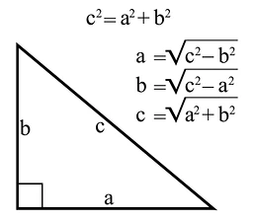
Theorem of Pythagoras

Slide 14
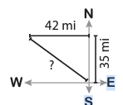
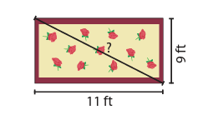
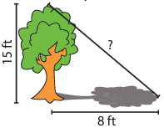
Practice
Adam is on his way home from work. He drives 35 miles due North and then 42 miles due West. Find the shortest distance he can cover to reach home early.
Rachel bought a rug for her apartment. The rug is 11 feet long and 9 feet wide. Find the diagonal length of the rug.
A 15 feet tree casts a shadow that is 8 feet long. What is the distance from the tip of the tree to the tip of its shadow?
Notes:
Answers:
54.7 miles
14.2 feet
17 feet

Slide 15

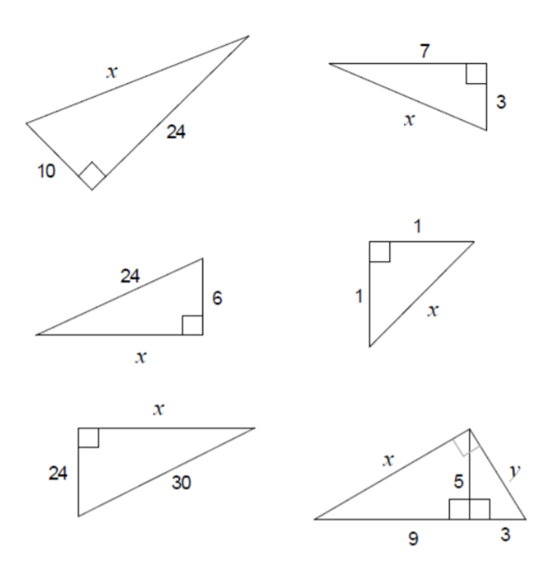


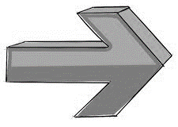


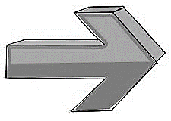

Slide 16

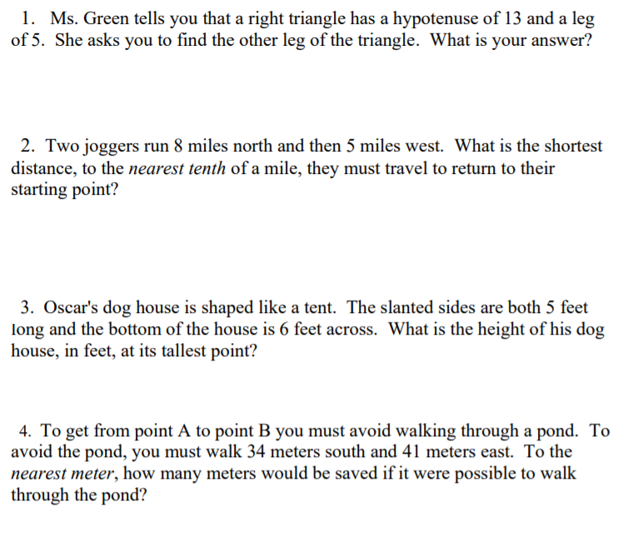
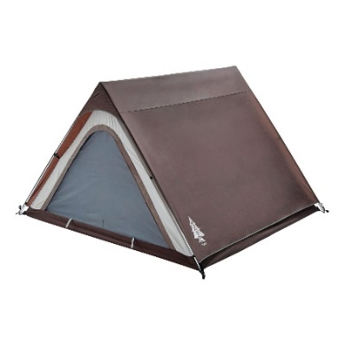

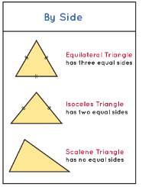

Slide 17

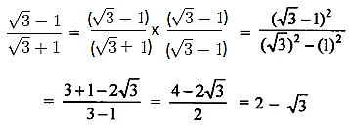

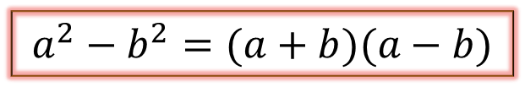
Rationalizing the denominator
$\frac{1}{a±\sqrt{b}}=\left(\frac{1}{a±\sqrt{b}}\right)\left(\frac{a∓\sqrt{b}}{a∓\sqrt{b}}\right)=\frac{a∓\sqrt{b}}{a^{2}−b}$
$$a^{2}−b^{2}=(a+b)(a−b)$$

Slide 18













Practice
$\frac{2}{\sqrt{2}}$
$\frac{1}{3−\sqrt{5}}$
$\frac{1}{\sqrt{9}−\sqrt{8}}$
$\frac{y+1}{5+2\sqrt{11}}$
$\frac{5}{\sqrt{5}}$
$\frac{2}{4+\sqrt{3}}$
$\frac{\sqrt{8}}{\sqrt{24}}$
$\frac{x−2}{6−7\sqrt{2}}$
$\frac{\sqrt{5}}{\sqrt{45}}$
$\frac{6}{5−\sqrt{2}}$
$\frac{x}{4−3\sqrt{7}}$
$\frac{1}{\sqrt{x}−\sqrt{y}}$

Slide 19
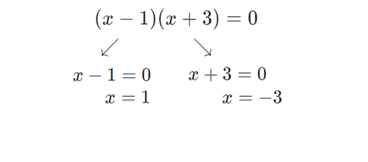
Factorization of Zero

Slide 20








Practice
$(2x+1)(3x−4)$
$(−\frac{2}{5}x+1)(4x+4)$
$3(\frac{4x}{5}−\frac{1}{7})(1\frac{1}{3}−\frac{3x}{10})$
$9(\frac{x}{11}−2\frac{2}{5})(\frac{2}{3}−\frac{3x}{12})$
$(2\sqrt{3}y−4)(4y+7)$
$(9\sqrt{5}z−13)(24z+43)$
$(7−3\sqrt{5}y)(3y+\frac{2}{3})(\frac{15y}{17}+\frac{34}{55})$

Slide 21

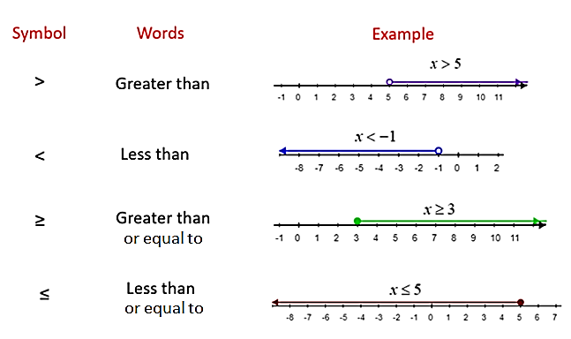
Inequalities

Slide 22

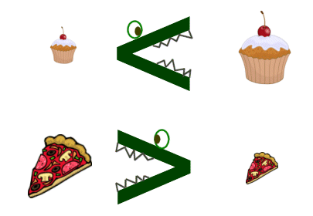
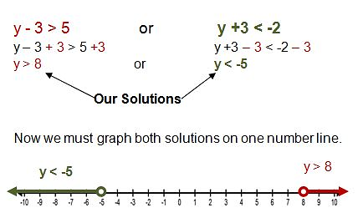
Inequalities

Slide 23



Practice
If 5 times a number is increased by 4, the result is at least 19. Find the least possible number that satisfies these conditions.
The sum of twice a number and 5 is at most 15. What are the possible values for the number?
Three times a number increased by 8 is no more than the number decreased by 4. Find the number.
The cost of a gallon of orange juice is $3.50. What is the maximum number of containers you can buy for $15?

Slide 24
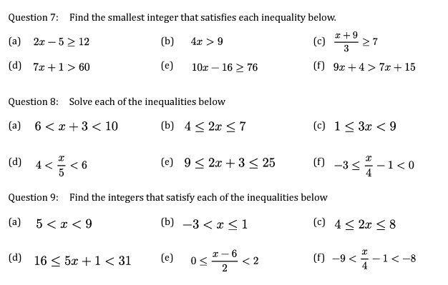

Slide 25
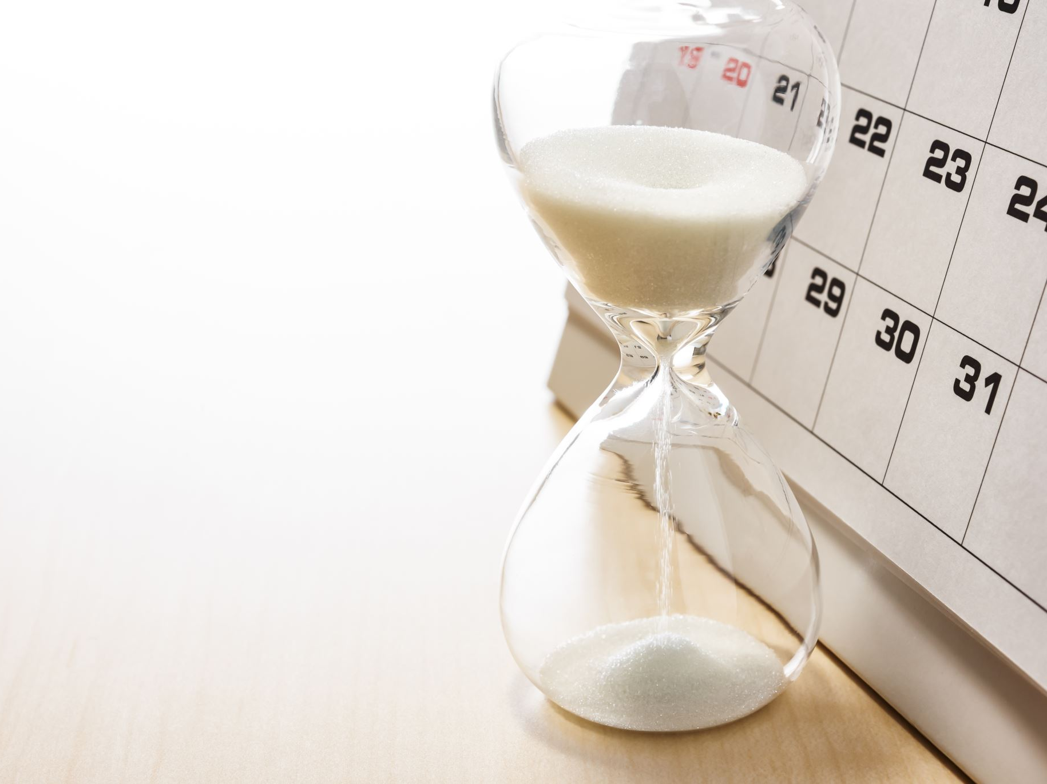
Practice Time

Slide 26
Perfect Square Trinomials & Difference of two squares

Slide 27



























$(4m^{3}+n^{3})(4m^{3}−n^{3})$
$9x^{4}−4$
$(3x+1)(3x−1)$
$5(5m^{2}+2n^{2})(5m^{2}−2n^{2})$
$36m^{2}−121$
$x^{2}−9y^{2}$
$6\left(7r + 5\right)\left(7r − 5\right)$
$6(2x+3)(2x−3)$
$x2 + 18x + 81$
${(3x+2)}^{2}$
$−x^{2}+16$
$36x2 + 132x + 121$
$4a^{2}−81b^{2}$
${(5p+3)}^{2}$
${(2y+5)}^{2}$
$12x^{2}−75$
${(8y−2)}^{2}$
${(5x^{2}−9)}^{2}$
$a^{2}b−b^{3}$
${(4z^{2}+8)}^{2}$

Slide 28
Pythagorean theorem

Slide 29
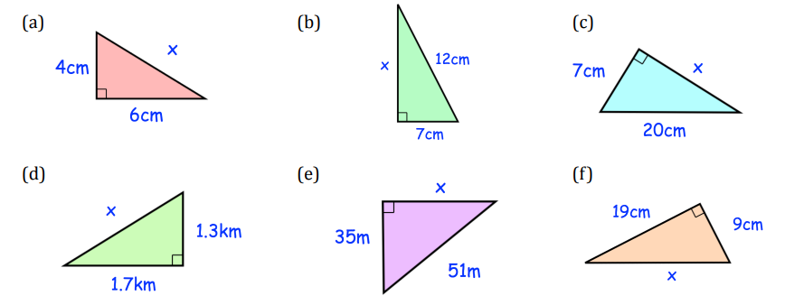
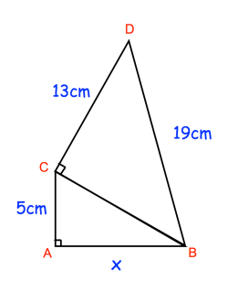
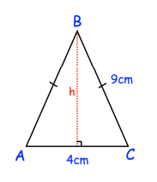
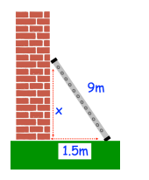


To wash a window that is 8 metres off the ground, Aisha leans a 10 metre ladder against the side of the building. To reach the window, how far from the building should Aisha place the base of the ladder?

Slide 30
Rationalising the Denominator & Factorization of Zero

Slide 31







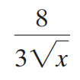





$4(\frac{3y}{12}+2\frac{3}{7})(\frac{5}{9}−\frac{3y}{15})$
$(6\sqrt{3}x−18)(16x+70)$
$(13−2\sqrt{8}y)(5y+\frac{6}{13})(\frac{14y}{23}−\frac{46}{77})$

Slide 32
Inequalities

Slide 33




















$$2\left(4x−1\right)<38$$
$$4\left(x+1\right)<2x+3$$
$$1−\frac{3}{2}x≥x−4$$
$$−9−\frac{x}{2}≥\frac{x}{2}+1$$

Slide 34




Atomic Habits is the definitive guide to breaking bad behaviors and adopting good ones in four steps, showing you how small, incremental, everyday routines compound into massive, positive change over time.
Why must we read?
Reading is good for you because it improves your focus, memory, empathy, and communication skills. It can reduce stress, improve your mental health, and help you live longer. Reading also allows you to learn new things to help you succeed in your work and relationships.

Slide 35



