Slide 1

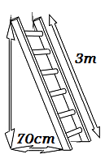
Problems for Revision
Find the measure of the hypotenuse of a right-angled triangle whose sides measure square root of 2 and square root of 3.
Calculate the height that we can reach with a 3m ladder leaning against a wall if the bottom of the ladder is 70cm from the wall.

Slide 2
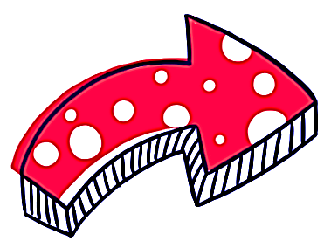
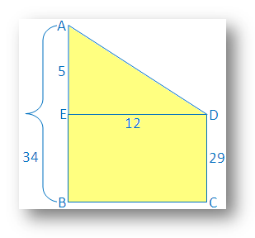
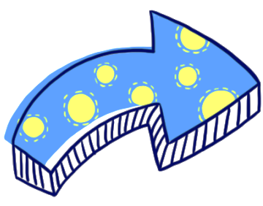
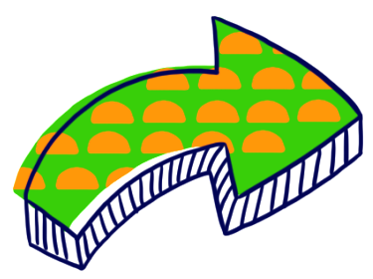
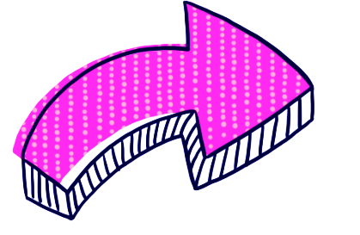
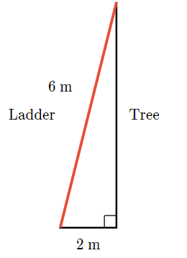

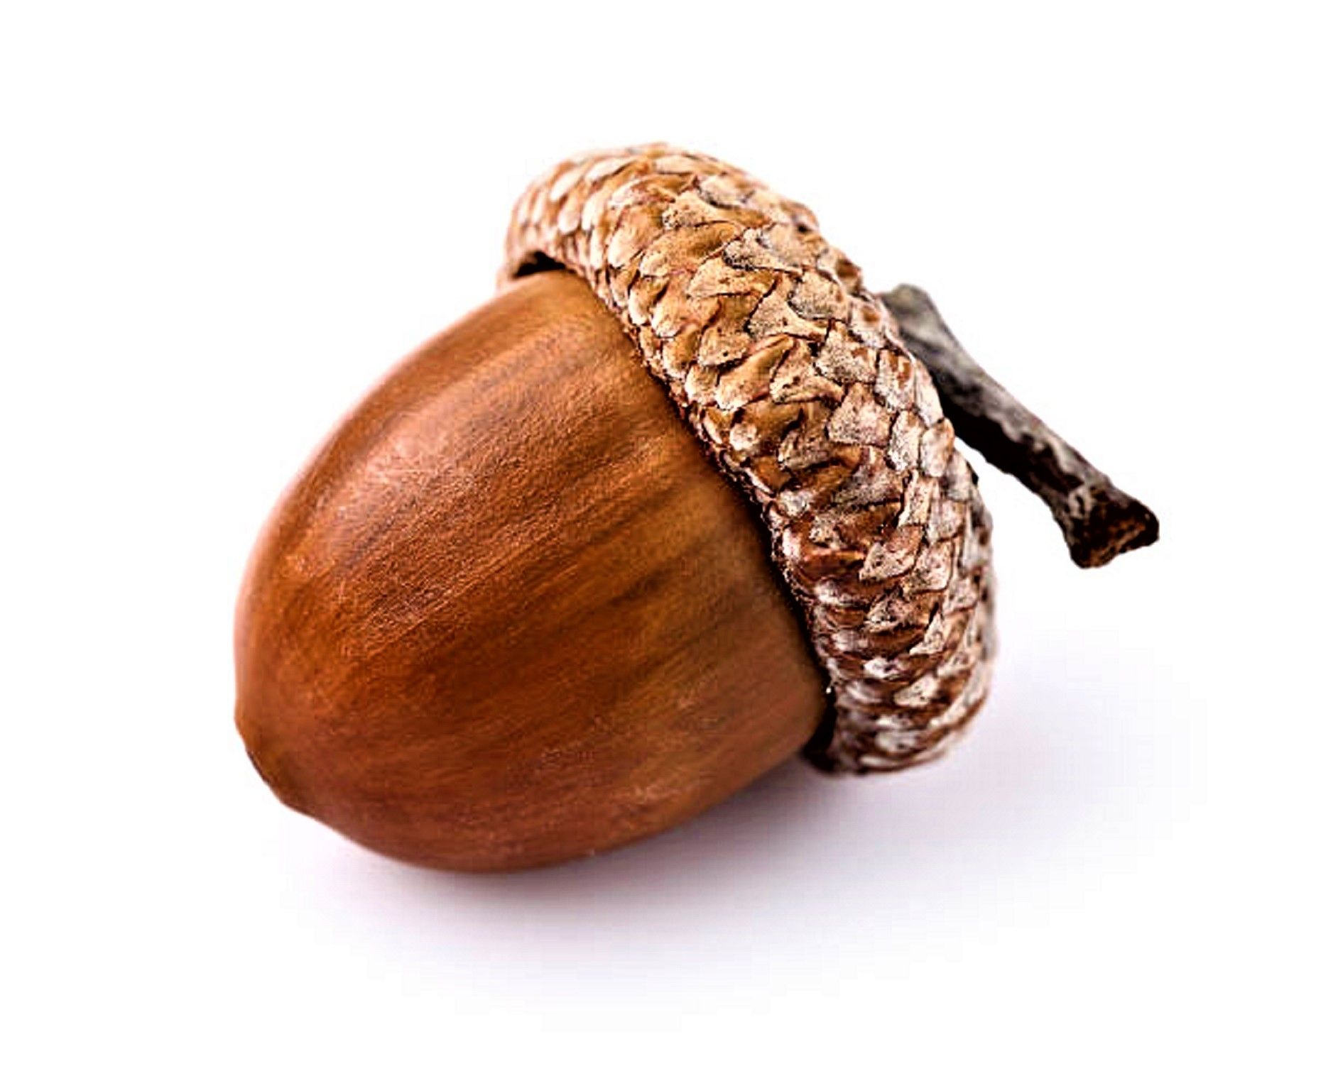
Factorization of zero: $(3\sqrt{4}y−4)(\frac{4}{5}y+12)$
Rationalize the denominator: $\frac{2}{\sqrt{5}−\sqrt{x}}$
The height of two building is 34 m and 29 m respectively. If the distance between the two building is 12 m, find the distance between their tops.
Find the perimeter of a rectangle whose length is 150 m and the diagonal is 170 m.
Ahmed has a 6 meter ladder that he wants to use to get his cat out of a tree. He puts the base of the ladder 2 meters away from the base of the tree. How high into the tree will the ladder reach?
A flying squirrel lives in a nest that is 16 feet high in a tree. To reach a fallen acorn that is 12 feet from the base of the tree, how far will the flying squirrel have to glide?
Negative six times a number decreased by 19 is no more than the seven times the number increased by 23. Find the number.

Slide 3

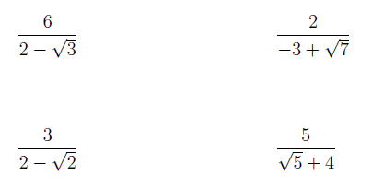




$2\left(4x−1\right)<38$
$−9−\frac{x}{2}≥\frac{x}{2}+1$
$1−\frac{3}{2}x≥x−4$
$4\left(x+1\right)<2x+3$

Slide 4

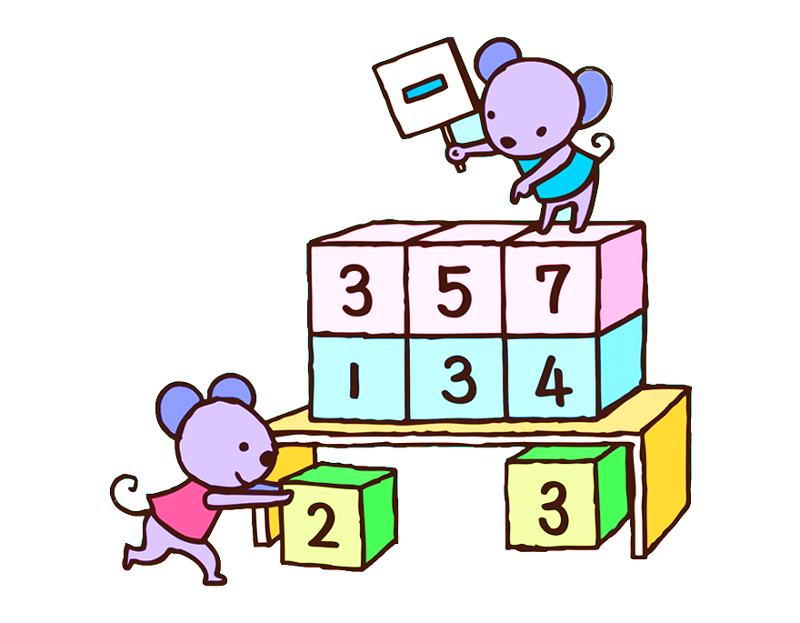

($2\sqrt{3}x+5) \left(x^{2}−9\right)\left(12x−10\right)\left(\frac{3}{4}x+\frac{11}{16}\right)=0$
$\left(\frac{7}{8}y−5\right)\left({3x}^{3}−81\right)\left(3x+1\frac{5}{13}\right)\left(\sqrt{3}x−1\right)\left(12x+12\right)=0$
$\left(3x−\frac{2}{5}\right)\left(\sqrt{5}x−10\right)\left(x^{3}−64\right)=0$

Slide 5
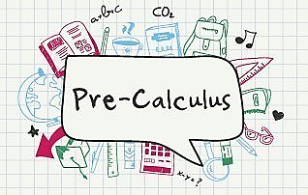
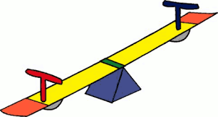
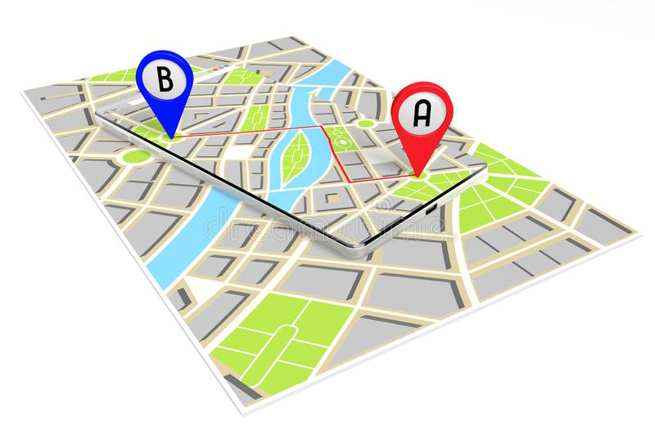

Lecture 3
Distance and Midpoint
Absolute Value: equation & inequality
Line Equation
Systems of Equations
Ms. Togzhan Nurtayeva
Course Code: IT 161/A
Semester 1
Week 5-6
Date: 09.01.2024

Slide 6




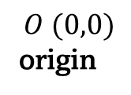
The Cartesian Plane
$y$-axis
$xy$-plane – Cartesian plane
Plot points on a graph:
$x$-axis
$$O (0,0)$$
origin
$$P (2, 1)$$
$$Q (6, 4)$$
$$R (6, 1)$$

Slide 7

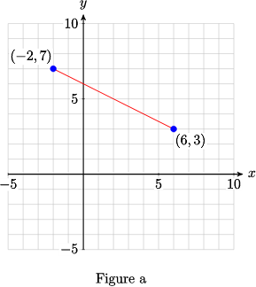





Distance
$$y$$
$$d=\sqrt{{{(x}_{2}−x_{1})}^{2}+{(y_{2}−y_{1})}^{2}}$$
Q ($x_{2}, y_{2}$)
d
P ($x_{1}, y_{1}$)
$$x$$

Slide 8
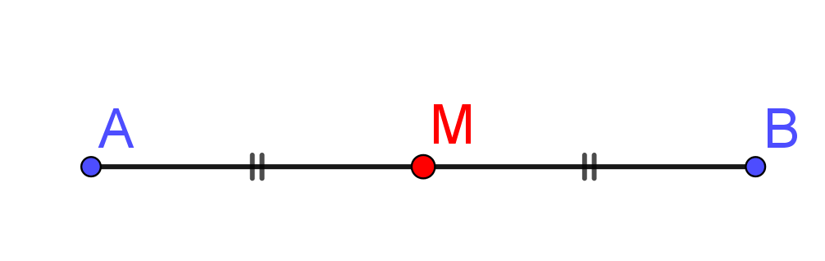
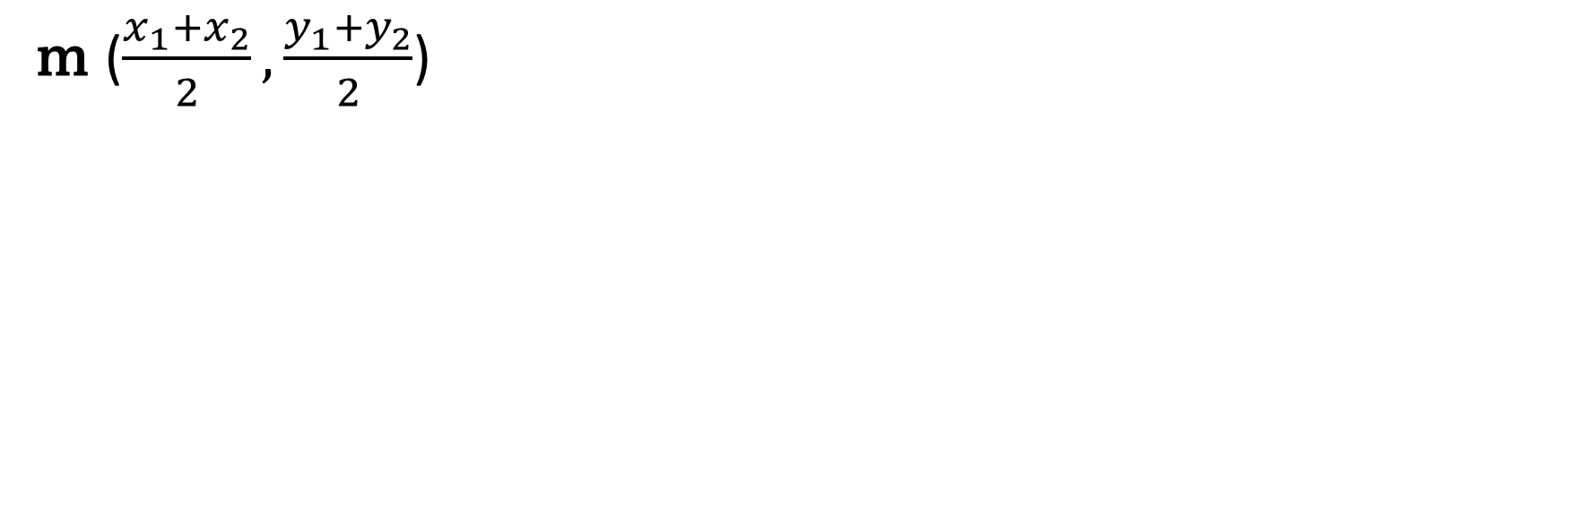
Midpoint
m ($\frac{x_{1}+x_{2}}{2},\frac{y_{1}+y_{2}}{2}$)
Find midpoint of a segment $PQ$, where $P (−2, 4)$and $Q (4, −2).$

Slide 9

P (1, 2)
Q (5, 6)
R (a, 2) – at this point occurs right-angle
Find a. Find the length of PQ, QR and PR.
A (0, 2)
B (4, 5)
C (4, 2)
Find the length of AB, BC, and AC.
Find distance between two points (1, 3) and (3, 12).
Find distance between two points (2, 3) and (8, 27). Find midpoint of the line segment.
Find midpoint of the line segment between two points (1, 4) and (3, 10).

Slide 10
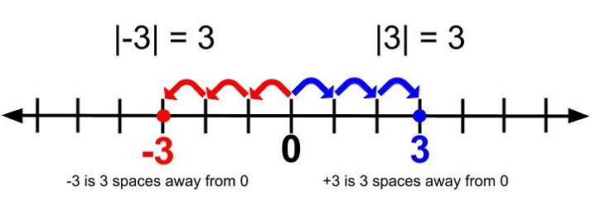










Distance and Absolute Value
Let $x ∈ ℝ$
Define the absolute value or magnitude of $x$ to be
$$x, if x ≥ 0$$
$|x|=$
$=$ distance between $x$ and $0$ on the real line.
$$x, if x < 0$$
$$−x = |x|$$
$$x = |x|$$
$$−x$$
$$0$$
$$x$$

Slide 11

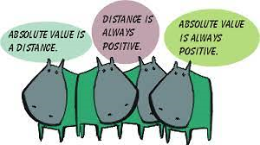
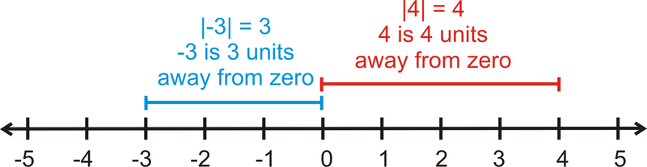
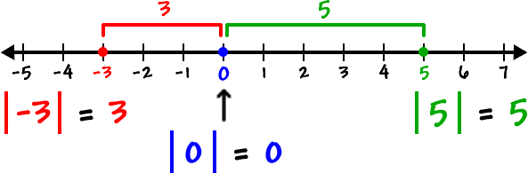

Slide 12
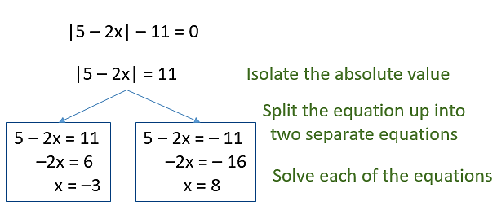
Absolute Value Equation

Slide 13
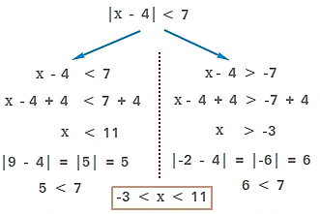
Absolute Value Inequality

Slide 14






Absolute Value on both sides
$$\left|2x+1\right|=|3x−5|$$
$$\left|number\right|=|number|$$
Check each case that is true:
$$\left|number\right|=|number|$$
$$\left|number\right|=|−number|$$
$$\left|−number\right|=|−number|$$
$$\left|−number\right|=|number|$$

Slide 15

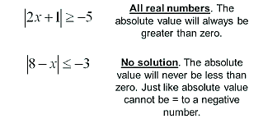
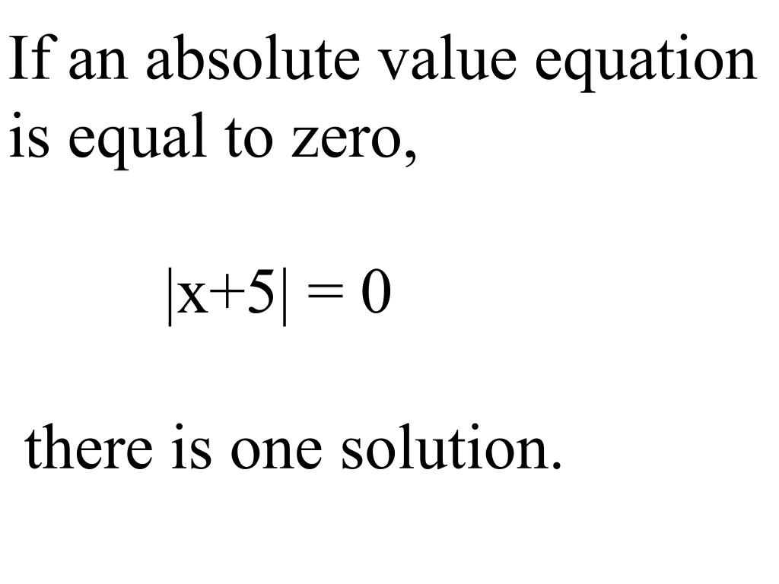
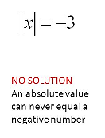
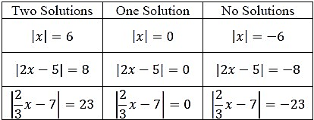
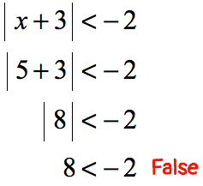
Example:

Slide 16

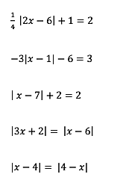
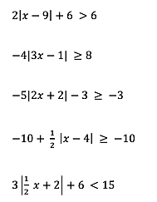
Solve the equation.
Solve the inequality.

Slide 17

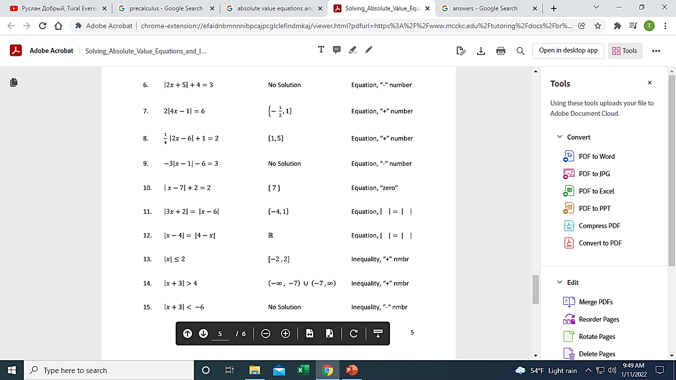
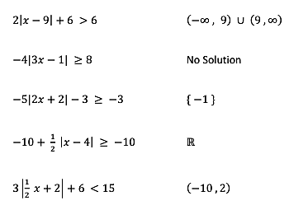

Slide 18











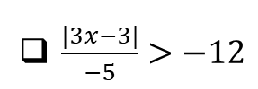






| 6x + 4 | = 8x + 10
$\left|x−5\right|>7$
| 3x - 1 | + 5 = 3
$\left|2x+3\right|≤12$
| x - 2 | = 2x - 3
$2\left|x−6\right|≥24$
| 12 - 6x | = 42
$\left|4x−1\right|−11<20$
| 2b - 4 | = 2b - 4
$−3\left|x+2\right|≤−9$
| 2a + 1 | = a + 5
$\frac{|3x−3|}{−5}>−12$
$−3\left|x+5\right|+1=7\left|x+5\right|+8$
$8+\left|4v−7\right|≥17$
5 | c - 2 | = 30

Slide 19
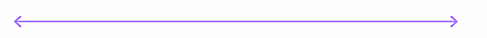
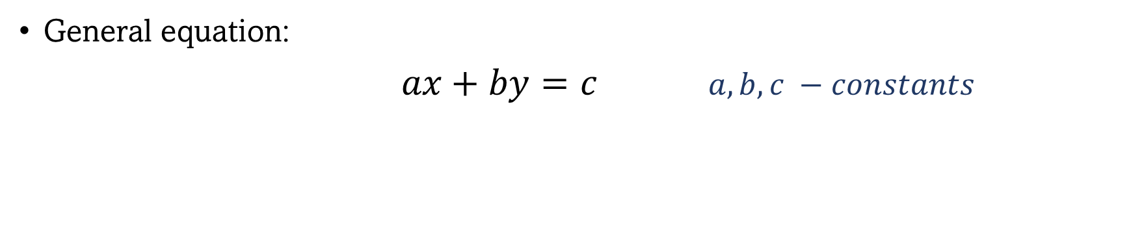
Lines
A line is a one-dimensional figure, which has length but no width.
A line is a set of collinear points with no curves and extends limitlessly in opposite directions is called a Straight line.
General equation:
$ax+by=c$ $a, b, c −constants$
variables

Slide 20
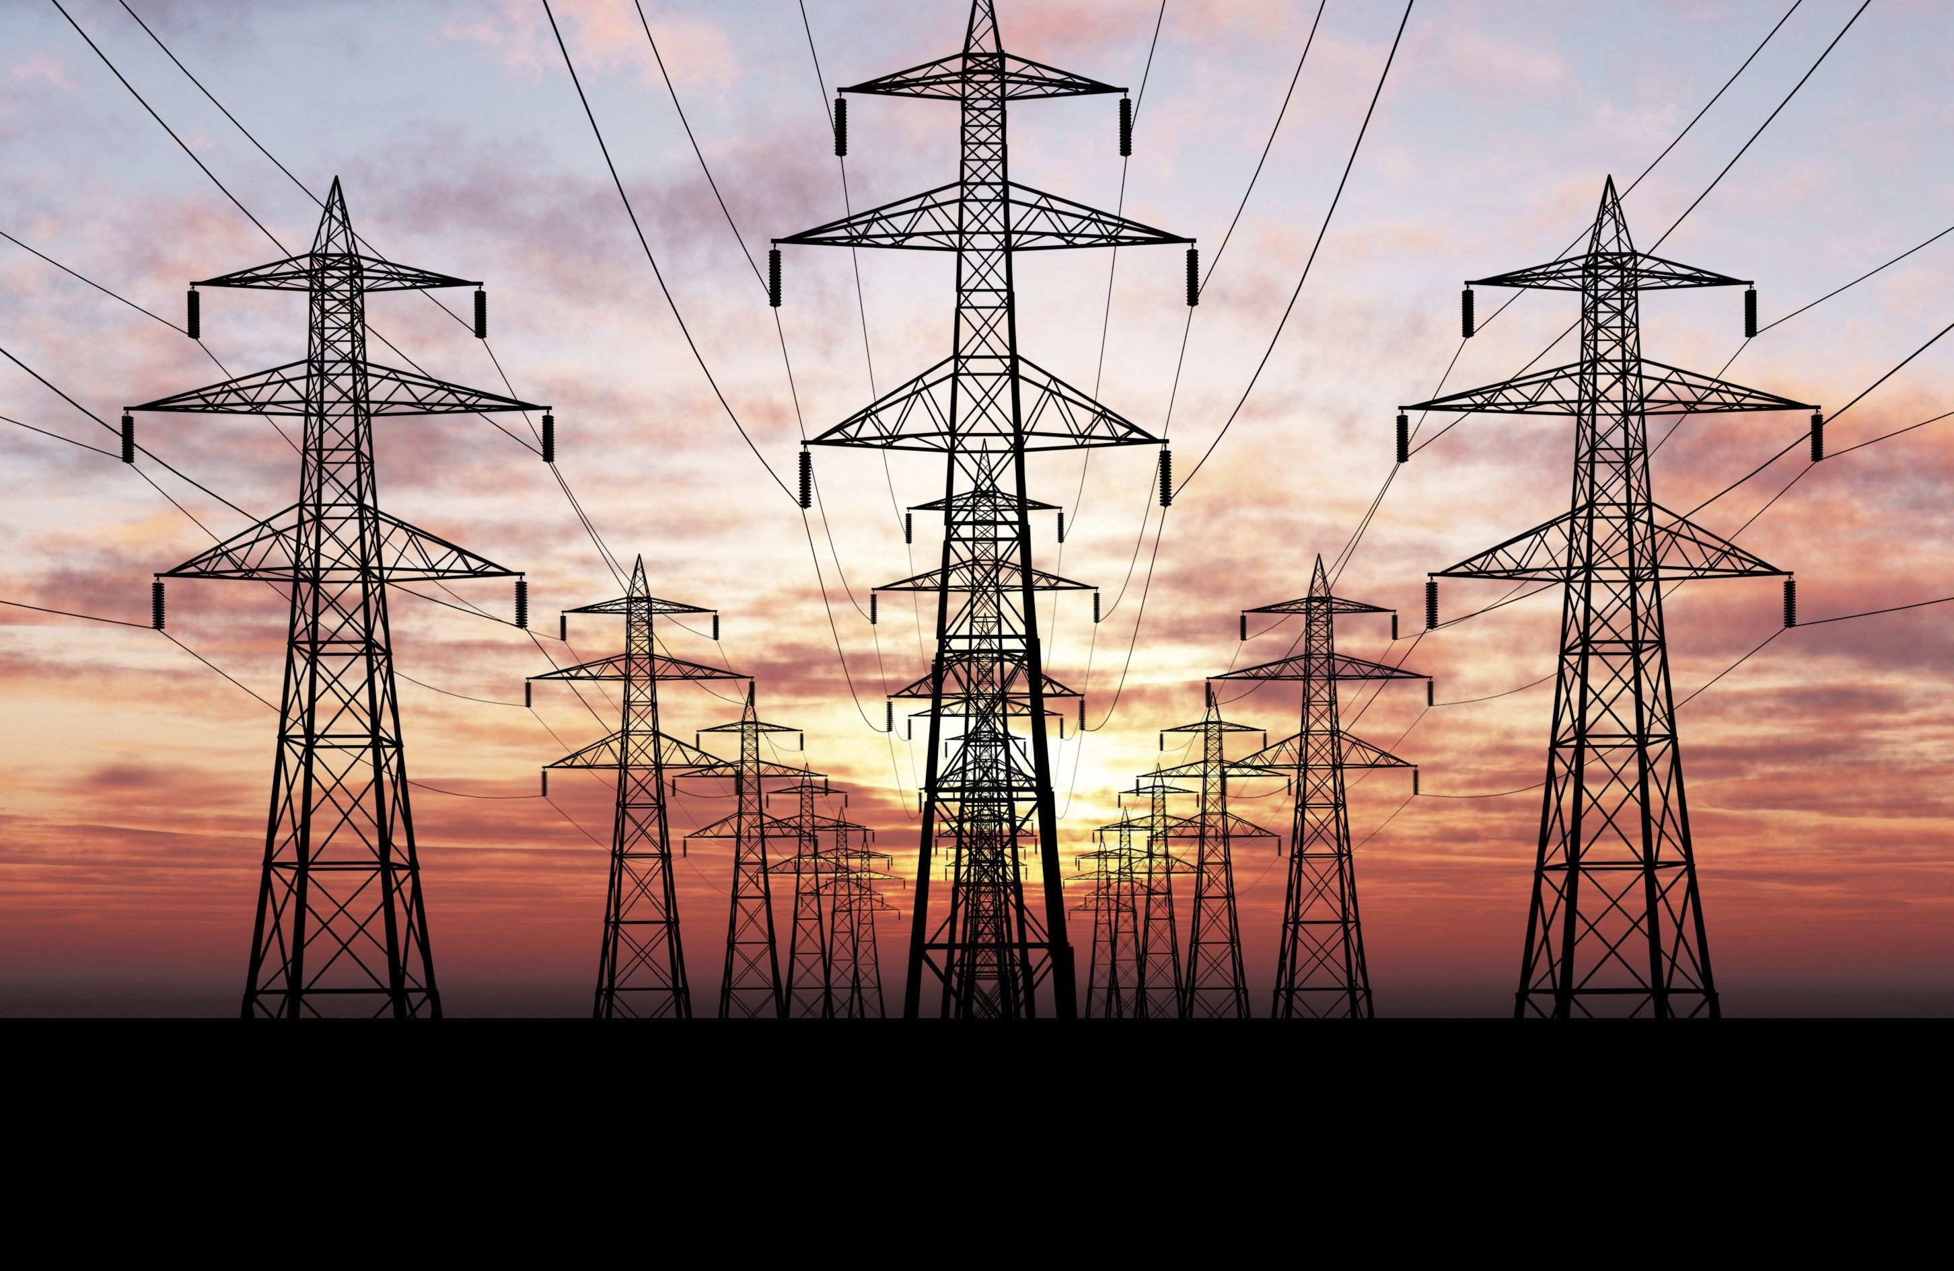
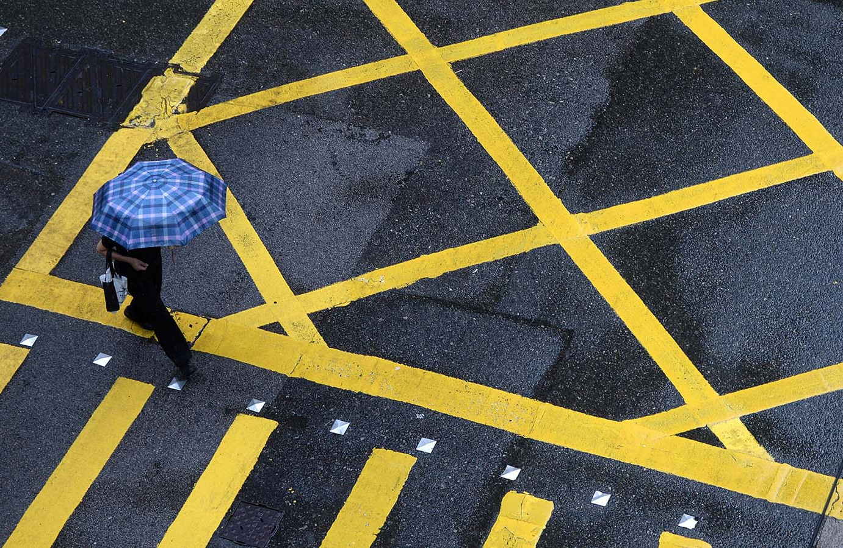
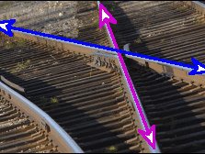
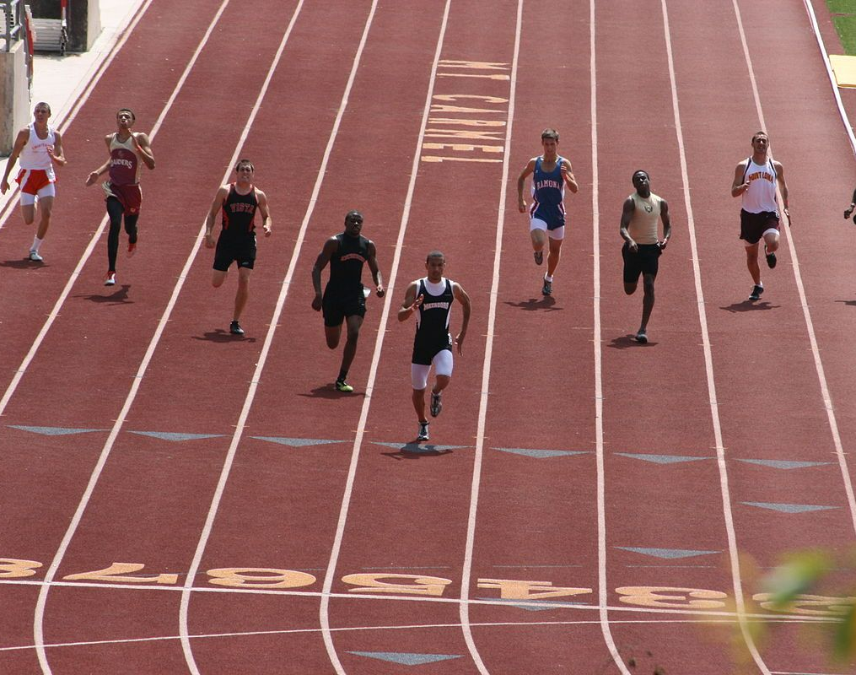


Slide 21



How do we find the equation of a line?
$ax+by=c$
$by=−ax+c$
$y=\frac{−ax+c}{b}$, $b≠0$
$y=\left(−\frac{a}{b}\right)x+\frac{c}{b}$
$$y=mx+k$$

Slide 22

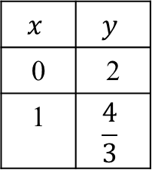



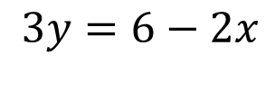
Lines
A line is determined by two points.
Sketch the line.
$$y$$
$$x$$ | $$y$$
0 | 2
1 | $$\frac{4}{3}$$
$$2x+3y=6$$
$$3y=6−2x$$
$$x$$
$$y=−\frac{2}{3}x+2$$

Slide 23
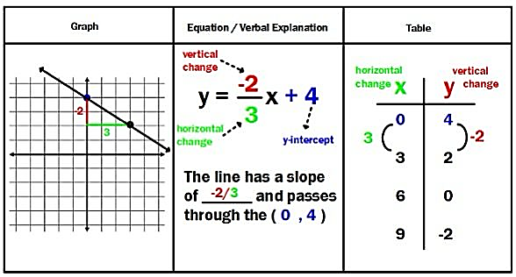

Slide 24
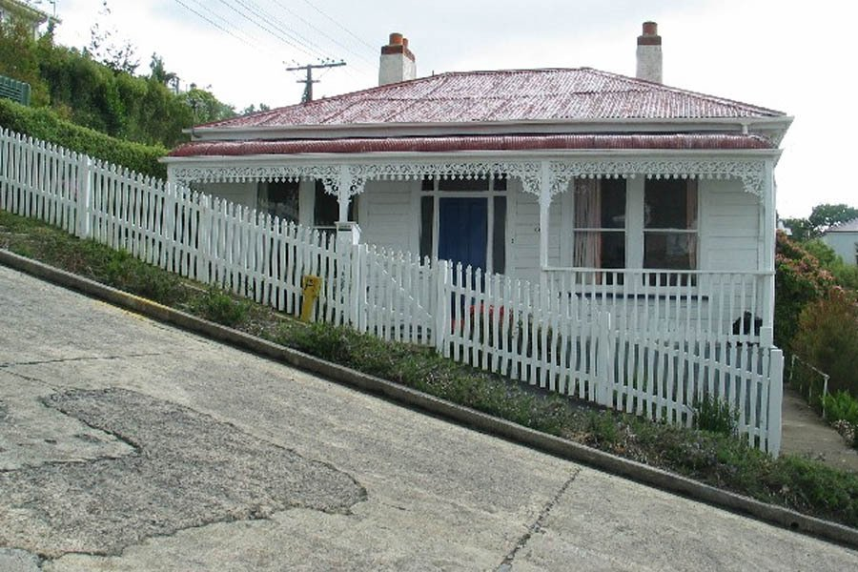

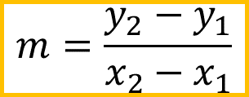
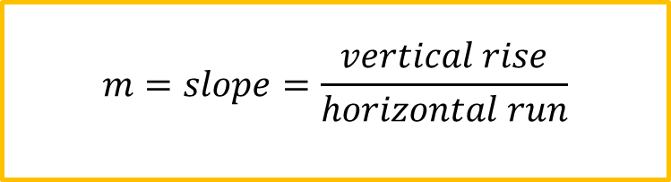



Slope
The slope or gradient of a line is a number that describes both the direction and the steepness of the line.
$$m=slope=\frac{vertical rise}{horizontal run}$$
Q$(x_{2},y_{2})$
$$y_{2}−y_{1}$$
$$m=\frac{y_{2}−y_{1}}{x_{2}−x_{1}}$$
$$P (x_{1},y_{1})$$
$$x_{2}−x_{1}$$

Slide 25
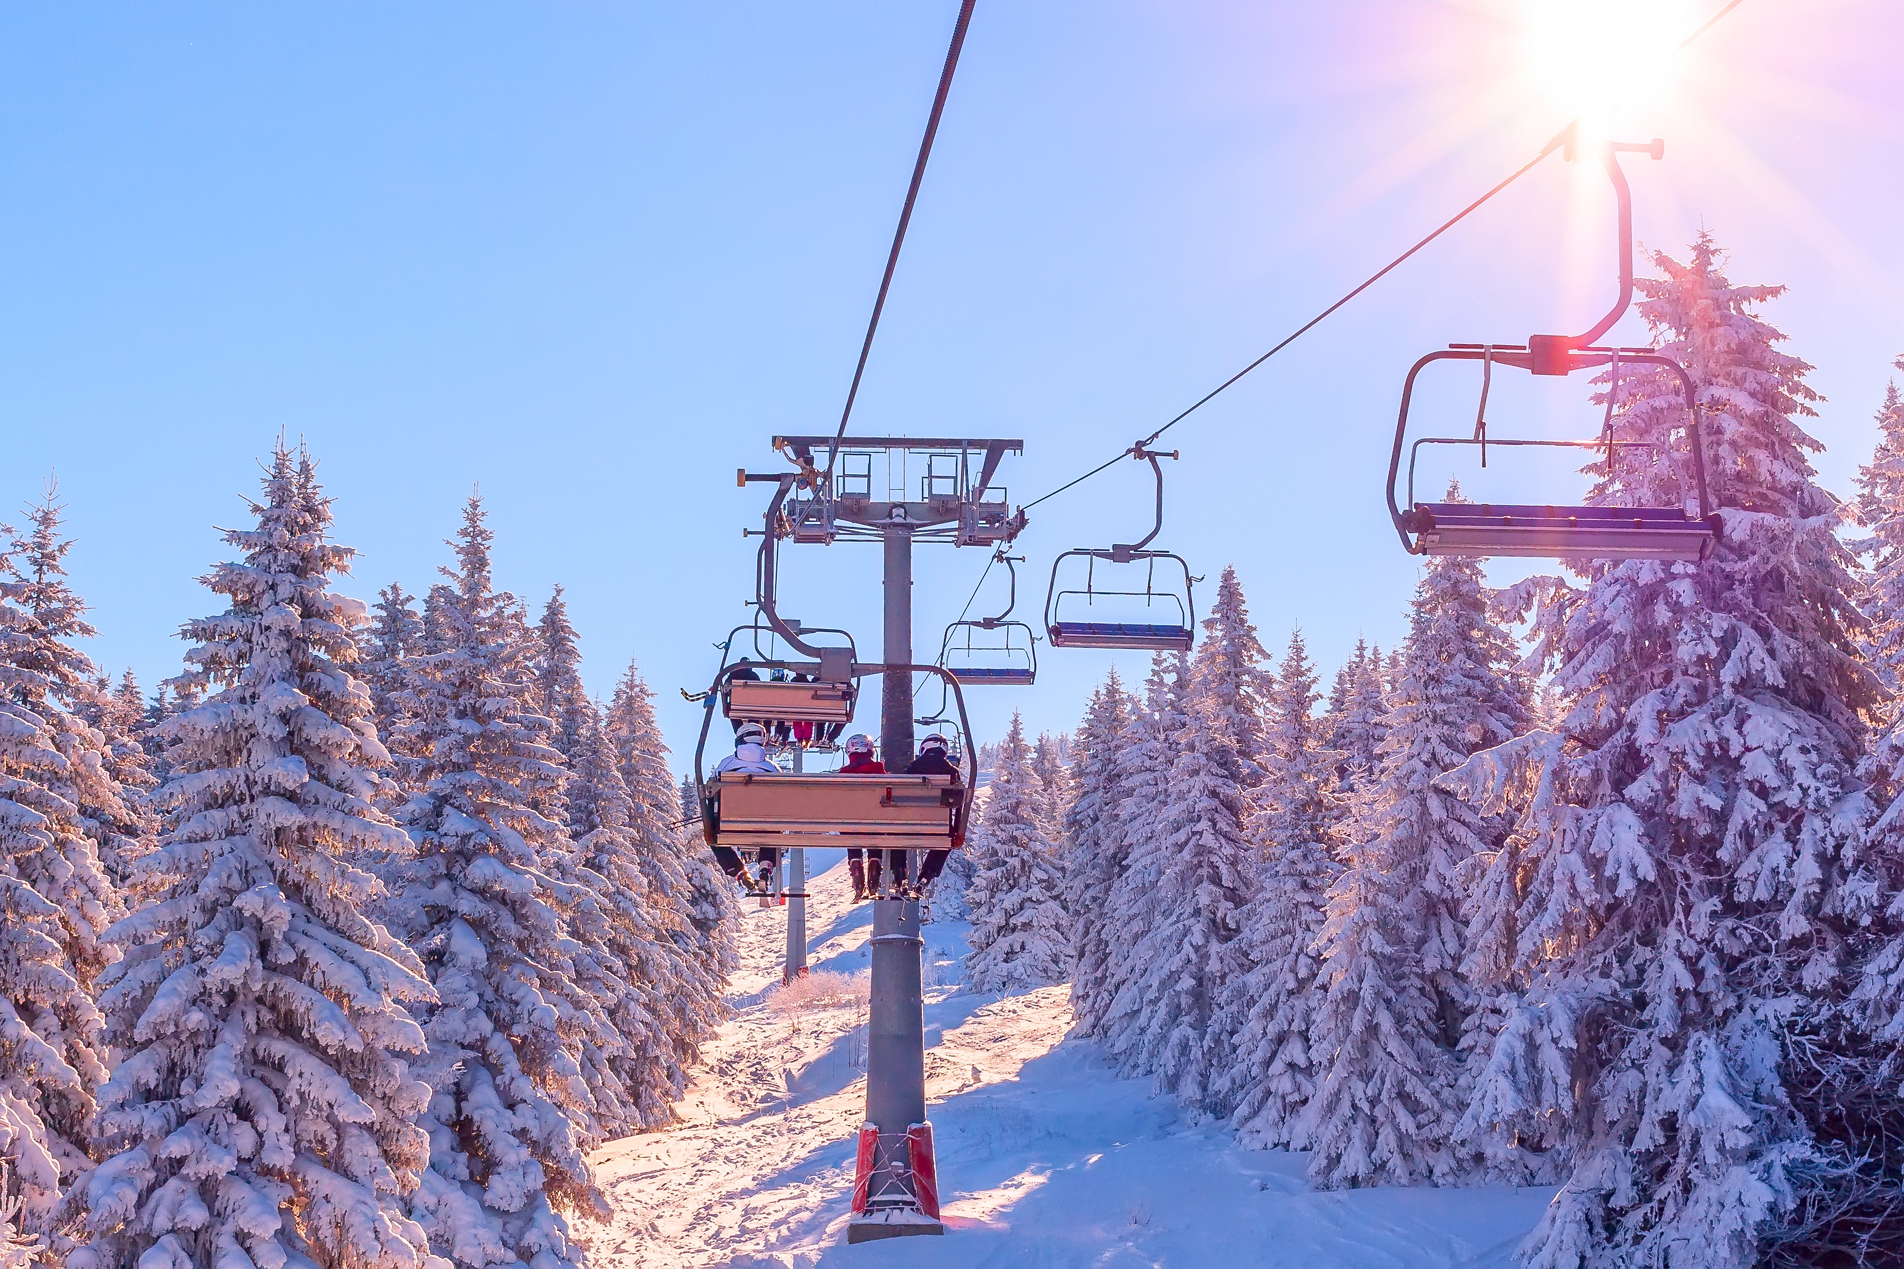
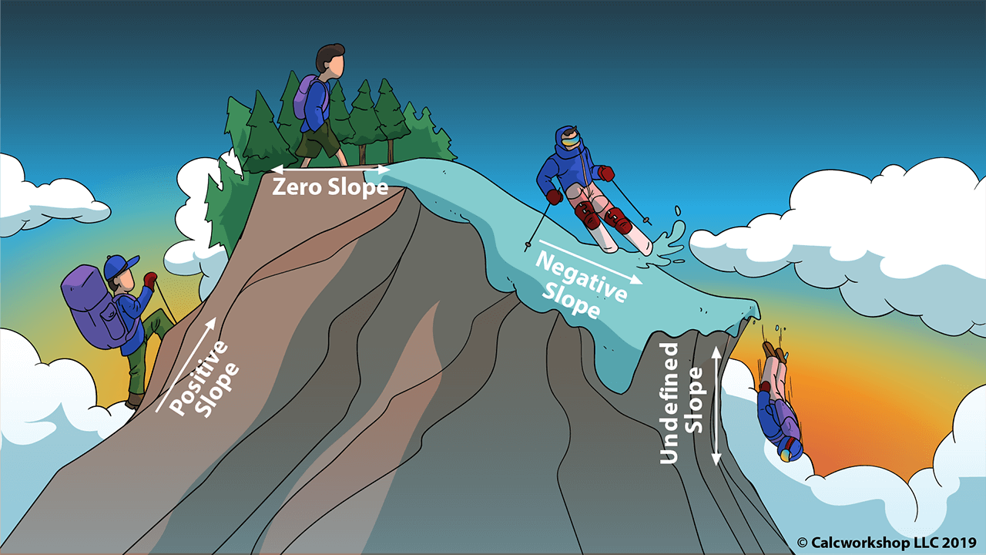

In mathematics, the slope or gradient of a line is a number that describes both the direction and the steepness of the line.
Slope tells you how steep a line is, or how much $y$ increases as $x$ increases. The slope is constant (the same) anywhere on the line.
Some real life examples of slope include:
in building roads one must figure out how steep the road will be.
skiers/snowboarders need to consider the slopes of hills in order to judge the dangers, speeds, etc.
when constructing wheelchair ramps, slope is a major consideration.

Slide 26


Find the slope of the line passing through P (2, 2) and Q (5, 6)
P($x_{1},y_{1}$) Q ($x_{2},y_{2}$)
$$slope=m=\frac{y_{2}−y_{1}}{x_{2}−x_{1}}=\frac{6−2}{5−2}=\frac{4}{3}$$
Find the slope where P (-1, 2) and Q (5, -4)

Slide 27
Slope
Positive
Negative
Zero
Infinite

Slide 28



The $y$-intercept and the $x$-intercept

Slide 29


Find the equation of line L passing through P (2, 3) and Q (7, 13)
1) find a slope.
2) put coordinates of any of given points and find constant k.
1. $m=\frac{13−3}{7−2}=\frac{10}{5}=2 (slope)$
2. $y=mx+k$ – line equation
$y=2x+k m=2$
P(2,3): $3=2×2+k$
$3=4+k$
$k=3−4$
$k=−1$
$m=2, k=−1$
$y=2x−1$

Slide 30

P (2, 5) and Q (4, 9) – find a line equation.
A (2, 0) and B (8, 3) – find a line equation.
W (-2, 5) and Y (4, -9) – find slope.
What is the slope of a line that runs through points: (-2, 5) and (1, 7)? Write the line equation.
A line passes through the points (–3, 5) and (2, 3). What is the slope of this line and line equation?

Slide 31


Slide 32


Slide 33



Slide 34


Slide 35

Practice Problems

Slide 36






Systems of Equations

Slide 37








Systems of Equations

Slide 38




Solve and show a solution set for each problem.
$\left|−6x+3\right|=27$
$2\left|3x−1\right|−1=7$
$2\left|3x−1\right|−1≤7$
$\left|−2x+7\right|+5≥14$
$A\left(5, −6\right) and B \left(−3, 1\right)$
$$find midpoint coordinates and distance$$
$$between given two points.$$

