Slide 1

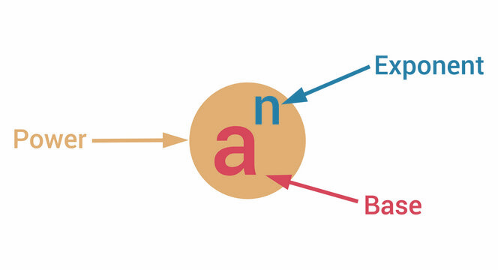
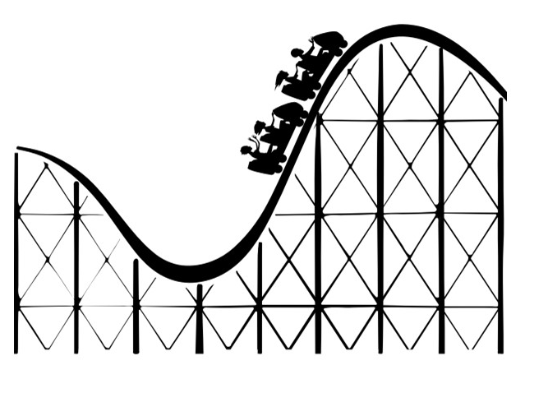
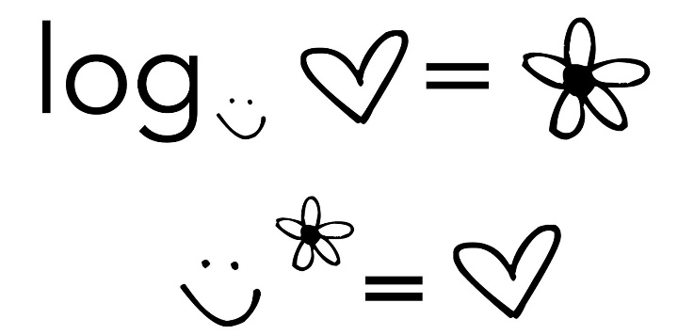
Lecture 5:
Powers
Logarithms

Slide 2
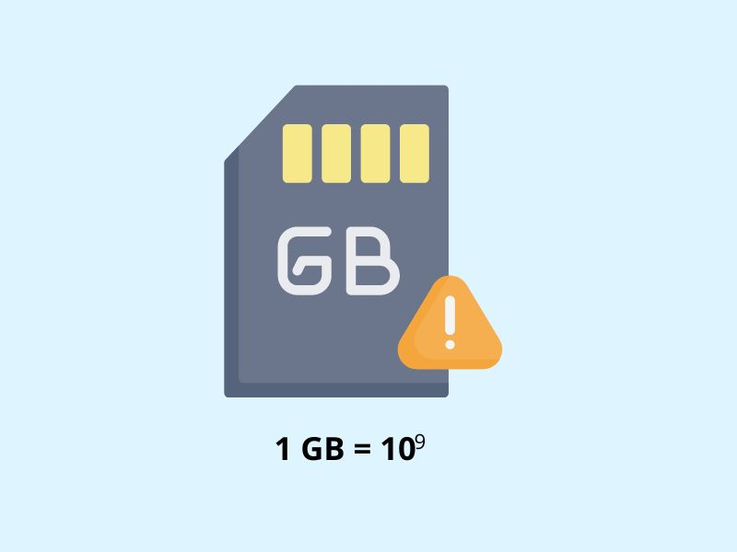
What will we learn?
Power and nth root functions
Fractional powers and nth roots
Number System Conversion
Logarithmic Functions

Slide 3

Powers / Exponents

Slide 4
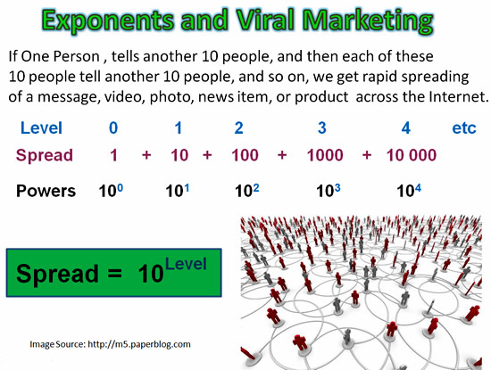
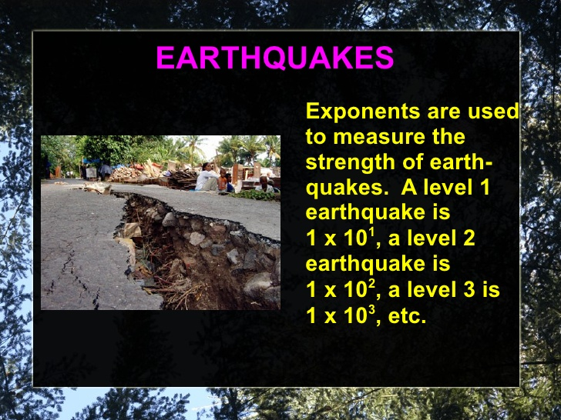
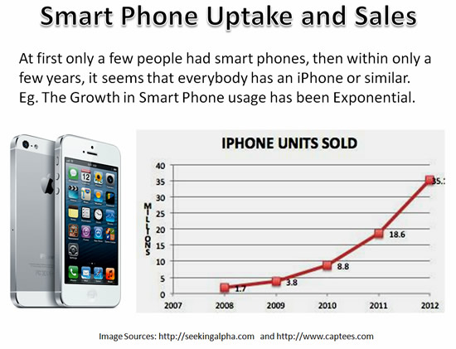
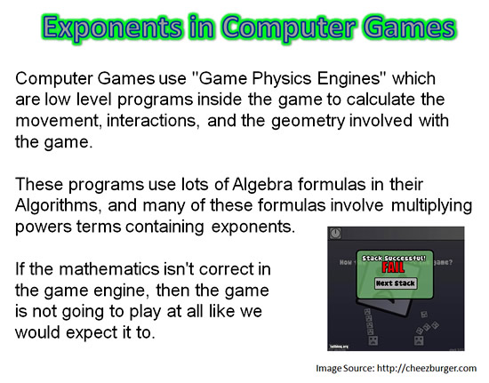

Slide 5

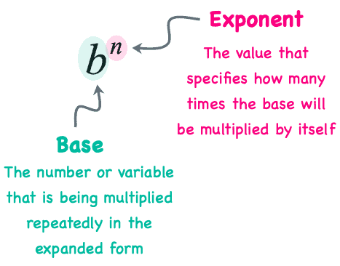
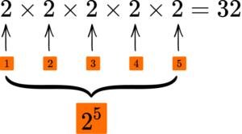

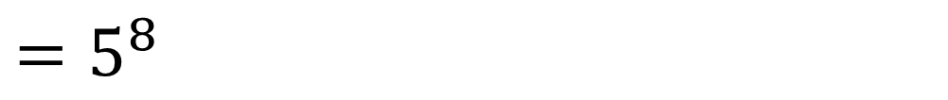

Exponents / Powers
$$5×5×5×5×5×5×5×5$$
$=5^{8}$
$8 times$
$$7×7×7×7×7×7×7×7×7$$
$${=7}^{9}$$

Slide 6

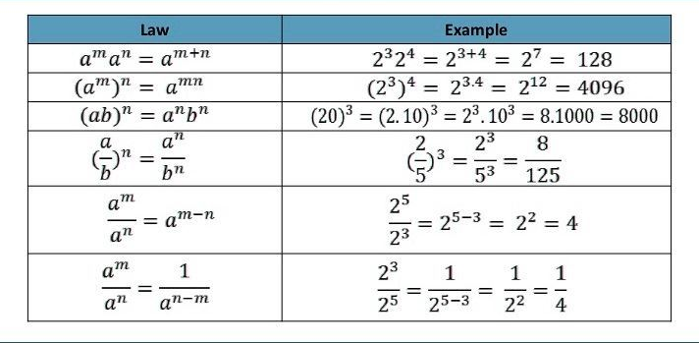
Exponents/Powers Properties

Slide 7
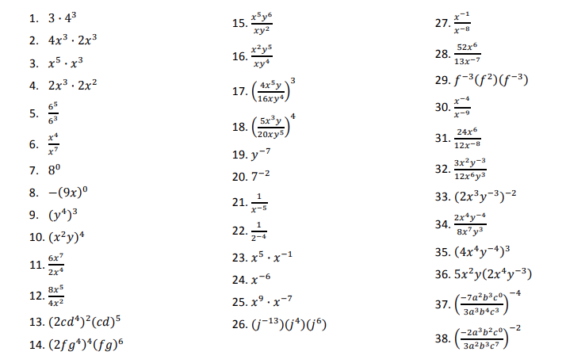

Slide 8

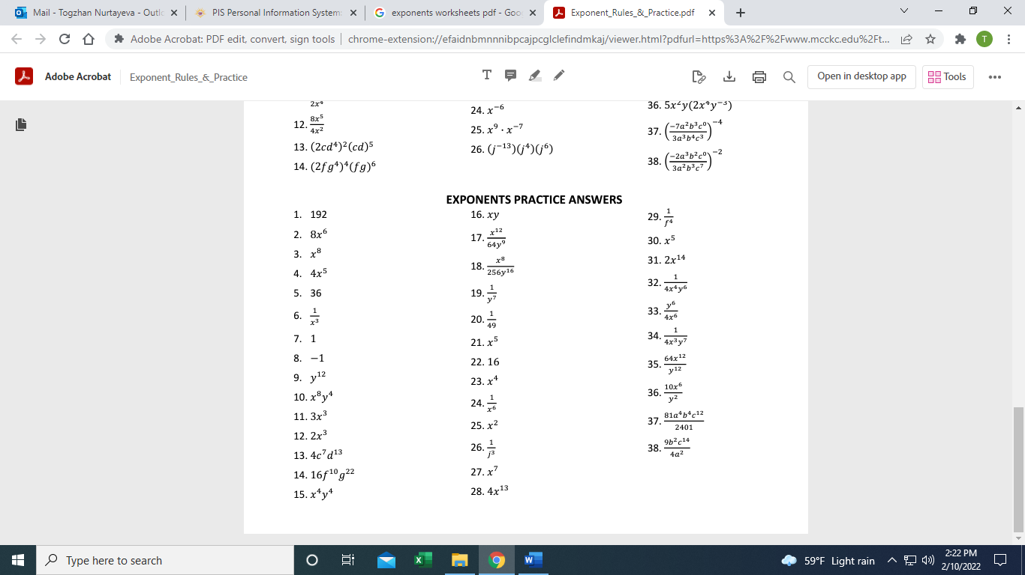

Slide 9
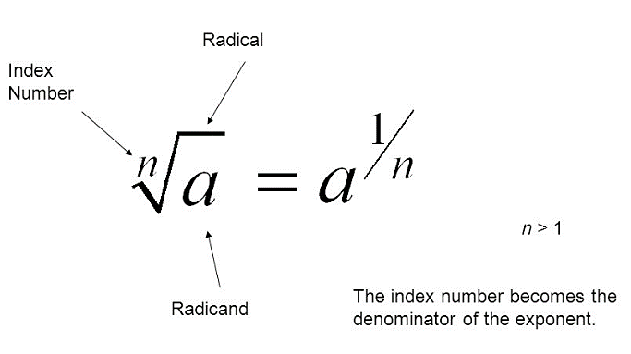
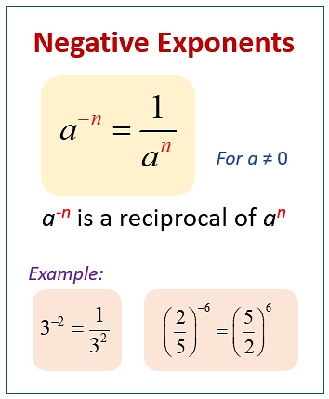
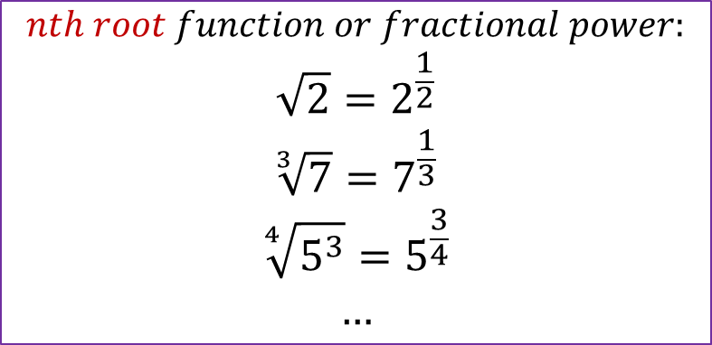
Exponents/Powers with Roots
$$nth root function or fractional power:$$
$$\sqrt{2}=2^{\frac{1}{2}}$$
$$\sqrt[3]{7}=7^{\frac{1}{3}}$$
$$\sqrt[4]{5^{3}}=5^{\frac{3}{4}}$$
$$…$$

Slide 10
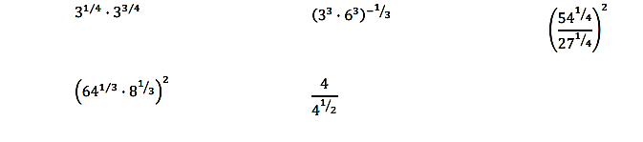

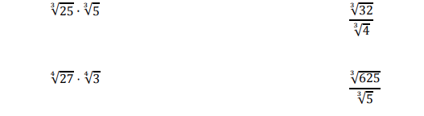
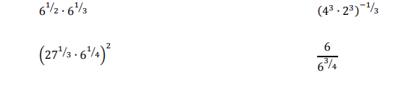

Slide 11
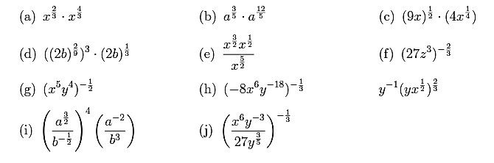
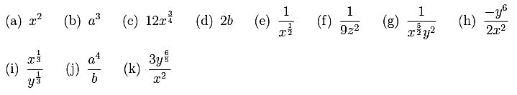

Slide 12
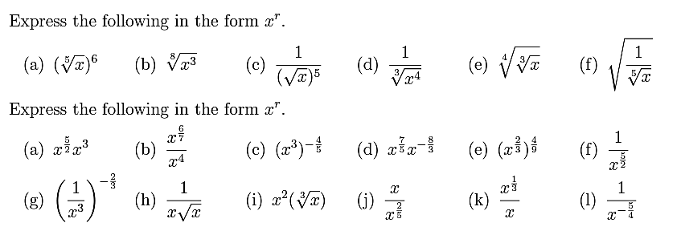


Slide 13
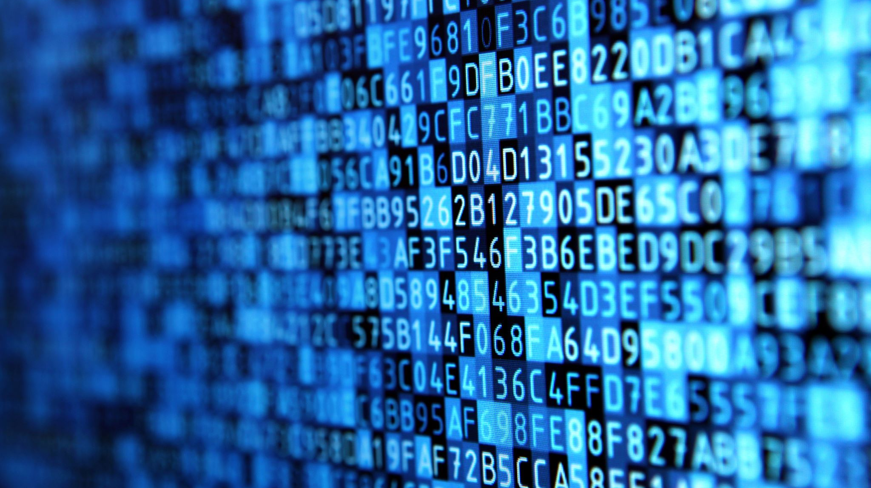
Number System Conversion

Slide 14
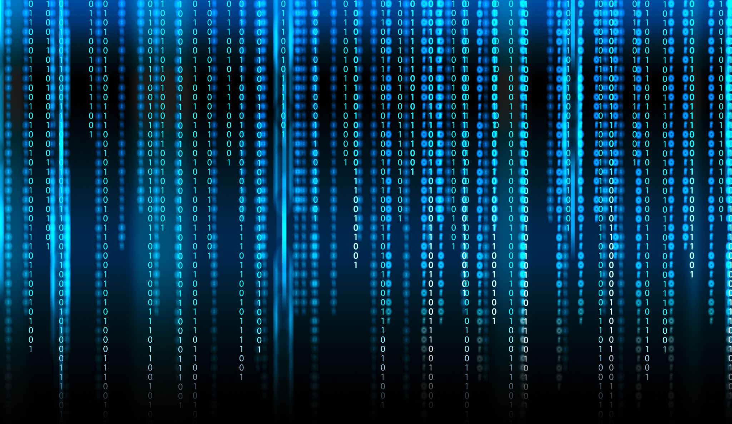
Numeral Systems in Computer Science refer to the numeric base systems used for performing computation, storing and representing data. They include the binary (base-2), decimal (base-10), octal (base-8), and hexadecimal (base-16) systems.
Database systems use decimal numbers for all financial data, dates, and time. In fact, for any numeral data that is input or output in interaction with a user, the decimal system is ordinarily used.
In scientific computing, decimal numbers are essential for complex calculations and computations involving real numbers, representing them more naturally.
For error-correcting codes, the decimal system is used to represent parity bits. In cryptography, decimal numbers are used in key generation operations.
Binary code governs the realm of machine language, the lowest level of programming languages. Each assembly instruction corresponds to a unique binary code, instruction set architecture being processor-specific.
Bit manipulation tasks often utilise binary operations, which can prove more efficient and swift.

Slide 15
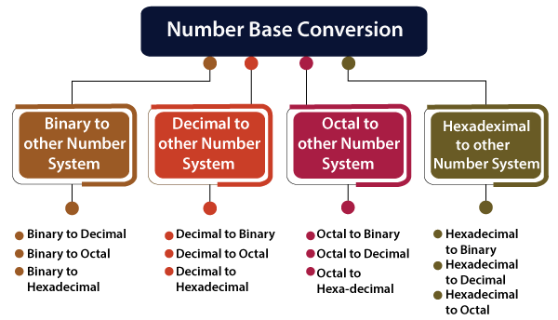

Although machines operate using binary, human-interface devices primarily use the decimal system. It forms the backbone of numeric data in user-centric applications. When processing numeric data, computers convert decimal values into binary and perform computations. The resulting binary data is then transformed back into decimal form for user-friendly output.

Slide 16
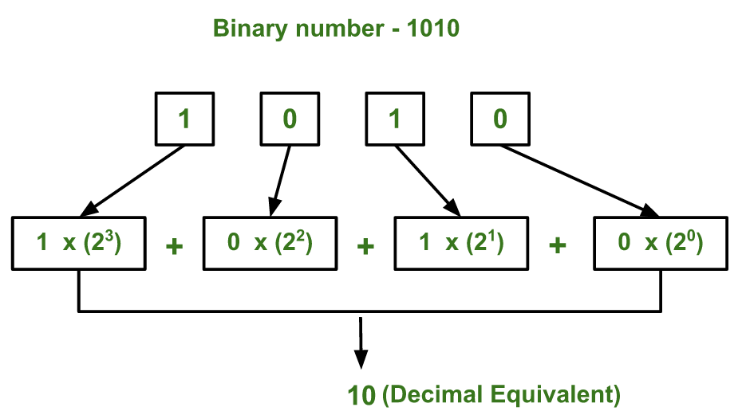
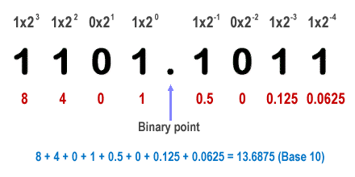
Binary to Decimal

Slide 17
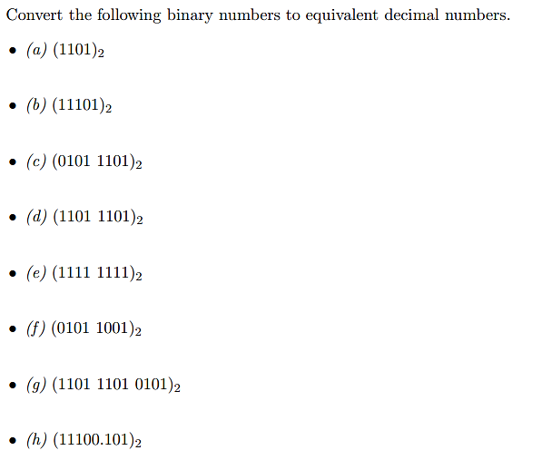

Slide 18













Successive Division Method
Decimal Number:
$$75$$
$$75÷2=37 (R=1)$$
LSB (Least significant bit)
$$37÷2=18 (R=1)$$
$$18÷2=9 (R=0)$$
$$9÷2=4 (R=1)$$
$$1001011$$
$$4÷2=2 (R=0)$$
$$2÷2=1 (R=0)$$
$$1÷2=0 (R=1)$$
MSB (Most significant bit)
Decimal Number:
$$142$$
$$=10001110$$
$$339$$
$$=101010011$$

Slide 19

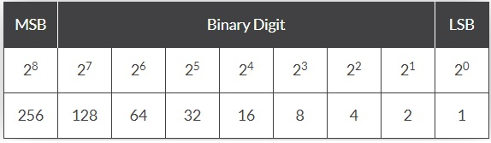

















Decimal Number:
$$75$$
$$=64+8+2+1$$
Highest base 2 number, that is less than 75 is 64:
Highest base 2 number, that is less than 11 is 8:
$$1$$
$$75−64=11$$
$$11−8=3$$
$$3−2=1$$
Decimal Number:
$$142$$
$$=10001110$$
$$339$$
$$=101010011$$
$$1$$
$$0$$
$$0$$
$$1$$
$$0$$
$$1$$
$$1$$

Slide 20
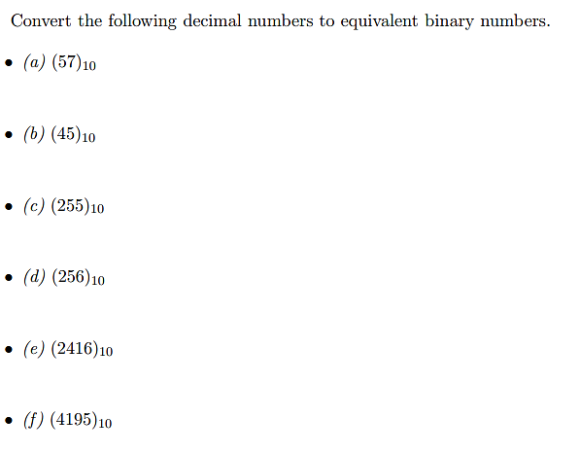

Slide 21

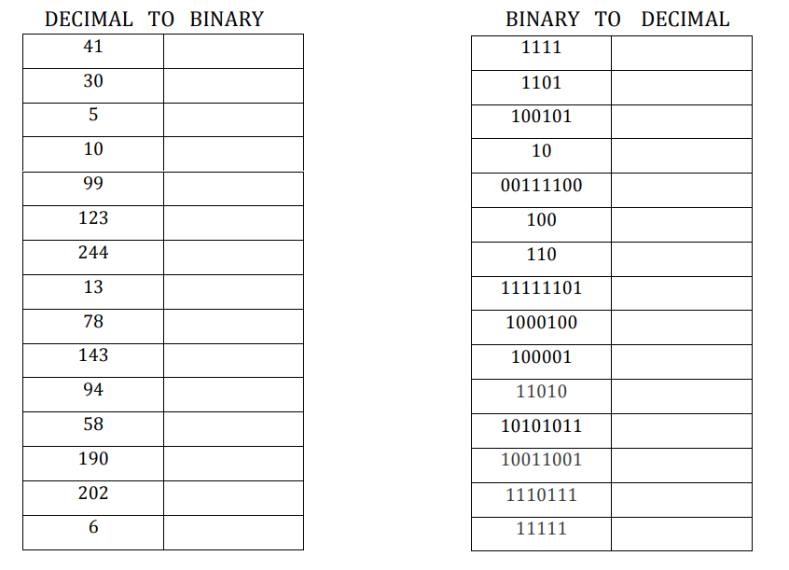

Slide 22
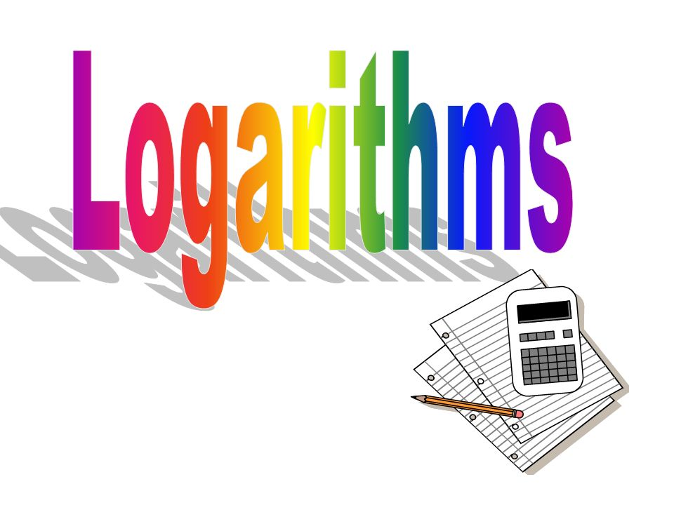
Logarithms play a crucial role in various aspects of computer science, from algorithms and data structures to cryptography and information theory.

Slide 23
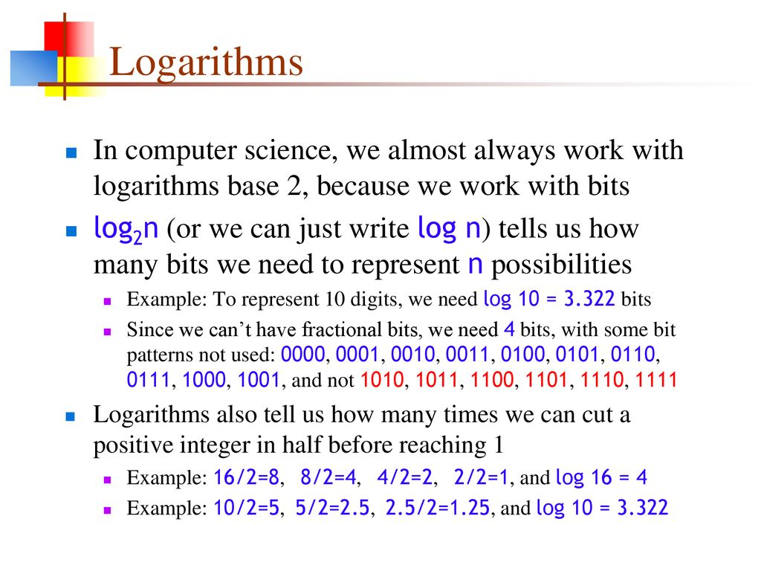

Slide 24

Data compression
Ever wondered how such large data obtained from various organizations and governments is stored and used? Storing such large data requires various storage devices, which will still be insufficient. In that case, the data compression technique is used, which uses logarithms to simplify and compress the data.
The data is compressed using different coding processes, such as arithmetic, transform, Huffman, Delta, entropy, Shannon-Fano, run-length encoding, etc., based on logarithm and its application.

Slide 25
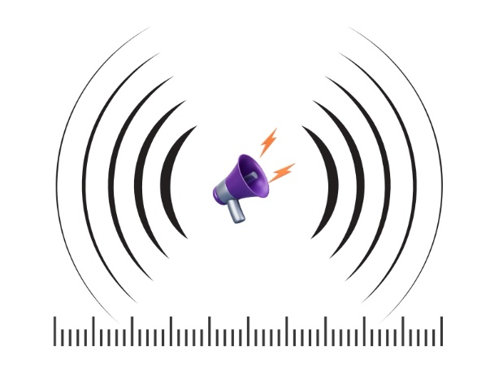

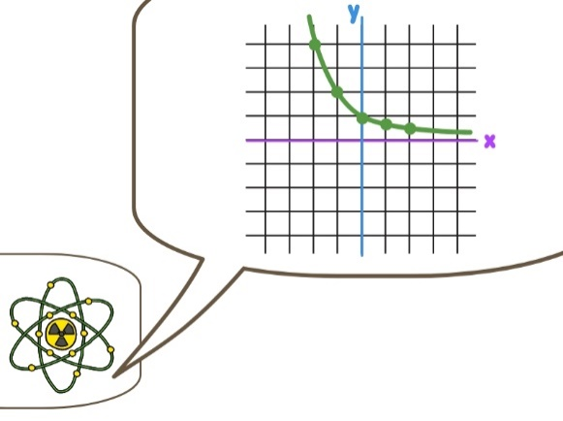

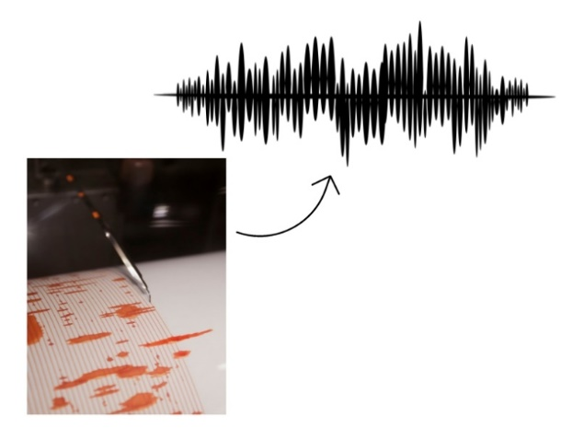

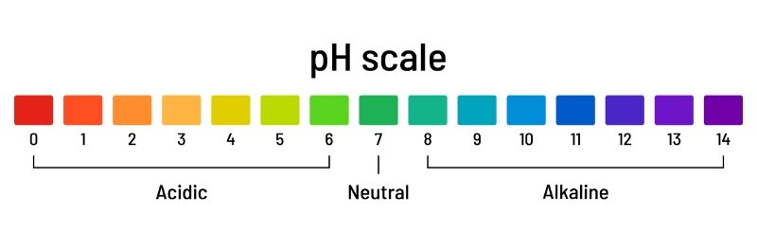
Measuring the sound intensity
Studying the process of decay of radioactive elements
Stock market analysis
Analyzing drug concentrations in medicines
Assessing the magnitude of earthquakes using the Richter scale
Calculating the growth of the human species or other living species
Measuring pH levels of chemicals

Slide 26
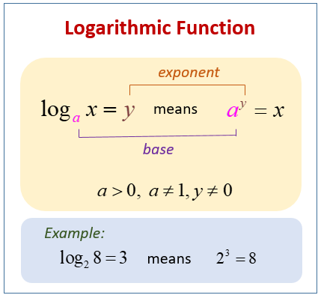
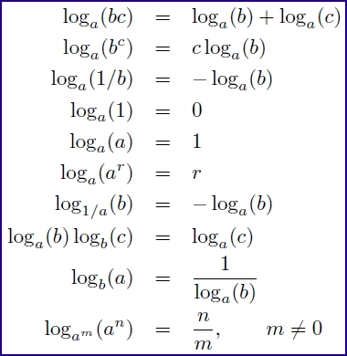
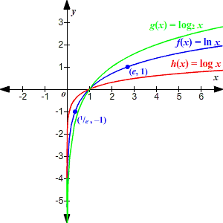
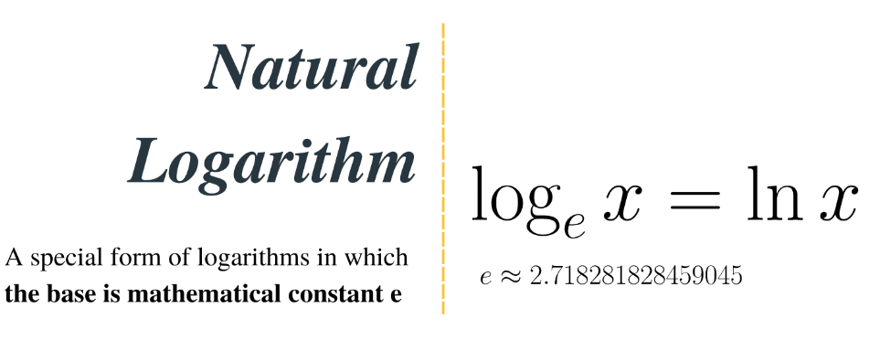
List of logarithm rules
Graph of logarithmic functions

Slide 27
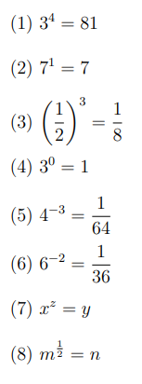
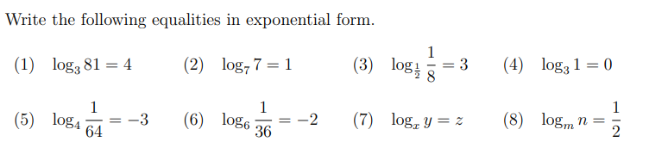
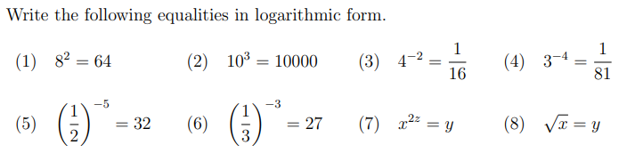
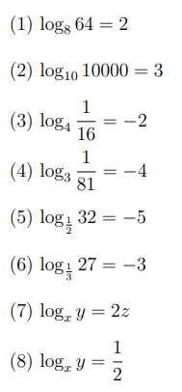

Slide 28
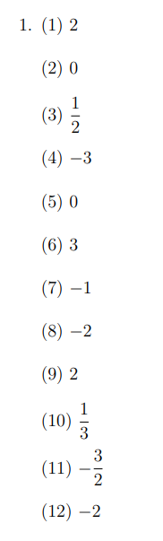
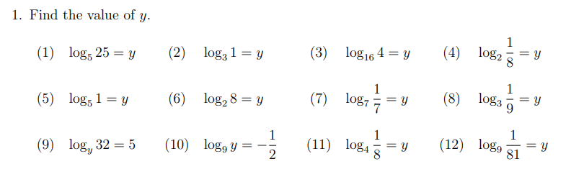
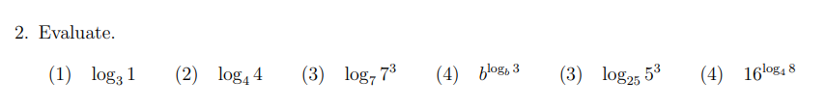
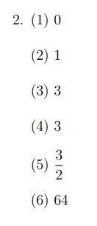
(5)
(6)

Slide 29





Slide 30



Graphing Logarithmic Functions
When no base is written, assume that the log is $base 10$.
$$y=logx$$
The domain of log function $y = log⁡x$is $x > 0$(or) $(0, ∞).$
The range of any log function is the set of all real numbers $(R)$

Slide 31




The graph of the function $y=\log_{2}{x}$.
$$x=2^{y}$$

Slide 32




The graph of the function $y=\log_{\frac{1}{3}}{x}$.
$$x={\frac{1}{3}}^{y}$$

Slide 33


Graph the logarithmic function $f(x) = 2 log3 (x + 1).$
For domain$: x + 1 > 0 ⇒ x > −1$. So domain $= (−1, ∞).$
Range $= R.$
Vertical asymptote is $x = −1.$
At $x = 0, y = 2 log3 (0 + 1) = 2 log3 1 = 2 (0) = 0$
At $x = 2, y = 2 log3 (2 + 1)= 2 log3 3 = 2 (1) = 2$

Slide 34




The graph of the function $y=\log_{2}\left(x+1\right)−3$.
The graph of the function $y=\log_{2}{(x+1)}$.

Slide 35



Slide 36








Slide 37


