Slide 1

Red Blood Cell Life Cycle: From Birth to Breakdown
Zhikal O. Khudhur
Endocrinology BIO 414
Spring Semester
Week number: 13
Date: 5 / 2025

Slide 2

Objectives
Identify key features and functions of red blood cells.
Outline the process and requirements of RBC production.
Describe how RBCs are destroyed and cleared from the body.
Explain hemoglobin breakdown and the origin of urine and feces color.
Zhikal Omar Khudhur
5/25/2025
2

Slide 3
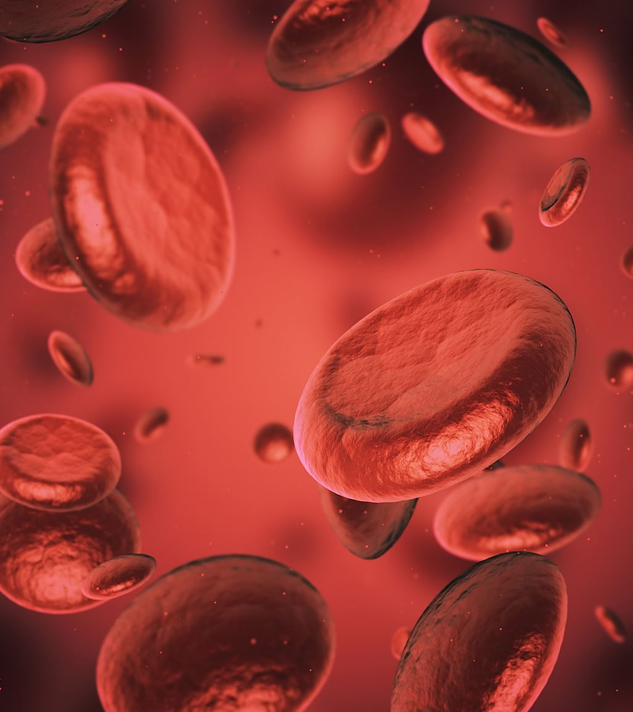
Introduction
Red Blood Cells (RBCs) or Erythrocytes
Most abundant blood cells
Transport oxygen and carbon dioxide
Lifespan: ~120 days

Slide 4
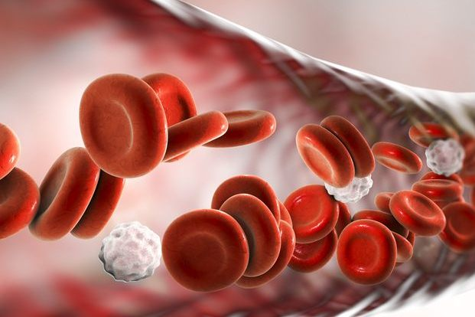
Characteristics of RBCs
Biconcave disc shape
Flexible to pass through capillaries
No nucleus or organelles
Packed with hemoglobin

Slide 5
Requirements for RBC Production
Iron for hemoglobin
Vitamin B12 and folic acid for DNA synthesis
Protein and amino acids
Hormones: Erythropoietin (EPO), Testosterone

Slide 6
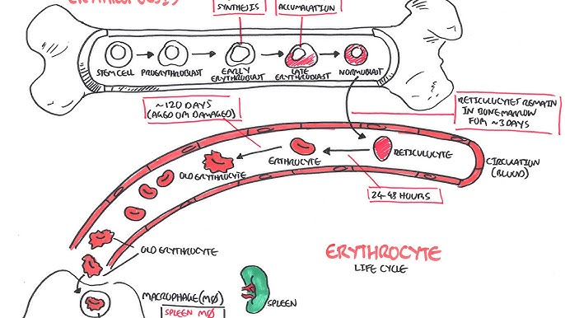

Slide 7
Role of Organs in RBC Lifecycle
Bone marrow: site of erythropoiesis
Kidneys: produce EPO in response to hypoxia
Liver: stores iron, processes bilirubin
Spleen: removes aged RBCs
Macrophages: digest old RBCs

Slide 8
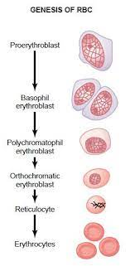
Erythropoiesis Stages
1. Hematopoietic Stem Cell
2. Myeloid Progenitor
3. Proerythroblast
4. Basophilic Erythroblast
5. Polychromatic Erythroblast
6. Orthochromatic Erythroblast
7. Reticulocyte
8. Mature Erythrocyte

Slide 9
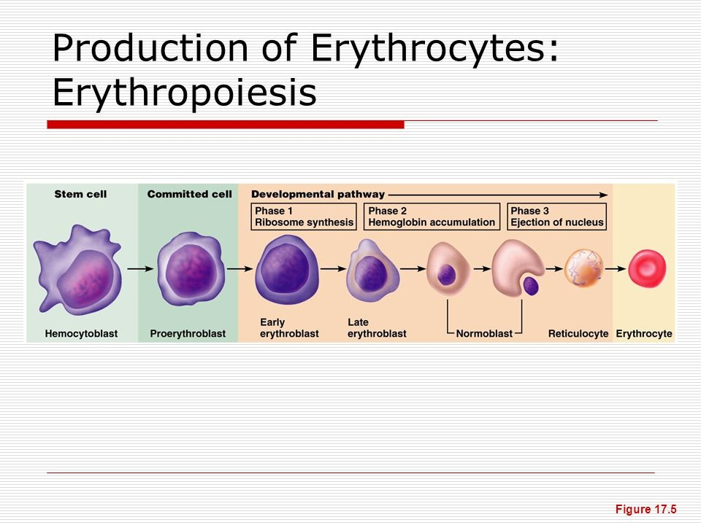

Slide 10
RBC Destruction Process
Happens in spleen, liver, bone marrow
Hemoglobin breakdown:
- Globin → amino acids
- Heme → iron + biliverdin → bilirubin

Slide 11
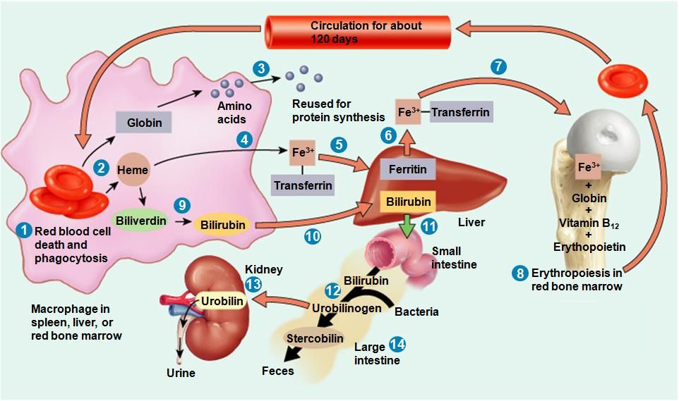

Slide 12
1. RBC Death and Phagocytosis
Old or damaged RBCs (~120 days old) are removed by macrophages in the spleen, liver, or bone marrow.
2. Hemoglobin Breakdown
Inside macrophages, hemoglobin (Hb) is broken into:
Globin → sent for protein recycling
Heme → further processed
3. Globin → Amino Acids
The globin chains are broken into amino acids and reused in protein synthesis.
4. Heme → Iron (Fe³⁺) + Biliverdin
The heme group splits into:
Iron (Fe³⁺) → bound to transferrin
Biliverdin → converted into bilirubin

Slide 14
5. Iron Transport via Transferrin
Iron is transported in the blood by transferrin to be reused or stored.
6. Iron Storage in Liver
Excess iron is stored in the liver as ferritin.
7. Iron Recycling for RBC Production
Stored or transported iron returns to the bone marrow to support erythropoiesis.
8. Erythropoiesis in Bone Marrow
New RBCs are produced in the red bone marrow using iron, globin, vitamin B12, and erythropoietin (EPO).

Slide 16
9. Biliverdin → Bilirubin
Non-iron portion of heme becomes bilirubin.
10. Bilirubin Transport to Liver
Unconjugated bilirubin binds to albumin and is transported to the liver.
11. Conjugation and Excretion via Bile
In the liver, bilirubin is conjugated and excreted in bile into the small intestine.
12. Bilirubin in Intestine → Urobilinogen
In the intestine, bacteria convert bilirubin into urobilinogen.
13. Urobilinogen → Urobilin (Urine)
Some urobilinogen is reabsorbed, filtered by the kidneys, and excreted as urobilin, giving urine its yellow color.
14. Urobilinogen → Stercobilin (Feces)
Most urobilinogen stays in the intestine and becomes stercobilin, giving feces its brown color.

Slide 17
Bilirubin Pathway
Unconjugated bilirubin binds albumin → liver
Conjugated in liver → bile → intestine
In intestine:
- Urobilinogen → urobilin (urine)
- Stercobilin (feces)

Slide 18
Color Explanation
Urobilin: yellow color of urine
Stercobilin: brown color of feces

Slide 19
Clinical Relevance
Jaundice: excess bilirubin
Anemia: low RBCs/hemoglobin
Hemolytic diseases: abnormal RBC destruction

Slide 20
References
Greenstein B. & Wood D. F. (2011). The endocrine system at a glance (3rd ed.). Wiley-Blackwell
Melmed S. Auchus R. J. Goldfine A. B. Koenig R. Rosen C. J. & Williams R. H. (2020). Williams textbook of endocrinology (14th ed.). Elsevier. Boron W. F. & Boulpaep E. L. (2021).
Boron & boulpaep concise medical physiology. Elsevier. Barrett K. E. Barman S. M. Yuan J. X.-J. & Brooks H. (2019).
Ganong's review of medical physiology (review questions) (26th ed.). McGraw-Hill Education LLC Molina P. E. (2018). Endocrine physiology (Fifth). McGraw-Hill Education.

Slide 21
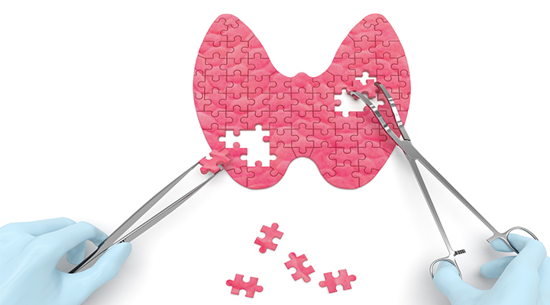
Thank you

