Slide 1

Hemostasis
Zhikal O. Khudhur
Endocrinology BIO 414
Spring Semester
Week number: 14
Date: 5 / 2025

Slide 2

Objectives
Understand the phases of hemostasis and their sequence.
Explain the coagulation cascade in detail.
Identify clotting factors by name and number.
Understand the role of D-dimer in fibrin degradation.
Zhikal Omar Khudhur
5/25/2025
2

Slide 3
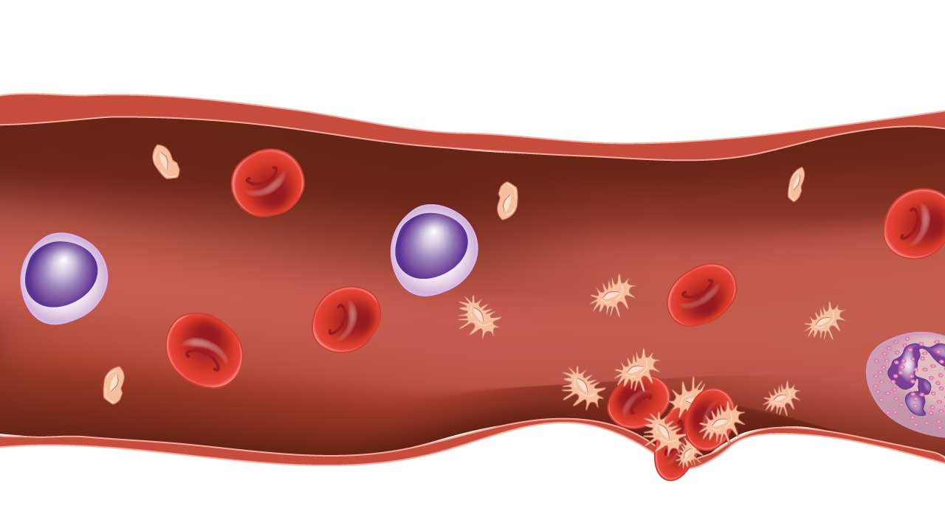
Introduction to Hemostasis
Process that stops bleeding after injury.
Involves blood vessels, platelets, clotting factors, and fibrinolytic system.
Must balance clot formation and prevention.

Slide 4
Phases of Hemostasis
1. Vascular Spasm
2. Platelet Plug Formation (Primary Hemostasis)
3. Coagulation Cascade (Secondary Hemostasis)
4. Clot Retraction and Healing
5. Fibrinolysis

Slide 5
Vascular Spasm
Immediate vasoconstriction after injury.
Reduces blood flow.
Mediators: endothelin, serotonin, thromboxane A2.

Slide 6
Platelet Plug Formation
Platelet adhesion to collagen via vWF.
Activation: release ADP, serotonin, TXA2.
Aggregation via fibrinogen and GPIIb/IIIa receptors.

Slide 7
Coagulation Cascade Overview
Intrinsic Pathway: XII → XI → IX + VIIIa → X
Extrinsic Pathway: TF + VIIa → X
Common Pathway: X → Xa + Va → II → Thrombin → I → Fibrin → XIII

Slide 8
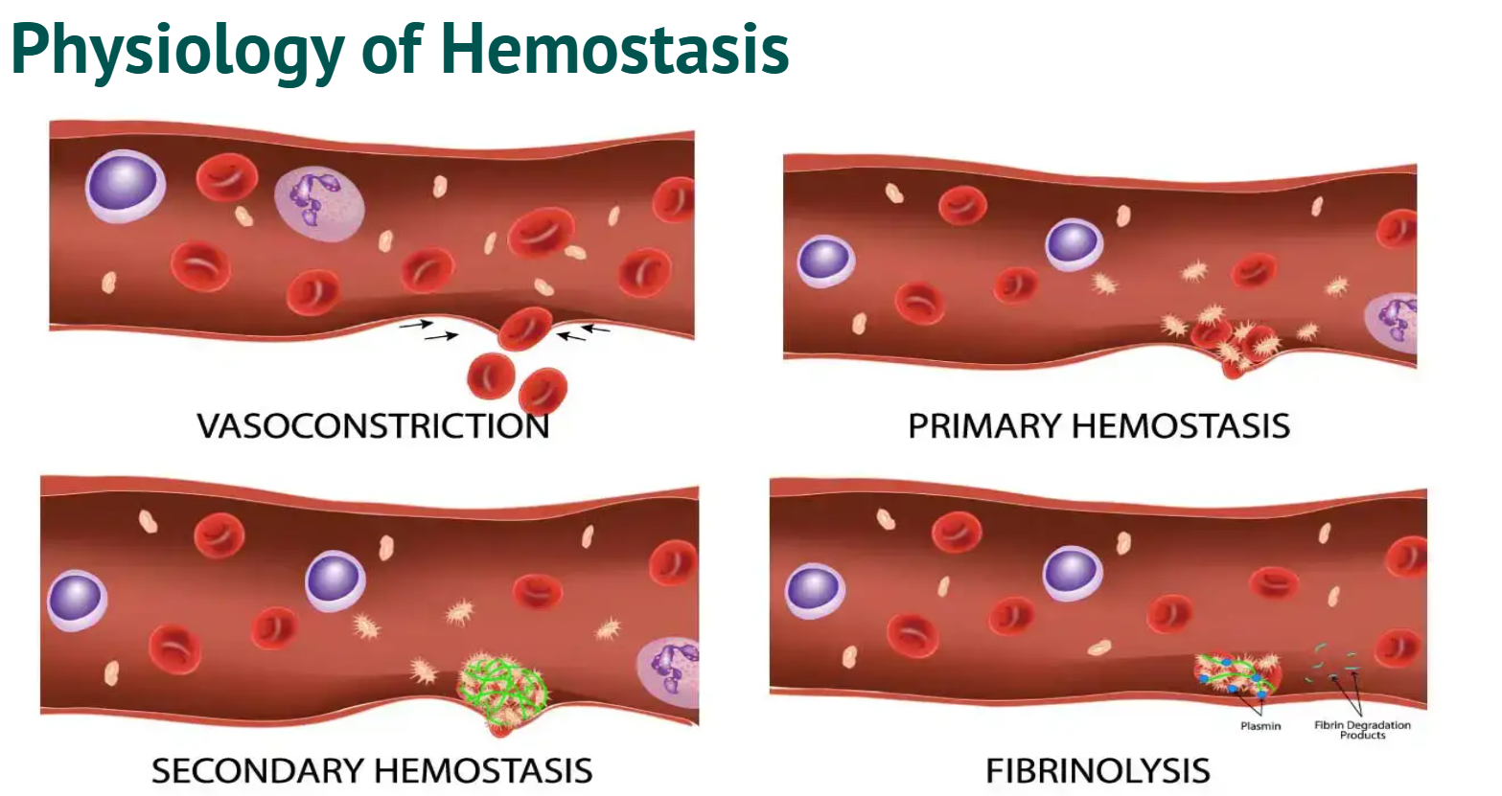

Slide 9
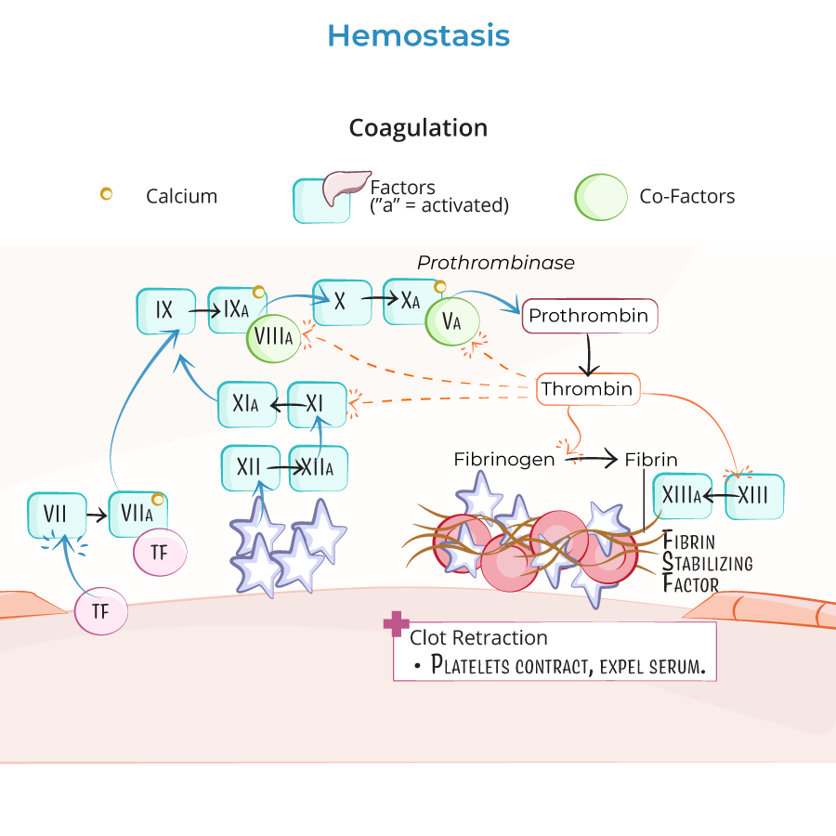

Slide 10
Clotting Factors I–XIII
I – Fibrinogen, II – Prothrombin, III – Tissue Factor
IV – Calcium, V – Labile Factor, VII – Stable Factor
VIII – Anti-Hemophilic A, IX – Christmas Factor
X – Stuart-Prower, XI – PTA, XII – Hageman, XIII – Fibrin-Stabilizing

Slide 11
Fibrinolysis
Plasminogen → Plasmin via tPA.
Plasmin digests fibrin into FDPs including D-dimer.
Occurs after vessel healing is complete.

Slide 12
Role of D-Dimer
FDP from cross-linked fibrin breakdown.
Elevated in DVT, PE, DIC, infection, surgery.
Used to rule out thromboembolic events.
Represents evidence of clot formation and breakdown.

Slide 13
Clinical Conditions
Hemophilia A (Factor VIII deficiency)
Hemophilia B (Factor IX deficiency)
Vitamin K deficiency (II, VII, IX, X)
Liver disease, Thrombocytopenia, Thrombosis

Slide 14
References
Greenstein B. & Wood D. F. (2011). The endocrine system at a glance (3rd ed.). Wiley-Blackwell
Melmed S. Auchus R. J. Goldfine A. B. Koenig R. Rosen C. J. & Williams R. H. (2020). Williams textbook of endocrinology (14th ed.). Elsevier. Boron W. F. & Boulpaep E. L. (2021).
Boron & boulpaep concise medical physiology. Elsevier. Barrett K. E. Barman S. M. Yuan J. X.-J. & Brooks H. (2019).
Ganong's review of medical physiology (review questions) (26th ed.). McGraw-Hill Education LLC Molina P. E. (2018). Endocrine physiology (Fifth). McGraw-Hill Education.

Slide 15
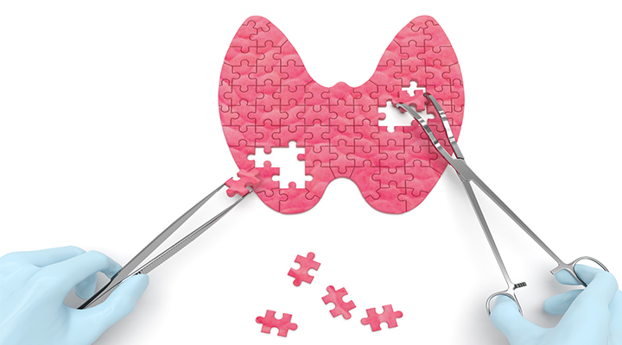
Thank you

