Slide 1

Tishk International University
Faculty of Applied Science
Medical Technical Radiology
7
Biological Effects and Risks of Radiation Procedures
First Grade- 2024-2025
Instructor: Prof. Dr. Ronak T. Ali

Slide 2
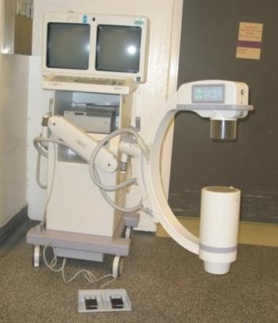
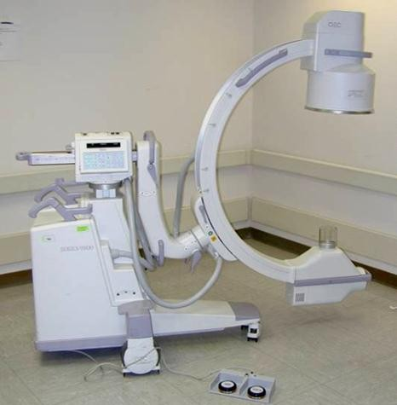
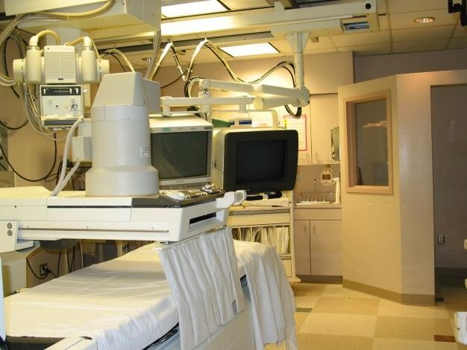
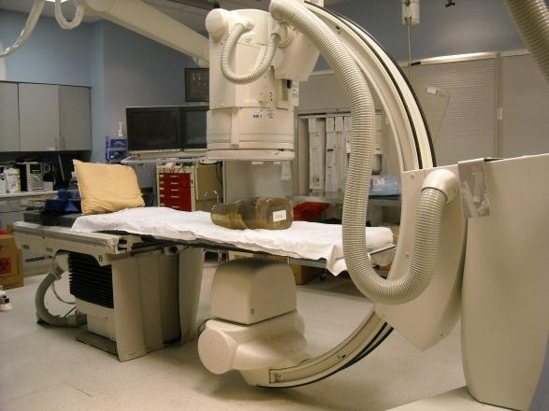
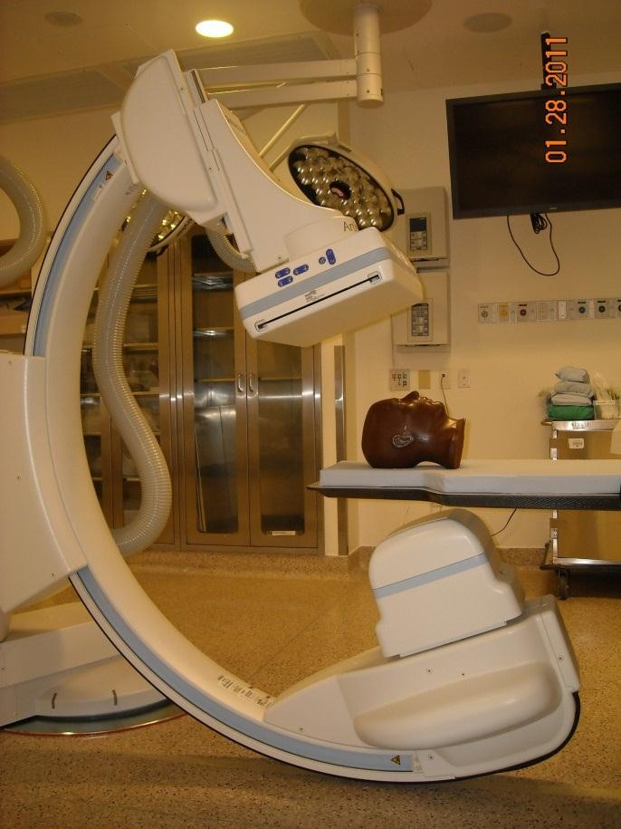
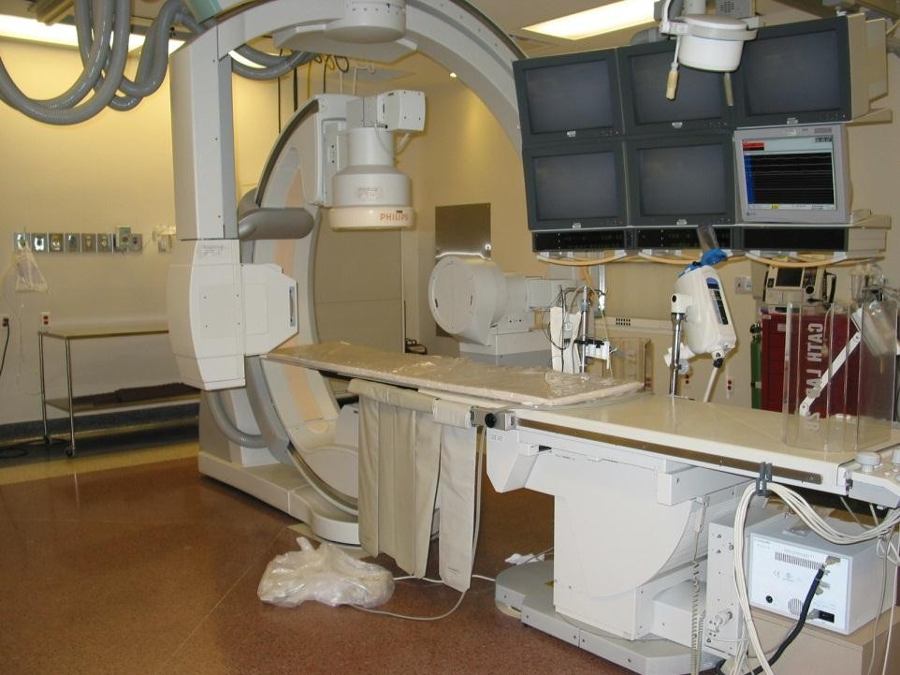
Image intensified angiography
Mini C-arm
Mobile C-arm
GI (R&F) Room
Flat Panel
angiography
Bi-Plane angiography

Slide 3
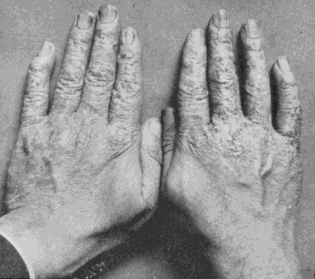
Effects from inappropriate use of fluoroscopy
Reference: Vañó E et al, BJR 1998; 71, 728-733
In workers effects commonly due to long-term accumulation (chronic build-
up) of radiation dose.

Slide 4
Priority of concerns for fluoroscopy :
Short-term (weeks to months) debilitating deterministic effects (e.g., radiation injury)
Long-term (years to decades) debilitating deterministic risks (e.g., cataract,
osteonecrosis)
Long-term stochastic risks (e.g., cancer) [Typically this is primary concern in abdominothoracic procedures in small children]
Short-term cosmetic risks (e.g., epilation)
Special concern:
1. Pregnancy (pregnancy test required for many procedures that potentially deliver high doses to uterus – e.g., hysterosalpingogram)

Slide 5
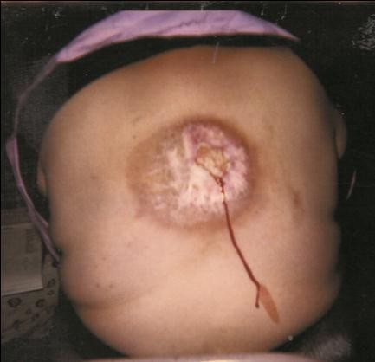
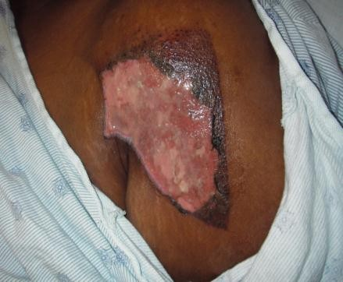
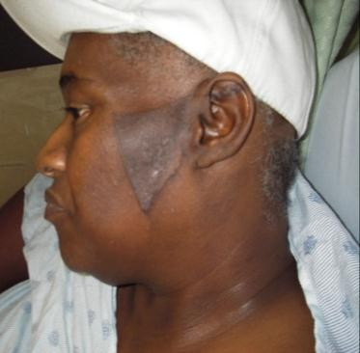
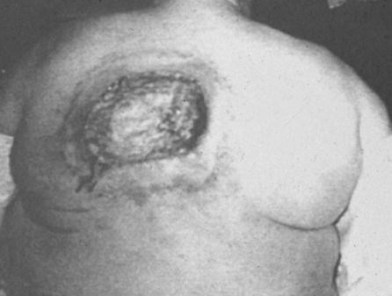
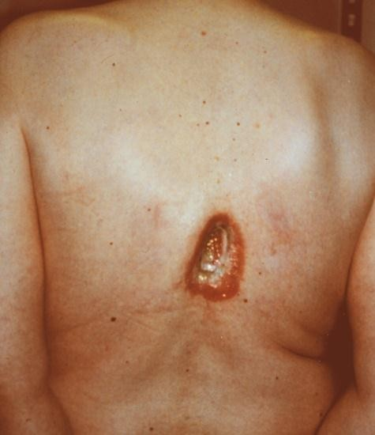
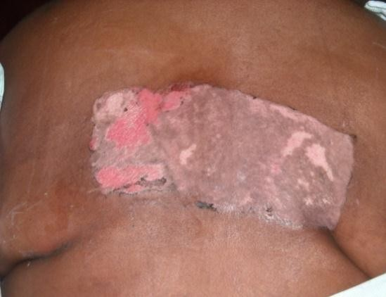
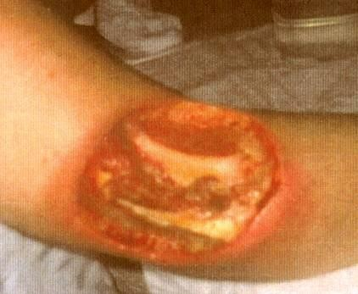
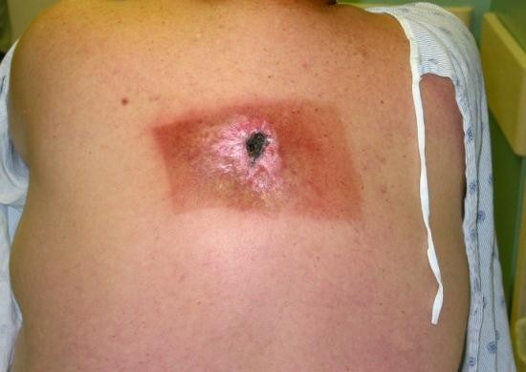
Some images courtesy Fred Mettler , Ron Vlietstra, R. M. Partnership
5

Slide 6
Consent Topics for Complex Interventions
Hair loss
Usually temporary; regrowth of hair may be
incomplete.
Skin rashes
Infrequent, on very rare occasions they may result in tissue breakdown and possibly severe ulcers.
Slightly elevated risk for cancer
Later in life. This risk is typically low compared to the normal incidence of human cancer.
Cataracts occur rarely.
Courtesy of anonymous contributor
11

Slide 7
Radiation risk as an appropriate part of the informed consent process.
Patient size
Anticipated complexity
Coexisting diseases or conditions
Scleroderma; systemic lupus erythematosus; possibly rheumatoid arthritis; Hyperthyroidism; poor nutritional status; compromised skin integrity (diabetes mellitus – thought to negatively impact recovery from raidation damage)
Genetic factors
heterozygous for the ATM gene; Fanconi anemia; Bloom syndrome; xeroderma pigmentosum; Familial polyposis; Gardner syndrome; hereditary malignant melanoma; dysplastic nevus syndrome; Neurofibromatosis; Li-Fraumeni syndrome; Hereditary retinoblastoma
Medication use
actinomycin D; doxorubicin; bleomycin; 5-fl uorouracil; methotrexate; when given in conjunction with radiation therapy: paclitaxel, docetaxel, and possibly tamoxifen can result in cutaneous toxicity
Radiation history
Pregnancy
12

Slide 8








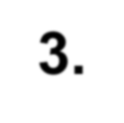



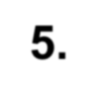



Most important facts about radiation injury from fluoroscopy:
A delay of weeks often occurs between irradiation and recognizable symptoms of injury, shorter delays also occur;
This delay results in a lack of association on the parts of physicians and patients between the fluoroscopy and the injury;
Patients are often unaware that fluoroscopy procedures use x rays and are usually totally unaware that fluoroscopy can cause injury;
Physicians are often unaware that fluoroscopy can cause injury;
Physicians are often poorly trained in dose management.

Slide 9
Prevalent features of radiation injury (burn) cases
Large patient
Vessel hard to see - small, overlap with spine, high angle needed
Trouble passing lesion, calcium, dissection
Less experienced interventionalist
Long fluoroscopy, many cines, hi-dose used
Interventionalist unaware of radiation risk to patient
No monitoring of dose – not available or not used

Slide 10
Diagnosis of Radiation Injury
Skin absorbed dose must be high (beam mostly fixed on same skin site)
Must be located at entrance beam site
Temporal patterns must fit with progression of injury
Pattern must match collimation in size and shape (with consideration to movement of beam during procedure)
Biopsy generally unnecessary and to be avoided if possible

Slide 11
30 weeks

Slide 12
Recent communications on radiation injury
no one knows...nor does anyone want to know...what do I do...please help me.
Happened during stent placement December 2008.@ well-known hospital, two lengthy procedures with-in 3 days.
No one advised me nor informed me that I was exposed to excessive radiation. I recently received my records,(Dec 2010). I had a long duration of radiation exposure and yet not one person told me so.
I went through months of infection and pain and to this day it still hurts and unbearable itching.

Slide 13
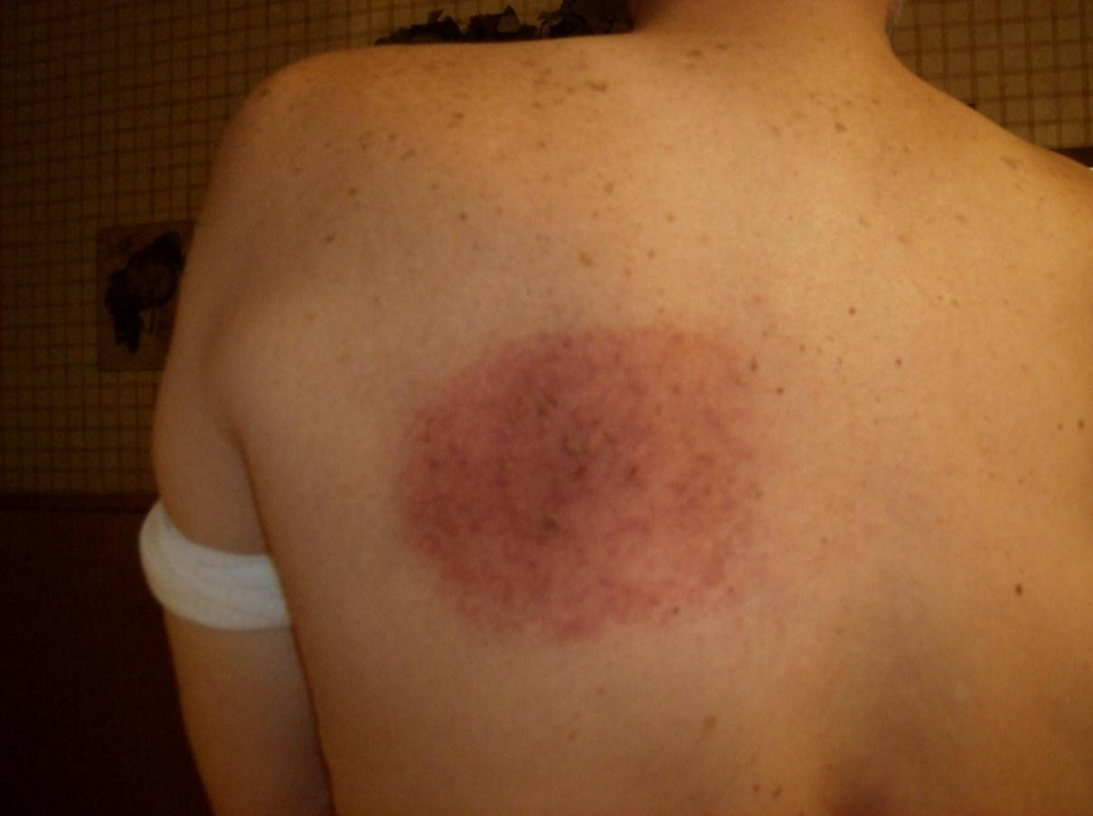
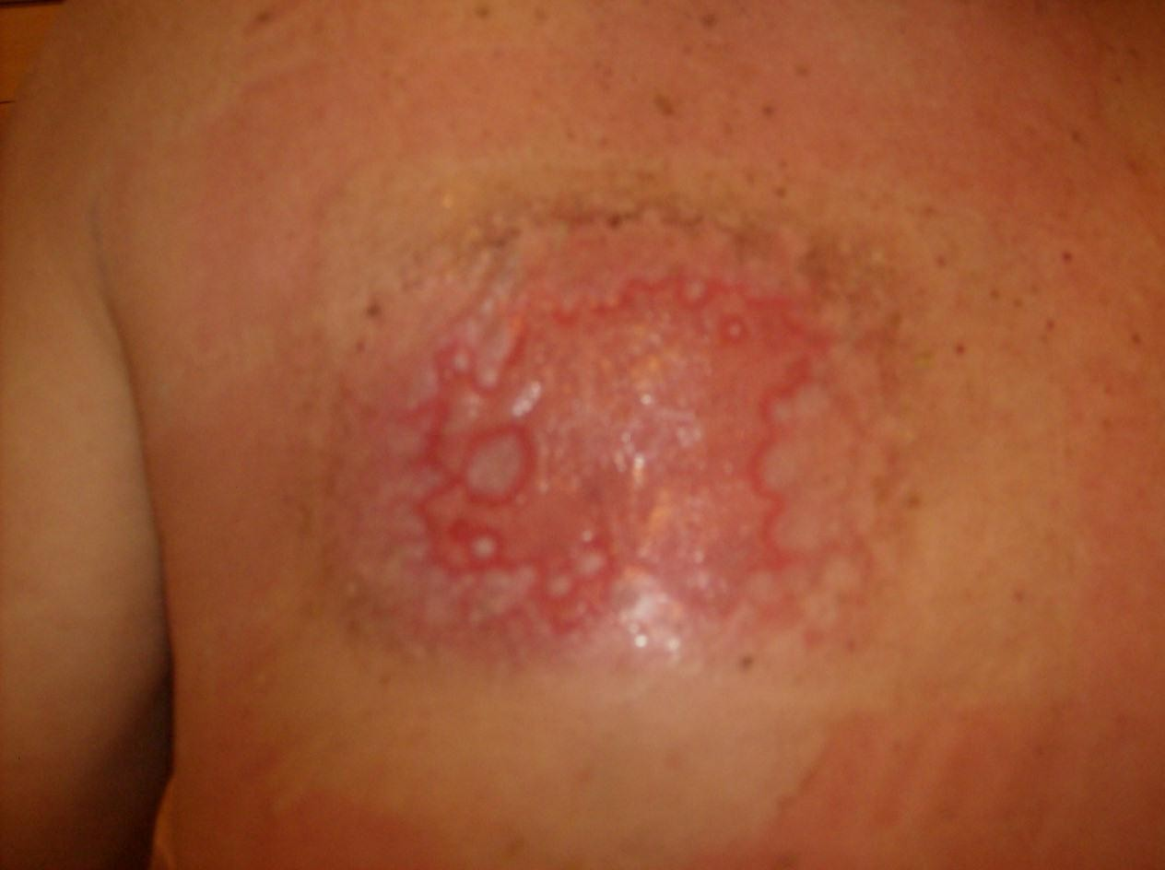

Slide 14
Recent communications on radiation injury
As you know, radiation is the gift that keeps on giving.
After several weeks of having a different kind of pain on top of his usual ongoing pain, K had an MRI, showing rib fractures, posterior T9, possible nonunion, and a fracture at posterior T8.
With his debilitating ongoing pain, K does very little in the way of physical activity so it is baffling to try to figure a cause of two fractured ribs.
The doctor who did the surgery for K's latissimus flap diagnosed it as osteoradionecrosis.
Ribs T9 ad T8 are in direct line of what he figures to be the strongest blast of radiation from K's two heart ablation procedures

Slide 15
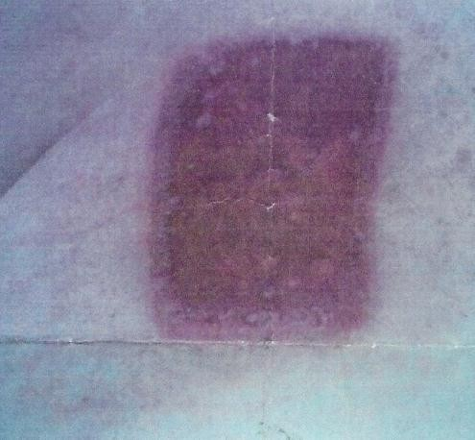
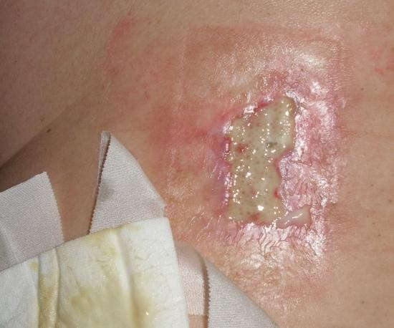
9 ½ Months after procedure
Five weeks after procedure
i really don't know how much more of this i can stand!!!!..do you have any idea looking at the photos, what i might be up against? it is so amazing but it seems i know more about my condition than all the doctors i have been to HOW CAN THAT BE???? do you have any stats on how many people suffer thru this????
Former major league professional athlete

Slide 16
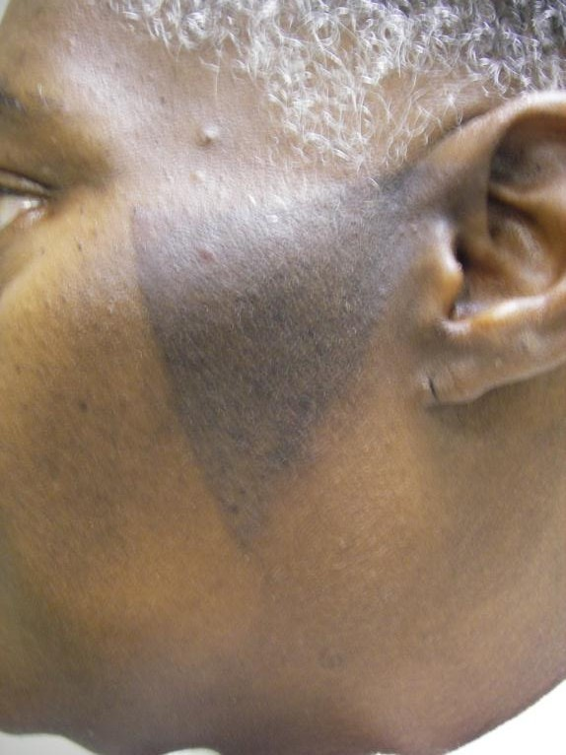
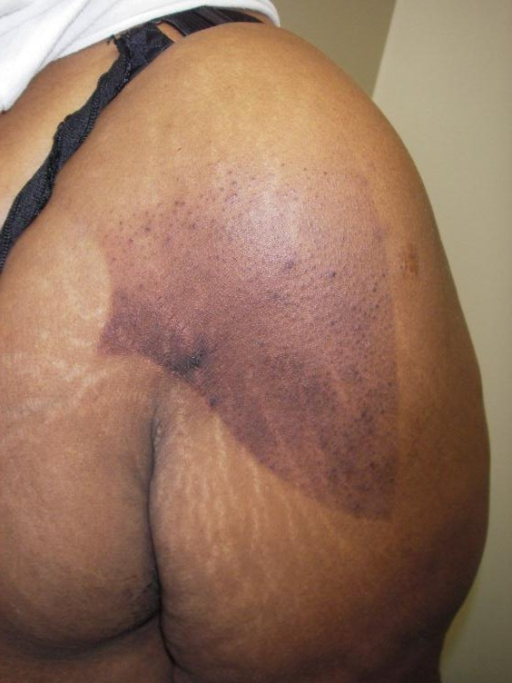

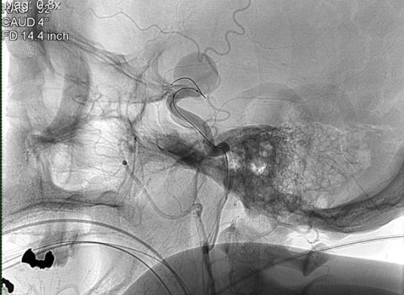


7th July (treatment was on the 15th June)
19th July
25

Slide 17

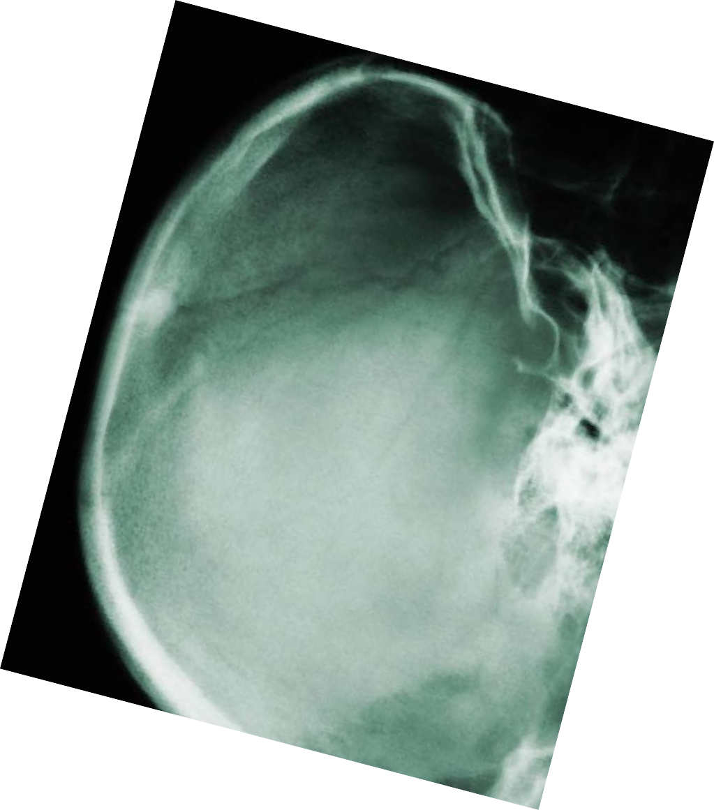
Radiation Risks
Induced Cataract Threshold < 0.7 Gy Onset depends on dose
Radiation-induced cataract in medical personnel
PA orientation delivers only exit dose
Shield eyes from lateral beam using collimation
26
32

Slide 18
Follow-Up Plan
Necessary when large radiation doses are used
Self-exam at 2 –3 weeks
May not cause symptoms
The patient can’t see his/her own back
Patient needs to know location of the radiation field
May need follow-up for > 1 yr
Useful for operator QI

Slide 19
Without a Plan…
Patient goes to dermatologist, not you
Neither dermatologist nor patient may consider fluoroscopy as the etiology
Patient doesn’t think it is relevant
Dermatologist thinks dose is too low
Unnecessary skin biopsy performed
Biopsy not pathognomonic
May result in non-healing ulcer
Diagnosis can be made from a careful history and the appearance of the lesion
Diagnosis likely to be delayed

Slide 20
Case Report
Patient scheduled for anticipated long and difficult coronary intervention.
Patient not a candidate for surgery.
Cardiologist explained benefits/risks to patient.
After very long and difficult procedure, patient advised of radiation exposure and that erythema was likely to develop. Patient told what to expect and what to do if symptoms arose.
Patient called two weeks later indicating that the itching had begun and erythema was developing.
Patient referred to dermatologist. Cardiologist advised dermatologist
that radiation was likely cause of skin effects.
Dermatologist studied up on radiation treatment and prepared a course for the patient.
Result: Patient treated early for skin effect and not surprised by the development. Patient has more confidence in physician’s quality of care. Case is ongoing.

Slide 21
Organs at highest risk for induced cancer
Female Breast (under ~35)
Lung
Childhood thyroid
Colon
Bone marrow (Leukemia) Bladder
21

Slide 22
Risk for induced cancer from a whole-body dose:
For 20-year-olds, induced risk somewhere ~0.6% - 2.0% per 100 mGy
For infants it’s about twice that of 20-year-old.
For 50-year-olds it’s about half that of 20-year-old.
Mortality risk is about half that of incidence.
Females are at greater risk than males by about a factor of 1.3 – 2.0, depending on age at exposure.
22

Slide 23

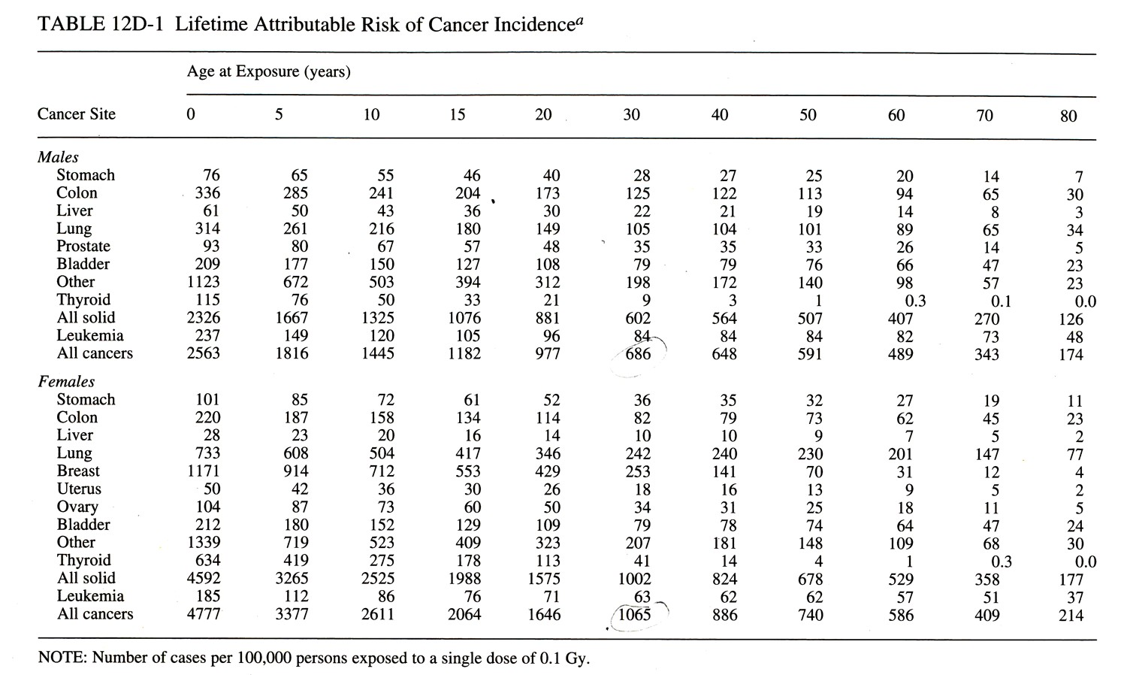
100,000 women
aged 30
Single dose of 100 mGy
Over their lifetime

Slide 24

Health Physics Society Position
Recommends against quantitative estimation of health risks below an individual dose of 50 mSv in one year or a lifetime dose of 100 mSv above that received from natural sources
…because
For doses below 50–100 mSv risks of health effects are either too small to be observed or are nonexistent.

Slide 25
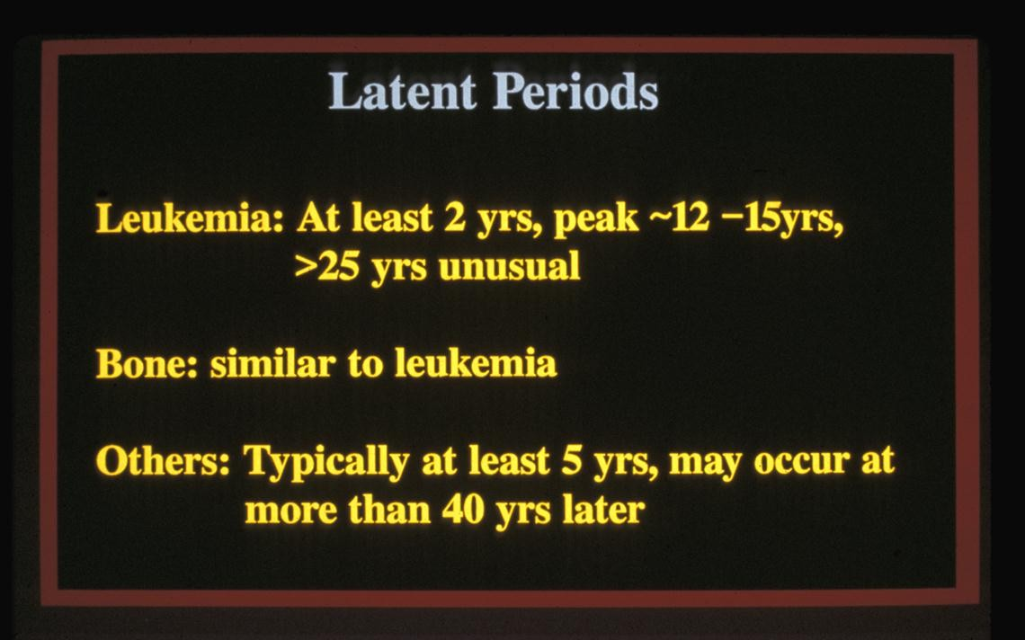
40

