Slide 1

Unit One
Presenting Complaints Technical English
ELT 104/6
ELT 104/P
ELT 104/T
2024 – 2025 Second Semester
Zainab Nizar Karam

Slide 2

Objectives:
In this unit, the students will be able to:
Employ a compassionate and non-intrusive questioning approach when eliciting patient information.
Define adjectives related to describing pain.
Define illnesses.
Distinguish between technical and non-technical terms.
Writing a case report.

Slide 3
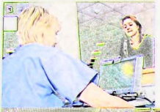
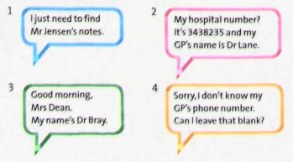
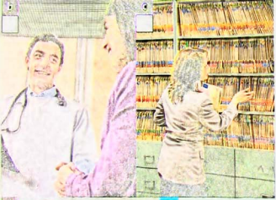
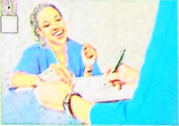
Match each photo with what the person is saying?

Slide 4

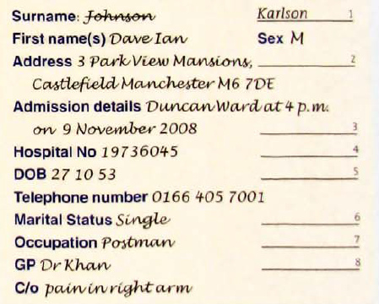


Listening one

Slide 5
3. Work in pairs. Decide what questions the doctor asks for each piece of information on the form.
Can you tell me what your family name is?
And your first name?
Any other names?
And can you tell me what your address is?
When were you admitted?
And do you know your hospital number?
And what's your date of birth?
Your telephone number?
Are you married or single?
What do you do for a living?
And lastly, who’s your GP?

Slide 6
Language Spot Asking short and gentle questions
Ask gentle questions to put the patient at ease.
Can you tell me what/who + subject + verb?
What’s your family name?
Can you tell me what your family name is?
Remove words to make questions shorter.
What’s your first name? Your first name?
Do you have any other names? (And) Any other names?

Slide 7
Direct Questions
Indirect Questions
Where is Dr Jane?
What did you eat last night?
Is it your first time?
Can you tell me where Dr Jane is?
Can you tell me what you ate last night?
Can you tell me if it is your first time?

Slide 8
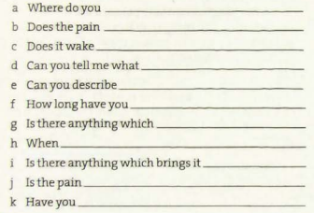
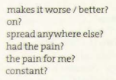

When taking the history of the presenting complaint (HPC), You often ask about pain. Use these words to complete the questions.

Slide 9
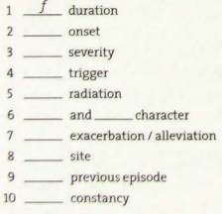
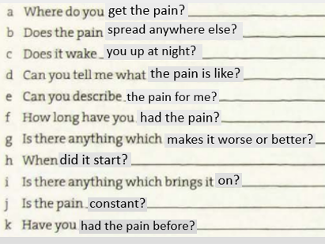
Match these words to questions in exercise 2.

Slide 10
Adjectives describing pain
Throb (v): to feel a series of regular painful movements./ having a strong, regular beat.
My feet were throbbing after the long walk home. Her finger throbbed with pain.
Boring (adj): (of a pain) passing through one part of the body to another.
Tender (adj) :(of a part of the body) painful when you touch it.
Gnawing (adj) :is a dull, constant pain, or hunger pains.
An example of a gnawing is a continuous pain in the elbow.
Sharp (adj) : (of a pain) When you feel a sudden, intense spike of pain.
Crushing: feeling that something is pressing down extremely hard on a particular area of your body.

Slide 11

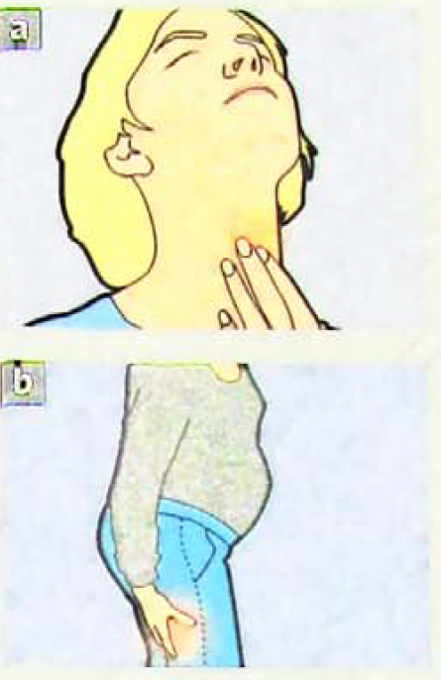
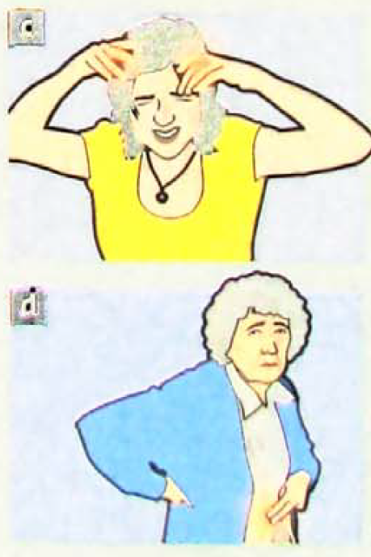
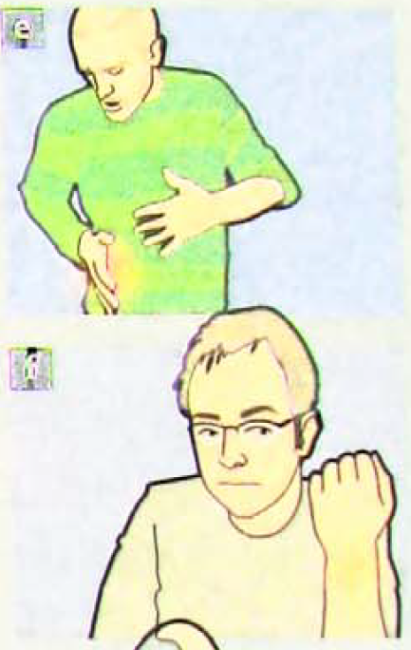

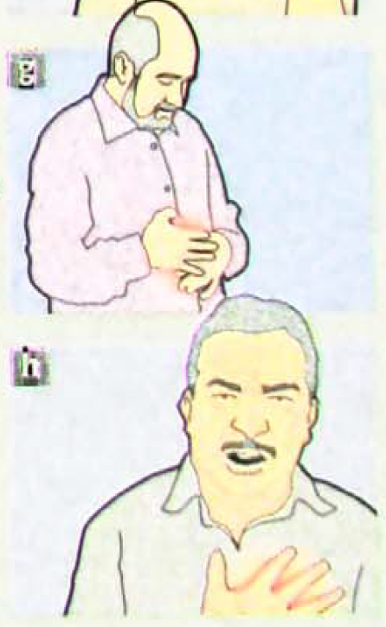








Slide 12
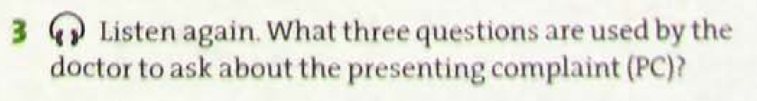
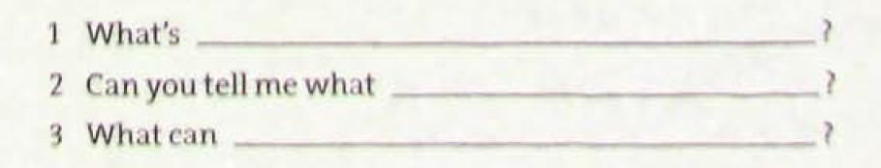




Slide 13
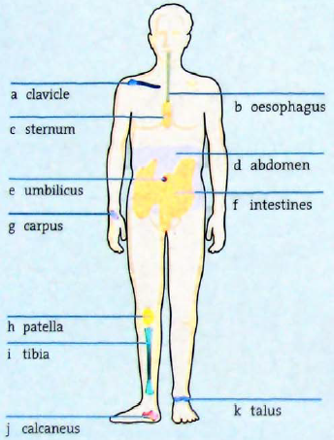











6. Think about non-technical terms for body parts a-k

Slide 14
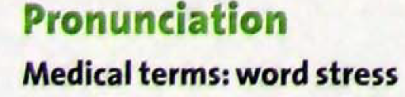


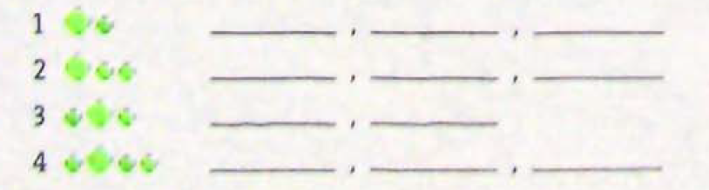










Slide 15
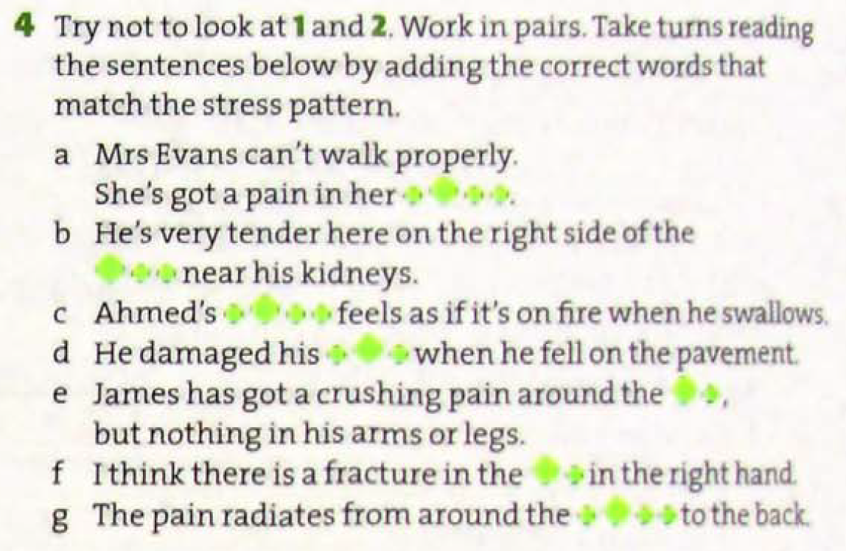








Slide 16
SOCRATES
Use SOCRATES in the history of presenting complain to help you remember the main questions you need to ask about pain.
Site
Onset
Character
Radiation
Association
Timing
Exacerbating and alleviating factors
Severity

Slide 17
SOCRATES: Site, onset , character, radiation, association, timing, exacerbating and alleviating factors, severity
Where do you get the pain?
Does the pain spread anywhere lese?
Does it wake you up at night?
When did it start?
Can you describe the pain for me?
Is there anything which brings it on?
How long have you had the pain?
Is there anything which makes it worse/better?
site
radiation
severity
onset
character
Association
timing
exacerbating and alleviating factors

Slide 18
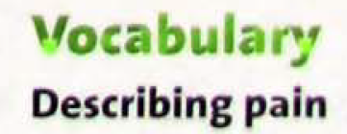
piercing / boring
extremely severe / intense
aching
scalding / burning
like a tight band around my head
dull / persistent / vague
excruciating / thunderclap
shooting
spasmodic
crushing / gripping
sciatica
ureteric colic
acute pancreatitis
appendicitis
degenerative arthritis
cluster headache
cystitis
tension headache
sub-arachnoid haemorrhage
angina pectoris
Next

Slide 19
boring (of a pain) passing through one part of the body to another.
piercing: feeling as a sharp object is pushing in your body.
scalding: very strong and giving a feeling of burning.
dull: not very severe, but continuous.
persistent: continuing for a long period of time without interruption.
Vague: mild, not very severe
excruciating: extremely severe.
thunderclap: sudden and very tense.
Next

Slide 20
Shooting: a sudden sharp pain that moves quickly across an area of the body.
Spasmodic: 1.(of a pain) caused by your muscles becoming tight in a way that you cannot control.
2. Happening suddenly for short periods of time; not regular or continuous.
Crushing: feeling that something is pressing down extremely hard on a particular area of your body.
Gripping: feeling as if something is squeezing or holding a part of your body very hard.
back

Slide 21
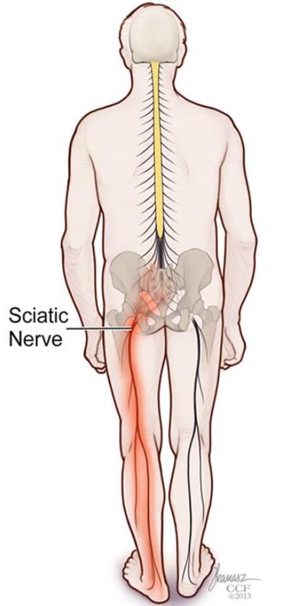
Back
Sciatica refers to back pain caused by a problem with the sciatic nerve. This is a large nerve that runs from the lower back down the back of each leg.

Slide 22
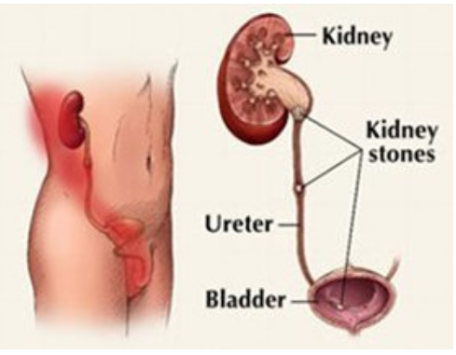
Ureteric colic (renal colic) is defined as a medical condition characterized by the presence of a urinary stone, leading to a severe urinary system pain.
(Han)
Back

Slide 23
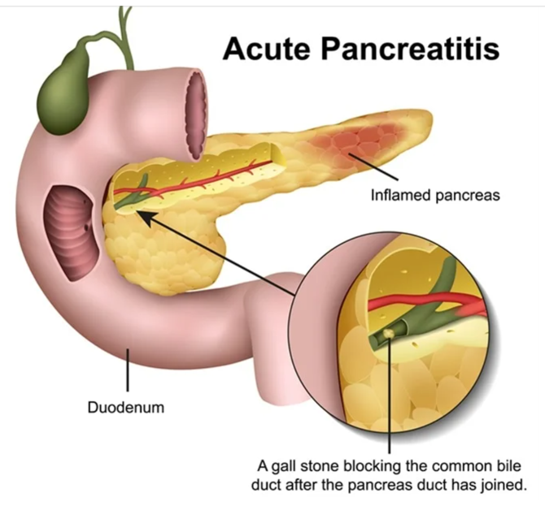
Acute pancreatitis is sudden inflammation of the pancreas.
(Dreams time)
Back

Slide 24
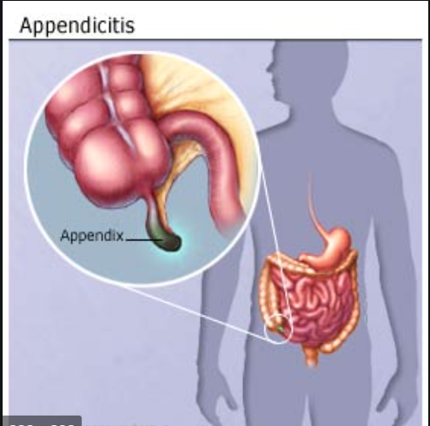
Appendicitis occurs when the appendix becomes inflamed and filled with pus. It requires surgery.
(Khatri, 2019)
Back

Slide 25
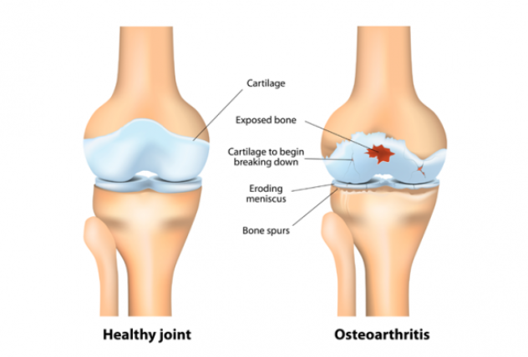
Degenerative arthritis (Osteoarthritis) is a condition that involves the chronic breakdown of cartilage in the joints leading to painful joint inflammation. (Mayo Clinic, n.d)
Back

Slide 26
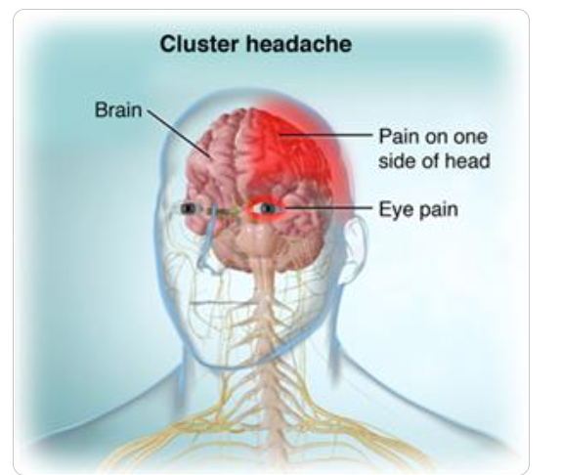
Back
Cluster headache (CH) is on one side of the head, typically around the eye. There is often accompanying eye watering, nasal congestion, or swelling around the eye on the affected side. (Orchard Health, n.d)

Slide 27
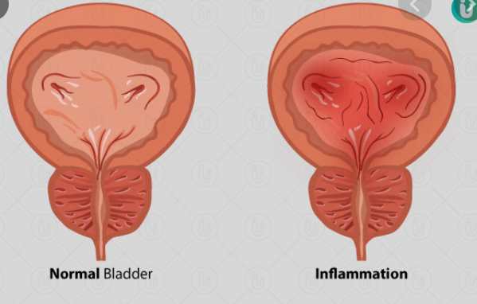
Back
Cystitis is an inflammation of the bladder.
(Rajalakshmi, n.d)

Slide 28
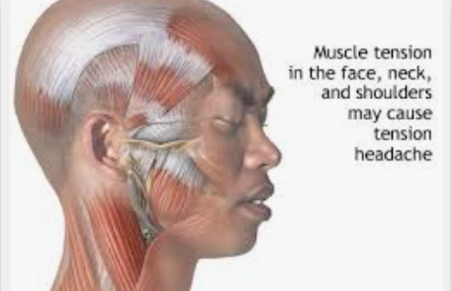
A tension headache is the most common type of headache. It can cause mild, moderate, or intense pain behind your eyes and in your head and neck. Some people say that a tension headache feels like a tight band around their forehead.
(medlineplus, n.d)
Back

Slide 29
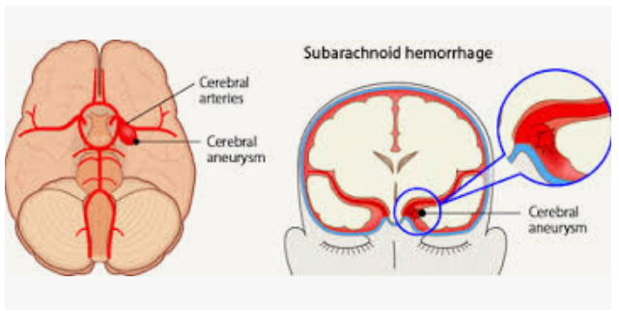
Subarachnoid hemorrhage (SAH) is a life-threatening type of stroke caused by bleeding into the space surrounding the brain.
Back
(Furst, 2020)

Slide 30
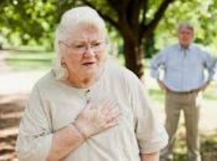
Angina pectoris is the medical term for chest pain or discomfort due to coronary heart disease. It occurs when the heart muscle doesn't get as much blood as it needs.
(American Heart Association, 2015)
Back

Slide 31


Which descriptions 1-10 do you associate with the conditions a—j? In some cases, there may be mare than one answer.
piercing / boring
extremely severe / intense
aching
scalding / burning
like a tight band around tray head
dull / persistent / vague
excruciating / thunderclap
shooting
spasmodic
crushing / gripping
sciatica
ureteric colic
acute pancreatitis
appendicitis
degenerative arthritis
cluster headache
cystitis
tension headache
sub-arachnoid haemorrhage
angina pectoris

Slide 32



3. For each description, write M (mild), S (severe), or V (very severe). Then say which condition a–j in 1 each patient below is possibly describing.
……….. I get this vague headache sometimes during the week.
……….. The headache is excruciating. I can’t bear to look at the light.
……….. The pain in my stomach is so bad it makes me double up.
……….. I get this sharp pain when you press my side here on the right and then let go.
……….. All my joints hurt. I am wracked with pain.
Possible conditions: 1. Tension headache 2.Cluster headache 3. Acute pancreatitis 4. Appendicitis 5. Degenerative arthritis.

Slide 33
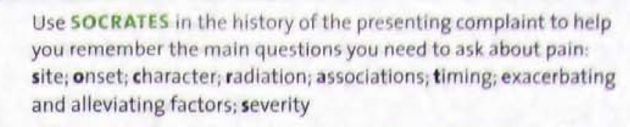
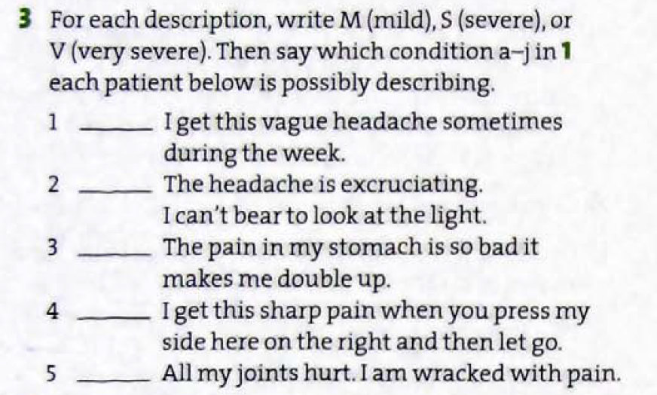

Slide 34
4. You can ask a patient to describe pain on a scale of 1 to 10. What other ways can you ask a patient to assess the severity of pain?
Visual Analog Scale (VAS): Ask the patient to mark their pain level on a straight line from ‘no pain’ to ‘worst pain imaginable’.
Verbal Rating Scale (VRS): Use words to describe pain, such as mild, moderate, severe, or unbearable.
Faces Pain Scale (FPS-R): Show a series of facial expressions ranging from a smiling face (no pain) to a crying face (worst pain) and ask the patient to choose one.
Descriptive Pain Scale: Ask the patient to describe their pain using terms like throbbing, stabbing, burning, or crushing.

Slide 35
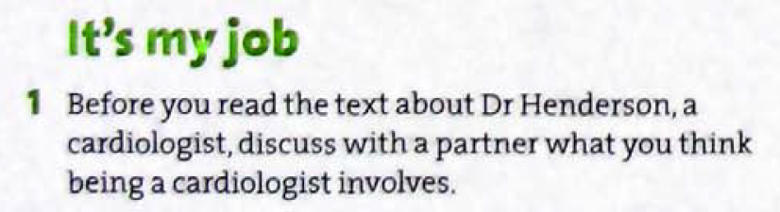
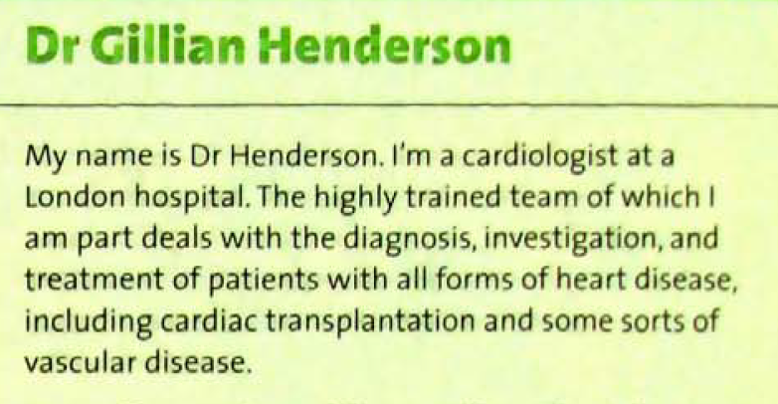

Slide 36
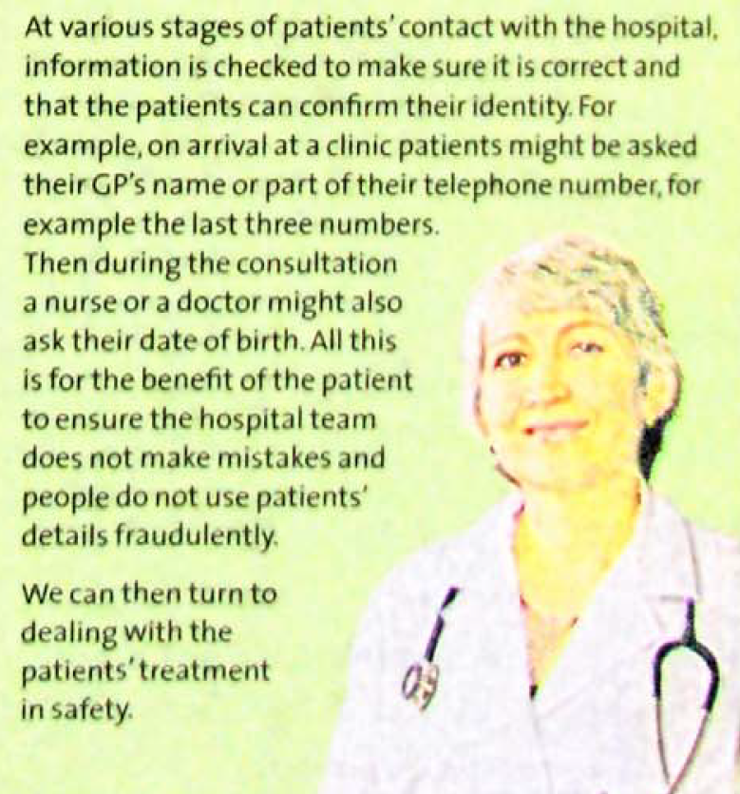
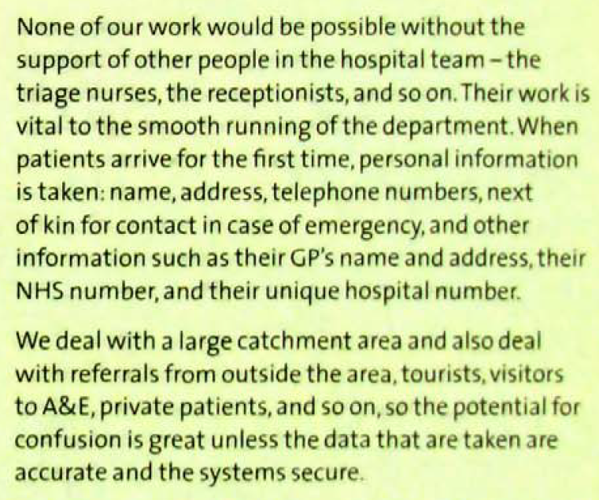

Slide 37
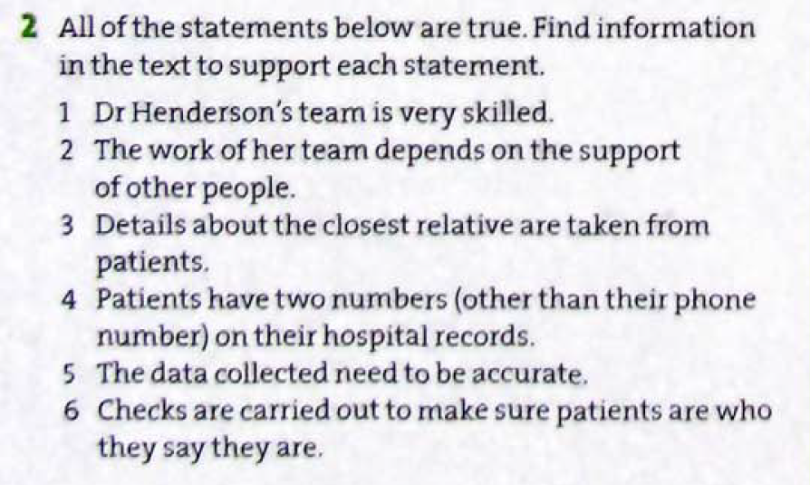

Slide 38
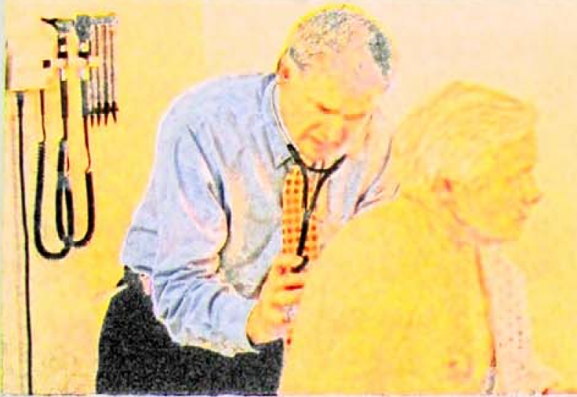
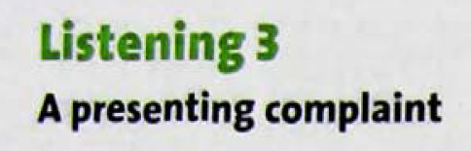
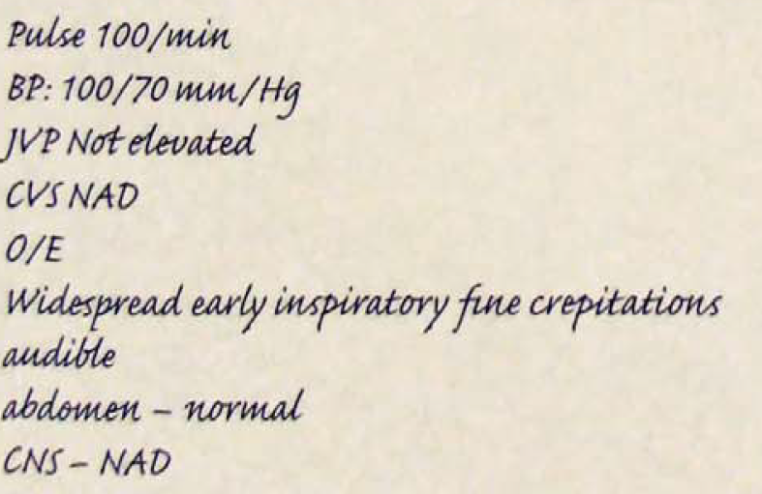
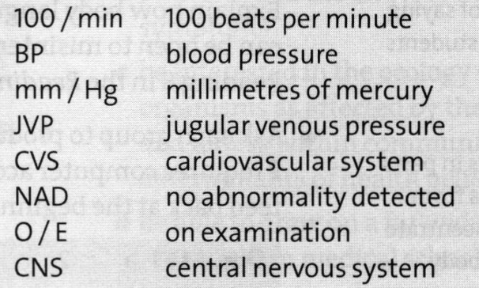








Listen and make notes about Mr. Wood’s presenting complaint.
Hydrargentum/ Hydrargyrion
Hydrargentum/ Hydrargyrion

Slide 39

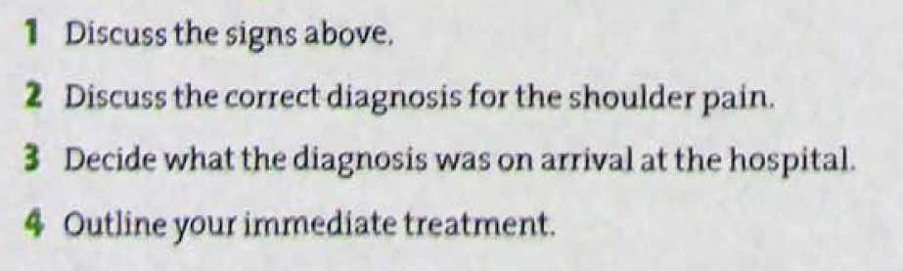


Slide 40
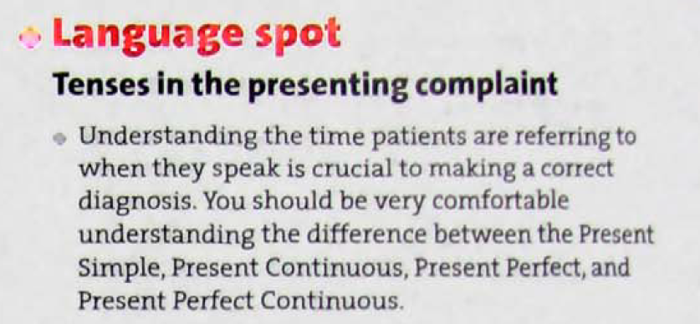
Grammar

Slide 41
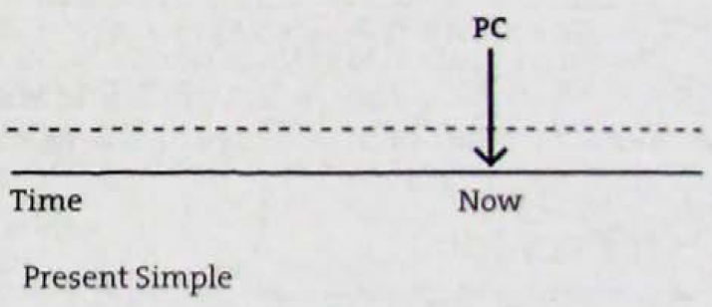
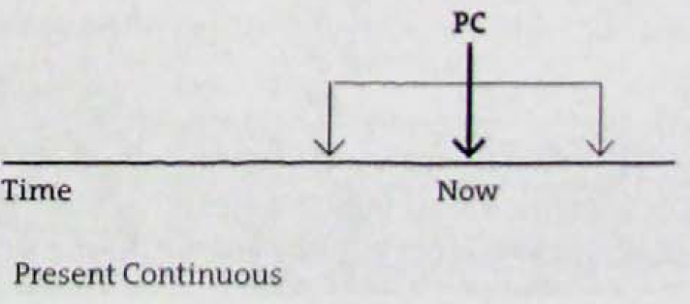

Slide 42
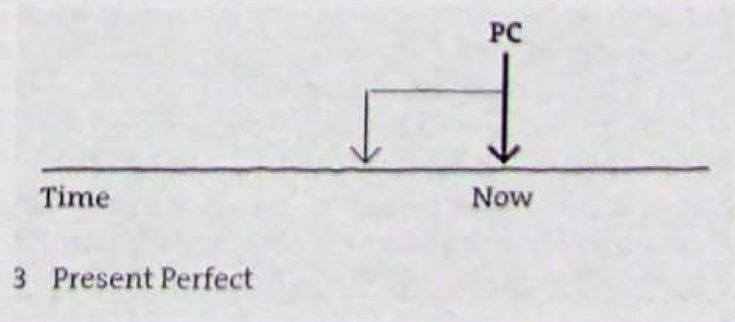
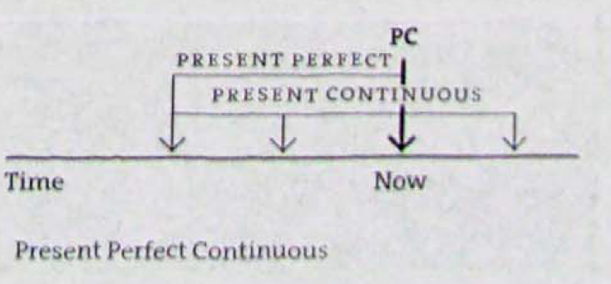

Slide 43
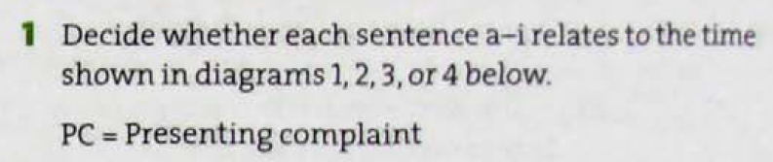
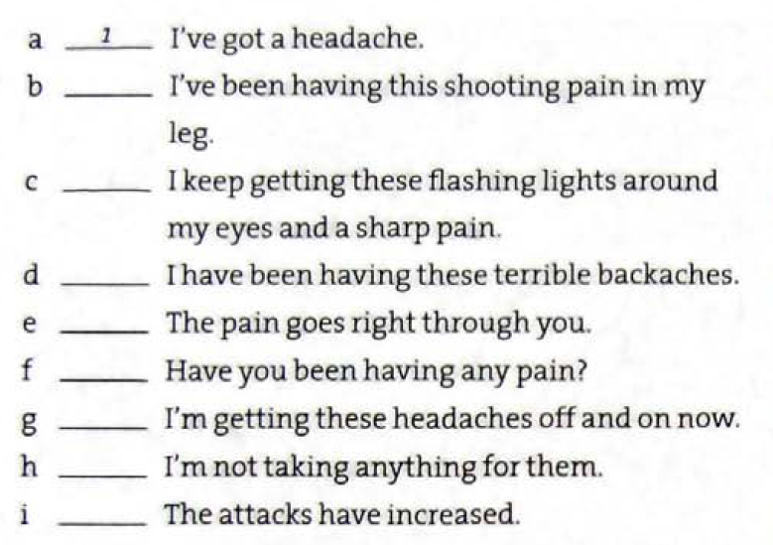





Slide 44
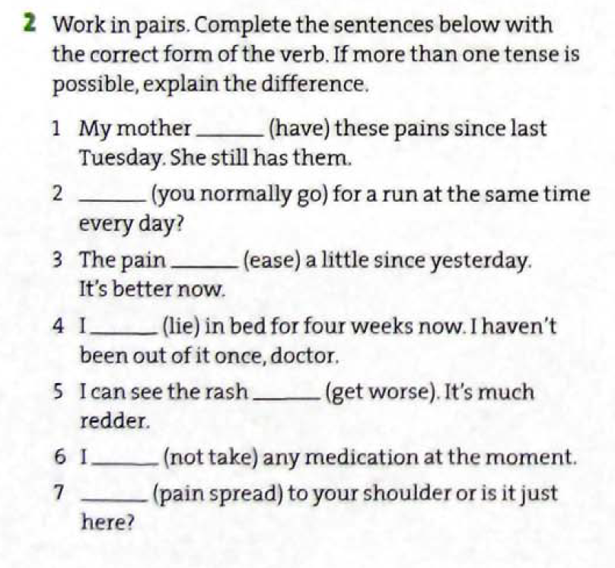







Slide 45


Speaking
B
appendicitis
cholecystitis (gallbladder inflammation)
gallstone
ureteric colic
A
acute pancreatitis
gastritis: (Inflammation of the lining of the stomach)
Duodenitis (inflammation in your duodenum lining)

Slide 46





Slide 47


b
c
b
c
c

Slide 48
3. Use the internet to find:
Other fields beside medicine where understanding non-verbal communication is important.
Every area of life where people communicate with each other for example business, diplomatic service, teaching, counselling, shops, buying and selling, etc.
2. What a patient-centered approach in history taking means?
lt is an approach which means that the doctor needs to deal with the patient as a person, rather than just the illness, giving them the opportunity to speak and make decisions about their treatment. The doctor needs to be able to interpret the patient! body language and mood, not just their illness.
3. What the Calgary Cambridge method is?
The Calgary Cambridge method is a patient-centered approach to communicating. lt teaches tools such as asking open questions, dealing with patients’ concerns and expectations, and non verbal communication such as body language.

Slide 49





Slide 50





Glyceryl trinitrate (GTN) is a spray used to relieve angina (chest pain).

