Slide 1

Tishk International University
Faculty of Applied Science
Medical Technical Radiology
6
The Basic of Fluoroscopy
First Grade- 2024-2025
Instructor: Prof. Dr. Ronak T. Ali

Slide 2
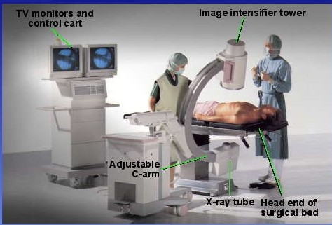

Slide 3


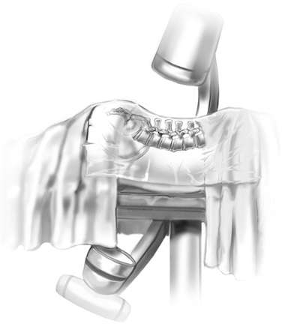
Study of moving body structures.
Similar to an x-ray
Fluoroscopy is also an imaging tool.
Allows physicians to look at various body systems.

Slide 4

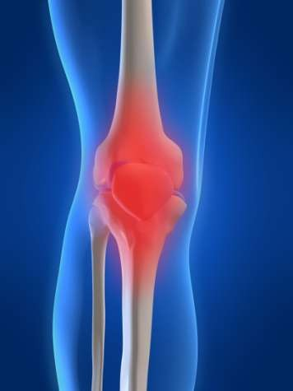
Show continuous x- ray image
Plays out like a movie
Images taken quickly allow for this to happen
Shows movement of body parts
Also shows
instruments or dye

Slide 5

The primary function of a fluoroscope is to perform dynamic studies; that is, the fluoroscope is used to visualize the motion of internal structures and fluids.
The purpose of this technique is to get real-time and moving images of the insides of a person by way of the fluoroscope.
If something is observed that the radiologist would like to preserve for later study, a radiograph can be made with little interruption of fluoroscopic examination. Such a radiograph is known as spot film.

Slide 6
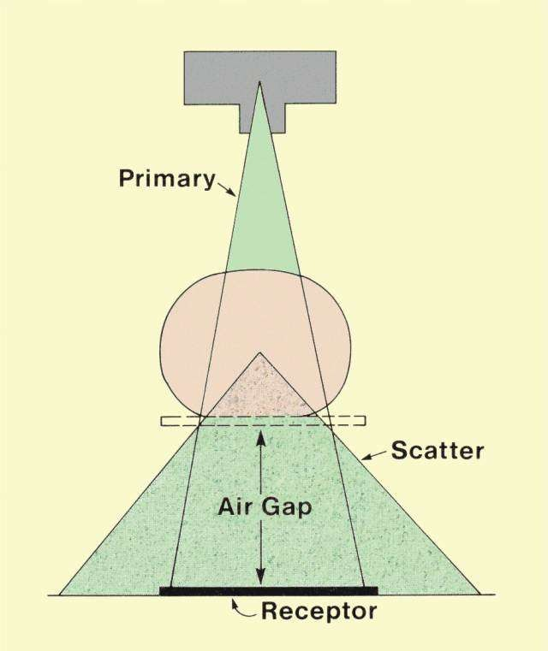
Scattered radiation
There are three types of X –rays:
primary X –rays : are released from the X -ray tube
scattered X –rays : are scattered from the primary substance and occur as a result of collision of electrons;
residual radiation : is X -rays that pass through the patient and strengthen the image.

Slide 7
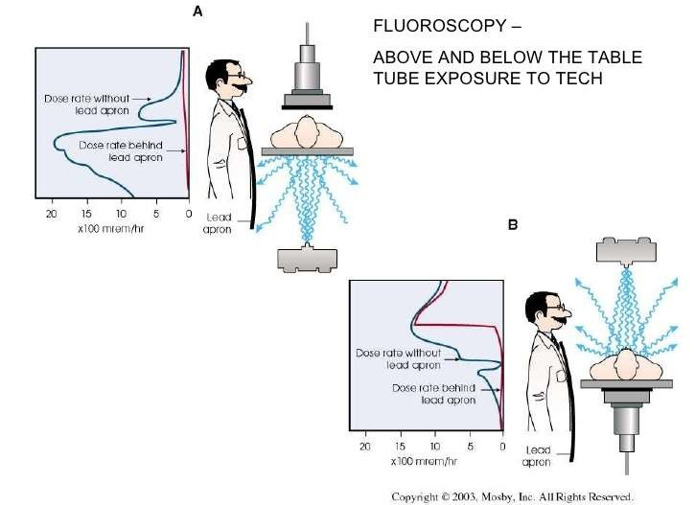
Scattered radiation
If the X -ray tube is on the patient and at eye level to the physician performing the scanning, the physician ’s face is relatively close to the X -ray tube and is unprotected against radiation leaks scattered from the tube.
The image booster, if it is positioned above the patient, also serves as a barrier to protect the physician ’s face.
in this position the tube is placed below the patient, back scattering also occurs toward the ground

Slide 8
Scattered radiation
Fluoroscopy devices that automatically determine the beam settings also automatically adjust the tube potential (kV) with increasing thickness of the patient ’s body
With an increase in tube potential, the force of the primary beam increases and scattering radiation will be more penetrating

Slide 9
Fluoroscopy usage types
Continuous fluoroscopy:
found in all the old machines, and is still a format that is used.
Fluoroscopy continues as long as the pedal is held down.
This format is used incorrectly by many physicians.
From the aspect of radiation safety, this is very dangerous.
High-speed fluoroscopy:
used in situations where normal fluoroscopy is inadequate.
it is not recommended.
Pulsed fluoroscopy:
The image speed and frames per second rate (fps) is selected.
This is the most advantageous format.

Slide 10
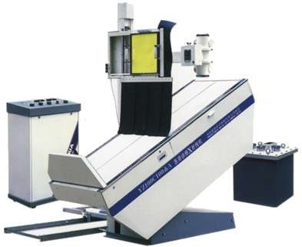
Takes a continuing stream of x-ray images
Approximately 25- 30 images per second
Images are viewed on a monitor
Sort of like a
television screen.

Slide 11

Amount of radiation needed various
Based on procedure
Important characteristic of Fluoroscopy
Sensitivity
Amount of exposure needed to create an image
Non-intensified Fluoroscopy
Uses a fluorescent screen only for a receptor
Should not be used because of excessive exposure

Slide 12
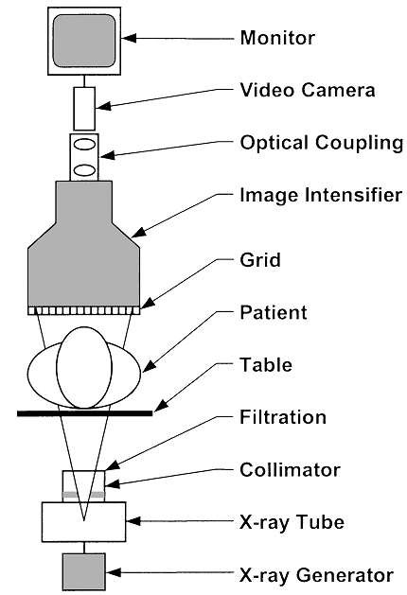
Components of Fluoroscope
x-ray generator
x-ray tube
collimator
filters
patient table
grid
image intensifier
optical coupling
television system
image recording

Slide 13
Used in a variety of procedures
Examples include:
Orthopedic Surgery
Observe fractures and healing bones
Catheter Insertion
Direct catheter placement (Angiography/Angioplasty)
Barium X-Rays
Observe movement through GI tract
Blood Flow Studies
View blood flow to organs

Slide 14

Injections into the knees
Viscosupplementation injections
Locating foreign bodies
Percutaneous Vertebroplasty
Treating compressed fractures of the spine
Injections into joints or spine
Image-guided anesthetic injections

Slide 15


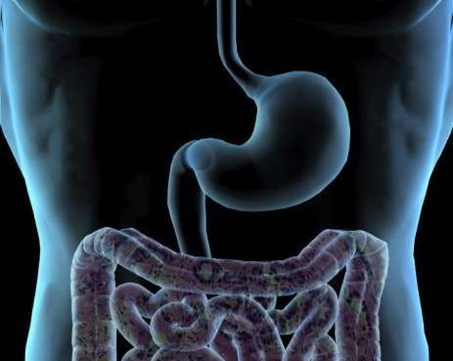
Fluoroscopy used alone
Gives physician opportunity to see movement in the intestines
Barium moves through them during procedure

Slide 16
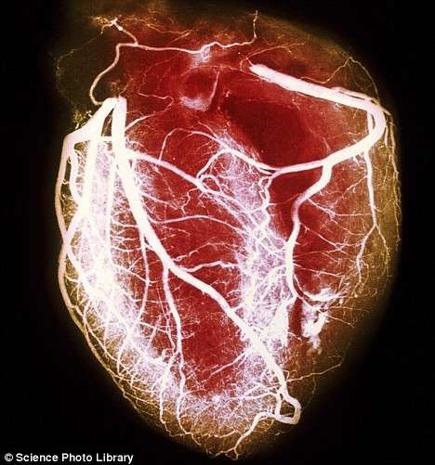
Fluoroscopy used alone
Aids physicians in inserting a catheter
Also aids them in detecting blockages in arteries
Physicians can see the flow of blood

Slide 17

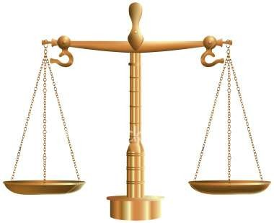
Because Fluoroscopy is an x-ray machine, it has the same risks as other x-ray machines.
Two major risks
There is a small possibility of developing cancer due to the exposure to the radiation
Injuries such as burns caused by the radiation
Benefit
If a patient is in need of a Fluoroscopy, the benefit outweighs the minute risks

Slide 18
Insertion of an IV into patient’s hand or arm
Patient moved onto x-ray table
Additional line may be inserted for catheter procedures
X-Ray scanner used to create fluoroscopic images of the body
Dye may be injected into the IV at this point
Type of care will be decided on after the procedure has finished

Slide 19
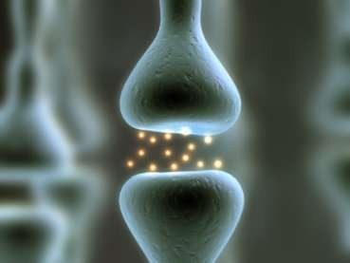
Continuous x-ray passes through the body
Beam passes onto a television monitor
Body part and motion can be seen in great detail

Slide 20

Two main things to consider
Area most exposed
Total radiation absorbed
Area Most Exposed
Highest absorbed dose
In the general area, as well as specific organs
Total Radiation absorbed
Can result in injuries
Burns, etc.
Caused by prolong exposure

Slide 21
Fluoroscopy is also an imaging tool.
Allows physicians to look at various body systems.
Shows movement of body parts.
Also shows instruments or dye
Takes a continuing stream of x-ray images.
Approximately 25-30 images per second
Used in a variety of procedures
Orthopedic Surgery
Catheter Insertion
Barium X-Rays
Blood Flow Studies

Slide 22

Two major risks
There is a small possibility of developing cancer due to the exposure to the radiation
Injuries such as burns caused by the radiation
Benefit outweighs the risks
Precise procedure
Plenty of steps followed to ensure a successful procedure
Plenty to consider during procedure
Area Most Exposed
Total Radiation absorbed

Slide 23



Effects of radiation on biological systems
Radiation effects on biological systems are divided into two Groups:
Cytocastic
(indirect, nondefinitive) effect
Determining (direct, definitive) effect

Slide 24
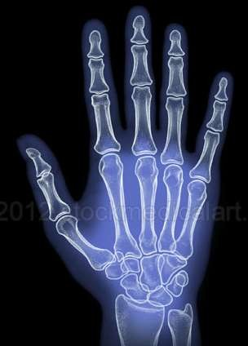
Cytocastic (indirect, nondefinitive) effect
The International Committee on Radiation Safety Protection ICRP has produced estimates of the maximum permissible dose (MPD) of annual radiation to various organs
Exposure below these levels is unlikely to
lead to any significant effects
the ICRP recommends that workers should not receive more than 10% of the MPD

Slide 25
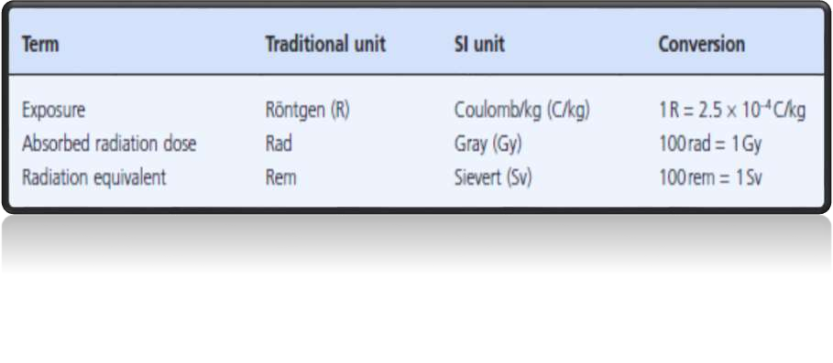
Radiation exposure and dose units

Slide 26
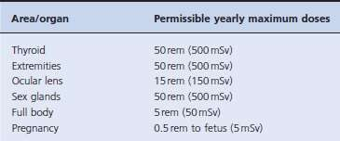
Yearly maximum radiation dosages

Slide 27
Radiation safety
necessity for imaging or the procedure should be
assessed:
effectiveness of the procedure
personal dose limits
risk assessment
radiation protection should take into account three basic rules:
Time
Distance
use of protective materials (shielding)

Slide 28
Fundamental principles of radiation protection
Hold the tube low.
Keep away from sources of radiation.
Consider the scattering profile.
Keep the beam time brief.
Set the appropriate geometry
Eliminate X -rays from the outside
The device should undergo technical checks
Wear protective clothing.

Slide 29



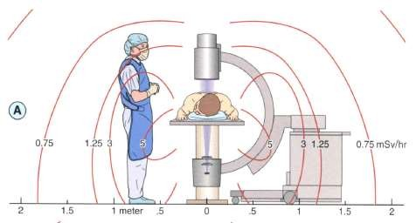
During routine use in the anterior-posterior plane, the x-ray tube (source) should be positioned below the patient and the detector above the patient to minimize radiation exposure to both the patient and the practitioner.

Slide 30
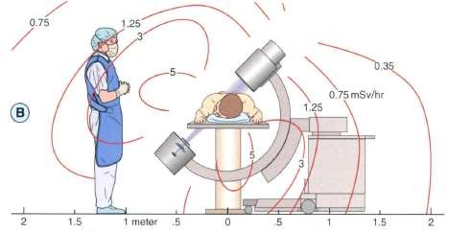
The oblique projection results in markedly increased exposure to the practitioner

Slide 31
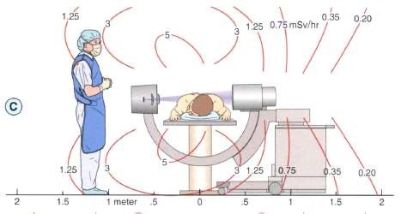
During use in the lateral projection, the practitioner should step completely behind the x-ray tube (source) to minimize radiation
exposure.
When it is necessary to work close to the patient during lateral fluoroscopy, the practitioner should step away from the x-ray tube and move to the side of the table opposite the x- ray tube to minimize exposure
DR MOHSEN ABAD 55

Slide 32
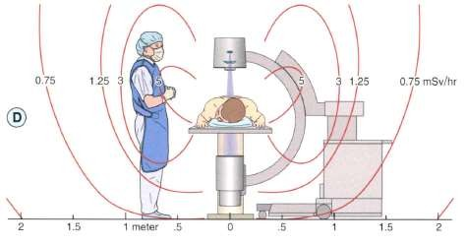
Radiation exposure to both the patient and the practitioner is dramatically increased when the x-ray tube (source) is inverted above the patient.
Some practitioners invert the (-arm to allow for more extreme lateral angle (e.g., rotation beyond 35 to 45 degrees oblique to the side opposite the (-arm is not possible without inverting the (-arm on some units). Radiation exposure can be reduced by rotating the patient on the table and keeping the x-ray source below the table.

Slide 33
Keep away from sources of radiation
what is a safe distance?
stand 3 meters away from the table to reduce the beam level that can be absorbed to an acceptable level.
best place to stand for staff is where the X -ray scatters twice before it reaches them
radiation intensity decreases approximately 1000 times with each scattering event
in other words one -millionth of the original value

Slide 34
Every fluoroscopy operator should do the following
Track the beam time:
– The C -arms of fluoroscopy devices have an irradiation alarm that sounds for every 5 minutes of irradiation
Save the last image:
Storing the last image in memory in this manner will significantly reduce the radiation dose
Pressing the pedal for a long time is not a factor in increasing quality the image brightness, or contrast.
Use the pulse mode:
two different modes, continuous and pulse.
In pulse –mode imaging, intermittent versus continuous radiation.
This mode reduces the irradiation time by up to 2 to 4
times.

Slide 35
Every fluoroscopy operator should do the following
Limit the beam size (collimation)
If possible, should restrict the irradiated area by reducing the diaphragm or with the collimator.
This process reduces the amount of scattered radiation and
improves the image quality
Set the appropriate geometry:
If the X -ray tube is brought too close to the patient, it can
cause skin burns during long -term applications
if the X-ray tube is too far from the patient, this can increase the size of the image
As a rule, doubling the focus distance increases the rate of
exposure to radiation fourfold.

Slide 36
Every fluoroscopy operator should do the following
Eliminate X -rays from the outside:
Outside light barriers interacting with the fluoroscopy device can block the image details from being seen.
In such a case, the fluoroscopic image needs to be enlarged or
the amount of scattered light increased.
The device should undergo technical checks:
Technical control is very important
image intensifier ages
automatic brightness control mode

Slide 37
Every fluoroscopy operator should do the following
8. Wear protective clothing
Elastic protective clothing such as aprons, vests, shirts, skirts, thyroid protectors, and gloves, glasses, are used in stationary or moving environments without shielding
they will never completely stop X-rays, only reduce them to an acceptable level
At 100 kV, 3.2% of the beam will pass through a 0.5 mm lead shirt, and at 70 kV 0.36% will pass.
if the physician wears a lead apron and gloves but stands in the way of the primary radiation path, full security is not guaranteed
A lead apron used correctly can offer 80% protection to active blood -producing organs
A well -chosen apron should start just below the manubrium sternum to include the pubis symphysis index down to just above the knee.

Slide 38
Every fluoroscopy operator should do the following
8. Wear protective clothing
g. for the protection to be effective, the face of the person must be turned toward the scattering source
h. The physician who is implementing the fluoroscopy procedure
should not turn their back on the beam
i. reinforced or equivalent materials that are filled with lead, copper, barium, and tungsten
j. These aprons should not be folded or wrinkled, and should not be thrown around randomly
k. addition, they should be checked every year, including vital areas to ensure there are no cracks or breaks
l. To protect against scattered radiation from the patient, two hanging
lead curtains next to the sides of the fluoroscopy tables can be used

