Slide 1


An Introduction to Fundamentals of Aviation Management
Lecture 1
Faculty Of Engineering
Aviation Engineering Department

Slide 2
Outlines
Learning outcomes ……………………………………………………………………………………….1
Introduction ……………………………………………………………………………………………….. 2
Commercial Air Transport …………………………………………………………………………….. 3
Characteristics of the commercial air transport industry …………………………………….. 4
Characteristics of the commercial air transport industry – Macro Factors ………………. 5
Characteristics of the commercial air transport industry – micro factors ……………….. 6
References………………………………………………………………………………………………… 7

Slide 3
Learning outcomes
Operational Management Skills: You will learn about the operational aspects of aviation management, including airport operations, airline management, and flight operations, and how these functions interact.
Strategic Planning: You will develop skills in strategic planning and decision-making, including market analysis, route planning, and competitive strategy in the aviation sector.
Technological Trends: Students will be introduced to technological advancements in aviation, such as innovations in aircraft design, air traffic control systems, and passenger service technologies.
Understanding Aviation Industry Structure: You will gain insight into the structure of the aviation industry, including the roles of various stakeholders such as airlines, airports, regulatory bodies, and service providers.

Slide 4



Introduction
The provision of a safe, efficient and reliable commercial air transport industry has become one of the most important factors in delivering global economic growth
Every year, over 3.3 billion passengers and 50 million tones of air freight (worth over US$6.4 trillion) are flown on 37.4 million scheduled flights on all seven continents.
Air transport both drives and is driven by processes of :
Globalization,
International trade,
Growing cultural and social exchange,
And it has been responsible for changing patterns of international migration, commerce and tourism.

Slide 5
Commercial Air Transport
Commercial air transport describes the scheduled or non-scheduled aerial conveyance of passengers, cargo or mail in exchange for revenue.
Commercial air transport, which is available to members of the public, is distinct from military aviation, which concerns the use of specialized aircraft by nation states for reasons of defense and national security, and from general aviation.
The commercial air transport industry includes a wide range of business approaches and operational practices, incorporating everything from 500-seat A380s flown by leading airlines between major airports to seasonable charter flights and small single-engine aircraft that serve some of the most remote regions on earth.

Slide 6
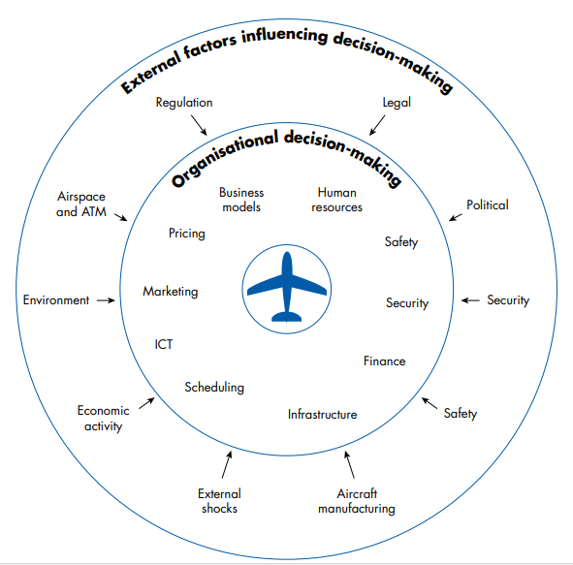
Characteristics of the commercial air transport industry
Commercial air transport is characterized by a number of factors which have major implications for the management of the industry. Some of these operate at the macro or inter/national level, whereas others occur at the organizational level.

Slide 7


Characteristics of the commercial air transport industry – Macro Factors
1. Regulation: The air transport industry was historically subject to strict regulations and control, which has shaped how the global industry has developed.
Policies of deregulation and liberalization
Privatization and commercialisation of airlines, airports and, increasingly, Air Navigation Service Providers (ANSPs).
2. Environmental impact: air transport operations have a social and environmental impact in terms of :
noise,
vibration,,
air pollution
and ground access congestion.

Slide 8

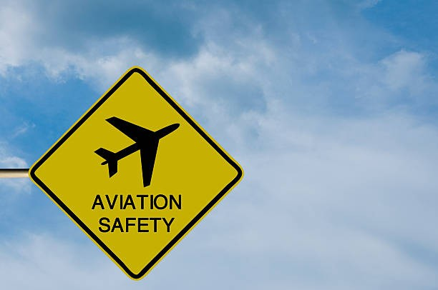
Characteristics of the commercial air transport industry – macro factors
Politics: Political decisions can greatly impact air transport through:
regulation,
taxation,
and international agreements.
For instance, governments can set policies on airport construction, safety standards, and environmental regulations, affecting airline operations and costs
Security: Security measures in air transport management increase operational costs and complexity but are essential for ensuring passenger safety and preventing threats.
5. Safety: Safety measures in air transport enhance passenger protection and prevent accidents but can lead to increased operational costs and regulatory requirements

Slide 9

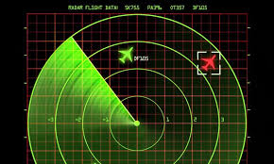
Characteristics of the commercial air transport industry – macro factors
6. Economic activity: economic activity drives demand for air travel, influencing routes and frequency. Economic downturns can reduce travel demand and revenues, while booms can increase investment in infrastructure and services.
7. Airspace and ATM: airspace management and air traffic management (ATM) ensure safe and efficient flight operations. Effective ATM minimizes delays and optimizes routes, while congestion or inefficiencies can lead to increased flight times and costs.

Slide 10
Characteristics of the commercial air transport industry – micro factors
Business model: selecting the most appropriate airline business model for the market, taking into account the competitive environment and prevailing market conditions
Pricing: Pricing and revenue managing of airline and airport products so as to maximize profits and manage yields
Scheduling: scheduling aircraft and crew to maximize resource utilization and minimize costs
Safety and Security: Ensuring safety and security through the adoption of company-wide safety and security management systems that comply with international protocols and regulations

Slide 11
Characteristics of the commercial air transport industry – micro factors
5. Information and Communication Technology (ICT): ICT underpins air transport operations and is vital to the effective management of revenues, marketing, human resource control and flight operations
6. Human resources: managing human resources to ensure the consistency and reliability of service delivery
7. Marketing: marketing the product using a variety of online and offline channels to attract and retain customers and engender brand loyalty through the use of initiatives such as frequent flyer programmes.
8. Infrastructure: the provision and utilisation of runway, terminal and ground access infrastructure are vital to safe and efficient operations, and the relationship between airlines and airports is integral to the effective management of these scarce resources and mitigating their adverse environmental effects.

Slide 12
References
Budd, L. and Ison, S. (2020) Air Transport Management: An international perspective. Milton Park, Abingdon, Oxon: Routledge.
Meijer, G. (2021a) Fundamentals of Aviation Operations. Abingdon, Oxon: Routledge, an imprint of the Taylor & Francis Group.

