Slide 1

IT – TECHNICAL ENGLISH
ESSENTIAL POINTS TO CONSIDER
IN 2024 – 2025 SPRING SEMESTER

Slide 2
DURATION AROUND 10 WEEKS, EXCLUDING EXAM WEEKS
UNITS TO BE COVERED ARE: 45
AROUND 5 UNITS WILL BE COVERED EACH WEEK.
STUDENTS WILL TAKE POP QUIZZES TO MEASURE THEIR LEARNING AT THE END OF EACH WEEK. THEY MAY BE MATCHING ACTIVITIES, VIDEOS, PODCASTS OR WRITING TASKS. THEY WILL BE COUNTED UNDER HOMEWORK & PARTICIPATION GRADES.
ALSO, STUDENTS WILL BE IN CHARGE OF ORGANIZING A WORD GAME TO TEACH ESSENTIAL VOCABULARY. EACH STUDENT WILL PREPARE IT ONLY ONCE DURING THE SEMESTER.

Slide 3
OBJECTIVES. AT THE END OF THE SEMESTER, STUDENTS WILL BE ABLE TO …………….
IMPROVE THEIR COMMUNICATION SKILLS IN A WORK ENVIRONMENT BY EQUIPPING THEMSELVES WITH FUNDAMENTAL KNOWLEDGE OF COMPUTER COMPONENTS, ACCESSORIES, SOFTWARE, INTERNET SECURITY, WEB DESIGN AND THE FUTURE OF THE INDUSTRY
LEARN HOW TO MANAGE TIME WISELY IN INDIVIDUAL PRESENTATIONS, POP QUIZZES AND MAIN EXAMS
WRITE ESSAYS COHERENTLY ABOUT CAREER-SPECIFIC TOPICS

Slide 4
GRADING CRITERIA %
QUIZ 15
MIDTERM 25
FINAL 40
POP-QUIZZES 5
ORGANIZING WORD GAMES 5
HOMEWORK 5
ATTENDANCE 5

Slide 5
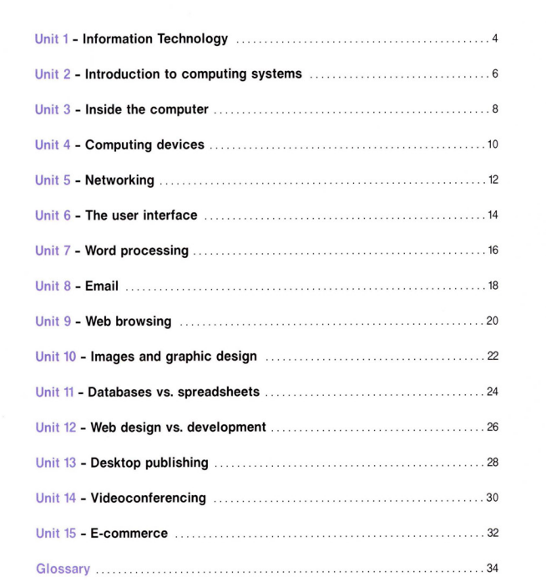
MODULES 1

Slide 6
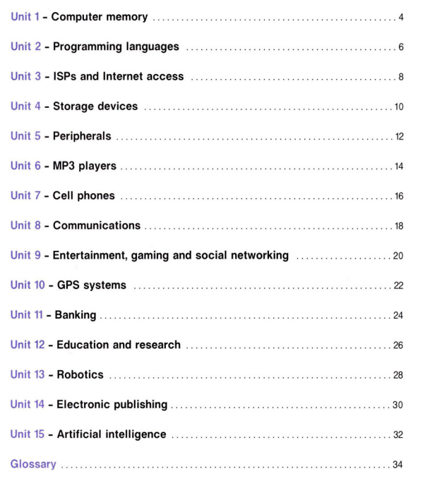
MODULES 2

Slide 7
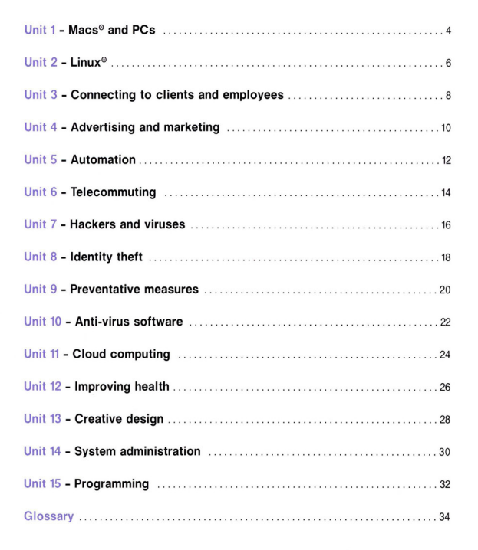
MODULES 3

Slide 8

COURSEBOOK

Slide 9
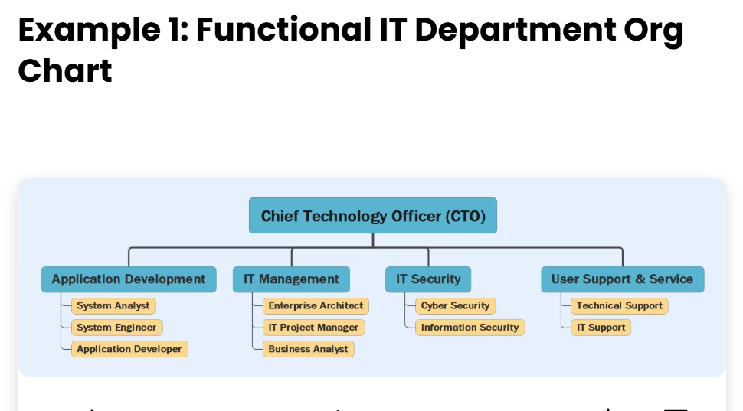
WHAT IS YOUR DREAM ROLE IN A COMPANY?

Slide 10
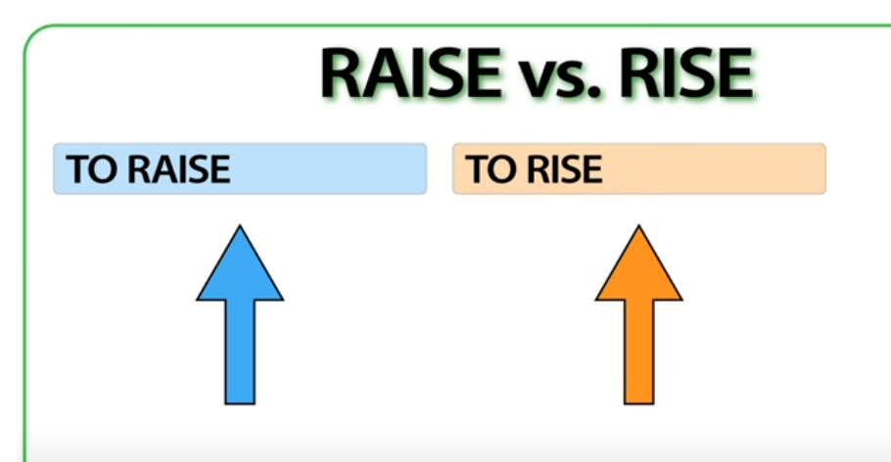

Slide 11
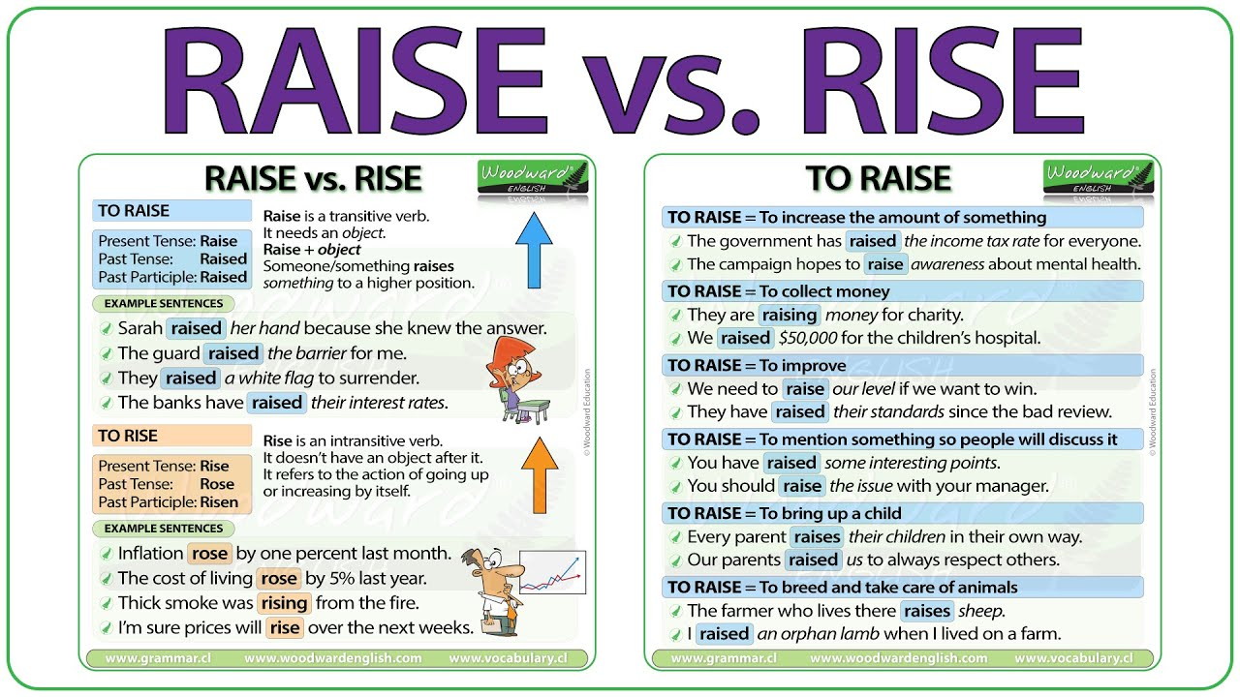

Slide 12
IMAGINE THAT YOU WORK FOR A WELL-KNOWN COMPANY WITH A WELL-PAID SALARY. HOWEVER, YOU ARE NOT HAPPY THERE. DO YOU RESIGN OR WORK THERE?

Slide 13
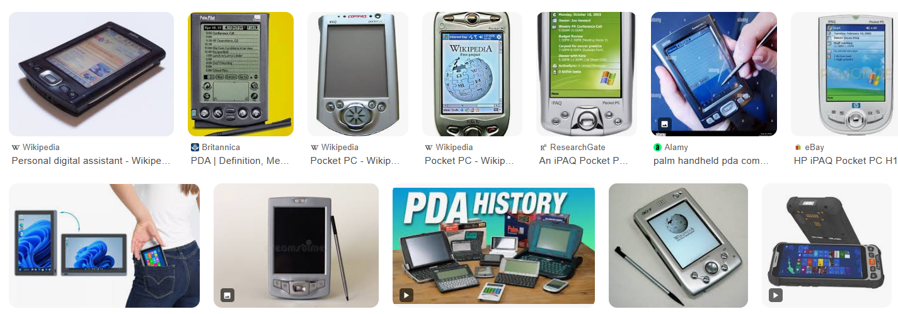
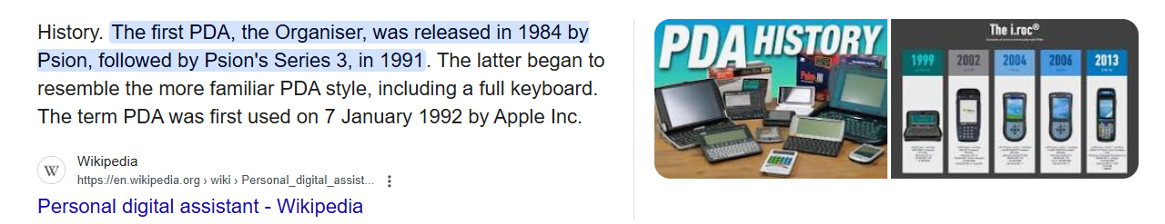
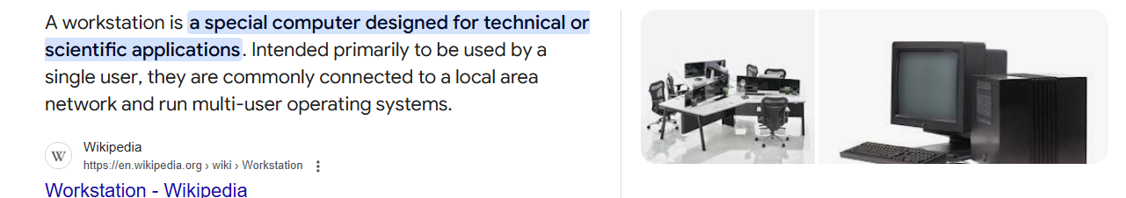

Slide 14
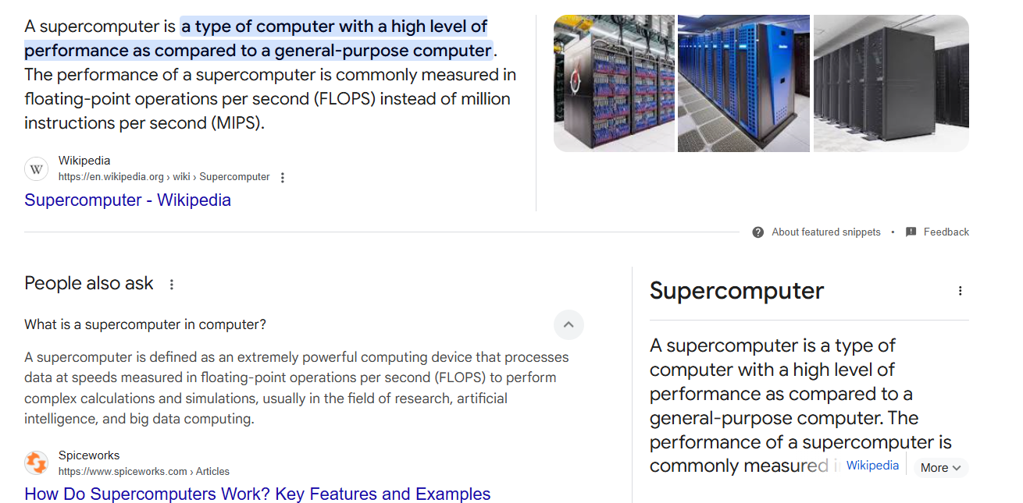

Slide 15
