Slide 1
Eigenvalues and Eigenvectors

Slide 2
Introduction
Eignvalues and eigenvectors are foundational concepts in linear algebra, offering powerful tools for understanding how linear transformations affect vector spaces. At their core, they help identify directions in a space that remain unchanged (except for scaling) when a transformation—represented by a matrix—is applied.
Mathematically, if A is a square matrix, a non-zero vector v is an eigenvector of A if:
Av=λv
Here, λ is the corresponding eigenvalue, which tells us how much the eigenvector is stretched or compressed during the transformation.

Slide 3
Introduction
Applications of Eigenvalues and Eigenvectors in Cybersecurity
Eigenvalues and eigenvectors play a crucial role in various cybersecurity domains, including data encryption, intrusion detection, network analysis, and biometric authentication. Below are key applications:
1. Principal Component Analysis (PCA) for Anomaly Detection
How It Works:
PCA reduces high-dimensional data (e.g., network traffic logs) into fewer dimensions using eigenvectors of the covariance matrix.

Slide 4
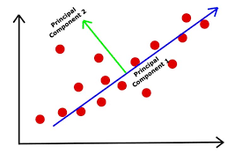

Slide 5
Introduction
2. Google’s PageRank Algorithm (Network Security)
How It Works:
Models the internet as a graph where webpages are nodes and hyperlinks are edges.
The dominant eigenvector of the adjacency matrix ranks webpage importance.
Used to detect malicious link farms (SEO spam) by analyzing eigenvector centrality.

Slide 6
Introduction
3. Facial Recognition & Biometric Security
How It Works:
Eigenfaces (a PCA-based method) represent faces as linear combinations of eigenvectors.
Used in authentication systems to detect spoofing (e.g., photo/video replay attacks).

Slide 7


Slide 8
Introduction
4. Cryptography (RSA & Lattice-Based Encryption)
How It Works:
RSA Encryption relies on the difficulty of factoring large numbers, which is related to matrix eigenvalues.
Lattice-based cryptography uses eigenvectors to resist quantum attacks.

Slide 9
Introduction
5. Graph-Based Threat Detection
How It Works:
Eigenvectors of Laplacian matrices identify critical nodes (e.g., central servers) in a network.
Used to detect botnets or lateral movement in cyberattacks.

Slide 10
Introduction
6. Machine Learning for Malware Classification
How It Works:
Eigenvalues help in feature selection for malware detection models.
Support Vector Machines (SVMs) use kernel methods involving eigenvectors.

Slide 11
Eigenvalues and Eigenvectors
Definition of Eigenvalues and Eigenvectors
Let A be an n×n square matrix.
Eigenvector: A nonzero vector v such that:
Av=λv,
where λ is a scalar called the eigenvalue corresponding to v .
Key Points:
Eigenvectors cannot be the zero vector.
Eigenvalues can be zero (e.g., singular matrices have at least one zero eigenvalue).
The German prefix "eigen" means "self" or "own," reflecting how eigenvectors are scaled but not rotated by A

Slide 12
Eigenvalues and Eigenvectors
Eigenvalue:
The scalar λ in the equation above is called an eigenvalue of the matrix A.

Slide 13
Eigenvalues and Eigenvectors
Finding Eigenvalues and Eigenvectors
Step 1: Find Eigenvalues
To find eigenvalues, solve the characteristic equation:
det⁡(A−λI)=0
Where:
I is the identity matrix of the same size as A.
det⁡ means the determinant.

Slide 14
Eigenvalues and Eigenvectors
Detailed Step-by-Step Computation of Eigenvalues
To find the eigenvalues of a matrix A, follow this in-depth procedure:
1. Construct A−λI
Subtract λ (a scalar variable) from each diagonal element of A.
The matrix I is the identity matrix of the same size as A.

Slide 15
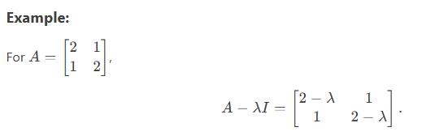
Eigenvalues and Eigenvectors

Slide 16
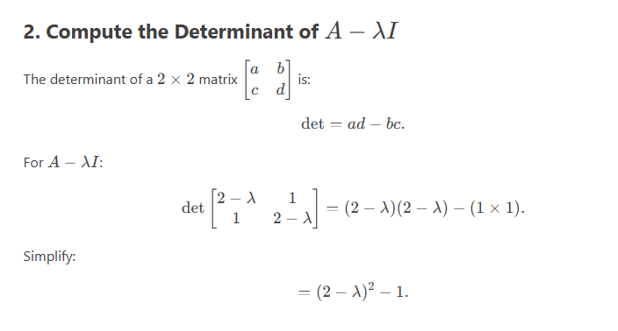
Eigenvalues and Eigenvectors

Slide 17
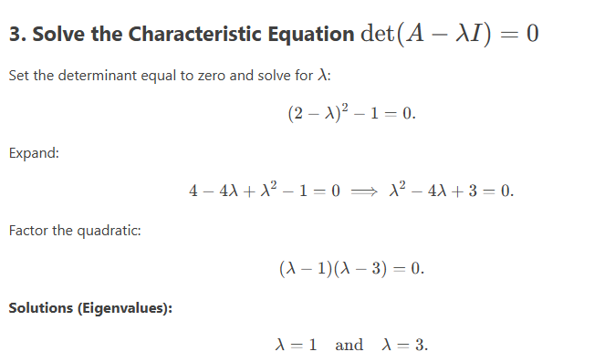
Eigenvalues and Eigenvectors

Slide 18
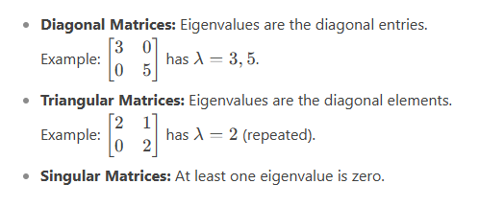
Eigenvalues and Eigenvectors
Key Observations

Slide 19
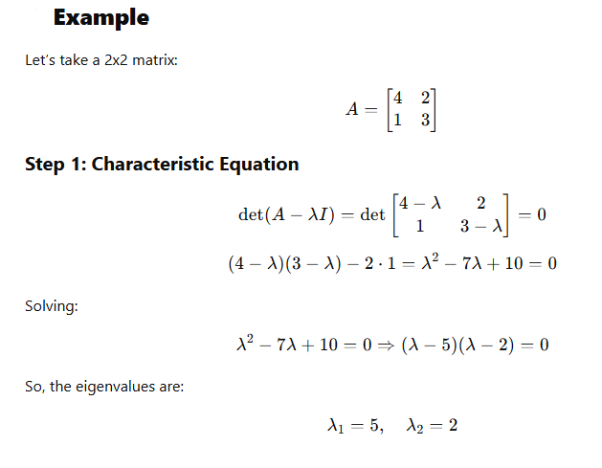
Eigenvalues and Eigenvectors

Slide 20
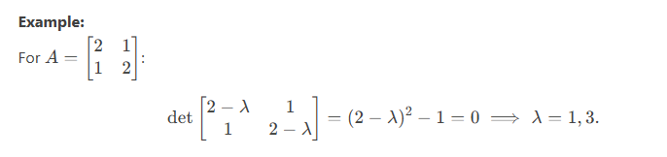
Eigenvalues and Eigenvectors

Slide 21
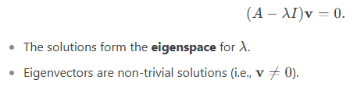
Eigenvalues and Eigenvectors
Step 2: Find Eigenvectors
For each eigenvalue λ, solve:

Slide 22
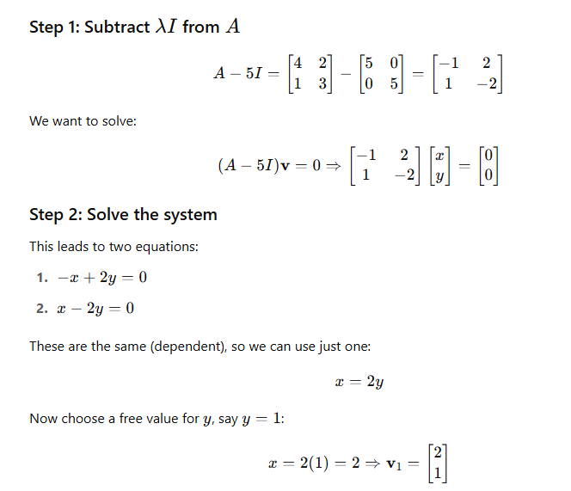
Eigenvalues and Eigenvectors
Eigenvector for λ=5 in previous example , then find corresponding eigen vector we have

Slide 23
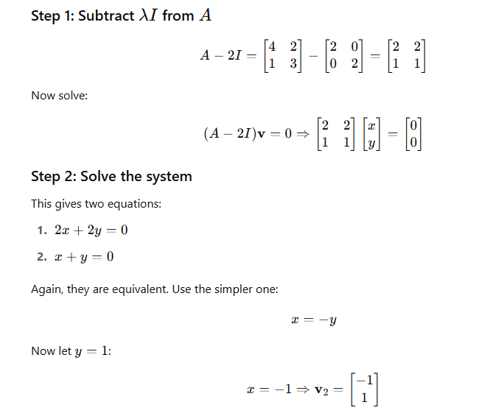
Eigenvalues and Eigenvectors
Eigenvector for λ=2 in previous example , then find corresponding eigen vector we have

Slide 24
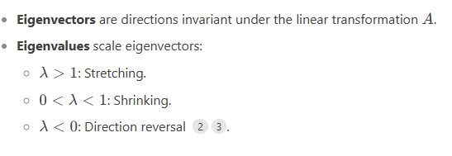
Eigenvalues and Eigenvectors
Geometric Interpretation

Slide 25
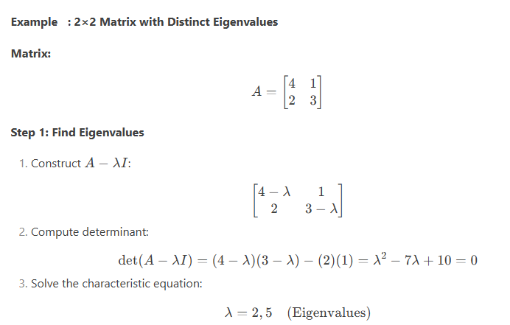
Eigenvalues and Eigenvectors

Slide 26
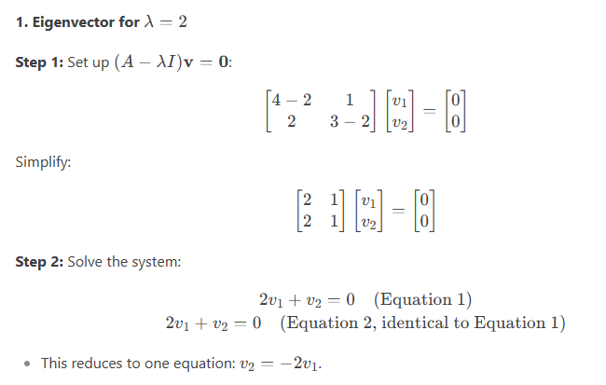
Eigenvalues and Eigenvectors

Slide 27
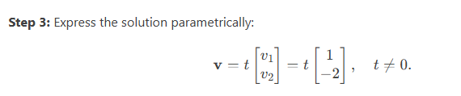
Eigenvalues and Eigenvectors

Slide 28
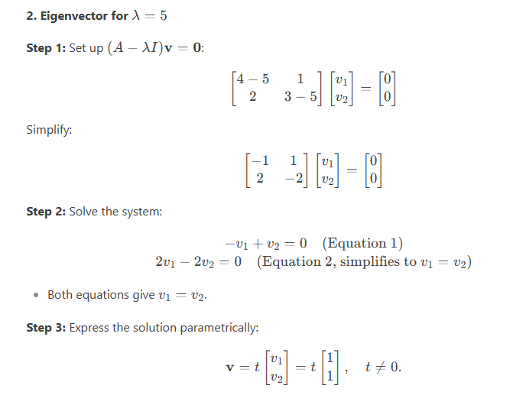
Eigenvalues and Eigenvectors

Slide 29
Eigenvalues and Eigenvectors
Key Observations
Free Variable:
For each eigenvalue, one variable is free (here, v1​), leading to infinitely many eigenvectors (scaled versions).
The eigenvector is not unique; any scalar multiple tv is also valid.
Linearly Independent Eigenvectors:
Eigenvectors for distinct eigenvalues (λ=2 and λ=5) are automatically linearly independent.
Defective Matrices:
If an eigenvalue lacks enough eigenvectors (e.g., repeated eigenvalues with insufficient solutions), the matrix is defective.

