Slide 1
The Process of Normal Labor and Birth
Lect. Dr. Sahar I. Abdulla
2025

Slide 2
Outline
A. Process of labor
First stage labor
Second stage labor
Third stage laboe
B. Episiotiomy
C. Degress of episiotomy

Slide 3
Learning Objectives
1- students should know the definition of labor
2- should know the process of labor
3- know episiotomy and types of episiotomy
4. Identify laceration and the degree of it

Slide 4
Theories Concerning Labor Onset
For the majority of women, the onset of labor usually occurs between the 38th and 42nd weeks of pregnancy.
For most of the pregnancy, the uterus stays in a relaxed state and the cervix remains closed and firm to maintain the pregnancy.

Slide 5
Cont…
The cervical changes result from the breakdown of collagen fibers, which produce a decrease in the binding capacity.
This change, coupled with an increase in cervical water content, causes weakening and softening.

Slide 6
The critical factors are often referred to as the “P’s” of labor:
Powers (physiological forces)
Passageway (maternal pelvis)
Passenger (fetus and placenta)
Passageway +Passenger and their relationship
(engagement, attitude, position)
Psychosocial influences (previous experiences,
emotional status)

Slide 7
Signs and Symptoms of impending Labor
1- Lightening
2- Braxton-hicks contractions
3- Cervical changes
4- Bloody show
5- Rupture of the membranes

Slide 8
The downward settling may also lead to the following maternal symptoms:
• Leg cramps or pains
• Increased pelvic pressure
• Increased urinary frequency
• Increased venous stasis, causing edema in the lower extremities
• Increased vaginal secretions, due to congestion in the vaginal mucosa

Slide 9
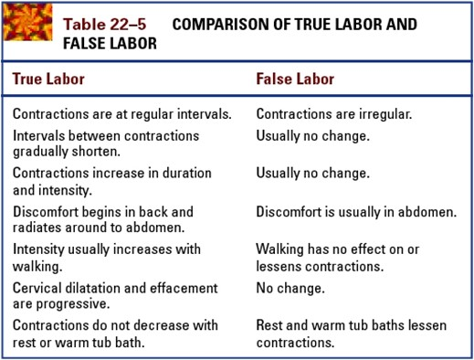

Slide 10
First Stage
The first stage of labor begins with the initiation of regular contractions that produce cervical dilation and continues through complete dilation. The first stage is the longest one and is composed of three phases.
The latent phase is followed by the active phase and then the transition Phase.

Slide 11
Stages and Phases of Labor
Its average duration is 12 hours in primigravida and 6 hours in multigravida.
First Stage (0–10 cm dilated)
1- Latent phase: 0–3 cm; contractions are mild –
every 5-10 min and last for 30 s Or 30 to 40 seconds
2- Active phase: 4–7 cm; contractions are moderate every 3–5 min and last for 40 - 60 seconds),
3- Transition phase: 8–10 cm; contractions are strong every 2–3 min and last for 60-90 s.

Slide 12
1- Latent Phase
*Beginning cervical dilatation and effacement
*Cervical dilatation from 0–3 cm
*No evident fetal descent
*Uterine contractions are usually mild in frequency, duration, and intensity
The latent phase of labor can last as long as 10 to 14 hours

Slide 13
2- Active Phase
*Cervical dilatation from 4 to 7 cm
*Progressive fetal descent
*Contractions more frequent and intense
The length of the active phase is variable, nulliparous women generally progress at an average speed of 1 cm of dilation per hour and multiparas at 1.5 cm of cervical dilation per hour.

Slide 14
3- Transition
*Cervical dilatation from 7 to 10 cm
*Progressive fetal descent
*Contractions more frequent and intense
(1 cm/hr for a Primepara and 1.5 cm/hr for a multipara).

Slide 15
Labor Support
1-Assessment of the Maternal
2- Assessment of the Fetus
3-Promotion of comfort
*Position Changes
*Personal Comfort Measures
A-Environment.
B-Personal hygiene.
C- Elimination.
D-Supportive relaxation techniques.

Slide 16
2nd stage of labor
The second stage of labour starts when the cervix is fully dilated (10cm) and complete effacement (100%) and ends when the infant is completely delivered.
The median duration is approximately 50 minutes for nulliparous and about 20 minutes for multiparas, but it is highly variable

Slide 17
Symptoms and signs indicate of the second stage
1- Uterine contractions increase in both frequency and duration, they are more frequent and last longer.
2- The women becomes restless.
3-Nausea and vomiting often occur.
4- The women has an uncontrollable urge (desire) to bear down (push).
5- The perineum bulges during a contraction as it is stretched by the fetal head.

Slide 18
Observations must be made during the second stage of labour?
If the head is engaged and the women is asked to bear down, the following observations must be done:
Listen to the fetal heart between contractions to determine the baseline fetal heart rate.
Observe the frequency and duration of the uterine contractions.
Look for any vaginal bleeding.
Record the progress of labour.

Slide 19
Normal vaginal delivery management
1-Emptying the bladder: Any factor, such as a full bladder, that prevents descent of the fetal head or decreases the strength of uterine contractions should be corrected.
2-Supporting the perineum: A swab should be placed over the women’s anus to prevent the vulva, and later the fetal head, being soiled with stool (i.e. faeces).
3-Important to support the perineum in order to prevent tear.

Slide 20
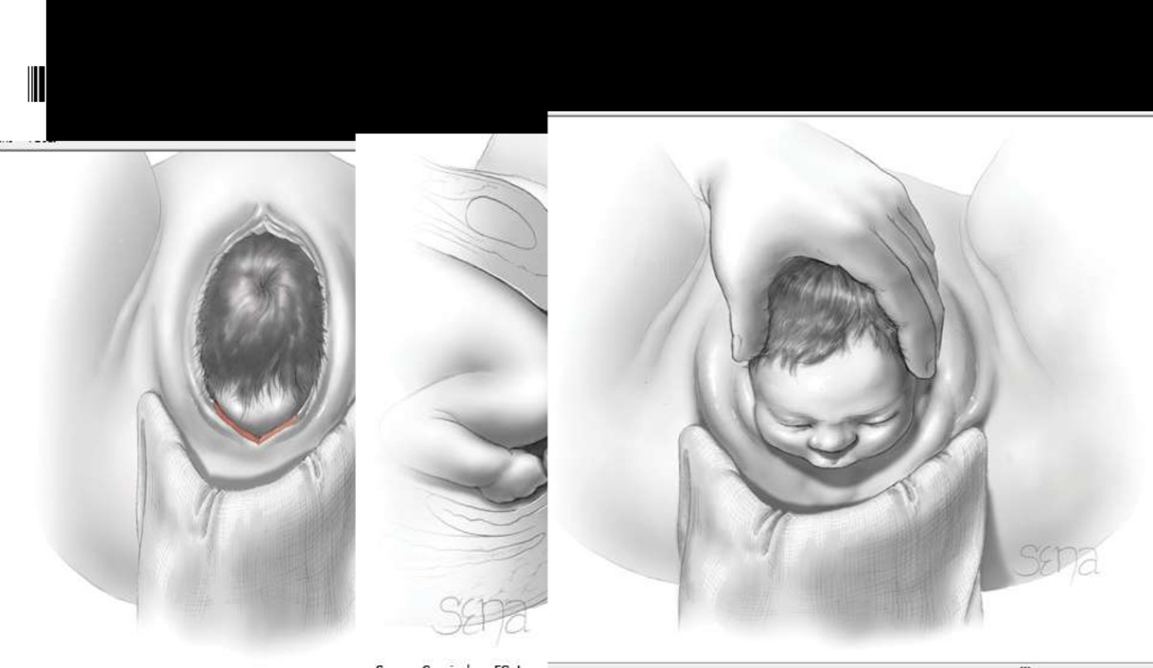
Supporting the perineum

Slide 21
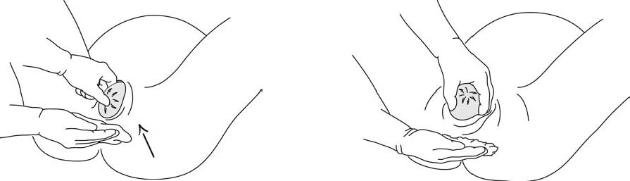

Slide 22
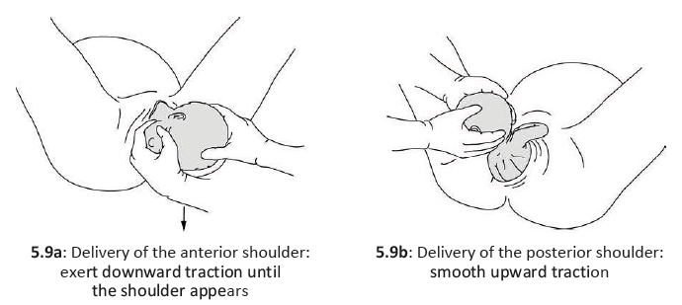

Slide 23
4-Crowning of the head: When the head is crowning, the vaginal outlet is stretched and an episiotomy may be indicated. The midwife or doctor should place one hand on the vertex to prevent sudden delivery of the head. The other hand, supporting the perineum, is now moved upwards to help extend the head. It is important that the fetal head is only controlled and not held back.

Slide 24
Cont...
5-Feeling for a cord: Check that the umbilical cord is not wrapped tightly around the infant’s neck. A loose cord can be slipped over the head, but a tight cord should be clamped and cut.

Slide 25
6- Delivering of the shoulders and body: With gentle continuous posterior traction on the head and lateral flexion, the anterior shoulder is delivered from under the symphysis pubis. The posterior shoulder is then lifted over the perineum. The rest of the infant’s body is now delivered, following the curve of the birth canal and not by simply pulling it straight out of the vagina

Slide 26
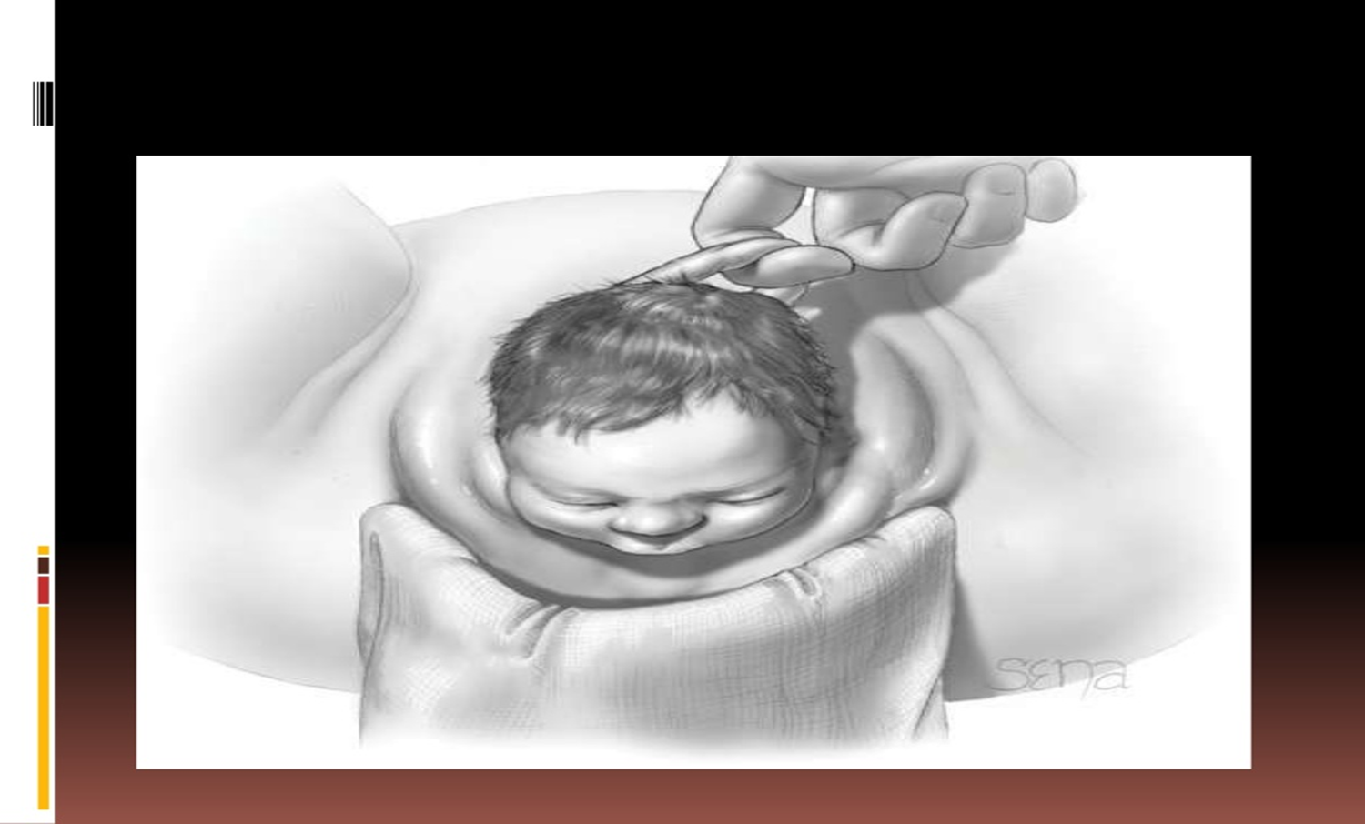

Slide 27
Lacerations
Perineal Lacerations
A Laceration (tear) happens spontaneously as the baby stretches the vagina during birth.
First degree: Involvement of mucosa and skin only
Second degree: Extension into the sub mucosa
Third degree: Disruption of the anal sphincter
Fourth degree: Lacerations extending through the rectal mucosa

Slide 28
Episiotomy
Is the surgical planned incision on the perineum and the posterior vaginal wall during 2nd stage of labar.
It is incised midline, down the center of the perineum, rather than mediolaterally, which extends in a diagonal angle to either the left or right side.
with or without episiotomy the perineum also may suffer from lacerations during delivery.
we have two types of episiotomy;
midline, and mediolaterally

Slide 29
Indications of Episiotomy
threatening signs of perineal laceration.
Prolonged second stage of labor;
Fetal distress;
Vaginal delivery requires assistance with use of forceps or a vacuum extractor;
Baby in a breech presentation
Twin or multiple deliveries
Large-sized baby
Abnormal position of the baby's head; and
When the mother has a history of pelvic surgery.

Slide 30
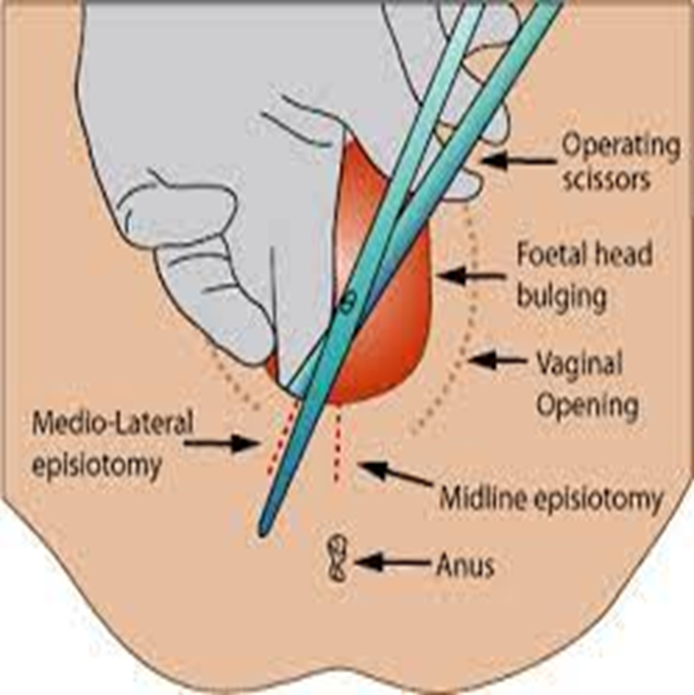
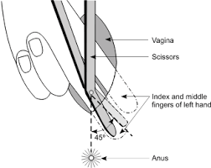
Type of episiotomy
1- Mediolateral or oblique.
2- Midline.

Slide 31
Mediolateral Episiotomy
In a mediolateral episiotomy, the incision begins in the middle of the vaginal opening and extends down toward the buttocks at a 45-degree angle.
The primary advantage of a mediolateral episiotomy is that the risk for anal muscle tears is much lower.
Disadvantages associated with this type of episiotomy, including:
increased blood loss
severe pain
difficult repair
higher risk of long-term discomfort, especially during sexual intercourse

Slide 32
Midline Episiotomy
In a midline episiotomy, the incision is made in the middle of the vaginal opening, straight down toward the anus.
The advantages of a midline episiotomy include easy repair and improved healing. This type of episiotomy is also less painful and is less likely to result in long-term tenderness or problems with pain during sexual intercourse. There is often less blood loss with a midline episiotomy as well.

Slide 33
The main disadvantage of a midline episiotomy is the increased risk for tears that extend into or through the anal muscles. This type of injury can result in long-term problems, including fecal incontinence, or the inability to control bowel movements.

Slide 34
Degrees of episiotomy
First degree: This cut includes your vaginal mucosa and perineal skin but doesn’t cut any underlying tissue.
Second degree: This cut also includes your underlying subcutaneous tissue and your perineal muscles.
Third degree: This cut goes deep enough to impact the musculature of your anal sphincter.‌
Fourth degree: This cut goes deep enough to extend through your rectal muscle and into your rectal mucosa

Slide 35
Cord clamping and cord care
Wait at least 1 to 3 minutes before clamping the cord (especially neonates weighing less than 2500 g).
Clamp the cord with two Kocher forceps 10 cm from the umbilicus and cut between the two forceps. Use sterile blade or scissors; a different pair than those used for episiotomy.
Tie off the cord with a Barr clamp leaving a 2 to 3 cm stump.

Slide 36
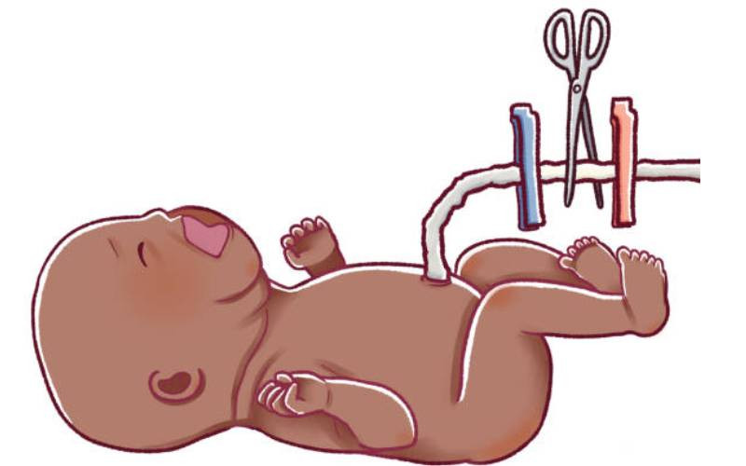

Slide 37
Third stage labor
The third stage of labor or placental stage begins as soon as the fetus is delivered and lasts until the placenta is delivered.
The mechanism of placental separation is a combination of uterine contractions and involution
After expulsion of the fetus, the uterus continues to contract every 3 to 4 minutes. as the uterus contracts and begins the process of involution, shrinkage of the site of implantation of the placenta occurs.
Within 10 to 15 minutes after delivery of the infant, most of the placenta has detached from the uterine wall. At this point, vaginal bleeding from the uncovered implantation site increases, and delivery of the placenta generally soon follows.

Slide 38
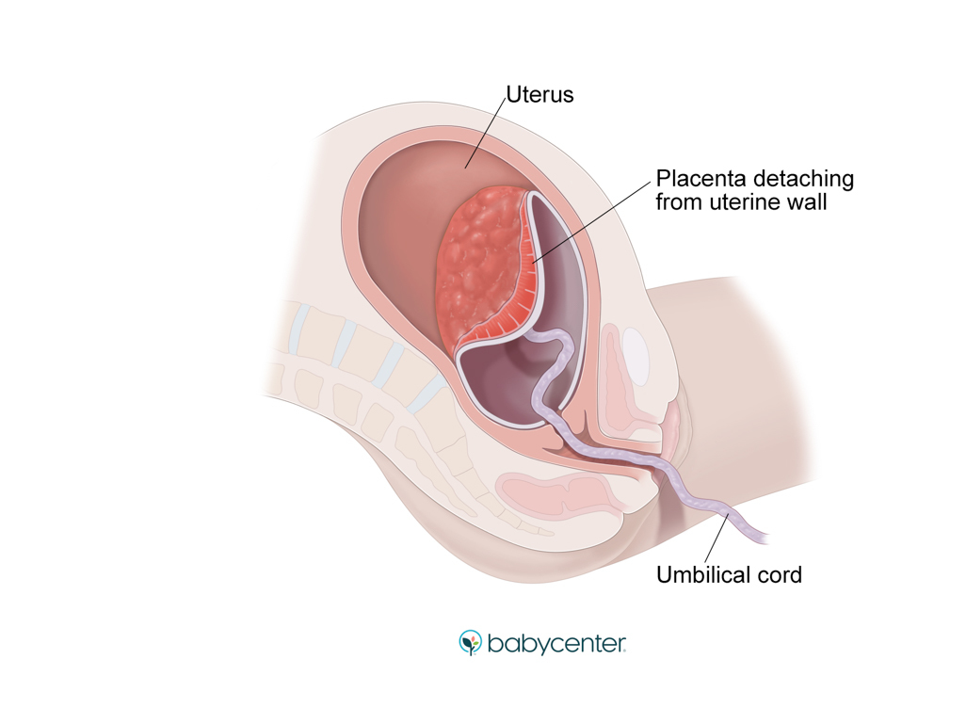
Signs of placental separation are:
1- Rounding up and rigid of the uterus,
2- Upward movement of the fundus,
3- Lengthening of the umbilical cord
4- Cush of blood from the vagina.

Slide 39
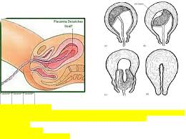

Slide 40
Fourth stage
The fourth stage of labor or recovery stage is defined as the first 4 hours after delivery of the placenta. During this time, many maternal physiologic readjustments are occurring.
The average blood loss from a vaginal delivery is 500 ml. Because of the blood loss and the return of a more normal abdominal anatomy as the uterus returns to a more normal size, there is a decrease in blood pressure and slight tachycardia.
The fundus is midline and usually is halfway between the umbilicus and the symphysis pubis. The fundus should remain firm and contracted.

Slide 41
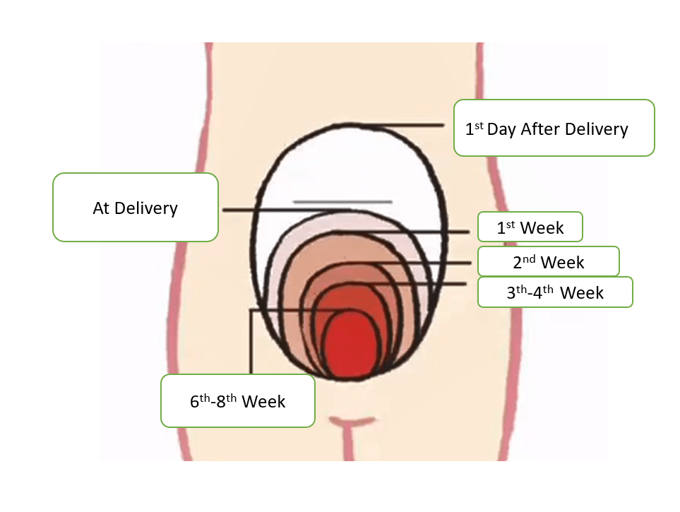

Slide 42
Conclusion
The physiological event that leads to the birth of a baby. it typically progresses through three main stages:
This process involves the coordinated efforts of the uterus, cervix, and maternal efforts, under hormonal regulation, particularly by oxytocin and prostaglandins.

Slide 43


