Slide 1


Normal postpartum Nursing care
Lect. Dr. Sahar I. Abdulla

Slide 2

Out line:
Objectives
Definitions of postpartum
Physiological change during postpartum period
Nursing care of the woman ,new born and her family in the postpartum
postpartum complications

Slide 3

Objectives:
To define postpartum period
To describe normal physiological change during postpartum period
To identify the post partum assessment
To explain the nursing care and intervention

Slide 4
introduction:
The post partum or puerperium period, it means fourth stage of lobar. Lasts from delivery of the placenta to approximately 6weeks afterward.
During the postpartum period, the woman is referred to as the puerperal. The first 24hours after delivery it called immediate postpartum period, from second day after birth to the end of the first week it is called early postpartum period, and this time continues until 6weeks it is called late postpartum period.

Slide 5
Physiological change during postpartum period:-
Dramatically Changes in everybody systems, while the changes are normal, the possibly weight loss is 15-17Ibs.the nurse should follow an organized method when examining the postpartum client. This manner provides a consistent, quality approach to nursing care.

Slide 6
The BUBBLE-HE can helpful in postpartum assessment. The nurse should assess these elements every 8 hours, along with vital signs.

Slide 7
Breasts
Uterus
Bladder
Bowel
Lochia
Episiotomy
Humans sing
Emotional status

Slide 8
1- Breasts:
After birth, when palpate the breasts usually are enlarged, soft and warm and contain a small amount of colostrums.
The nipples should be intact (inverted) without redness, tenderness, cracks or blisters.colostrum may be expressed, if the mother is not breast feeding, the breast changes as a result of pregnancy regress after 1 to 2 weeks postpartum.

Slide 9
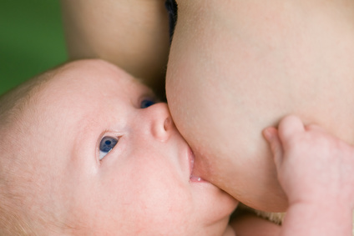
The mother may experience breast engorgement (enlargement and filling of the milk), may begin as a tingling sensation in her breasts, 2 to 4 days after birth.
The breasts feel very full, tender and uncomfortable until the milk is released through infant sucking, manual expression or pumping

Slide 10
2- Uterus:
After delivery immediately the uterus begins the process of involution or reduction in size. This process takes 6 weeks for complete physiologic involution and for the reproductive system to be restored to normal pre pregnancy.
Sub involution or failure of the uterus to return to pre pregnancy, occurs when the process of involution is prolonged or stopped, as result of hemorrhage, infection, or remained parts of placenta.
Involution of uterus to non pregnant condition-diminishing in size and weight and anatomic location return back in to the pelvis.

Slide 11
The uterus weights immediately after delivery is about 1000g (2Ib) at the end of 6 weeks postpartum the weight is 50 to 100g.
Breast feeding or breast stimulation assists in hastening the speed of uterine involution.

Slide 12
Assessment of the fundus:
Immediately after delivery, the fundus usually can be located midline and should be at or below the level of umbilicus.
At 12 hours after birth the fundus should be approximately 1 cm below the umbilicus.
The fundus descends or involutes 1 to 2cm each day after the first postpartum day.
At the end the fundus is non palpable as it gradually descends in to the true pelvis on about 8 to 9 days postpartum.

Slide 13
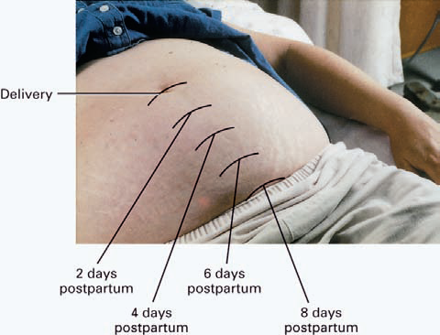

Slide 14
The fundus should be massaged for firmness which is provides the opportunity to maintain contraction of the uterine blood vessels where the placenta once attached, preventing hemorrhage and expelling placental fragments and blood clots.
If it is not firm or palpable, the fundus may feel boggy.
A boggy uterus may be due to an over distended uterus or structural anomalies

Slide 15
(e.g., fibroid) a fundus that remains soft is warning sign of uterine a tony and potential postpartum hemorrhage.
The position of the fundus should be noted if it is midline or displaced to the left or right of the umbilicus, because of the full bladder the fundus may be displaced higher and to the right of the umbilicus.
Women who have had several pregnancies or large babies may have a large uterus that is palpated higher than is normally expected.

Slide 16
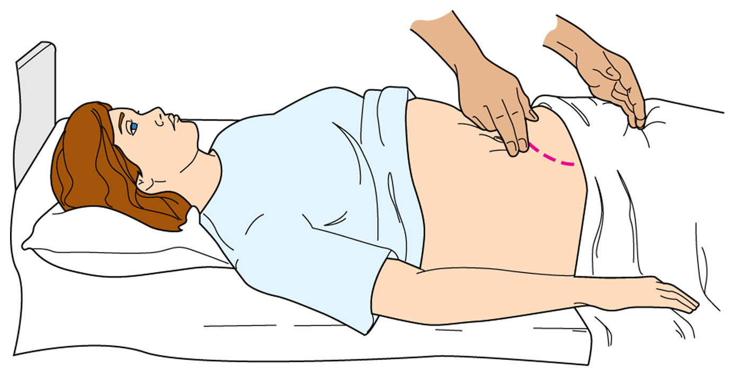
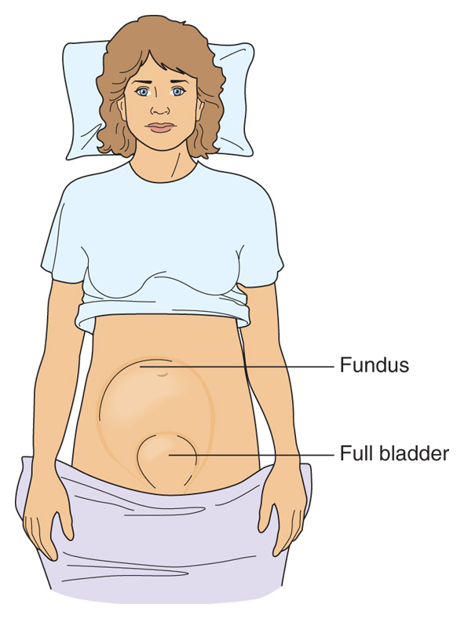

Slide 17
3- Bladder distention:
In the immediate postpartum period, urinary distention, incomplete empting and residual urine are complications that result in a full bladder.
These complications are related to an edematous perineum, pain, spasms. Full bladder interferes with contraction of uterine and increases risk for hemorrhage or bleeding.

Slide 18
The nursing responsibility to teach the mother to empty her bladder after delivery, to assist in controlling pain and bleeding, the nurse should note complaints of urinary frequency, dysuria and retention. The primary provider should be notified if the woman has not voided 6 to 8 hours after birth.
Residual urine is urine remaining in the bladder after elimination, and can result in urinary tract infection.

Slide 19
4- Bowels:
constipation may occur in early postpartum period due to decreased bowel motility during labor, and postpartum fluid loss.
For women who have had an episiotomy, fear of tearing the stitches may lead to or exacerbate the occurrence of constipation.
The women should be encouraged to drink six to eight glasses of fluids daily and eat a high-fiber diet.
When constipation is severe, administering an analgesic and stool softener, if the woman has not yet had a bowel movement by 2 to 3 days postpartum, bisacodyl suppository (Dulcolax) or enema may be prescribed to stimulate intestinal activity.

Slide 20
5- Lochia:
The usual uterine discharge of blood, mucus, and tissue after birth is called lochia.

Slide 21
Lochia is assessed according to its amount, color, and change with activity and time; the duration of lochia is not affected by breast-feeding or the use of oral contraceptives.
The character and amount of lochia indirectly indicated the progress of endometrial healing.
We have three types of lochia and have their own characteristics.

Slide 22
1- Lochia rubra:
Is the discharge in the first 3 days after delivery, is small to moderate in amount and having a bright-red color, contain small clots.
2- Lochia serosa:
Which occurs 4 to 10 days after birth, is a pink or brown-tinged color, which is lighter in amount than rubra, no clots present.

Slide 23
3- Lochia alba:
A whitish yellow creamy discharge on days 10 to 17.it is not uncommon for lochia alba to last until 6 weeks postpartum.
The amount of lochia varies with position changes but should continually decrease throughout the first 4 to 6 weeks postpartum.

Slide 24
The first menstrual period usually begins within 8 weeks after delivery for non lactating women. The timing may be delayed from 2 to 18 months in breast-feeding mothers.
However, ovulation may occur without the onset of the first menstrual period, it is possible for a woman to become pregnant before the return of menses.

Slide 25
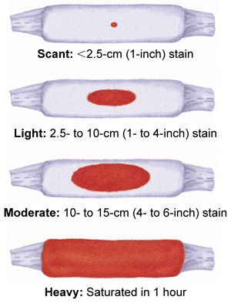

Slide 26
6- Episiotomy – laceration, bruising, swelling
Inspect the perineum for episiotomy/lacerations with REEDA assessment.
  R = redness (erythema)
  E = edema
  E = ecchymosis
  D = drainage, discharge
  A = approximation

Slide 27
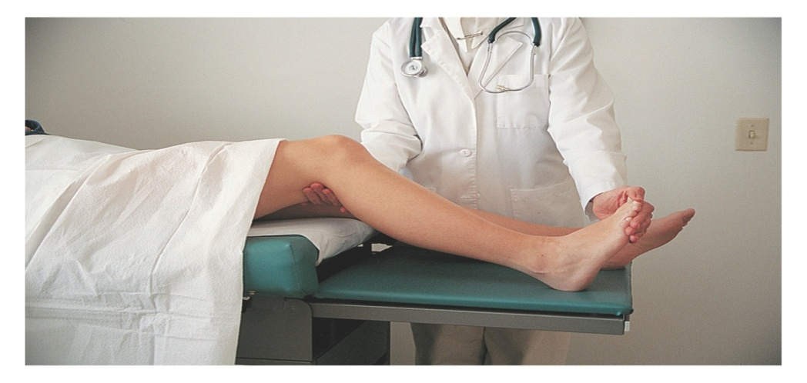
Homans Sign
  Assess for pedal edema, redness, and warmth
  Check Homans’ sign(positive indicator of thrombophlebitis).
  Assess calf for redness and warmth
  assessment of the extremities for varicosities, deep tendon reflexes, and tenderness.

Slide 28
7-Emotional Status/Bonding Assessment
Describe level of attachment to infant
Determine mother's phase of adjustment to parenting
Postpartum Blues.
During postpartum period up to 85% of women suffer from some type of mood change.
symptoms are:
Rapidly fluctuating mood, tearfulness, irritability and anxiety , poor concentration and feeling of loss.
  Usually resolves in 10 to 14 days.

Slide 29
Causes of postpartum Blue:
  Changing hormone levels, fatigue, discomfort
  Psychological adjustments
  Unsupportive environment, insecurity.
  postpartum depression:
  10 to 15% of women experience a more disability and persistent from disturbance of mood.
  symptoms:
  depressed mood, tearfulness, inability to enjoy pleasurable activities, insomnia, fatique,loss of appetite, suicidal thoughts, and thought of death.

Slide 30
8- other assessment:
Weight loss: Return to normal weight by 6 – 8 weeks
Breastfeeding will assist with weight loss even with extra calorie intake.
Postpartum Chill Shaking . Due to vasomotor instability.
Postpartum diaphoresis night sweats and increased odor

Slide 31
Nursing care of the woman ,new born and her family in the postpartum period

Slide 32
  Relief of after pains:
  1. Positioning comfortable
  2.Analgesia administered an hour before breastfeeding
  3.Encourage early ambulation - monitor for dizziness and weakness
Prevention of infection :
Nurses in the post partum setting are acutely aware of the importance of preventing infection in their patients by maintaining clean environment ,bed linens should be changed as needed, and disposable pads and draw sheets are changed frequently

Slide 33
Promotion of comfort ,rest, ambulation and exercise
Common cause of postpartum discomfort include pain from uterine contraction , perineal laceration, episiotomy, hemorrhoids, sore nipple and breast engorgement, the nurse can relive these discomfort either by:
Non pharmacologic measures( by massage, relaxation )
or pharmacologic measures like analgesic

Slide 34
POSTPARTUM COMPLICATIONS
Despite the normalcy of childbirth, complications may arise that will have detrimental effects on the postpartum patient. These include
1- Postpartum hemorrhage
2- Thrombophlebitis,
3- Infections
(including mastitis, endometritis, and urinary tract infections)

Slide 35
Summary:
Postpartum period is the interval between the birth of the newborn and the return of the reproductive organs to their normal non-pregnant state. There's many important Physiological change during postpartum period occur like (uterus , lochia , cervix , vagina, perineal area , systemic and psychological changes).

Slide 36
Thank you

