Slide 1

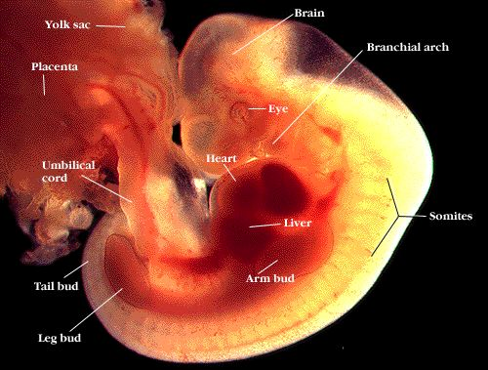
Stage of embryo and fatal development
lecturer
Dr. Sahar Ismail Abdulla

Slide 2
Prenatal Baby Development
A baby goes through several stages of development, beginning as a fertilized egg.
The egg develops into a blastocyst, an embryo, then a fetus.
Prenatal development is a time of remarkable change that helps set the stage for future psychological development. The brain develops over the course of the prenatal period, but it will continue to go through more changes during the early years of childhood

Slide 3
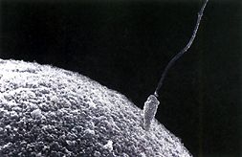
Conception
the process of becoming pregnant, when a sperm and egg join to form a single cell
Cell division begins approximately 24 to 36 hours after conception.
Once a month and ovum is released
  Ovum- A female egg
The Egg moves through the Fallopian Tube to the uterus
Uterus-Where the fetus develops during pregnancy

Slide 4
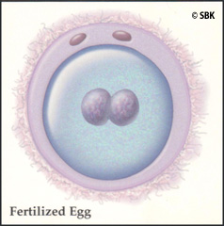
But . . .
If it is fertilized in the Fallopian Tube by a sperm Conception will occurs
This Union is what
we call a zygote!
Fertilization is the union of the ovum and spermatozoa. must occur fairly quickly after release of the ovum because it usually occurs in the outer third of a fallopian tube.

Slide 5
Fertilization
Fraternal
  Dizygotic- fertilization of two separate eggs with two different sperm during the same pregnancy.
  Separate placentas, amnions.
  May be same sex or different.
  Incidence increases with( maternal age, in families with genetic factors, using treatment for induction of ovulation).
Identical
Monozygotic- derived from a single fertilized egg with single sperm then splitting into two.
  Same placenta and amnion.
  Same sex.

Slide 6
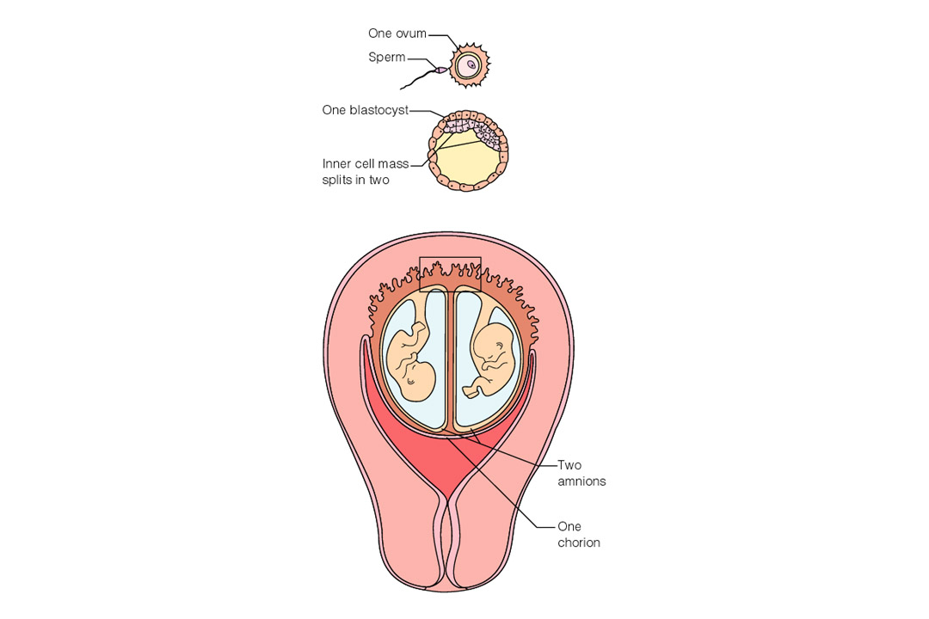
Figure 3–3a Formation of identical twins.

Slide 7
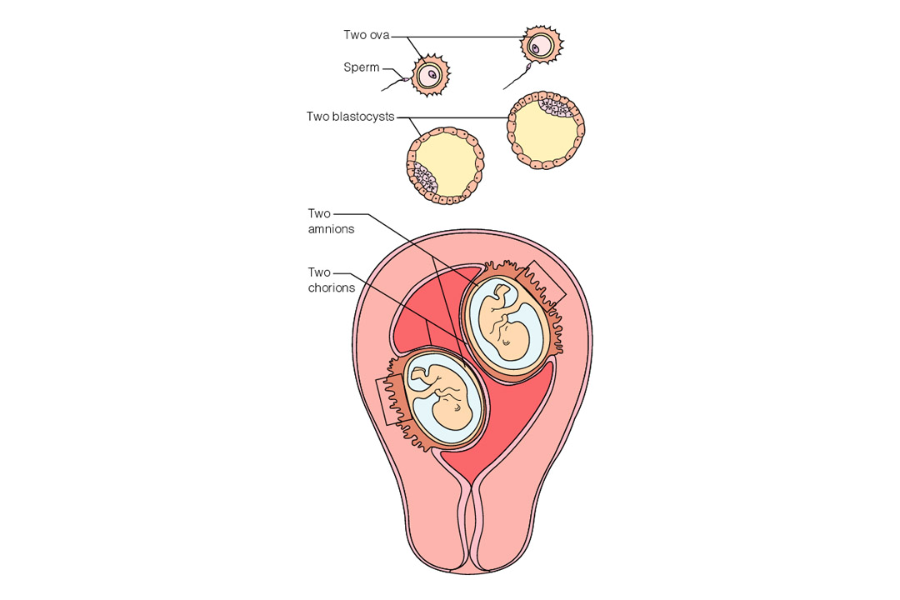
Figure 3–3b Formation of fraternal twins (Note separate placentas.)

Slide 8
There are three stages of prenatal development include:
Germinal stage: from 0-2 weeks The division of cells and implantation of the blastocyst.
Embryonic stage: 3-8 weeks The development of the neural tube and organs.
Fetal stage: 9 weeks to birth Continued growth of organs and physical development in preparation for birth.

Slide 9
The germinal stage;
begins at conception when the sperm and egg cell unite in one of the two fallopian tubes. The fertilized egg is called a zygote. Just a few hours after conception, the single-celled zygote
As the cells multiply, they will also separate into two distinctive masses: the outer cells will eventually become the placenta, while the inner cells form the embryo.
The cells develop into what is known as a blastocyst.

Slide 10
The blastocyst is made up of three layers, each of which develops into different structures in the body.
Ectoderm: Skin and nervous system
Endoderm: Digestive and respiratory systems
Mesoderm: Muscle and skeletal systems

Slide 11
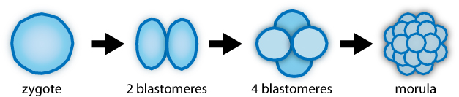
Pre embryonic Development
1st 2 wks of development
Cellular Multiplication
  Zygote moves through fallopian tube.
  Morula- a solid mass of blastomeres that forms when the zygote splits
    in the uterus, the cells continue to divide, becoming a hollow ball of cells called a blastocyst. The blastocyst implants in the wall of the uterus about 6 days after fertilization

Slide 12
  (Blastocyst) develops into:
  Embryo
  Amnion: It is a membrane that closely covers the embryo when first formed. It fills with the amniotic fluid which causes the amnion to expand and become the amniotic sac which serves to provide a protective environment for the developing embryo.
  Trophoblast: is the outer layer of Blastocyst and develops into chorion Implantation: fertilized egg becomes implanted in the lining of the uterus and Attaches to surface of endometrium (process called, decidua)
  Occurs 7 – 9 days after fertilization

Slide 13
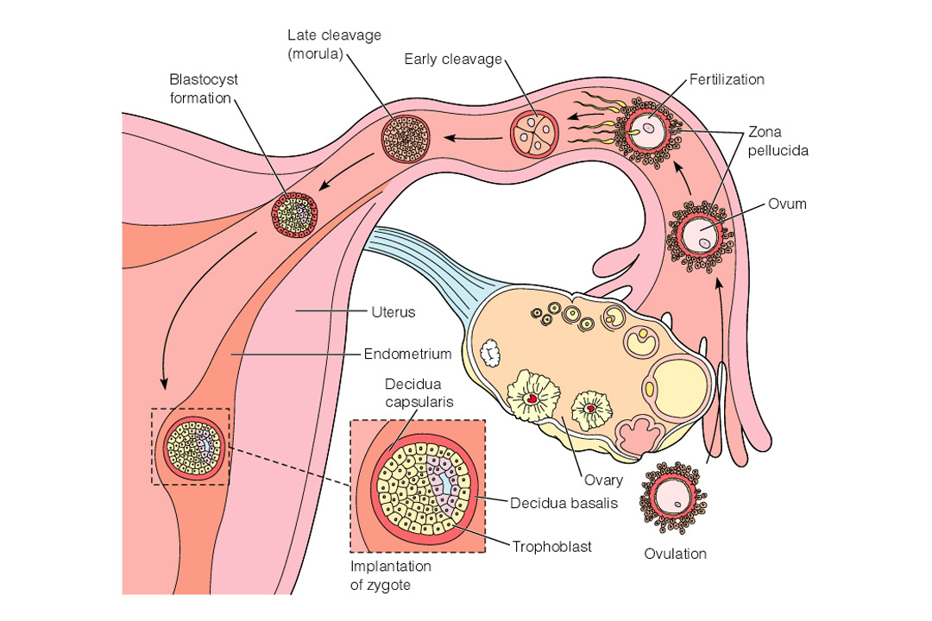
Figure 3–4 During ovulation, the ovum leaves the ovary and enters the fallopian tube. Fertilization generally occurs in the outer third of the fallopian tube. Subsequent changes in the fertilized ovum from conception to implantation are depicted.

Slide 14
The function of amniotic fluid:
Fluid allows the fetus to move.
Helps the lungs develop.
Provides a heat buffer that keeps the fetus at a constant temperature.
Aiding digestive system development,
Preventing the amniotic sac from coming in contact with the fetus.

Slide 15
Preembryonic / Embroyonic
Yolk Sac
  Second cavity developed at 8 –9 days.
  Forms primitive RBC’s during 1st 6 weeks.
Umbilical Cord
  Formed from the amnion; attaches the embryo to the yolk sac.
  Three vessels – two arteries and one vein.
  Wharton’s jelly surrounds vessels in cord preventing cord compression.
Lack of Jelly

Slide 16
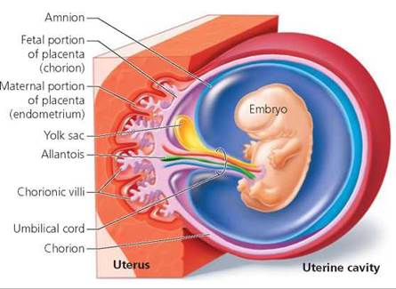

Slide 17
Embryonic Stage of Development
The beginning of the third week after conception. Is a time when the mass of cells becomes distinct as a human. The embryonic stage plays an important role in the development of the central nervous system including the spinal cord and brain
Around the fourth week, the head begins to form, quickly followed by the eyes, nose, ears, and mouth. The blood vessel that will become the heart start to pulse. During the fifth week, buds that will form the arms and legs appear.
.

Slide 18
In the eighth week of development, the embryo has all of the basic organs and parts except those of the sex organs. At this point, the embryo weighs just one gram a
By the end of the embryonic period, the basic structures of the brain and central nervous system have been established.
At 5 weeks the embryo is ¼ inch long
All major organ systems develop.

Slide 19
The placenta and Umbilical Cord develop
  Placenta- The tissue that connects the sac around the unborn baby to the mother’s uterus
  Umbilical Cord- Tube that connects the baby to the placenta
  Brings the baby nourishment and oxygen from the mother’s blood
  Takes away waster products
Amniotic Fluid surrounds the baby
Face, and limbs take shape

Slide 20
Fetal Stage of Prenatal Development
the embryo enters the next stage and becomes known as a fetus.
This period of development begins during the ninth week and lasts until birth. This stage is marked by amazing change and growth.
The early body systems and structures established in the embryonic stage continue to develop. The neural tube develops into the brain and spinal cord and neurons continue to form.

Slide 21
Between the ninth and twelfth week of gestation the fetus begins to make reflexive motions with its arms and legs. The genital organs can be recognized as male or female
The end of the third month also marks the end of the first trimester of pregnancy

Slide 22
In month 4-6
During the second trimester, the heartbeat grows stronger and other body systems become further developed. Fingernails, hair, eyelashes, and toenails form. the fetus increases about six times in size.
Around 28 weeks, the brain starts to mature faster, with an activity that greatly resembles that of a sleeping newborn.
The fetus is 8-10 inches long and weighs 4-5 oz
The baby can such thumb, swallow and hiccup.
1 oz = 0.02 kg

Slide 23
Your baby is covered with a layer of thick, downy hair called lanugo.
His heartbeat can be heard clearly.
A protective coating called vernix begins to form on baby's skin
This may be when you feel your baby's first kick.
During the period from seven months until birth, the fetus continues to develop, put on weight, and prepare for life outside the womb. The lungs begin to expand and contract, preparing the muscles for breathing.
While development usually follows this normal pattern, there are times when problems with prenatal development occur. Disease, malnutrition, and other prenatal influences can have a powerful impact on how the brain develops during this critical period.

Slide 24
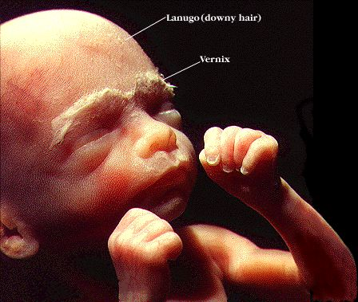
6 Months

Slide 25
The Fetus—Month 7
Fetus is 10-12 inches long and weighs about 1-2 pounds
Fetus is active and then rests.
The baby now uses the four senses of vision, hearing, taste and touch
1 pound = 0.4 kg

Slide 26
The Fetus—Month 9
Fetus is about 17-18 inches long and weighs 5-6 pounds
Skin is smooth because of the fat
Baby’s movement slows down due to lack of room
“Lightening” occurs when the baby drops in the pelvis

Slide 27
The first 13 weeks of pregnancy ( first trimester) are considered the most critical in prenatal development. It is during this period that the embryo forms organs. It is also the period when most miscarriages occur.

Slide 28
Stage of pregnancy
Although pregnancy involves a continuous process, it is divided into three 3-month periods called trimesters :
1st trimester (0 to 13 weeks)
2nd trimester (14 to 25 weeks)
3rd trimester (26 weeks to delivery).

Slide 29


