Slide 1

Physiological & psychological Changes During pregnancy
Sahar ismail
PhD in maternity Nursing

Slide 2
The major maternal physiological adaptation to pregnancy
1-skin change
2-Respiratory changes.
3-urinary tract and renal function..
4-Reproductive organs.
6-Endocrine changes.
7- Systemic changes:
-Blood volume homeostasis.
-cardio vascular system.

Slide 3
BODY WEIGHT AND COMPOSITION
Maternal weight gain-∼12.5kgs.
Fetus 3400g
Placenta 650g
Amniotic 800cc
Uterus 960g
Plasma, red cells 1450
Mammary glands 405
Extracellular, extravascular water 1480
Deposition of fat and protein 3345

Slide 4
Respiratory changes
The respiratory rate is unchanged, but in the third trimester the enlarged uterus will make pressure on the lung leading to increase ventilation
Breathlessness due to hyperventilation and elevation of diaphragm.

Slide 5
Blood changes
The marked increase in plasma volume associated with normal pregnancy causes dilution of many circulating factors.
Hematological changes
Decrease in:
Red cell count
Hemoglobin concentration
Platelets

Slide 6
Increase in :
Plasma volume
Red cell mass
Total blood volume
white cell count.
Fibrogen concentration (cloating factor).

Slide 7
Supine Hypotensive Syndrome
The enlarging uterus compresses both the inferior vena cava and the lower aorta when the woman lies in supine position. This reduces venous return to the heart this condition happen in 10% of pregnant women.
Signs of supine hypotension
(hypotension, bradycardia, dizziness, light-headedness).

Slide 8
Average blood loss at delivery:
500-600 ml with vaginal delivery.
1000ml with C/S (casern seasion).

Slide 9
Endocrinal changes
Pituitary gland:
- Anterior pituitary increases in size and activity.
- Posterior pituitary releases oxytocin on the onset of labor.

Slide 10
Renal change
Frequency of micturation

Slide 11
Reproductive organs
the uterus:
the ratio of muscle to connective tissue increase from the lower part of the uterus to the fundus.

Slide 12
the cervix:
The cervix becomes softer and swollen in pregnancy
Prostaglandins act on collagen fiber make cervix more softer.

Slide 13
the vagina :
The vaginal mucosa becomes thicker during pregnancy.
The vaginal discharge during pregnancy increased.
Leukorrhea: increase in vaginal discharge, rich in glucose, lactic acid, low vaginal pH .

Slide 14
D-Breasts and lactation :
The earliest changes is a swelling of the breast tissue.
Estrogen leads to increase in number of glandular ducts.
Prolactin leads to active secretion of milk after birth.

Slide 15
Diagnosis of pregnancy
History: symptoms.
Examination: signs.
Investigation : pregnancy test and ultrasound.

Slide 16
Symptoms of pregnancy
1-Amenorrhoea:
Abrupt cessation of menses in a woman with regular cycle is highly suggestive.
2-Breast symptoms:
Tenderness and fullness may be noticed .
3-Frequency of micturation :
Pressure on the urinary bladder by enlarging uterus.

Slide 17
4-Nausea with or without vomiting (morning sickness).
5-Abdominal enlargement.
6-Fetal movement:
quickening is the first feels fetal movement at (16-20wks).

Slide 18
Signs of pregnancy
1-breasts signs:
Enlargement and increase pigmentation of the nipple.
Increased pigmentation in the areola (areola).

Slide 19
2- skin signs
linear nigra.
Stria gravidarum.
Chloasma.
These changes are thought to be due to the deposition of melanin

Slide 20
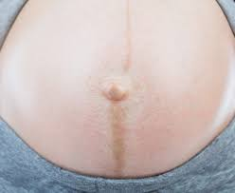
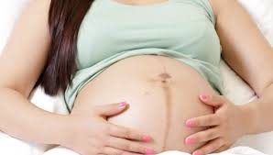
linear nigra.

Slide 21
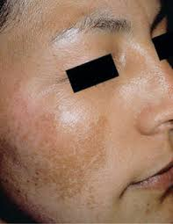

Chloasma

Slide 22
Striae Gravidarum;
Are depresses streaks on the skin of the fat areas (abdomen, breasts and thighs. After delivery they regress and persist as striae albicantes.
They are due to stretching of the skin.

Slide 23
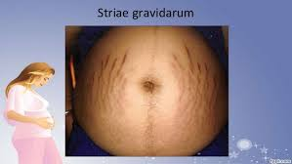
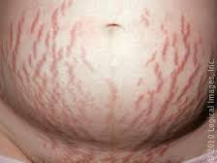
Stria gravidarum

Slide 24
3-Genital tract signs:
Bluish discolouration of the vulva.
Uterus becomes soft due to increase vascularity.

Slide 25
4-Signs due to presence of the fetus:
Fetal heart sounds:
10- 12 weeks fetal heart heard with fetal sonicaid.
FHR 110-160 beats/minuts.

Slide 26
investigation
1-pregnancy tests:
A pregnancy tests detects human chorionic gonadotrophine(HCG) in mother urine or serum.
1. Urine tests: Agglutation inhibition (day 35 after LMP).
2. Blood tests: (day 10 after implantation):
Can detect pregnancy before the patient missed period.

Slide 27
Psychological changes during pregnancy
Psychological tasks of pregnancy:
1st Trimester:
Accepting the pregnancy :
50% of all pregnancies are unintended , unwanted or mistimed . Surprise!
Women sometimes experience dissatisfaction
(displeasure),anxiety.

Slide 28
2nd Trimester
Accepting the baby:
Second turning point is often quickening
Evidence of the childs existence(being)
May accept at conception, at birth or later

Slide 29
3rd Trimester:
Preparing for parenthood
Attending prenatal classes or parenting classes.

Slide 30
Any Question

