Slide 1

Antenatal care
Dr.Sahar Ismail Abdulla
PhD. Maternity Nursing
2025

Slide 2
learning objectives
1. Ensure a healthy pregnancy for mother and fetus.
2. Detect and manage complications early.
3. Prepare the mother for labor, delivery, and postpartum period.
4. Promote health education and healthy behavior

Slide 3
Definition of Antenatal care
it is planned examination, observation and guidance given to the pregnant woman from conception till the time of labor.

Slide 4
Introduction to Antenatal Care
Definition:
Antenatal care is the routine health control of presumed healthy pregnant women without symptoms (screening), to diagnose diseases or complicating obstetric conditions and to provide preventive care.

Slide 5
Objectives of ANC
Monitor maternal and fetal well-being.
Prevent and manage complications.
Provide immunizations (e.g., tetanus toxoid).
Educate on nutrition, hygiene, and birth preparedness.
Encourage skilled birth attendance.

Slide 6
Timing and Frequency of Visits (WHO Guidelines)
Old WHO Model:
4 ANC visits (Focused Antenatal Care).
New WHO Model (2016):
8 contacts recommended:
1st contact: Up to 12 weeks
2nd: 20 weeks
3rd: 26 weeks
4th: 30 weeks
5th: 34 weeks
6th: 36 weeks
7th: 38 weeks
8th: 40 weeks

Slide 7
Components of First ANC Visit
1. History Taking:
Obstetric, medical, surgical, family, social history.
2. Physical Examination:
General exam: weight, BP, pallor, edema.
Abdominal exam: fundal height, fetal heart rate (after 16–20 weeks).
Pelvic exam (if indicated).
3. Investigations:
Hemoglobin level Hb)
Blood group and Rh typing
Urine analysis (sugar, protein)
Blood sugar
Ultrasound

Slide 8
Routine Care in Follow-Up Visits
Monitor maternal weight, BP, fundal height, fetal heart sounds.
Fetal heart sound is heard by sonicaid as early as 10th weeks of pregnancy.
Check urine for protein/sugar.
Monitor fetal movements.
Assess danger signs (e.g., bleeding, hypertension, severe headache).
Provide iron and folic acid supplementation.
Give TT immunization (2 doses at least 4 weeks apart).

Slide 9
Health Education During ANC
Nutrition and hydration.
Importance of rest and exercise.
Danger signs in pregnancy (e.g., vaginal bleeding, blurred vision, swelling of face/hands).
Birth preparedness and complication readiness (BPCR).
Breastfeeding counseling.
Family planning options post-delivery.
To give anti-D at 28 weeks and post delivery within 72 hrs.

Slide 10
High-Risk Pregnancy Identification
Nurses must recognize high-risk factors like:
Hypertension, diabetes, anemia
Previous C-section or stillbirth
Multiple pregnancies
Teen or advanced maternal age
Abnormal presentation or fetal growth

Slide 11
Role of the Nurse in ANC
Provide respectful, non-judgmental care.
Monitor and document findings accurately.
Offer counseling and emotional support.
Ensure referrals when complications arise.
Promote continuity of care.

Slide 12
Minor discomfort during pregnancy
  Nausea and vomiting
  RELIEF MEASURES:
    Avoid food or smells that exacerbate condition.
    Eat small, frequent meals.
    Avoid sudden movements. Get out of bed slowly
    Breath fresh air to help relieve nausea.

Slide 13
Heartburn
  RELIEF MEASURES:
    Eat small, more frequent meals.
    Use antacids.
    Avoid overeating and spicy foods.

Slide 14
Edema
    Avoid standing for long periods.
    Elevate legs when laying or sitting.
    Avoid tight stockings.

Slide 15

Varicosities
    Rest in Sims' position.
    Elevate legs regularly.
    Avoid crossing legs.
    Avoid long periods of standing

Slide 16
Hemorrhoids
  RELIEF MEASURES:
    Maintain regular bowel habits.
    Use prescribed stool softeners.
    Apply topical or anesthetic ointments to area.

Slide 17
Some daily activity
Exercise:
  Exercise is avoided in women with twin pregnancies, pregnancy induced hypertension,
  Coitus:
  Coitus should only be avoided in threatened abortion, PROM, threatened preterm delivery or if there is a placenta previa

Slide 18
    Clothing
      should be practical and non-restricting.
      High heels are avoided to prevent loss of balance and prevent increased backache.
  Traveling.
  Care of teeth.

Slide 19
Nutritional Supplements

Slide 20
Folic Acid
Start before conception and throughout the first 12th weeks.
reduces the risk of having a baby with a neural tube defect (for example, anencephaly or spina bifida).
The recommended dose is 400 micrograms per day.

Slide 21

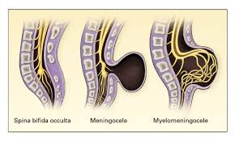

Slide 22
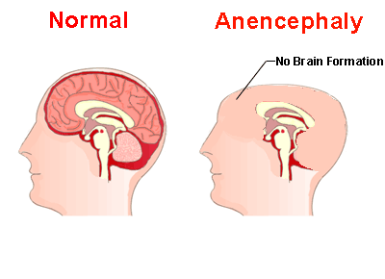

Slide 23
Vitamin D
women who have limited exposure to sunlight, such as women who are predominantly housebound, or usually remain covered when outdoors
women who eat a diet particularly low in vitamin D, such as women who consume no oily fish, eggs, meat, vitamin D-fortified should be taking.

Slide 24
Conclusion
Antenatal care is vital in reducing maternal and neonatal morbidity and mortality. Nurses play a key role in providing quality care, early detection of risks, and promoting healthy behaviors during pregnancy.

Slide 25


