Slide 1

physiology & mechansim of labor
Lect.Dr. Sahar Ismail Abdullah
2025

Slide 2
Outline
Definition of labor
Mechanism of labor
Signs and Symptoms of impending Labor

Slide 3
Introduction and Definition of Labor
Labor is the physiological process through which the fetus, placenta, and membranes are expelled from the uterus, typically occurring between 37 and 42 weeks of gestation. It is the culmination of a complex series of hormonal, biochemical, and mechanical events involving both maternal and fetal systems.
More specifically, labor requires regular, effective contractions that lead to dilation and effacement of the cervix

Slide 4
Cont..
The mechanism of labor refers to the sequential physical movements and positional changes the fetus undergoes during its passage through the birth canal. These steps include:
Engagement
Descent
Flexion
Internal Rotation
Extension
External Rotation (Restitution)
Expulsion

Slide 5
Uterine contraction :
During contraction, uterus becomes hard and some what pushed anteriorly to make the long axis of the uterus in the line with that of pelvic axis

Slide 6
Uterine contraction :
At the same time, the patient experiences pain which is located more on the hypogastric region, often radiating to the thighs.

Slide 8
Intensity
The intensity gradually increases with the advancement of labor until it becomes maximum in the second stage during delivery of the baby.

Slide 10
Duration
In the first stage, the contractions last for about 30 seconds initially but gradually increases in duration with the progress of labor.
Thus in the second stage, the contractions last longer than in the first stage.

Slide 11
Frequency
In the early stage of labor, the contractions come at intervals of ten to fifteen minutes.
The intervals gradually shorten with
advancement of labor until in the second stage, when it comes every two or three minutes.

Slide 13
Retraction
Retraction is a phenomenon of the uterus in labor in which the muscle fibers are permanently shortened.
The effect of retraction on normal labor are:-
Essential property in the formation of lower uterine segment and dilatation and effacement up of the cervix.

Slide 15
Mechanics of labor
The ability of the fetus to successfully cross the pelvis during labor and delivery depends on the complex interactions of three variables:
1- Uterine activity (Powers)
2- The fetus (Passenger)
3- The maternal pelvis (Passage)

Slide 16
Uterine activity (Powers)
The powers refer to the forces generated by the uterine musculature. Uterine activity is characterized by the frequency, amplitude (intensity), and duration of contractions.

Slide 17
The Fetus (Passenger)
The passenger, of course, is the fetus. Several fetal variables influence the course of labor and delivery.
1-Fetal Size,
2- Lie
3- Presentation,
4- Position,
5- Attitude, and
6-Station.

Slide 18
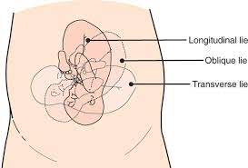
Fetal Size
Fetal size can be estimated clinically by abdominal palpation or with ultrasound, but both are subject to a large degree of error.
Fetal macrosomia (defined by the American College of Obstetricians and
Gynecologists [ACOG] as actual birth weight greater than 4500 g)
Fetal lie:
1-Longitudinal lie
2-Oblique lie
3-Transverse lie

Slide 19
Fetal presentation
Presentation is determined by fetal lie and by the body part of the fetus that enters the pelvic passage first.
Fetal presentation may be cephalic, breech or shoulder.
The most common presentation is cephalic, this presentation occurs labor and birth are likely to proceed normally.
Breach and shoulder presentations are associated with difficulties during labor and labor does not proceed as expected; therefore , they are called malpresentation.

Slide 20
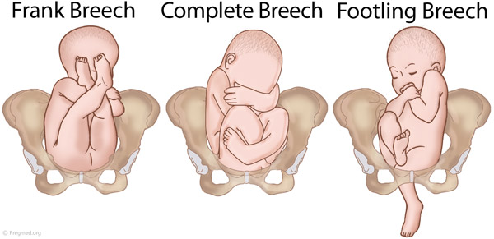
1- Cephalic
( Vertex presentation) Is the most common Presentation
Brow presentation:
Face presentation
2- Breech presentation
Breech presentation occur in 3% of term birth.
Complete breech
Frank breech
Footling breech

Slide 21
Fetal position
The relation of a chosen point (occiput) of the fetal presenting part to the Right or Left side of the maternal birth canal.
The chosen point
1- Vertex presentation – occiput
2- Face presentation - mentum
3- Breech presentation - Sacrum
Each presentation has two positions Rt or Lt Each position has 3 varieties : anterior, transverse, posterior

Slide 22
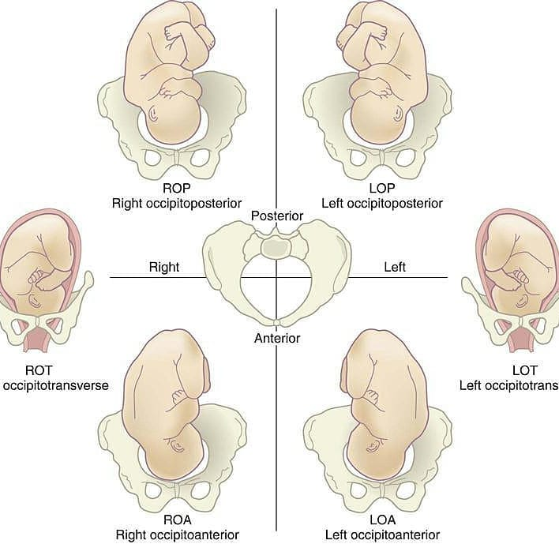

Slide 23
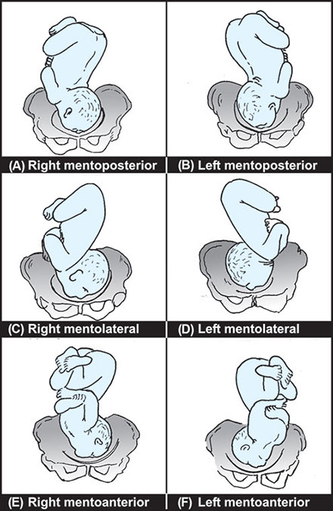

Slide 24
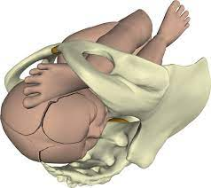
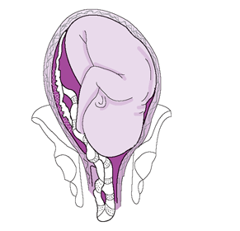

3-Compound presentation:
Refers to the presence of more than one fetal part overlying the pelvic inlet, such as a fetal hand and the vertex.
4-Funic presentation: refers to presentation
of the umbilical cord and is rare at term.
5- Shoulder presentation:
Shoulder present first

Slide 25
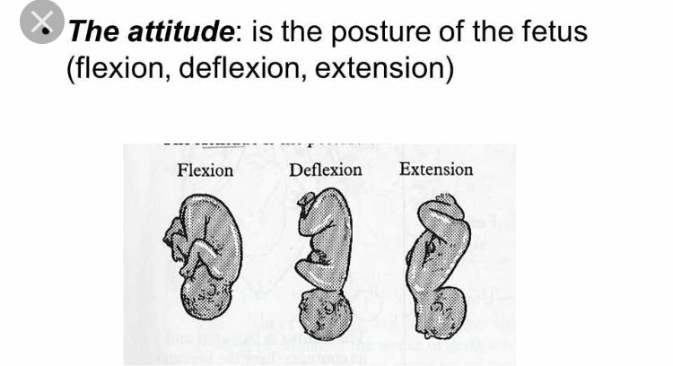
Attitude:
The relationship of fetus' body parts to one another. Normal fetal attitude is when the head is tucked down to the chest with its arms and legs drawn in towards center of chest.

Slide 26
Engagement
Engagement of the presenting part occur when the largest diameter of the presenting part reach or passes through the pelvic inlet.
Engagement can be determined by vaginal examination.
In primigravida, engagement occurs approximately 2 weeks before term.
In multipara engagement occur several weeks before the onset of labor or during the onset of labor.

Slide 27
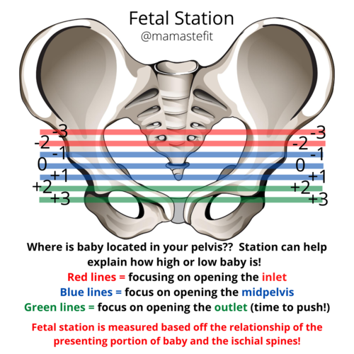

Slide 28
Signs and Symptoms of impending Labor
Lightening:
The presenting part (usually the fetal head) settles downward into the pelvic cavity, causing the uterus to move downward as well.
Leg cramps or pains
• Increased pelvic pressure
• Increased urinary frequency
• Increased venous stasis, causing edema in the lower extremities
• Increased vaginal secretions, due to congestion in the vaginal mucosa

Slide 29
2- Braxton-hicks contractions:
Irregular contractions, are usually felt in the abdomen or groin region and patients may mistake them for true labor.
Braxton-Hicks contractions do not lead to dilation or effacement of the cervix, and thus are often termed “false labor.”

Slide 30
3- Cervical changes:
In preparation for passage of the fetus, the cervix undergoes many physiological changes. The cervix softens (“cervical ripening”), stretches, and thins, and eventually. This softening and thinning is called cervical effacement.

Slide 31
4- Bloody show
The added pressure created by engagement of the presenting part may lead to the expulsion of a blood-tinged mucus plug, called bloody show.

Slide 32
5- Rupture of the membranes
The amniotic membranes rupture once labor is well established, either spontaneously or by amniotomy, the artificial rupture of the membranes by the primary care provider.
The fluid should be clear and odorless. A yellow green tinged amniotic fluid may indicate infection or fetal passage of meconium and this finding always signals the need for further assessment and fetal heart rate monitoring.

Slide 33
Conclusion
he mechanics of labor involve a complex interplay of physiological and anatomical processes that enable the safe delivery of a baby. This process is traditionally divided into three stages—each with distinct mechanical and hormonal components that coordinate the mother's body and the fetus during childbirth.

Slide 34
Question

