Slide 1

Introduction to Gerontological Nursing
Dr. Salih A Abdulla
Geriatric and gerontology
Fall Semester
Week 1
2025-2026

Slide 2
LEARNING OBJECTIVES
History and development of gerontological nursing
Clarify of terms related to gerontology
Explain stages of ageing
Know about advantages of learning geriatric care
Discuss roles of the gerontological nurse

Slide 3
Outline
Introduction
Development of Geriatric Nursing
Basic terminology in gerontological nursing
Stages of ageing
Advantages of learning geriatric care
Roles of the gerontological nurse

Slide 4
Introduction
The history and development of gerontological nursing is rich in diversity and experiences, as is the population it serves. There has never been a more opportune time than now to be a gerontological nurse. No matter where nurses practice, they will at some time in their career care for older adults.

Slide 5
The health care movement is constantly increasing life expectancy; therefore, nurses must expect to care for relatively larger numbers of older people over the next decades.
With the increasing numbers of acute and chronic health conditions experienced by elders, nurses are in key positions to provide disease prevention and health promotion, and to promote positive aging.

Slide 6
The specialty was formally recognized in the early 1960s when the ANA recommended a specialty group for geriatric nurses and the formation of a geriatric nursing division and convened the first national nursing meeting on geriatric nursing practice.

Slide 7
Development of Geriatric Nursing
• In the 1960's gerontological nursing became a subspecialty of nursing.
• In the 1980's gerontological leaders stated that most practicing nurses did not have sufficient knowledge about gerontological nursing.

Slide 8
• As a result, since 1990's schools of nursing provide classes or courses about nursing care of the elderly. Practicing gerontological nursing can obtain gerontological nursing certification through the American Nurses Association.
• Advanced practice in gerontological nursing requires a master's degree in nursing, of which here are two options: the gerontological clinical nurse specialist and the gerontological nurse practitioner.

Slide 9
Basic terminology in gerontological nursing:
1. Gerontology is the branch of biomedical sciences that studies aging. “ Gerontology is the study of all aspects of the ageing process and its consequences‘’. Scientists and educators in the field of aging are referred to as "gerontologists".

Slide 10
2. Geriatrics is a sub-specialty of internal medicine and family medicine that focuses on health care of elderly people. It aims to promote health by preventing and treating diseases and disabilities in older adults.
3. Gerontological nursing is the specialized area of nursing that focuses on providing care to elderly persons through the use of nursing process.

Slide 11
4. Gerontic nursing is the nursing care and services provided to the aged which aim to safeguard and increase health to the extent possible and to provide comfort care to the extent necessary.

Slide 12
5. Ageing (British English) or aging (American English) is the accumulation of changes in a person over time. Ageing in humans refers to a multidimensional process of physical, psychological, and social change.
Some dimensions of ageing grow and expand over time, while others decline.

Slide 13
Also Aging can be defined as continuous, complex, and dynamic process that begins with birth and ends with death.

Slide 14
6. The process of ageing is defined as the accumulation of structural and functional changes in an organism as time passes.

Slide 15
7. Older or elderly person: Most developed world countries have accepted the chronological age of 65 years as a definition of 'elderly' or older person, but like many westernized concepts, this does not adapt well to the situation in Africa.

Slide 16
8. Chronological age: Age measured by the time (years and months) that something or someone has existed; "his chronological age was 71 years". The number of years a person has lived, used especially in psychometrics as a standard against which certain variables, such as behavior and intelligence, are measured.

Slide 17
9. Functional age: A combination of the chronologic, physiologic, mental, and emotional ages. Functional age also refers to an individual’s functional fitness level, compared to others of his or her same chronological age and sex for example: how much and what types of physical activity can one successfully perform?

Slide 18
What is the status of one’s cardiovascular system? One's musculoskeletal system? What are an individual's capacities and/or limitations in terms of carrying out activities of daily living?

Slide 19
IO. Primary Aging is the physiologic changes associated with age irrespective of the disease process. This is more than "dying of cells" and it is known that good mental health and exercise can slow the aging process.
11.Secondary Aging: The definition of secondary aging is the increased rate of aging changes that stems from disease and psycho-socioeconomic
problems.

Slide 20
12. Psychological ageing: It refers to how old a person feels, acts, and behaves, and is not always the same as chronological age.
13. Social ageing: It refers to how society influences the meanings and
experiences of aging.

Slide 21
14.Senescence is a period of one's life during which the greatest amount of aging occurs.
15.Senility is the pathological and functional defects resulting from the aging process.

Slide 22
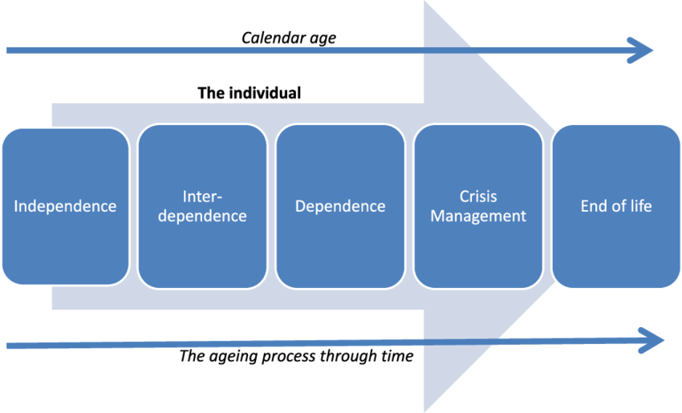
Stages of Ageing

Slide 23
Stage 1: Independence
■ It is early stages of the aging process where the vast majority of older people will continue to live in their own homes.
■ During this stage, a person can still take care of all of their necessities, such as transportation, finances, and health care.

Slide 24
■ A person may have suffered a little deterioration in mental and physical abilities, but not enough to affect their lives.
■ At this age, an older adult is still in good health and has a great quality of life.

Slide 25
Stage 2: Interdependence
■ In stage 2, older persons are more likely to struggle with everyday duties.
■ They will lose both physical and mental activity, and they may begin to forget things.

Slide 26
■ People will be able to accomplish many things on their own during stage 2, but not everything
■ Their quality of life will deteriorate if they do not receive support.
■ A caregiver may be required to assist with one or more tasks, such as driving, shopping, or bill paying.

Slide 27
Stage 3: Dependency
■ By stage 3, age-related changes are more obvious, and an older adult is likely to have trouble performing a variety of daily duties on their own.
■ Because many older persons will have increasing problems with physical and mental activities, it may no longer be safe for them to drive or travel freely.
■ A person's quality of life will be considerably impacted, and they will require increasingly considerable caring help.

Slide 28
Stage 4: Crisis Management
■ When one requires immediate medical attention, it is in the crisis management stage.
■ Either they must reside in a skilled nursing facility or they must receive significant professional care at home.
■ Memory care is sometimes required because the elder has Alzheimer's or dementia.

Slide 29
Stage 5: End of life
■ The final stage of aging.
■ The elderly is approaching the end of his or her life.
■ The goal at this point, though, is for the older adult to feel as relaxed as possible.

Slide 30
Advantages of learning geriatric care:
Learning patience, tolerance, understanding, and basic nursing skills
2. Witnessing the terminal stages of disease and the need for skilled nursing care.
3. Preparing for the future because the aged will always be a part of the care you provide
4. Recognizing the importance of rehabilitation.

Slide 31
Gerontological nurse may be work in:
1. Skilled nursing facilities
2. Retirement communities
3. Adult day care center
4. Residential care facilities
5. Rehabilitation-center
6. Community based home care
7. Acute care hospitals

Slide 32
Roles of the gerontological nurse:
1. Provider of Care: In the role of caregiver or provider of care, the gerontological nurse gives direct, hands-on care to older adults in a variety of settings.

Slide 33
2. Teacher: An essential part of all nursing is teaching. Gerontological nurses focus their teaching on modifiable risk factors and health promotion.

Slide 34
3. Manager: Gerontological nurses act as managers during everyday practice as they balance the concerns of the patient, family, nursing, and the rest of
the interdisciplinary team.
Nurse Manager must be skilled in leadership, time management, building relationships, communication, and managing change.

Slide 35
4. Advocator: As an advocate, the gerontological nurse acts on behalf of older adults to promote their best interests and strengthen their autonomy and decision making.
Advocacy may take many forms, including active involvement at the political level or helping to explain medical or nursing procedures to family members on a unit level.

Slide 36
5. Research Consumer: The appropriate level of involvement for nurses at the baccalaureate level is that of research consumer.
Gerontological nurses must remain abreast of current research literature, reading and putting into practice the results of reliable and valid studies. Using evidence-based practice, gerontological nurses can improve the quality of patient care in all settings.

Slide 37
THANKS

