Slide 1

Aging Population
Dr. Salih A Abdulla
Geriatric and gerontology
Fall Semester
Week 2
2025-2026

Slide 2
LEARNING OBJECTIVES
After reading this chapter, students will be able to:
Classify ageing groups
To know importance of focusing on ageing
To explain causes of ageing
To know criteria for ageing

Slide 3
Outline
Introduction
Classification of ageing
Importance of focusing on ageing
Criteria for ageing
Causes of ageing population
Impact of ageing
Challenges for the future
Developmental tasks

Slide 4
Introduction
One of the biggest social transformations is the ageing of populations worldwide. In the World Health Organization (WHO) Eastern Mediterranean Region, every country is facing the challenge of population ageing, with minor variations in magnitude and pace.

Slide 5
Nurses must be prepared to meet the challenges of caring for this rapidly increasing segment of population. The nurse must be aware of the characteristics of the aging population, special concerns of these individuals, and issues of importance to those individuals who will most likely dominate nursing practice in the 1st century.

Slide 6
Classification of Aging:
Age classification varied between countries and over time, reflecting in many instances the social class differences or functional ability related to the workforce.

Slide 7
In the United States older adult population can be divided into three life categories subgroups:
• Young-old (approximately 65-74)
• Middle-old (ages 75-84)
•Old-old (over age 85)

Slide 8
According to WHO, the elderly population is categorized into the following groups in Africa:
• Age 60 to less than 75 years ................. The young-old
• Age 75 to less than 85 years ... ............. The middle -old
•Age 85years and the older .................. The old-old

Slide 9
Why is it urgent and highly important for all of us to focus on ageing?
First, there will be older persons than ever before the number of people aged 60 and above today is double what it was in 1980, and the absolute number of persons aged 60 years and over is expected to increase from 605 million to 2 billion by 2050.

Slide 10
Second, the most rapid ageing is in less developed countries. Developed countries will see the fastest change. By 2050, 80% of older adults will reside in low- or middle-income countries, a reverse of what we see today.

Slide 11
Third, non-communicable, chronic diseases and disabilities are on the rise diseases, of 26 million a year; occur in adults over the age of 60.
In 1900, a person primarily died because of infectious diseases has changed considerably. Today, the greatest causes of disease among all countries are non-communicable, chronic diseases such as heart disease and stroke, cancer, asthma and diabetes.

Slide 12
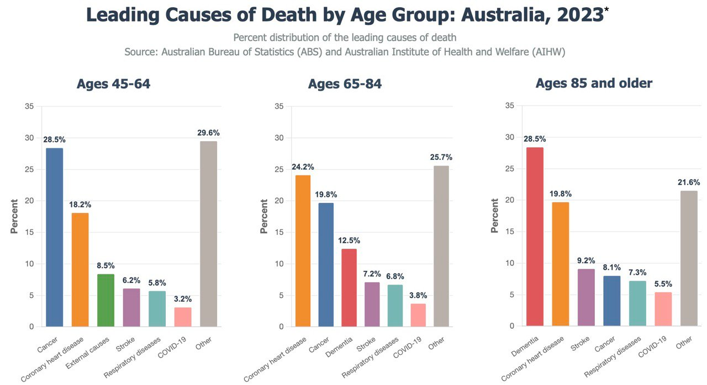

Slide 13
Causes of ageing:
Although the exact causes of aging remain unknown, scientists are learning a great deal about the aging process and the mechanisms that drive it. They also mentioned that, ageing is caused by the accumulation of damage to the cells.
Some of the causes are unavoidable such as:
1.ultraviolet radiation 2.free radicals 3. genetic effects
4.Others involve environmental and behavioral influences.

Slide 14
The following is a description setting out five criteria for ageing:
1. Cumulative: Effects of ageing increase with time.
2. Universal: All members of a species display signs of ageing.
3. Progressive: Ageing is a series of gradual changes.
4. Intrinsic: Changes would take place even in a "perfect" environment.
S. Deleterious: Changes which occur compromise normal biological functions

Slide 15
Causes of ageing population:
1. Demographic transition from high levels of both fertility and mortality to low levels of both fertility and mortality.
2. Improved National Health Services (NHS) means that the elderly is living longer and are living through diseases that they previously wouldn't have survived.

Slide 16
3. Improved health awareness is allowing us to live longer lives. As People choosing to live healthier lifestyles, improved knowledge about healthy eating.
4. Great improvement in medicine, science, technology, health promotion
and disease prevention activities and programs.

Slide 17
5. Continued economic development is usually accompanied by better and more widespread education, particularly for females, as well as improved life expectancy. Economic improved standard of living, benefits of smaller families, pensions, transition to tertiary employment
6. Migration

Slide 18
Impact of ageing:
Strain on the National Health Services (NHS) and government money, as more funds are needed to provide medical and health care to the elderly.
2. Governments have to provide more pensions.
3.Health care is not securing adequate funding.

Slide 19
4. All of the above means more taxes on the workers, as more money is
needed by the government, and the workers that they get that money.
5. Get even more money, the retirement age is being raised from 65 to 70,
which means fewer pensions are being paid for, and more people are being taxes.

Slide 20
6. Most of older persons have at least one chronic condition.
7. Women will make up the greater number of the elderly population, due to their higher life expectancy and morbidity patterns.
8.Changing sectors within the economy. An increase in the numbers of retired people will create a bigger market for goods and services linked to older people (e.g. retirement homes).

Slide 21
9. Changing population structure implications for the elderly as the proportion of youth decreases in the region and as the family structure becomes more nuclear based, there will be fewer young people to support the elderly in the future.
10.Governments have to provide more care-homes.

Slide 22
11. Ageing population could lead to a shortage of workers and hence push up wages causing wage inflation. Alternatively, firms may have to respond by encouraging more people to enter the workforce, through offering flexible working practices.

Slide 23
12.Increase the importance of the private sector in providing pensions and health care. However, this may cause increased inequality if people can't afford private pensions.

Slide 24
Challenges for the future:
• Utilize evidence-based practices
• Promote integrative care
• Educate caregivers
• Develop new roles
• Advance research
• Balance quality care and health care costs.

Slide 25
The developmental tasks that is necessary for successful aging:
1. Adjusting to declining health and physical strength
2. Adjusting to retirement and reduce income
3. Adjusting to death of a spouse
4. Establish associations with others in the same age
5. Maintaining a satisfactory living arrangement
6. Adapting to changes in social roles

